Slide 1
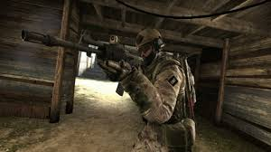
Competitive First Person Shooters
By: Timothy Warren

Slide 2
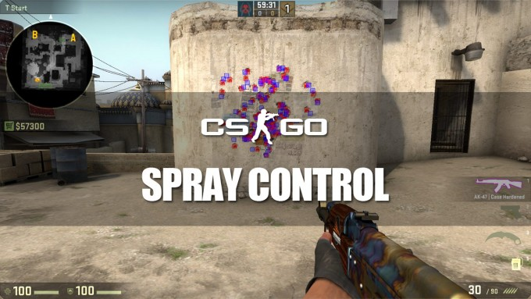
Realism
Most competitive first person shooters are realistic.
They include recoil, bullet spray, and accuracy depending on if you are still or walking.
Realistic damage is important as well.

Slide 3
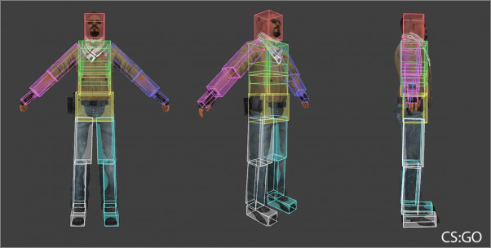
The Basics
For a game to be competitive, there has to be a goal, and it must be equally fair on each team.
The only imbalances that can impact the outcome should be each team’s skill level.

Slide 4
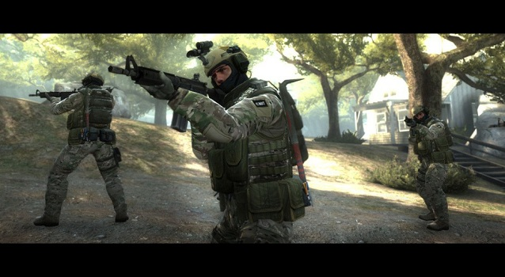
Balance
As previously stated, for a game to be competitive, it must be equally fair for each side.
This means weapons have to be balanced, as well as the amount of players on each team.
The only thing that should provide an advantage is skill.

Slide 5
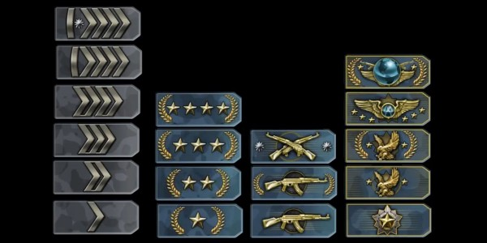
Ranking System
With each competitive game, there is typically a ranking system.
This means when you do well, you can rank up and play with and against harder opponents.
This helps the game to become even more balanced, matching ranks for each game.

Slide 6
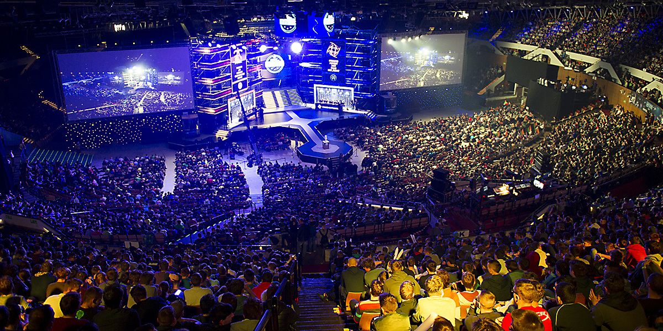
Professional Following
With any competitive shooter, there is surely a professional league.
Counter-Strike is a great example, they have tournaments and games weekly, with huge cash prizes. Much of the profits are donated to charties.

Slide 7
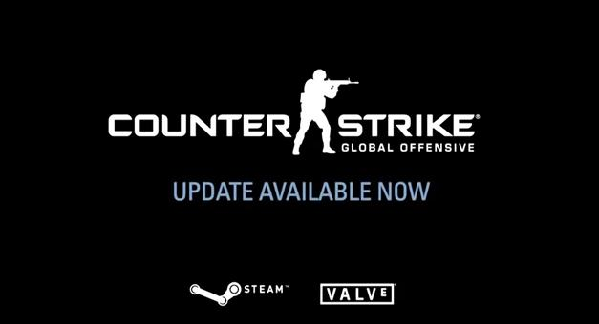
Updates
For a game to remain competitive, there should be an occasional update to keep it feeling fresh and balanced.
Most games have updates that add new content, such as maps, weapons, graphical updates, performance updates, weapon balances, and more.

Slide 8
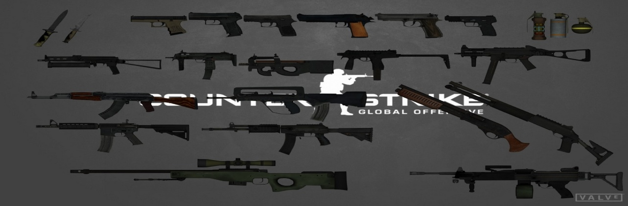
Weapons
In Counter-Strike, each team has specific weapons.
The Terrorist team is iconic for having AK 47’s, while the counter-Terrorists are iconic for being able to use M4’s.
Any player has the opportunity to drop the weapon they are carrying and pick up a weapon.
While the guns may be different for each team, they are still balanced so that one does not overpower another.

Slide 9
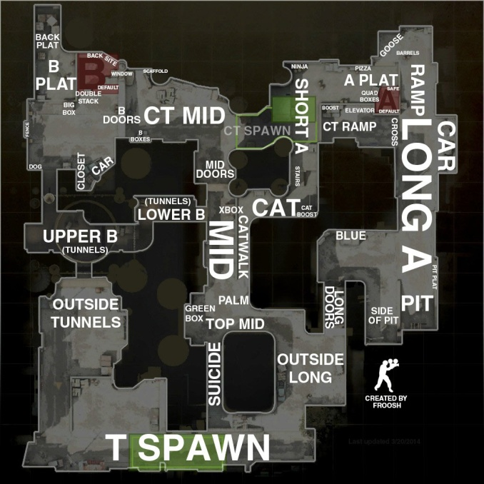
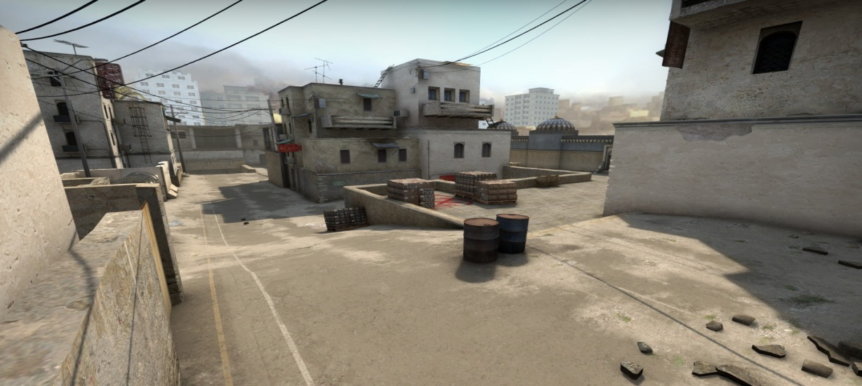
Maps
Most competitive shooters have a wide variety of maps, from banks, to jungles, and even mansions.
A map has to be balanced and fair for each team.
For example, each team should have equal spawn locations so that one team is not instantly eliminated after leaving spawn due to an unfair advantage of the other team’s spawn.

