Slide 1
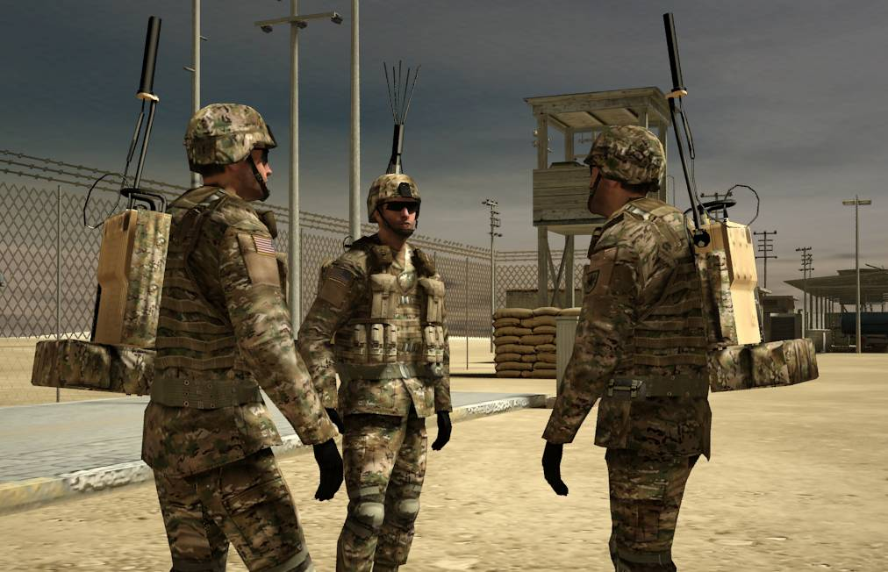
Military Simulations
Military simulations are games that are used to train people in the army to go on runs or missions. They can go through procedures and missions without facing any sort of real danger. This can be very beneficial to a soldier because it gives them a second chance to help them improve upon their mistakes.

Slide 2
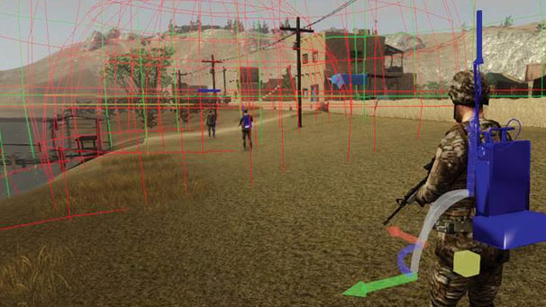
Military Simulation Examples
There many military simulation games that are used for training. One example of a game would be Virtual Battlespace 2: U.S. Army. This game is used to train soldiers in realistic immersive environments.

Slide 3
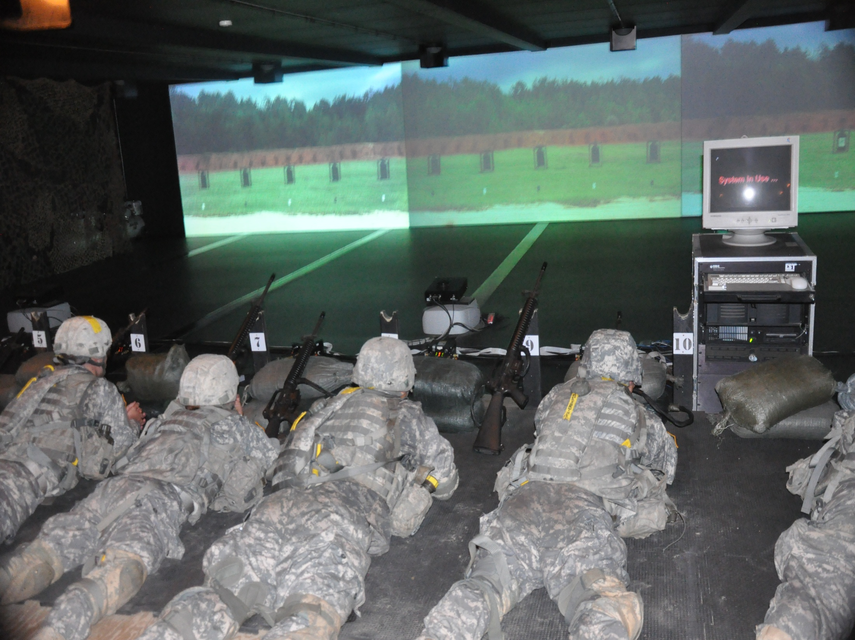
Virtual Battlespace 2: U.S Army
This game simulation is extremely beneficial. The audience it is intended for are trainees for the U.S Army. The creator of this simulation is known as “Bohemia Interactive Simulations.” An example of how this game achieves its purpose is the simple fact that instead of a member of the army actually going out into a fatal firefight, they can practice one over and over by using the simulation to improve their skills.

Slide 4
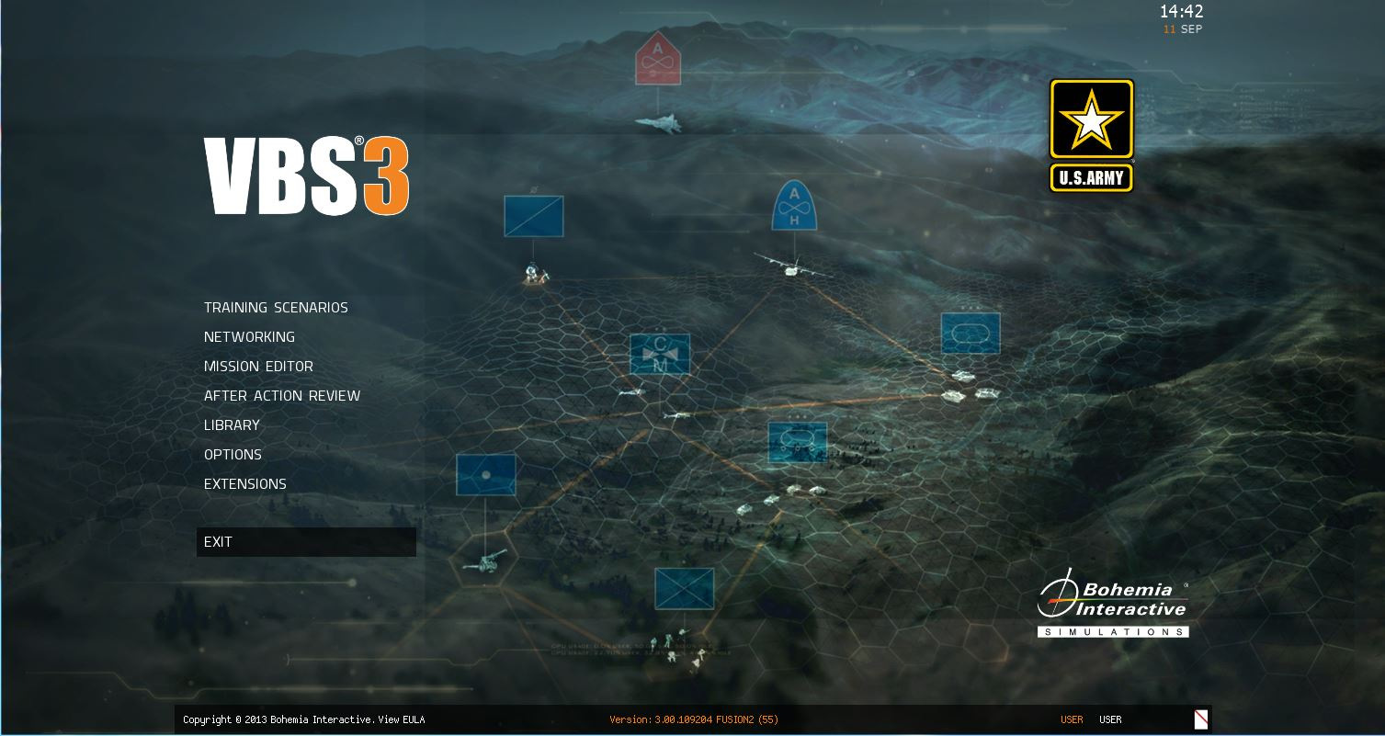
Virtual Battlespace 3
As you can see on the left side, there are so many options for the types of military simulations you can perform. VBS3 includes better graphics, which help influence an immersive environment for trainees. The program definitely uses the random function in this simulation. It is probably put to uses such as a surprise ambush, random grenade tosses, or randomly places ground mines. As you can see, this function can be used in many interesting and creative ways.

Slide 5
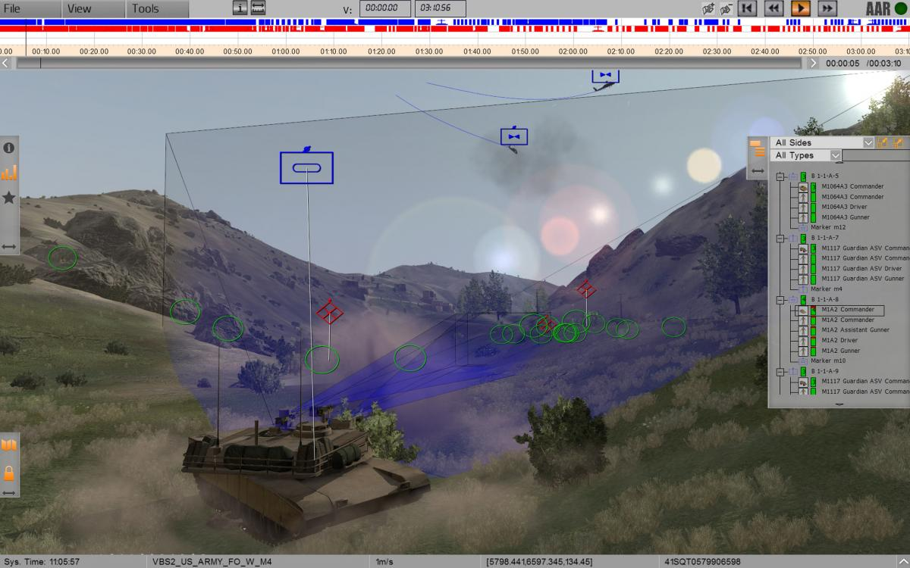
Virtual Battlespace 3
As you can see from the background image, a lot of coding and complicated processes are combined to create such a satisfying and well-made simulation to prepare future soldiers. These games are certainly popular because they represent an effective means of training soldiers. This program is especially popular for different militaries of different governments. Even the United Kingdom military are using this program.

Slide 6
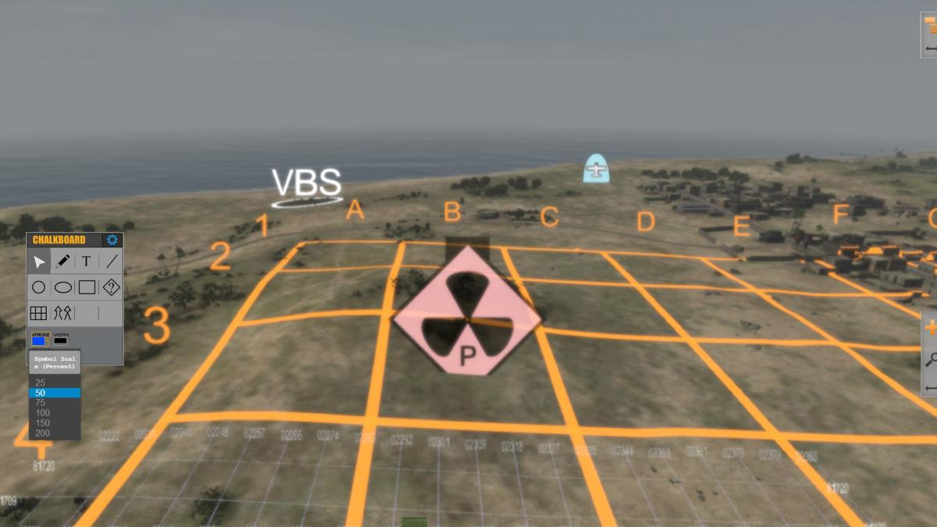
Military Simulation Games
There is almost certainly a huge market for this simulation program like I mentioned before. There is also probably a way to play this online, or at least connect multiple games to one server to help perform a group raid or training mission to practice together with fellow military trainees. This seems like it would be a really cool way to implement cooperative teamwork between one another.

Slide 7
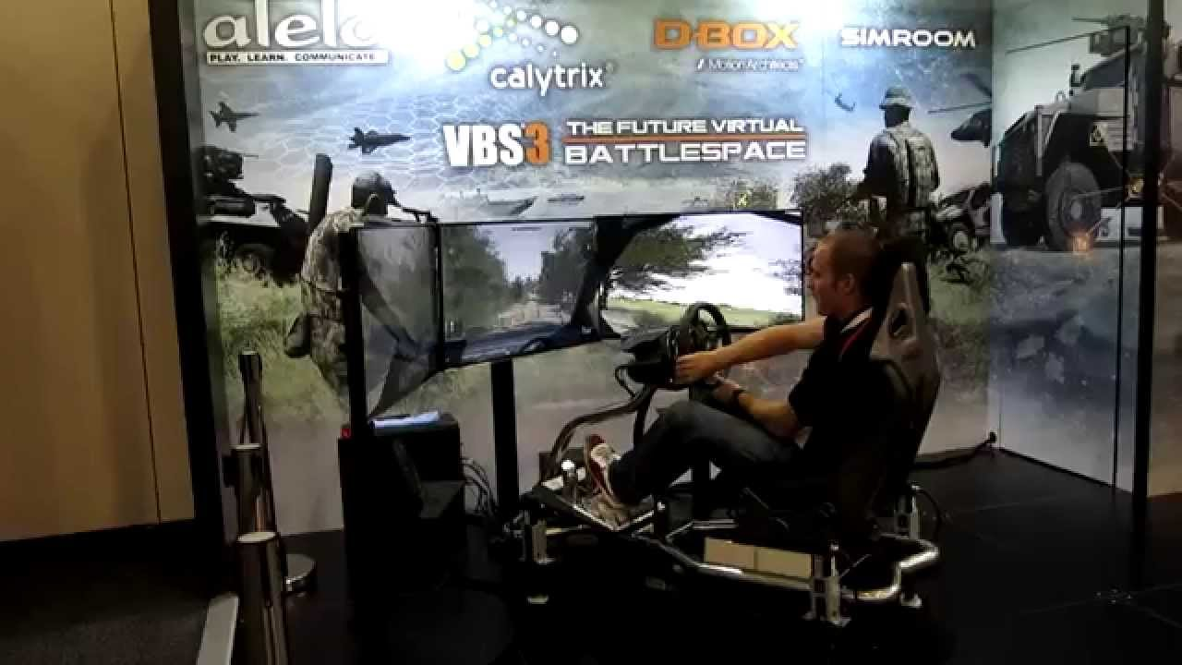
Military Simulation Games
Military simulation games such as Virtual Battlespace are extremely popular within military programs considering they are some of the best forms of training army members. I think that these games can be very fun, along with it being educational to a military member. The simple act of playing the simulation seems like it would be fun to me. I think that this implementation of fun was another purpose of the programmer. My reasoning for this is because for someone to learn, they have to want to learn, and a game like this would definitely cause that.

Slide 8
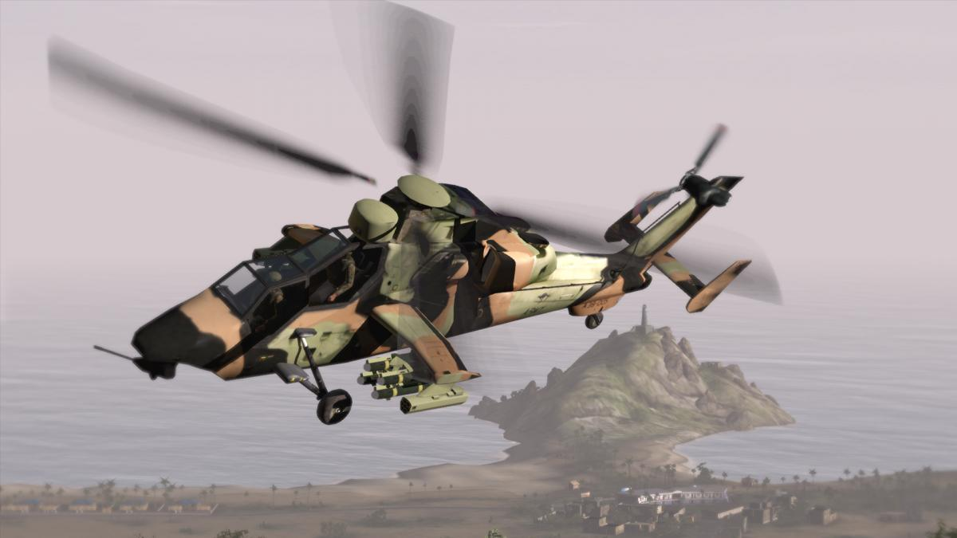
Military Simulation Games
As you can see, military simulation games are fantastic examples of a video game being put to a creative and effective use. This concept of simulation is used throughout many military programs and is quite popular. As technology continues to advance, so will simulations and video games like these.

Slide 9
Bibliography
"Bohemia Interactive Simulations.“ BISim. https://bisimulations.com/ N.p., n.d. Web. 30 Sept. 2015.
"U.S. ARMY GAMES FOR TRAINING PROGRAM." U.S. ARMY GAMES FOR TRAINING PROGRAM. http://www.peostri.army.mil/PRODUCTS/USAGFTP/ "UK
Government Signs up Virtual Battlespace 2." GameSpot. N.p., n.d. Web. 30 Sept. 2015. N.p., n.d. Web. 30 Sept. 2015.
"Military and Government Simulations « Serious Games Association."Serious Games Association RSS. http://www.seriousgamesassociation.com/military-and-government-simulations/ N.p., n.d. Web. 30 Sept. 2015.

