Slide 1
Outline
CNN 10
Ch. 1 – The Land
Traditional Territory
Mapping Assignment

Slide 2
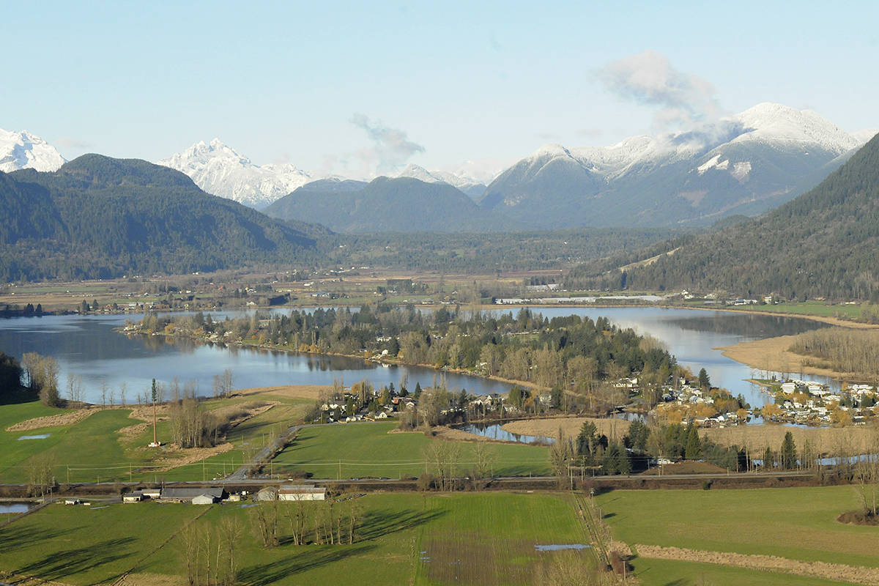
Ch.1 – The Land

Slide 3
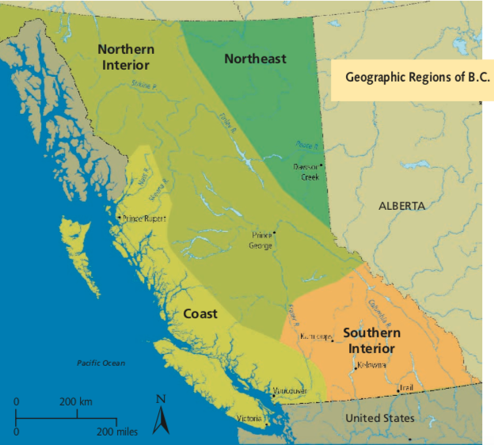
Identifying First Nations Traditional Territories
What is the meaning of a “Traditional Territory”?

Slide 4
First Nations Traditional Territories ☺
Traditional Territory is the geographic area identified by a First Nation to be the area of land which they and/or their ancestors traditionally occupied or used.
Each First Nation in BC identifies its own traditional territories.
These are lands which they have always occupied and had stewardship over.
Most nations/groups are organized collectively according to the language they speak.

Slide 5
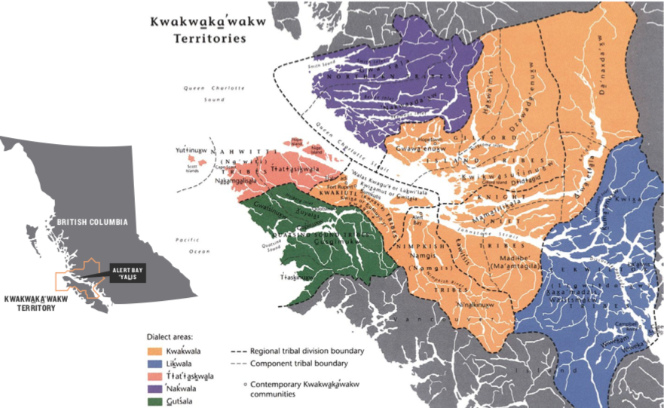
The Traditional Territory of the Kwakwaka’wakw Nation

Slide 6
Identifying First Nations Traditional Territories
How many Traditional Territories do you know about in British Columbia?

Slide 7
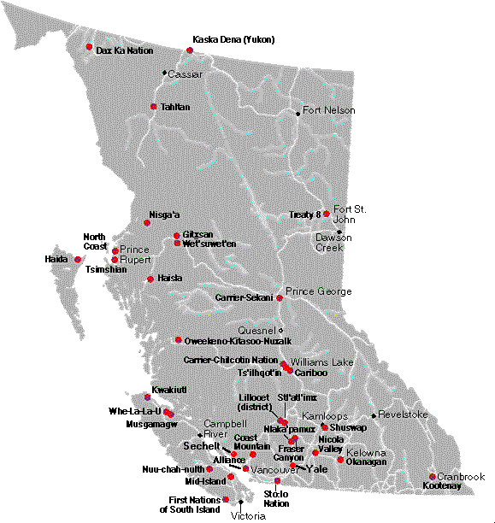

Slide 8
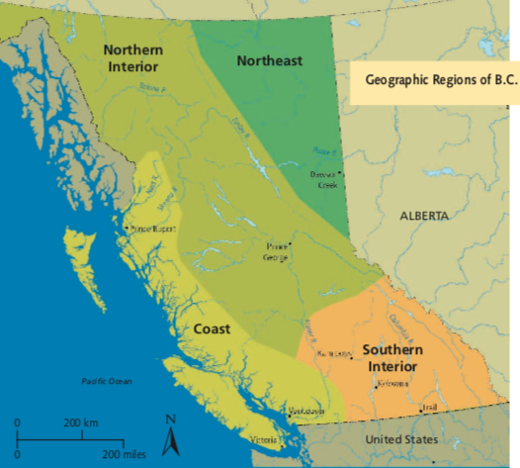
B.C. First Nations
There are over 200,000 First Nations living in B.C.
There are 198 distinct First Nations in B.C.
They have over 30 different languages, and 60 dialects.
These groups are scattered over four geographical regions.

Slide 9
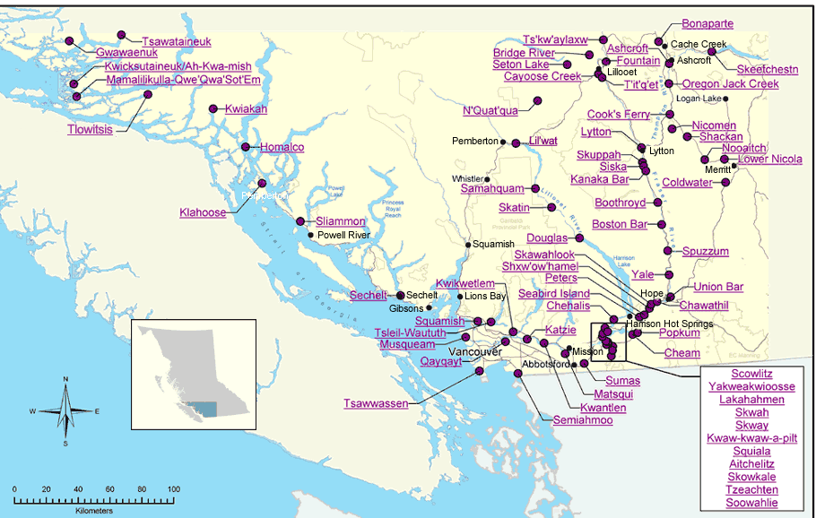
Identifying First Nations Bands

Slide 10
Traditional Territories Assignment
Use the additional handout, “Outline Map: First Nations of British Columbia” identify the traditional territory of as many nations as possible on the map matching the number on the front to the list of First Nations on the back of this sheet.

Slide 11
Traditional Territories
Use the map on page 17 in your textbook and the additional handout to help complete the outline map.
Work together/share what you have found.

Slide 12
The Physical Geography of BC
On the Map of BC provided using Google – Label and Colour the following:
Major Rivers: Nass, Columbia, Fraser, Peace, Mackenzie, Kootenay, Thompson, Stikine, and Skeena
Major Lakes: Kinbaset, Babine, Williston, Okanagan, Quesnel, Atlin, Stuart, Upper + Lower Arrow, Harrison, Kootenay
Major Mountain Ranges: Cascade, Cassiar, Skeena, Omnica, Coast, Columbia, Rocky
Major Waterways: Queen Charlotte Sound, Hecate Strait, Pacific Ocean, Salish Sea (Strait of Georgia + Juan Du Fuca

Slide 13
Outline
CNN 10
Regions of B.C.
The Coast
The Southern Interior

Slide 14
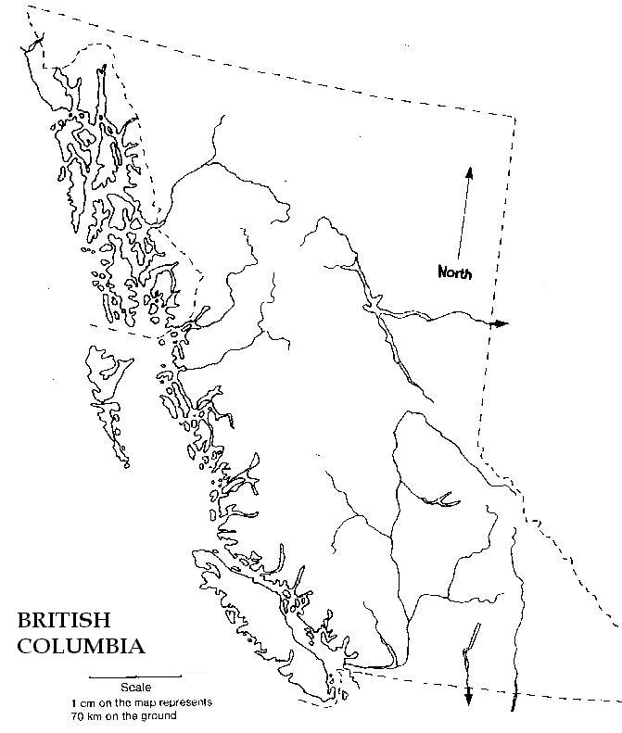
The Regions of B.C. ☺
Q: What characteristics might we look for when creating a region?
Consider what makes the Okanagan different then the Fraser Valley?
Similar Habitat – Climate, Temperatures.
Similar Cultures/Traditions
Similar Language

Slide 15
The Coast
Mild, wet climate.
Red Cedar is important.
Thousands of bays, and islands.

Slide 16
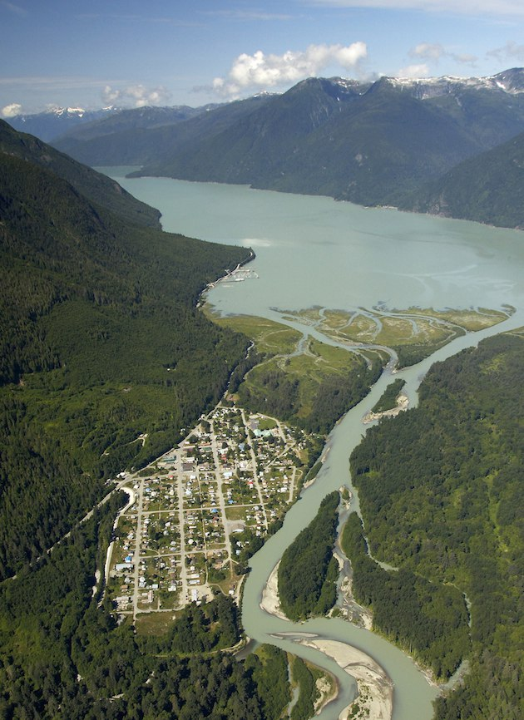
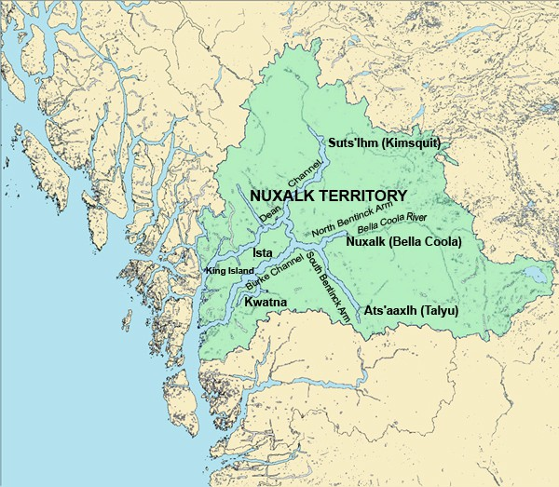
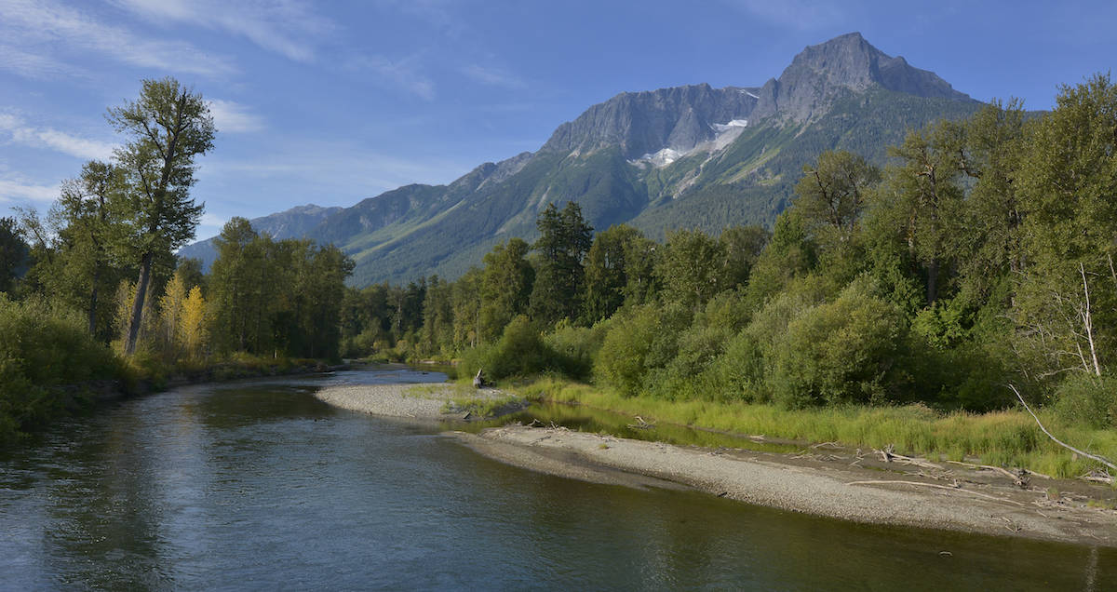
Bella Coola, B.C. – Coastal City

Slide 17
The Coast ☺
Mild, wet climate.
Red Cedar is important.
Thousands of bays, and islands.
Need for boats → Canoes
Many Coastal Rivers: Nass, Skeena, Kitimat, Kitlope, Dean, Bella Coola, Klinaklini, Homathko, and Squamish

Slide 18
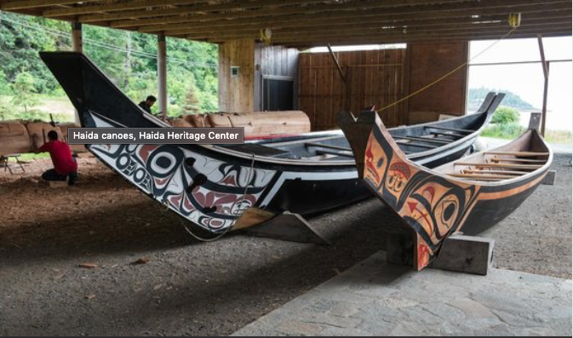
The Coast: Canoes

Slide 19
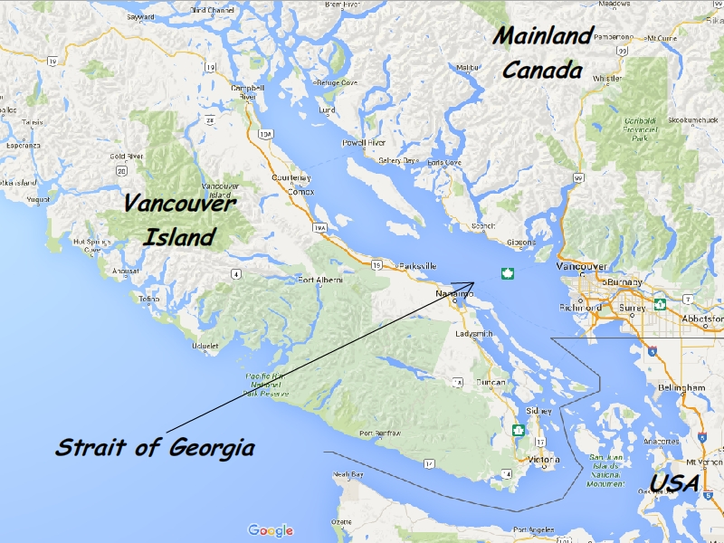
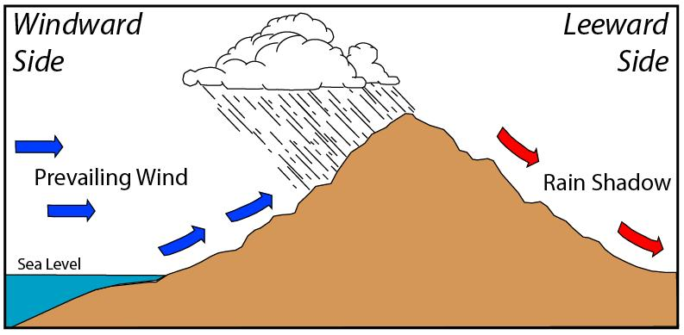
The Coast: Strait of Georgia
Strait of Georgia
Rain Shadow: This is often a dry area on the leeward side of a mountainous region.

Slide 20
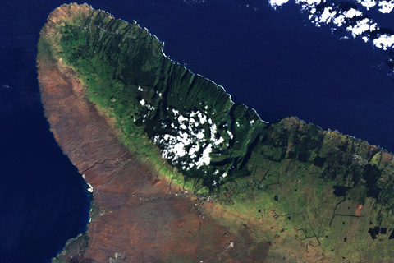
The Coast: Rain Shadow in Hawaii

Slide 21
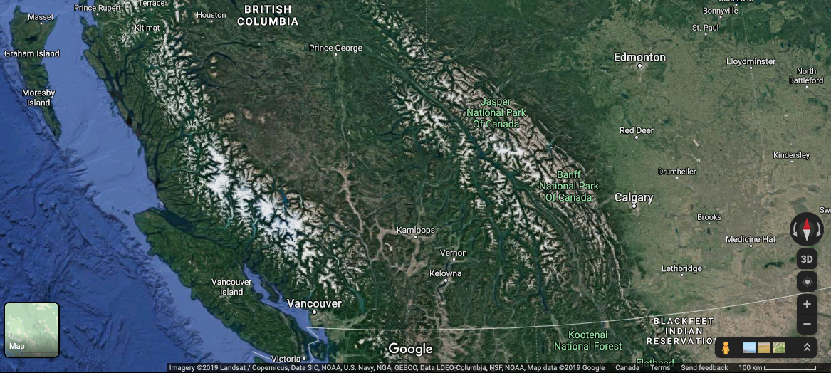
The Coast: Rain Shadow in BC/Alberta

Slide 22
The Coast
Strait of Georgia
Rain Shadow
Sandspit (Haida Gwaii) = 235.
Prince Rupert = 229.
Tofino = 208
Victoria = 148
Vancouver = 168
Abbotsford = 179
Chilliwack = 190
Penticton = 119
Cranbrook = 122

Slide 23
The Coast – Resources
“If mankind in his infancy had prayed for the perfect substance for all material and aesthetic (beauty) needs, and indulgent God could have provided nothing better.” Bill Reid, Haida Artist – pg. 21
In this quote Bill Reid is referring to the Red Cedar tree. What do you know about the use of cedar for aboriginal nations of the coast?
Why would he say this?

Slide 24
The Coast: Resources ☺
Trees: Cedars, Douglas Fir
Fish: Salmon, Oolichan, Halibut, Sole, Cod, and Red Snapper.
Intertidal Zone: Shellfish, clams, mussels, oysters and abalone, crabs.
Berries: Huckleberry, Salal, Salmonberry, Blackberries
Mammals: Black bears, deer (black-tailed), mountain goats, river otter, mink, wolverine and marten.
The south coast around the Salish Sea/Georgia Straight (CBC - Georgia Straight renamed Salish Sea) is much warmer and drier so it provides a more diverse variety of plants including the Camas Bulb, member of the lily family, which is an important source of starch.

Slide 25
The Coast – The People ☺
Home to the greatest number of distinct First Nations in Canada
Why is this?

Slide 26
What about our landscape would lead to distinct nations/cultures?

Slide 27
The Coast – The People ☺
Home to the greatest number of distinct First Nations in Canada
Why is this?
The governance of first nations on the Coast was Aristocratic – hereditary and patrilineal (birthright through the father)
Male chiefs were in place
Most Coastal First Nations followed similar seasonal patterns moving from location to location when resources became available

Slide 28
The Coast: The People
Nine different nations live along the Coast.
Haida, Tsimshian, Nisga’a, Haisla, Xai-Xais (Hai-Hais), Heiltsuk, Kwakwa-ka’wakw, Nuxalk, and Nuu-chah-nulth.
17 different nations live on Vancouver Island/Fraser Valley
All are members of the Coast Salish language group.
When societies have an abundance of food, they’re able to grow and proper in areas – Maslow’s Hierarchy of Needs (Psychology)

Slide 29
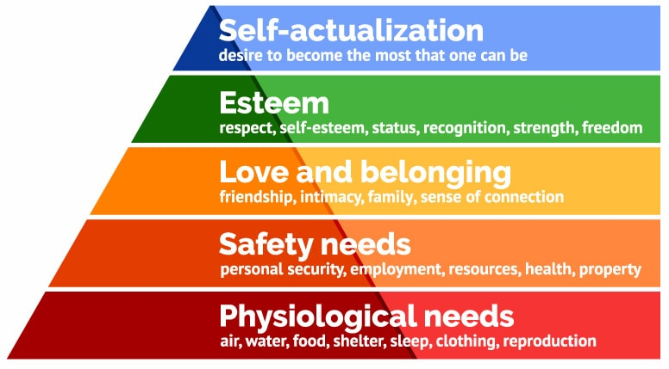
The Coast: The People – Maslow’s Hierarchy of Needs
Art, Literature, Music
Universities, School, Education, Laws
Language, Marriage, Alliances
Housing
Food, Water, Clothing.

Slide 30
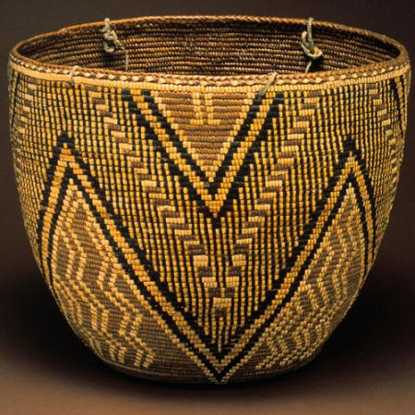
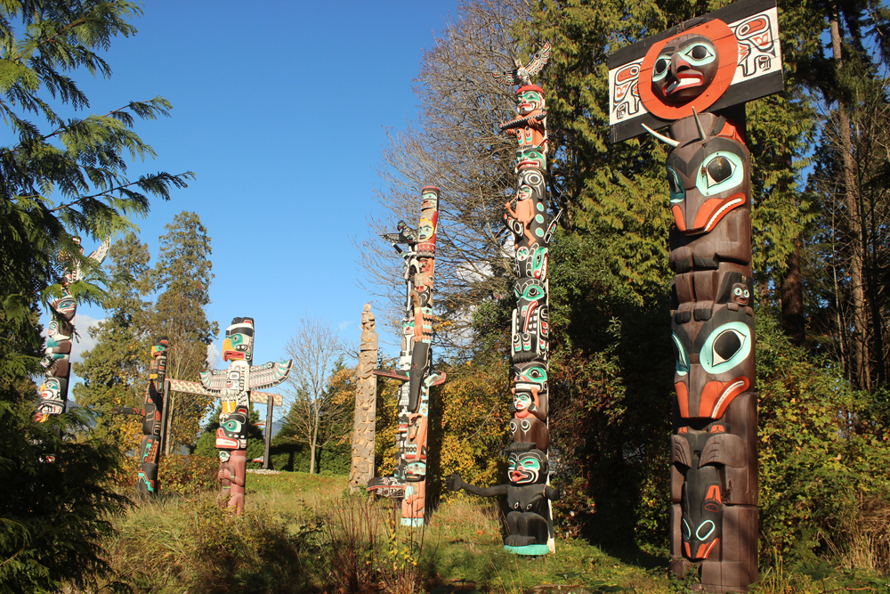
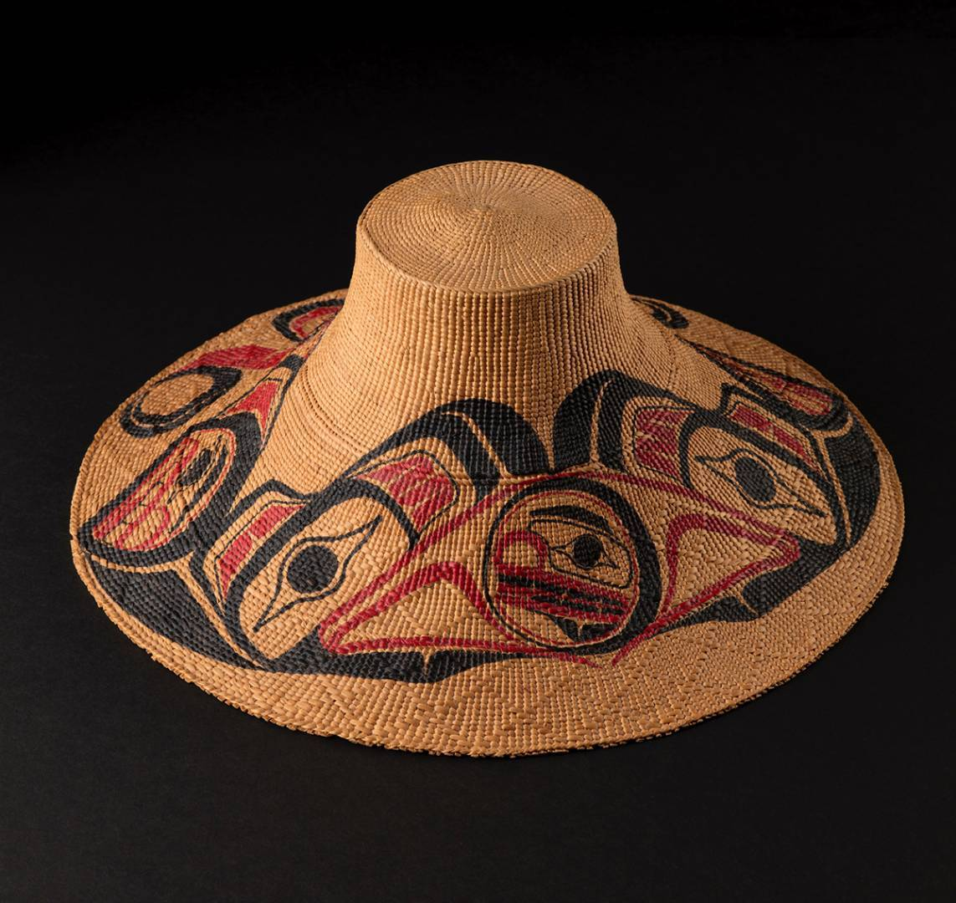
The Coast: The People
This abundance of food, led to amazing works of art/music/stories amongst the Coastal people.

Slide 31
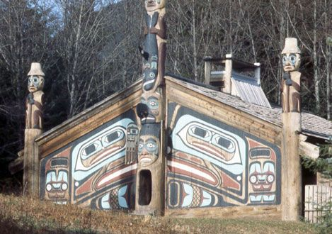
The Coast: Social Structure
Social Structure – Families lived together in large Coastal houses (Wood plank houses).
Dependent on the resource-units in the area, an entire house might be in charge of one single resource.
Ex: One family/house might gather only berries.

Slide 32
The Coast: Seasonal Rounds ☺
Often times, groups (tribes) would move from one camp to another dependent on what was available/in season.
It was common place for Coastal First Nations to have a /Spring/Summer Camp/Winter Camp, and sometimes Oolichan camps.
From these camps they would access their:
Salmon Grounds
Berry Grounds
Hunting Grounds
Cedar Grounds
Fishing Grounds

Slide 33
The Coast: Constant Movement
This constant movement brought different tribes in contact with other tribes, which led both to conflict in areas, as well as the formation of trade routes.
In the winter though, most tribes would hunker down and utilize the resources they had gathered throughout the rest of the year.
The seasonal ‘rounds’ were unique to each nation depending on the resources available which resulted in different seasonal practices and spirituality creating great differences between nations
Territories where inherited by whole groups of extended families and not individuals which was the main reason for potlatches
Potlatches, including dances, songs, crest masks, and great quantities of food and gifts is the ultimate expression of the Coastal Peoples Relationship with the land.

Slide 34
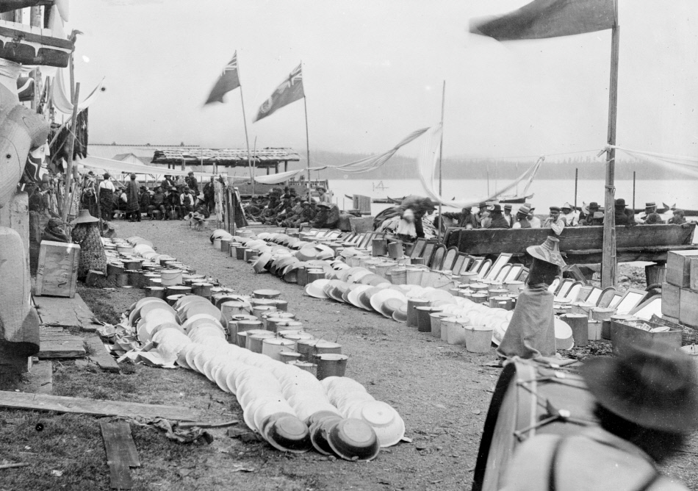
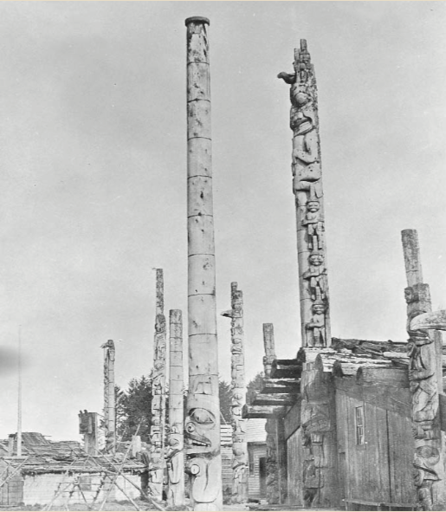
The Coast: Potlatch

Slide 35
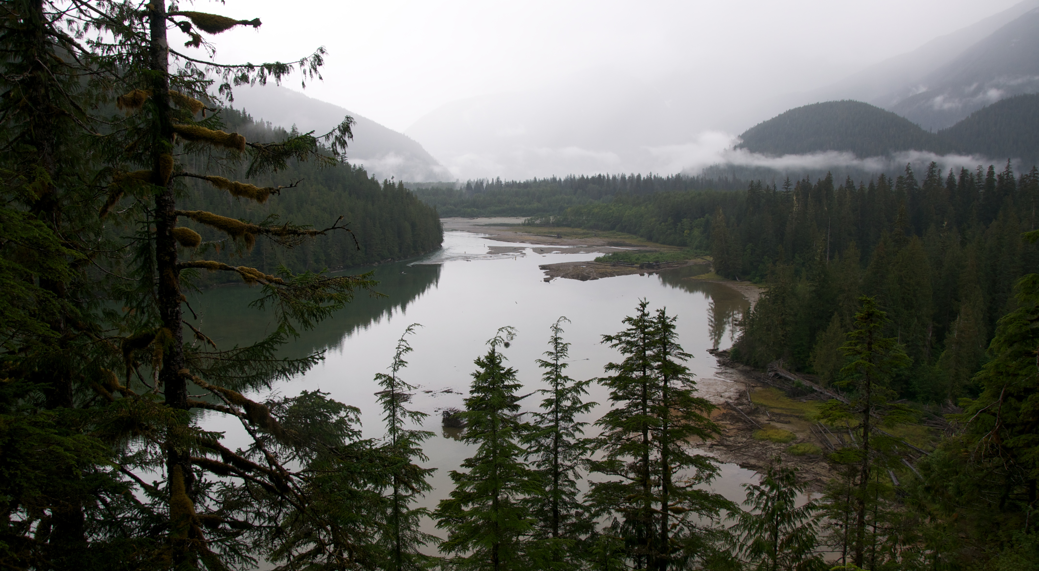
Case Study: Bella Coola Great Bear Rainforest

Slide 36
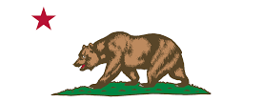
Whose State Flag is this?
Notes:
California Sate – In 1785, there were over 10,000 Grizzly bears here. By 1922, they were extinct.

Slide 37
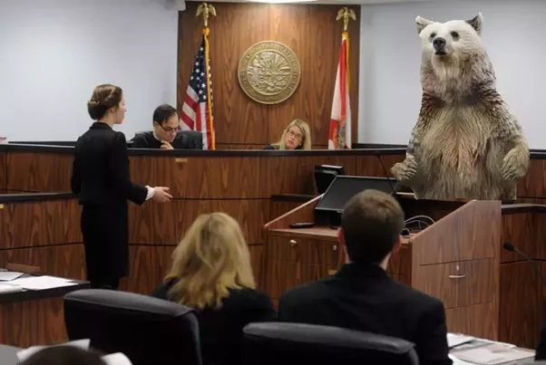
Bear Witness

Slide 38
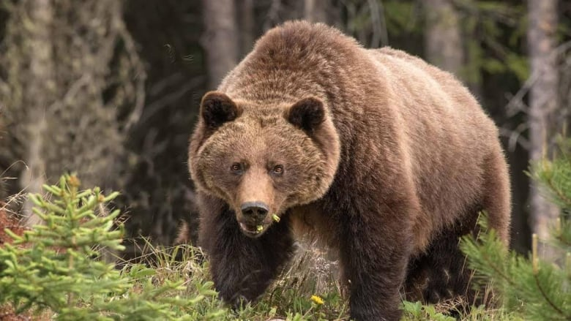
B.C. Sport Hunting

Slide 39
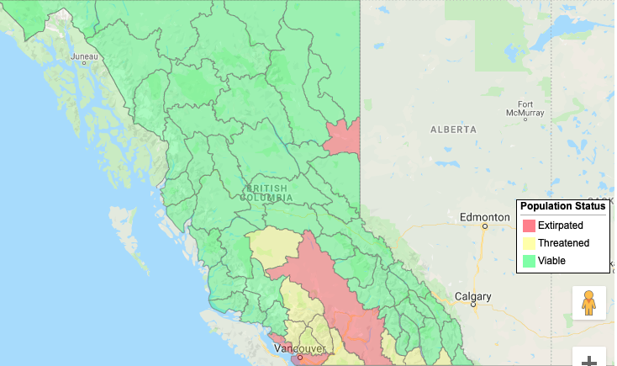
Statistics
B.C. is home to 15,000 Grizzly Bears represents 25% of the Grizzly Bear Population of North America.
In December of 2017, thanks to First Nations and Scientists working jointly together it is now illegal in B.C. to hunt Grizzly bears.
Hunters must also use all the edible portions of any large animal they kill, including cougars, black bears, elk and deer to name a few.

Slide 40
Classwork
Please work on the following:
Stations Activity
Origin Story Question + Venn Diagram
T’lina: The Rendering of Wealth Questions
Intro Booklet
Ch.1 Booklet + Map

Slide 41
Outline – Please Read!
September 23rd (TODAY) - Please meet down at Portable 6 today for B.C. First Peoples 12.
Please keep your phones away during the presentation/activities out of respect for the Speaker.
Please also keep your ear buds out.
See you there ☺

Slide 42
Outline
CNN 10
Southern Interior
Northern Interior
North-East Region
Project
Wednesday (Mapping)
Thursday (Work on It)
Friday (Talk about it)

Slide 43
Southern Interior ☺
This area we often refer to as the Okanagan, West/East Kootenays.
Two main rivers move through this area: The Fraser / Columbia.
Two main Tributaries: The Thompson and the Kootenay.
Lots of Lakes!

Slide 44
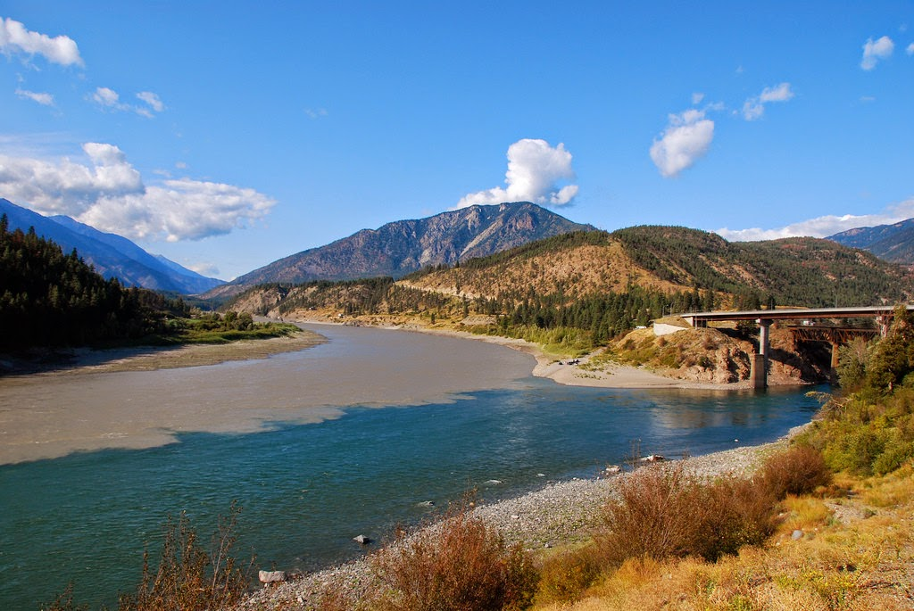
Southern Interior T’LK’emchEEn
Notes:
Confluence of the Fraser River and the Thompson at Lytton, BC.

Slide 45
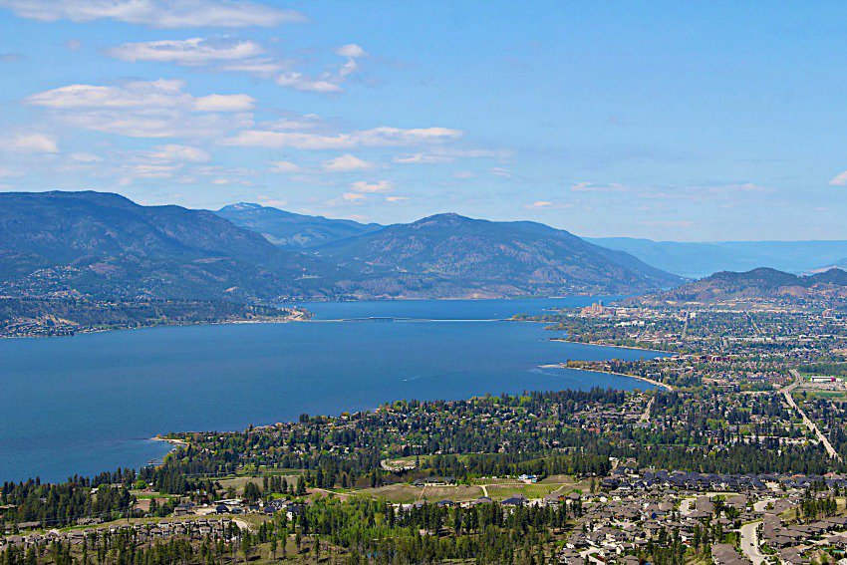
Southern Interior
Notes:
Okanagan Lake, Kelowna.

Slide 46
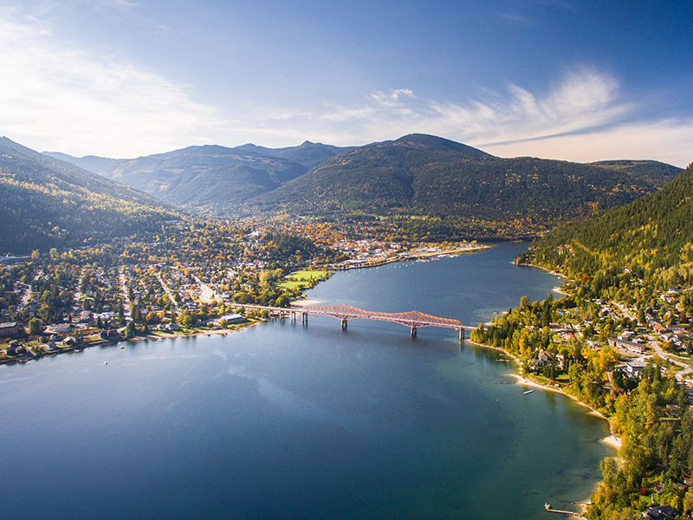
Southern Interior
Notes:
Kootenay Lake, Nelson BC

Slide 47
Southern Interior
The Southern Interior is Dry; Like my Jokes.
Grasslands, Pine Forests, and Desert make up the habitat of this region.

Slide 48
Southern Interior Climate
Warm and dry in the summer and cold and dry in the winter.
The southern Okanagan is classified as a desert that extends all the way up from the USA and Mexico
The western slopes of Mtn. ranges can be very wet similar to the coastal rainforest

Slide 49
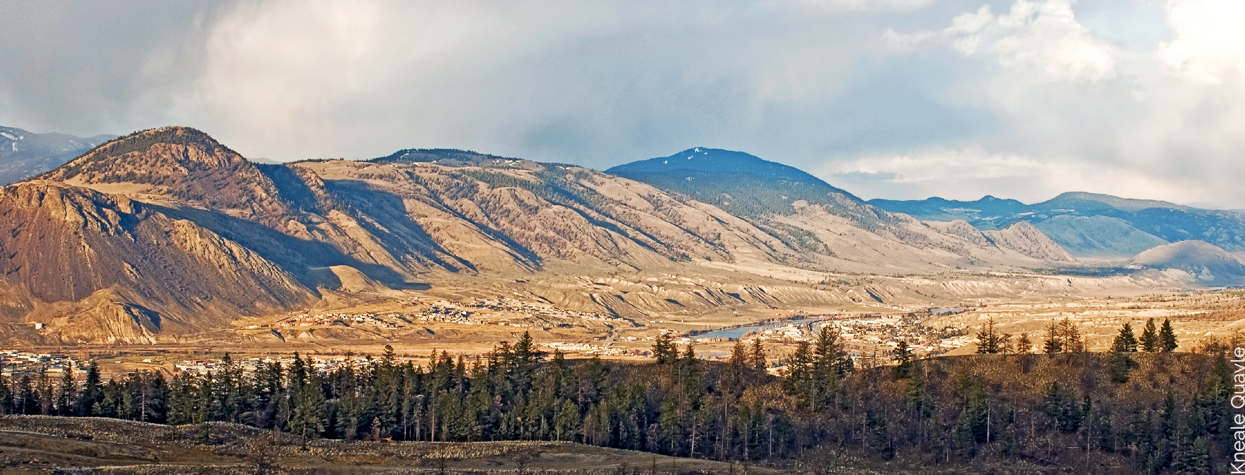
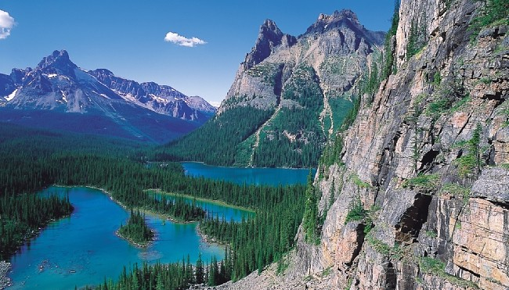
Southern Interior Landscape
Notes:
Western Kootenays vs. Eastern Kootenays.

Slide 50
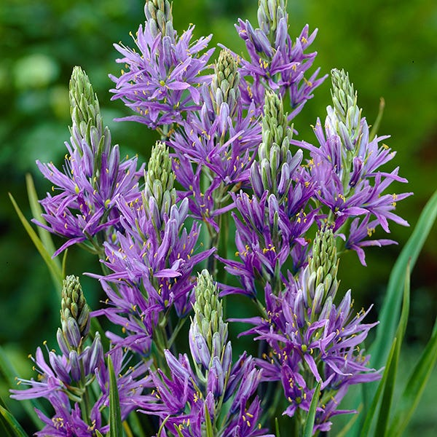
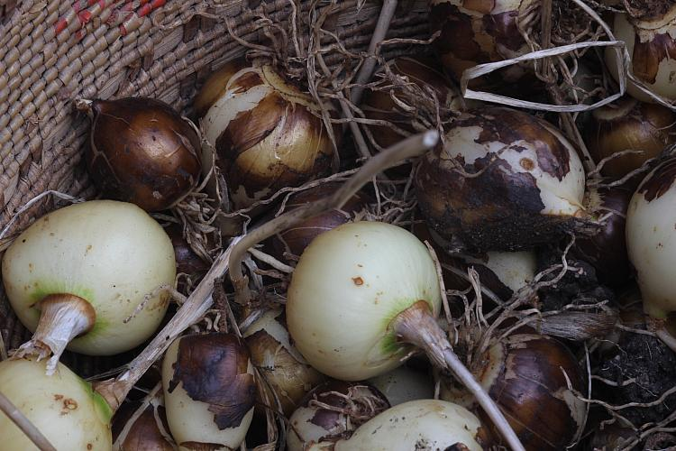
Southern Interior: Resources
This topography is home to rich vegetation.
50% of FN peoples diet came from eating plants such as berries, wild potatoes and bitter root.
Salmon, Elk, Deer, Moose, Bear, provided clothing/food.
Camas Lily
Camas Bulbs

Slide 51
Southern Interior People
The Southern Interior is home to five distinct Nations:
The Nlaka’pamux (the Thompson)
The St’at’imc (Lillooet)
The Secwepemc (Shuswap)
Okanagan
The Ktunaxa (Kootenay)
Similar to the Coastal people, the Southern Interior had seasonal movements.
Spring time = gathering plants/berries.
Late Summer = Salmon Fishing
Fall = Hunting bear, elk, mountain goat, caribou, beaver and deer.
Constructed Pit Houses near the River Basins.

Slide 52
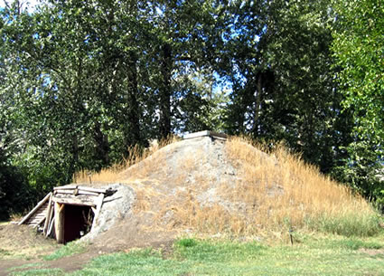
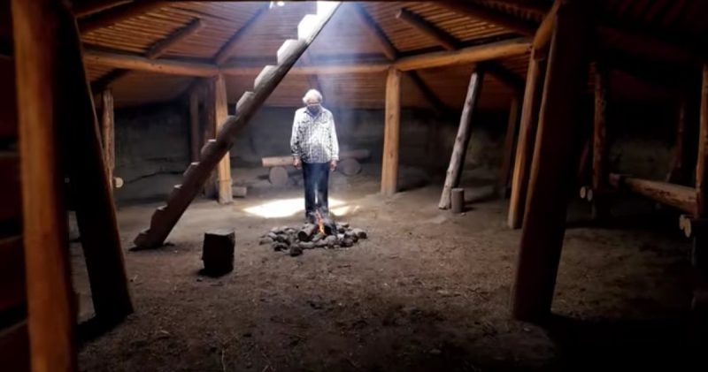
Southern Interior Pit Houses

Slide 53
North-East Region
This area is separated from the rest of the province by the Rocky Mountains
It’s landscape has more in common with the prairies or the Northwest Territories than the rest of BC
Has three distinct landscapes: foothills of the Rockies, muskeg, and prairies.
Summers are Warm – Winters are Cold.
Major Rivers include the Peace, Liard, and Mackenzie.

Slide 54
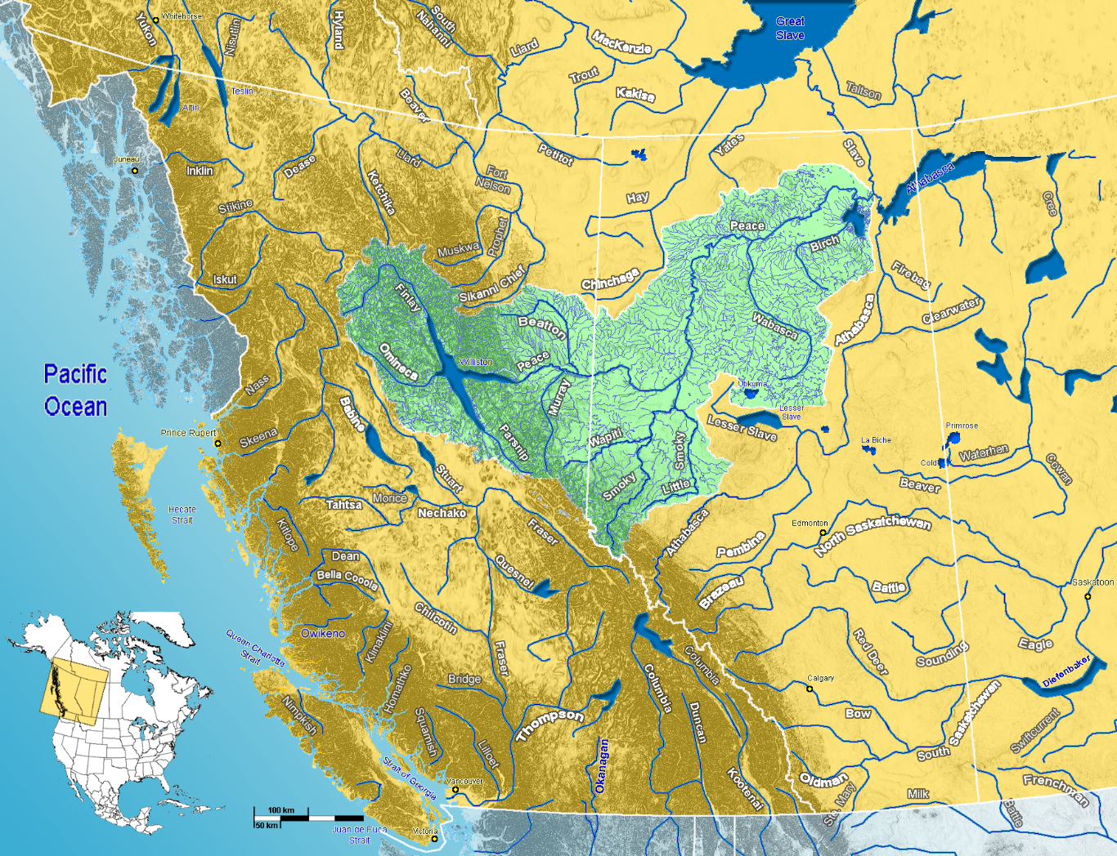
The Northeast

Slide 55
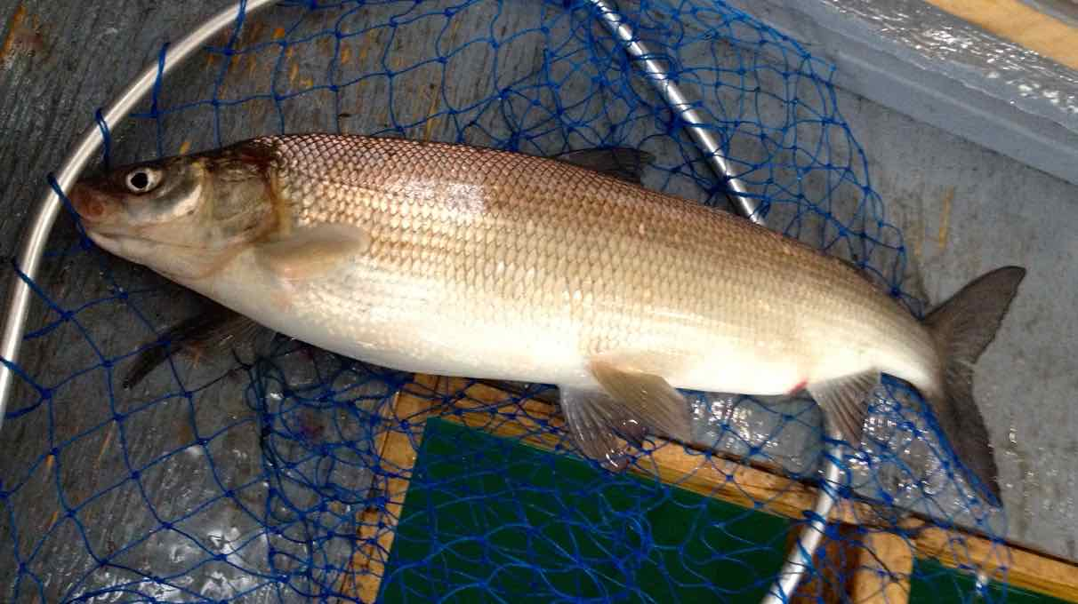
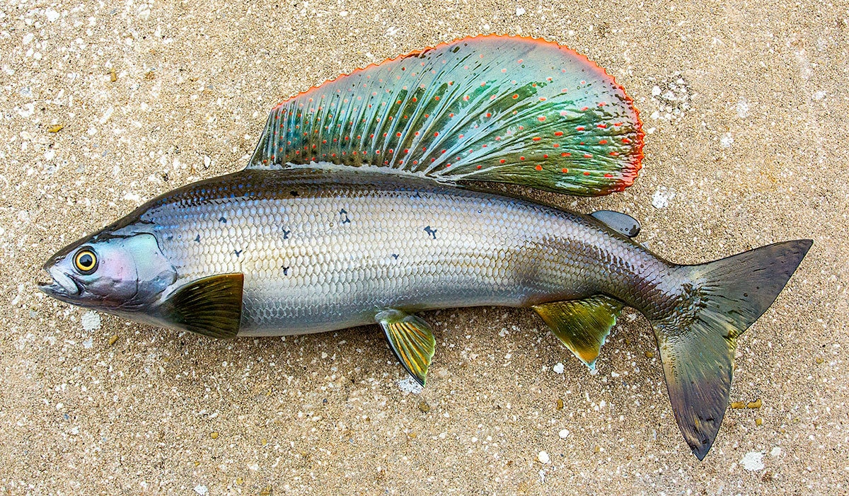
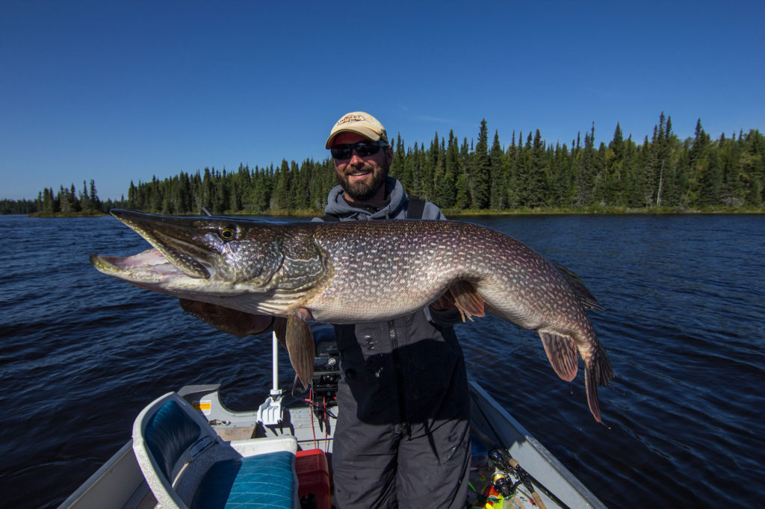
North-East Resources
Mammals: Moose, Elk, Caribou, Deer, Grizzly, Black Bear, and Beaver.
Fish: Trout, Whitefish, Artic Grayling and Northern Pike.
Birds: Grouse, Ducks, Geese.
Berries: Chokecherries, Huckleberries, and Saskatoon's

Slide 56
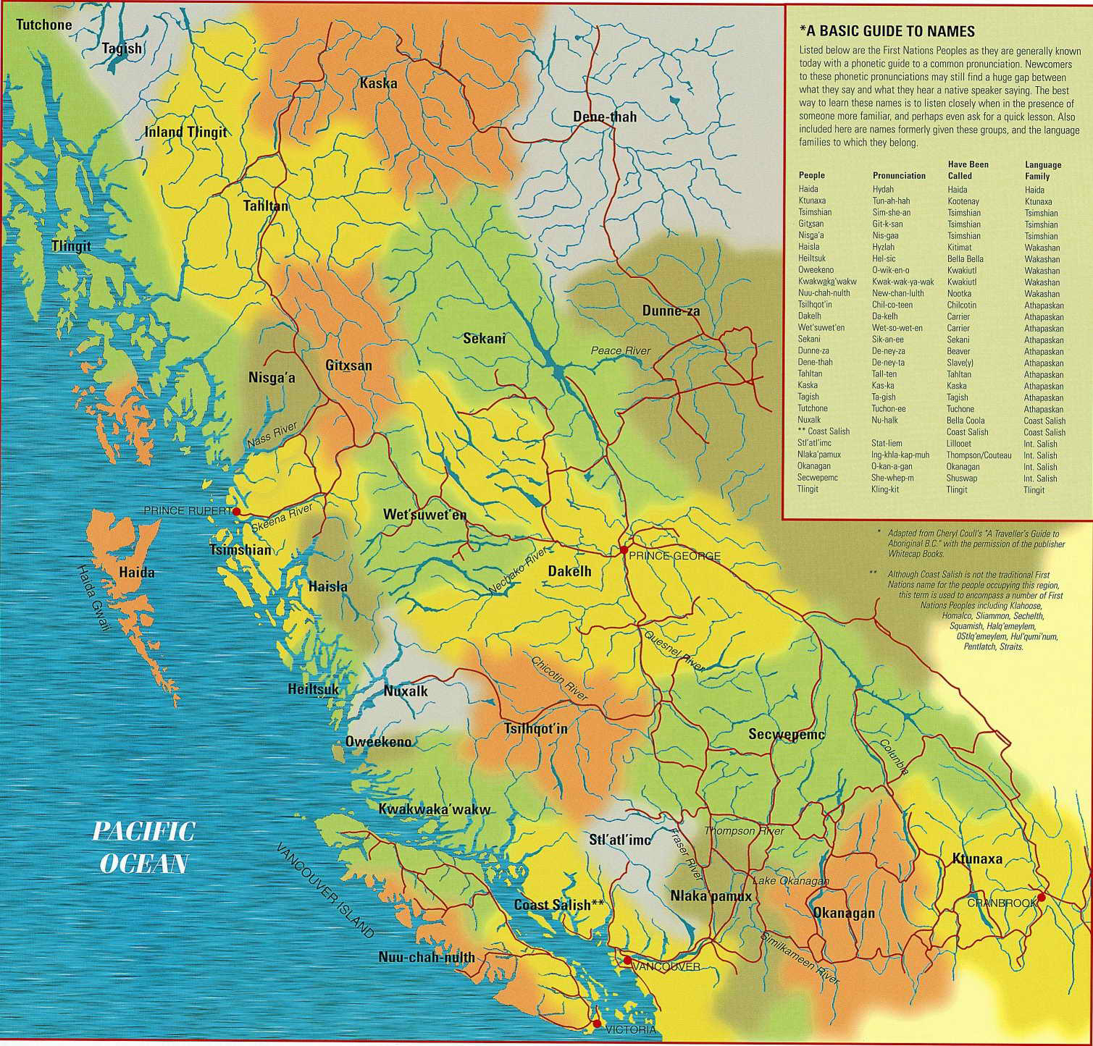
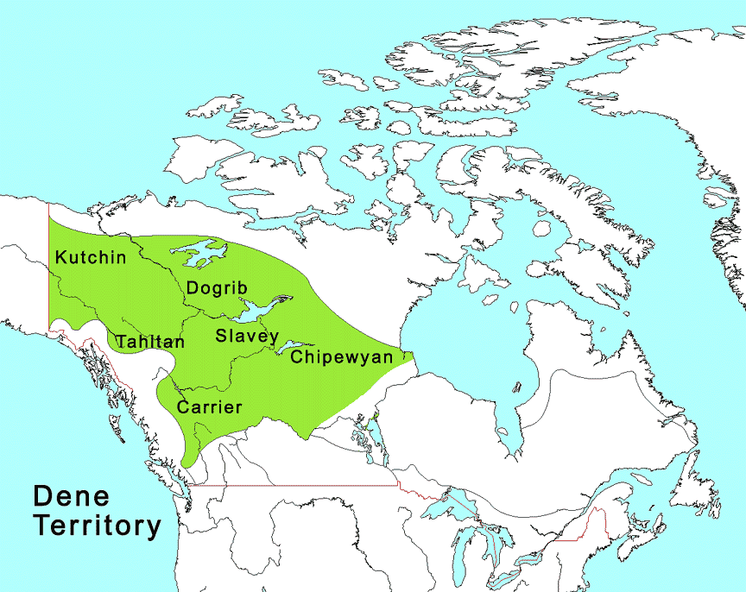
North-East People
3 Groups of First Nations →The Dene, The Dunne-za and the Sekani.

Slide 57
The Northeast – The People
The people here are in the ATHAPASKAN language family which was spoken from Alaska to the Southwest United States
Why would there be such a large geographic area for this language family?
The Dunne-za lived in the region between the Liard river and the Peace river
They would also hunt rabbits, beaver, bear, muskrats and marmots for fur and food as well as the larger mammals. They would also hunt birds.
Berries like chokecherries, huckleberries and Saskatoon were harvested too along with some roots.
The Dunne-za were very mobile people.
Why would this be? Think resources and climate.

Slide 58
Northern Interior
The largest region in British Columbia.
Mainly Boreal Forest (Spruce/Fir) and Lakes
Climate is Cold and Precipitation is Low.
Landscape is a large plateau with mountains.

Slide 59
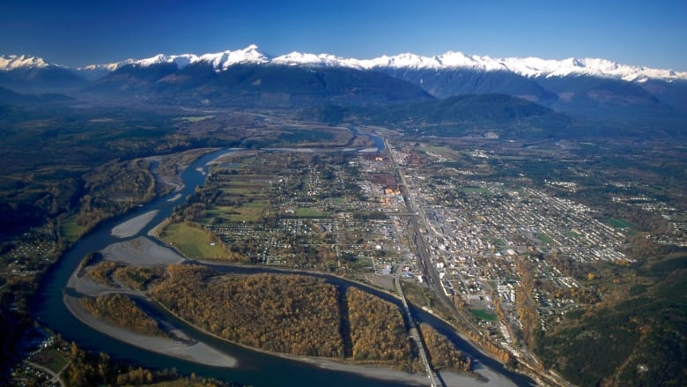
Northern Interior Terrace, B.C.
Notes:
Terrace BC

Slide 60
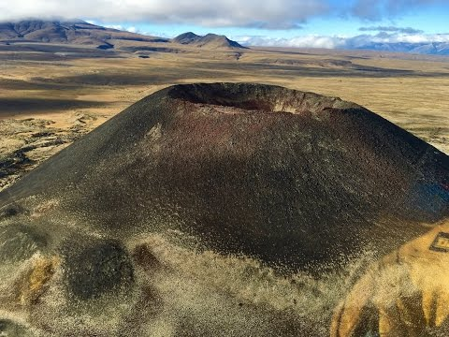
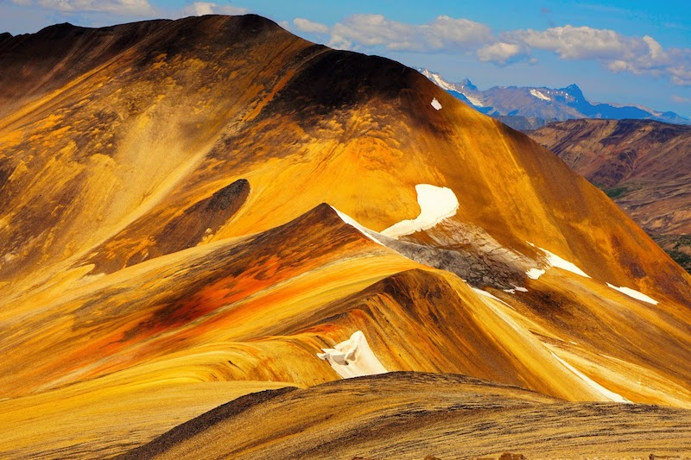
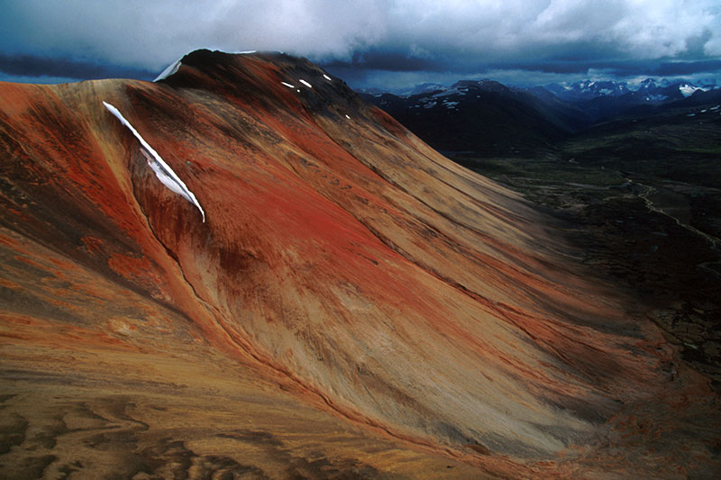
Northern Interior Mount Edziza
Notes:
Terrace BC

Slide 61
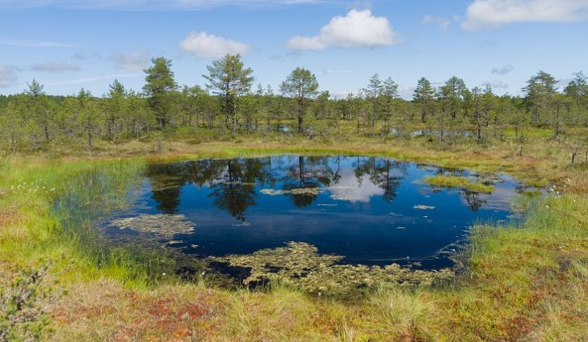
Northern Interior Muskeg (Swamp)
Notes:
Terrace BC

Slide 62
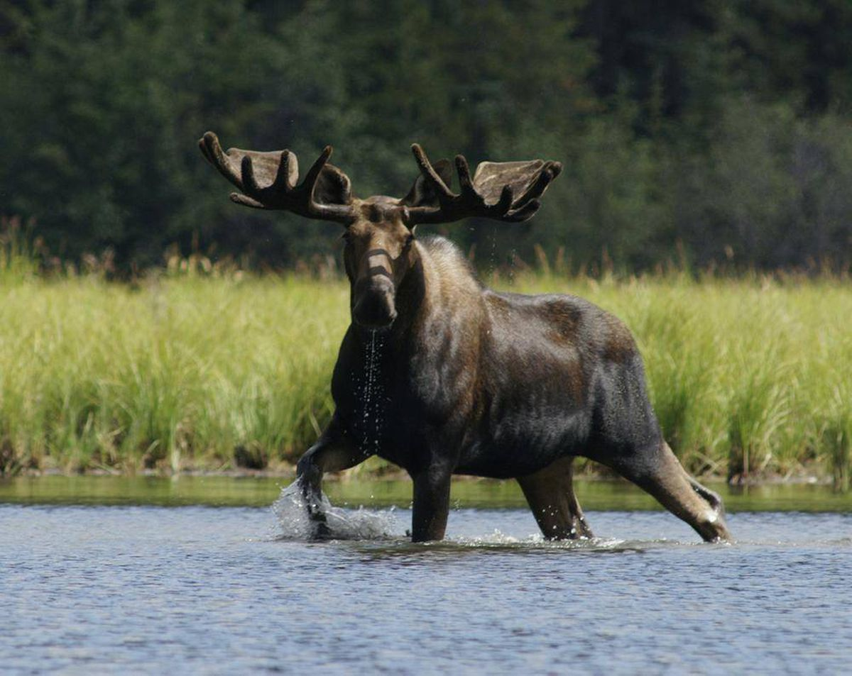
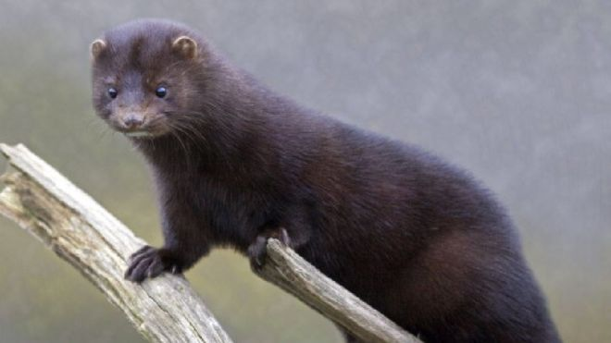
Northern Interior Resources
Mammals: Moose, Caribou, Mule Deer, Cougars
Black Bear, Coyotes and Wolves
Fur Bearing: lynx, fisher, muskrat, marten, mink and Beaver (Trap Lines)
Notes:
Terrace BC

Slide 63
Northern Interior People
First Nations in the Northern Interior belong to the large Athapaskan language family.
Four of the Nations are the Yinka-Dene ‘People on the Land’, the Dakelh (The Carrier), the Tahltan (along the Stikine River) the Gitxsan (along the Skeena)
Due to limited resources and harsh climate, the people in the Northern Interior moved around becoming a mobile society.
Notes:
Terrace BC

Slide 64
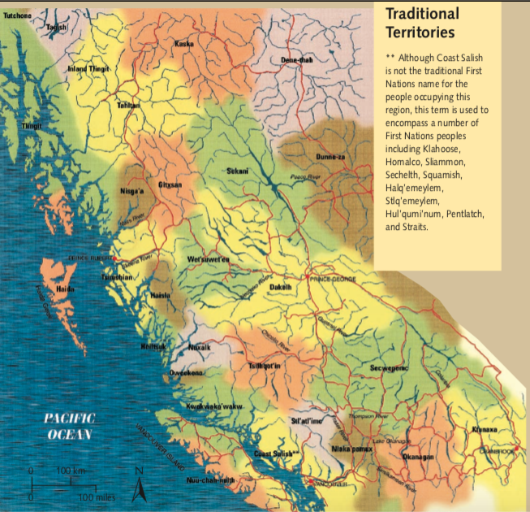
Northern Interior People
Notes:
Terrace BC

Slide 65
Kwakwaka’wakw Case Study
This is the people from the film we watched “T’hina, the Rendering of Wealth”
Be sure to answer questions #4 in your booklets after reading the Case Study!

Slide 66


Skeena River Trapline (1949)

Slide 67
Outline
CNN 10
Creating a Map

Slide 68
Creating a Map
Imagine we were to create a Map of a Traditional Territory for the First Nations.
What would we need to include?
What should we draw first on the Map?

Slide 69

#3 – Mapping Traditional Territory of the Sto:lo People

Slide 70
Mapping Criteria
What should we put on our map?
Important Land Features/Landmarks
Mountains
Sumas Mountain
Mount Cheam
Mount Robbie Reid
Rivers
Fraser River
Lakes
Harrison
Pitt Lake
Alouette Lake
Coquitlam Lake
Stave Lake
Hayward Lake
Cultus Lake
Jones Lake
Reserve Land
Leq'á:mel – (Deroche)
Matheqwí (Matsqui)
Qwó:ltl'el (Kwantlen – Fort Langley)
Sq'éwlets (Harrison)
Pekw'xe:Yles
(Peckquaylis – Mission)
Legend
Compass
Title

Slide 71

Mapping

Slide 72
Local Geography Project
Please come grab a copy of our first Project – Local Geography.

Slide 73
Outline
CNN 10
Journal Prompt
Work on Project
You should be creating your poster/ppt. at this point.
Finish up missing assignments.
Intro + Ch.1 Work Package
T’Lina the Rendering of Wealth Questions
Stations Activity Booklet
Origin Story

Slide 74
Journal Prompt
1. How has your understanding of First Nations people’s relationships with the land changed?
a. What have you learned in this Chapter in regards to resources/landscapes/climates?
b. What are the responsibilities of individuals to the land?
c. What are the responsibilities of communities to the land?
2. “The Land is our culture” – Explain what this statement means.

Slide 75
Classwork
Finish your journal prompts + HAND in ☺
Finish and hand in Stations Activity
Finish and hand in film questions – T’Lina
Finish and hand in Intro Questions
Finish and hand in Ch. 1 Questions
Finish and hand in Origin Story
Keep working on Project

Slide 76
Film: Laxwesa Wa, Strength of the River: Fishing on the Fraser River/Coast
As you watch the film look for examples of the following:
spiritual connections with the salmon
traditional fishing and processing technologies
education of the children
resource management systems (traditional fishing rights)
Notes:
First Nations Man fishes in Moricetown BC, along the Bukley River.

Slide 77
Outline
CNN 10
Stewardship/Sustainability
Film

