Slide 1
Outline
CNN 10
T’LINA THE RENDERING OF WEALTH (FILM)
Questions on the Film

Slide 2
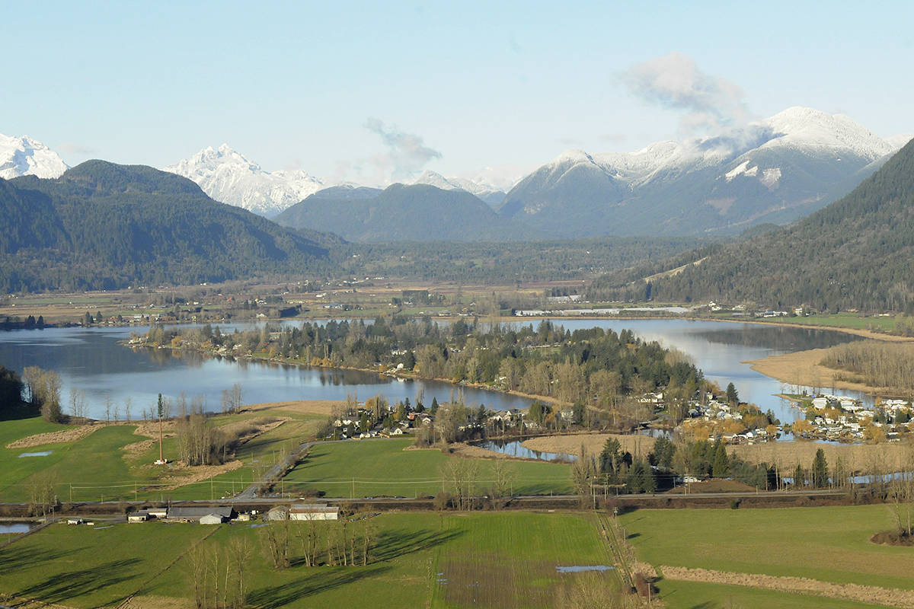
Ch.1 – The Land

Slide 3
The Transformer Raven and Coyote
According to the Kwakwaka'wakw, before there were humans, the sky, the forests, the underworld and the sea were occupied by supernatural beings who could take on animal or human form at will. It was one of these beings, the Transformer, who wandered through the world making it ready for human occupation by changing some of the other supernatural beings, according to their wishes, into mountains, rocks, islands and rivers. It was the Transformer who created the salmon, the oulachon and other fish and placed them in the rivers and streams and other locations where they are now found. While travelling about the world, the Transformer also permanently changed evil and greedy supernatural beings and people into animals. To others, he gave the proper human form and instructed them in how to live in the world. Some supernatural beings voluntarily shed their supernatural forms to become human.
These first humans appeared at specific locations and founded the first Kwakwaka'wakw families,..." (Speck, 1987: p2)

Slide 4
Creation Story of the Nimpkish River
It is said that Qwa'niqilakw, the Transformer, travelled around the world changing many things. In time, he reached the place where Gwa'nalalis lived. The Transformer asked, "Would you like to become a cedar tree?"
Gwa'nalalis replied, "No, cedar trees, when struck by lighting, split and fall. Then they rot away for as long as the days dawn in the world."
Then Qwa'niqilakw asked, "Would you like to become a mountain?"
"No," said Gwa'nalalis, "for mountains have landslided and I would crumble away as long as the days dawn in the world."
A third time Qwa'niqilakw asked, "would you like to become a boulder?"
Again, Gwa'nalalis replied, "No, do not let me become a boulder, for I may crack in half and crumble for as long as the days dawn in the world."
Finally, the Transformer asked, "Would you like to become a river?"
Gwa'nalalis said, "Yes, let be become a river, that I may flow for as long as the days shall dawn in the world."
This is how the man Gwa'nalalis became the Gwa'ni River, now called the Nimpkish River.

Slide 5
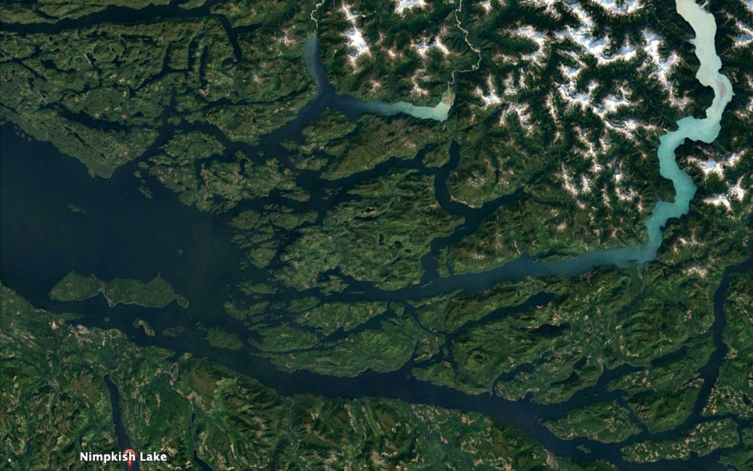
Creation Story of the Nimpkish River

Slide 6
Loss of Land
"The... report recommended that about 47,000 acres of generally speaking good land be taken from the Indians, and about 80,000 acres of generally speaking poor lands, be given in their place... In monetary terms, only $444,838 worth of lands were added to existing reserves whereas $1,522,704 worth of land were cut off." (Speck, 1987:12).

Slide 7
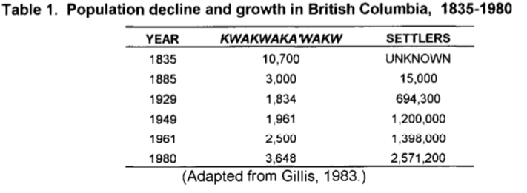
Decline over the Centuries

Slide 8
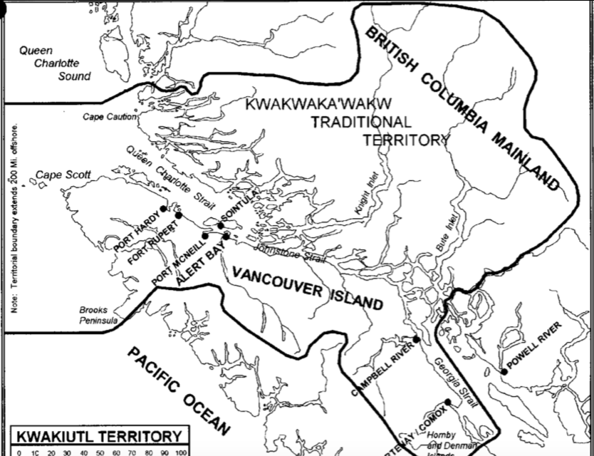

Slide 9
Eulachons are small smelt-like fish that are caught by the ton in late March and April. Some are eaten fresh, others are smoked and dried for later use.
Most are used to make eulachon grease or "g'leena".
G'leena is rendered from the eulachons by heating them in a large cedar box after they have been allowed to decompose for several days.
G'leena is a highly valued delicacy.
It is eaten as a condiment with clam or fish chowder, dried fish, potatoes, salads and other foods.
It is often the prize for a charity raffle, or given to important guests at potlatches.
G'leena is also highly valued for its medicinal properties.

Slide 10
The process of making g'leena takes about a month.
Organizing an expedition requires purchasing groceries for four to 10 people for a month, arranging for transportation to Knight Inlet (about 80 nautical miles by water), small boats, nets, bottles, rendering equipment, camping supplies and equipment, and numerous other supplies and materials.
Often, deals are made over borrowed equipment and other needs, such as "2 gallons to borrow your outboard motor", a family often finds that much of their production is committed before the first gallon is made.
Usually, some g'leena is sold when the expedition returns to cover the cost of expedition expendables such as fuel, groceries and ammunition. The usual price is $100 to $150 per gallon, depending on its quality.

Slide 11
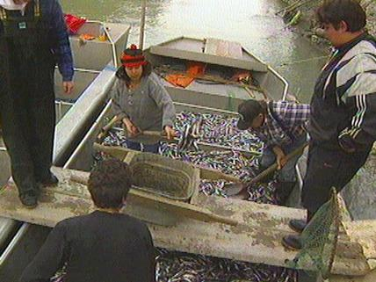
T’Lina: The Rendering of Wealth
Q: What does a “Spiritual Connection” Mean?
*** As you’re watching the film, watch for the “Spiritual Connection” that the people have when they visit Dzawadi.

Slide 12
T’Lina: The Rendering of Wealth Q’s
Please use this time to answer the Questions from the Film.

