Slide 1

Welcome to M.S.S
2018 - 2019

Slide 2
Mental Health
Mental Health is not a Taboo Subject…
Your mental health is important – just like your physical health.
Many of us felt anxiety this week, even now…
  what is my course going to be like,
  what is my teacher going to be like
  what will this year be like
  who am I and who am I going to become? What do people think of me?
Each of us in some form or another will experience mental distress this year.

Slide 3
Mental Health
If you ever need to take a day for your mental health – DO IT.
If you ever need a place to come vent, talk, or just be – you’re always welcome here and I will always do my best to make time and a safe space for you.
Remember that your perspective and attitude about others reflects more about you, then about them.

Slide 4
Things I wanted you to know…
I may ask questions throughout the course – never feel pressured to answer (If you don’t want to, simply say ‘pass’ or if you need time to think about it say “come back to me”)
Feel Free to Ask Questions – Be Inquisitive
If you don’t understand something please let me know!

Slide 5
Stations Package

Slide 6
Canada, Eh?
Good Morning!
Today will be beginning a Canadian Map Unit.
Here’s why…

Slide 7
Canada, Eh?
Map 1 Instructions: locate and label the following on an outline map of Canada. Print small. Use an atlas if necessary. Arguably, many would say that as Canadian citizen you should all know some basic geographic info about Canada, including all the provinces and their capitals, and major rivers and lakes.

Slide 8
Canadian Jurisdictions
10 provinces
10 provincial capitals
3 territories + 3 territorial capitals
Other cities
Ottawa (national capital)
Montreal
Calgary
Vancouver
Coastal Features
Pacific Ocean,
Atlantic Ocean
Arctic Ocean,
Beaufort Sea,
Baffin Bay,
Davis Strait
Hudson Bay
James Bay
Strait of Belle Isle
Gulf of St. Lawrence
Bay of Fundy
Haida Gwaii
Victoria Island
Baffin Island
Rivers
Fraser
Columbia
Yukon
North Saskatchewan
South Saskatchewan
Nelson
Churchill
Red
Mackenzie
Peace
St. Lawrence
Lakes
Superior,
Huron
Michigan
Erie
Ontario
Lake Athabasca
Lake Winnipeg
Great Bear Lake
Great Slave Lake
Other Jurisdictions
Alaska (USA)
United States of America
Greenland

Slide 9
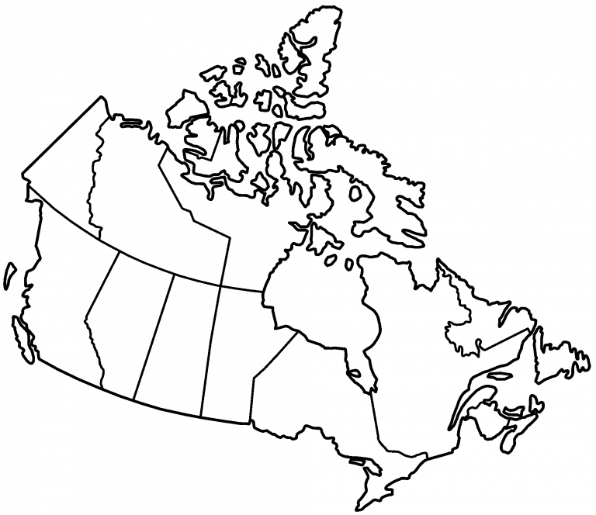

Slide 10
Good Morning
Outline
Survey
CNN 10
Look at the Criteria for the World Map
Finish the Canadian Map
Finish the World Map
When you’re done please hand them into the bin.

Slide 11
Survey
Topic | Yes | No
1920’s Jazz Age | 0 | 27
1930’s Great Depression | 3 | 24
WWII | 9 | 18
Korean War | 1 | 26
Vietnam War | 3 | 24
The Cold War | 3 | 24
First Nations in BC | 20 | 4

Slide 12
World Map
For the section on Cities – You don’t need to put them on the map, rather just write down which country/state/province, they are located in.
You can write this beside the name of the city.

Slide 13
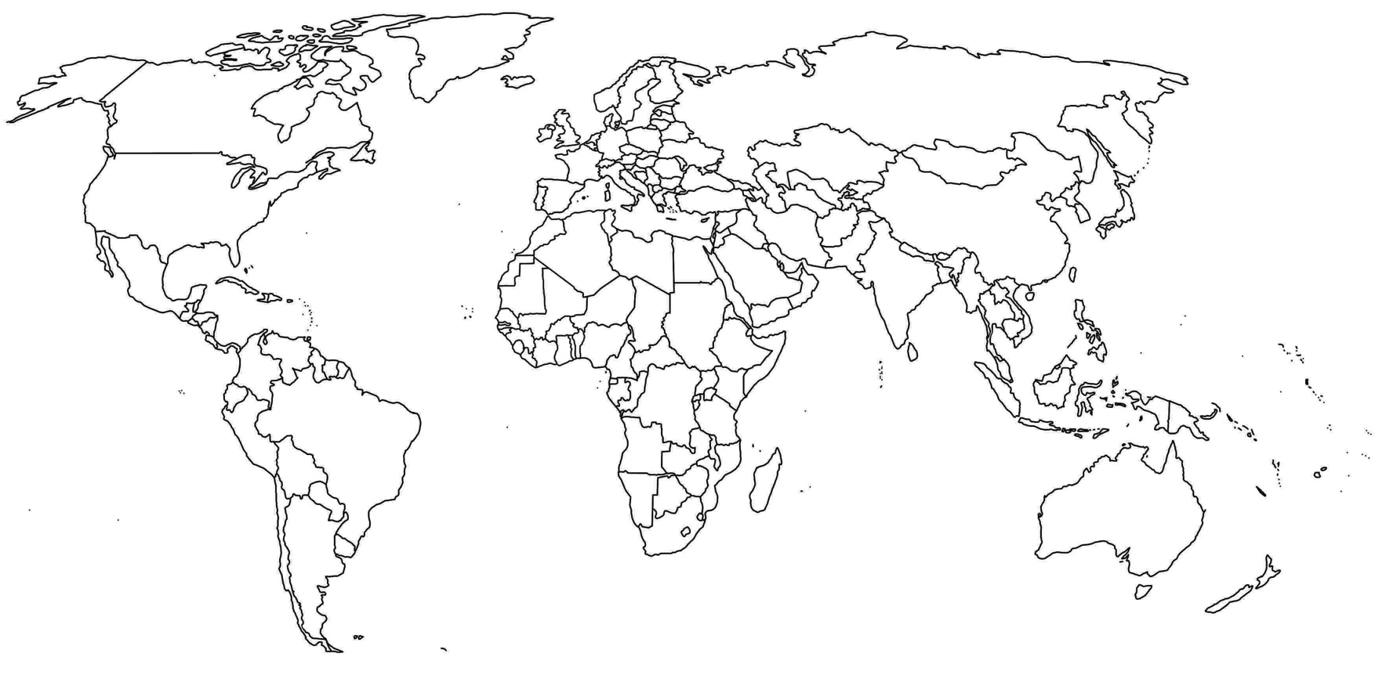
Artic Circle
Prime Meridian
Tropic of Cancer
Equator
Tropic of Capricorn
Antartic Circle

Slide 14

Russia
Canada
USA
China
India
Brazil
Australia

Slide 15
Quiz
Map Quiz will be on Wednesday
It will be on the Map of Canada, with emphasis on British Columbia.
You need to be able to identify the following:
65 Cities in British Columbia
All the major lakes in British Columbia
All the major Hydro Dams and their districts
10 Local Mountains, including whether they have hiking trails
The major highways in BC and which towns they go through

Slide 16
Quiz
Map Quiz will be on Wednesday
It will be on the Map of Canada, with emphasis on British Columbia.
You need to be able to identify the following:
Each of the Provinces and Territories
Each of their Provincial Capitals
The Fraser River,
The Mackenzie River
The Columbia River
The Pacific Ocean
The Atlantic Ocean
The Artic Ocean

Slide 17
Good Morning
Outline
CNN 10
Review Survey
Begin Demographics
Finish the Canadian Map
Finish the World Map
When you’re done please hand them into the bin.

Slide 18
Survey
Topic | Yes | No
1920’s Jazz Age | 0 | 27
1930’s Great Depression | 3 | 24
WWII | 9 | 18
Korean War | 1 | 26
Vietnam War | 3 | 24
The Cold War | 3 | 24
First Nations in BC | 20 | 4

Slide 19

What is Geography?
Social Studies 11
Mr. Koe

Slide 20
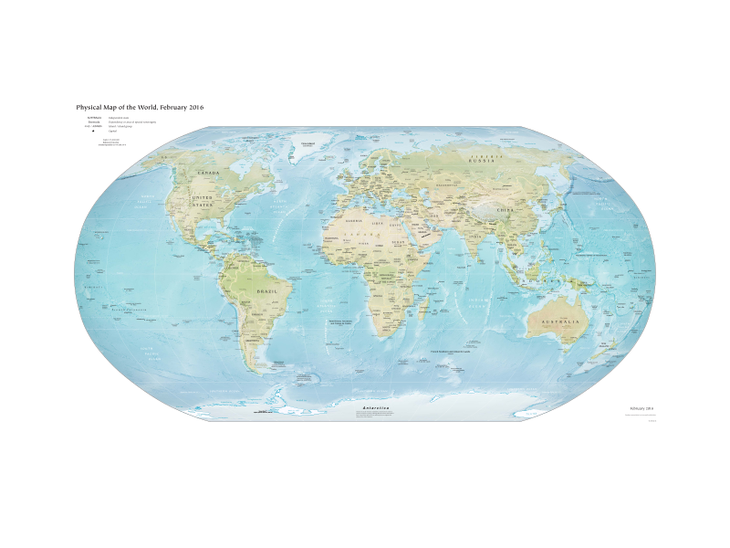
Geo = Earth, + Graphy = The Study of
Geography = The Study of the Earth

Slide 21
Geography
Human Geography
Physical Geography
Focuses mainly on the impact and behavior of people on the world.
Urban-geography
Cultural Geography
Development Geography
Population Geography
Focused mainly on the natural processes of the Earth.
Geomorphology
Climatalogy
Glaciology
Coastal Geography
Environmental Geography
Focuses on the Connection

Slide 22
What will be Exploring
Demographics – Population Densities, Models, Immigration etc.
Standards of Living – Human Development Index, GDP, Developed/Developing Countries
Resources of British Columbia – Forestry, Natural Gas, Mining, Fisheries, and Hydro
Local History of Mission
  Mini Research Project
  Human Geography is considered a Science which means there is a bit of basic math to do in this unit (subtracting, adding, multiplying, dividing)

Slide 23
Vocabulary
We’re going to ease into this unit today by exploring some of the vocabulary associated with it.
Demography
Developed Country
Developing Country
Birth Rate
Death Rate
Immigration Rate
Emigration Rate
Natural Increase
Exponential Rate
Rule of 70
Doubling Time
Net Migration
Population Growth Rate
Life Expectancy
Demographic Transition Model
Mortality
Population Pyramid
One-Child Policy
Age Cohort
Dependency Ratio
Carrying Capacity
Population Distribution
Population Density
Nutritional Density

Slide 24
Vocabulary ☺
Demography: the study of population numbers, distribution, trends and issues.
Census: the process of collecting, compiling, and publishing demographic, economic, and social data about all people living in a particular area.
Developed country: a country with a highly developed economy and infrastructure and high living standards.

Slide 25
Vocabulary ☺
Developing country: a country with a less sophisticated economy and lower standard of living than developed countries; may have extensive poverty.
Birth Rate: the number of births per 1000 people in a country in a given year.
Death rate: the number of deaths per 1000 people in a country in a given year.

Slide 26
Geography
A broad subject that is concerned with describing and analyzing relationships between people and their home.
  In which direction do you see Mission growing in the future?
  What sort of infrastructure (roads, hospitals, etc) do we need to support a doubled population in Mission?
Links the physical sciences with humanities.
  Statistics
Geography seeks to answer the WHERE, HOW, and WHY questions and to understand their importance.
  Why are people moving to Mission?
  How can Mission support such a large growth?
  Where will Mission Expand in the Future?

Slide 27
Introduction
Many of the world issues that confront us today cannot be understood without studying our relationship to the planet on which we live. (True or False)
  Poverty: Why is there such a large percentage of the homeless people of B.C. living in the Fraser Valley?
We must understand geography in order to make sense of the complex issues that surround our world.
  Environmental Sustainability: How do we continue to keep green space for future generations well providing affordable housing for people?
We will be studying examining the issues and problems related to the physical world around us.
The significant growth in population, reasons for this growth, and the ability to meet the demand for resources are examples of topics to be investigated.

Slide 28
☺
Global issues – topics/events that have the ability to change or alter the way each person on earth lives their day-to-day life. ☺
Human geography – explains how people interact with the environment in which they live. ☺
Inter-connectedness – the connection between all humans, animals, and plants. ☺
Global Village – Marshall McLuhan coined the term. Refers to the world and all the inhabitants as a small village system. ☺

Slide 29
Demography
The study and analysis of trends relating to human populations.
  2000 years ago – 300 million people on Earth.
  200 years ago – 1 Billion people on Earth
  Roughly 76,000,000 people are born each year.
  This equates to 208,219 people born each day.
  8675 people born each hour.
  144.5 people born each minute.
  2.4 people born each second.
  In 10 seconds will have repopulated this classroom.
  In 10 minutes will have repopulated this entire school.
  In 4.5 hours will have repopulated this entire city.
Notes:
76 Million People are born Each Year
208219 people a day.
/365 = 8675 an hour
2.4 children are born every second.
In 10 Seconds – we’ve repopulated this classroom.
In 10 Minutes – we’ve repopulated this school.
In 4.5 Hours – We’ve repopulated Mission.

Slide 30
Demography
The study and analysis of trends relating to human populations.
Many demographers believe that the world’s rate of population growth needs to slow down.
Q: Why might the population growth need to slow down?
Q: What are ways by which a Population can slow down?
Q: What changes (new technologies, innovations, etc) have come about in the 21st Century to slow these processes down?
In ancient times, demographers believed that population growth was beneficial:
  A large population allowed for a strong military and therefore better security.
  Allowed some cultures to expand their empires (ex. Romans).

Slide 31
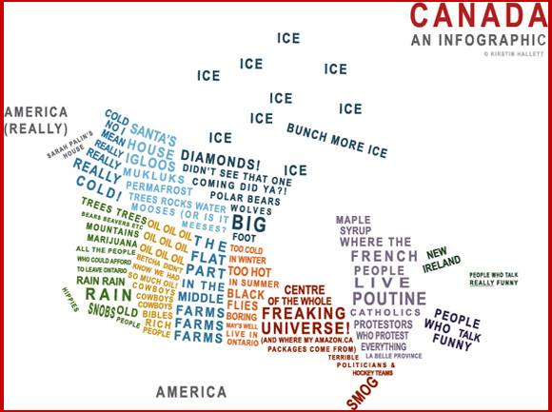
HaHa :’)

Slide 32
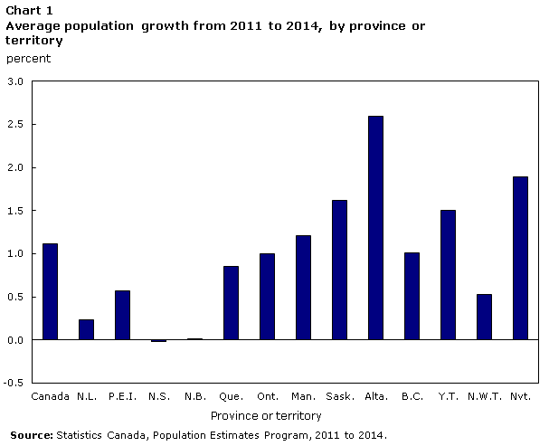
What does this information tell us about the Economy?

Slide 33
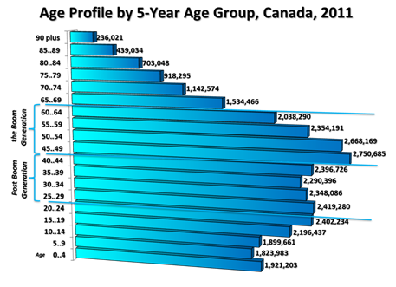
If you are a business owner, how could you use this information?

Slide 34
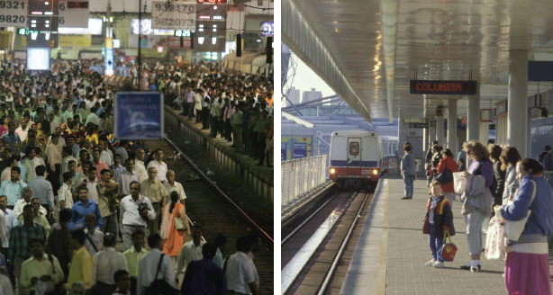
What differences do you see in these two photographs?
How might these differences affect the lifestyles of people living in either place?

Slide 35
Demography
Q: “All levels of government need accurate figures of population change…” Why though?
  List 5 reasons below on your sheet!
Businesses are interested in demographic information as they plan marketing strategies.
  Have you ever noticed when you go into a store, shortly after you may see an advertisement for that store on your Facebook or Instagram feed?
Helps us to understand the causes and consequences of population change.

Slide 36
Quiz
Please place the following items on your map where they geographically belong.
BC
AB
SK
MB
ON
QB
NS
NL
NB
NWT
YK
NU
FRASER RIVER
MACKENZIE RIVER
COLUMBIA RIVER
IQUALUIT
YELLOWKNIFE
WHITEHORSE
EDMONTON
VICTORIA
REGINA
TORONTO
CHARLOTTETOWN
FREDERICTON
ST. JOHN’S
HALIFAX
WINNIPEG
QUEBEC CITY
OTTAWA
ARTIC OCEAN
PACIFIC OCEAN
ATLANTIC OCEAN
BONUS
ST. LAWRENCE RIVER
VANCOUVER ISLAND
HAIDA GWAII
KOMA KULSHAN

Slide 37
Caution…
Deciphering Demographic Data
In Developed Countries the data can still have a margin of error.
In Developing Countries the census data are usually much less accurate. (True or False)
Why might this be?
  People don’t keep track of births and deaths.
  People live far away in isolated towns.
  Fear of Government, of Taxation, etc.

Slide 38
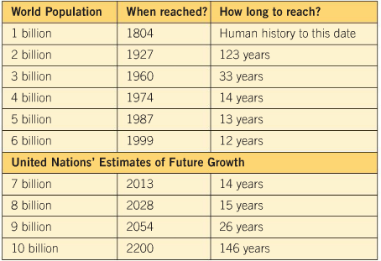
Activity 1
Brainstorm reasons for
  The rapid growth in the 20th century.
  Reasons for the different UN estimates
  Possible consequences of rapid growth.

Slide 39
Classwork
Finish any questions you didn’t in the workbook up to Activity 1
Finish Activity 1
Finish the Canadian Map
Finish the World Map
Study for the Quiz tomorrow!

Slide 40

What do you want to know about your Friends?

Slide 41
Census
In order to help governments maintain accurate records of its people, most countries complete a census every five to ten years.
A census is a national count of the population.
It is the process of collecting, compiling, and publishing demographic, economic, and social data pertaining to a particular time.

Slide 42
BRAIN-STORM
Q: For this exercise I want you to put yourself into the shoes of someone else (not literally). Brainstorm 3 questions that you might want to ask on a census based on the perspective of each person below.
Teacher
A Developer
Police Officer

Slide 43
Questions you’ll find on a census
Basic: Age, Gender, Address, Household Members, Relationship Status
Personal: Mental Health, Finances, Occupations, Ethnicities.
  Do you suffer from a mental illness
  How much do you make in earnings?
  How much do you pay for rent.

Slide 44
Census
Limits of a census:
  Rarely completely accurate.
    Why is this?
  Difficult to track individuals without a permanent address.
  Many births/deaths go unrecorded and skews census data.
  Illiteracy and poor communication make it difficult to complete → therefore it’s difficult to combat the problem and the trends becomes circular.

Slide 45
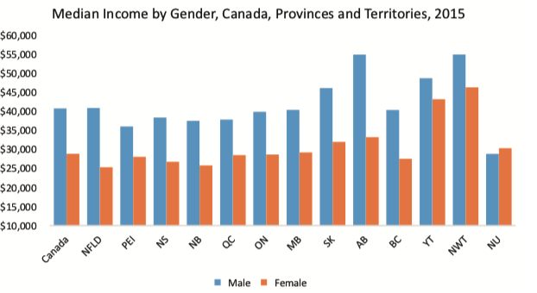

Slide 46
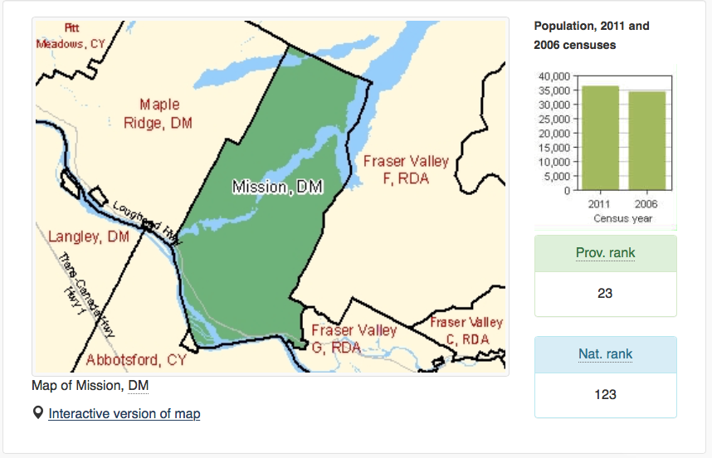

Slide 47
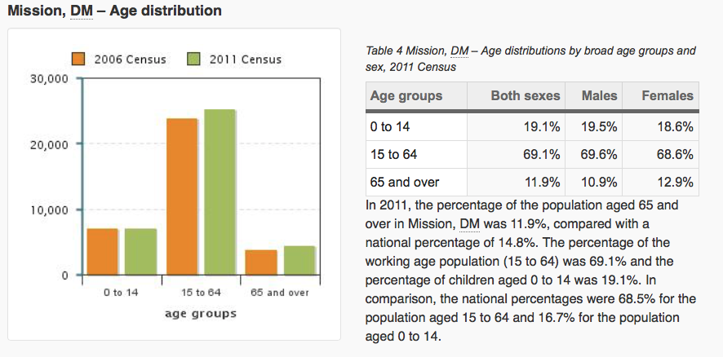

Slide 48
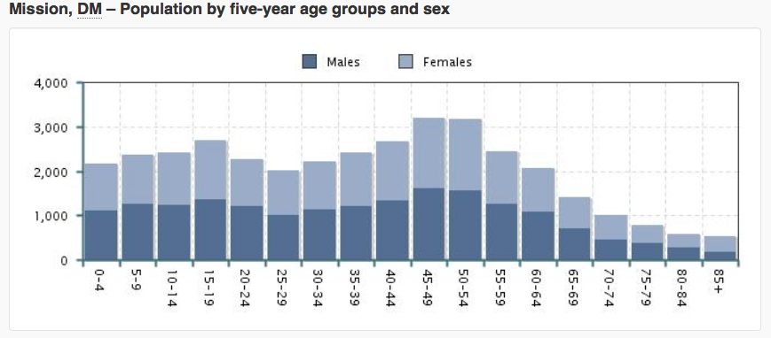

Slide 49
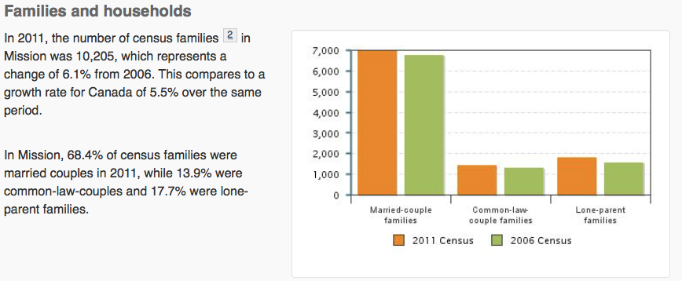

Slide 50
Activity #3
Working with Census Data

Slide 51
Outline
CNN 10
Quiz Hand-back
Activity #3
Vocabulary

Slide 52
27000 - 32000 | $29, 743 $30,961 $31,744 $31,813
32000 - 37000 | $32, 975 $33, 012 $33,539 $34, 188
37000 - 42000 | $38,299
42000 – 47000 | $42,717 $45,804 $46,088
47000 - 52000 | $50,618

Slide 53
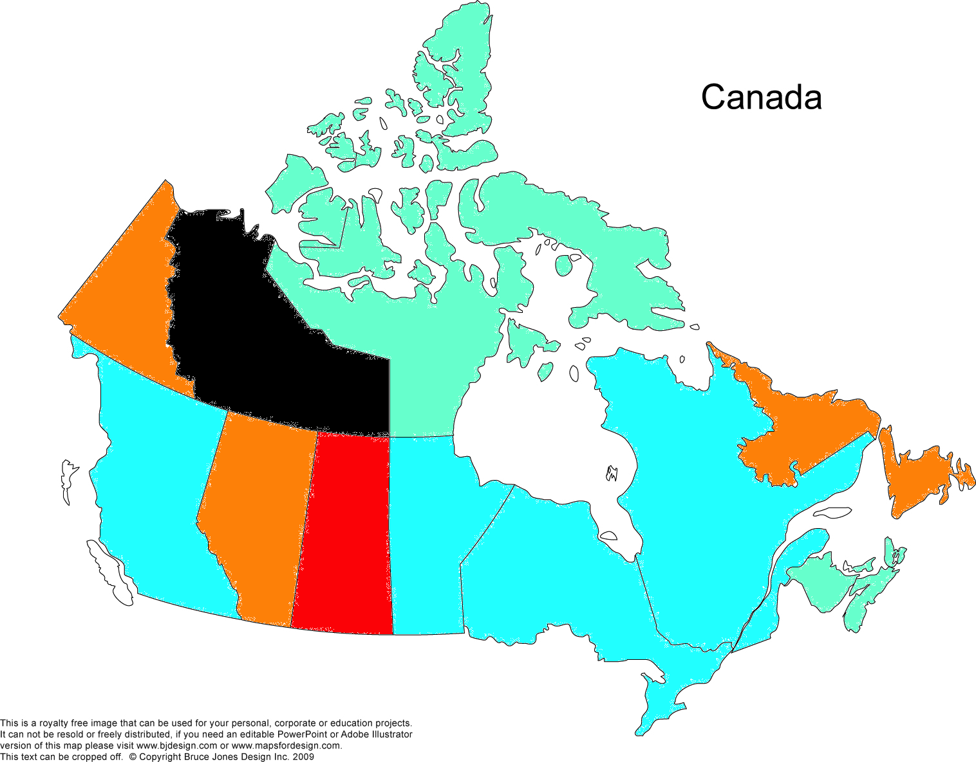

Slide 54
= $250,000 house price

Slide 55
Vocabulary ☺
Immigration rate: the number of new arrivals in a country in a given year per 1000 people.
Emigration rate: the number of people leaving a country in a given year per 1000 people.
Natural increase (NI): the rate at which a population increases (or decreases) in a year expressed as a percentage of the total population; calculated by subtracting the death rate from the birth rate.

Slide 56
Vocabulary ☺
Exponential rate: a rapid rate of population growth as each generation doubles in size.
Rule of 70: the time it takes a country to double its population, approximately 70 divided by the country’s growth rate.
Doubling Time: The amount of time it takes for the population to double in size.
Net migration: the difference between the number of people immigrating to a country and the number of people emigrating.
Migrant: a person who moves from one region to another.

Slide 57
Outline
CNN 10
Calculating Population Change
Exponential Growth Rate
Activity #4
Activity #5
Classwork time to finish Activity #3/#5

Slide 58
How to take data from a Graph and put it on a Map ☺
Step 1 – Arrange your data from lowest to highest.
Step 2 – Assign a increment increase (i.e. 3000 units)
  0-3000, 3000-6000, 6000-9000, etc.
Step 3 – Place your lowest to highest data into the range you created.
Step 4 – Assign a color or symbol for each range.
Step 5 – Color or place your symbol unto your Map

Slide 59


Calculating Population Change ☺
Demographers are most interested in statistics that help them predict trends or changes in a population.
There are four basic components to population change –
  How many people are born (Birth Rate)
  How many people die (Death Rate)
  How many people move into a region (Immigration rate)
  How many people move out of a region (emigration rate)

Slide 60
Population and Demography
Just Think About It:
Now apply the WHERE & WHY questions. Boom! You’re a geographer!
Year | World Population
6, 000 BCE | 5 million
1 CE | 250 million
~1800 | 1 billion
1960 | 3 billion
Today | 7.6 billion
2100? | 10 billion?

Slide 61
Exponential Population Growth ☺
The table of the previous page highlight the exponential population growth the world has experienced since 1800.
Exponential population growth is characterised by ultra-rapid growth occurring over a short period of time.
  Imagine that you have 2 children, and each of those has 2 children, and each of those have 2 children. That’s a lot of gifts at Christmas….
Does not occur equally across the globe, some regions are faster/slower than others.
Population clock: http://www.worldometers.info/world-population/

Slide 62
  Activity #4 -
List 3 Problems with this type of rapid population Growth.
List 3 Benefits of this type of rapid population growth.

Slide 63
Natural Increase Equation ☺
Birthrate is the number of children born in a region for every 1000 inhabitants.
  Canada = 10.6 = Birthrate per 1000
Death rate is the number of people who die in a region for every 1000 inhabitants.
  Canada = 7.4 = Death rate per 1000.
  Equation =
  If we take the Death Rate and subtract it from the Birthrate
  BOOM!!!!
  You have the natural increase number
  10.6 – 7.4 = ______
  Natural Increase in Canada per 1000 = 3.2 people.

Slide 64
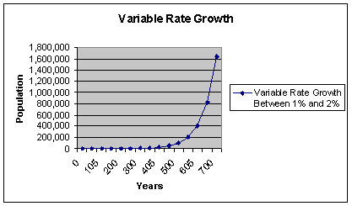
Doubling Time ☺
The amount of time it takes a population to double.
Rule of Seventy – Doubling time is equal to seventy divided by the growth rate (per year).
Canada’s natural growth rate = 0.6
Canada’s growth rate (including immigration) = 0.9
How long will it take for our population to double?
70/0.9 = 77.7 years

Slide 65
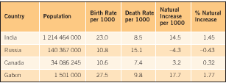
Activity #5

Slide 66
Outline
CNN 10
Classwork Day
  Finish Activity #1-5
  Finish Stations Activity Workbook
  Finish Canadian Map/World Map
  Discuss with me Re-Writing of Maps Quiz

Slide 67
Sheldon’s Method
14.5 / 1000 = 0.0145 x 100 = 1.45%
Faster Way…
100/1000 = 1/10
You can just divide by 10 to get your Percent Value.

Slide 68
Activity #5
Natural Increase
Step 1 – Calculate your Natural Increase per 1000 = BR – DR
Step 2 – Organize your Natural Increase Data from Least to Greatest
Step 3 – Create a series of ranges (-5-0, 0-5, 5-10, 10-15, etc) and put your Natural Increase Data into them.
Step 4 – Assign each range a specific color (i.e -5 to 0 = blue)
Step 5 – Color in your world map.
Step 6 – Create a legend showing your information.
Step 7 – Answer the Questions

Slide 69
Classwork
Finish and Submit ‘Stations Package’
Finish and Submit – Map of Canada/World
FINISH Activities 1-4
Begin Activity #5 (two classes to complete)

Slide 70
Brain Break – 10 Min
Choose one of the following activities:
  You’ve been hired as a marketing consultant to research the feasibility of launching a new product.
    Come up with a product.
    Create a research tool that will help you to maximize profit.
  Conduct a mini census to use in this class to help the government plan for education in the province.
    Design a questionnaire.
    Execute the questionnaire.
    Analyze the questionnaire.

Slide 71
Outline
CNN 10
Notes
Classwork – Begin Activity #6
  Finish Activity #1-6
  Finish Stations Activity Workbook
  Finish Canadian Map/World Map
  Discuss with me Re-Writing of Maps Quiz

Slide 72

A.L.I.C.E
Pennsylvania
Notes:
Alert
Lockdown
Inform
Counter
Evacuate

Slide 73
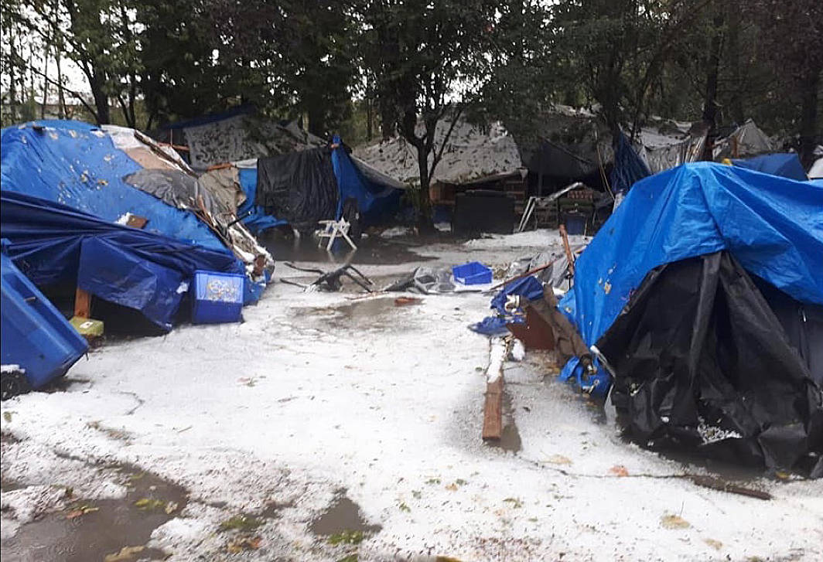
Maple Ridge Homeless Camp

Slide 74
Net Migration
Countries like Canada and the United States are dependent on Immigrants for Population Growth.
The rate at which immigrants move into the country and emigrants leave the country is known as the NET MIGRATION
Net Migration Calculation = Immigration Rate – Emigration Rate ☺
We can calculate this rate using the following equation
  Immigration Rate (People entering the country)
  - Emigration Rate (People leaving the country)
  == Net Migration

Slide 75
Activity #6 - Net Migration
Date | Immigrants | Emigrants
2010 | 280,700 | 52,335
2011 | 248,700 | 56,677
2012 | 257,905 | 61,904
2013 | 259,024 | 60,370
2014 | 260,411 | 63,629
2015 | 240,844 | 64,079
2016 | 320,932 | 67,144

Slide 76
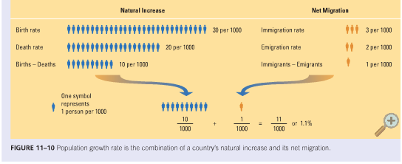
Population Growth Rate ☺
By adding the Natural Birthrate to the Net Migration, we can calculate the Population Growth Rate of a Country.

Slide 77
Outline
CNN 10
Vocabulary
Notes
Activity #7-8

Slide 78
Vocabulary ☺
Population Growth Rate: the rate at which a country’s population increases or decreases, calculated by adding the natural increase and the net migration together.
Life expectancy: the average number of years an individual is expected to live.
Demographic Transition Model: a model that shows changes in a population’s birth and death rates and growth based on technological development.

Slide 79
Vocabulary ☺
Industrialization: the overall change in a society from farm production and craftsmanship to mechanized manufacturing production.
Urbanization: the move of people from farms to cities where jobs are available.
Mortality: deaths in a population.

Slide 80
Demographic Revolution
In the 1700’s people had a life expectancy of 30 years.
1750’s Agricultural Revolution brought more food
1800’s – 1900’s - Clean drinking water, sanitation, proper hygiene and vaccinations mean more kids are reaching adulthood and having children.
1930’s and 1940’s – Lower Birth Rates… Why?
1950’s – 1960’s – Huge Birth Rates…Why?
Humanitarian aid, assistance programs, medicine are helping developing countries to become developed countries.

Slide 81
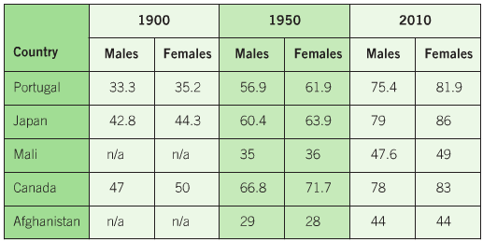
Activity 7
List 3 factors that have contributed to population growth in these countries?
Suggest 2 reasons for the higher life expectancies.
How might a demographer use the information to argue that Japan and Canada in the 1900’s were a developing country?

Slide 82
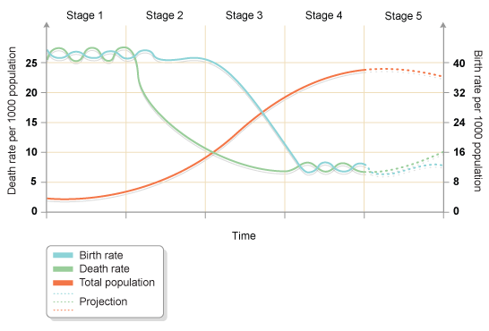
Demographic Transition Model

Slide 83
☺ Demographic Transition Model: A model that shows the changes in a population’s birth and death rates and growth based on technological developments

Slide 84
This model makes a few assumptions:
That all countries will go through a process of Industrialization and Urbanization.

Slide 85
Stage 1 ☺
Birth and death rate high.
Low life expectancy because of disease, poor medical care, poor nutrition, unsanitary living conditions.
Large families required to survive.
Results in stable but low population.
Pre-developed or massively underdeveloped countries (probably non-left in this category)

Slide 86
Stage 2 ☺
Death rate fell due to agricultural revolution, improved hygiene, sanitation and medicine.
Birth rate remain high
Results in rapid increase in population
Developing countries include Kenya, Chad, Haiti, Botswana, Burma

Slide 87
Stage 3 ☺
Falling death rate followed by decline in birth rate (contraception, education)
Population growth increases rapidly due to large number of children reaching childbearing age
Newly developed countries – China (just), Brazil, Canada (almost done)

Slide 88
Stage 4 ☺
Low birth rate and death rate
Small family size is the norm
People live longer
Stable populations
Fully developed economies (Canada and USA)

Slide 89
Stage 5 ☺
Low birth rate and death rate
Smaller family size makes deep impact
Increasing amount of elderly people
Declining populations
Highly developed economies (“Post Industrial”) – Austria, Japan

Slide 90
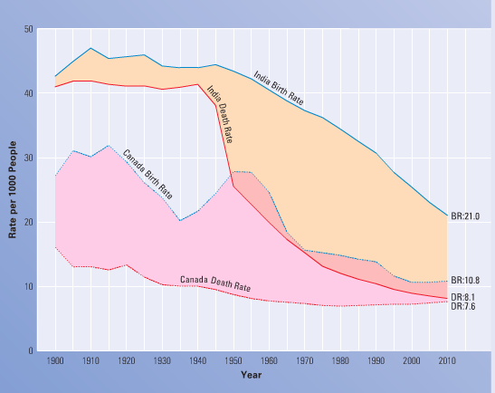
Activity 8

Slide 91
Classwork
Please Begin and Finish Activity #7-8
Go Back and Finish any Missing Assignments.
There will be a Test coming up in the future.
The Test will be on Graphing and Demographic Information.
Will talk more about it on Tuesday of Next Week.

Slide 92
Outline
Vocabulary
CNN 10
Dependency Ratio
Thomas Maltus + One Child Policy

Slide 93
Vocabulary ☺
Population Pyramid: a bar graph that shows male and female population back to back at age intervals for five years.
Age Cohort: an age group in a population, for example, the number of people between the ages of 10-14.
One Child Policy: A Policy instituted by China to restrict their population growth rate. Parents were only allowed to have one child, or be forced to pay heavy fines.
Dependency Ratio: the proportion of the population (children and those over 65 years of age) that is being supported by the working age group.

Slide 94
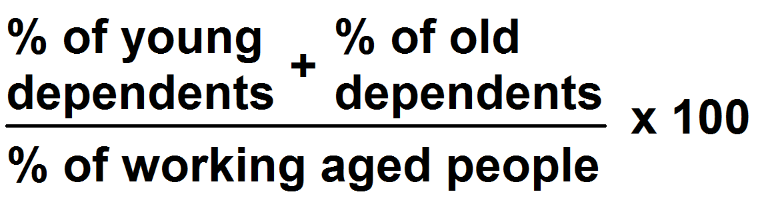
The Dependency Ratio ☺
Dependency – A measure of the people that are too young or too old to be employed in the workforce and therefore require government support.
The Dependency Ratio is the percentage of young dependents (U15) and old dependents (+64) divided by the percentage of old people aged 15 to 64.

Slide 95
Population Pyramids ☺
A population pyramid is a graph that shows the age, sex, and structure of a population.
  A bar graph that divides a population by age and gender.
    Age: population is divided into 5-year age groups (cohorts).
    Gender: usually males on the left, females on the right.
It makes it easier to analyse the distribution of ages within a particular population.
There are four different types of pyramids:
  Early expanding
  Expanding
  Stable
  Contracting

Slide 96
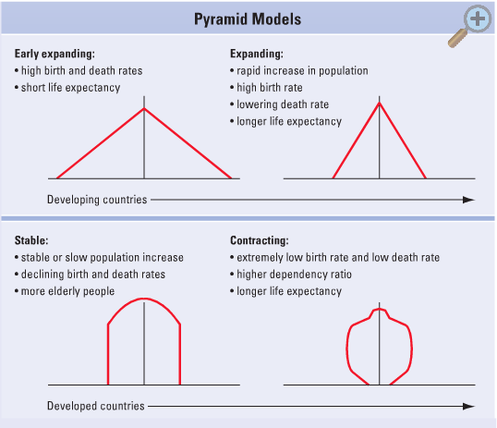
☺

Slide 97
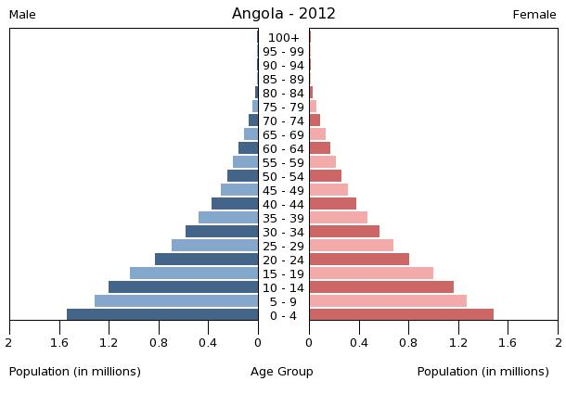
Early Expanding
Reflects a very high birth rate and a very short life expectancy. Corresponds to Stage 1 of the DTM.
Wide bases and narrow tops. Lots of young people, few old people.

Slide 98
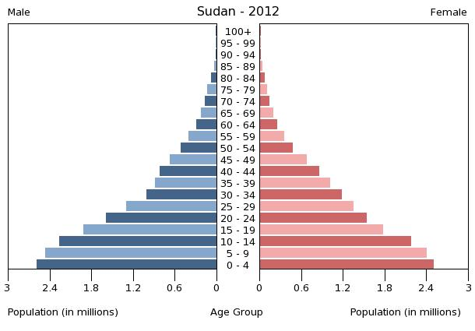
Expanding
Not as wide of a base as early expanding, narrow top.
There are not as many young people, but the population is still growing. Stages 2 and 3 of the DTM

Slide 99
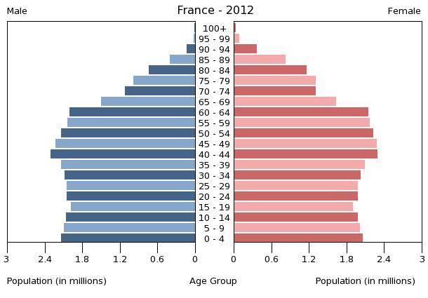
Stable
Base and middle are about the same width.
Young and old people are in balance, little growth (Stage 4 DTM).

Slide 100
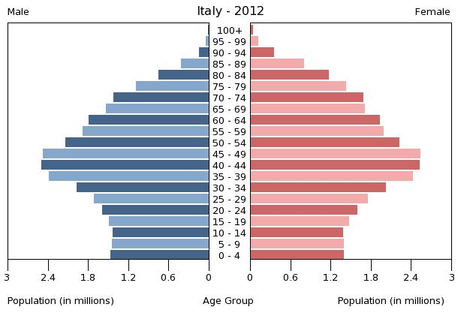
Contracting
Base is narrower than the middle.
Fewer younger people than older, population decreasing (Stage 5 of the DTM).

Slide 101
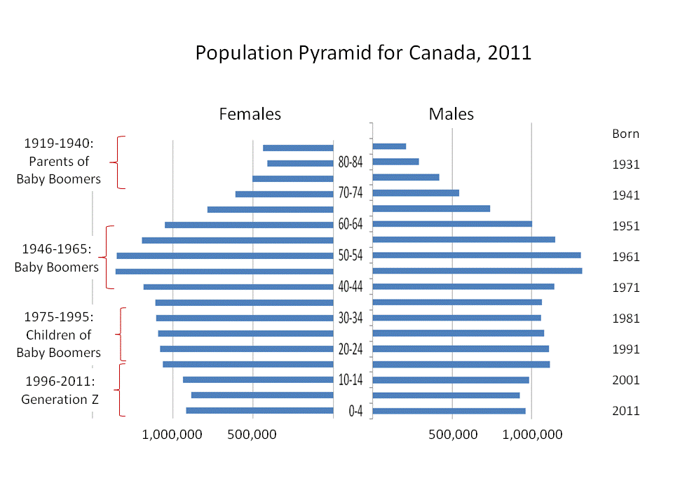
Source: www.med.uottawa.ca

Slide 102
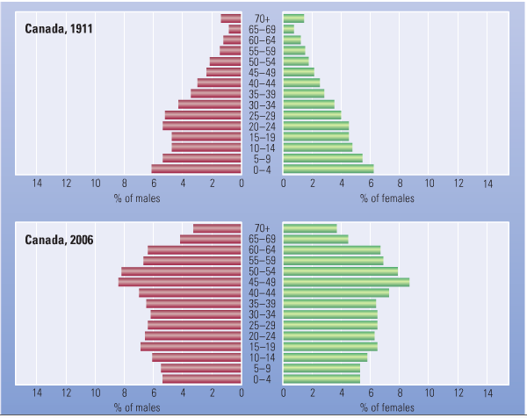

Slide 103
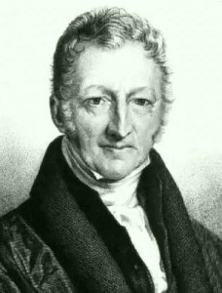
Thomas Malthus
An English economist and philosopher.
Warned of Population Growth Problems
Malthus witnessed first hand, the decline of living conditions during the Industrial Revolution.
Malthus believed that if population rates
did not slow down food production would
not keep up with population growth.
Never proven in his time, he was
eventually correct elsewhere in the world.

Slide 104

The One Child Policy

Slide 105
Timeline
1958-1960: A program called “The Great Leap Forward” brought massive instability to food supplies as agricultural land was organized into large collective farms. Famine and food shortages reduced birth rates and increased death rates which led to population decline.
1970: The growth rate reached 2.61% (Pop. 816 Million) – people encouraged to have only 2 children.
1979: One Child Policy. Cash, Free medical care, and education offered as rewards.
  People who did not co-operate were punished.

Slide 106
Timeline
1980’s/1990: Pressure to sterilize or have abortions. Reports began to come in of infanticide if the first born was a girl. The government relaxed their policy and allowed a 2nd girl in rural areas if the first was a girl.
2002 – China’s population reaches 1.27 billion. Gender selection was banned, no longer allowed to discriminate against female infants.
2008 – One Child Policy resulted in 400 million fewer people.
2009 – Population aging and a low work force results in abandonment of all restrictions.

Slide 107
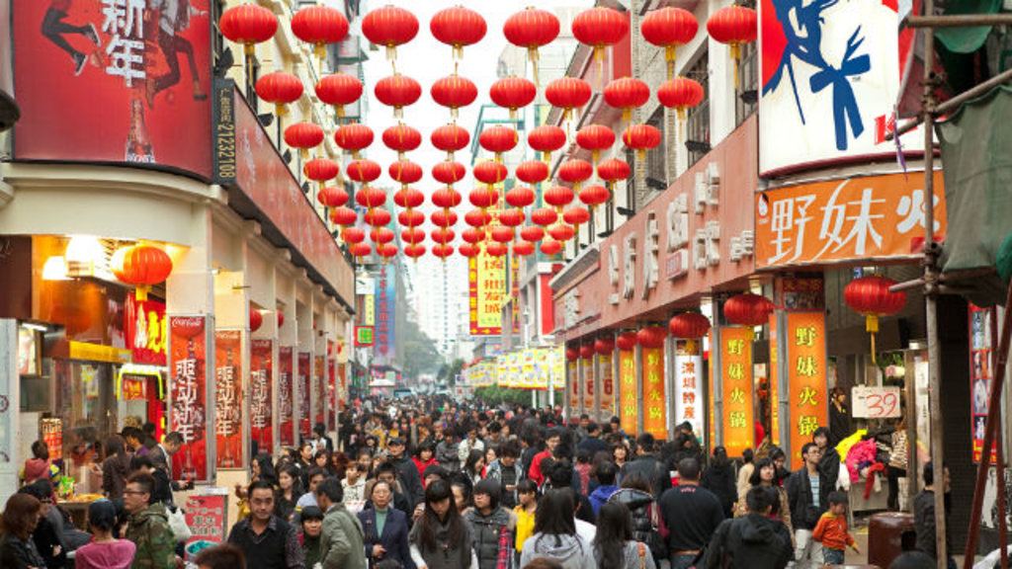
Case Study on China
As of 2016 the Population of China is 1.379 Billion (18.9% of the world’s population)
Birthrate = 12.95
Death rate = 7.06
Growth Rate = + 5.89 or .59%
They are growing at about 8.34 million people a year.
Doubling Rate = 118 years.

Slide 108
Discussion
Do you believe that Thomas Malthus’ predictions have come true in China?
What are the consequences of unlimited population growth?
Should other countries in the world institute a similar policy, as the One Child Policy?

Slide 109
Canada’s Population Pyramid
The birth rate has been declining since the baby boom after WWII.
Life expectancy has increased from 45 in 1900 to 81 in 2010.
Canada’s population is aging.
  More and more seniors, especially as baby boomers are getting older.

Slide 110
Age Structure of Populations
An age structure of a population can help us understand the reasons for changes in a population.
Demographers divide populations into 3 age groups:
  Children up to age 15
  Working people from age 15 – 64
  Adults 65 years and older
These give us what is known as the Dependency Ratio; that is the percentage of the population that is being taken care of by the working group.
  Canada’s 2006 population included 17.7% children and 13.7% adults over age 65 = 31.7% dependency load or a dependency ratio of 1 in 3.

Slide 111
  Activity #9
  What challenges does a high dependency ratio put on a country?
  List 3 challenges that a young dependency ratio (0-15 years of age) would have on a country like Kenya?
  List 3 challenges that an old dependency ratio (65 years or older) would have on a country like the United States.
  Historical Significance
    List the 3 most likely consequences that Canada’s aging population will have on you.

Slide 112
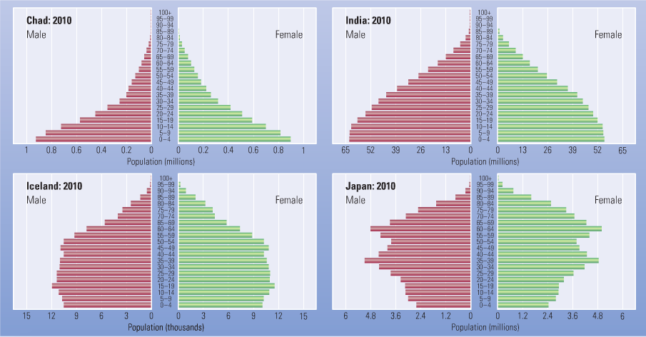
Workbook

Slide 113
Classwork
Finish Stations Activity and Hand In
Finish Map of Canada/Map of World and Hand In
Finish Activity #1-8
Begin Activity #9

Slide 114
Outline
CNN 10
Vocabulary
Carrying Capacity
Why Canada?
The Rest of the Week
Upcoming Units

Slide 115
Vocabulary ☺
Carrying Capacity: The Maximum number of the maximum number of people that can be sustained by an environment.
Population distribution: the pattern of where people live in an area.
Population Density: the number of people living in a given area; calculated by diving the populations by its area.
Nutritional density: a measure of how much nutrition in calories can be produced from a certain area; an area with fertile soil and adequate temperatures and precipitation will have a higher nutritional density than an area such as Canada’s North.

Slide 116
Why come to Canada?
With a partner create a list of reasons you think a person might want to
Immigrate to Canada?
Emigrate from Canada?

Slide 117
Canada’s Population
The majority of Canada’s population are immigrants.
Between 2001 to 2006 Canada’s population grew by 1.6 million, 1.1 million of which was due to immigrants.
As a population grows older the need for government services increases, as well as the need for replacement workers (i.e. taxes)
Immigrants enable the tax base to remain steady, while improving the economy.
Many skilled immigrants, such as health care professionals find it difficult to get accredited in Canada.

Slide 118
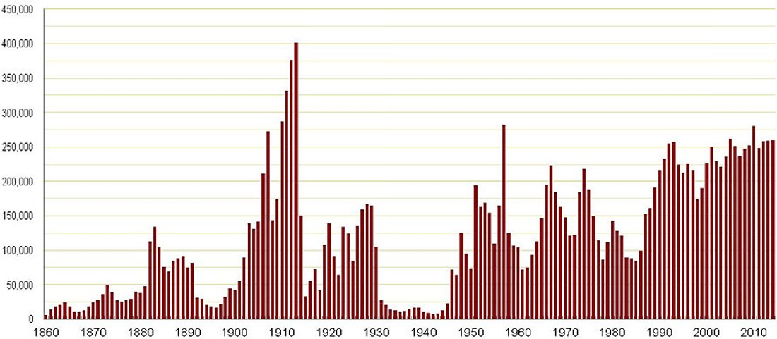
Historical Immigration #’s

Slide 119

Canada’s Aboriginal Population
As of 2016, Canada’s aboriginal population is 1,673,780.
This number represents 4.9% of Canada’s population.
Chief Justice Murray Sinclair of the Truth and Reconciliation Commission

Slide 120
Think-Pair-Share
With a partner discuss the way in which we could assist immigrants with getting accreditation in Canada for their skills elsewhere?
What would need to be done to accomplish this?

Slide 121
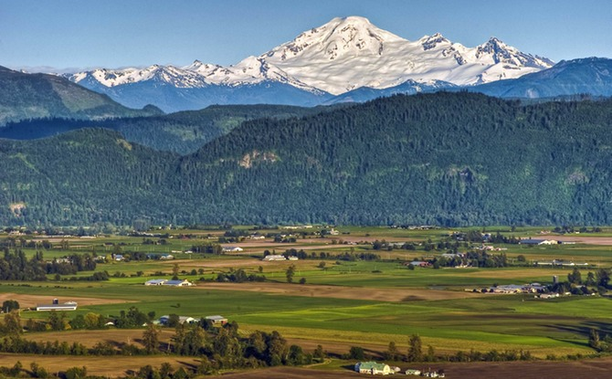
Problems about Growing Populations
The earth has a ‘Carrying Capacity’ this is the maximum number of people that can be sustained by an environment.
Our ecological footprint is growing larger.

Slide 122
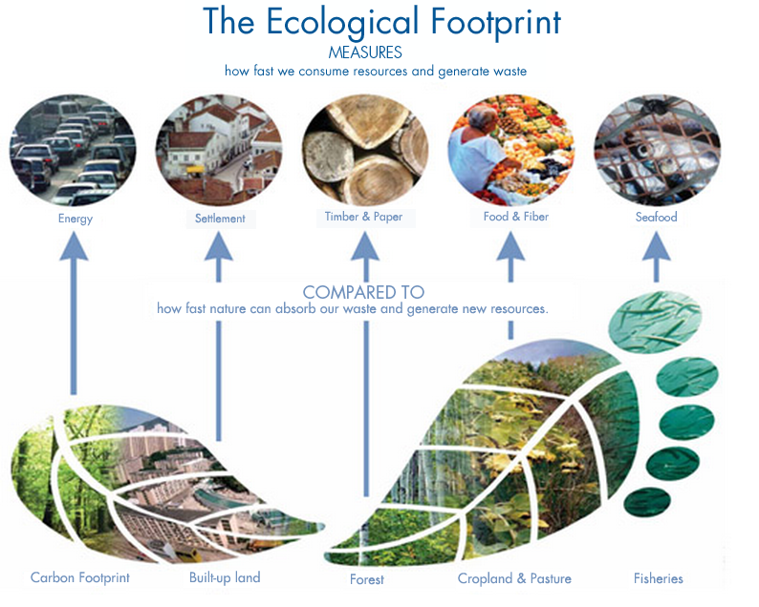

Slide 123
Population Distribution
Refers to the way people are spread out over the Earth’s surface.
Permanently inhabited areas are known as ecumene.
35% of the world’s land is not suitable for settlement.
Over half of the world’s population lives on 5% of the land.
90% of the people live on 10% of the land.
90% of the people live north of the equator.
2/3 of people live within 500km of the ocean.

Slide 124
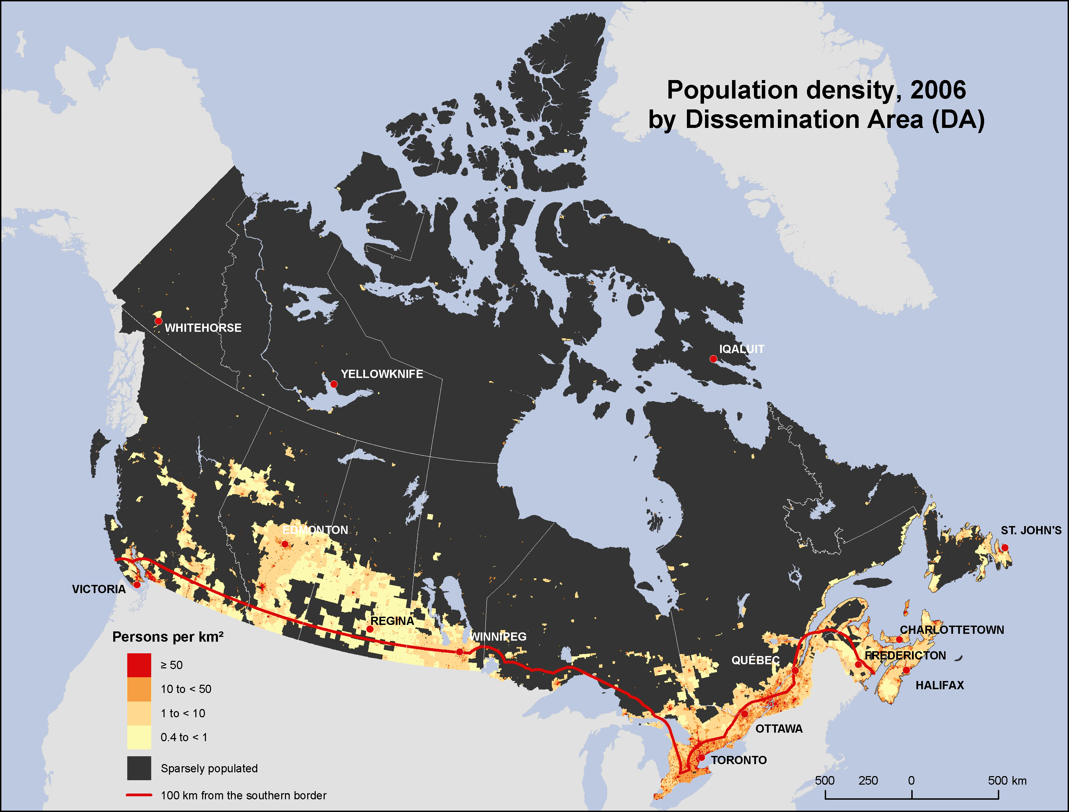

Slide 125
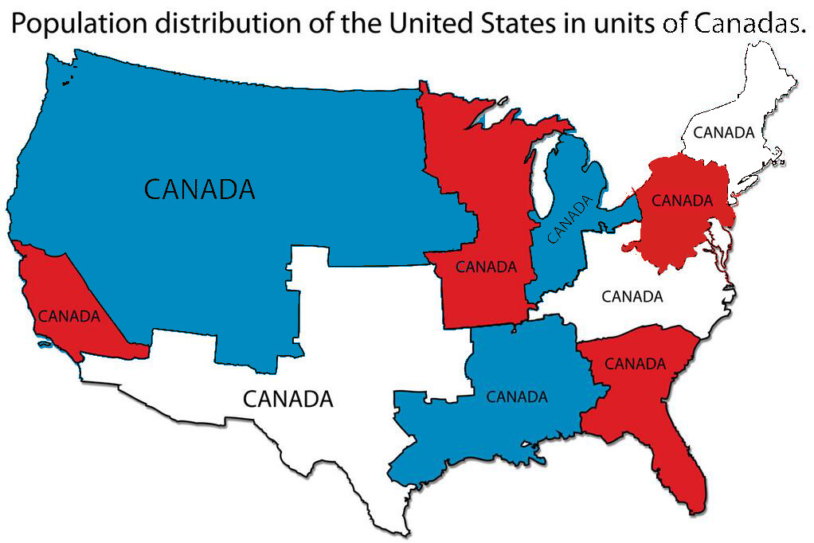

Slide 126
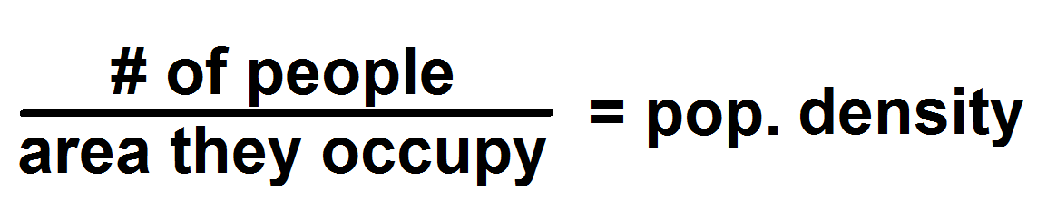
Population Density
The concentration of people living in a geographic area:
What is the population density of Vancouver?
  # of people = 603,502 (2011)
  Area = 114.97 km²
  Answer = 5249/km²
  There are 5249 people per square km living in Vancouver.

Slide 127
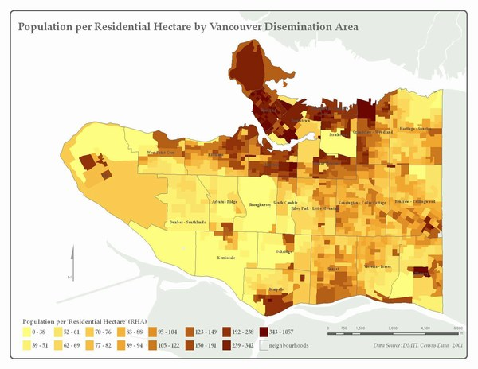

Slide 128
Population Density
Physical Factors
Human Factors
Climate: Very dry or very cold = low density.
Landscape: lowlands = higher density.
Resources: Areas rich in a variety of resources = higher density.
Soils: Rich river valley’s results in higher densities.
Vegetation: Areas of very dense vegation (amazon) = low density; grasslands = higher.
Water: reliable water source.
Accessibility: Easy to reach by land or sea.
Government Policies: May force people to move (Inuit, Siberia, Amazon)
Disease: Higher incidence of diseases = less density
Development: Highly developed economy = higher density
Culture: Nomadic or Agriculture.
Communications: Easy to reach by land or sea.

Slide 129
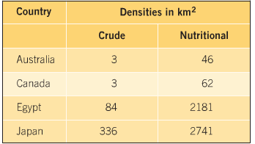
Nutritional Density
Nutritional density of land is a measurement of how much nutrition in calories can be produced from the land.
In British Columbia, the Fraser Valley has an exceptionally rich agricultural soil, but a short growing season.
Areas of China can produce 3 crops a year.
Crude = Population
Why are our numbers so much smaller compared to Egypt and Japan?

Slide 130
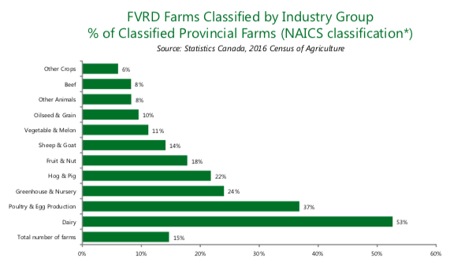

Slide 131
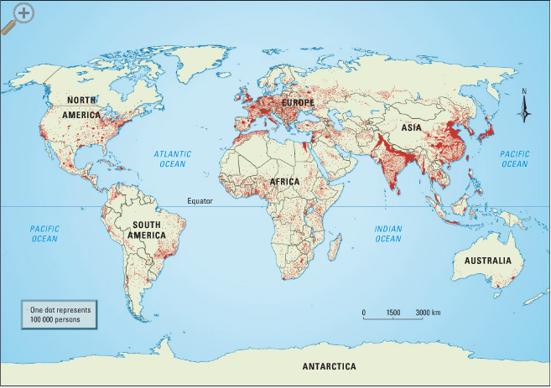
Activity #10

Slide 132
Rest of the Week!
Monday – Finish up Activity #1-10
Tuesday – Finish up Activity #1-10 + Discuss the Test + Kahoot Review
Wednesday – Prep your Essay + Study Guide
Thursday – Write Test + Documentary
Friday – Documentary

Slide 133
Next Week
We can do one of the following:
  1) Government Unit – How the Government works in Canada.
  2) Standards of Living – Poverty, Health, Hunger both in Canada and Abroad.
  3) 1920’s Unit – Prohibition, Women’s Rights, Harlem Renaissance
  4) Geography Unit – Volcano’s, Earthquakes, Landslides, Rock Formations, Tectonic Plates
  5) Genocide

Slide 134
Essay
What problems will Canada face with a continued growing world Population? Give evidence to support your claims.

Slide 135
Future Issues
Abbotsford is currently in the process of trying to remove protected farmland.
Limit Housing Development on Agricultural Land
Climate Change

Slide 136
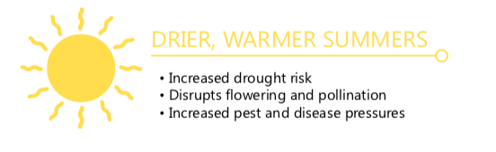
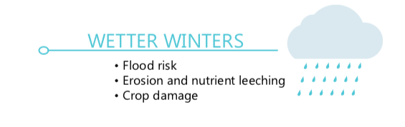
Future Farming Issues

Slide 137
Outline
CNN 10
KAHOOT
Vocab + Essay + MC = TEST
Finish #1-10

Slide 138

Kahoot

Slide 139
Vocabulary
Demography
Natural Increase
Doubling Time
Population Pyramid
Carrying Capacity
Population Distribution
Nutritional Density
Census
Developing Country
Developed Country
You will be required to define 5 of the 10 Vocabulary words listed here.

Slide 140
Essays
What are the benefits or consequences of a growing population on the economy, environment, and agriculture.
Support your argument with facts, not just opinion.
OR
2. Should policies/laws be implemented to control population growth. Discuss or argue FOR the use of Laws, or AGAINST the use of laws.
Be sure to site at least 2 places that have used laws to control a population.
OR
3. Explore your own topic related to Population Growth but please clear it with me first.

Slide 141
Multiple Choice
There will be 25 Multiple-Choice Questions. /25
Definitions /2x5 = 10
Essay = /20
Test = …/55

Slide 142
Test
You have the entire class to write the test.
Step 1 – Do the Vocabulary
  Hand to Mr. Koe when done.
Step 2 – Write the Multiple Choice
  Hand to Mr. Koe when done.
Step 3 – Write the Essay
  Hand to Mr. Koe when done.
  If you finish early, please don’t disrupt others – find something quiet to do like read, or work on classwork, or go on your phone.

Slide 143
Demographic Transition Model

