Slide 1
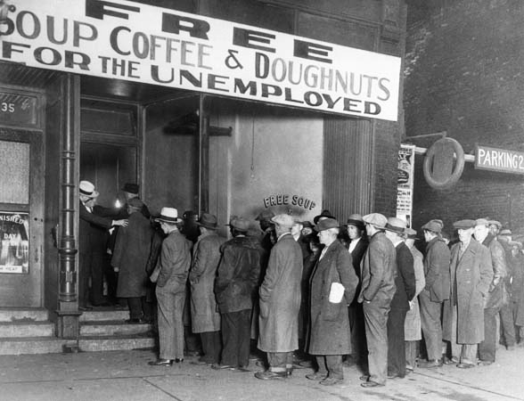
Canada and the Great Depression

Slide 2
Outline
CNN 10
Photo Interpretation

Slide 3
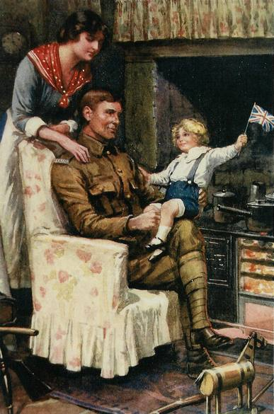
Prohibition and the Spanish Flu
1919 to 1923

Slide 5
When soldiers return home from war they encounter both joys and challenges.
Joys
Challenges
Seeing their Partner
Finding a Job

Slide 6
Post-World War I Life
Soldiers returned home expecting to have a stable job. After all, they had just fought for their country.
However, there were few jobs as industries shifted from wartime production to peacetime production.
Inflation (cost of living) had risen, but not wages. As a result, housing was very expensive.

Slide 7
A Time of Change ☺
When the First World War ended there was great excitement.
Soldiers soon returned home and expected to have a smooth transition to civilian life.
However, the transition would not be easy; there were a number of post-war issues in Canada.

Slide 8
Post-War Issues and Events
This lecture will focus on the following events and their effect upon Canada.
Prohibition
Spanish Flu
Winnipeg General Strike

Slide 9
Prohibition
☺
Definition:
Banning the production, import and transportation of alcohol and liquor across the country.
In 1918, the federal government introduced prohibition due to pressure from the following groups:
Women’s Christian Temperance Union
Church
Lodges
Farm and Merchant Associations

Slide 10

Why?
☺
Common Reasons:
All grain should be used to feed the soldiers.
Workers should be used for wartime production not breweries.
Harmed the stability of the family.
A morale sin.

Slide 11
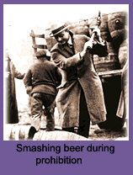
The Positive Effects of Prohibition
☺
Crime rate dropped.
Arrests for public drunkenness decreased.
Workers took pay cheques home rather than to the tavern.
Improved the efficiency of industrial workers.

Slide 12
The Reality of Prohibition
☺
Very difficult for the government to enforce.
Many people illegally transported and produced alcohol:
Bootleggers
Rumrunners
Speakeasies
Those who made and sold alcohol illegally.
Those who smuggled alcohol.
Private clubs where alcohol was sold.

Slide 13
How long did prohibition last?
☺
The government realized how difficult it was to enforce prohibition and instead eventually chose to set up the liquor control board and tax the sale of liquor (eg. Liquor Control Board of Ontario - LCBO).
Slowly prohibition was eliminated.
British Columbia voted on Prohibition in 1916.
Came into law on Oct 1st, 1917
British Columbia allowed a ‘Loop-Hole’
Medicinal Liquor – 180,000 prescriptions
Repealed in 1921
P.E.I. was the last province to eliminate prohibition (1948).
Notes:
In 1853, BC was known as one of the ‘Wettest’ provinces in Canada.
Saloons were open for 24 hours a day. British Columbians drank twice the national average of alcohol.

Slide 14
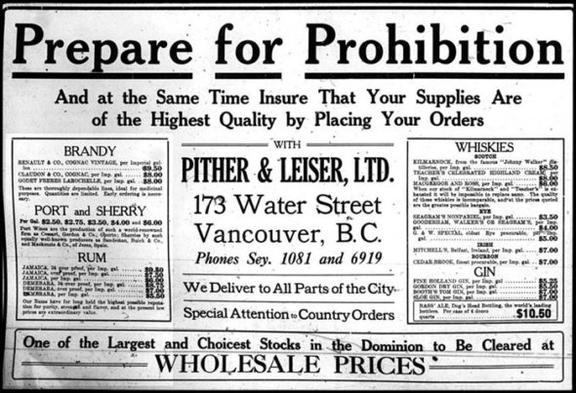

Slide 15
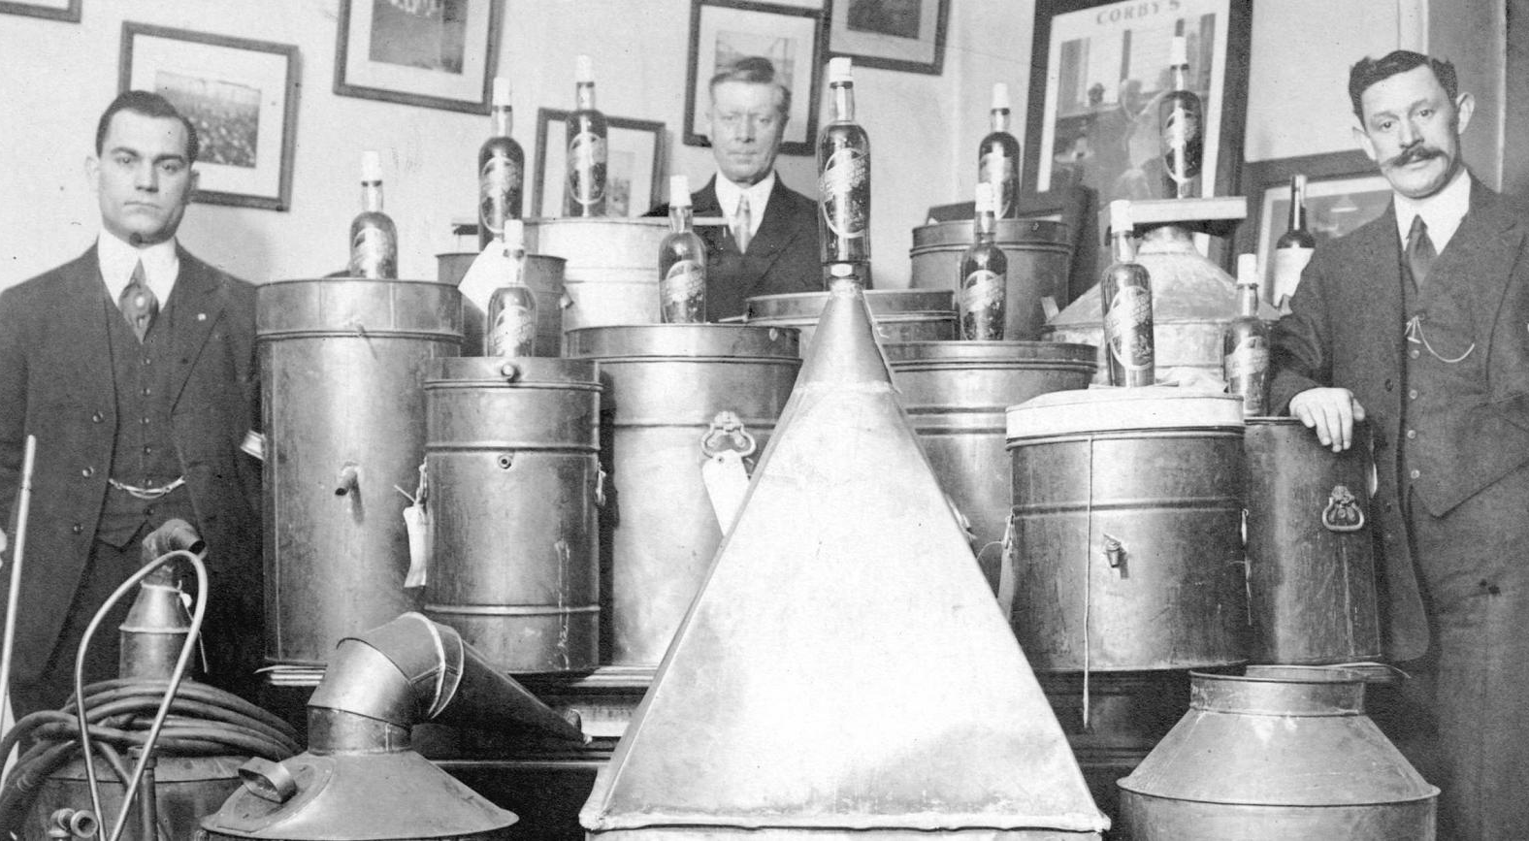
Walter Findlay
Notes:
Walter Findlay opposed the consumption of alcohol in public.
Member of the People’s Prohibition Association, became the Prohibition Commissioner of BC
He was importing alcohol into Vancouver and selling it at a number of speakeasies.

Slide 16
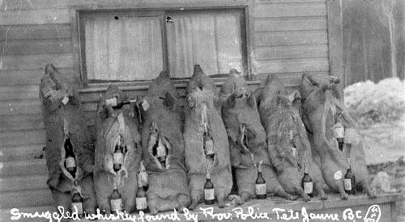
Whiskey Hogs

Slide 17
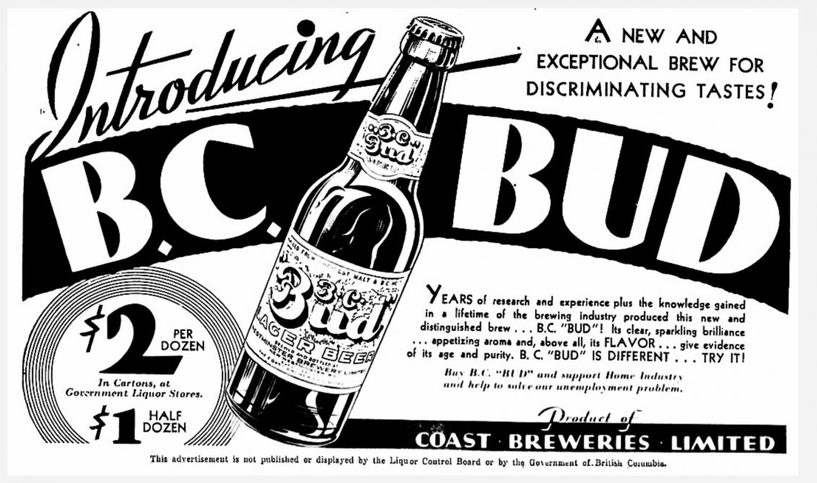

Slide 18
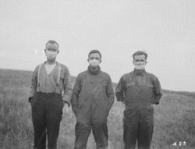
The Spanish Flu
☺
After the war the soldiers carried the “Spanish Flu” virus with them back to Canada.
The virus quickly spread among the Canadian population.
Soon schools, churches theatres and other places of meeting were closed in order to stop the spread of the virus.

Slide 19
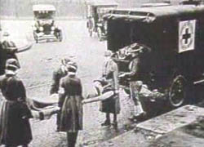
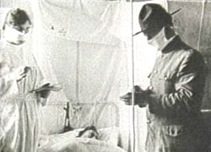
The Effects of the Spanish Flu
☺
50, 000 Canadians died (10, 000 less than the amount of Canadian soldiers killed during WW1).
21 Million people died world wide.
It was an epidemic that devastated a nation recovering from war.
The government was forced to set up the Federal Department of Health in 1919.

Slide 20
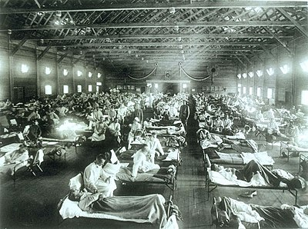

Slide 21
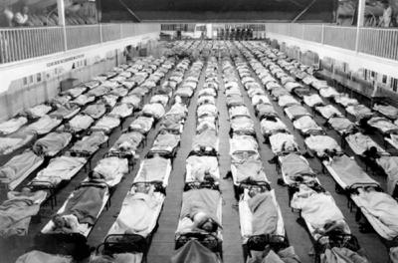

Slide 22
Classwork
Read Larry Baum’s Article “The Deadliest Fall” Page 5-8
Answer Questions on Page 4
Answer Questions on Page 9 (It says Number 5 at the TOP)

Slide 23
Outline
CNN 10
Winnipeg General Strike
Canada’s Booming Economy
Web-quest

Slide 24
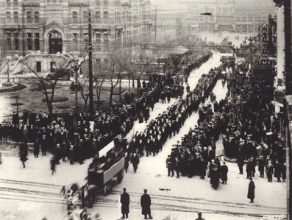
The Winnipeg General Strike
☺

Slide 25
Following the War
Soldiers returned back to Canada to find it had major problems.
Inflation had raised the cost of living up 63% from 1913 to 1919.
Soldiers were unable to find work, many workers lost their employment at the end of the war.

Slide 26
A Soldiers View Point
“In Germany, I fed on grass and rats. I would prefer going back to eating grass than give up the freedom for which I fought so hard and suffered so much.”

Slide 27
Working Conditions
☺
No unemployment insurance or compensation for injuries or pensions.
Unions had limited power (collective bargaining).
Those who were a part of unions could be fired if they went on strike.

Slide 28
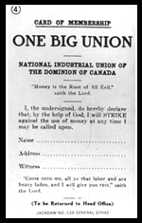
The Formation of “One Big Union”
☺
1918-1919 saw a huge increase in union membership across Canada.
In Calgary, workers gathered to form the organization called One Big Union which united both skilled and unskilled workers.
They felt by standing together they could make much needed changes for all workers.

Slide 29
The Strike Begins
☺
Many immigrants had settled in Winnipeg and were unhappy with the working conditions.
On May 1, 1919 the Building and Metal Trades Councils in Winnipeg voted to strike.
They asked for:
1) Decent wages
2) 8 hour work day
3) Right bargain for better working conditions

Slide 30
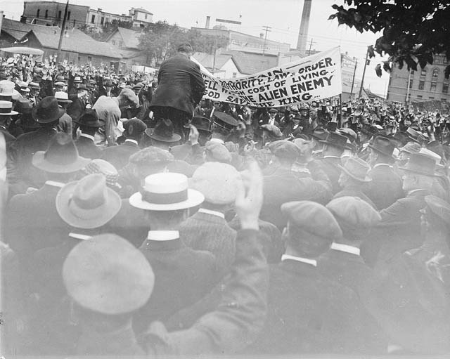
The Strikes Continues
☺
Soon 30,000 other workers in Winnipeg joined the strike and sympathy strikes occurred in cities around the country.
The strikes then spread from industry to industry
(eg. dairies, bakeries, streetcar operators, garbage collectors, postal workers, telephone operators, firefighters…).

Slide 31
Winnipeg was Shut Down for 6 weeks
Telephone Operators were on strike.
Elevators were shut down.
Postal service stopped.
The city was frozen still.

Slide 32
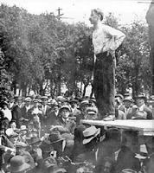
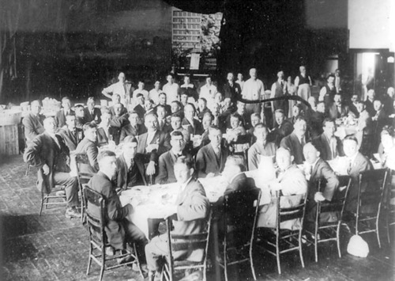
Two Sides
☺
Central Strike Committee:
Those leaders who started the strike.
Citizens’ Committee of One Thousand:
Those who were against the strike.

Slide 33
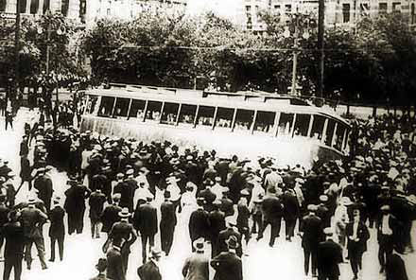
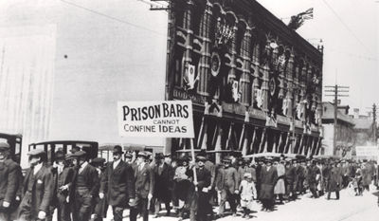
The Government Responds
☺
The strike dragged on until June of 1919.
Some workers, who had used up all their resources, returned to their jobs.
The Federal government then sent in troops to control the situation.
Mounties raided the home of union leaders and arrested them.

Slide 34
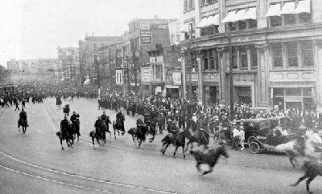
“ Bloody Saturday”
☺
On June 21, 37 days after the strike began, the mayor of Winnipeg read the Riot Act to those still on strike (crowd must disperse or risk being imprisoned for life).
The crowd begins to riot and the Mounties charge the crowd and fire shots.
30 injured, one dead.
5 days later the strike ended.

Slide 35
Results of the Strike
☺
1
2
3
4
5
Strikers lost savings and even their jobs in many cases.
Increased division between employees and employers.
Government places restrictions on unions.
Strike made people realize how important workers were to cities.
Labour leaders enter politics to improve working conditions (eg. J.S. Woodsworth).

Slide 36
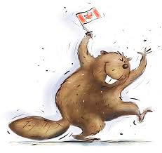
Canada’s Booming Economy

Slide 37

The Booming Canadian Economy
After several difficult years following WWI, the Canadian economy entered a time of unprecedented prosperity.
Why?
Wheat on the Prairies
Pulp and Paper
Hydroelectric Power
Oil and Gas
Mining
Foreign Investment

Slide 38
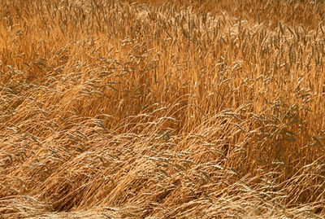
1) Wheat on the Prairies
☺
From 1925 to 1929 the Prairie provinces enjoyed huge wheat crops.
Recovering Europe could now afford to buy Canadian wheat.
With the extra profits farmers bought more mechanized farm equipment and created wheat pools and co-operatives.

Slide 39
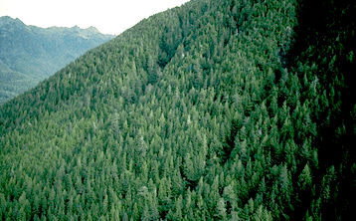
2) Pulp and Paper
☺
Giant American newspaper companies needed paper.
As a result, across the country the Canadian forest industry thrived.
On the downside many forests were clear cut.

Slide 40
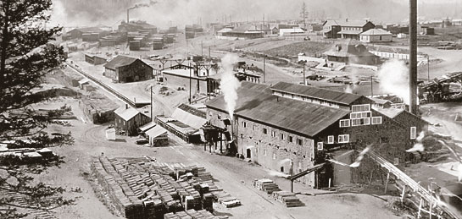
Boom
Redwoods

Slide 41
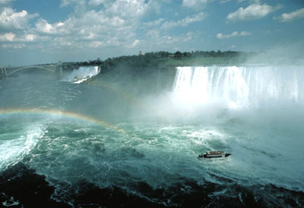
3) Hydroelectric Power
☺
The need for electricity grew during the 1920s. New home appliances and a growing manufacturing sector increased this need.
“White coal” had become a major industry in Quebec and Ontario (eg. Niagara Falls).
Canada became the second largest producer of hydroelectric power

Slide 42
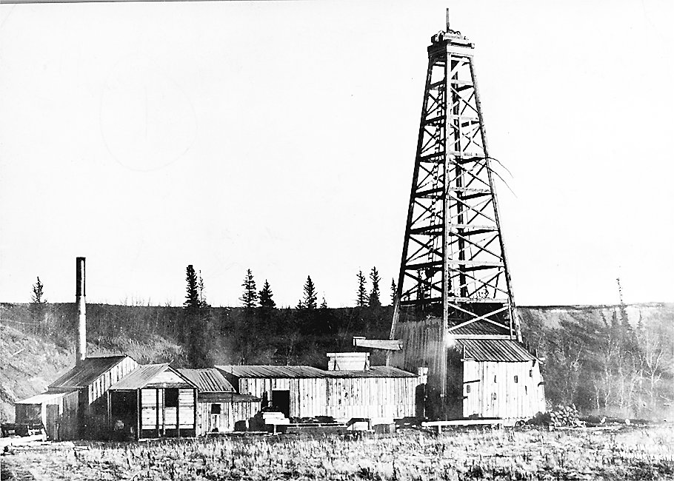
4) Oil and Gas
☺
Automobiles created a great demand for oil and gas.
The search for “black gold” was on!
In 1924, Turner Valley, Alberta struck it rich - the Alberta oil industry had begun.

Slide 43
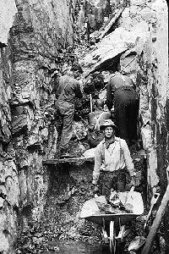
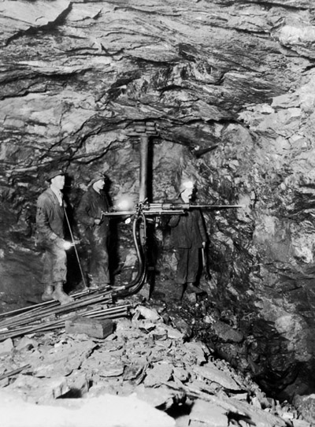
5) Mining
☺
Rich deposits of copper, nickel, lead and zinc were found across the Canadian Shield during the 1920s.
There was greater demand for metals in the manufacturing industry (eg. Automobiles).
Most notable mines: Sudbury, Flin Flon, Kimberley and Noranda.

Slide 44

6) Foreign Investment
☺
Prior to WW1 the biggest investors in Canadian industry were the British.
However, during the war British investment decreased and was replaced by American investment.
Americans invested in all the new thriving industries (eg. Wheat, hydroelectric power…).

Slide 45

The Branch Plant System
When the British had invested in Canadian industries they left control to Canadians.
New American investment was different.
American companies would open up branch industries in Canada run by Americans (copies of American parent companies).
This way the Americans could produce and sell products in Canada without having to pay tariffs.

Slide 46
Classwork
Please begin working on the DBQ
Please begin working on the Roaring Twenties
Please begin working on the ‘The Deadliest Fall” Quesitons

Slide 47
The Economy is Finally Roaring
Canada’s economy was now booming as a result of new industries and increased American investment.
The mid-1920s would become an era of unprecedented economic growth in Canada and in many other parts of the world (especially the United States).
As a result, the Canadian way of life drastically changed.

Slide 48
Discussion
☺
What examples are there of American branch plants in Canada today?
Make up a list of positives and negatives associated with American investment?
Should Canada continue to allow American investment in Canada?
How has American economic influence affected Canadian culture and identify?

Slide 49
Classwork
Begin Activity 2
Begin Activity 3
Begin Activity 4
You will need to use your Cellular Device to do the Research; or you can follow along on the big screen!

Slide 50
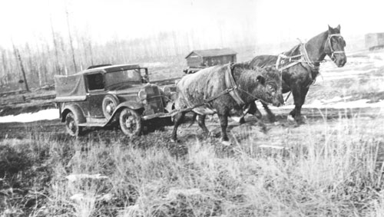
Canada and the Depression

Slide 51
From Riches to Rags
☺
The 1920s had been a time of unprecedented prosperity for many Canadians.
However, the economy was beginning to have problems.
The economy is commonly looked upon as a cycle:
“The business cycle”:
1) prosperity
2) recession
3) trough or depression
4) recovery

Slide 52
The Business Cycle
☺
Prosperity
High Production
Low Unemployment
Recession
Declining Production
Increasing Unemployment
Depression
Low production
Recovery
Increasing Production
Declining Unemployment
High Unemployment

Slide 53
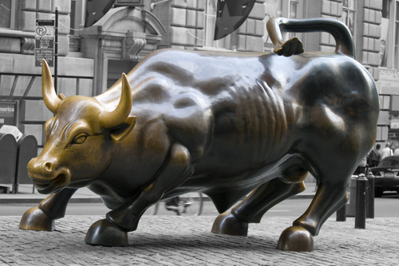
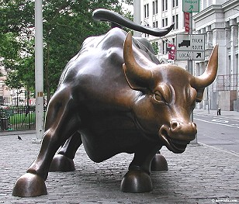
The 1920s and the Stock Market
☺
During the 1920s many people invested in the stock market.
Many people borrowed money to buy shares.
The value of stocks increased dramatically; this is known as a "Bull Market."
Individuals made significant profits if they invested correctly.

Slide 54
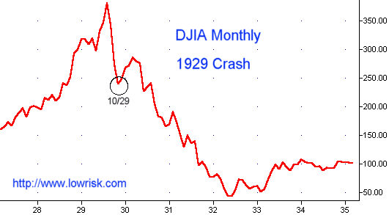
What Caused the Stock Market Crash?
☺
In September of 1929 the value of stocks began to decline.
People began to panic and sell their stocks in order to regain their money.

Slide 55
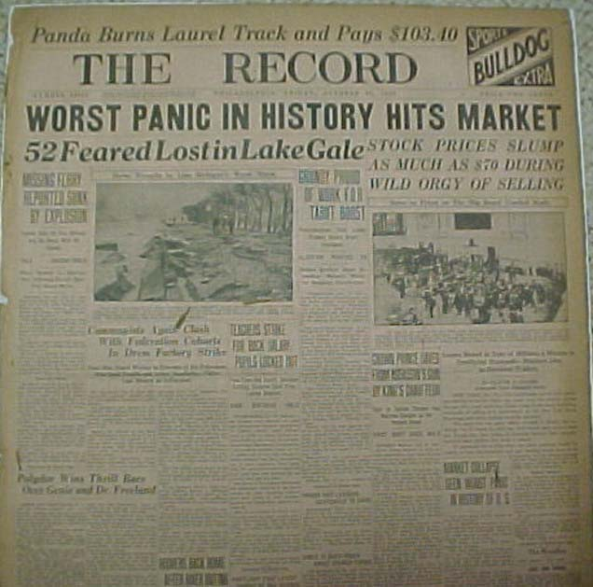
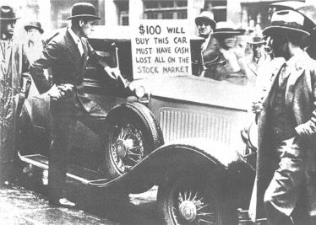
“Black Tuesday"
☺
On Tuesday October 29, 1929, the Toronto, Montreal and New York Stock Exchanges crashed.
Many companies went bankrupt and those companies who did not had the value of their shares drop by as much as 50%.
Banks closed as well.

Slide 56
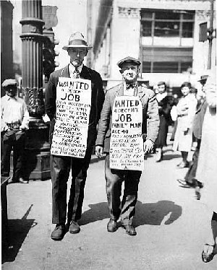
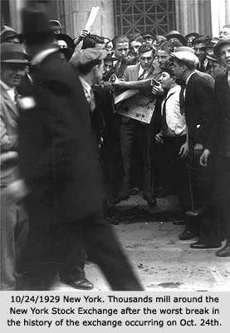
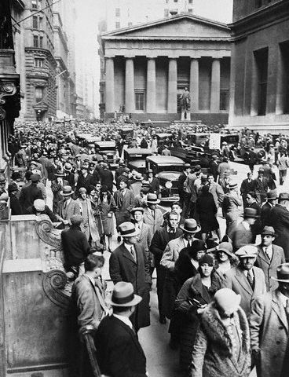
The Day the Stock Market Crashed
☺

Slide 57
The Stock Market Crash and Canada
☺
Few Canadians owned stocks.
However, the American and Canadian economies were directly tied.
Canada exported many products to the United States.
Many of the companies who bought Canadian products were now bankrupt.
There was little demand for Canadian products and, as a result, the Canadian economy began to suffer.

Slide 58
The Start of the Depression
☺
The Stock Market crash helped trigger a decade of hardship for many people.
The stock market crash should be viewed as a trigger effect that helped start the depression, but not the cause.

Slide 59
The Causes of the Depression
☺
Overproduction and Overexpansion
Dependence on Few Primary Products
Canada’s Dependence on the U.S.A.
High Tariffs Choked off International Trade
Too Much Buying Stocks on Credit
Too Much Buying on Credit

Slide 60
1. Overproduction and Overexpansion
☺
Too many products had been produced and left unsold (eg. Cars, newsprint, radios, clothing…).
Factories and other businesses had expanded beyond their means.
Production was slowed and employees were laid off.
People had less money to spend.

Slide 61
2. Canada’s Dependence on Few Primary Products
☺
Canada’s economy relied too heavily on pulp and paper, mining, wheat and fish .
When the demand for these products decreased around the world the Canadian economy dropped.
Eg. European demand for wheat decreased; Canadian farmers had difficulty selling their wheat.

Slide 62
3. Canada’s Dependence on the U.S.A.
The Canadian economy was very closely tied to the American economy.
65% of imports came from U.S.A.
40% of CDN exports went to the U.S.A.
When the stock market crashed and the depression started in the U.S.A. it inevitably hit Canada hard.

Slide 63
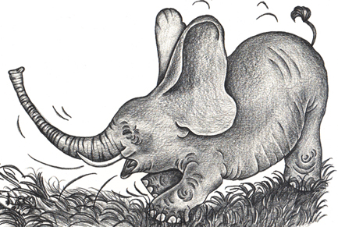
American Economy: World Wide Impact
“When the U.S. sneezed, the rest of the world got pneumonia.”

Slide 64
4. High Tariffs Choked off International Trade
☺
Countries would increase tariffs on imports to protect industry within their country, as a result, Canada couldn’t export as many of their goods
Example:
USA increases tariffs on radios.
Cost of American Made radio = $20
Cost of Canadian Made radio = $20 + $10 (tariff)= $30
Who would an American buy from? How would this affect Canada?

Slide 65
5. Too Much Buying On Credit
☺
Canadians encouraged to, “buy now, pay later.”
Cars and home appliances were bought on credit and paid off using monthly payments.
Interest charged on these products made them very expensive in the long-term.
When people lost their jobs they had no money to make monthly payments.

Slide 66
6. Too Much Buying of Stocks on Credit
☺
People bought stocks on credit (buying on margin) and paid back their debts with profits made on stocks.
Eg. $1000 worth of stock bought with only a $100 down payment. Value of stocks increases to $2000, and the debt is paid off.
However, if the stock value decreased the shareholders had no money to pay back their creditors.

Slide 67
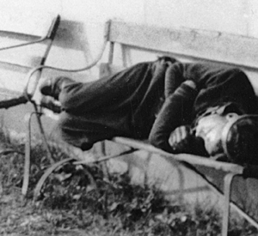
The Depression Begins
☺
At first many thought that the economic slump would only be temporary.
However, the 1930s would be a time of extreme hardship for Canadians.
Unemployment, starvation, malnutrition, and a lack of other basic necessities would become a common struggle for many Canadians.

Slide 68
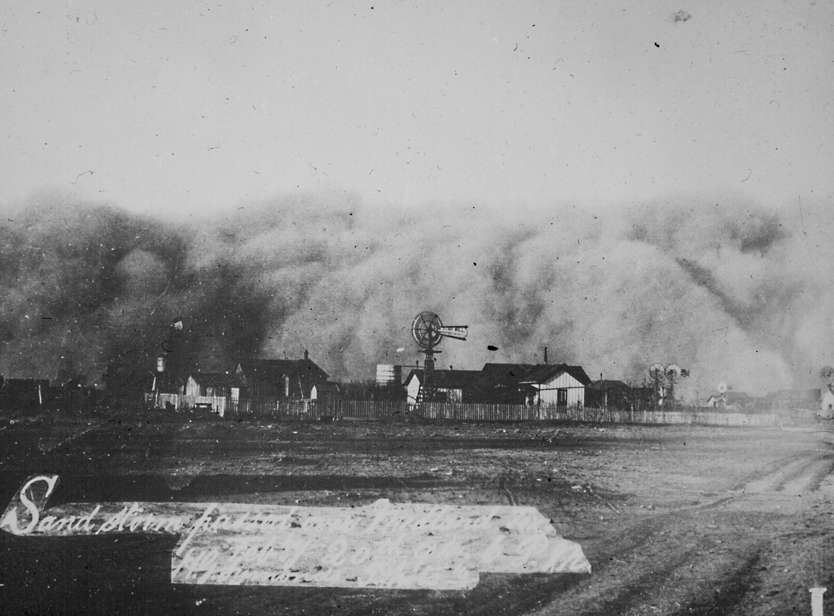
1
The Story: The Canadian Prairies experienced several years of drought. As a result, the soil became very sandy, crops did not grow and sandstorms changed the landscape.
4
What word best describes the picture?
4
What’s the story in the picture?

Slide 69
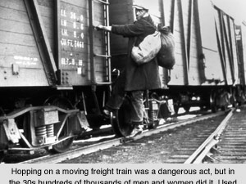
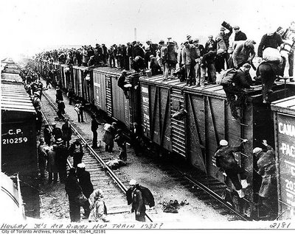
2
The Story: Unemployed men would often “ride the rails” from town to town across the country trying to find work. Unemployed men also used this method of transportation during the “On-to-Ottawa” trek – a protest against the government.
4
What word best describes the picture?
4
What’s the story in the picture?

Slide 70
3
The Story: Unemployment reached 33% in Canada. Many Canadians lost their homes or had to live with relatives. “Relief,” or financial assistance, was provided by the government.
4
What word best describes the picture?
4
What’s the story in the picture?

Slide 71
4
The Story: Canadians could no longer afford fuel for their vehicles. So many had their vehicles powered by horse or cow! They called these “Bennett Buggies” after Prime Minister R.B. Bennett.
4
What word best describes the picture?
4
What’s the story in the picture?

Slide 72
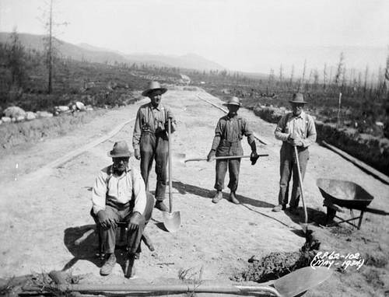
5
The Story: To address the rising unemployment the government created “relief camps.” These camps, located in remote areas, provided work, pay and lodgings for unemployed men.
4
What word best describes the picture?
4
What’s the story in the picture?

Slide 73
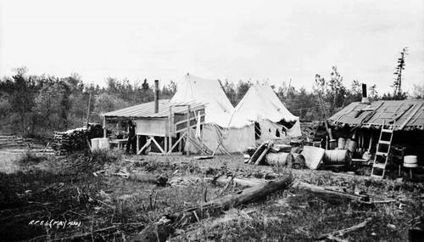
6
The Story: “Shanty towns” began to appear on public lands. Politicians and police were not happy with this and people could be arrested for “vagrancy.”
4
What word best describes the picture?
4
What’s the story in the picture?

