Slide 1
World War I

Slide 2

Why do people win Awards and Medals?
Notes:
Students will do a Whiteboard Splash on ‘Why do people win Awards’
We will then explore the battle of Vimy Ridge to understand some of the ‘Heroic Deeds’ individuals did to become ‘Victoria Cross’ recipients.

Slide 3
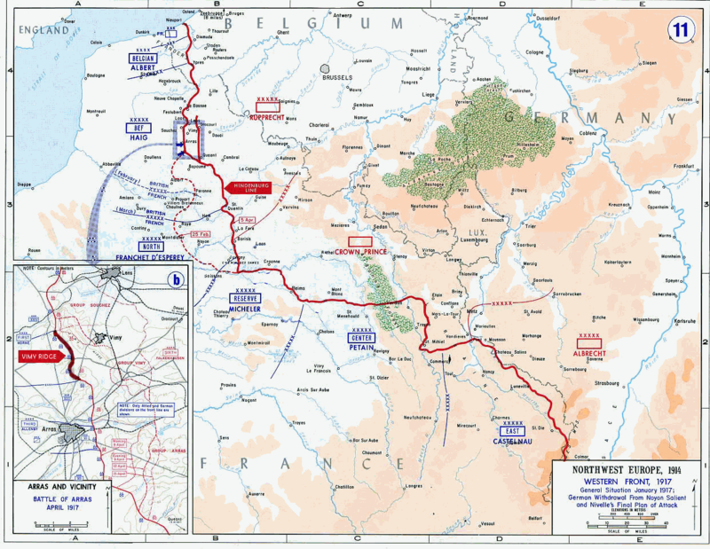
Battle of Vimy Ridge
Notes:
During the Race to the Sea, the Germans occupied this ridge along the Arras.
It was no higher than Mount Mary Anne.
Captured in October, 1914.

Slide 4
The Endless Attempts
May 1915
The French 10th Army tried to capture it.
Sept 1915
The French 1st Moroccan Division tried to capture it.
May 1916
British 140th and 141st Brigades tried to capture it.

Slide 5
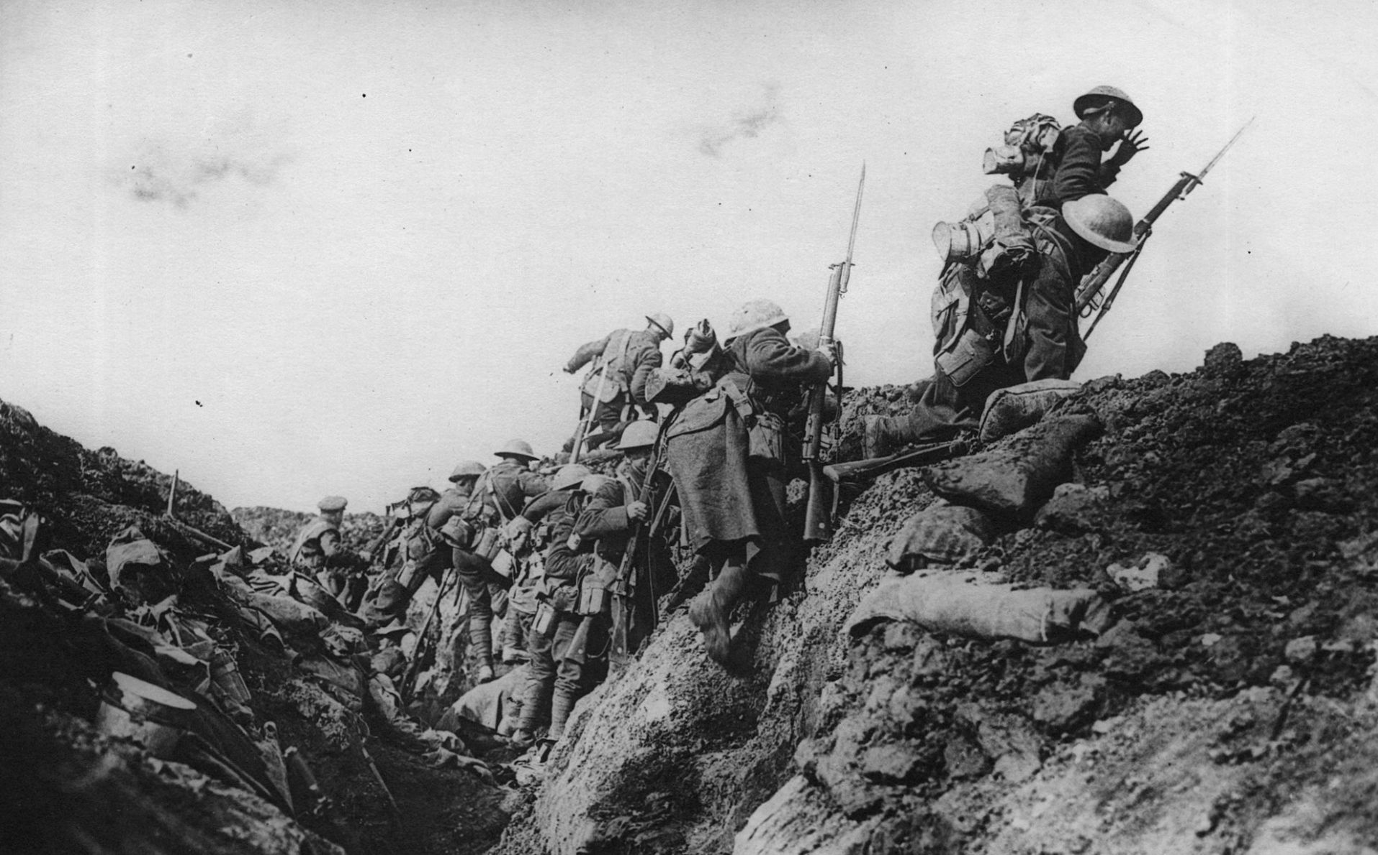
Enter the Canadian Corps
April 9th – 12th 1917
British 5th Artillery, with the Canadian 1st, 2nd, 3rd, and 4th Division.
‘Creeping Barrage’

Slide 6
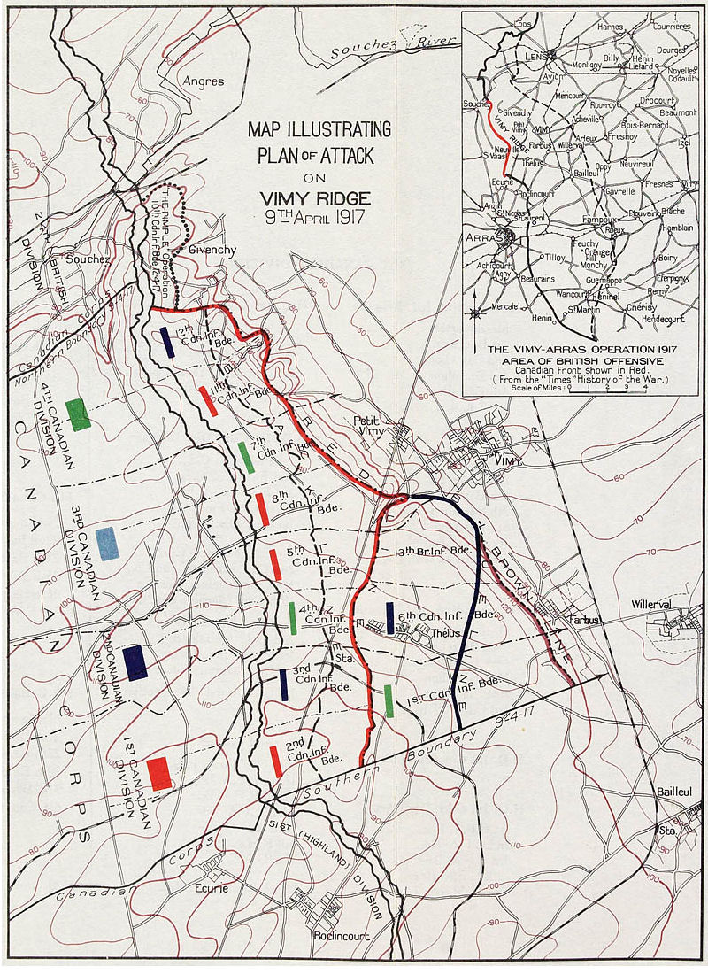

Slide 7


Slide 8
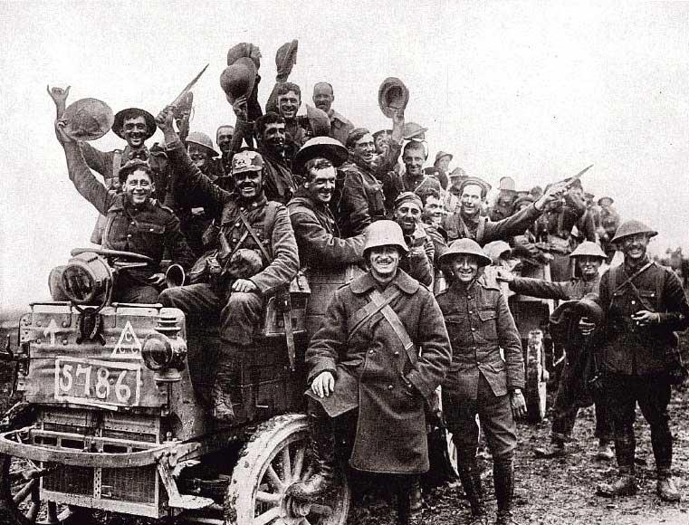
Canadians celebrating at Vimy Ridge

Slide 9
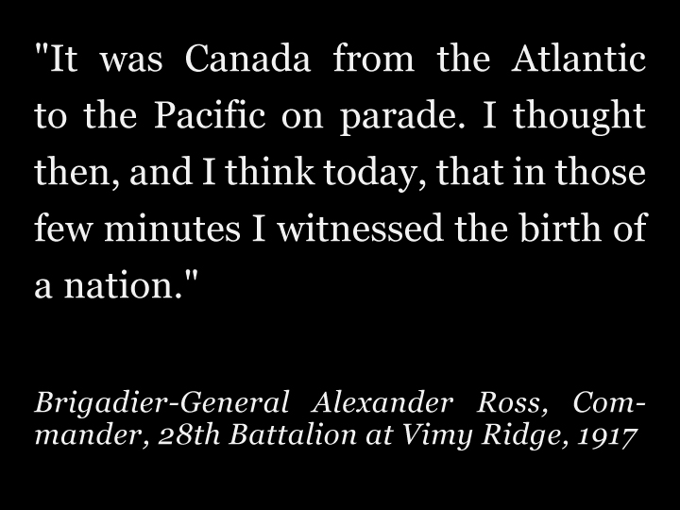

Slide 10
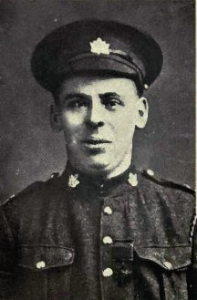
Private William Milne of the 16th Battalion
April 9th, 1917
While his friends were under heavy fire from a Machine Gun he crawled on hands and knees across no-man’s land at Vimy Ridge and attacked the gun crew.
He repeated this a second-time, but did not survive.

Slide 11
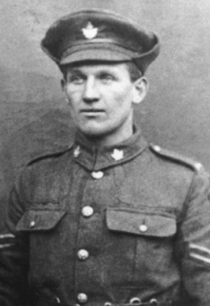
Lance-Sergeant Ellis Sifton of the 18th Battalion
April 9th, 1917
While his company and him were under fire by a Machine Gun placement, Sifton charged single-handedly at the enemy taking out the placement.
He then stood his ground against enemy reinforcements.

Slide 12
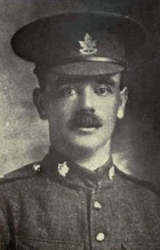
Private John Pattison of the 50th Battalion
April 10th, 1917
While under heavy gun fire, he ran across ‘No-man’s land’ jumping into a fox hole.
From there he threw grenades into the enemy gun-placement.
He then rushed into the trenches and killed the remaining 5 Germans via Bayonet.

Slide 13
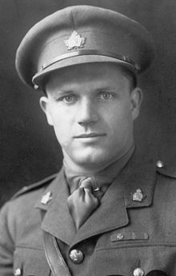
Captain Thain MacDowell of the 38th Battalion
April 9th, 1917
He and two friends, charged the Germany front lines.
They took out a Gun-Nest.
He then chased the Germans into a Tunnel and bluffed them to think he was part of a larger force.
77 Germans surrendered to him.
Held the position for 5 days.

Slide 14
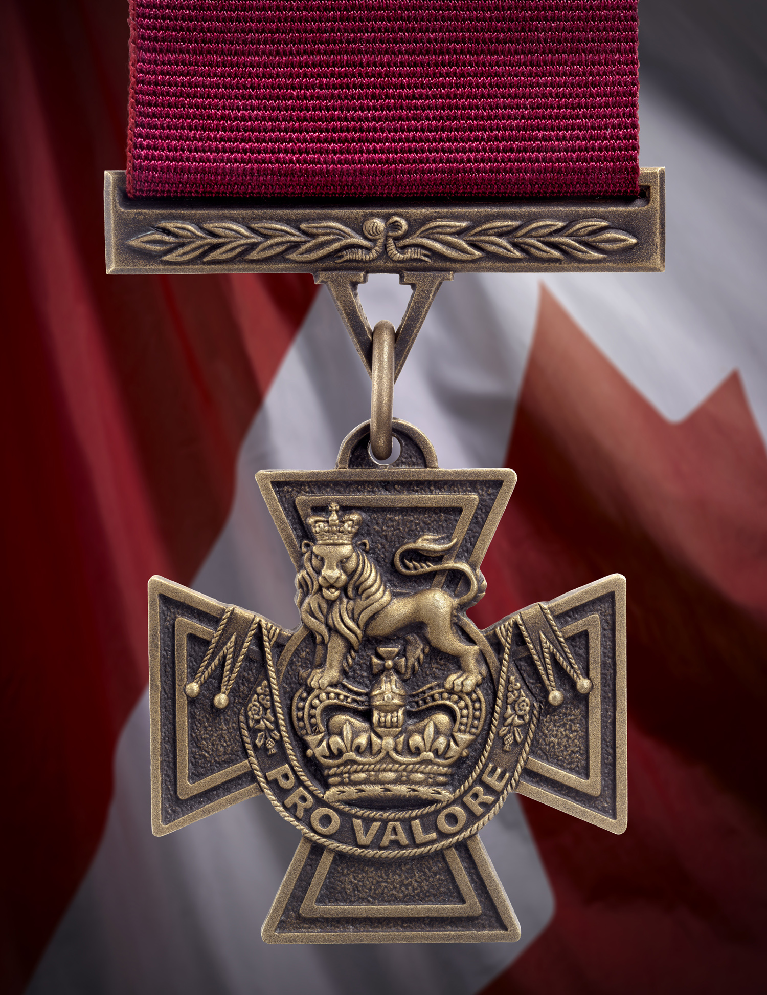
The Victoria Cross
Began in 1856
Awarded 1,358 times since.
Given for ‘Gallantry’ in Battle
Awarded 628 times in WWI

Slide 15
Chances of Receiving the Victoria Cross
In WWI
Britain sent 8,904, 467 troops to war.
628 received the Victoria Cross.
628/8, 904, 467
0.007% chance of receiving the medal.
1: 14,285 people received one.
You have a 1 in 3000 chance of being struck by lightning in your lifetime.

Slide 16
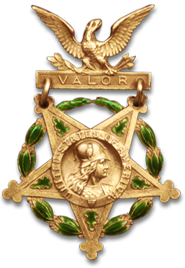
“No one is born a hero, rather they are given opportunities that allow them to do heroic things…”

Slide 17
World War I
Re-Enactment
Your Opportunity to be Heroic

Slide 18
June 11 (2:1) and June 12 (1:1)
We will be doing a World War I Re-Enactment.
There will be two parts:
Trench Warfare (20 Minutes) + (10 Min Set-Up)
WWI Total War (20 Minutes) + (5 Min Clean Up)

Slide 19
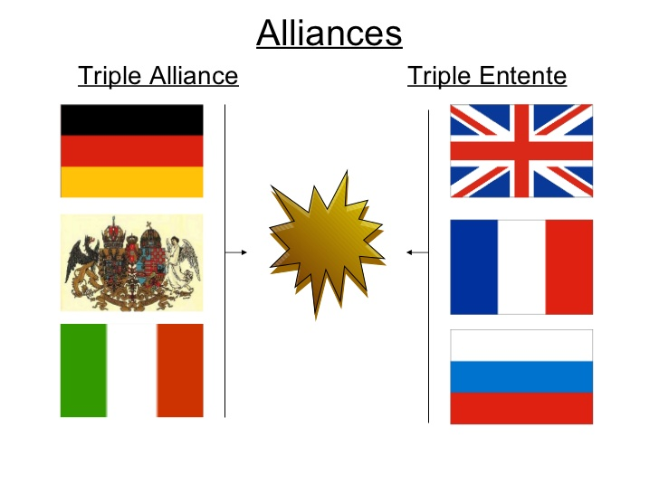
Which side will you be?
Notes:
Students will need to decide which side they want to be on.
You can either assign students or have them choose themselves.
If the numbers seem un-fair please have some students join the other group.

Slide 20
What Unit will you be a part of?
Canadian Army
2nd Canadian Division
1st Canadian Brigade
3rd Canadian Division
7th Infantry Brigade
Corps
Divisions
Brigades
Battalion &
Regiments
1st Canadian Battalion
Princess Patricia’s Canadian Light Infantry

Slide 21
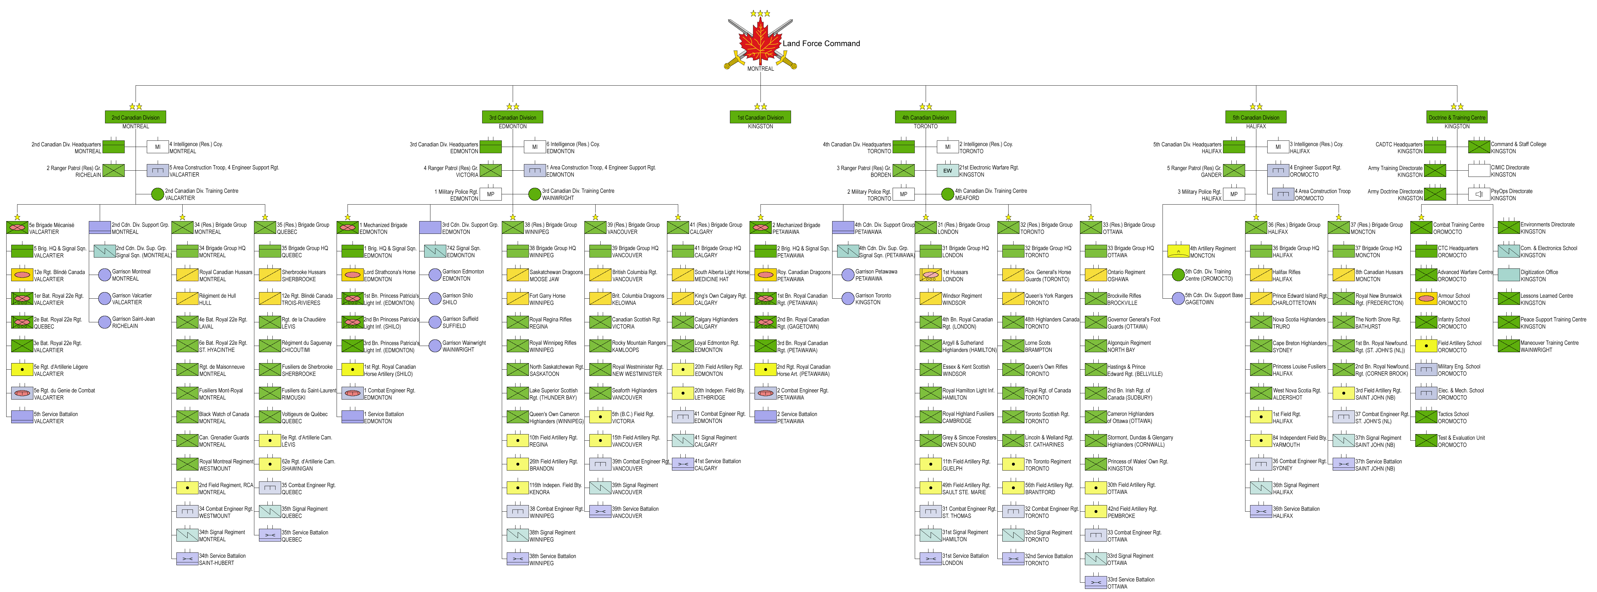

Slide 22
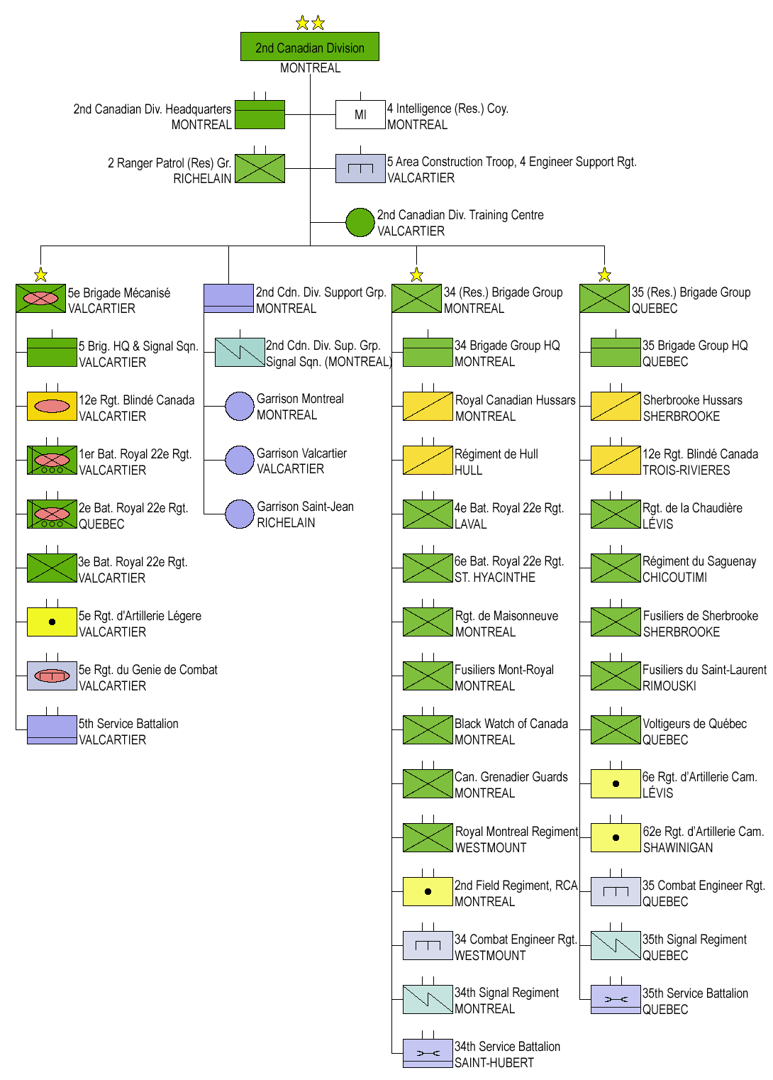

Slide 23
The Units for each Army
Triple Alliance
Triple Entente
1 General
(1) Artillery Unit – 5 Members
(1) Medical Unit – 3 Members
(4) Infantry Units – 16-20 Members
1 General
(1) Artillery Unit – 5 Members
(1) Medical Unit – 3 Members
(4) Infantry Units – 16-20 Members

Slide 24
Unit Structure
Each of your units will have the following:
(1) Captain – The person in charge of your unit.
(1) Lieutenant – The person in charge if the Captain dies.
(1) 2nd Lieutenant – The person in charge if the Lieutenant dies.
(1-2) Privates – The people who follow the orders from the Captain.

Slide 25
The Medical Unit
Your duty is to rescue injured infantry/artillery soldiers throughout the experience.
In order to save them, you will need to walk them back to your hospital.
There is no ‘freebie’ to get you back to your hospital; you can be taken out on the way back.

Slide 26
The Artillery Unit
Your job is to protect your infantry and medics from attack.
To do this you will be responsible for bombarding the enemy units with artillery (Dodgeballs).
Only artillery unit members may pick up and fire artillery rounds.

Slide 27
The Infantry Unit
Your job is to protect your Artillery and Medical units while completing your missions.
Each of you will be given a weapon (Powdered Chalk Beanies) to protect your self and your other units.
If you’re hit by an artillery round, or a chalk beanie you must wait for medical retrieval. Your General can save you at any time.
Only infantry members can pick up and use chalk beanies.

Slide 28
The Missions
Missions are to be accomplished in order of difficulty.
Once a Mission is complete, bring back verification to your General.
Your General will keep track of each Unit’s points.
Your General will issue you another ‘Mission’ to complete.

Slide 29
The Winner
There will be Three winners:
Most Missions Completed by a Unit
Most Missions Completed by a Country
Most Missions Completed by an Alliance
The Winner will be which ever unit has completed the most Missions.
The Winner will be which ever group (Triple Alliance / Triple Entente) has completed the most Missions.

Slide 30
Awards
In war, ranked officers would often recommend soldiers for receiving medals.
We will do the same.
If during the ‘Battle’ you see someone do something heroic, brave, selfless, kind, please let your General know.
Awards will be distributed on June 13th/14th

Slide 31
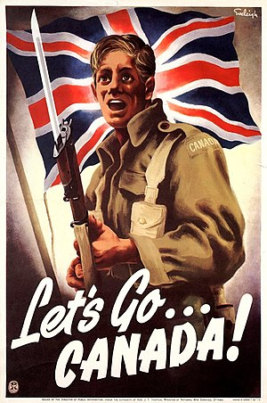
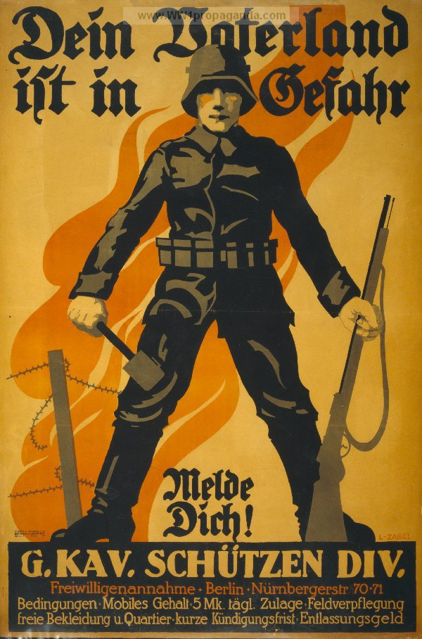
Enlist Today…
Get into a group of 4 to 5 people
Notes:
Students will come to their ‘General’s and Enlist into each of the Armies. Once they have enlisted they can meet in their ‘UNITS’ to begin assigning Ranks and working on their ‘Research Project’

Slide 32
Declare your Ranks by Age in your Unit
If you’re the eldest in your group, you’re the Captain and so on, therefore the youngest will be the private.
Rank | Name
Captain
First Lieutenant
Second Lieutenant
Private
Private
Notes:
The Students will decide who is their ‘Unit’ Leader.
I will explain that when we are in the ‘War Experience’ if your ranking person gives you a command you need to obey it, or be brought up on Mutiny Charges.

Slide 33
Oh Captain, my Captain
Send your Captain up to Enlist your Unit and to get your corresponding Unit Name.
Your Captain will also bring back your Research Package.

Slide 34

Please Take 1-2 I-pads per ‘Unit’ and Begin doing your research.
Notes:
Students will get into their groups briefly to assign ranks as well as to look up their Military Unit online.

