Slide 1
Imperialism ☺
Imperialism is a policy of extending control or authority over foreign countries/regions as a means of gaining resources and/or maintenance/expanding of empires.
This is either through direct territorial conquest or settlement, or through indirect methods of exerting control on the politics and/or economy.

Slide 2
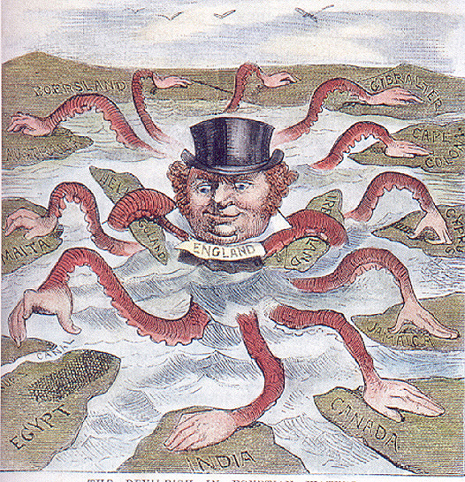

Slide 3
Colonialism ☺
Colonialism is the establishment, exploitation, maintenance, acquisition, and expansion of a colony in one territory by a political power from another territory.
It is a set of unequal relationships between the colonial power and the colony and often between the colonists and the Indigenous population.
At first the countries followed mercantilist policies designed to strengthen the home economy at the expense of rivals, so the colonies were usually allowed to trade only with the mother country.

Slide 4
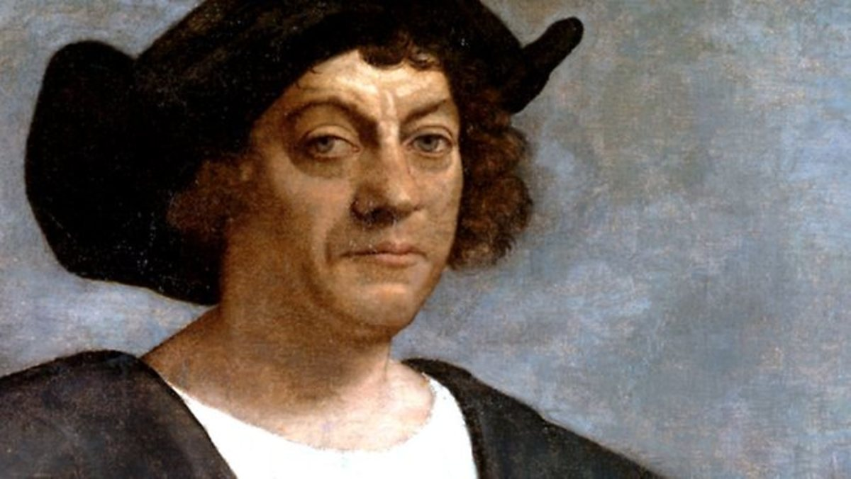
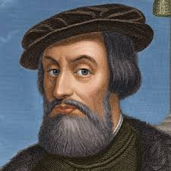
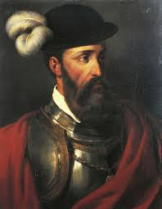
Chapter 4 European Expansion ☺
North America began to be colonized in the 15th/16th C. by the Spanish.
Christopher Columbus – 1492 – West Indies
Hernan Cortes – 1519 to 1521 – Aztecs (Mexico)
Fransisco Pizarro – 1532 – Incas (Peru)
Begin to push North into present day Mexico/California.

Slide 5
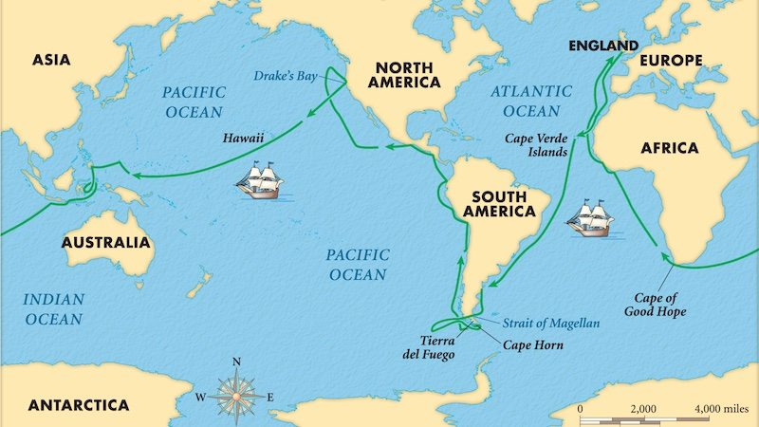
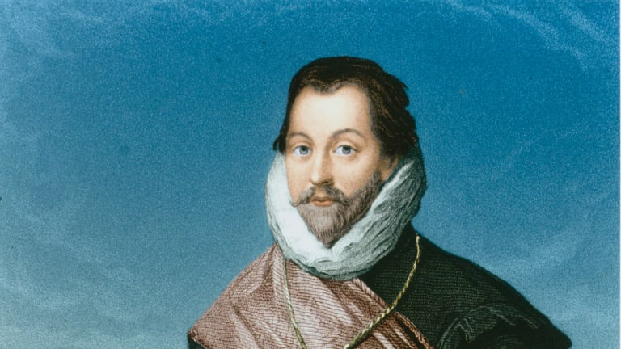
Chapter 4 European Expansion ☺
Sir Francis Drake 1577-1580 - Circumnavigated the Globe.
Off the coast of Oregon around 1579.

Slide 6
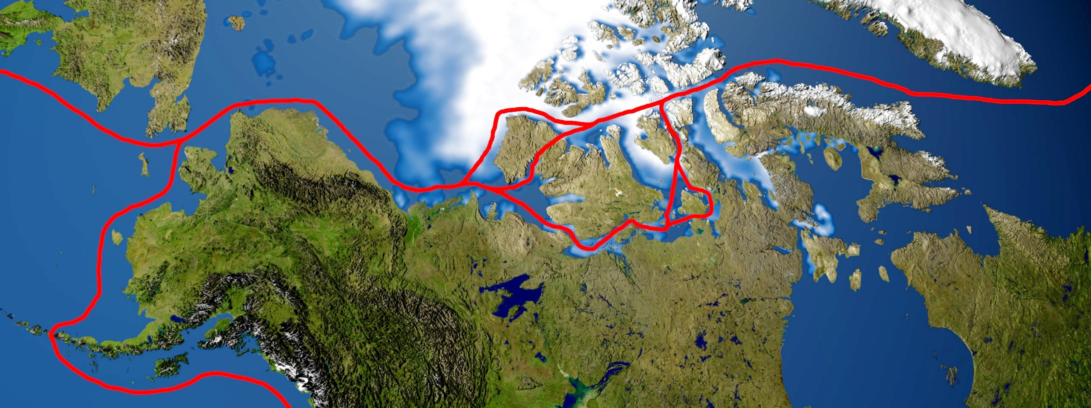
Chapter 4 European Expansion ☺
Spain and England become rivals, each seeking the Northwest Passage – a quick passage to the Asian market.
In 1745, the British Parliament offers a 20,000 Pound (5.2 Million U.S. in 2019) reward to any person able to find such a passage.

Slide 7
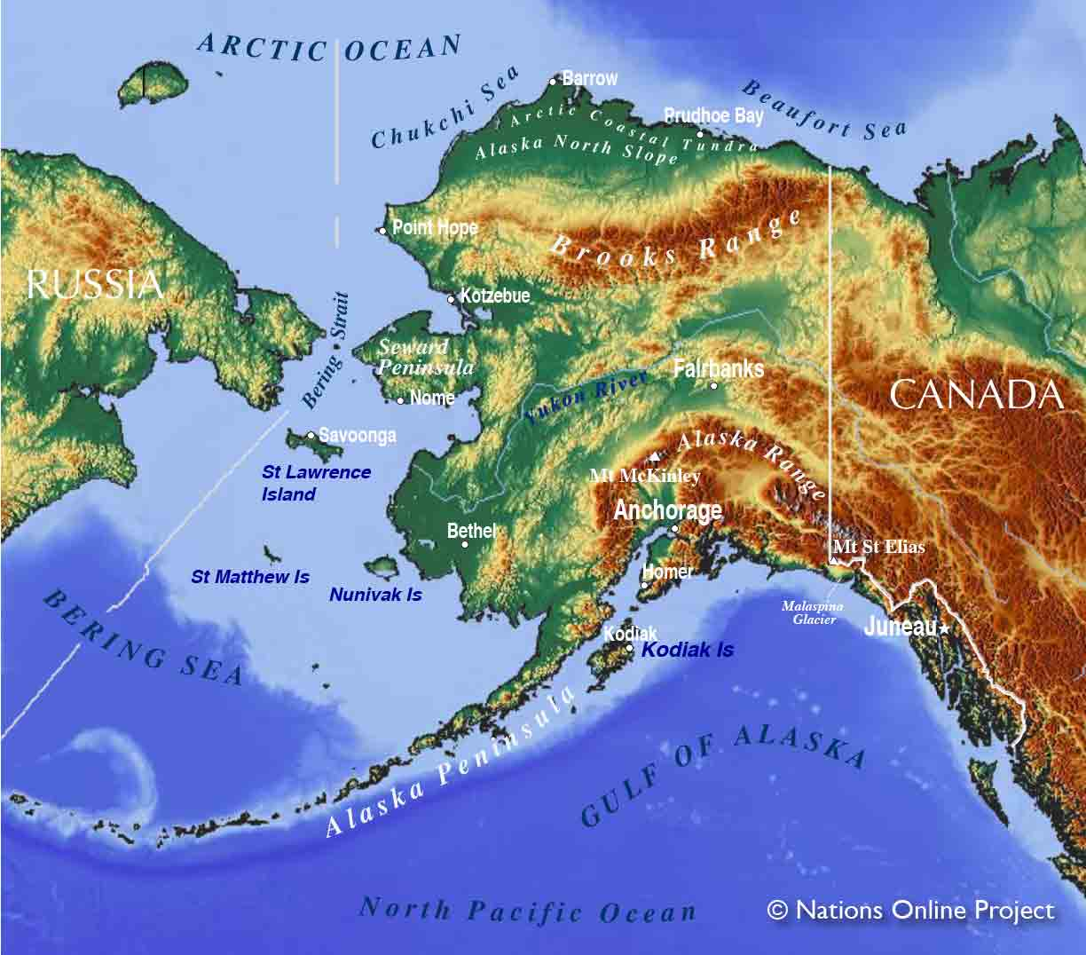
Chapter 4 European Expansion ☺
By the early 1770’s the Russians were descending down into Alaska along the Aleutian Islands.

Slide 8
Chapter 4 European Expansion
The Spanish sent Juan Perez in 1774 to Spy on them, he came into contact with the Haida on Haida Gwaii.
Perez stopped on the West Coast of Vancouver Island.
Noted the Nuu-chah-nulth had acquired iron/copper.
Proof that European trade goods were making their way out west.

Slide 9
Fransisco de Bodega y Quadra - 1775 - Sonora
" As we thus lay at anchor, [...] our Captain gave me orders (being himself indisposed) that I should land with some of our crew, and with the same precautions as at Los Remedios. He also directed me to take possession for his Majesty of this part of the coast, and name it Bucarelly. I accordingly obeyed his instructions in all particulars, without seeing a single Indian, though there were the following proofs of the country's being inhabited: viz a hut, some paths, and a wooden outhouse.”
– Fransisco Maurelle, 1781
How might Historians use this passage?

Slide 10
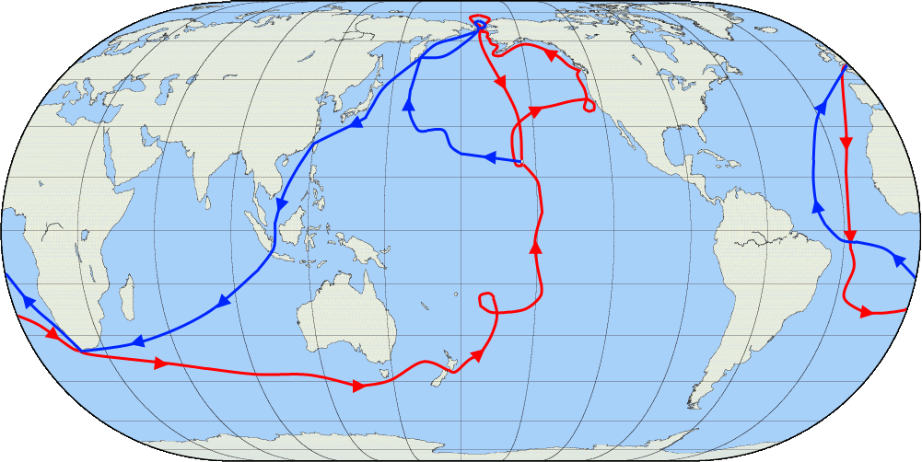
Chapter 4 Northwest Passage
James Cooke – Third Voyage → July 1776 to October 1780 → Left from Plymouth, England.

Slide 11
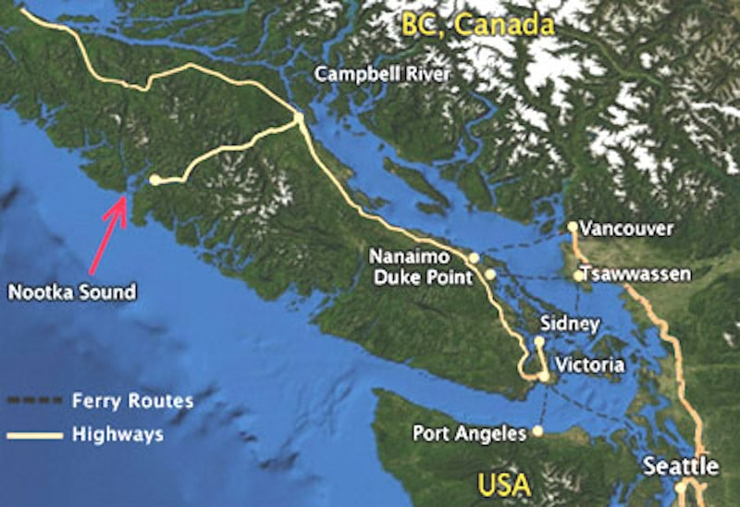

Slide 12
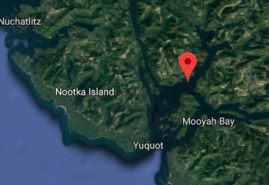

Slide 13
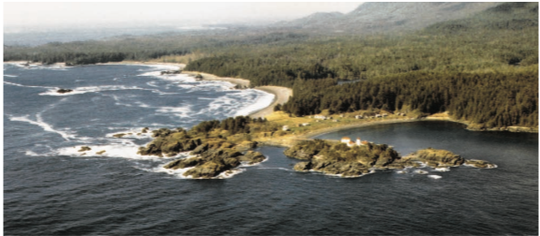
Chapter 4 The Nuu-chah-nulth meet Cooke ☺
Cooke approaches Vancouver Island, in his two ships, Resolution and Discovery on March 29th, 1778.
Confused the pronunciation of Nuu-chah-Nulth for ‘Nookta’
Took 1,500 Sea Otter Pelts with them.
Cooke died in Hawaii;
His crew realized the wealth in B.C. - Fur Trade begins
Yuquot

Slide 14
First Contact
Please open up to page 2 and the First Contact reading between the Nootka people of Vancouver Island and James King.

Slide 15
First Encounter Poem
With a partner, I would like you to create a First Encounter Poem.
Use the information from the First Contact Reading
Your poem must be 12 lines long.
You may only use 3 of the original lines (European/FN) from the “First Encounter Poem”
I would like for there to be three voices in your poem.
The Europeans
The First Nations
The Land

Slide 16
Adios Spanish from the West Coast
In 1788, the Spanish sent two Frigates to investigate the English.
They arrived in Nootka Sound, found the English assembling a fort.
Martinez (Spanish) and James Colnett (English) got into a fight, Colnett was arrested.
The Nootka People sided with the English, and began to revolt.
A Spanish Soldier accidentally shot the FN Chief.
In 1790, the two countries made peace and agreed that the British Forts could be used by the Spanish.
By 1795, the Spanish had left the coastal waters to the British.

Slide 17
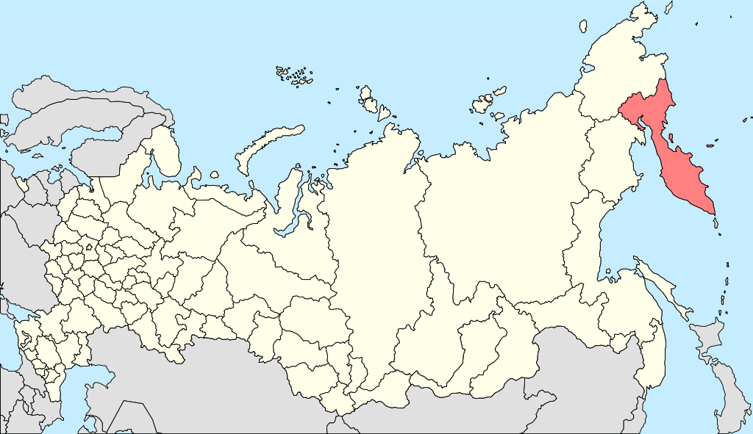
Kamtchaka, Russia

Slide 18
Chapter 4 The Nuu-chah-nulth meet Cook
“A great many canoes filled with the Natives were about the ships all day, and a trade commenced betwixt us and them, which was carried on with the Strictest honisty on boath sides. Their articles were the skins of various animals, such as Bears, Wolfs, Foxes, Dear, Rackoons, Polecats, Martins, and in particular the Sea Beaver, the same as is found on the coast of Kamtchatka.”
Natives came to them; they initiated the trade.
Natives are seen as honest.
They are excellent trappers/hunters.

Slide 19
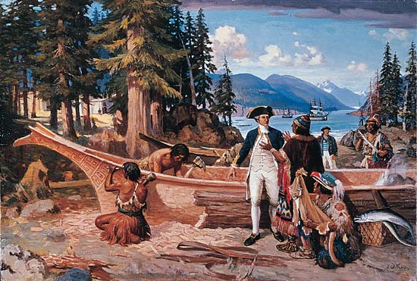
Chapter 4 The Nuu-chah-nulth meet Cook

Slide 20
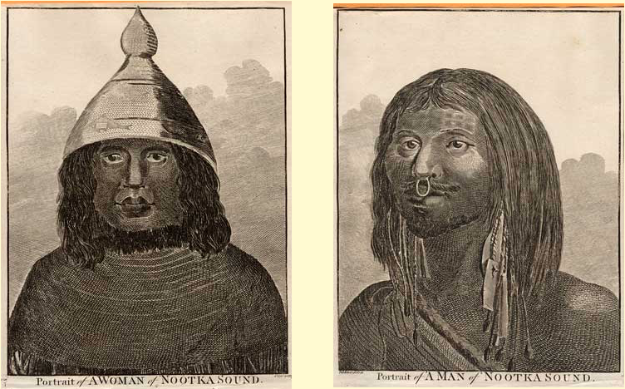
The Nuu-chah-nulth meet Cook Drawings courtesy of John Webber

Slide 21
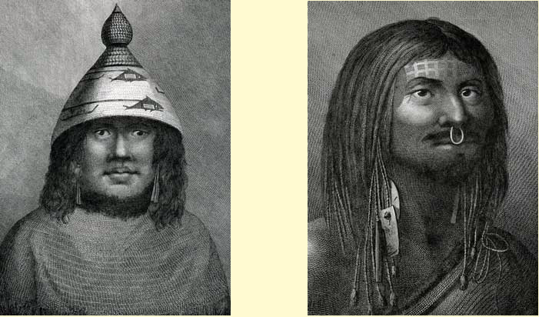
The Nuu-chah-nulth meet Cook Drawings courtesy of John Webber

Slide 22
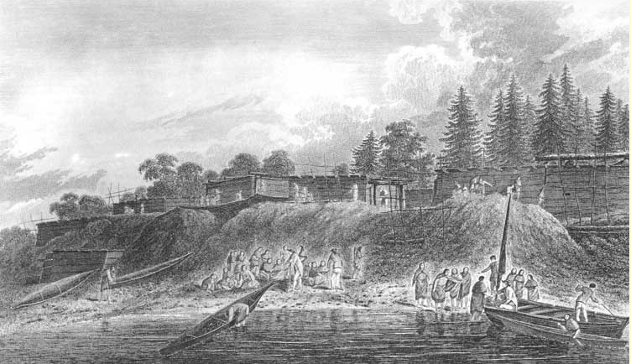
The Nuu-chah-nulth meet Cook Drawings courtesy of John Webber

Slide 23
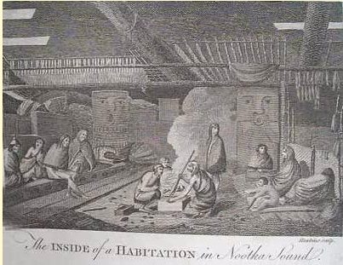
The Nuu-chah-nulth meet Cook Drawings courtesy of John Webber

Slide 24
Classwork
Finish Ch. 1/2/3 Questions
Begin working on your First Encounter Poem
☺

Slide 25
Outline
CNN 10
Fur Trade
Maritime and Land Based (16 Slides)
Classwork

Slide 26
Chapter 4 The Maritime Fur Trade
Over the course of the next 25 years, hundreds of ships will visit Vancouver Island and the Coast of B.C. looking for sea otter furs.
Begin to take Timber as well.
These Nations claimed Sovereignty over the area – eventually they withdrew, colonial powers went to the fur traders.
FN would often hold ceremonies, and treat Europeans like visiting Chiefs.
Europeans quickly realized that FN were expert traders/hard bargainers, women often setting the final price for goods.

Slide 27
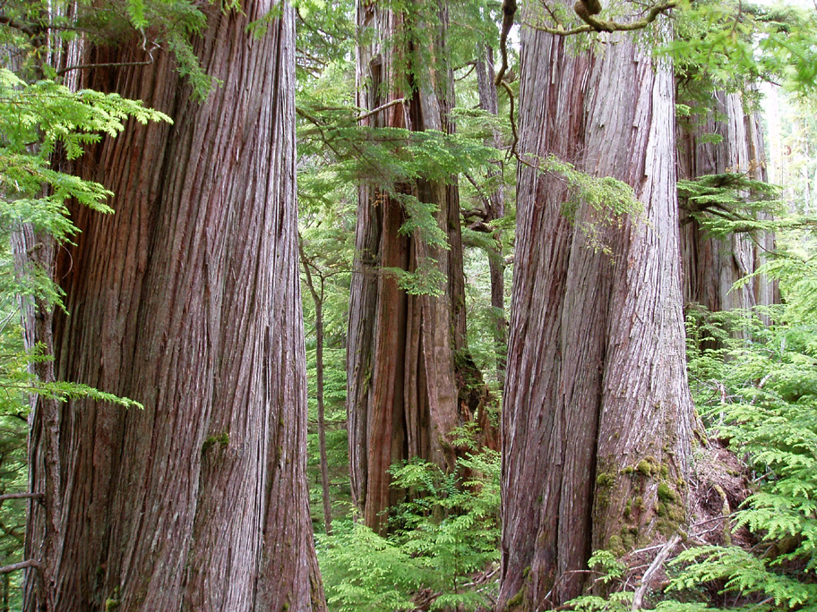
Coastal Cedars

Slide 28
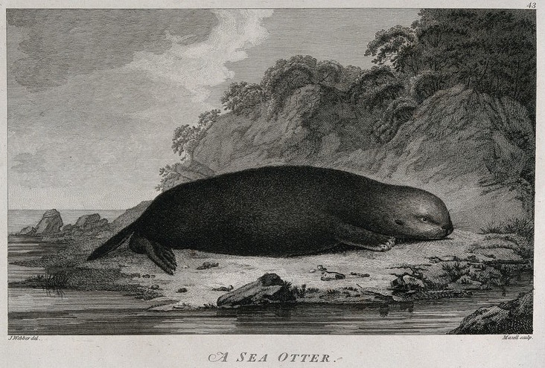

Slide 29
Chapter 4 The Maritime Fur Trade
Items Sought after by FN
Iron = Axes/Chisels
Firearms = Power
Copper = Shields
Cloth = Clothing
Clothing, Buttons, Mirrors and Dishes.
Food = Rice, Molasses, Pilot Biscuits.
Eventually Alcohol was traded.
During the Peak Maritime Trading Years (1790 – 1812) – 10-20 ships visited the B.C. coast each year
Collecting 18,000 pelts per year (Est. 300,000 Sea Otter when Cooke arrived)
This trade devastated the Sea Otter Population.
By 1900 they were almost extinct.
Between 1969 to 1972, 89 Sea Otters reintroduced to B.C.’s coast.
Today, Scientists est. 6000 Sea Otters on B.C.’s coast.
Notes:
Sea Otter picture from 1777-1780 in Captain Cooke’s Journal.

Slide 30
Discussion
Based off the Sea-Otter population in 1780 to 2019, what connections can be drawn between Capitalism (this need for Fur) and Stewardship/Sustainability (Caring for the Land/Animals)?

Slide 31
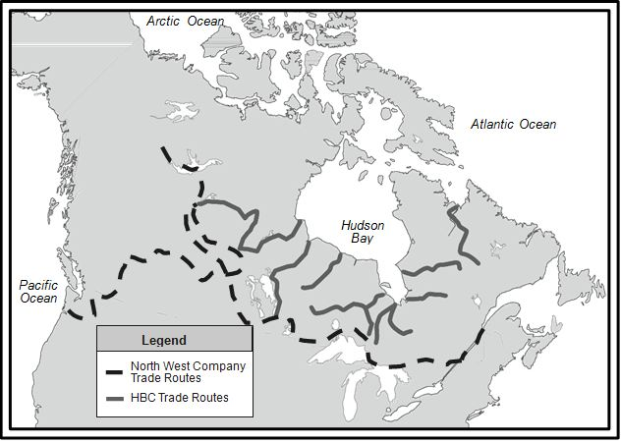

Slide 32
Chapter 4 The Land-Based Fur Trade
The North-West-Company (NWC) has been for years trading in the Interior, shipping furs back East to Montreal.
Their competition was the HBC.
Three important NWC traders pushed deep into present day B.C.
1793 – Alexander Mackenzie – Grease Trail to Bella Coola.
1805-1808 – Simon Fraser – built forts.
1805 – Fort McLeod
1806 – Fort Fraser/Fort St. James
1807-1811 – David Thompson
In 1821 – HBC/NWC merge together.
Notes:
Sea Otter picture from 1777-1780 in Captain Cooke’s Journal.

Slide 33
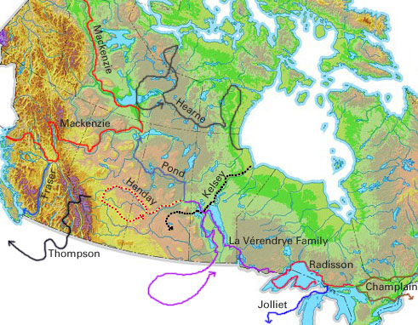

Slide 34
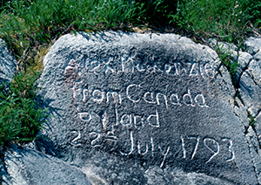

Slide 35
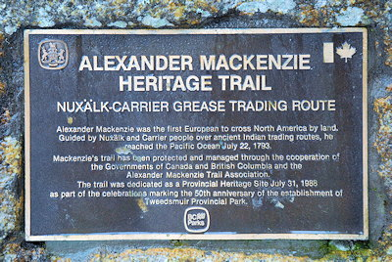

Slide 36
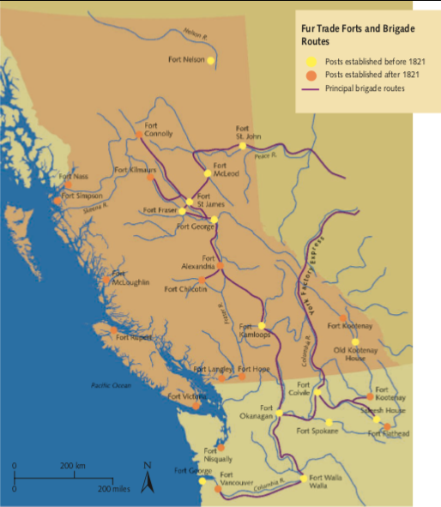
Notes:
Sea Otter picture from 1777-1780 in Captain Cooke’s Journal.

Slide 37
Chapter 4 The Land-Based Fur Trade
Fur trader sought beaver, mink, marten, muskrat, river otter, fox, and bear fur.
Europeans traded: blankets, guns, sugar, flour, tobacco, and household goods.
FN also supplied food to the forts: fish/meat.
When Forts were constructed on FN territory, those FN on that territory became intermediaries (mediator/middle man) between the Fort and other FN’s.
However, sometimes FN did not support these Forts, then they were forced to close
Ex: Fort Chilcotin (1844)
The presence of a fort increased the local groups’ status and power and the people acted as intermediaries.
Notes:
Sea Otter picture from 1777-1780 in Captain Cooke’s Journal.

Slide 38
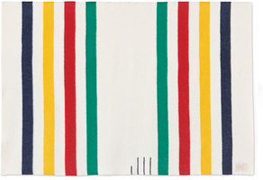

Slide 39
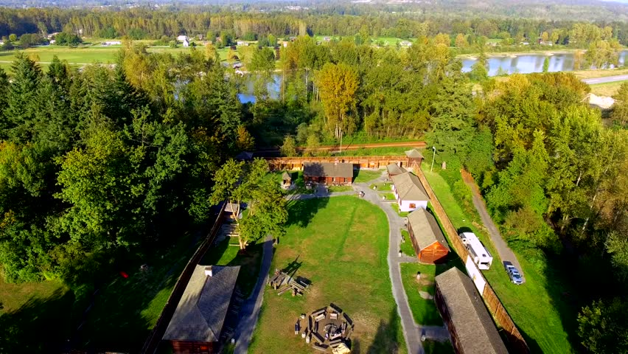
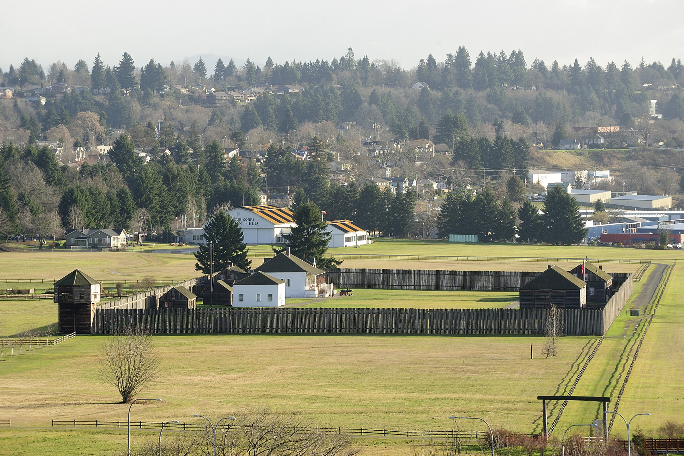
Chapter 4 The Land-Based Fur Trade
By 1820, HBC had Forts all along the Fraser/Columbia River with their headquarters at Fort Vancouver (WA)
By 1846, the HBC moved its headquarters to Victoria
Notes:
Sea Otter picture from 1777-1780 in Captain Cooke’s Journal.

Slide 40
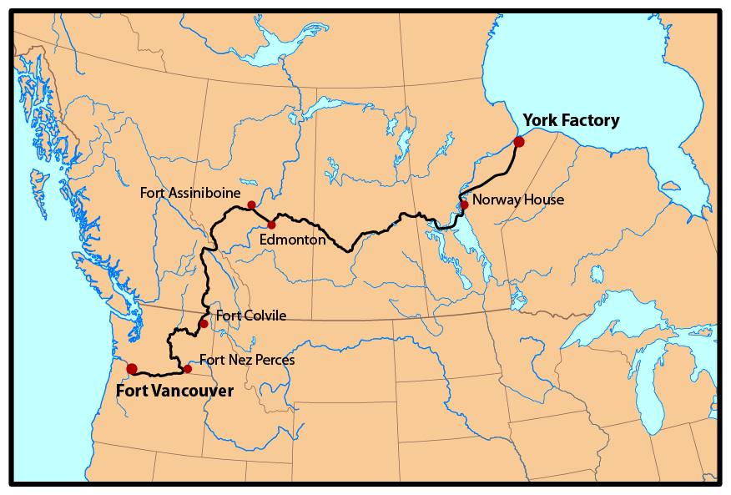
Fort Victoria

Slide 41
Companies and First Nations
The First Nations were recognized in this fur trade as integral and experienced traders who could, like their coastal counterparts, drive a hard bargain.
First Nations traders integrated the newcomers into their traditional trading system.
Without First Nations participation the fur trade would not have happened → True or False?
Europeans relied on their assistance and technology; without First Nations they would not have survived in North America. → True or False?

Slide 42
First Encounter Poem
With a partner, I would like you to create a First Encounter Poem.
Use the information from the First Contact Reading
Your poem must be 12 lines long.
You may only use 3 of the original lines (European/FN) from the “First Encounter Poem”
I would like for there to be three voices in your poem.
The Europeans
The First Nations
The Land

Slide 43
Classwork
Begin working on the First Encounter Poem.
Finish up Chapter 2/3 Questions.

Slide 44
Outline
CNN 10
Journal Prompt #6
Classwork ☺

Slide 45
Journal Prompt #6
1) Imagine that you’re an artist, accompanying James Cooke on his expedition to Nookta Sound. Draw a picture of the following:
The First Nations Village you see (or Cooke’s Ship)
The Sea Otter
The First Nations (or the Europeans)
2) Write a Paragraph from either the Point of View of the Europeans, or the First Nations, on their first encounter. Try to place yourself in their shoes and see things from their point of view. Use the First Encounter reading as a guide.

Slide 46
Classwork
Complete Journal Prompt #6
Complete the First Encounter Poem
Complete Ch. 1-3 Questions.
Complete + Hand in the Project
(Local Geography: Mission, B.C.)
Begin working on Chapter 4 assignments in the package booklet.

Slide 47
Outline
CNN 10
Review
Women in the Fur Trade
Connoly vs. Woolrich
Impact of the Fur Trade on FN
Impact of Disease on FN communities

Slide 48
Review
Which Spanish Explorer first came to Vancouver Island?
Juan Perez visited the island in 1774
What evidence do Historians have to prove that Canada’Eastern Trade, had made its way to Western Canada prior to first contact?
Juan Perez found Copper/Iron weapons/bowls/items with the Nootka in 1774.
Which English Explorer visited the people of Yuquot, on Vancouver Island?
Captain James Cooke in 1778.
What did European Explorers want to take back to Europe with them from B.C.’s coast?
Furs, specifically Sea Otter pelts
Which two companies merged together in 1821 that began a “Fur Empire”?
The HBC and the NWC merged to become the HBC.

Slide 49
Chapter 4 Women in the Fur Trade
Women played a vital role in the Fur Trade.
When the men were away, they took care of the families.
Women prepared the furs (hiding/tanning)
Women prepared the salmon for trade (cleaning/drying)
FN women also married company employees, entering into the social structure of the Fort.
These marriages were often seen as political alliances between FN and the Fort.
These unions brought a bridge between these two cultures – especially in the household.
However, sometimes men would abandon their families and move back East.
Connolly vs. Woolrich
Notes:
Sea Otter picture from 1777-1780 in Captain Cooke’s Journal.

Slide 50
Connolly vs. Woolrich
This case considered the legality of a marriage between a man employed by the Hudson Bay and an indigenous woman.
The wedding was not performed by a priest, but rather, in accordance with indigenous traditions.
The progeny of this relationship later made claim to the man’s estate upon his death; however, the man had married once again in a recognized institution upon his retirement.
His widow claimed the previous marriage was invalid and the son was entitled to nothing.

Slide 51
“This law or custom of the Indian nations is not found recorded in the solemn pages of human commentaries, but it is written in the great volume of nature as one of the social necessities – one of the moral obligations of our race – through all time and under all circumstances, binding, essential, and inevitable; and without which neither man, nor even barbarism itself, could exist upon; earth…It would; be sheer legal pedantry and pretention, for any man, or for any tribunal, to disregard this Indian custom of marriage, inspired and taught, as it must have been, by the law and the religion of nature among barbarians…” – Monk J.(Judge)

Slide 52
Connolly vs. Woolrich
Monk J. disagreed. He reasoned that we must not do away with indigenous traditions in favour of our own without good reason; rather, we ought to consider such traditions alongside our own legal traditions.
Ultimately, Monk J. went on the record to say that indigenous rights and customs mattered, to some degree, as much as those of the European settlers.

Slide 53
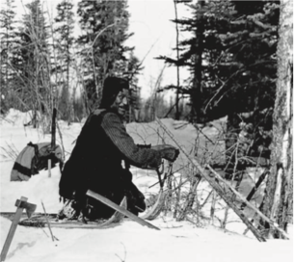
Chapter 4 Impacts of the Fur Trade
The Fur Trade brought significant changes to FN people.
Men would spend longer times trapping/hunting, to supply the fur trade.
Women spent longer preparing skins/furs.
Each unable to spend time on their traditional ways of life, became dependent on European trade goods.
FN began to be displaced/move as Furs decreased in their Territory.
These new supplies altered FN interactions with each other and Europeans.
Notes:
Sea Otter picture from 1777-1780 in Captain Cooke’s Journal.

Slide 54
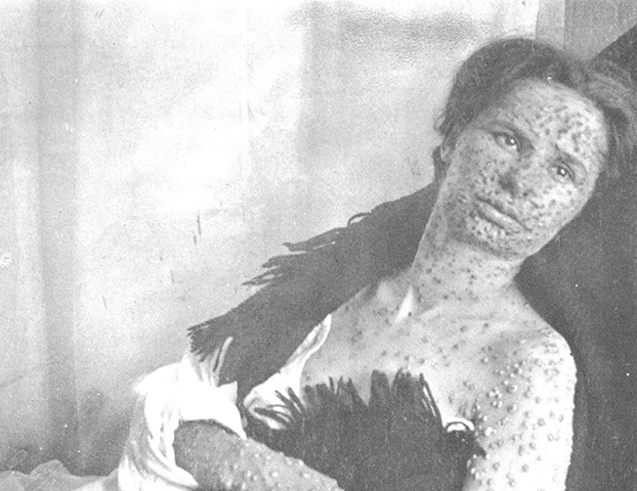
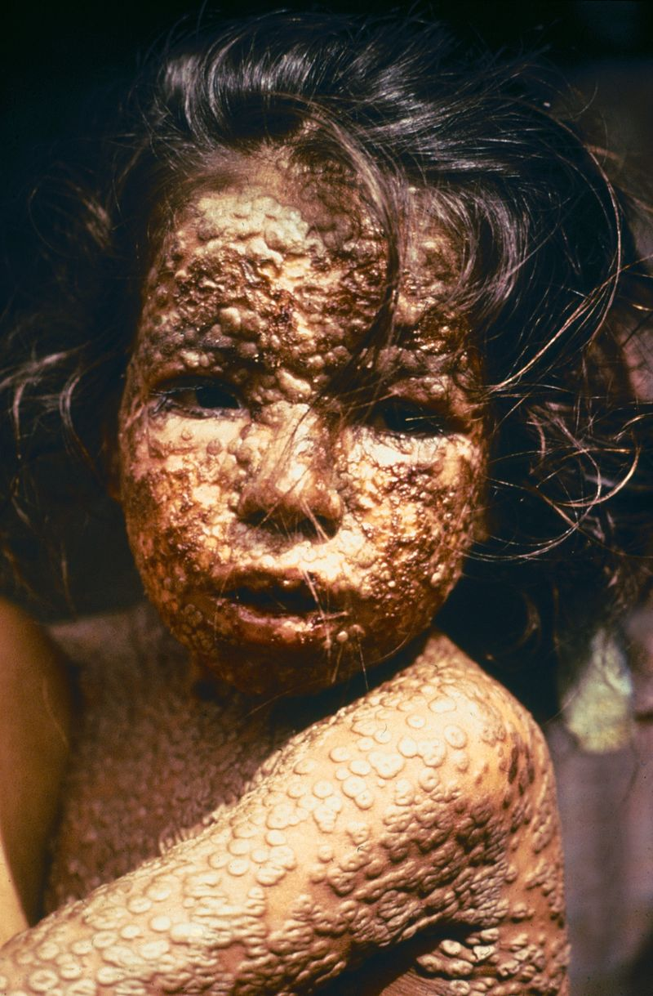
Chapter 4 Devastation by Disease
Notes:
Sea Otter picture from 1777-1780 in Captain Cooke’s Journal.

Slide 55
Chapter 4 Devastation by Disease
Prior to First Contact, FN population was estimated at 200,000 – 400,000.
By 1900, only 25,000 FN living in B.C. = 90-95% death rate.
1st Epidemic (1770) = Smallpox → Haida/Tshimshian People.
2nd Epidemic (1782) = Smallpox → Sto:lo
3rd Epidemic (1840-2) = Measles → All of BC
4th Epidemic (1862) = Smallpox → Killed 70% of FN people in the province.
These epidemics introduced by Europeans/Americans, left a costly mark on FN people in BC
Notes:
Sea Otter picture from 1777-1780 in Captain Cooke’s Journal.

Slide 56
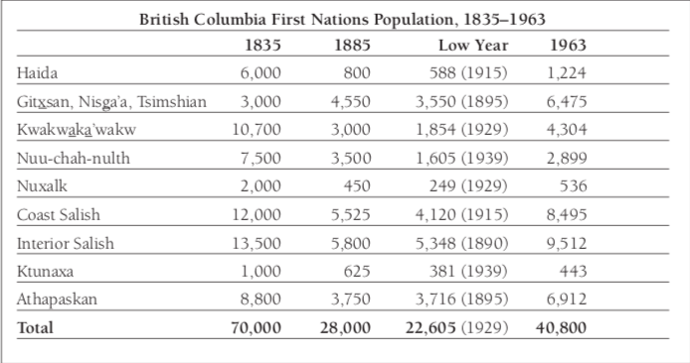
Chapter 4 Devastation by Disease
Notes:
Sea Otter picture from 1777-1780 in Captain Cooke’s Journal.

Slide 57
Chapter 4 – Assignment #1 Comparing World Views
Using Blackline Master 4-2, compare the two texts which describe the initial meeting between the Nuu-chah-nulth and Captain Cook’s crew.
Find examples of how each culture incorporated the other into their world view.
What previous knowledge does each use to interpret what he sees and hears?
You may consult images of Maquinna and Cook on-line at
www.bcarchives.gov.bc.ca/exhibits/timemach/galler07/frames/index.htm.

Slide 58
Chapter 4 – Assignment #2 Comparing World Views
Using Blackline Master 4-5, Compare and contrast the Maritime fur trade with the Land Based fur trade. Record information from pages 68-71 into the Fur Trade Venn Diagram worksheet.
Only write down IMPORTANT information!

Slide 59
Chapter 4 – Assignment #3 Four Transforming Factors
This assignment looks at various impacts that the fur trade had on First Nation society. Using pages 75-78 in the textbook, fill out the worksheet for Blackline Master 4-8.

Slide 60
Outline
CNN 10
The Colonial Era
The Founding of Canada
The Royal Proclamation of 1763

Slide 61
Review
Why were FN women vital to the fur trade?
What was the name of the Court Case that determined FN marriage rights?
What impact did smallpox have on FN communities in BC? Which area of BC was affected more severely?

