Slide 1
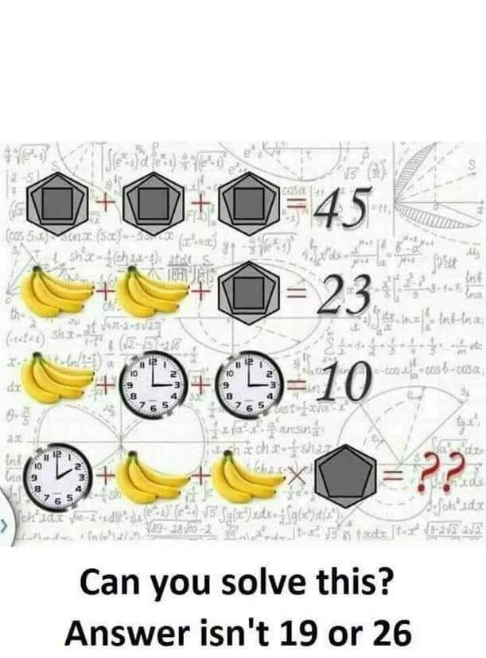
Silent Reading

Slide 2

The Five Paragraph Essay

Slide 3
Why should I learn this essay structure?
Can be used for both informative and persuasive writing.
Speeds up the writing process because of its formulaic nature.
Can be used for structure of a research-based essay when expanded.

Slide 4
What IS the Five Paragraph Essay?
An introduction
The first body paragraph
The second body paragraph
The third body paragraph
A conclusion

Slide 5
PART ONE:
The Five Paragraph Essay
Introduction

Slide 6
THE INTRODUCTION
Consists of:
The Hook
General topic sentences (2 or 3) which are more specific than the hook
A thesis statement including three supporting ideas, all written in parallel structure

Slide 7
First….
THE HOOK

Slide 8
THE INTRODUCTION important definitions
Hook: An opening sentence or two that grabs the reader’s interest and introduces the general topic of the essay
Examples:
Historical information
An anecdote
A surprising statement
A declarative statement
A quote

Slide 9
THE INTRODUCTION the hook
HISTORICAL INFORMATION: Some topics are better understood if a brief historical review of the topic is presented to lead into the discussion of the moment:
Make sure it’s factual
Keep it brief

Slide 10
Example of hook with Historical Information:
If I wanted to write an informative essay on cool skateboarding tricks:
In the spring of 1975, skateboarding took an evolutionary boost toward the sport that we see today. In Del Mar, California a slalom and freestyle contest was held at the Ocean Festival. That day, the Zephyr team showed the world what skateboarding could be. They rode their boards like no one had in the public eye, low and smooth, and skateboarding was taken from being a hobby to a serious, exciting sport.
TAKEN FROM: http://skateboard.about.com/cs/boardscience/a/brief_history.htm

Slide 11
THE INTRODUCTION the hook
ANECDOTE: An interesting little story
Include sights, sounds, smells and other sensory images
Keep it brief

Slide 12
Example of hook with Anecdote:
If I wanted to write an informative article on how students should have the right to choose their own clothing.
My older brother got jumped by gang members one day while walking home from the bus stop. He was hospitalized for a week due to his injuries. The reason: he was wearing a red shirt as part of his school uniform in an area that is controlled by a gang that wears blue. My brother knew this, but school officials didn’t. If my brother has been granted the simple freedom to choose his own clothes, it would’ve saved him a lot of pain and suffering.

Slide 13
THE INTRODUCTION the hook
A SUPRISING STATEMENT: There are many ways a statement can surprise a reader. Sometimes the statement is surprising because it is disgusting. Sometimes it is joyful. Sometimes it is shocking. Sometimes it is surprising because of who said it.
Take care to explain how the statement relates to your topic
Description is great, over- exaggeration is not
Make sure that the statement is relevant, not just shocking

Slide 14
Example of hook with a Surprising Statement:
If I wanted to inform you about purchasing the best running shoe I might use this:
Have a minute? Good. Because that may be all it takes to outrun a bear — any bear. Bears kill approximately 3 people each year and for every death by bear, 30 people are injured by bear encounters. Yet such deaths and injuries can be avoided by having the right type of running shoe – especially these Nike Flex. When wearing the Nike Flex, 3 out of 4 people have been able to outrun the bear; and the 4th person was able to give the bear his Nike Flex shoes in exchange for his life – that’s how stylish they are, even the bears want to be able to run faster in them.

Slide 15
THE INTRODUCTION the hook
A DECLARITIVE STATEMENT: In this pattern, the writer simply states straight out what the topic of his paper is going to be about. It is the technique that most student writers use with only modest success most of the time, but good professional writers use it too.
Don’t give too much information
Don’t write, “In this essay…”
Don’t write, “I’m going to tell you about…”

Slide 16
Example of hook with Declarative Statement:
If I wanted to explain why people should consider attending a free concert in a public park:
If you attend a concert in a city park, chances are you’re less interested in the performance than in the whole package, in which the music, the weather, the general gregariousness and the spirit of the moment become inseparable.

Slide 17
THE INTRODUCTION the hook
A QUOTE: When a writer uses the words of another to help illustrate a point
Your quote should be unusual, funny, or obscure
Don’t choose a long quote
Your quote should have a meaning you plan to reveal to the reader as the essay progresses
Remember to put opening and closing quotation marks around your quote
Include who said or wrote your quote

Slide 18
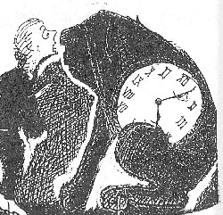
Example of hook with a Quote:
If I wanted to write an informative essay on how to recover from making a mistake:
"You must never feel badly about making mistakes," explained Reason quietly, "as long as you take the trouble to learn from them.” -Norton Juster, The Phantom Tollbooth

Slide 19
NEXT:
The
GENERAL TOPIC SENTENCES
after the hook

Slide 20
General Topic Sentences Why do we need them?
They keep the reader focused on the point of the essay
They serve as a transition between the hook and the thesis statement

Slide 21
Topic Sentences
A topic sentence is a statement that tells what your paragraph will be about.
Notes:
I took out some words

Slide 22
Topic Sentences
A good topic sentence does two important things.
Helps you stay focused on the main idea of your paragraph
Helps readers to know what your paragraph will be about
Notes:
I took out some words

Slide 23
Topic Sentences
A topic sentence should:
State the main idea,
Include or summarize reasons that support main idea, and
Make a claim about the main idea of the paragraph.
Notes:
I took out some words

Slide 24
Example of a Topic Sentence
Let’s read a topic sentence and see if we can identify the
Main idea (what you’re writing about)
Support (what you think about the topic)
A healthy diet includes fruits and vegetables.
Main idea
Support
What claim is being made?
For a diet to be healthy it must include fruits and vegetables.

Slide 25
Bubble Map to Topic Sentence
1. Ask yourself: “What am I writing about?”
The answer to this question will be your main idea.
2. Ask yourself: “What do I know about the main idea?”
The answer to this question will be your support.
3. Create a bubble map.
Main idea
Healthy diet
Fruits
Support
Vegetables

Slide 26
Writing a Topic Sentence
The pumpkin patch and hayride are two fun activities at Waimanalo Country Farms.
Things to do at Waimanalo
Country Farms
Pumpkin Patch
Hayride
The paragraph might be about…
activities at Waimanalo Country farms
the pumpkin patch and hayride
why Waimanalo Country Farms was fun.

Slide 27
Silent Reading <3

Slide 28
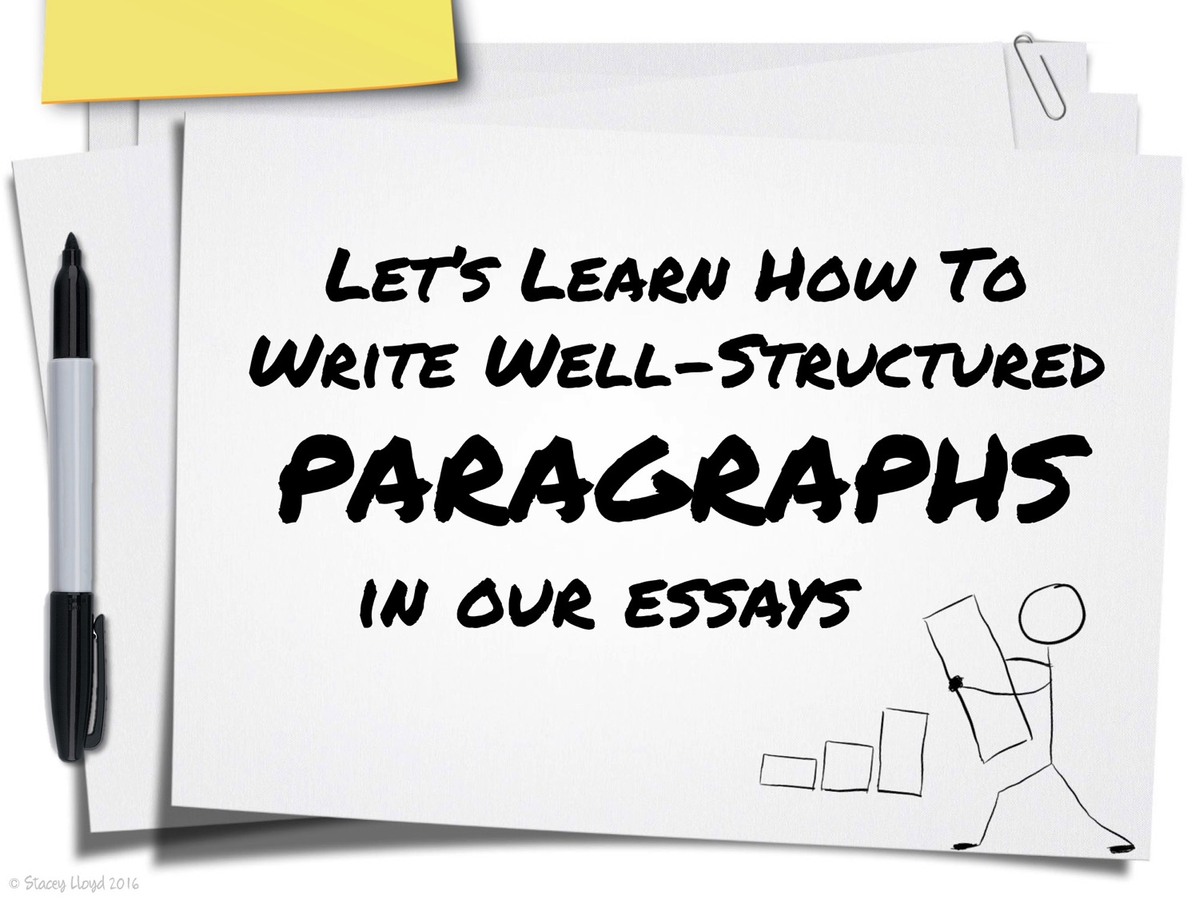

Slide 29
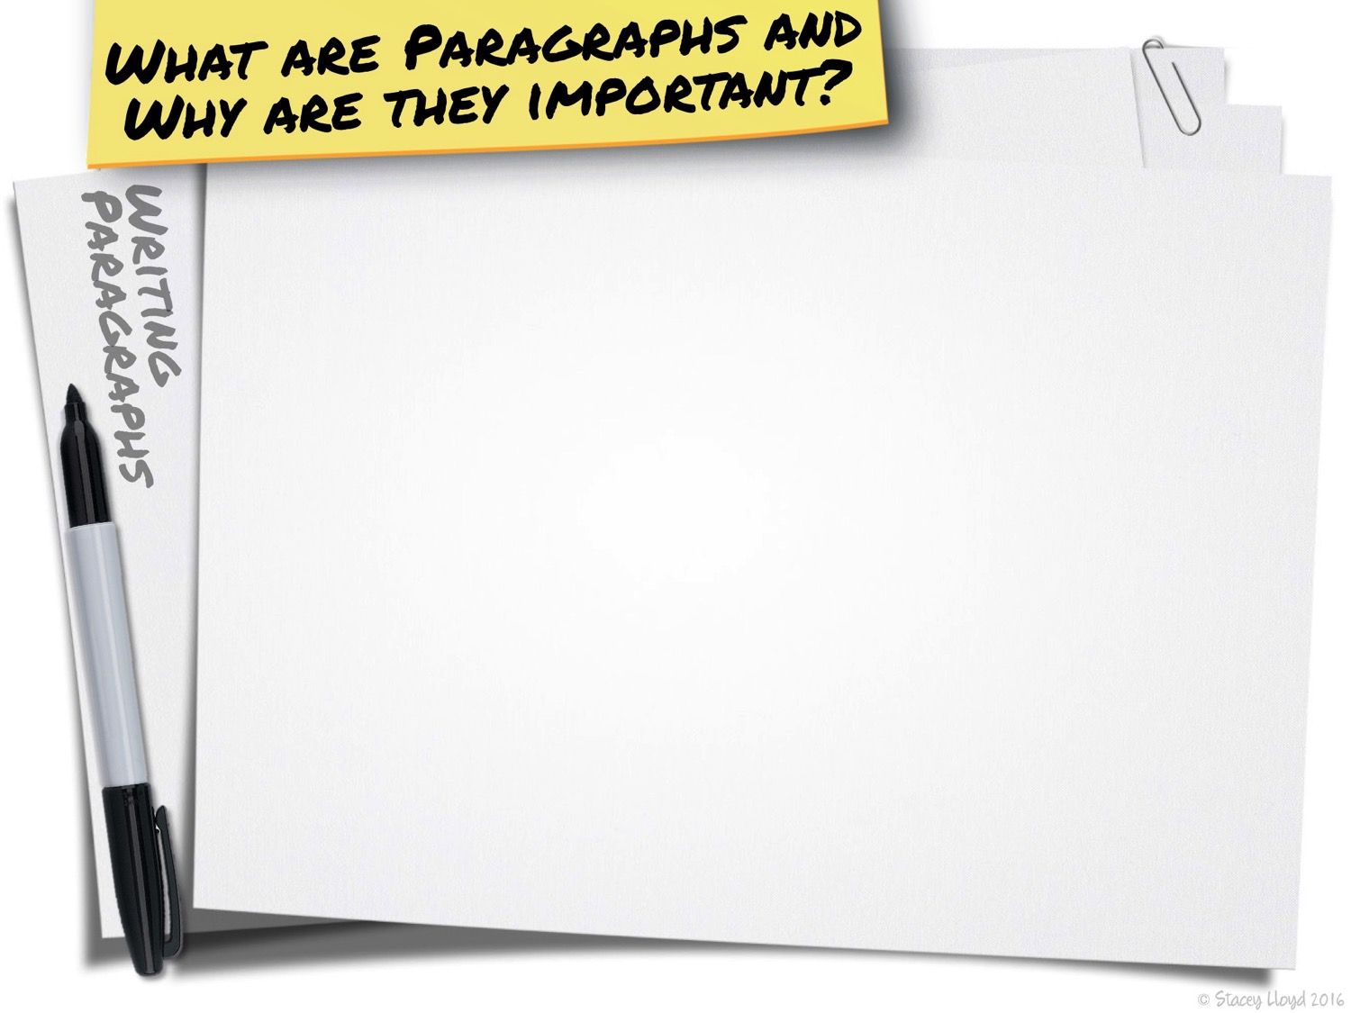

Slide 30
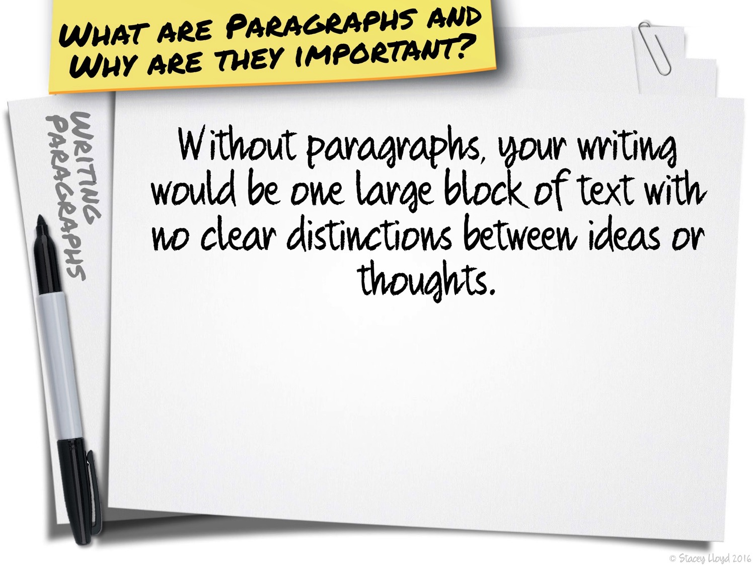

Slide 31
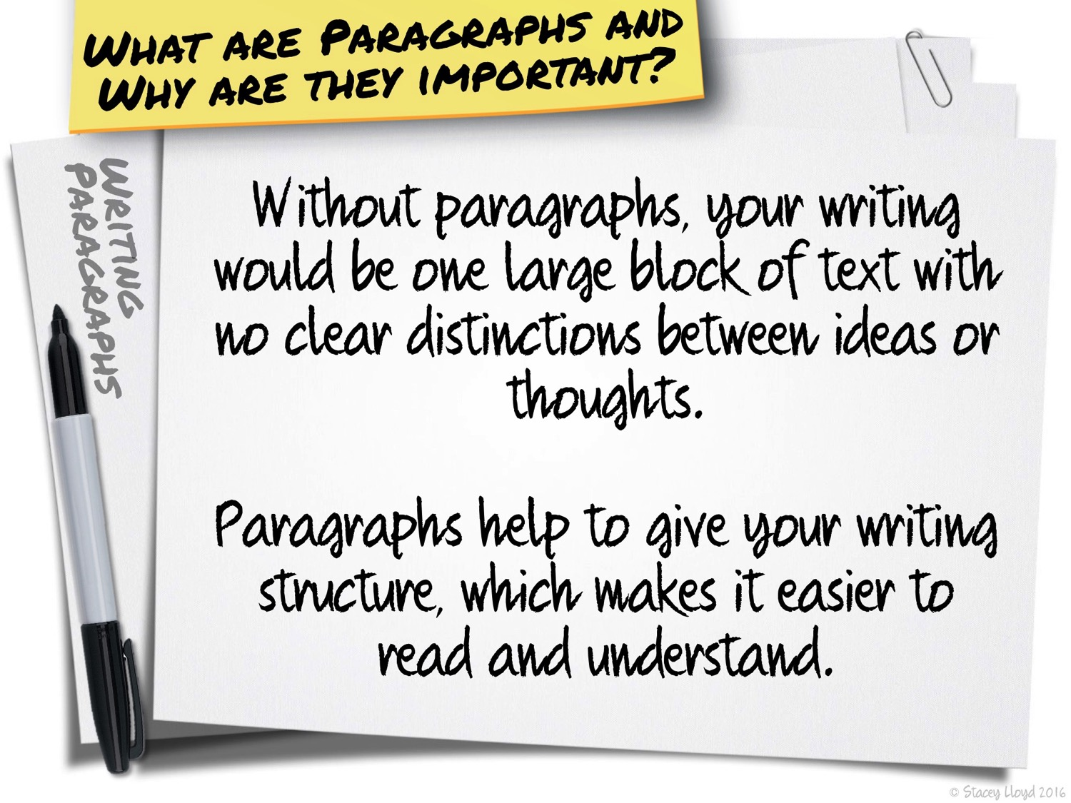

Slide 32


Slide 33
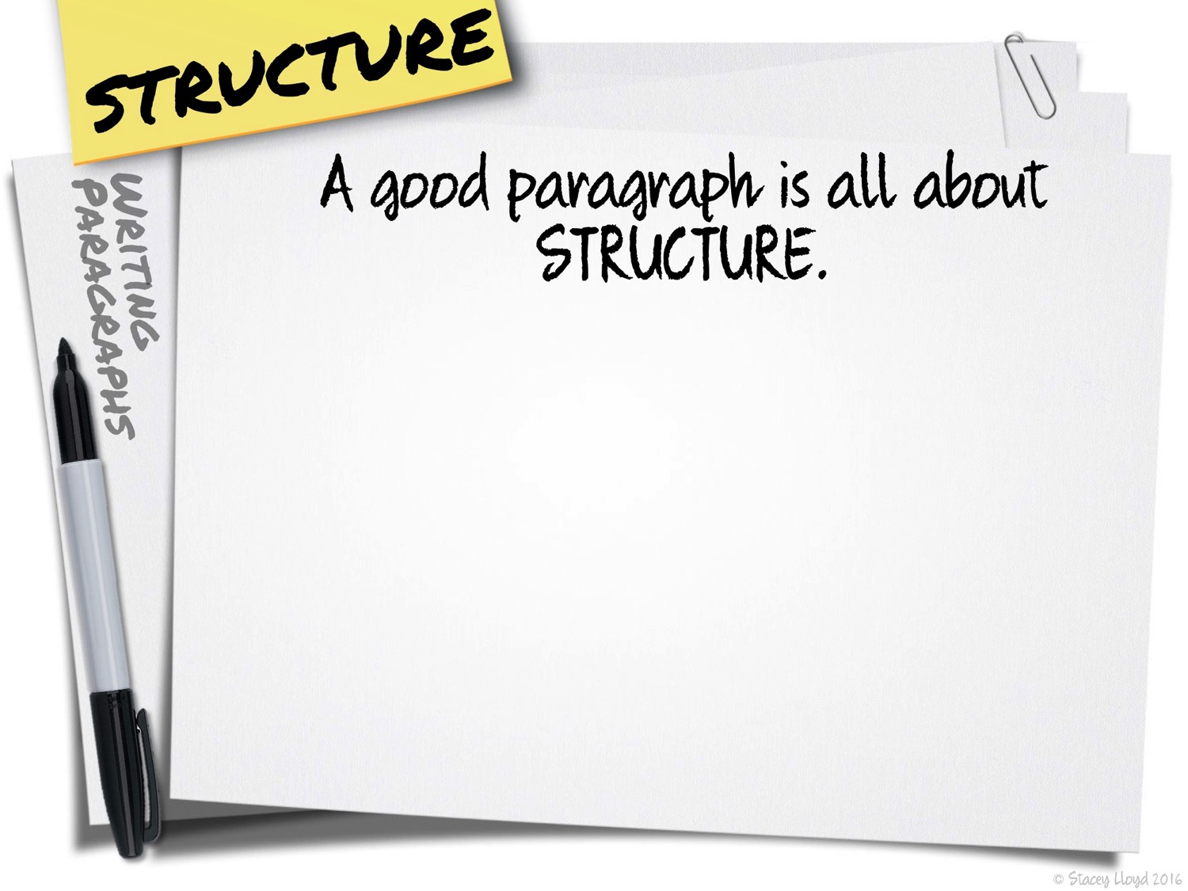

Slide 34
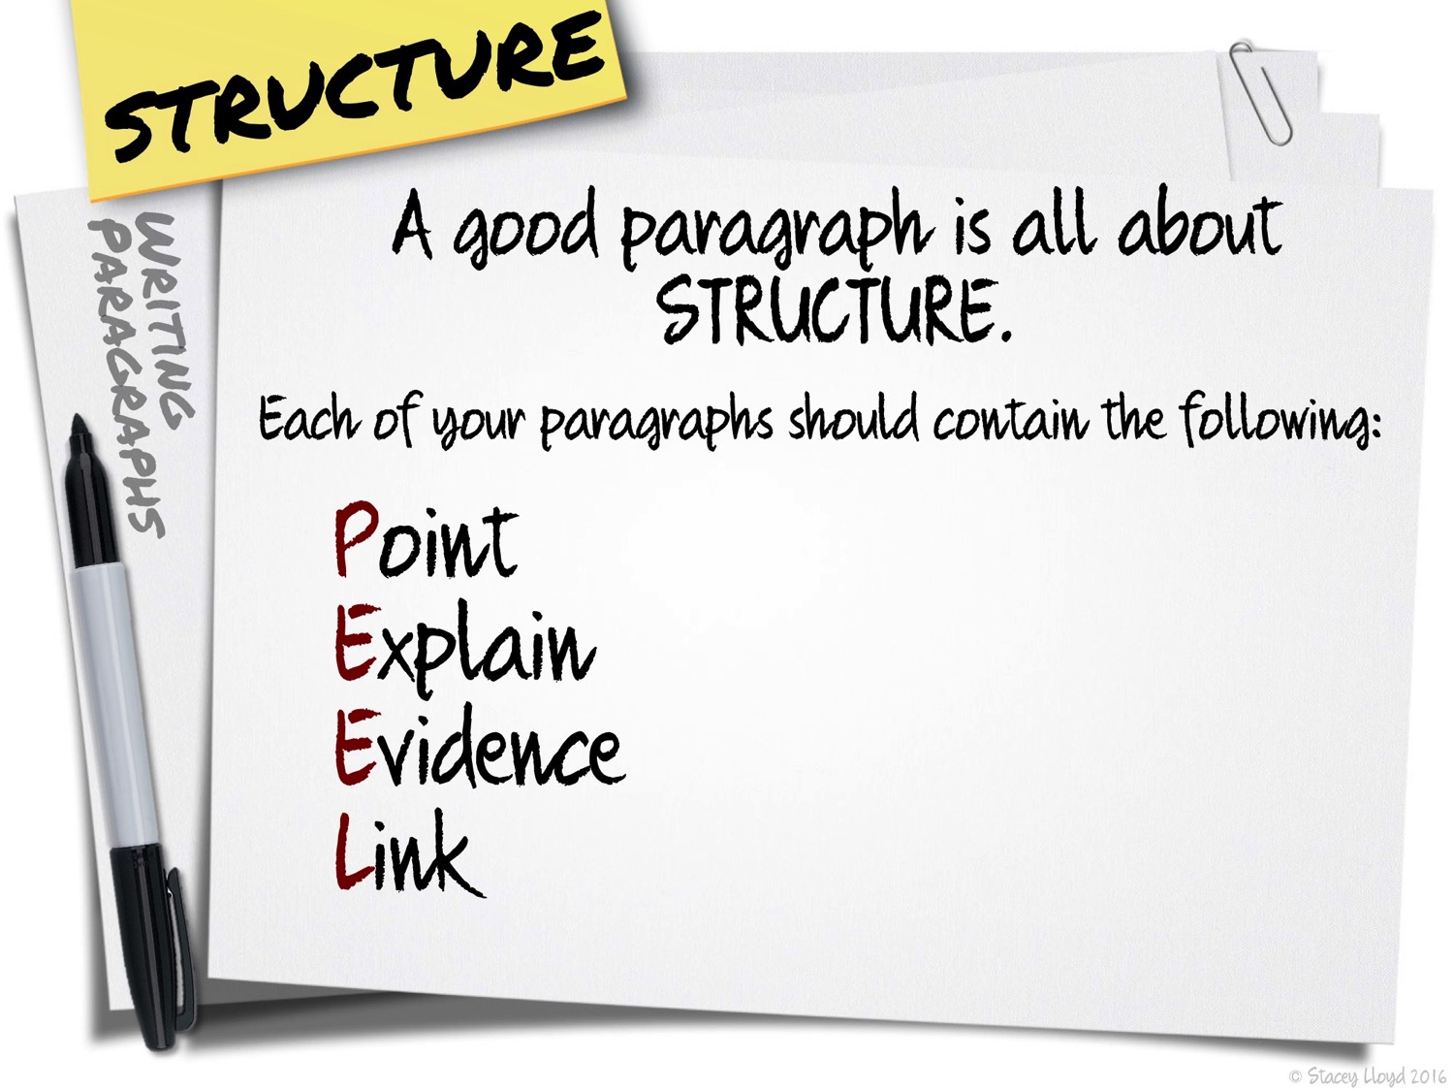

Slide 35
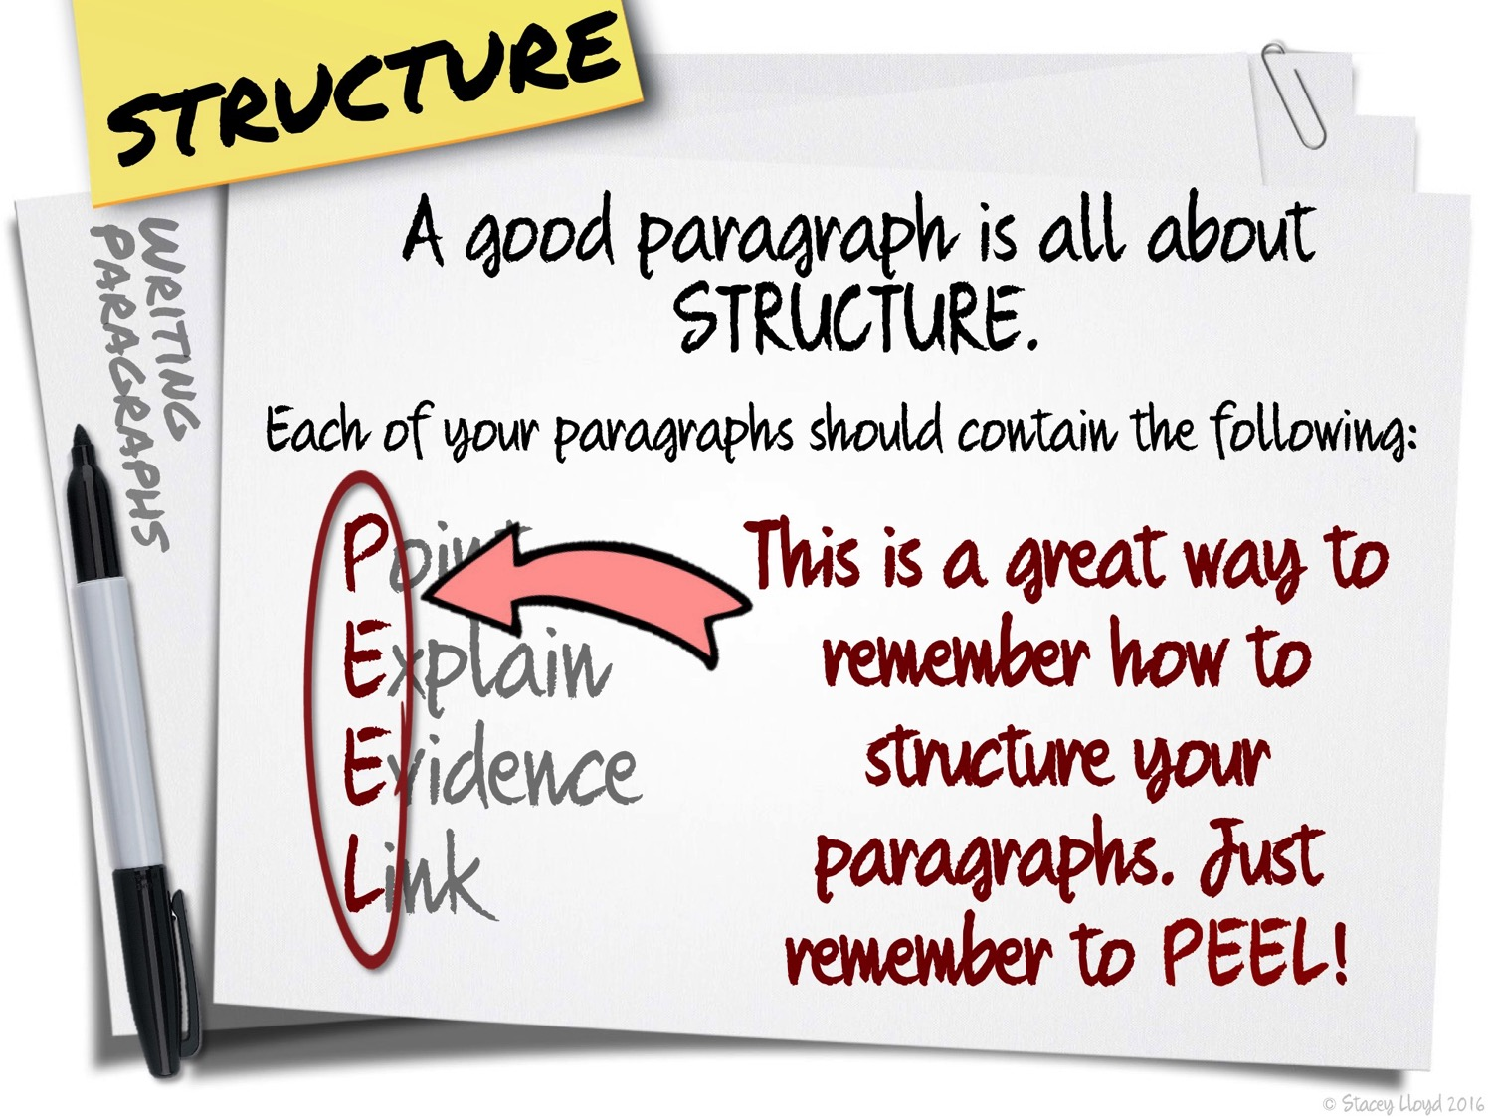

Slide 36


Slide 37
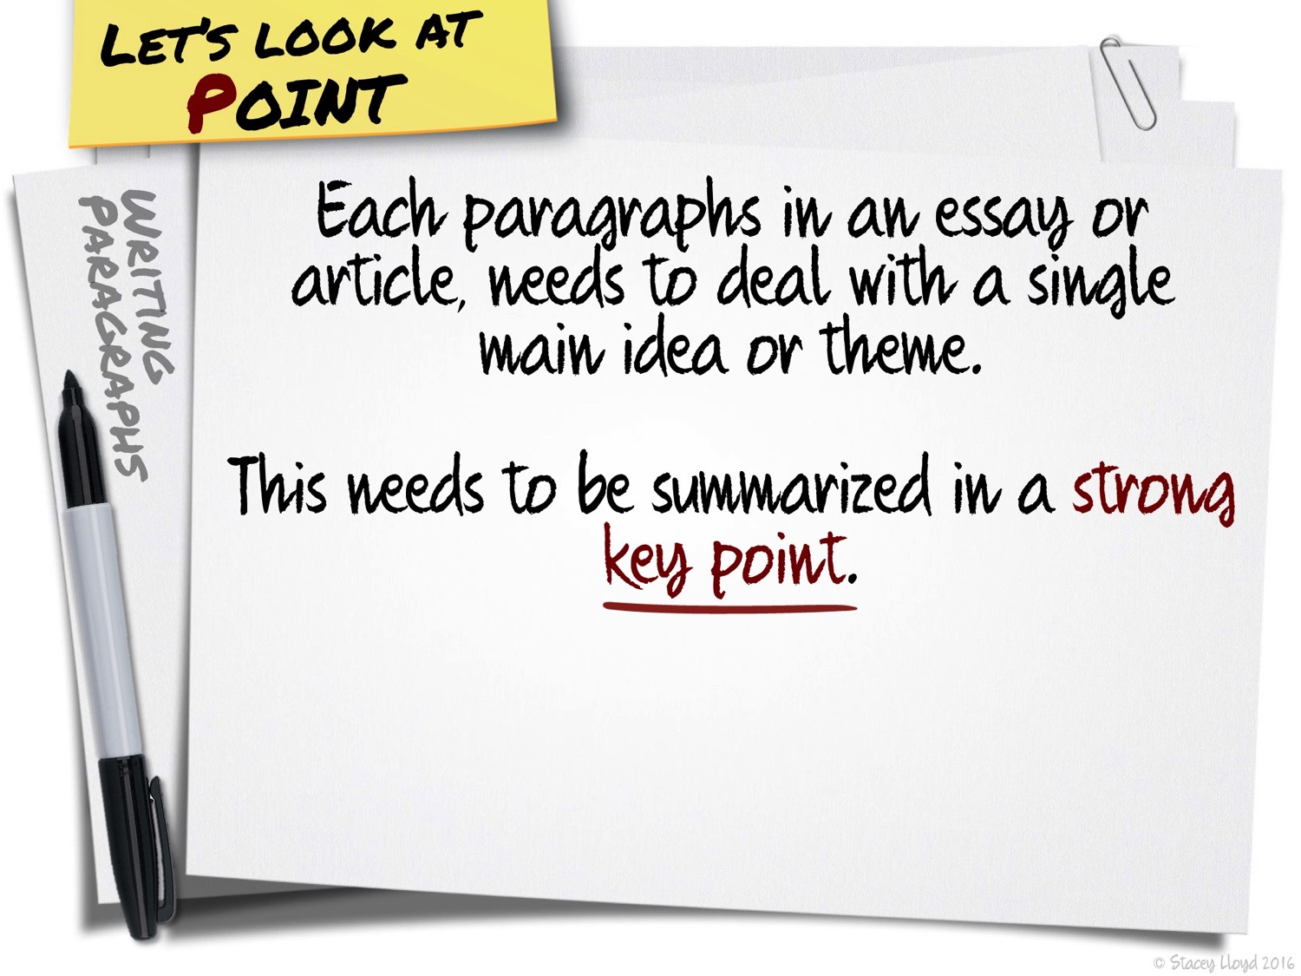

Slide 38
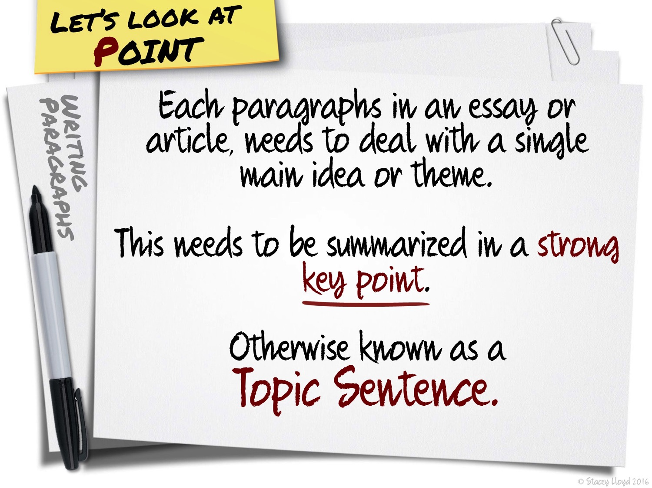

Slide 39
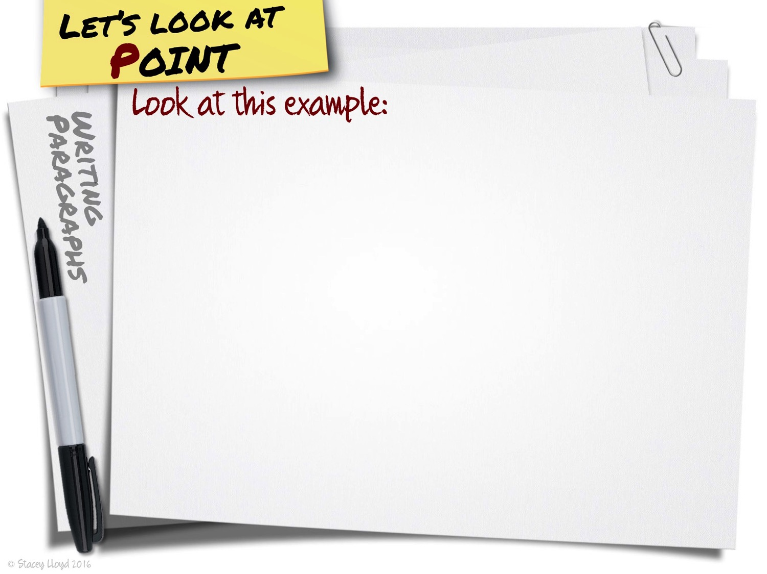

Slide 40
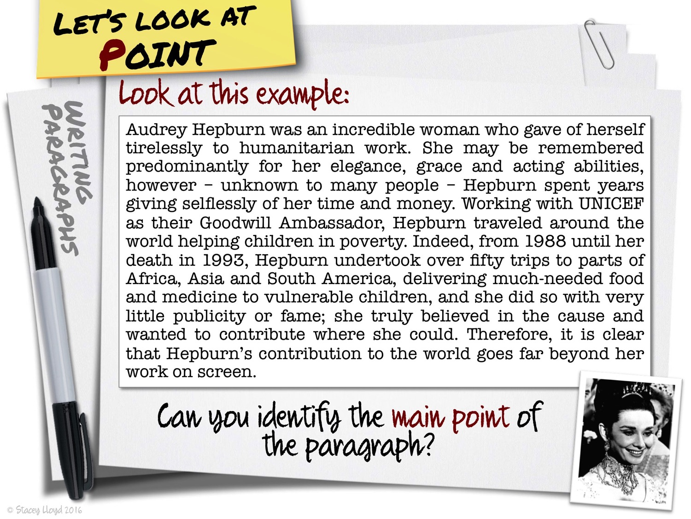

Slide 41
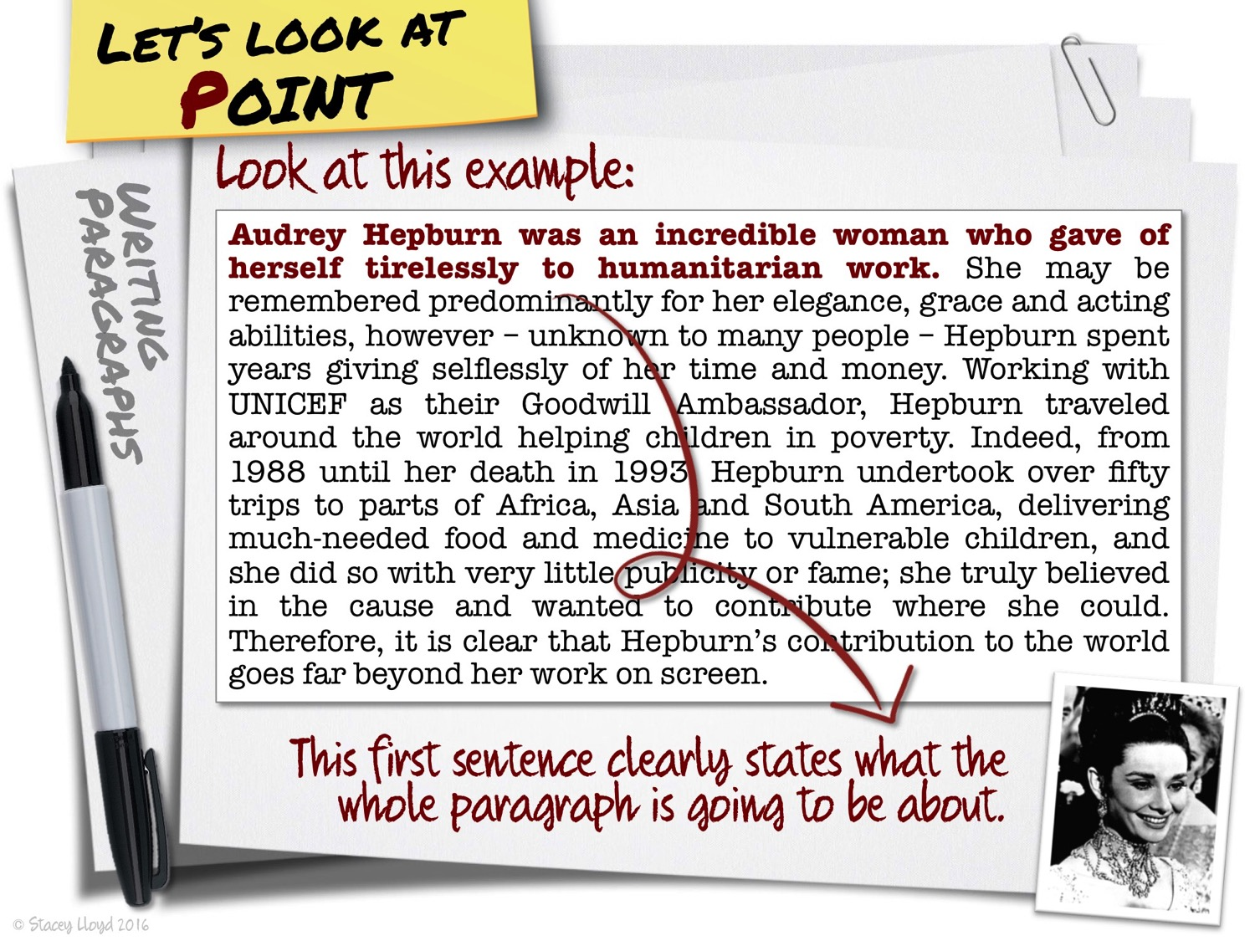

Slide 42
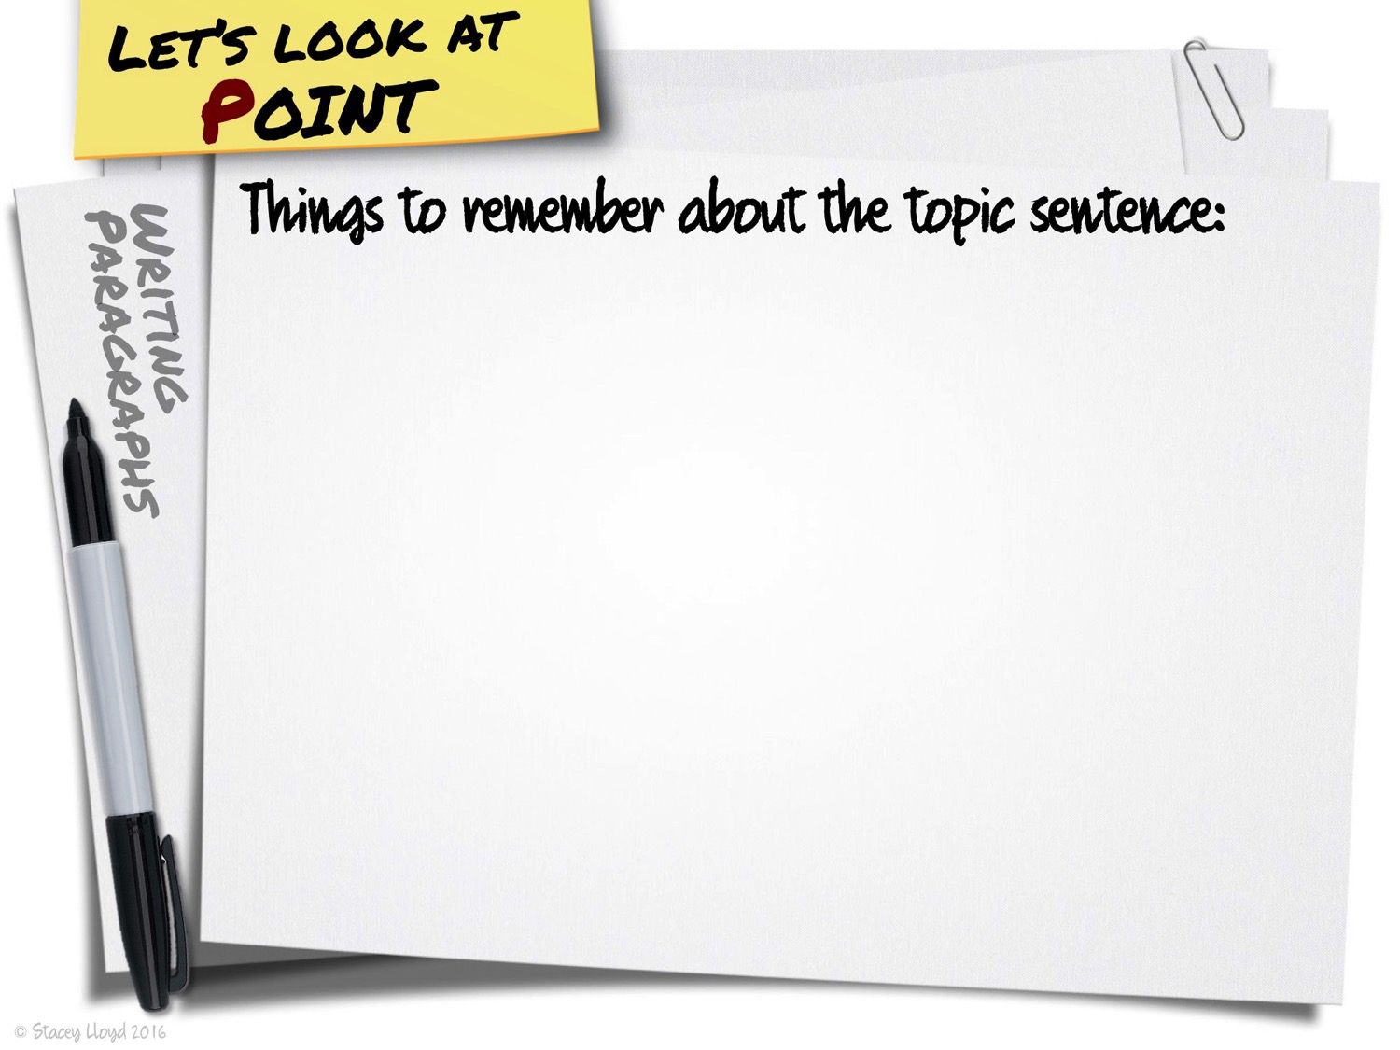

Slide 43
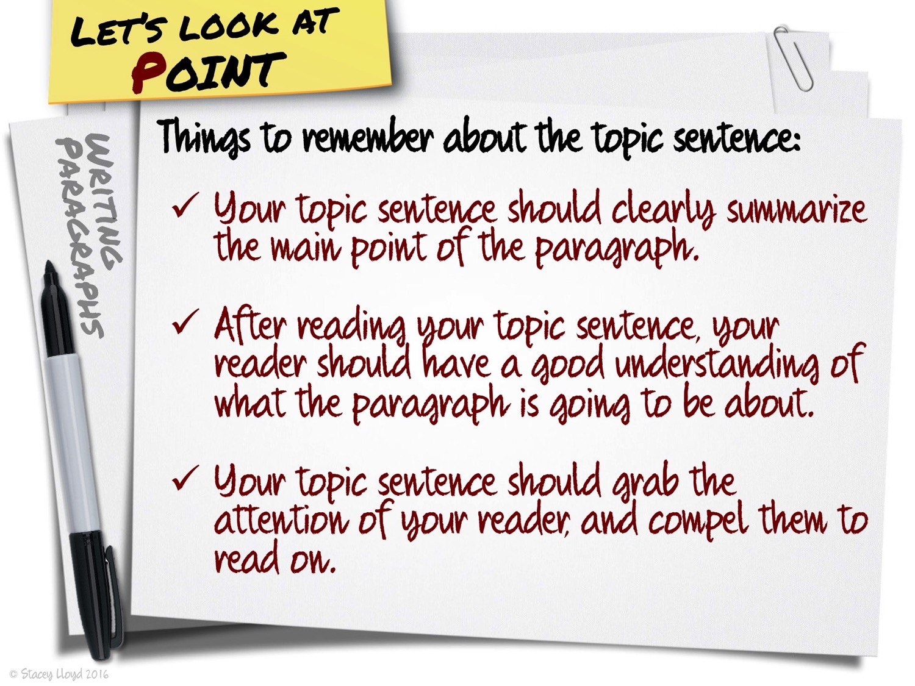

Slide 44


Slide 45
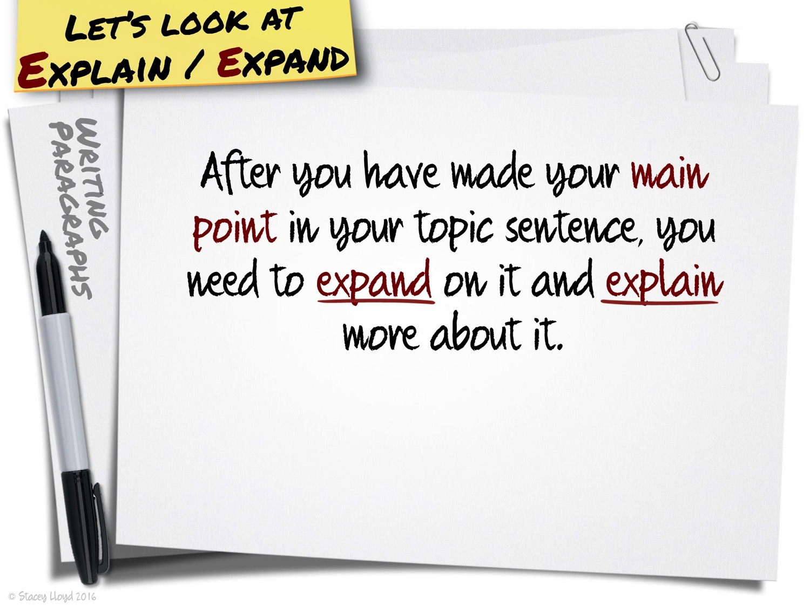

Slide 46
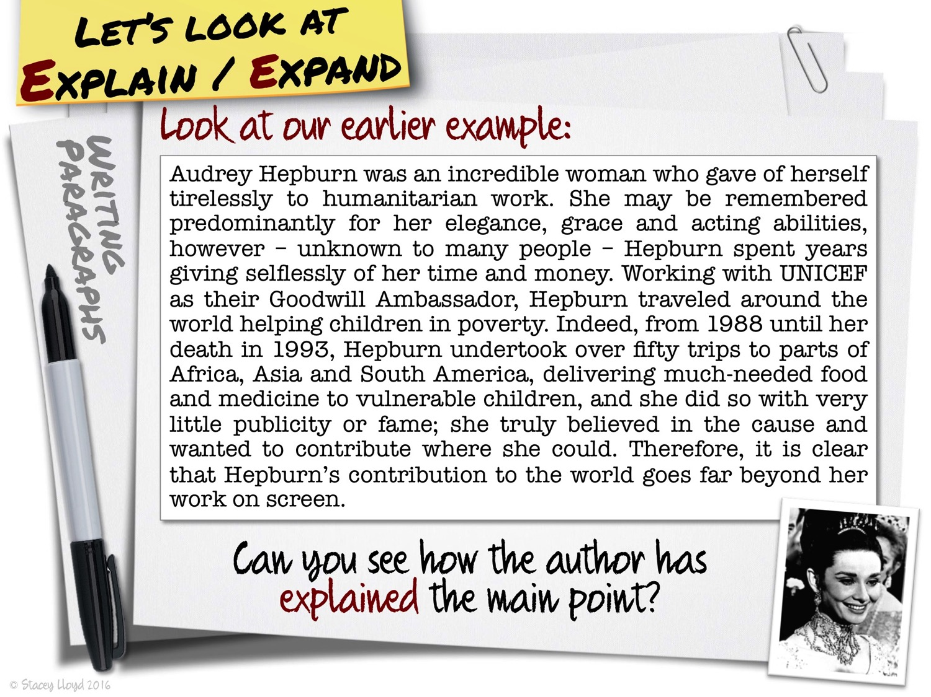

Slide 47
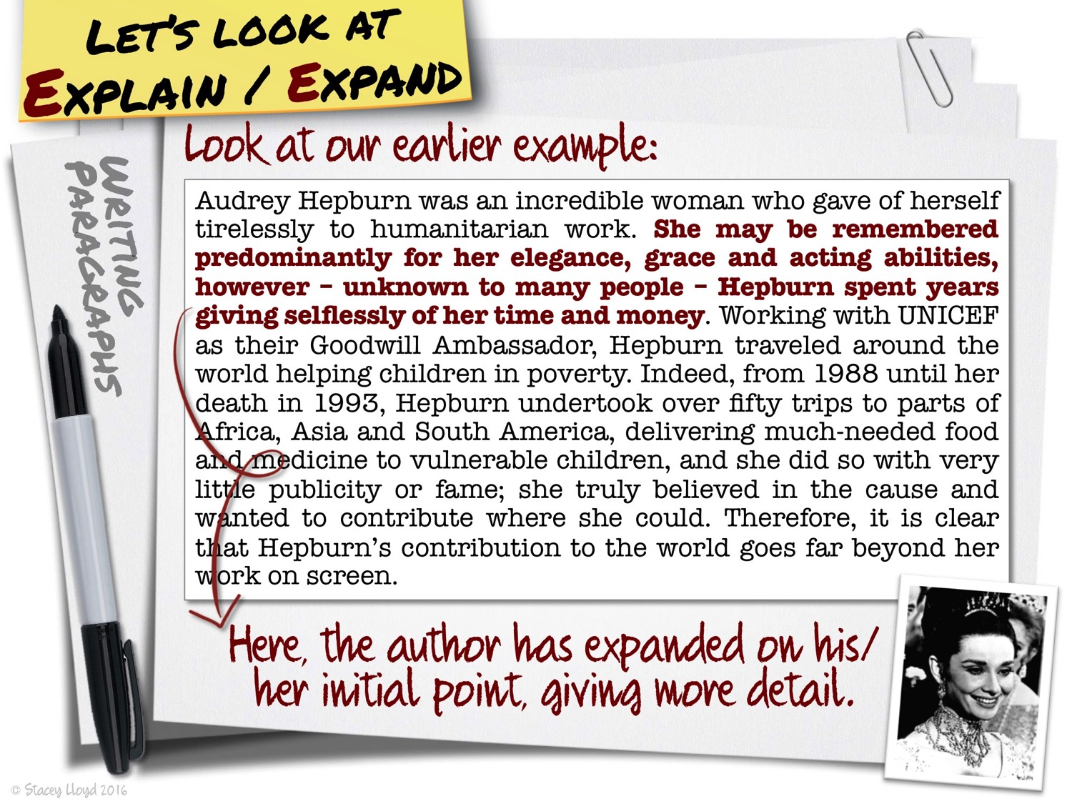

Slide 48
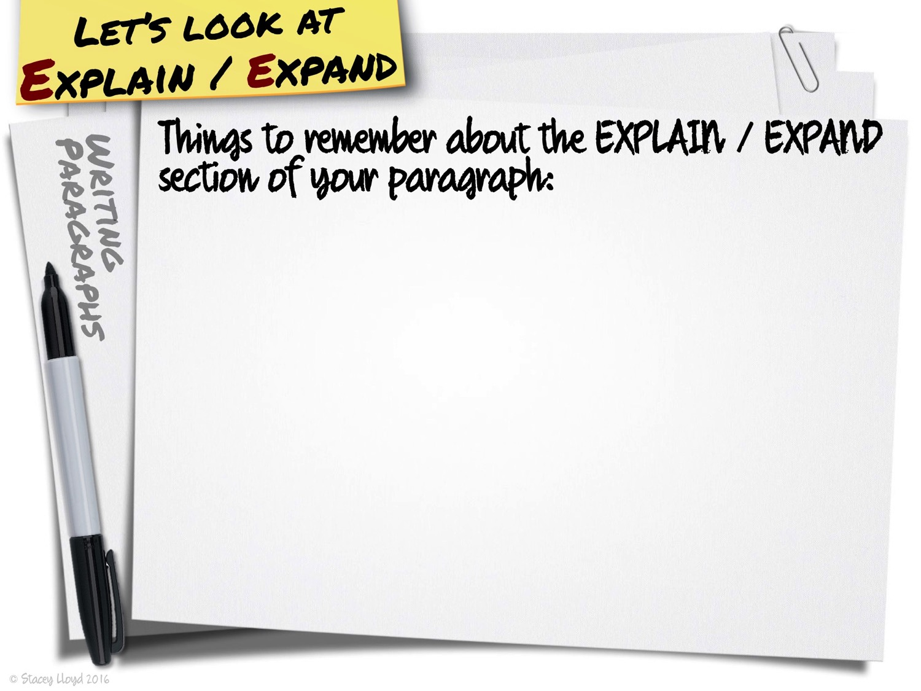

Slide 49
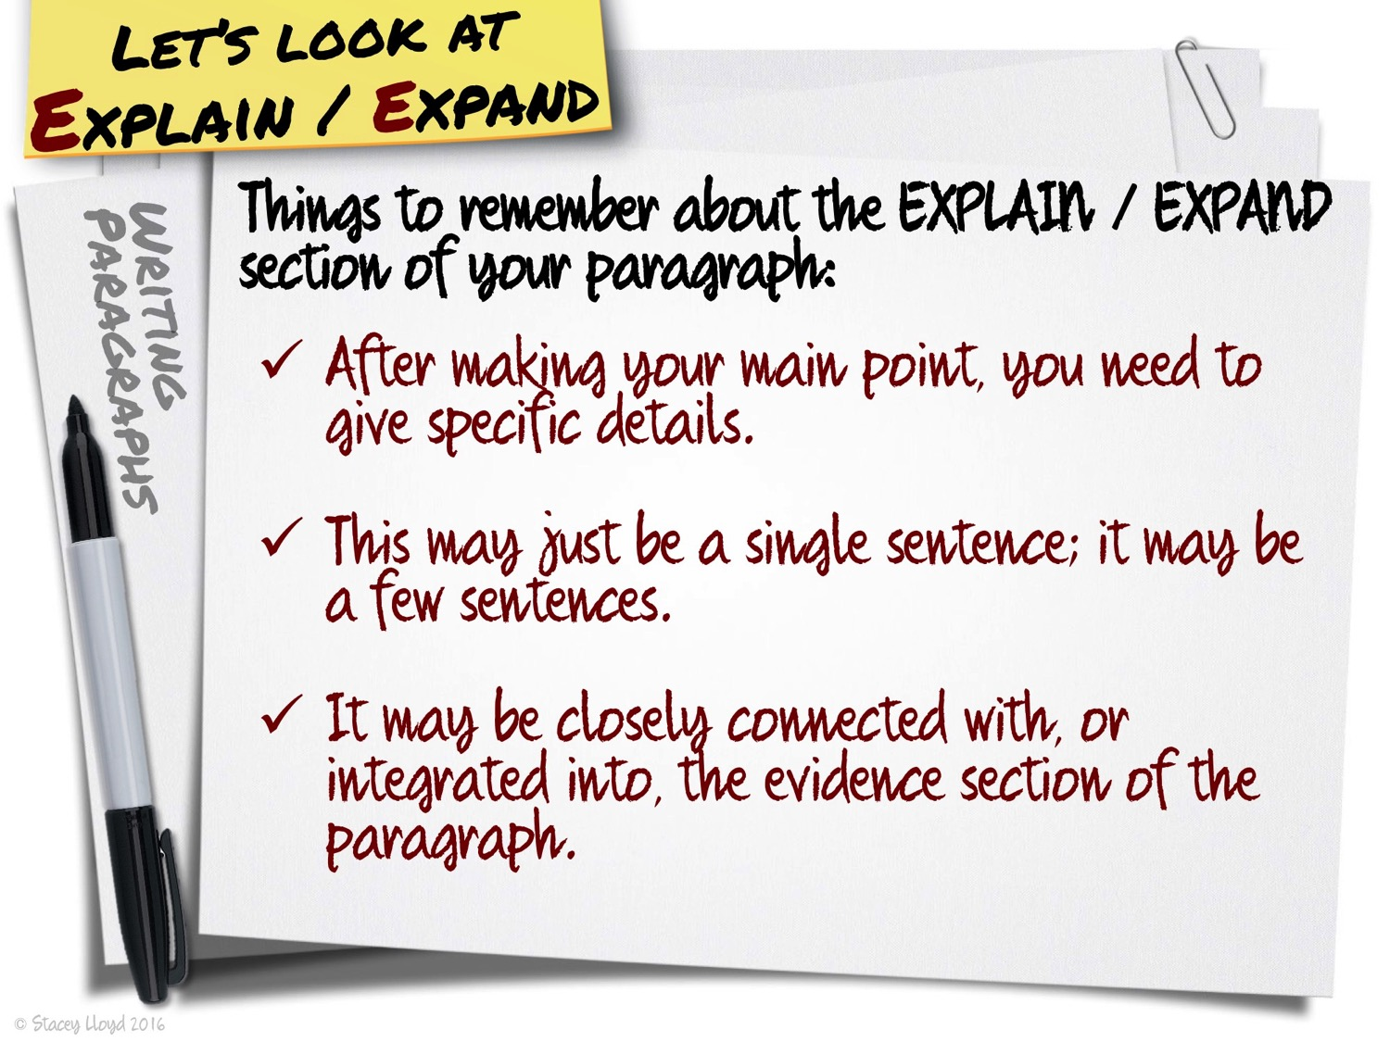

Slide 50


Slide 51
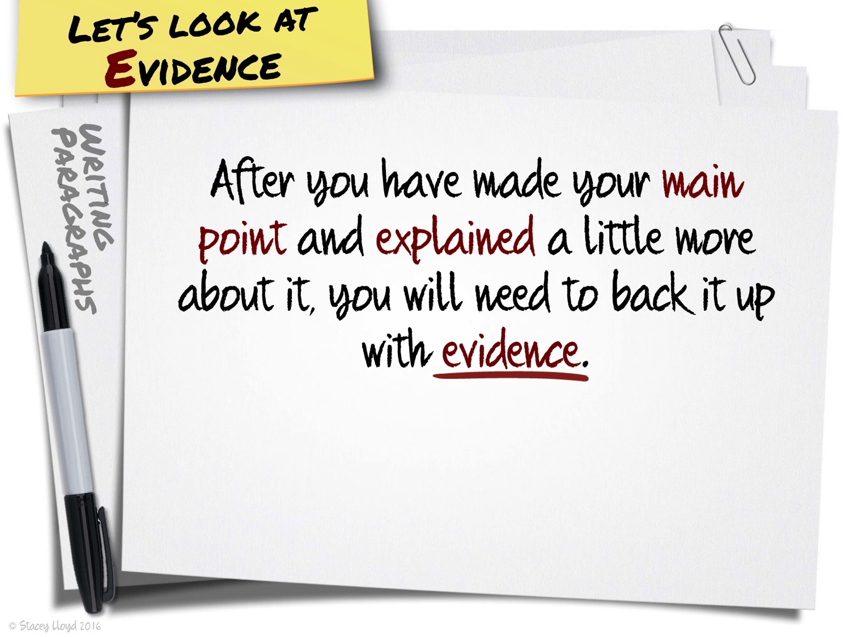

Slide 52
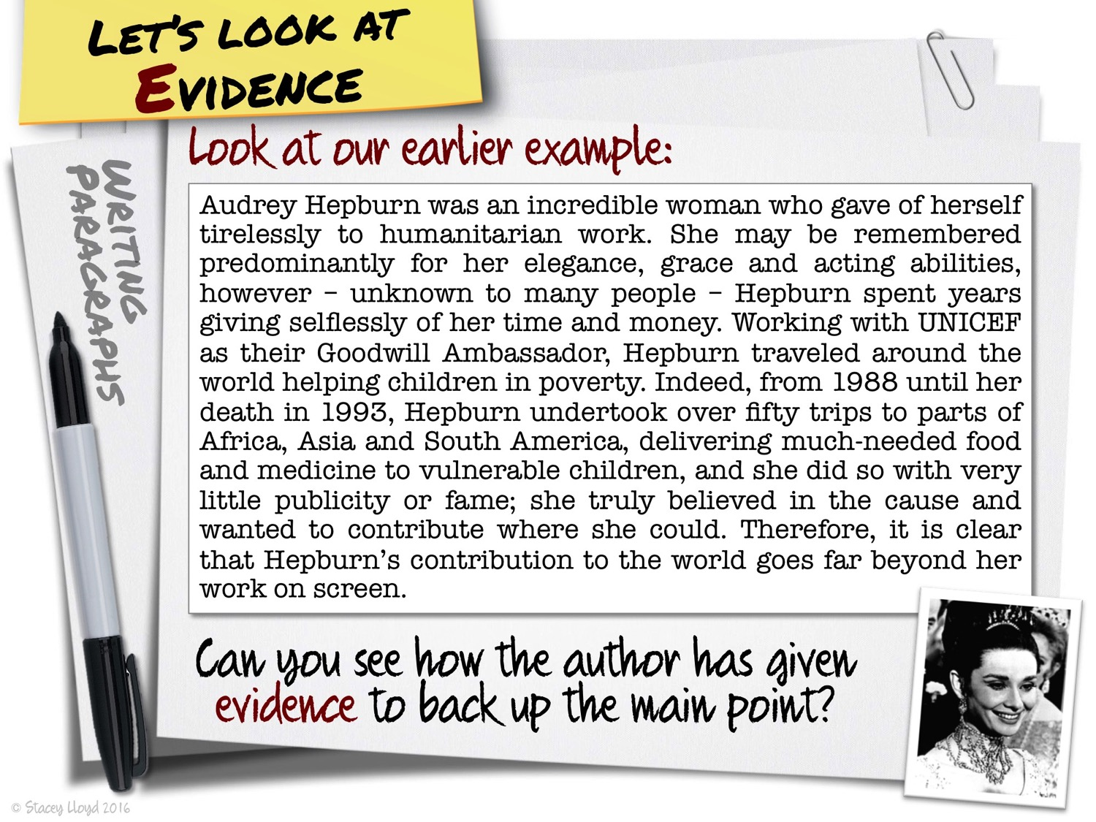

Slide 53
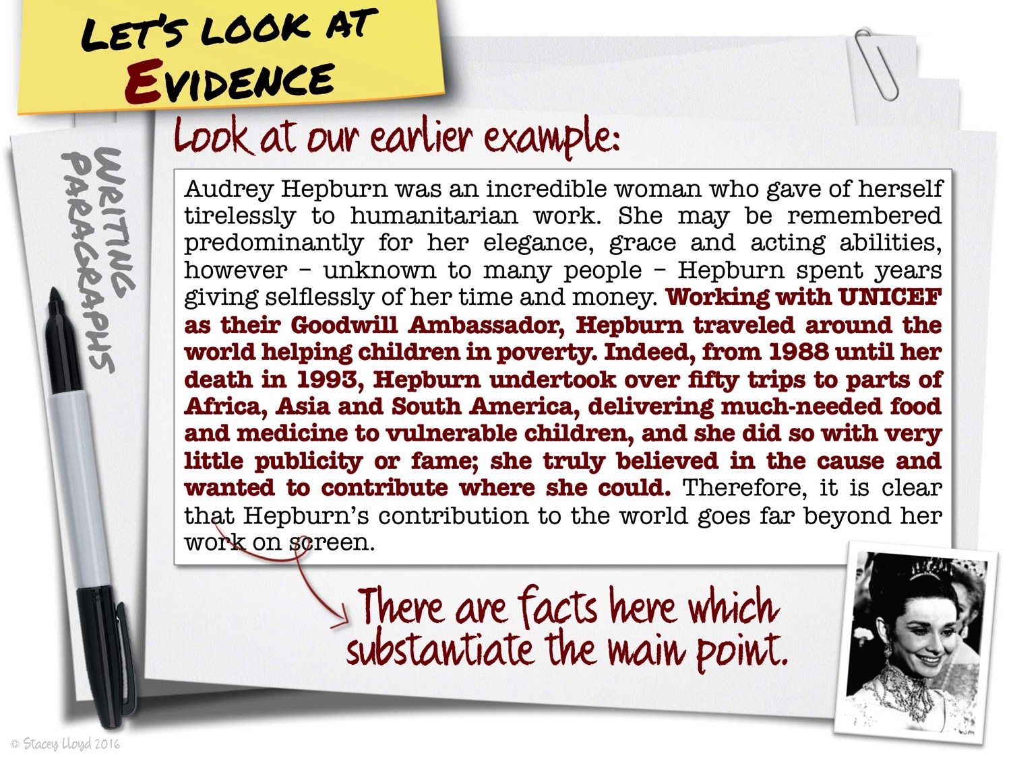

Slide 54
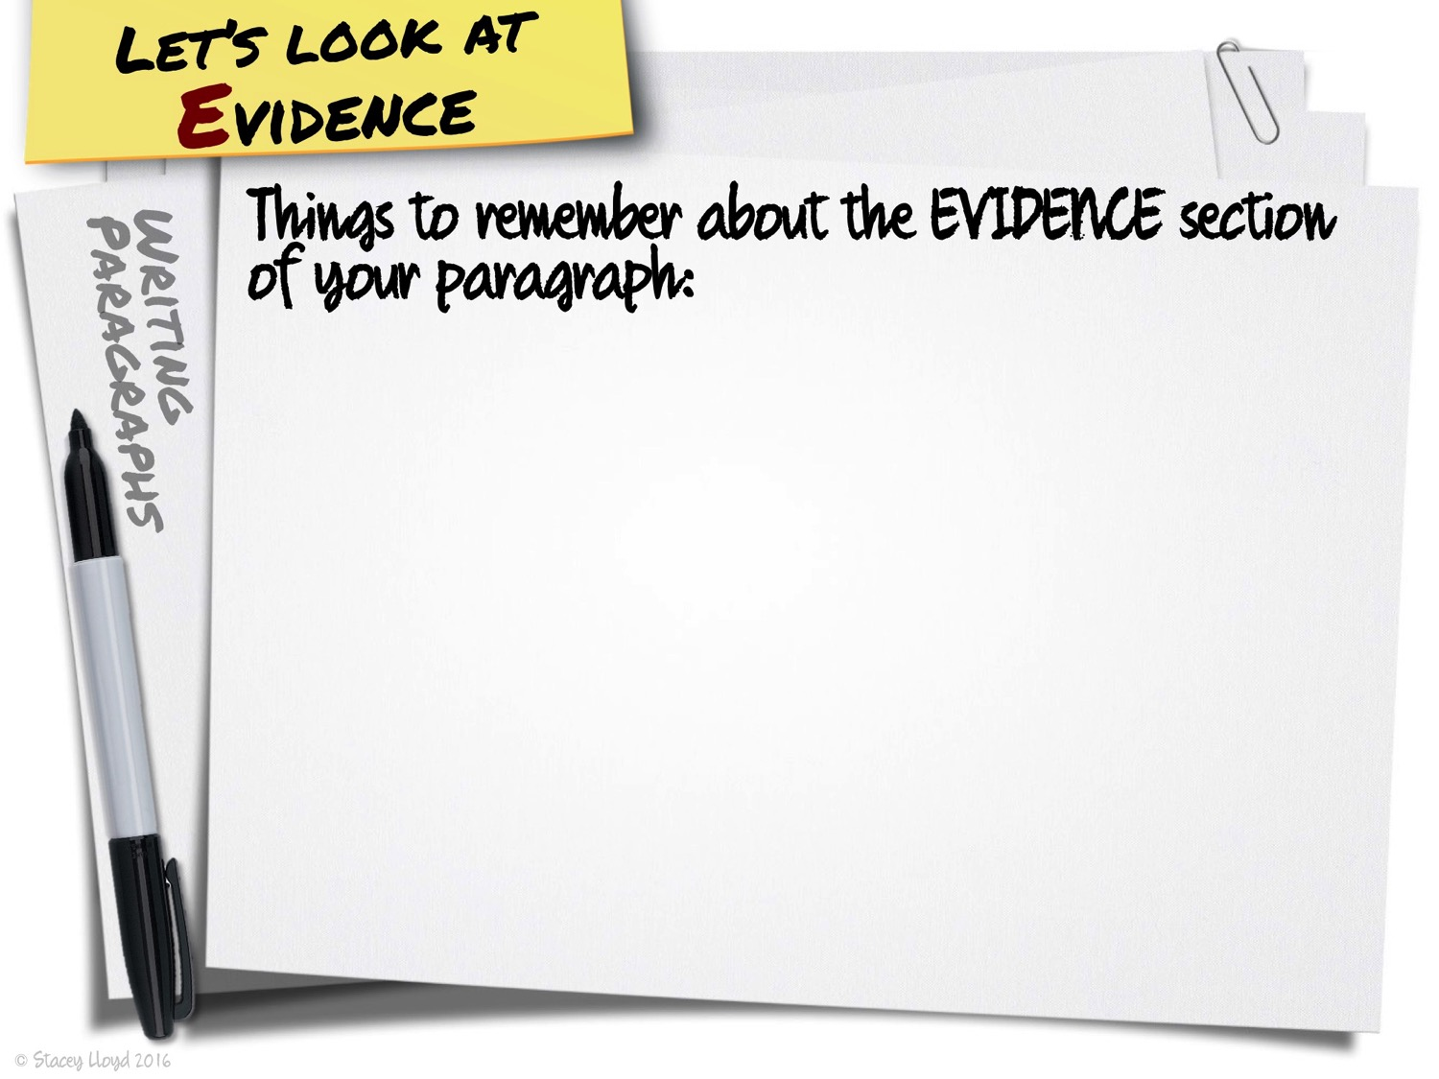

Slide 55
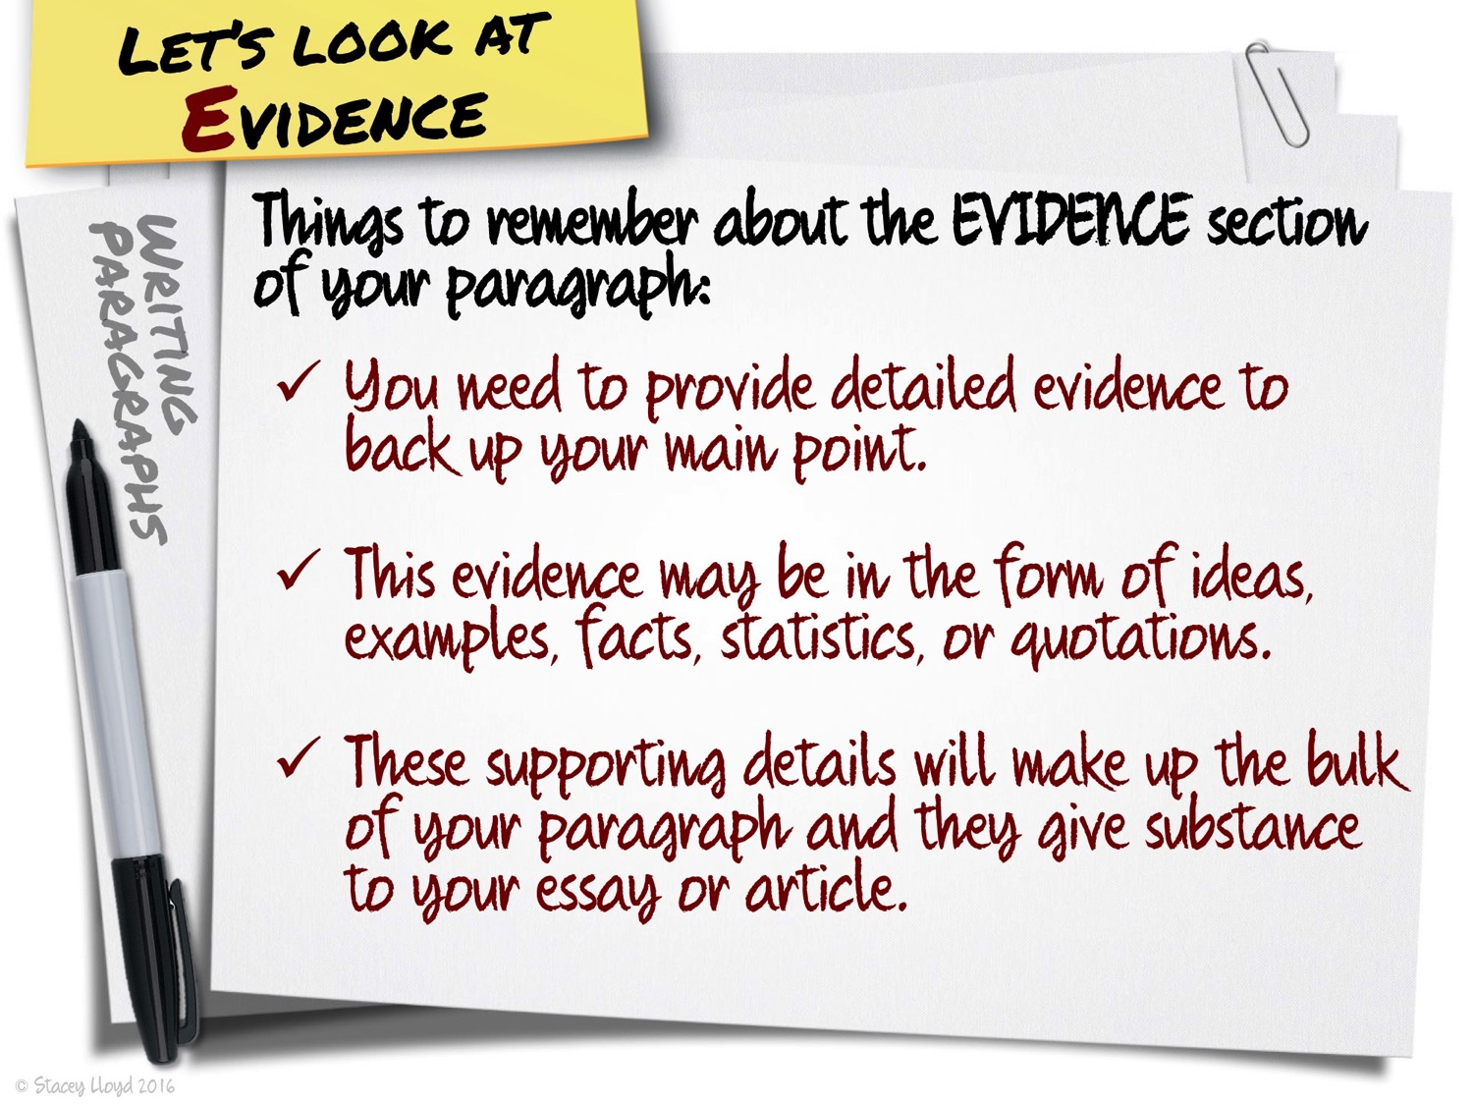

Slide 56


Slide 57
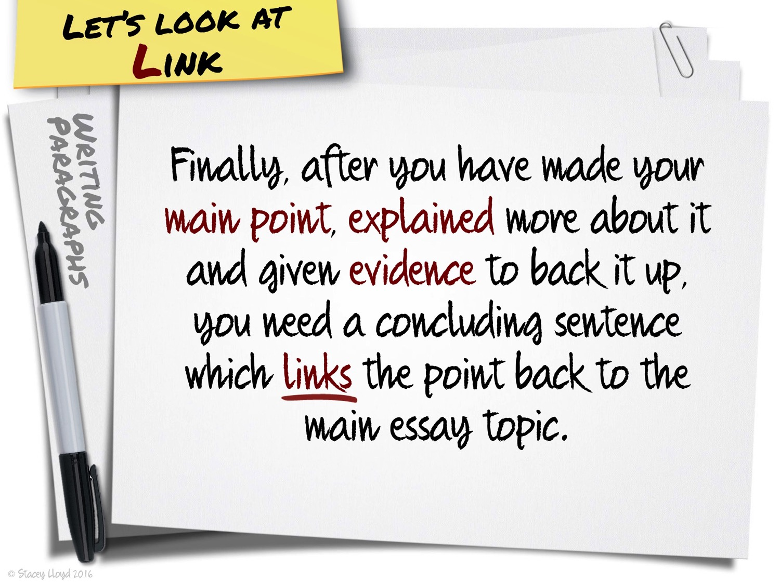

Slide 58
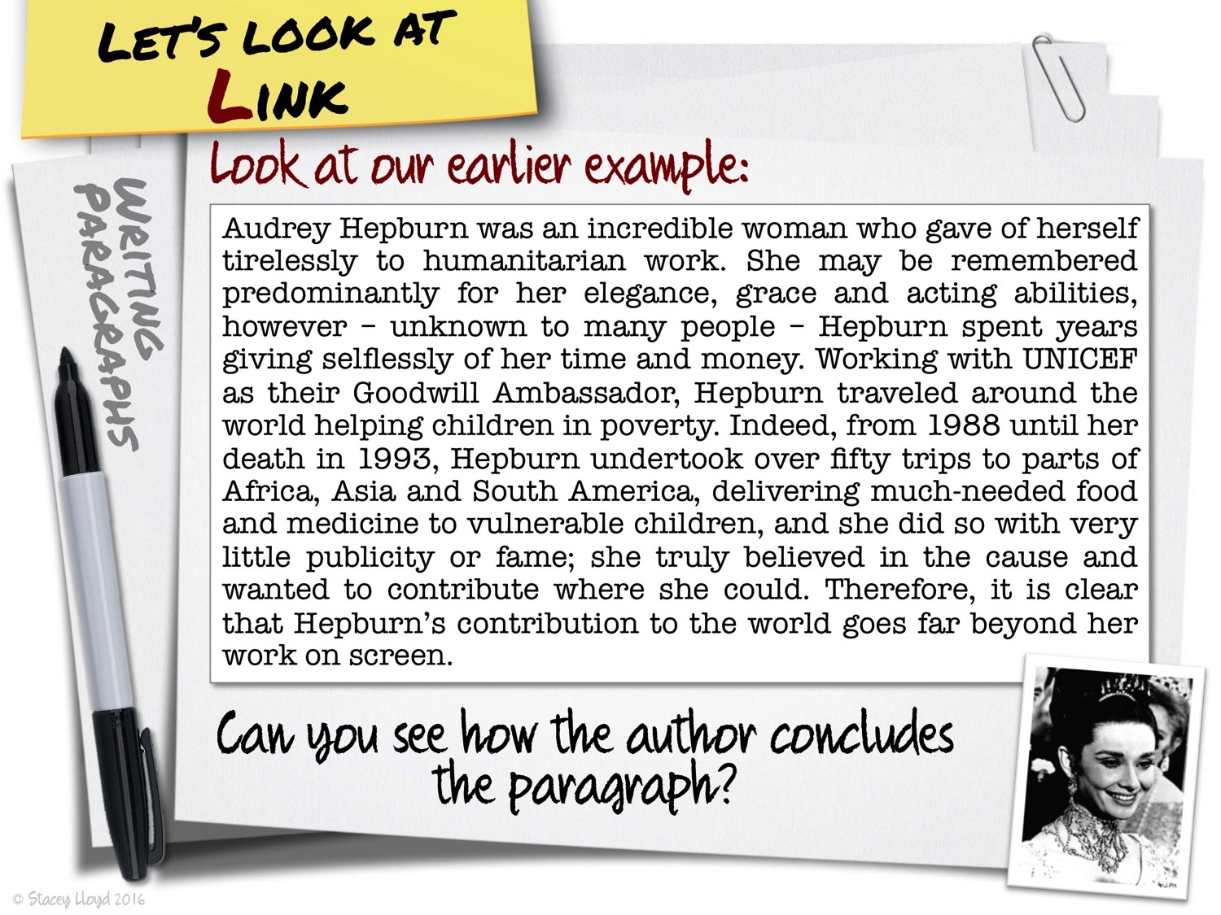

Slide 59
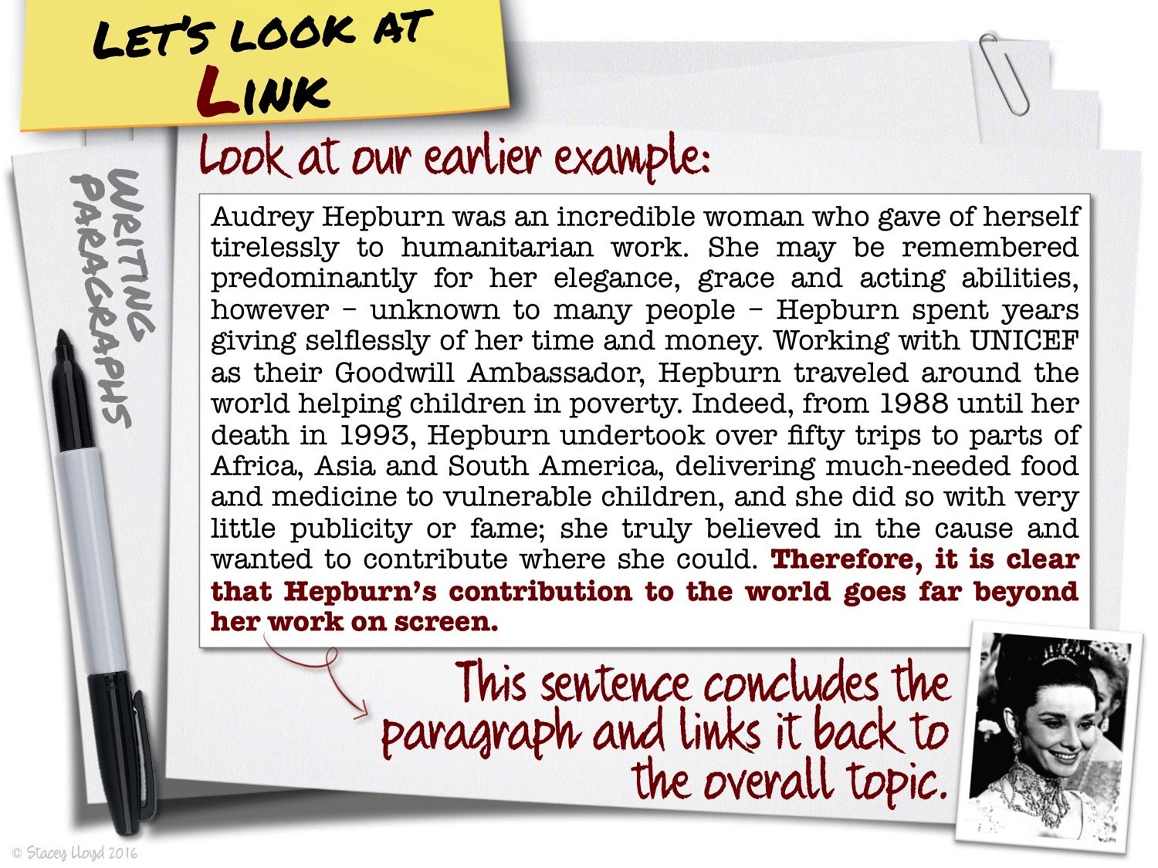

Slide 60
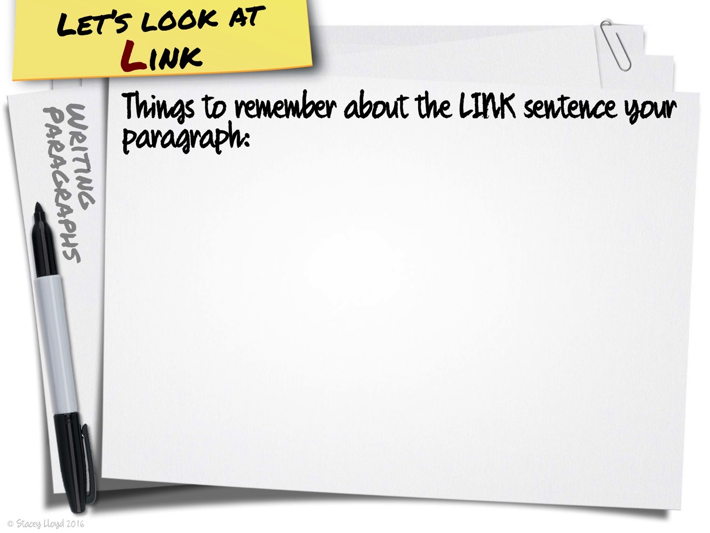

Slide 61
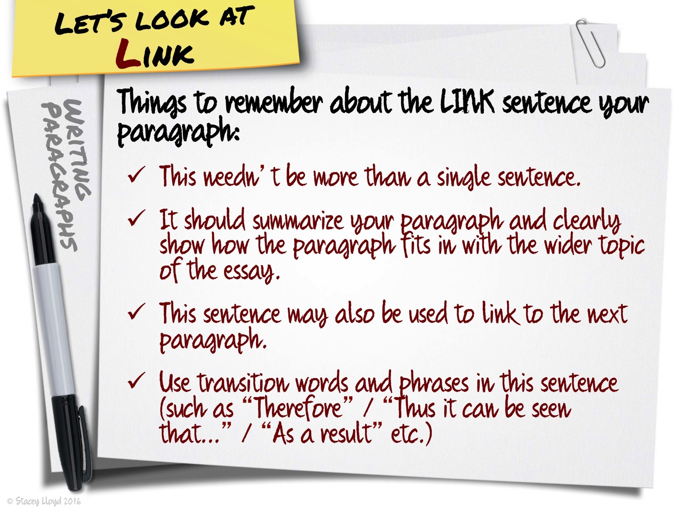

Slide 62


Slide 63
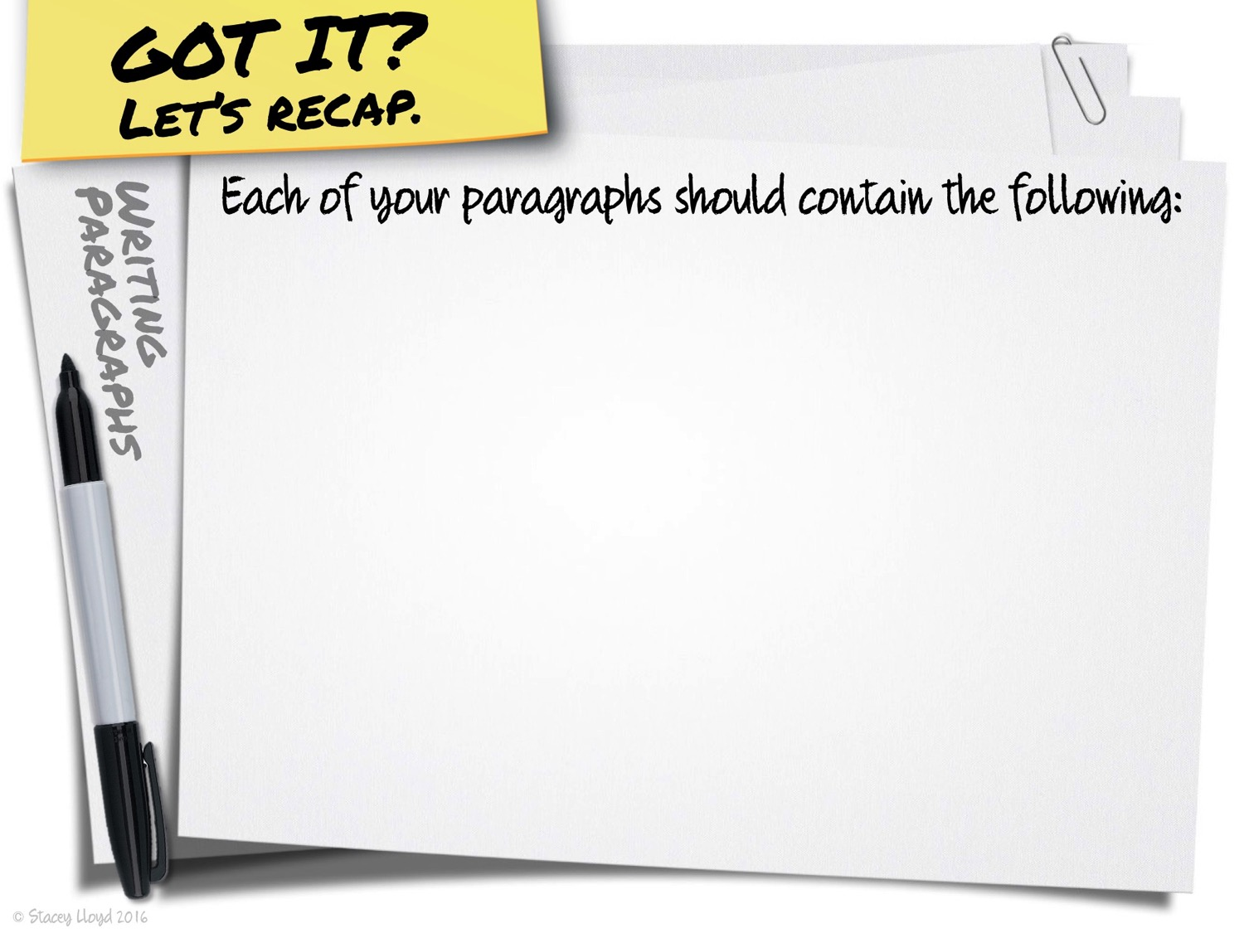

Slide 64
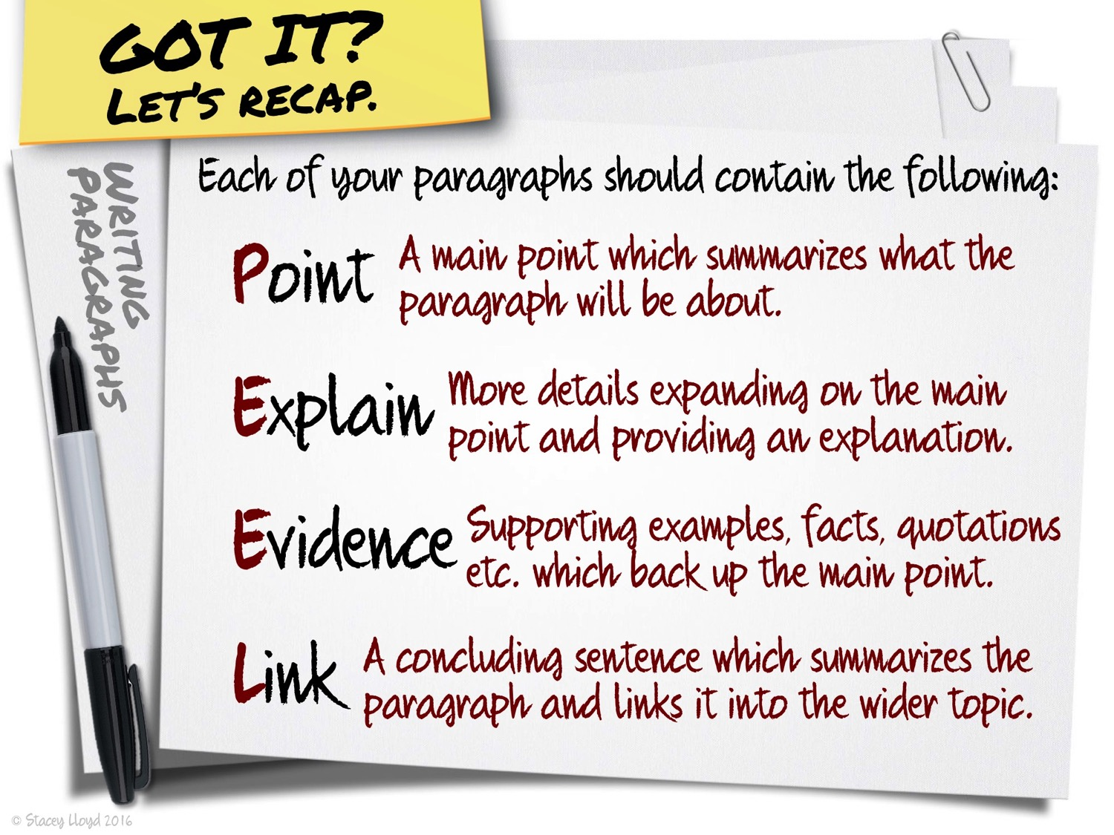

Slide 65


Slide 66
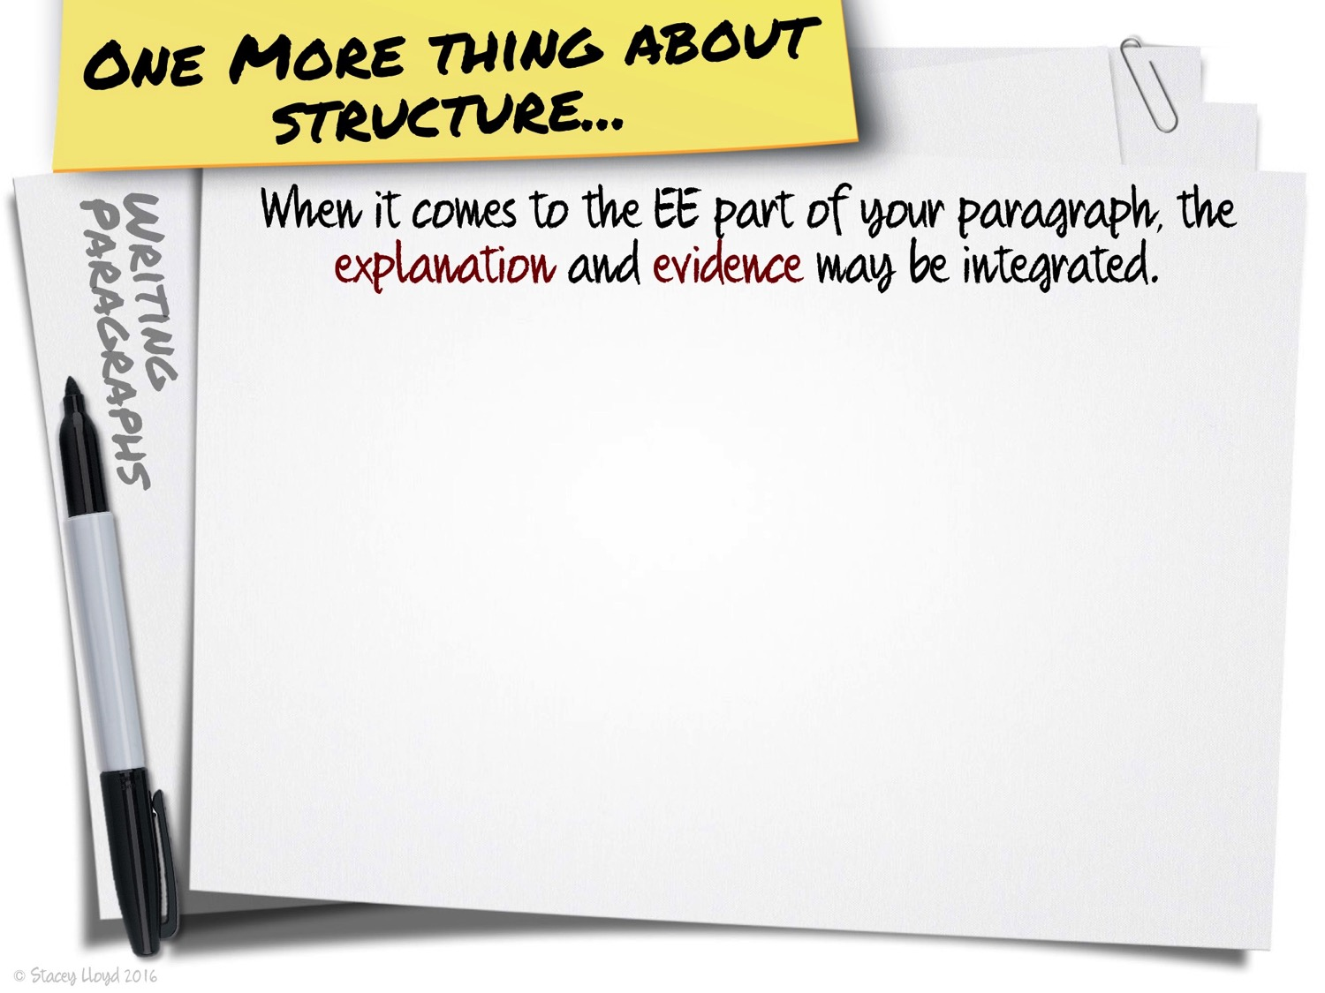

Slide 67
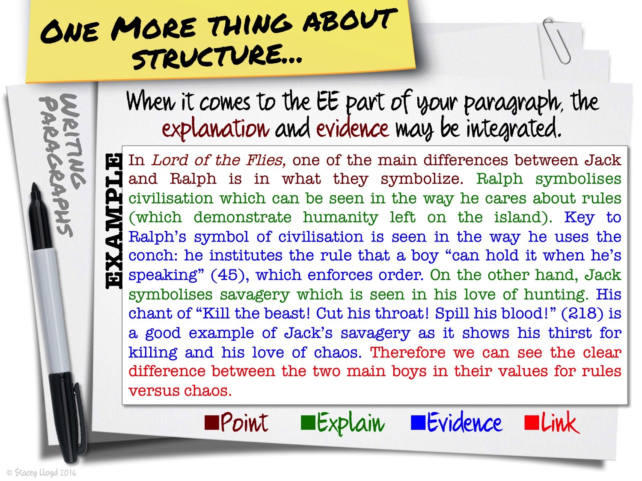

Slide 68
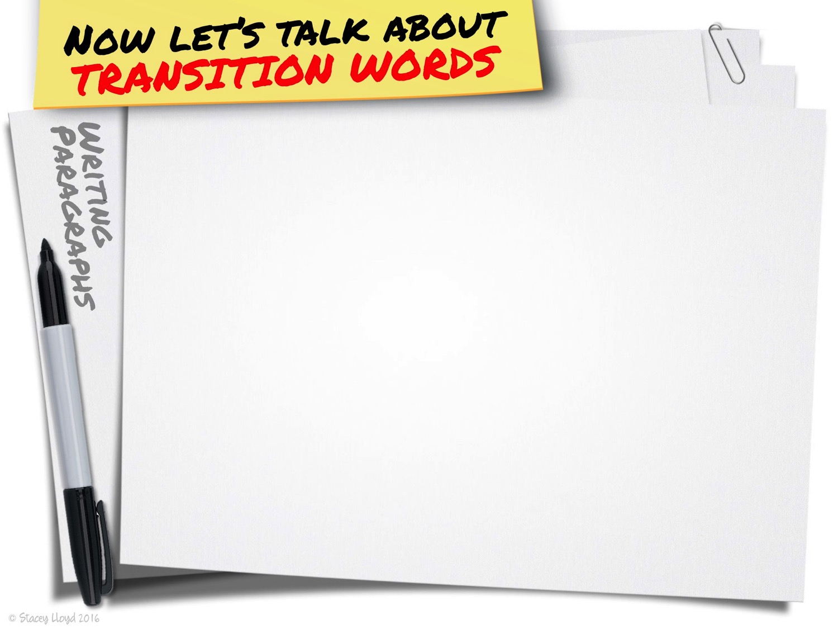

Slide 69
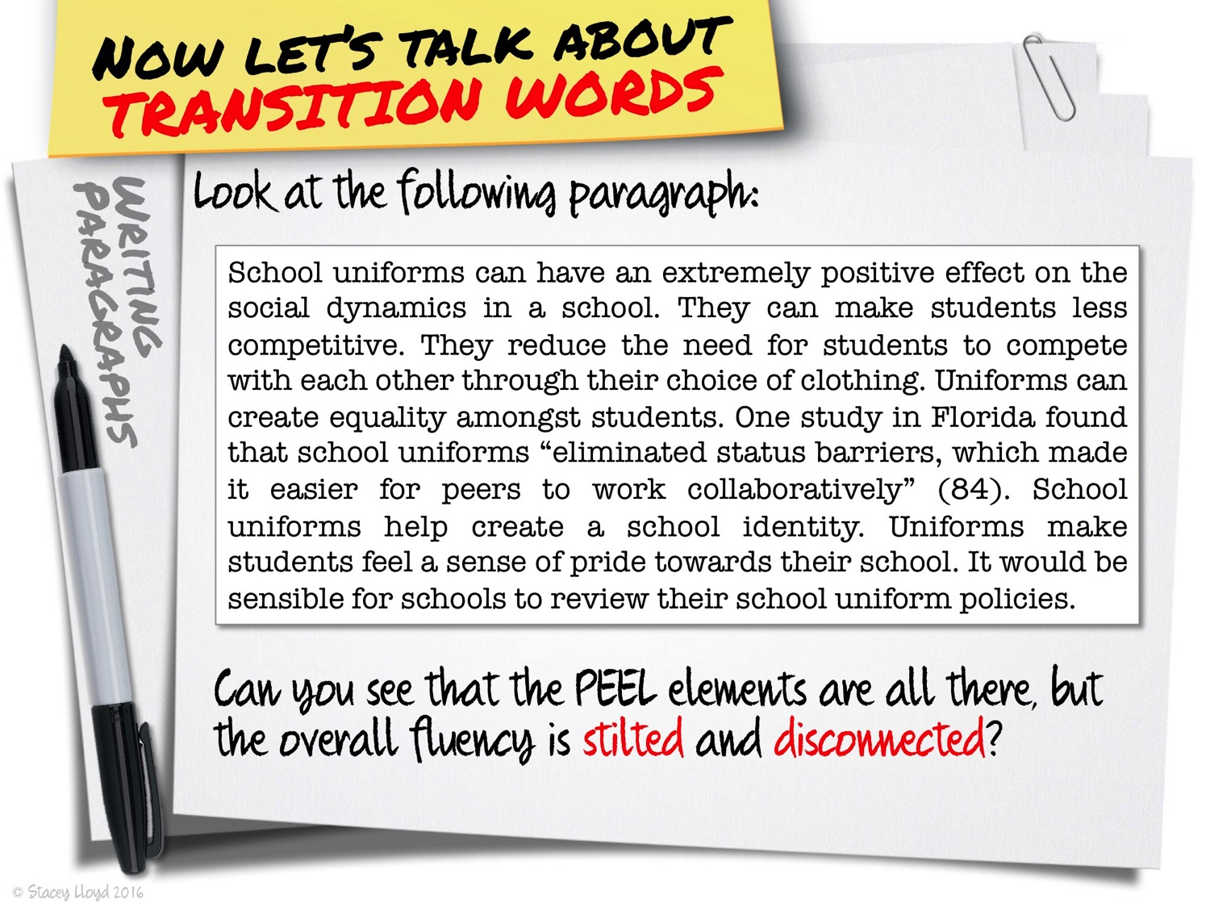

Slide 70
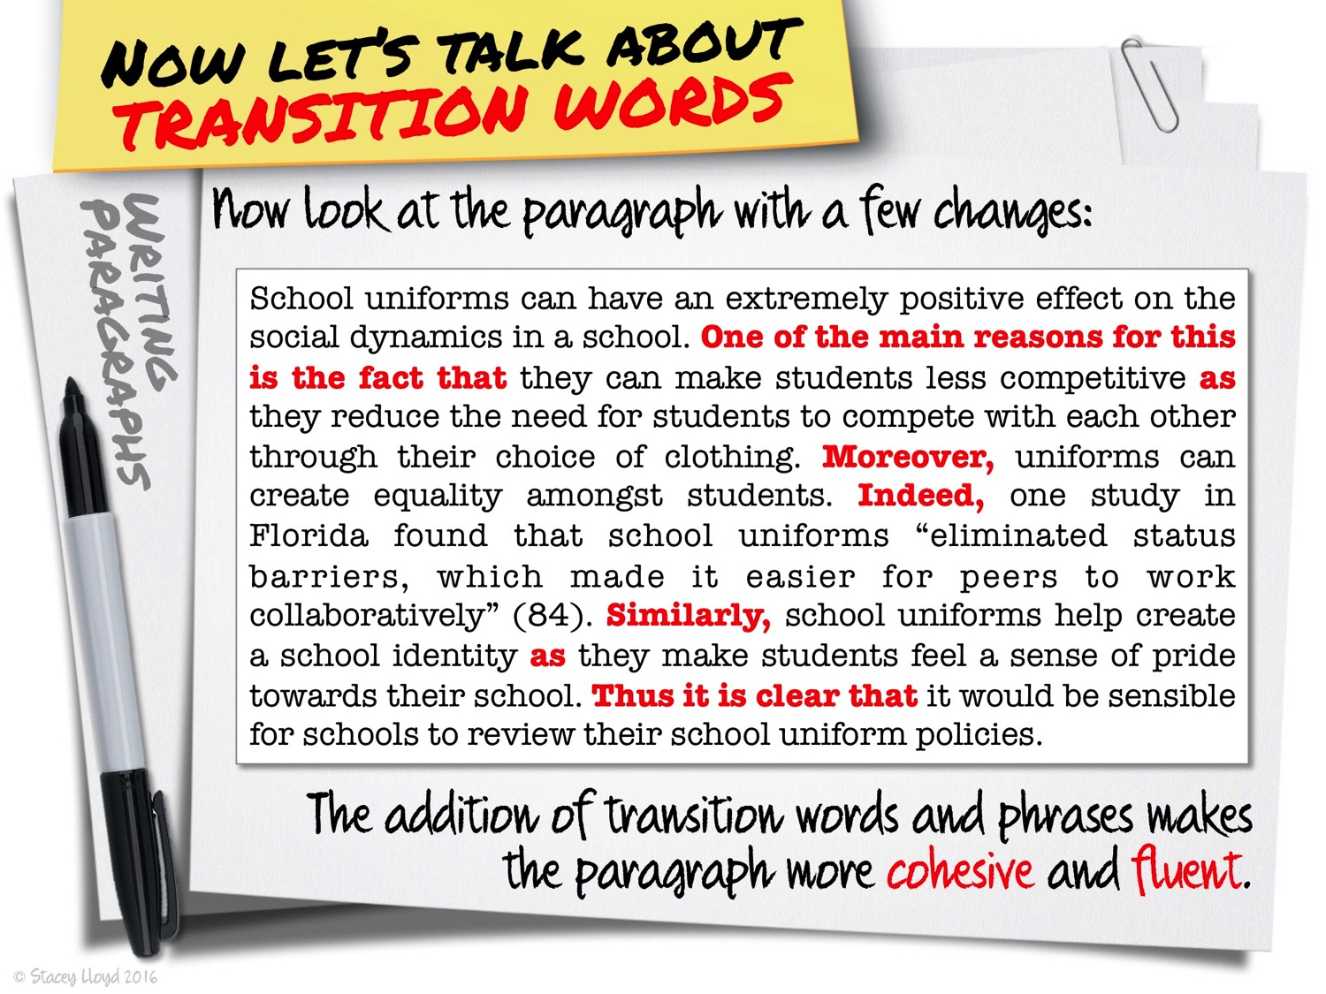

Slide 71
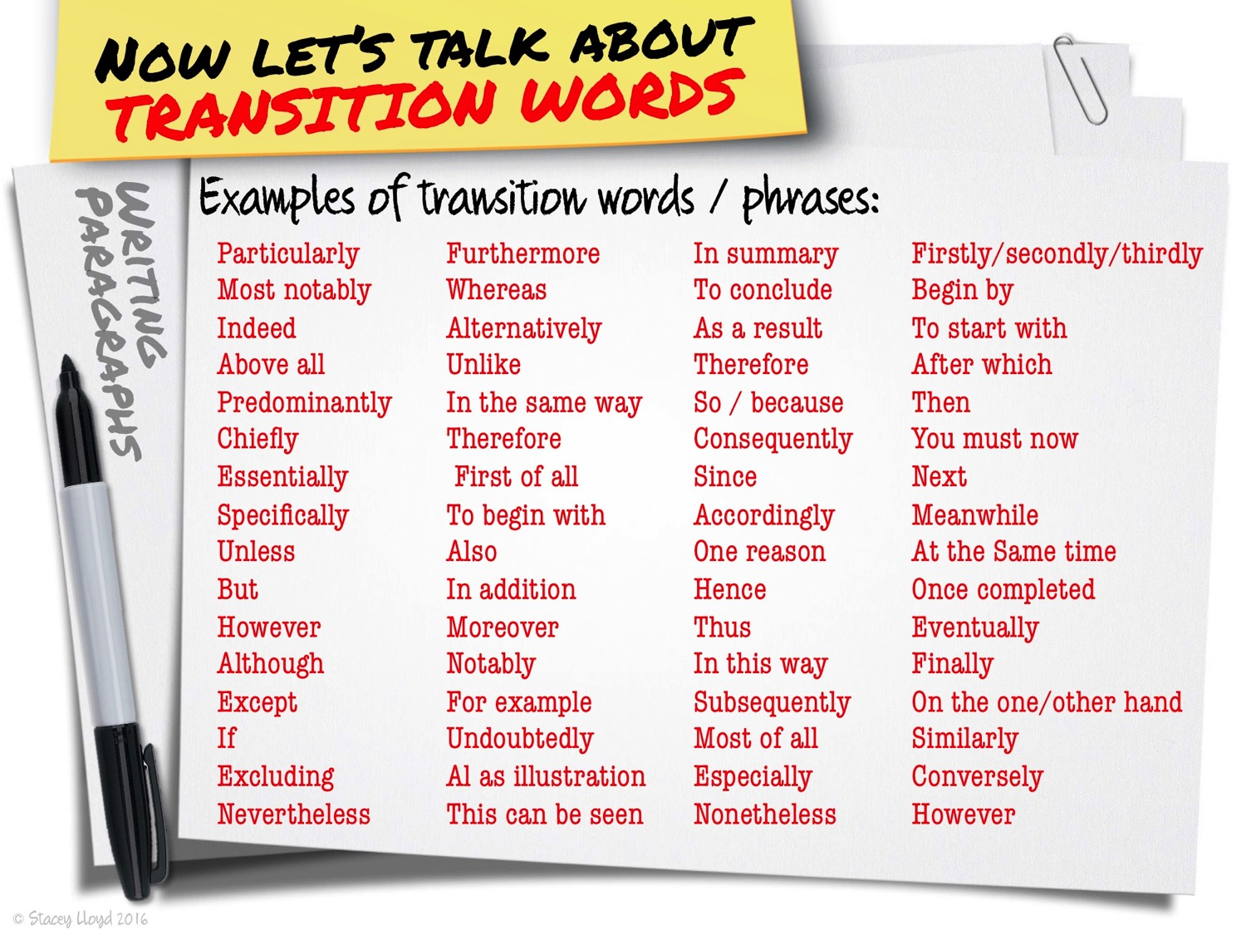

Slide 72
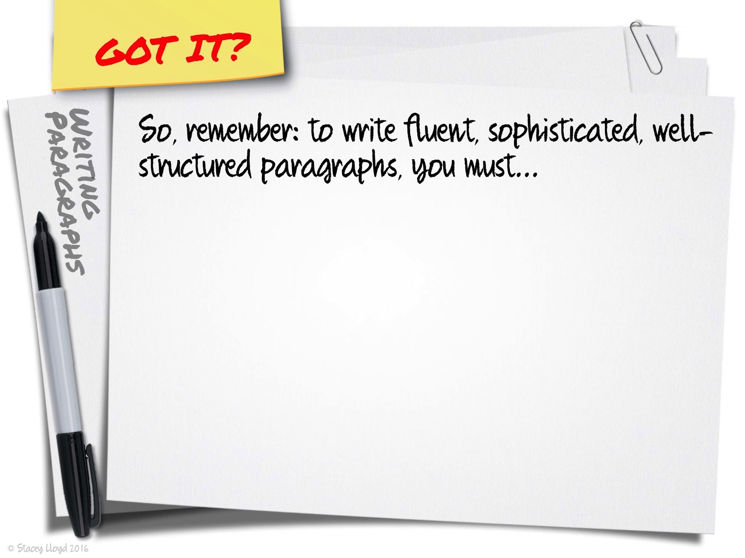

Slide 73
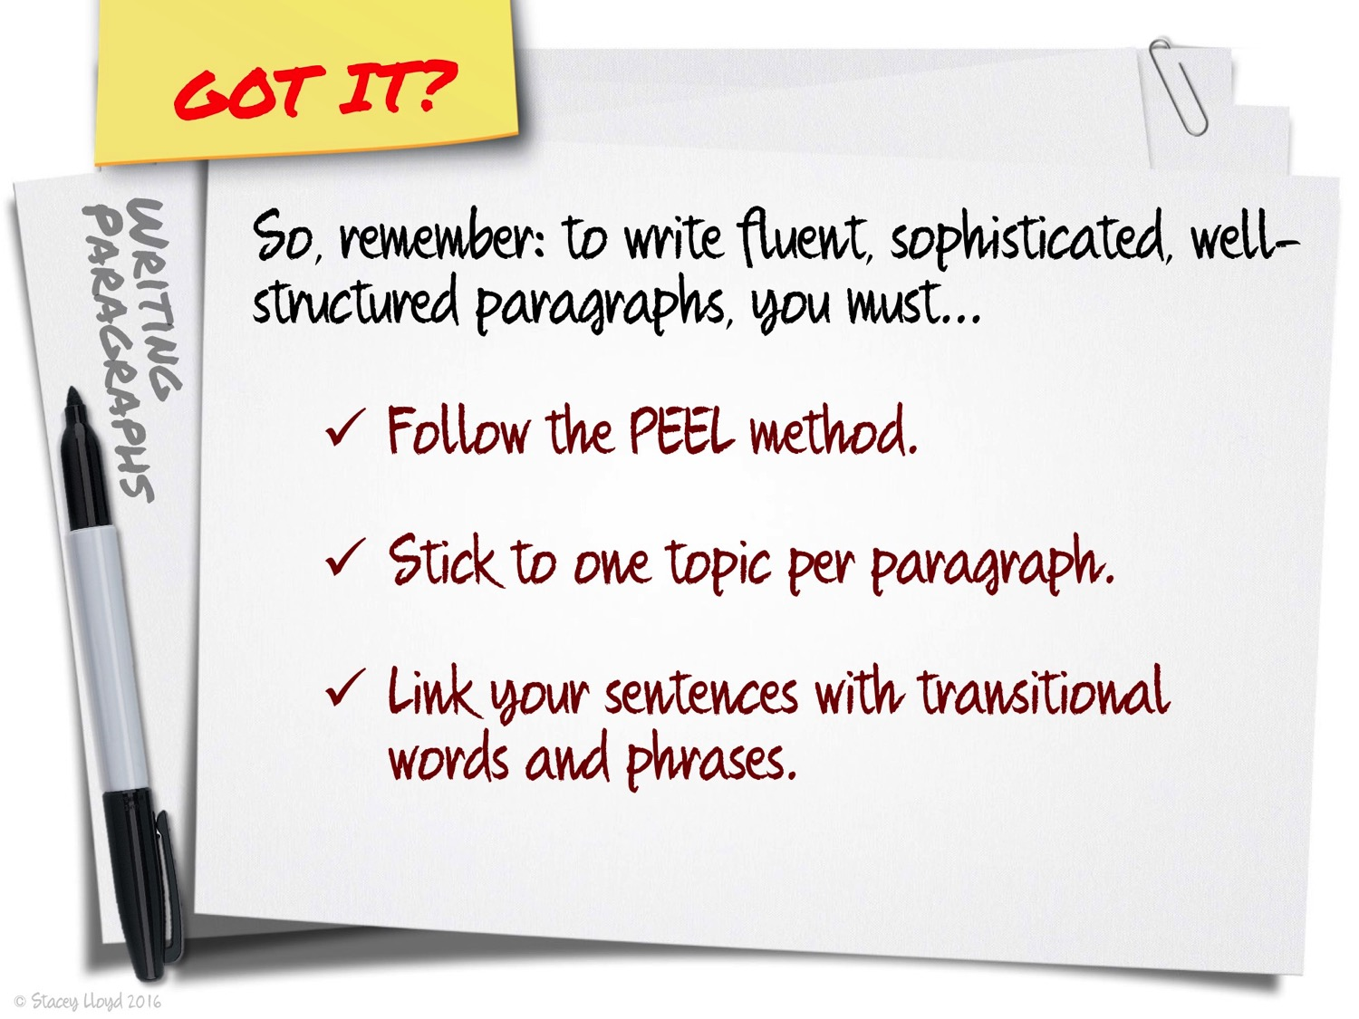

Slide 74


