Slide 1
Pre-Writing Activity
With someone sitting next to you, discuss the following questions:
- What is genocide?
- Where has it occurred?
Record your and your partner’s answers in your workbook.

Slide 2
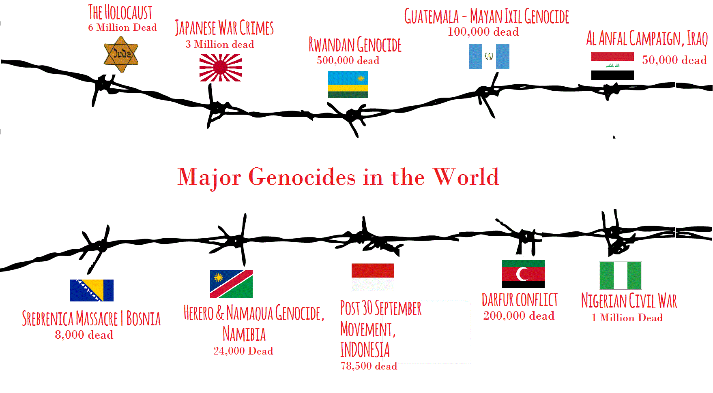

Slide 3
Genocide
The ten stages of genocide, as defined by Gregory H. Stanton

Slide 4
Genocide
☺
The term genocide was first used in 1944, although the crime itself has been committed often in history.
It was initially used to describe the systematic campaign for the extermination of peoples carried on by Nazi Germany, in its attempts in the 1930s and 40s to destroy the entire European Jewish community, and to eliminate other national groups in Eastern Europe.
The word genocide comes the words genos (Greek for family, tribe or race) and cide (Latin for killing)

Slide 5
Genocide
☺
Raphael Lemkin first termed the word genocide.
Lemkin was a Polish Lawyer fled Poland in 1939 to escape the Nazis.
Lemkin lost 49 family members in the Holocaust.
After World War Two Lemkin spoke out to the international community to create laws outlawing future genocides.

Slide 6
Genocide
☺
In 1948 the newly created United Nations came together to decide what was a genocide and how to stop future genocides.
The following was created to define genocides and to stop future genocides.

Slide 7
Genocide
☺
Convention on the Punishment and Prevention of the Crime of Genocide
The Contracting Parties,
Having considered the declaration made by the General Assembly of the United Nations in its resolution 96 (I) dated 11 December 1946 that genocide is a crime under international law, contrary to the spirit and aims of the United Nations and condemned by the civilized world,
Recognizing that at all periods of history genocide has inflicted great losses on humanity, and
Being convinced that, in order to liberate mankind from such an odious scourge, international co-operation is required,

Slide 8
Genocide
☺
In the present Convention, genocide means any of the following acts committed with intent to destroy, in whole or in part, a national, ethnical, racial or religious group, as such:
(a) Killing members of the group;
(b) Causing serious bodily or mental harm to members of the group;
(c) Deliberately inflicting on the group conditions of life calculated to bring about its physical destruction in whole or in part;
(d) Imposing measures intended to prevent births within the group;
(e) Forcibly transferring children of the group to another group.

Slide 9
Genocide-10 Stages
☺
In 1996 Dr. Gregory H. Stanton the President of Genocide Watch established the 10 Stages of a genocide.

Slide 10
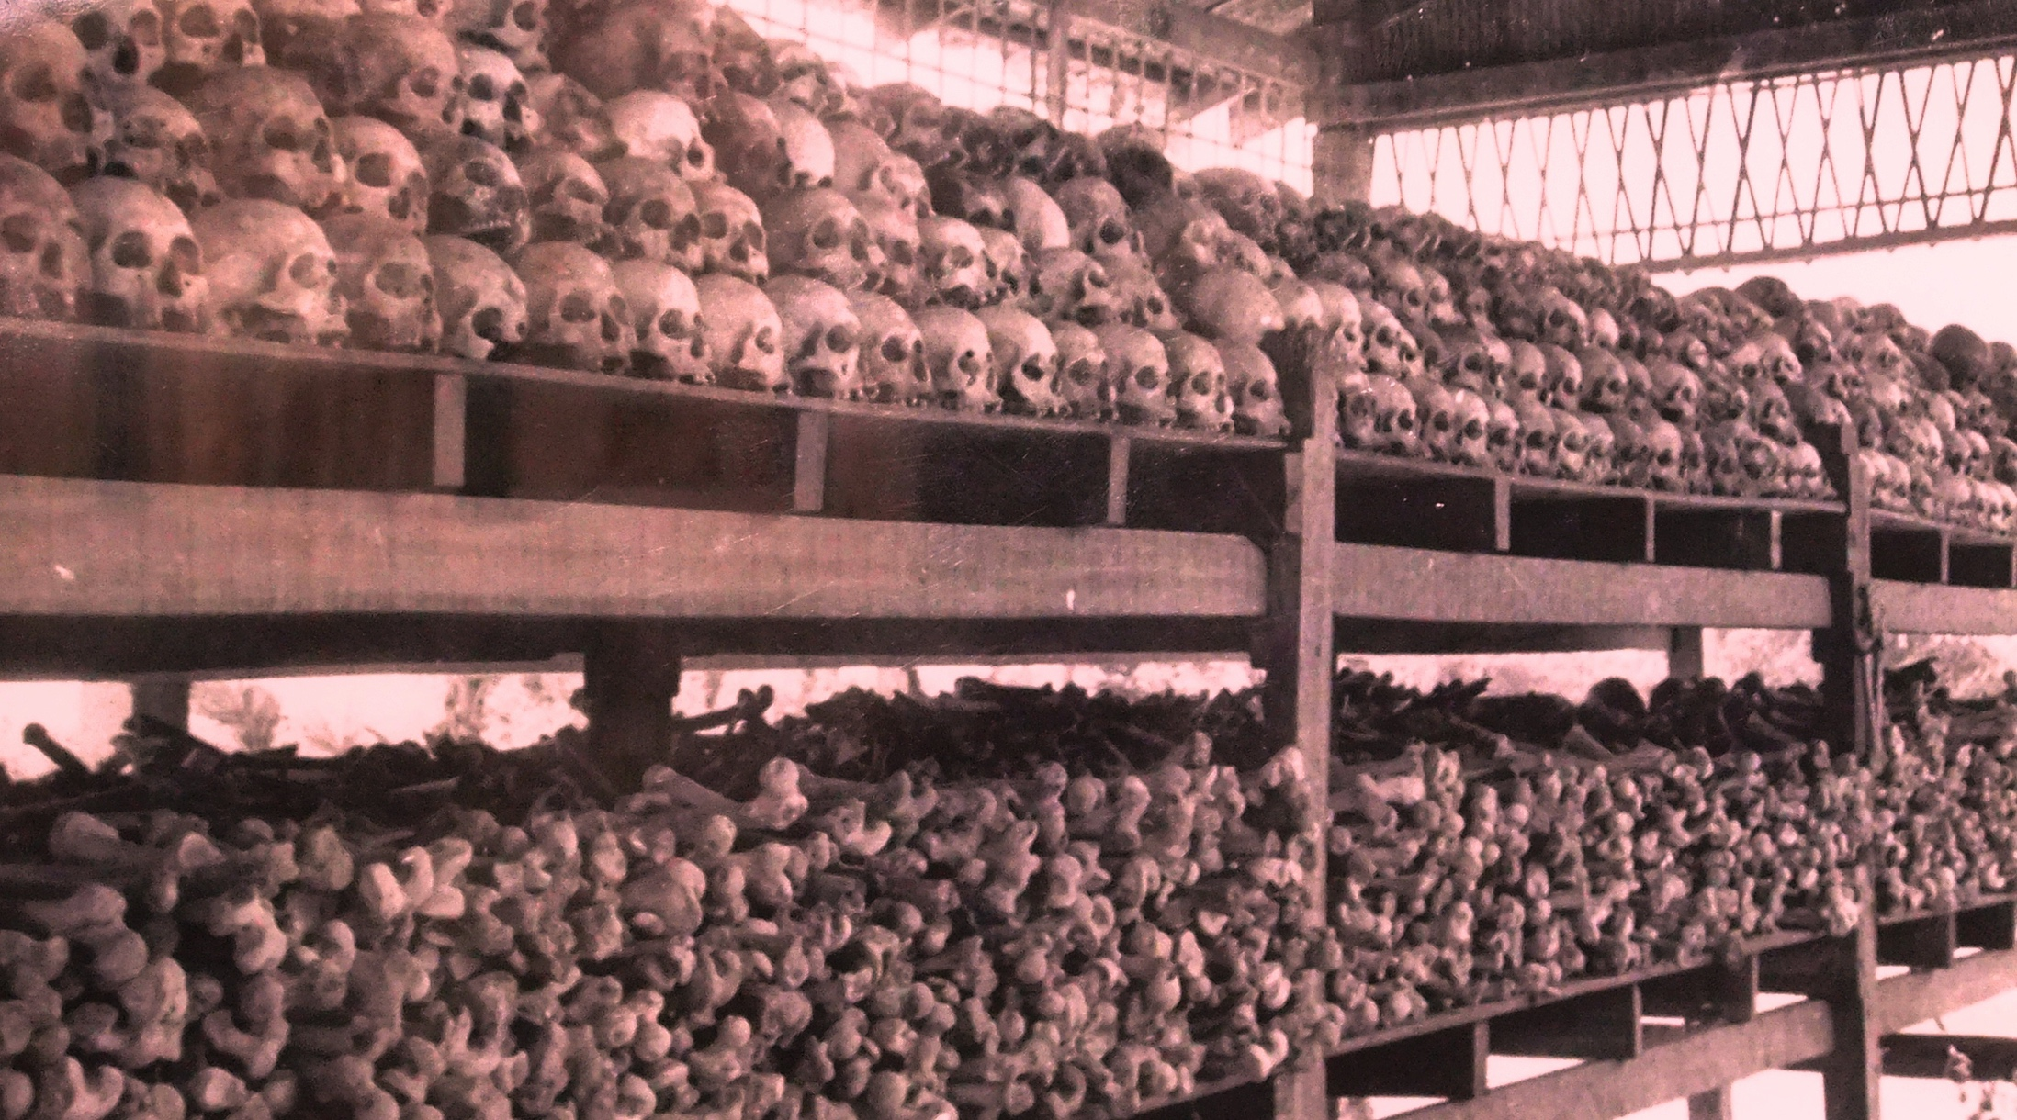
What are the Ten stages of genocide?
Classification
Symbolization
Discrimination
Dehumanization
Organization
Polarization
Preparation
Persecution
Extermination
Denial
☺

Slide 11
Genocide-10 Stages
☺
Dr. Stanton stated that most if not all genocides followed the ten stage path.
Dr. Stanton also stated that at each stage a genocide could be stopped.
Dr. Stanton also concluded that once a genocide starts the later stages must come after the earlier stages, however all stages may continue to operate in conjunction throughout the genocide.

Slide 12
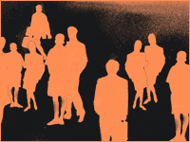
Stage One: CLASSIFICATION
Insert Photo Here

Slide 13
Stage One: CLASSIFICATION
PROMPT: Think of one way in which we separate people in our culture. Do you think this is likely to lead to a genocide? Why or why not?

Slide 14
Classification
All cultures have categories to distinguish people into “us and them” by ethnicity, race, religion, or nationality: German and Jew, Hutu and Tutsi, Blacks and Whites, Christians and Muslims.
Q: Where does this type of classification come from?

Slide 15
Genocide
☺
Classification -1st Stage
‘Us v. Them’ mentality
People are divided by their race, ethnicity, religion or nationality.
Our team and their team. Americans and Iraqis. Christians and Muslims. Straights and gays.Nazi v. Jews
This is an early stage of a genocide.
Once there is a classification then distinct lines can be drawn and people can be placed in groups to be later removed for the society.
This is the first stage of genocide, though it does not mean that every society in which classification occurs will have a genocide occur.

Slide 16
Genocide
To stop classification
Promote tolerance of other groups.
Outside or neutral organizations like the church/Red Cross/United Nations need to stop divisions.
Promotion of a common language and fair system of government.

Slide 17
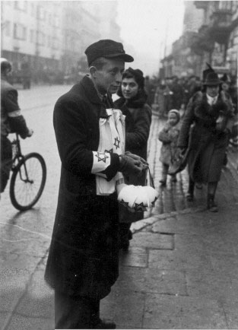
Stage Two: SYMBOLIZATION

Slide 18
Stage Two: SYMBOLIZATION
PROMPT: Do groups you identified for the last stage have symbols that allow them - or others - to tell them apart? If so, what are they?

Slide 19
Stage Two: SYMBOLIZATION
Once groups are classified, they typically - either of their own volition to establish their identity or by force so that the dominant group can easily identify them - adopt symbols so that they can be told apart.
In some cases - particularly where race or ethnicity is concerned - symbolization occurs even before classification, as the symbols that suggest they belong with a certain group are innate, such as the color of their skin or their physical features.
Again, this stage is one that does not necessarily lead to genocide.

Slide 20
Symbolization - 2nd Stage
Names or symbols are given to people to classify them.
As during the Holocaust-Jews or Gypsies.
Distinguish them by colors or dress and apply them to members of groups.
Classification and symbolization are universally human and do not necessarily result in genocide unless they lead to dehumanization.
When combined with hatred, symbols may be forced upon unwilling members of the groups:
The yellow star for Jews under Nazi rule.
A blue scarf for people in Cambodia

Slide 21
Genocide
☺
To stop symbolization
Outlaw symbols for groups both the perpetrators and the victims
The Star of David
The swastika
The Confederate flag?

Slide 22
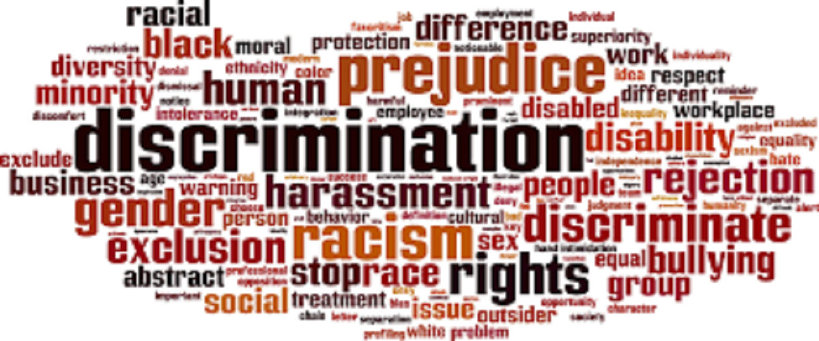
Stage 3 - Discrimination

Slide 23
Stage Three: DISCRIMINATION
PROMPT: Have you ever experienced discrimination before or witnessed it, if so why were you being discriminated against or why was the person you saw it happening to, being discriminated against?

Slide 24
Stage Three: Discrimination
A dominant group uses law, custom, and political power to deny the rights of other groups.
The powerless group may not be accorded full civil rights, voting rights, or even citizenship. The dominant group is driven by an exclusionary ideology that would deprive less powerful groups of their rights.
The ideology advocates monopolization or expansion of power by the dominant group. It legitimizes the victimization of weaker groups.
Advocates of exclusionary ideologies are often charismatic, expressing resentments of their followers, attracting support from the masses.

Slide 25
Stage 3: Discrimination
Segregation; apartheid: Separate groups in housing, schools, transport, and eating places.
Prohibit voting by members of victim group.
Fire group from professions.
Require “passes” to travel. Hunt and arrest “undocumented aliens.”

Slide 26
To Stop Discrimination
Prevention against discrimination means full political empowerment and citizenship rights for all groups in a society.
Discrimination on the basis of nationality, ethnicity, race or religion should be outlawed.
Individuals should have the right to sue the state, corporations, and other individuals if their rights are violated.

Slide 27
Classwork
Begin working on the Genocide DBQ at the end of your booklet!
Finish up any of the workbooks you still owe
Volcano
Earthquake
Plate Tectonics
Reminder – Dante’s Peak Essay was due today!

Slide 28
Outline
CNN 10
Stages 4-7
We may press on and finish all 10.
Classwork

Slide 29
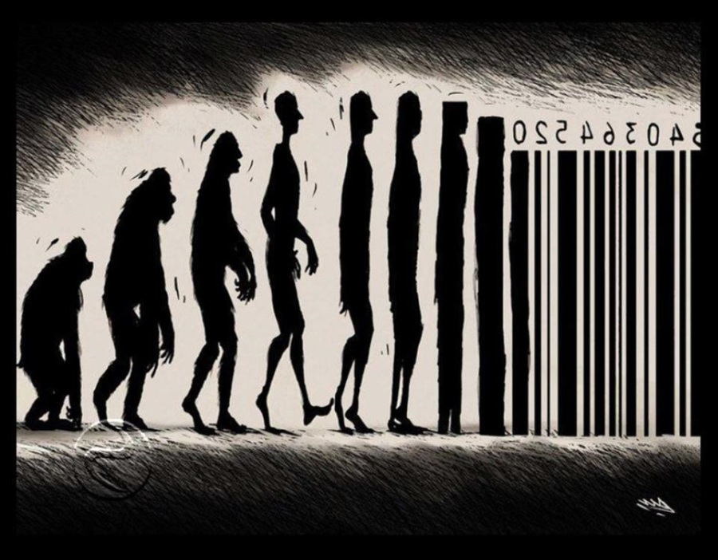
Stage Four: DEHUMANIZATION

Slide 30
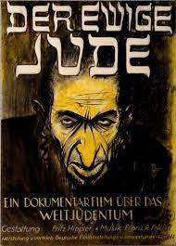
Dehuminzation
https://www.youtube.com/watch?v=puSgaZyepU8

Slide 31
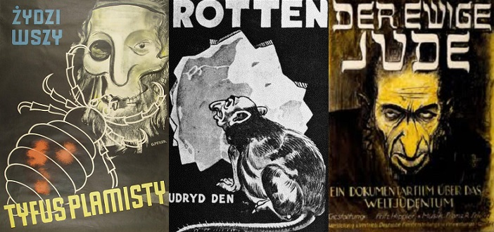

Slide 32
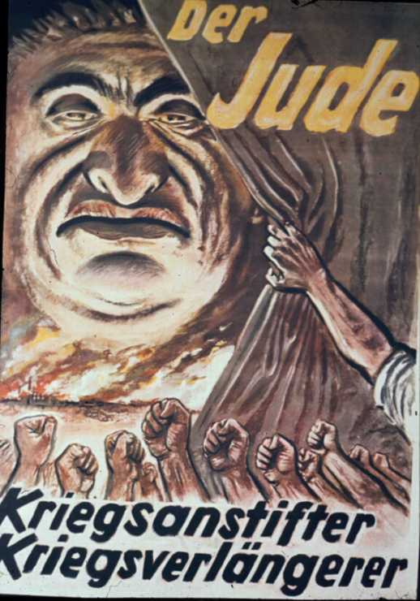

Slide 33
Stage four: DEHUMANIZATION
Prompt: Why is it necessary for a dominant power to dehumanize the victims of a genocide? Why would it be impossible for a genocide to accomplish its goal without this stage?

Slide 34
Stage four: DEHUMANIZATION
One group denies the humanity of the other group. Members of that group are equated with rodents, insects, other vermin, and even diseases.
If this stage takes hold, it becomes more difficult to stop the progression of genocide.

Slide 35
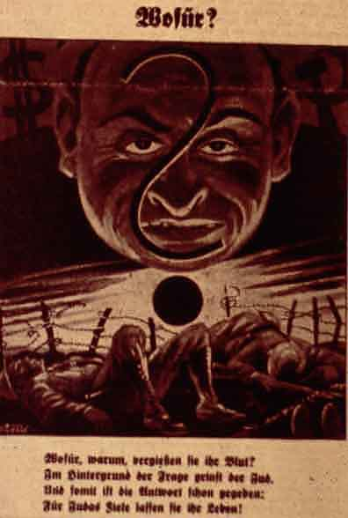

Stage 4: Dehumanization
Der Stürmer Nazi Newspaper:
“The Blood Flows; The Jew Grins”
Kangura Newspaper, Rwanda: “The Solution for Tutsi Cockroaches”
.

Slide 36
Dehumanization- 4th Stage
One group denies the humanity or rights of the other group.
Rights are taken away
Members of it are equated with animals, or a diseases.
People are seen as less then human
Words like parasite are used
Dehumanization of people allows normal people to overcome their fear of murdering humans and allows ordinary people to commit genocide.

Slide 37
How to stop Dehumanization
By this stage propaganda and hate speeches are being used.
Hate groups must be stopped or outlawed.
Propaganda must stop.
Rights must restored to the victims.

Slide 38
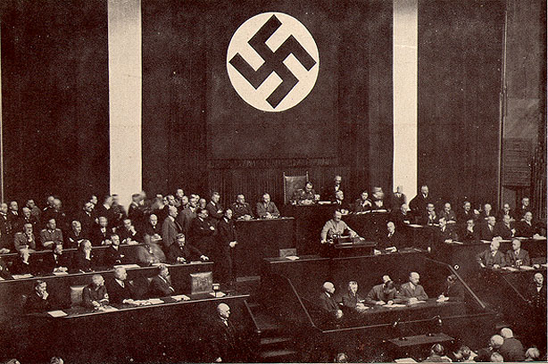
Stage five: ORGANIZATION

Slide 39
Stage Five: ORGANIZATION
Prompt: What specifics would have to be worked out by the enactors of a genocide?

Slide 40
Stage five: ORGANIZATION
In order for the final stages of genocide to take place, organization must occur.
The group that organizes in preparation is typically part of the state due to the amount of financial support required, because of the amount of organization required, though, any group that successfully organizes a genocide is usually sanctioned - at least to some extent - by a state. To a certain extent, you should think of this stage as the proverbial “calm before the storm.”

Slide 41
Organization-5th Stage
Plans are developed to rid the country or society of the group.
Plans are usually developed by the government.
The military is used to carry out the killings.
Military groups are trained to kill the classified group.

Slide 42
How to stop organization
International Peacekeeping organizations must monitor the countries.
Withhold food or military aid to the offending country.
Leaders must be held accountable for actions.
Arms embargos must be placed on the country.

Slide 43
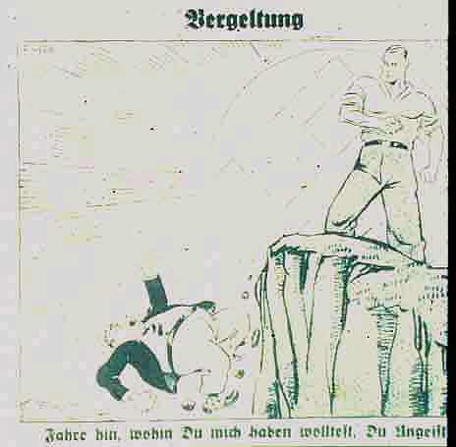
Stage six: POLARIZATION
“Go where you wanted me to go, you evil spirit.”

Slide 44
Stage six: POLARIZATION
Propaganda: Have you ever seen a piece of propaganda intended to polarize groups? If you have, please describe it. If you have not, please try to imagine what it might look like.

Slide 45
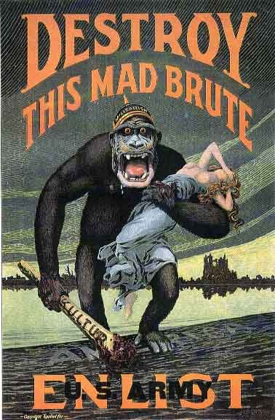

Slide 46
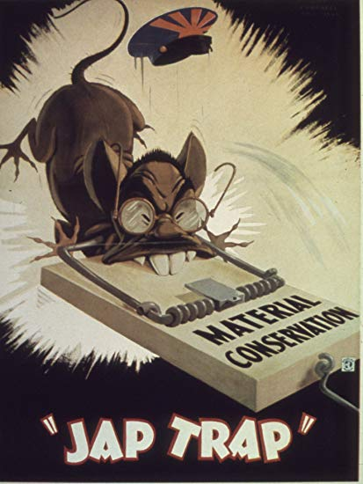

Slide 47
Stage six: POLARIZATION
During this stage, the groups are driven even further apart ideologically. Hate groups begin broadcasting propaganda with greater frequency, and laws typically are enacted to forbid any sort of relations between the two groups.
At this stage, it is not just the victimized group that suffers. Any “sympathizers” or moderates are either threatened or attacked by the dominant, oppressing group.

Slide 48
Polarization-5th Stage
Hate groups broadcast propaganda.
Laws may forbid intermarriage or social interaction.
Extremist terrorism targets moderates, intimidating and silencing the center. (Stop those in government who might speak out against the genocide)

Slide 49
How to stop polarization
Sanctions should be placed on the country.
Extremist groups should not be allowed to rule or have control of the government.
Peacekeeping forces should be put on alert.

Slide 50
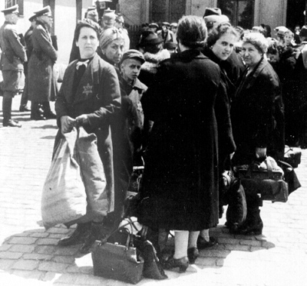
Stage seven: PREPARATION

Slide 51
Stage seven: PREPARATION
ON YOUR PAPER: Assuming that at this stage, the world cannot help but notice that the victimized group is being forced from their homes in preparation to be slaughtered, why wouldn’t this be the stage where every genocide ends?
This is not a rhetorical question.

Slide 52
Stage seven: PREPARATION
Whereas in the previous stage the victimized group was separated ideologically from the dominant group, in this stage the victimized group is separated physically from the rest of the society.
The victimized group or groups are gathered together, either in ghettoes or concentration camps. At times, they are even forced into a famine-struck area and starved, beginning the seventh stage of genocide.
At this stage, the world typically becomes aware of what is going on, whether they actually step in or not.

Slide 53
Preparation-7th Stage
Victims are identified and taken out of society.
They are placed in labor camps, ghettos or concentration camps.
They have lost all rights.
They have no means to speak out or defend themselves.
They are forgotten by the general society.

Slide 54
How to stop Preparation
At this point international military aid must be used.
Victims are now helpless and can not defend themselves.
The offending government must be stopped.

Slide 55
Classwork
Begin working on the Genocide DBQ at the end of your booklet!
Finish up any of the workbooks you still owe
Volcano
Earthquake
Plate Tectonics
Reminder – Dante’s Peak Essay was due Monday!

Slide 56
Outline
CNN 10
STAGES 8-10
Genocides World Wide
Finish DBQ

Slide 57
Stage 8: persecution
Victims are identified and separated out because of their ethnic or religious identity.
Death lists are drawn up.
In state sponsored genocide, members of victim groups may be forced to wear identifying symbols.
Their property is often expropriated.
They are segregated into ghettoes, deported into concentration camps, or confined to a famine-struck region and starved.

Slide 58
They are deliberately deprived of resources such as water or food in order to slowly destroy them.
Programs are implemented to prevent procreation through forced sterilization or abortions. Children are forcibly taken from their parents.
The victim group’s basic human rights become systematically abused through extrajudicial killings, torture and forced displacement.

Slide 59
How to stop Persecution
At this stage, a Genocide Emergency must be declared.
If the political will of the great powers, regional alliances, or U.N. Security Council or the U.N. General Assembly can be mobilized, armed international intervention should be prepared, or heavy assistance provided to the victim group to prepare for its self-defence.
Humanitarian assistance should be organized by the U.N. and private relief groups for the inevitable tide of refugees to come.

Slide 60
Stage nine: EXTERMINATION
This is the stage where this process legally becomes genocide. Mass killings occur quickly and systematically. When genocide is sponsored by the state, as it almost always is, the armed forces typically work with well-organized militias to exterminate the victims.

Slide 61
Stage nine: EXTERMINATION
Prompt: What previous stage or stages allow(s) extermination to happen so quickly? If you think that the answer is “all of them,” please identify which stage or stages most enable the rapidity of the execution.

Slide 62
Extermination-9th Stage
The killing begins quickly and usually in mass. This is when the incident can be called a genocide.
The victims are seen as less then human by the killers.
Armed forces are used to conduct the murders and killing centers (Death camps) or other areas are usually created.

Slide 63
How to stop extermination
International military intervention is the only possible way to stop the killing.
The government must be stopped, the military must be neutralized, and the killing centers closed.
Refugees must be safely escorted out of the country to a place of safety.

Slide 64
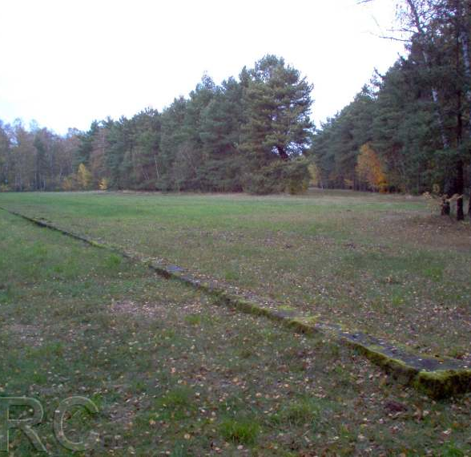
Stage ten: DENIAL

Slide 65
Stage Ten: DENIAL
Prompt: Think about the psychological factors that would contribute to the effectiveness of the denial. How could someone who witnessed or took part in a genocide come to believe that a genocide had not occurred?

Slide 66
Stage Eight: DENIAL
If intervention does not occur during the ninth stage of genocide, denial always follows extermination. Mass graves are dug up and bodies are burned; the evidence that the genocide ever occurred is systematically eradicated. Witnesses are bribed, intimidated, or killed.
Investigations into the crimes are blocked by the government that committed the atrocities.
Typically, the victims of the genocide are blamed for their fates if their disappearance is brought up.

Slide 67
Denial-10th Stage
Denial always follows a genocide.
It becomes an indicator that a genocide has taken place or might take place again.
The perpetrators dig up the mass graves, burn the bodies, try to cover up the evidence.
They deny that they committed any crimes, and blame the victims.
They continue to govern until driven from power by force and when they flee into exile.

Slide 68
How to stop denial
Punishment for those who planned and committed the genocide.
International investigations.
Keep the sites such as the concentration camps as memorials.

