Slide 1
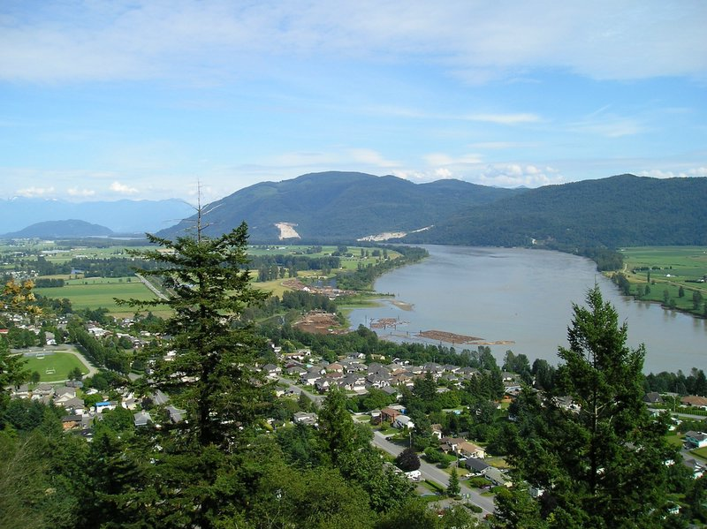
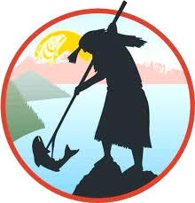
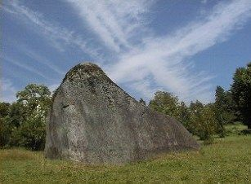
BC First Nations 12

Slide 2
Outline
CNN 10
Notebook ☺
Territory Acknowledgement
Sign up for Textbooks
Historical Thinking
Indigenous 101
Next day: Origin Stories – Time Immemorial
  Turtle Island
  Raven and the First People

Slide 3
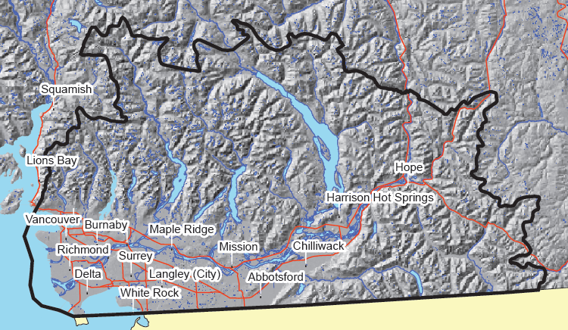
Our school district is located within the traditional, ancestral, unseeded and shared territories of the Leq'á:mel, Matheqwí, Qwó:ltl'el and Sq'éwlets peoples. ☺

Slide 4
Sto:lo Territory

Slide 5
Historical thinking
CONCEPTS TO THINK BY

Slide 6
The 6 Benchmarks of Historical Thinking
To think historically, you need to be able to:
Establish historical significance.
Use primary source evidence.
Identify continuity and change.
Analyze cause and consequence.
Take historical perspectives.
Understand the ethical dimension of historical interpretations.

Slide 7
Historical Thinking = Historical Literacy
Taken together, these concepts tie “historical thinking” to competencies in “historical literacy.”
“Historical literacy” means gaining a deep understanding of historical events through active engagement with historical texts.
Historically literate citizens can assess claims:
  That there was no Holocaust,
  That slavery wasn't so bad for African-Americans,
  That Aboriginal rights have a historical basis.

Slide 8
Historical Literacy
Such students/citizens have thoughtful ways to tackle these debates.
They can assess historical sources.
They know that a historical film can look "realistic" without being accurate.
They understand the value of a footnote.
In short, you can detect the differences between the uses and abuses of history.

Slide 9
Stereotypes + Aboriginals Video
What does the average Canadian know about Aboriginal people? By CBC reporter Connie Walker (5:53).
https://www.facebook.com/cbcdocs/videos/vb.82184406949/10155411819196950/?type=2&theater

Slide 10
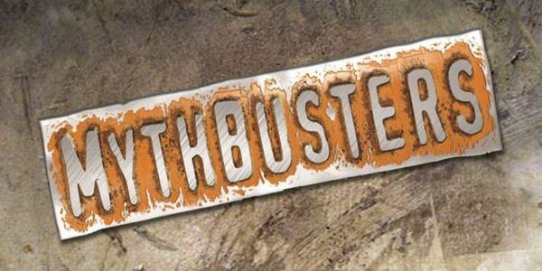
Quiz – Take about 3 mins to answer the questions

Slide 11
1. One of the acts consolidated into the Indian Act (1876) was called the “Gradual Civilization Act (1857)?
True
  This was one of the first acts geared towards FN people.
  Allowed for “Enfranchisement” of any Male Indian who could speak/read/write English or French.
  Could take 50 acres from his Tribe
  Given a last name of his choosing.

Slide 12
2. The Indian Act of 1876 is still in effect?
True
  In 1969 Piere Elliot Trudeau introduced what was known as the “White Paper”
    Wanted to Abolish the Indian Act – No more Indians, no more “Indian Problem” we are all Canadians.
    Pay out severance/reparations.
    Indigenous People responded with the “Red Paper” in 1971.
      Argued for Self-Sufficiency in FN communities; govern themselves.

Slide 13
3. Until 1961 First Nations people could not vote in Federal Elections?
True
  Differences based on Gender and whether a person lived on/off the reservation.
  Canadian women gained the vote in the 1920’s
    But Not Aboriginals.
  Could give up their Status card (be an Indian no more) and they could vote as a Canadian Citizen

Slide 14
4. It’s 1969 and Bill (Caucasian) and Bob (First Nations) have just completed their 12 hour shift at a local pulp mill and head to the local pub for a beer, both men are in their 30s. Is one or both of them committing a crime?
Both
First Nations are not allowed to purchase alcohol and are not allowed to be intoxicated on or off the reserve.
It was illegal to sell alcohol to an Indian.
  Indian Act – Section 94
    Dry Bones vs. Canada – Challenged this section of the act as being racial discrimination.
    Went to the Supreme Court of Canada and the agreed and struck it.

Slide 15
5. A “status card” means you are a registered Indian?
True
  “Certification of Indian Status”
  Given a number.

Slide 16
6. You have to be an Indian to be registered as an Indian
False
  Matter of Marriage
  Indian Act, Section 12 1b
    a woman’s status was entirely dependent on their husband. As is explicitly stated in Section 12 (1)(b) of the Indian Act, “a woman who married a person who is not an Indian… [is] not entitled to be registered.”

Slide 17
7. In 1980 if a First Nations man married a white woman, she would gain status?
True
  If a non-native woman married an Indian man, she would gain status.

Slide 18
8. In 1980 if a First Nations woman married a white man, he would gain status?
False
  She would lose her status (Gender Discrimination)
  Taken to court by a group of women, all the way to the supreme court.
  Did not agree that it was gender discrimination
    Treatment of all women within the group is equal
    They should be thankful, their status is being elevated.

Slide 19
9. In 1950 it was illegal for First Nations people to:
  A. Hire a Lawyer
    True
  B. Gather in Groups of Three or more
    True
  C. Pray
    True
      Unless following Catholic/Christian Prayers.

Slide 20
10. Reserve Land in BC is owned by the First Nations Community?
False
  Crown land – Queen’s land, passed onto the Federal Govt.
  11 numbered treaties were signed in other provinces, showing the acquisition of lands, but not in B.C.
  Preempting Land (Squatters), Buying/Trading land, Conquering, or Treaties – None of this in B.C.
  5 Douglas Treaties on the Island; not officially recognized.
  According to Indigenous Peoples, the land is still theirs.

Slide 21
11. First Nations people do not pay taxes?
False
  Status Card holders can be tax exempt on reserve land
    The government owns that land and is responsible for aboriginal people so why would it tax itself?
      Don’t Pay GST
      Don’t pay income tax if you work on reserve land
        But, make less money usually.
        Not a lot of jobs available.

Slide 22
12. Canada’s colonial history, including Residential Schools, happened a long time ago and First Nations people should get over it?
False
  1996 – Last Residential School closed in Saskatchewan.
  1984 – Last Residential School in B.C. Closed – St. Mary’s in Mission B.C.

Slide 23
13. If Mary and Sue are sisters then their children are siblings?
According to whose worldview?
  Aboriginal – True
  Western - False

Slide 24

Journal

Slide 25
“Learning is also reflecting” ☺
We will keep a weekly journal.
Journals will be due every Friday at the end of class.
Journal entries should be 1-2 Paragraphs in length (3-5 sentences per paragraph)
Journals should demonstrate the following:
  New knowledge/Something learned
  Questions being raised
  Insights into local issues
  Changes in beliefs/views

Slide 26
Outline
CNN 10
Terminology: Aboriginal, First Nation, Metis and Inuit.
Mythbusters
Time Immemorial – Origin Stories

Slide 27
What is meant by the term Aboriginal?

Slide 28
Aboriginal People ☺
An umbrella/all-encompassing term that refers in Canada to people who identify as Inuit, Metis or First Nations/Native.
First Peoples and Indigenous are also umbrella terms.

Slide 29
Aboriginal People ☺
Aboriginal people are the indigenous peoples of Canada/North America - the descendants of the original inhabitants of this continent.
Indigenous means "native to the area."

Slide 30
Aboriginal People ☺
The Canadian Constitution recognizes three groups of Aboriginal people — First Nations (“Indians”), Métis and Inuit.
These are three separate peoples with unique heritages, languages, cultural practices and spiritual beliefs.

Slide 31
Aboriginal People ☺
Aboriginal peoples are made up of diverse groups living across the country.
1,400,685 people identified an Aboriginal identity in 2011, representing 4.3% of the total Canadian population.

Slide 32
Aboriginal People
The largest numbers of Aboriginal people live in Ontario and the western provinces (Manitoba, Saskatchewan, Alberta, and British Columbia).
Aboriginal people make up the largest shares of the population of Nunavut and the Northwest Territories.

Slide 33
What is meant by the term Indigenous?

Slide 34
Indigenous Peoples ☺
An umbrella/all-encompassing term that refers in Canada to people who identify as Inuit, Metis or First Nations/Native.
First Peoples and Indigenous are also umbrella terms.

Slide 35
What is meant by the term First Nations?

Slide 36
First Nations People ☺
A term that came into common usage in the 1970s to replace the word "Indian" which many people found offensive/derogatory/inappropriate.
Although the term First Nation/Native is widely used, no legal definition of it exists.

Slide 37
First Nations People ☺
Among its uses, the term "First Nations peoples" refers to the “Indian” peoples in Canada, both Status and non-Status.
There are apparently legal reasons for the continued use of the term “Indian.”

Slide 38
First Nations People ☺
Such terminology is recognized in the Indian Act, Section 35 of the Constitution Act, and is used by the Government of Canada when making reference to this particular group of Aboriginal people.

Slide 39
First Nations People
Status Indian =
A person who is registered as an First Nations (“Indian”) under the Indian Act.
The act sets out the requirements for determining who is an “Indian” for the purposes of the Indian Act.

Slide 40
First Nations People
Non-Status Indian =
An First Nations (“Indian”) person who is not registered as an “Indian” under the Indian Act.

Slide 41
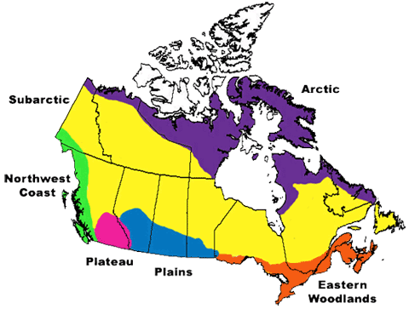

Slide 42
First Nations People ☺
In 2011, 851,560 people identified as a First Nations person, representing 60.8% of the total Aboriginal population and 2.6% of the total Canadian population.

Slide 43
First Nations People ☺
In 2011, 637,660 First Nations people reported being Registered Indians, representing 74.9% of all First Nations people, 45.5% of the total Aboriginal population and 1.9% of the total Canadian population.

Slide 44
First Nations People ☺
There are more than 600 First Nations/Indian bands (614 actually) in Canada (for example, Musqueam Indian Band, in British Columbia, Sturgeon Lake First Nation, in Alberta, and Atikamekw of Manawan, in Quebec) and over 60 Aboriginal languages reported by First Nations people – an indication of the diversity of First Nations people across the country.

Slide 45
What is meant by the term Métis?

Slide 46
Métis People ☺
People of mixed First Nation and European ancestry who identify themselves as Métis, as distinct from First Nations people, Inuit or non-Aboriginal people.
The word Métis is French for "mixed blood.”

Slide 47
Métis People ☺
The Canadian Constitution recognizes Métis people as one of the three Aboriginal peoples.
The Métis have a unique culture that draws on their diverse ancestral origins, such as Scottish, French, Ojibway and Cree.

Slide 48
Métis People ☺
The Métis originated in the mid-1800s in the Red River district of what is now known as Manitoba.
Historically, the term Métis applied to the children of French fur traders and Cree women in the Prairies and of English and Scottish traders and Dene women in the North.

Slide 49
Métis People ☺
Today, the term is used broadly to describe people with mixed First Nations and European ancestry who identify themselves as Métis, distinct from Indian people, Inuit or non-Aboriginal people.

Slide 50
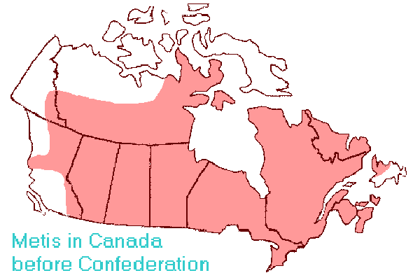

Slide 51
Métis People
In 2011, 451,795 people identified as Métis.
They represented 32.3% of the total Aboriginal population and 1.4% of the total Canadian population.

Slide 52
What is meant by the term Inuit?

Slide 53
Inuit People ☺
The Aboriginal people of Arctic Canada.
The word means "people" in the Inuit language — Inuktitut (Note: “Eskimo” is an outdated and inappropriate term for Inuit)
The singular of Inuit is Inuk.

Slide 54
Inuit People ☺
All Inuit live in four main areas that span from the NWT to Labrador which they call Inuit Nunaat (mean “Inuit Homeland”).
The Inuit live primarily in Nunavut, the Northwest Territories and northern parts of Labrador and Quebec.

Slide 55
Inuit People ☺
They have traditionally lived above the tree line in the area bordered by the Mackenzie Delta in the west, the Labrador coast in the east, the southern point of Hudson Bay in the south and the High Arctic islands in the north.

Slide 56
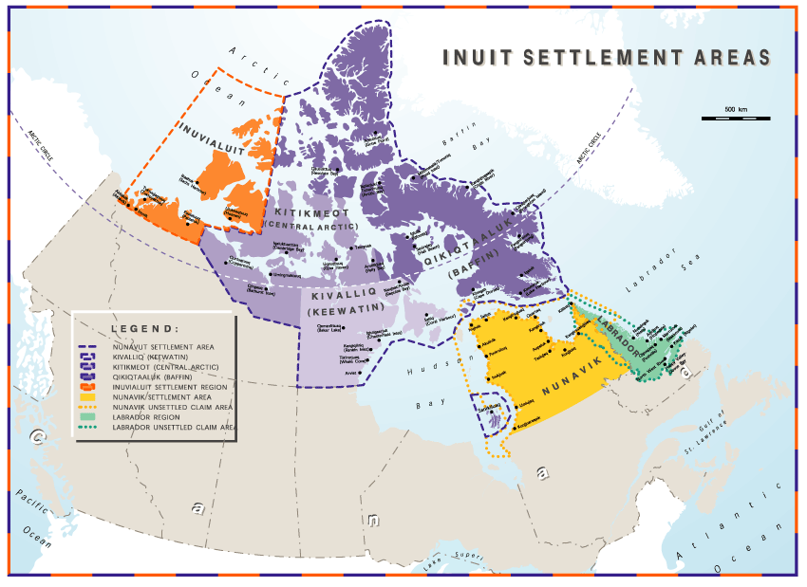

Slide 57
Inuit People ☺
Inuit in Canada have a unique culture, core knowledge and beliefs.
Many Inuit live within their distinct homeland.

Slide 58
Inuit People
In 2011, 59,445 people identified as Inuit.
They represented 4.2% of the total Aboriginal population and 0.2% of the total Canadian population.

Slide 59
Quick Quiz☺
Aboriginal is . . .
an all-encompassing term that includes Inuit, First Nations/Natives (Indians), and Métis.

Slide 60
Quick Quiz☺
"First Peoples" is also . . .
an all-encompassing term that includes Inuit, First Nations (Indians) and Métis.

Slide 61
Quick Quiz☺
Aboriginal and First Nations are NOT . . .
interchangeable terms = they do not have the same meaning; do not relate to the same peoples.

Slide 62
Quick Quiz☺
"Aboriginal" and "First Peoples" ARE . . .
interchangeable terms = "First Peoples" is also an all-encompassing term that includes Inuit, First Nations and Métis.

Slide 63
Quick Quiz☺
Inuit is the . . .
contemporary term for "Eskimo“ – not a commonly used term today.

Slide 64
Quick Quiz☺
First Nation is the . . .
contemporary term for "Indian“ – many find this term offensive/ inappropriate.

Slide 65
Quick Quiz☺
Inuit are "Aboriginal" or "First Peoples", but are not . . .
"First Nations" - Inuit are not First Nations, except the Innu are a First Nations group located in northeastern Quebec and central Labrador; they are represented by the Innu Nation.

Slide 66
Aboriginal Peoples Population:
Young + Growing

Slide 67
The Aboriginal Population is Young ☺
The Aboriginal population is the fastest growing population in Canada and has the most youth.
Aboriginal children aged 14 and under made up 28.0% of the total Aboriginal population and 7.0% of all children in Canada.
Non-Aboriginal children aged 14 and under represented 16.5% of the total non-Aboriginal population.

Slide 68
The Aboriginal Population is Young ☺
Aboriginal youth aged 15 to 24 represented 18.2% of the total Aboriginal population, and 5.9% of all youth in Canada.
Non-Aboriginal youth accounted for 12.9% of the total non-Aboriginal population.

Slide 70
Indigenous students receive free post-secondary education
True or False?
False
  Only “Status-Indians” are eligible to receive post-secondary funding.
    Non-Status, Inuit, Metis – receive nothing.
- post-secondary education funding is part of the legal and constitutional obligation of the federal government. (Set out by the BNA Act/The Indian Act/The Constitution)
- Each Band receives funding from the Cdn. Govt. then must decide who amidst their group can go to post-secondary.
- Ex: Leq’A:mel received $148,731 in 2013 for Education.
- Not Everyone Gets to go.
- Priority is 18 year old (Secondary) Graduates.
- Currently across Canada there are over 10,000 FN people waiting for funding.

Slide 71
Indigenous Peoples living on reserves get free housing
True or False?
False
  The Canada Mortgage and Housing Corporation (CMHC) offers assistance programs to help Status-Indians obtain access to rental-housing.
  The Bands own all the houses on the Reserve; ‘Status Holders’ then lease/rent from the Band.
  You cannot sell the house; because you don’t own the house or the land – meaning you never build up equity in your home (The value doesn’t increase)
  Current Housing Shortage on Reserves: 38,000 – 53,000; grows by 2200 houses per year in Canada.

Slide 72
Outline
CNN 10
Origin Stories – Time Immemorial
  Turtle Island
  Raven and the First People
  Myth Busters

Slide 73
Since time immemorial
Indigenous Presence: Origins

Slide 74
Aboriginal Origins ☺
Indigenous Peoples have been in North America since time immemorial.

Slide 75
Aboriginal Origins ☺
Time immemorial is a phrase meaning time extending beyond the reach of memory, record, or tradition, indefinitely ancient, "ancient beyond memory or record".

Slide 76
Aboriginal Origins ☺
First Peoples have many stories that carry knowledge from ancestors into the present day.
Many of these stories are origin stories about how the world began or how things in the world changed.

Slide 77
Aboriginal Origins ☺
Oral history can be defined as the recording, preservation and interpretation of historical information, based on the personal experiences and opinions of the speaker.

Slide 78
Aboriginal Origins ☺
Oral history often takes the form of eye-witness evidence about past events, but can include folklore, myths, songs and stories passed down over the years by word of mouth.

Slide 79
Aboriginal Origins
In the origin stories told by different Indigenous Peoples across Canada, Sky Woman, Glooscap, Sedna, Nanabush or Raven create the world, or change it into the world known to human beings.

Slide 80
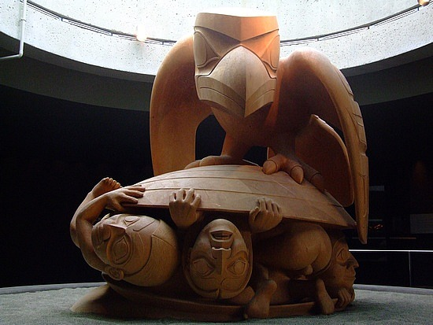
Indigneous Origins
Raven and the First People

Slide 81
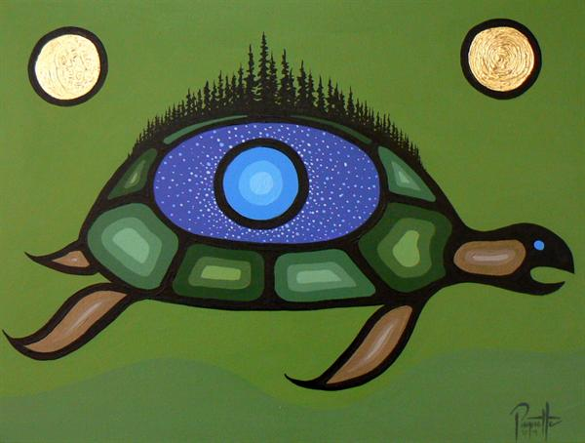
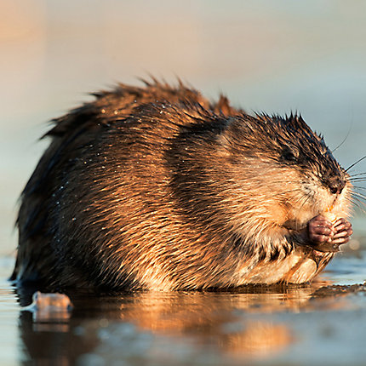
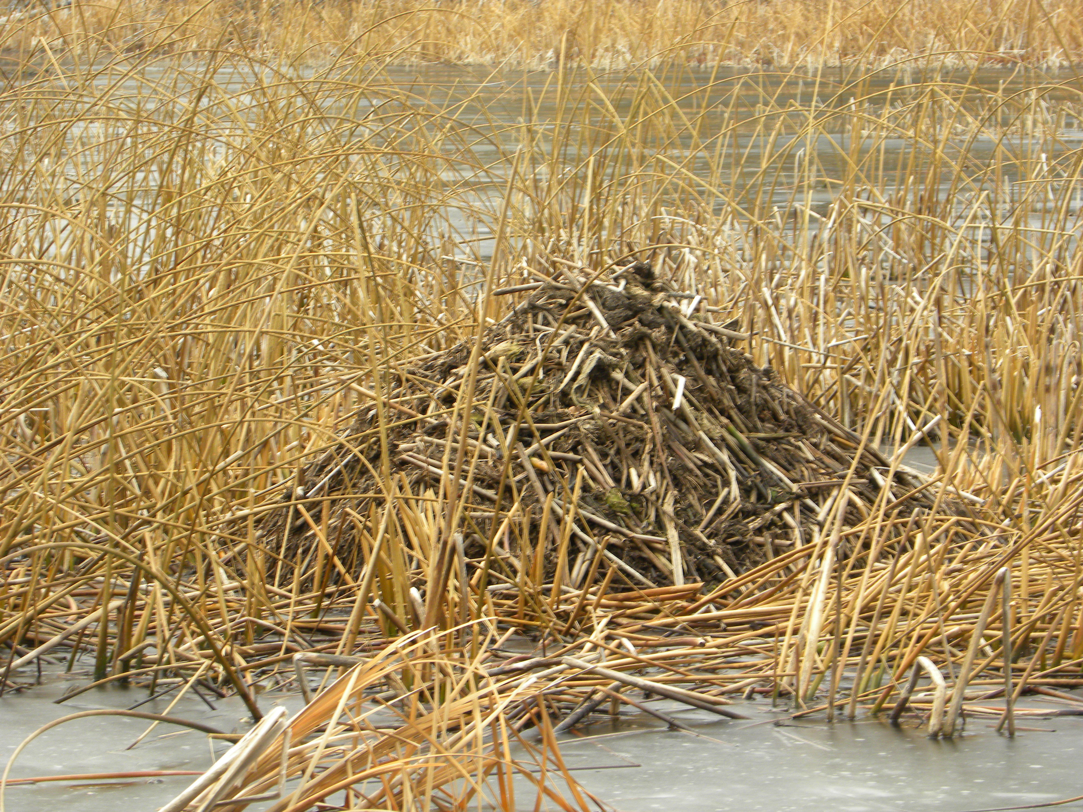
Indigenous Origins
The Creation Story = Turtle Island

Slide 82
Other “Stories” ☺
Many scientists (anthropologists, archeologists) disagree on where the First People came from or how they got to North America.
Scientists know that First Nations and Inuit Peoples have lived in what is now Canada for 12,000+ years because they found bones and artifacts.
Yet many scientists now believed that some of the First Peoples have been here much longer than that. . . since time immemorial.

Slide 83
Other theories: Migration ☺
For several years scientists believed that the ancestors of all North American First Nations crossed over on foot from Asia at the end of the last ice age about 12,000 years ago.
At that time North America and Asia were joined, and what is now the bottom of the Bering Sea between Russia and Alaska was dry land, (a “land bridge”) because sea levels were much lower than they are now = The Bering/Beringia Land Bridge Theory.

Slide 84
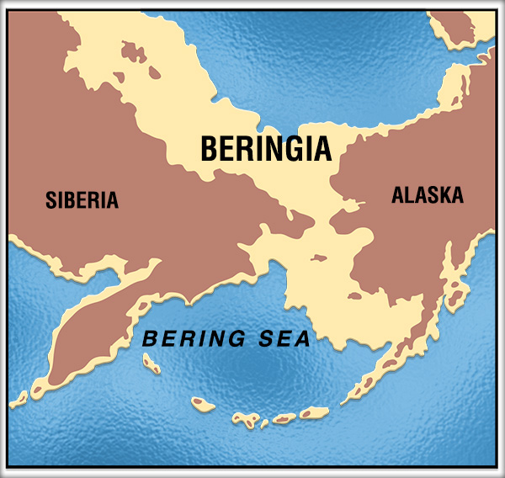

Slide 85
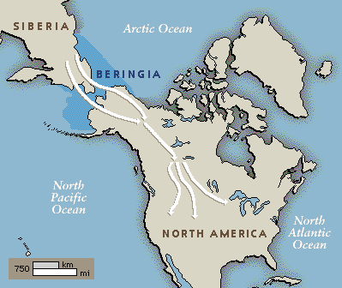

Slide 86
Other theories: Migration
The theory is that nomadic hunting people followed the big animals (moose, deer, elk, buffalo) for food, and eventually moved south and spread out as the ice sheets melted back; then they evolved different cultures to suit different environments.

Slide 87
Other theories: sea routes
Scientists speculate that the ancestors of First Nations people may have come to North America from several different parts of Asia and Polynesia, following several different routes, and maybe over the frozen Atlantic from Europe 6,000 years earlier than the Pacific during the last Ice Age.

Slide 88
Other theories: both
Still others may have crossed the ice fields that once connected Europe and North America.
The Inuit, who live in the high Arctic, were probably the last to arrive.

Slide 89
What is the significance of the scientific theories of first peoples migration to north America?
What could lie under these idea?

Slide 90
Immigrants too?!
But how did First Nations get to the Americas if they have not always been here?
Superiority complex – Europeans looked down on First Nations: “primitive.” with no technology or organized culture.

Slide 91
Immigrants too?!
Identify First Nations as “immigrants” too = no claim to land/rights.

Slide 92
Immigrants too?!
Europeans colonizing North America = land + resource acquisition.
Few, in the past, wanted to credit First Peoples with the ability to use boats or that they have been here since time immemorial.

Slide 93
mythology
Every tribe/nation in North America has a slightly different creation story, but they all are the same in one regard: they state that they have always been.

Slide 94
mythology
Few First Nations (only one group – Coast Salish) have a mythology about Beringia - it is a belief system a point of view constructed by other peoples.

Slide 95
The stories
We still do not “know” how the First Peoples came to North America (or if indeed they did – where always here) but we do have their creation stories which are a version of the truth/the truth.

Slide 97
Myth: Aboriginals can do what they want with their reserve lands and resources
False
  Canadian Govt. passed laws allowing the government to expropriate portions of reserve lands to provide for public utility rights of ways (railways, transmission lines and highways).
  Don’t need First Nations Consent.
  Don’t need to Compensate them.
  Ex: Sumas Lake, Abbotsford

Slide 98
Myth: Aboriginals can do what they want with their reserve lands and resources
False
  Canadian Govt. passed laws allowing the government to expropriate portions of reserve lands to provide for public utility rights of ways (railways, transmission lines and highways).
  Don’t need First Nations Consent.
  Don’t need to Compensate them.
  The Mineral Rights (Oil, Gas, Gold, Copper) found on Reserve Land is owned by the Government (unless stated in a treaty).

Slide 99
Myth: Reservations are Enormous and Never Change in Size
False
  Canada is 9.985 Million Square Kilometers in Size.
  Reservations make up 0.2%
  Reserves are not Traditional Territory.
  Ex: Sumas Lake

Slide 100
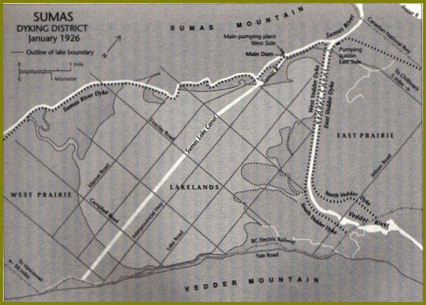
Sumas Lake 1920’s

Slide 101
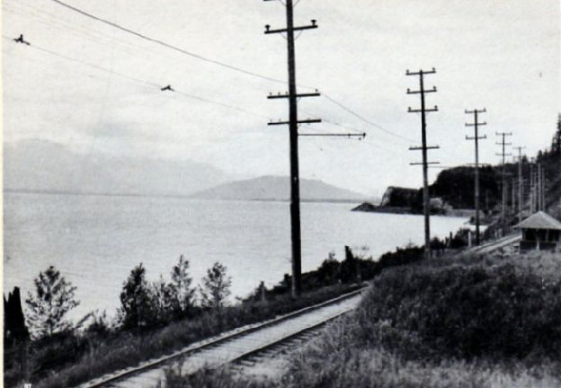
Sumas Lake 1920’s

Slide 102
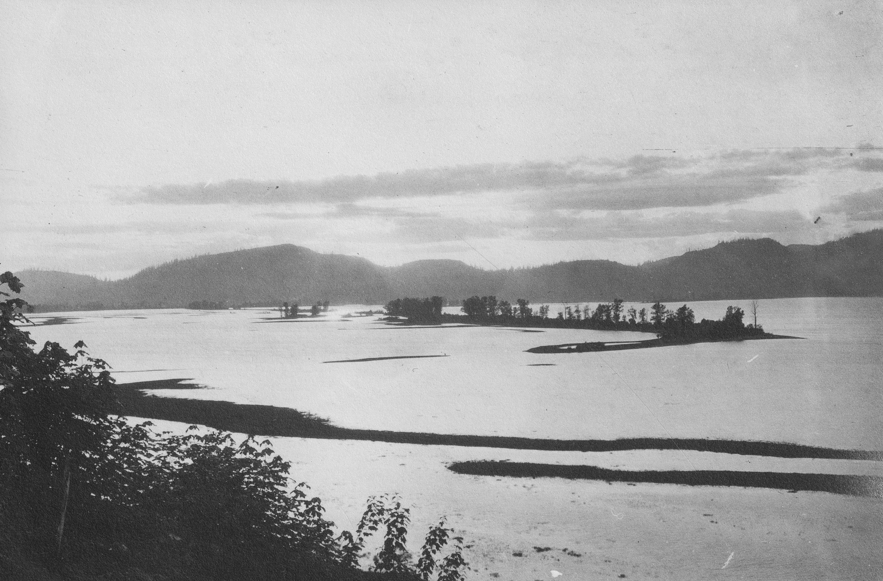
Sumas Lake 1920’s

Slide 103
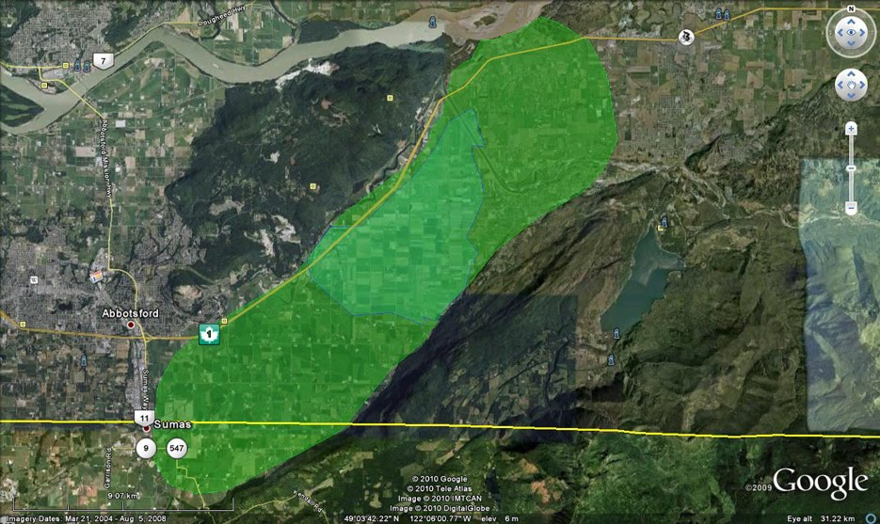
Sumas Lake – 33,000 Acres

Slide 104
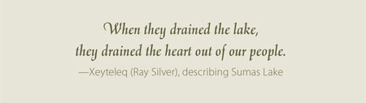
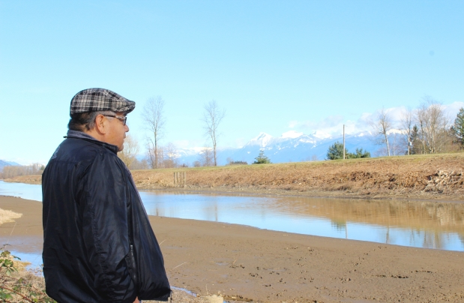

Slide 105
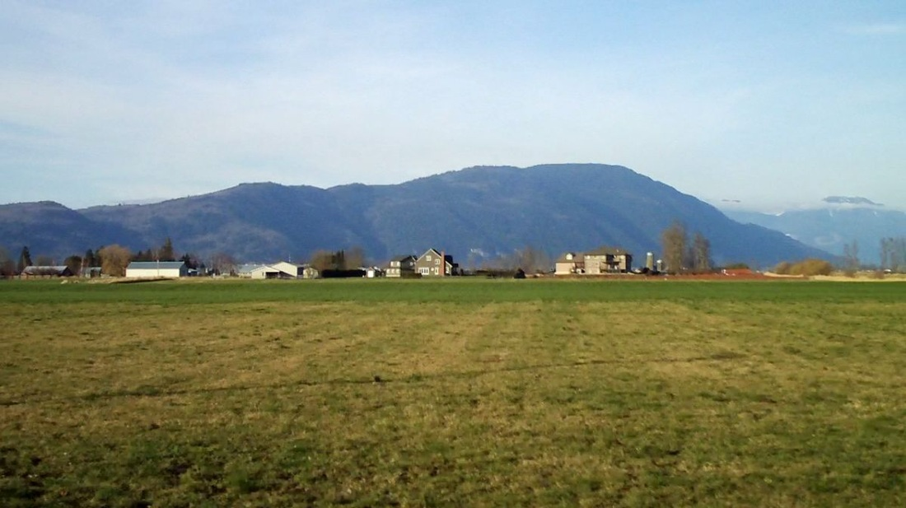
Sumas Lake Today

Slide 106
Origin Story Activity
Step 1 - Google “First Nations Origin Stories”
  Step 2 - Visit a few of the sites.
  Step 3 – Answer the Questions Below on a separate piece of paper.
Where did this Origin Story, originate? Whose Tribe/Band/People does it belong to?
Summarize the Origin Story → Explain what happens, who is involved, what does it lead to?
Create a Venn Diagram illustrating how it relates to the two stories we discussed in class. (What’s similar/different)
Opinion Question: Should we compare/contrast origin stories? What benefit/harm can come of this?

Slide 107
Origin Story Search Results that I found Useful!
Native Creative Myths: Native Creative Stories
Canada Museum of History
Creation/Migration/Origin Stories

Slide 108
Outline
CNN 10
Read Pages 8-15 together.
Note Taking for this Intro.
Haida Gwaii Totem Poles
Two Activities:
  Drawing
  Intro Questions

Slide 109
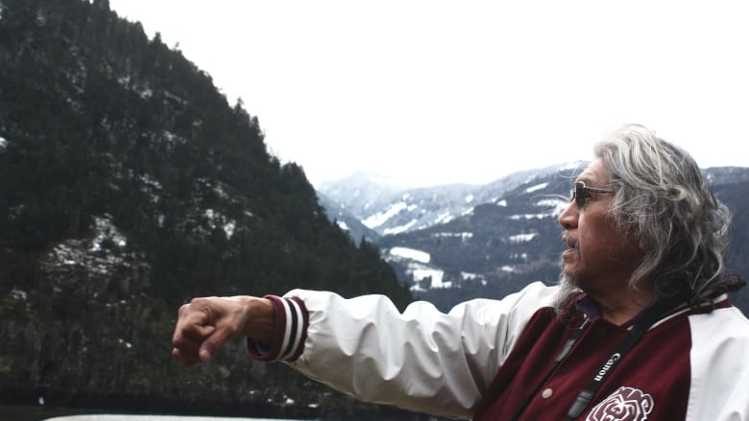
Intro:
The Voice of the Land is our Language
Notes:
Sonny McHalsie, a local elder and Sto:lo knowledge keeper.

Slide 110
Reading – Pg. 8-15

Slide 111
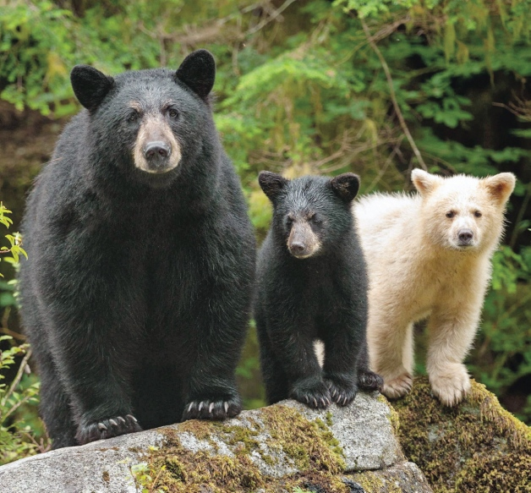
Spirit Bear
Stewardship, Spirituality, and the Land

Slide 112
Classwork
Finish Stations Activity
Finish ‘Origin Story’ Assignment
Begin working on Intro-Drawing Assignment
Begin working on Intro-Questions
Begin working on Totem Poles Research

Slide 113
Myth: Indigenous People Don’t Pay Taxes in Canada
False
  Only Status-Indians don’t pay taxes.
    If they live on the Reserve; no taxes.
    If they live off the Reserve; taxes.
    If they work on the Reserve; no taxes.
    If they work off the Reserve; taxes.
    If they purchase stuff on the Reserve; no taxes
    If they purchase stuff off the Reserve; taxes. (unless it’s being delivered to the reserve)
  Inuit, Metis and Non-Status all pay taxes.

Slide 114
Outline
CNN 10
World Views
Haida Gwaii Totem Poles
  Story of the Haida (6 min Video)
  Haida Totem Pole Carving (5 min Video)
  Classwork!!!!

Slide 115
Acceptable or Un-Acceptable
I’m going to show you a series of statements.
I simply want you to tell me whether they are acceptable or un-acceptable based on our world-view in North America.

Slide 116
Acceptable or Un-Acceptable:
Tipping a Waiter/Waitress
In North-America: Acceptable – It’s actually considered rude sometimes to not tip.
In Asia: Un-Acceptable – It’s considered rude to leave a tip, as workers are paid to do their job and don’t need extra incentive.

Slide 117
Acceptable or Un-Acceptable:
Giving the Thumbs-Up
In North-America: Acceptable – It’s just giving validation to a person for something they did good.
In the Middle East, Latin America, West Africa, Russia and Greece: It’s like giving someone the Middle Finger.

Slide 118
Acceptable or Un-Acceptable:
Opening a Present Immediately
In North-America: Acceptable – It’s expected because the gift giver wants to see your reaction.
In China and India: It’s unacceptable – opening a present in front of someone makes you look greedy.

Slide 119
Acceptable or Un-Acceptable:
Eating an Entire Meal
In North-America: Acceptable – shows you enjoyed the meal provided.
In China, Russia, the Philippines, and Thailand: Unacceptable – it signifies you’re still hungry, and the host failed to give you enough food (making them feel ashamed)

Slide 120
What is a World View?
Making sense of our world
How Do We Make Sense Of Our World?

Slide 121
Through Our World View ☺
Largely it is through our world view, the combination of personal and social understandings which we have of reality.
World view is like an invisible set of rules, behaviors, and experiences that help us understand how the world works.
A worldview is the basic perspective we use to understand the world around us and our experience of it.

Slide 122
World View: Not Realized or Articulated ☺
All of us live out of a worldview perspective, even if we do not realise it, or are unable to articulate it if asked.
What indicates our worldview is not necessarily how we react to individual events or specific situations, but the overall pattern or character of our lifestyle.

Slide 123
How Do We Learn About Our World View?

Slide 124
Learning from Culture, Family + Community ☺
We learn much of our world view from the culture we live in, from our family and significant people in our communities.
We build our attitudes, values, and norms of behaviour based on what we learn through things such as social interaction, languages, food, customs, gestures, rewards, and punishments.

Slide 125
The Lens + Meaning ☺
Through the lens of our world view, we make judgments about people based on how they act and what they say.
Even though we may not be aware of it, the meaning we get from what people do and say is culturally based.

Slide 126
Culture: Our Norm + Difference ☺
Cultural differences may cause us to misinterpret simple things like the nodding of a head, hand gestures, or making eye contact.
In some cultures, direct eye contact when you are speaking to someone is a sign of honesty and openness, while in other societies it is seen as disrespectful.

Slide 127
Cultural Expression =
Understandings or Assumptions? ☺
The context of cultural expressions is important in understanding them.
Often we make assumptions about other people based on our world view, but if our assumptions are wrong, misunderstandings may arise.

Slide 128
What Happens When We Do Not Accept Or Understand Other World Views?

Slide 129
Other Viewpoints Exist:
Beware of Ethnocentrism
Sometimes, if we do not take into account other viewpoints, we may act in a biased or prejudiced way.
Problems occur when people hold the mistaken belief that their world view is the only correct view, or that it is better than others. This is called ethnocentrism.
Ex: Colonialism

Slide 130
Prejudice, Stereotypes, Racism . . .
Out of an ethnocentric viewpoint can grow cultural stereotyping, where we tend to look at people from other cultures in superficial and simplistic ways.
Often, this develops into negative attitudes about people from other groups.

Slide 131
The Roots of Conflict: Awareness Needed
Throughout history, ethnocentrism and cultural stereotyping have been at the root of many conflicts between individuals and groups.
By becoming aware of our own world view, and understanding the cultural context of people with other world views, we can learn to value the rich diversity of cultures.

Slide 132
How Are World Views Connected To Our Basic Beliefs?

Slide 133
World View + Basic Beliefs ☺
World views deal with basic beliefs, not just any belief (an acceptance that a statement is true or that something exists; trust, faith, or confidence in someone or something).

Slide 134
Our Beliefs ☺
Our basic beliefs emerge whenever we enquire about concrete issues in life:
  What do you say to someone who has had a death in their family?
  Why do innocent people suffer?

Slide 135
Our Beliefs
  What should we do about famine, war or genocide?
  What is acceptable in terms of sexuality (your feelings about sex)?
  What is acceptable in terms of nudity?
  What is acceptable in terms of inequality?

Slide 136
How might our worldview affect specific areas?
Roles – How are they created? How does this apply to Gender?
Rituals or Superstition – When is something considered to be “true/real” vs. “made-up/phony”
Social Class and Status – How do we judge someone to be popular? How do we classify people in our society?
Work – Who works? How much time do we spend working? When is it un-acceptable to work?
Time – How does it dictate our lives?

Slide 137
Two World-Views
Western
First Peoples
Scientific/Written Record
There is one truth; based on science.
The land is a resource we should develop and extract.
Time is Linear: months, years, etc.
Humans are most important in the world.
Wealth is beneficial for the individual.
Spirituality/Oral Story
There are multiple truths; based on experiences.
The Land is Sacred.
Time is Cyclical: Seasons/Events.
Humans are not the most important in the world.
Wealth is beneficial for the community.

Slide 138
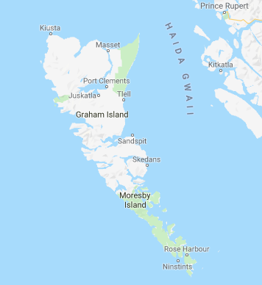
Haida Gwaii
Use to be called the “Queen Charlottes” or “The Charlottes”
June 3rd, 2010 – Reconciliation Act renamed it.
Haida Gwaii translates to “Island of the People”
Over 150 islands make up this Archipelago.
Some of the oldest First Nations sites in Canada, dating back 13,000 years ago.
Notes:
Sonny McHalsie, a local elder and Sto:lo knowledge keeper.

Slide 139
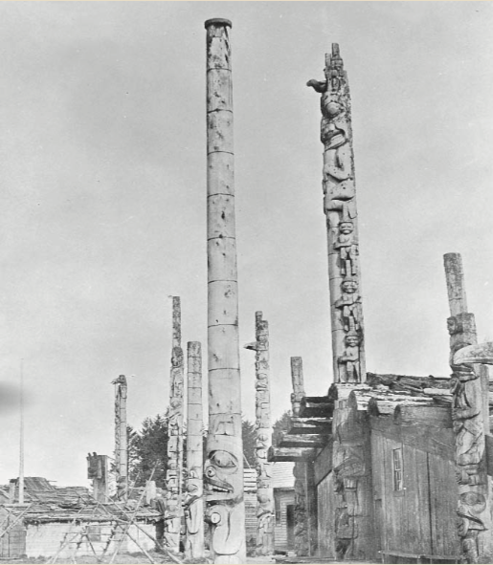
Haida Gwaii, Totem Poles https://indigenousfoundations.arts.ubc.ca/totem_poles/
What is the purpose of the Totem Pole?
What do the symbols represent?
How many types are there?
Explain the process of carving a totem pole, including selection.
Notes:
Sonny McHalsie, a local elder and Sto:lo knowledge keeper.

Slide 140
To Ponder: Dominant World View Vs Distinctive World Views :)
What is the dominant world view in our society? Identify + explain.
How could we communicate our distinctive world view to someone who has had no contact with our society? What would we say?

Slide 141
To Ponder: Dominant World View Vs Distinctive World Views
Can I have a personal world view and also share a cultural world view? Explain.
Can aspects of world views change as a person or group has new or different experiences? Why or why not?
Why do we not normally think about our world view?

Slide 142
Read Blackline Master-Intro 4
What is the world-view being presented here?
Questions to Consider:
  What is this person’s beliefs?
  What are their values?
  What do they care about?

Slide 143
Outline
CNN 10
Journal Prompt
Classwork
  Stations Activity (This should be handed in today)
  Intro Package
    Co-operative Teaching
    Intro Questions
    Haida Totem Poles Questions
    Etc. (This should be handed in today also, come see me if you need an extension)

Slide 144
Journal
“Learning is also reflecting”
We will keep a weekly journal.
Journals will be due every Friday at the end of class.
Journal entries should be 1-2 Paragraphs in length (3-5 sentences per paragraph)
Journals should demonstrate the following:
  New knowledge/Something learned
  Questions being raised
  Insights into local issues
  Changes in beliefs/views

Slide 145
Journal Prompts
Summarize what you have read in the text and other resource materials, or seen in a video.
Include one or two meaningful and thought-pro- voking quotes from the readings.
Describe your personal responses to the readings, discussions, or projects you are working on.
Illustrate (draw) your response to the readings and add a caption that explains your drawing.

Slide 146
Journal Themes
Throughout the book are four major themes.
  Respect
  Relationship with the Land
  Oral Tradition
  Spirituality
    Pg. 10/Pg. 45 offer definitions of Spirituality
    For each journal entry, you are required to reference one of these items.

Slide 147
Journal Entry
Three Items to Write About Today:
1) “What happened next in our world has taken our people to places that were unexpected and at times unbelievable.” What did happen next? What events are being referred to?
  2) What are something's you have learned this first week about First Peoples in B.C.? Tell me about minimum 5 things.
  3) Write me some questions you have about something you learned this week, or just in general.

Slide 148
Outline
CNN 10
Kwakwaka’wakw People @ Alert Bay
  Origin Story
  History
T’LINA THE RENDERING OF WEALTH (FILM)
Questions on the Film

Slide 149
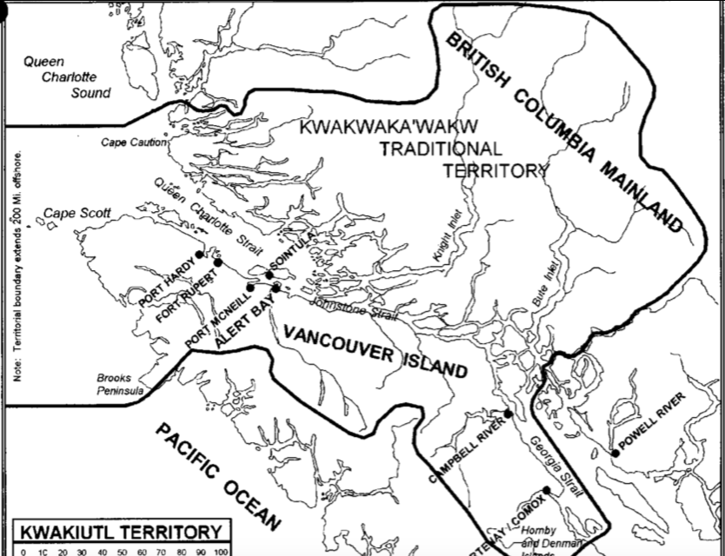

Slide 150
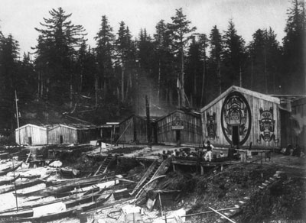
Kwakwaka’wakw
Pronounced - Kwak-wak-ya-wak (Kwakiutl)
Vancouver Island
Lived there for 8,000 years.
3,670 people identity as “Kwakiutl”

Slide 151
The Transformer
Raven and Coyote
According to the Kwakwaka'wakw, before there were humans, the sky, the forests, the underworld and the sea were occupied by supernatural beings who could take on animal or human form at will. It was one of these beings, the Transformer, who wandered through the world making it ready for human occupation by changing some of the other supernatural beings, according to their wishes, into mountains, rocks, islands and rivers. It was the Transformer who created the salmon, the oulachon and other fish and placed them in the rivers and streams and other locations where they are now found. While travelling about the world, the Transformer also permanently changed evil and greedy supernatural beings and people into animals. To others, he gave the proper human form and instructed them in how to live in the world. Some supernatural beings voluntarily shed their supernatural forms to become human.
These first humans appeared at specific locations and founded the first Kwakwaka'wakw families,..." (Speck, 1987: p2)

Slide 152
Creation Story of the Nimpkish River
It is said that Qwa'niqilakw, the Transformer, travelled around the world changing many things. In time, he reached the place where Gwa'nalalis lived. The Transformer asked, "Would you like to become a cedar tree?"
Gwa'nalalis replied, "No, cedar trees, when struck by lighting, split and fall. Then they rot away for as long as the days dawn in the world."
Then Qwa'niqilakw asked, "Would you like to become a mountain?"
"No," said Gwa'nalalis, "for mountains have landslided and I would crumble away as long as the days dawn in the world."
A third time Qwa'niqilakw asked, "would you like to become a boulder?"
Again, Gwa'nalalis replied, "No, do not let me become a boulder, for I may crack in half and crumble for as long as the days dawn in the world."
Finally, the Transformer asked, "Would you like to become a river?"
Gwa'nalalis said, "Yes, let be become a river, that I may flow for as long as the days shall dawn in the world."
This is how the man Gwa'nalalis became the Gwa'ni River, now called the Nimpkish River.

Slide 153
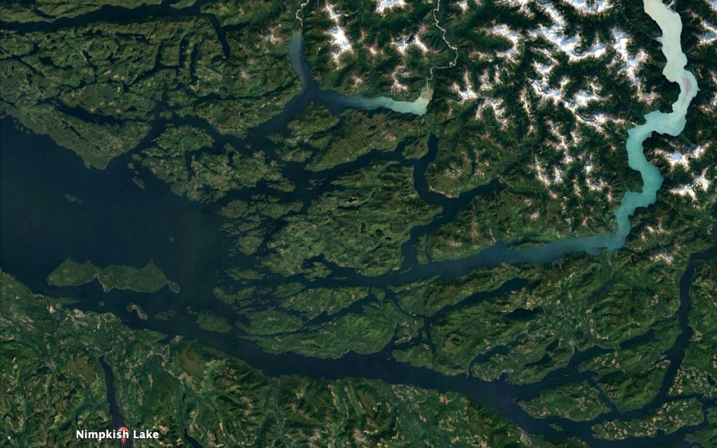
Creation Story of the Nimpkish River

Slide 154
Loss of Land
"The... report recommended that about 47,000 acres of generally speaking good land be taken from the Indians, and about 80,000 acres of generally speaking poor lands, be given in their place... In monetary terms, only $444,838 worth of lands were added to existing reserves whereas $1,522,704 worth of land were cut off." (Speck, 1987:12).

Slide 155
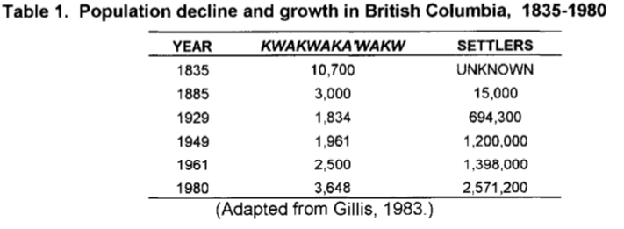
Decline over the Centuries

Slide 157
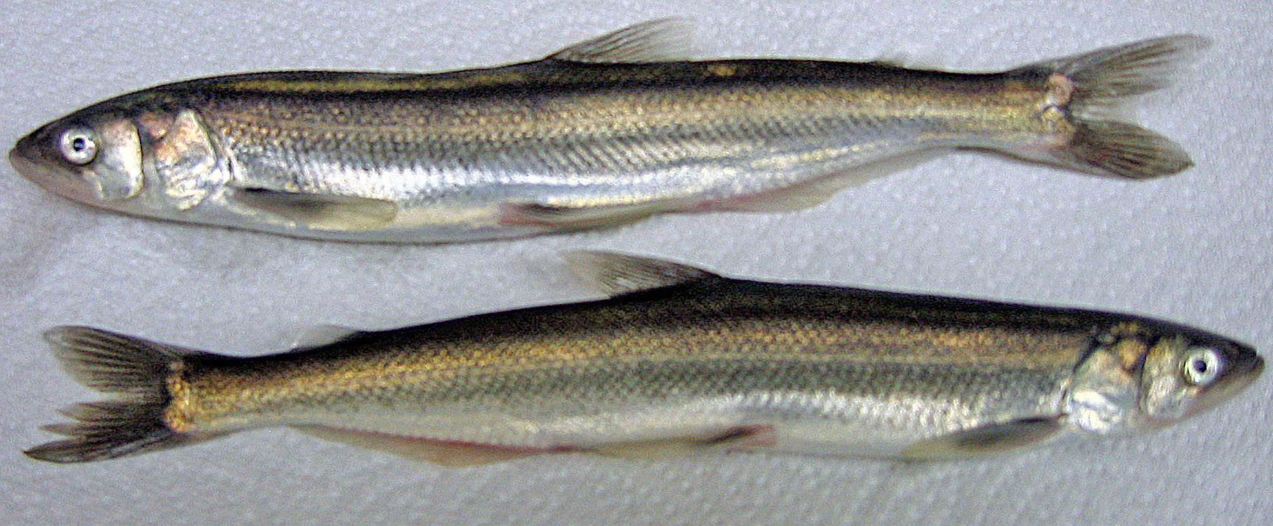
Eulachon (Oolichan) Fishing
Eulachons are small smelt-like fish that are caught by the ton in late March and April. Some are eaten fresh, or smokes and dried.
Used to make eulachon grease or "g'leena".
G'leena is rendered from the eulachons by heating them in a large cedar box after they have been allowed to decompose for several days.
G'leena is a highly valued delicacy.
It is eaten as a condiment with clam or fish chowder, dried fish, potatoes, salads and other foods.
It is often the prize for a charity raffle, or given to important guests at potlatches.

Slide 158
Cost of Fishing for EULACHON
The process of making g'leena takes about a month.
Organizing an expedition requires purchasing groceries for four to 10 people for a month, arranging for transportation to Knight Inlet (about 80 nautical miles by water), small boats, nets, bottles, rendering equipment, camping supplies and equipment, and numerous other supplies and materials.
Often, deals are made over borrowed equipment and other needs, such as "2 gallons to borrow your outboard motor", a family often finds that much of their production is committed before the first gallon is made.
Usually, some g'leena is sold when the expedition returns to cover the cost of expedition expendables such as fuel, groceries and ammunition. The usual price is $100 to $150 per gallon, depending on its quality.

Slide 159
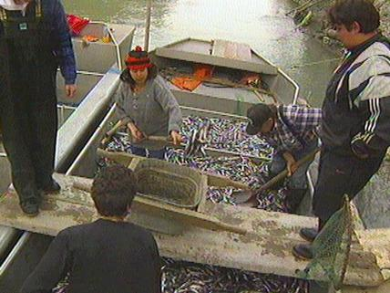
T’Lina: The Rendering of Wealth
Q: What does a “Spiritual Connection” Mean?
*** As you’re watching the film, watch for the “Spiritual Connection” that the people have when they visit Dzawadi.

Slide 160
Classwork
Finish the Questions for the Film.
Finish the Questions for the Introduction.
Finish the Stations Activity.

