Slide 1
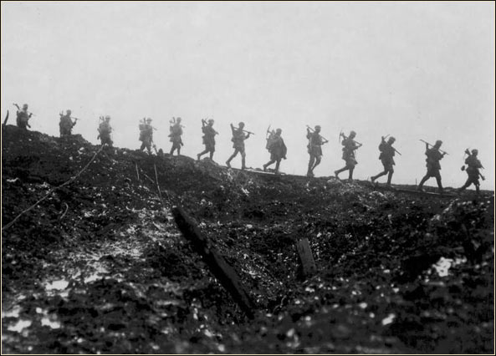
Canada Goes to War

Slide 2
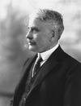
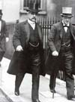
Robert Borden
In the 1911 election Prime Minister Wilfrid Laurier was defeated.
Robert Borden, leader of the Conservative Party, was elected.
He would lead Canada through World War One.

Slide 3
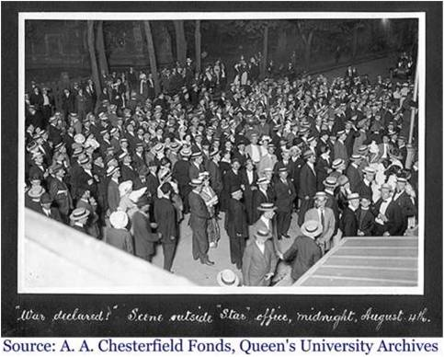
Canada Enters the War
When Germany invaded Belgium, Britain declared war on Germany (August 4, 1914).
Canada was therefore automatically at war with Germany as well.
Canadian leaders were quite unified in their support of Britain.

Slide 4
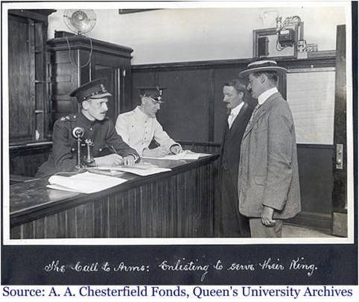
Canada’s First Contribution
Robert Borden established the Canadian Expeditionary Force (CEF).
Two days after the start of the war, Canada offered Britain a force of 25,000 soldiers.
This was quite a commitment considering the population of Canada at this time was only 7 million.

Slide 5
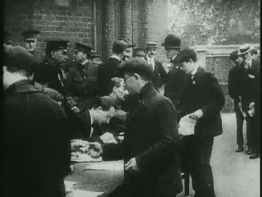
Registration for War

Slide 6

Sam Hughes
Minister of Militia responsible for military spending, training and recruitment.
Canada’s military and navy was very limited prior to the war.

Slide 7
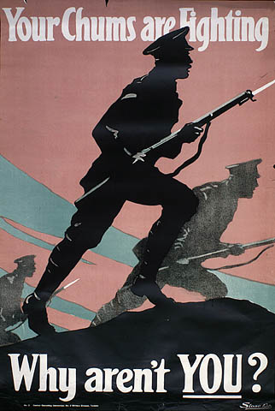
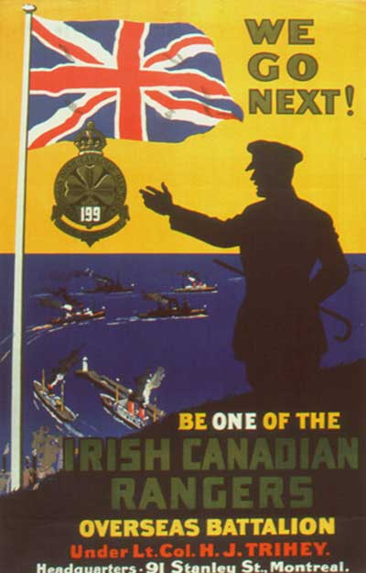
Recruitment of Soldiers
Within a few days the recruiting offices were filled with volunteers.
Many joined for the following reasons:
  1) Sense of Patriotism and Adventure
    Duty to protect Canada
    Form of adventure for young men
  2) Slowing Canadian Economy
    Limited employment
    Military offered secure job ($1 a day pay!)

Slide 8
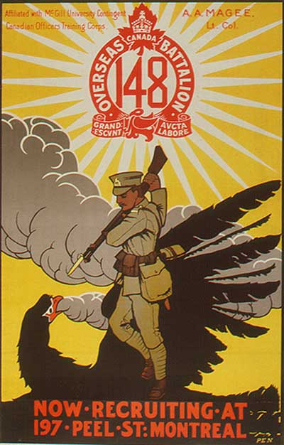
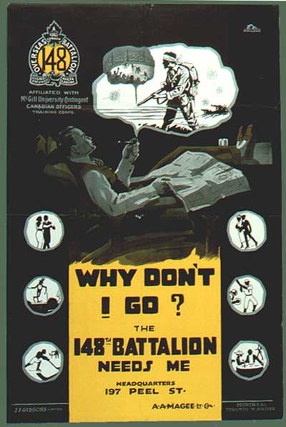
Propaganda posters
Propaganda posters became common on the home front. What are the messages from these posters?
Theme: “Guilt.” You should be at war!
Theme: “Honour.” Help defeat Germany!

Slide 9
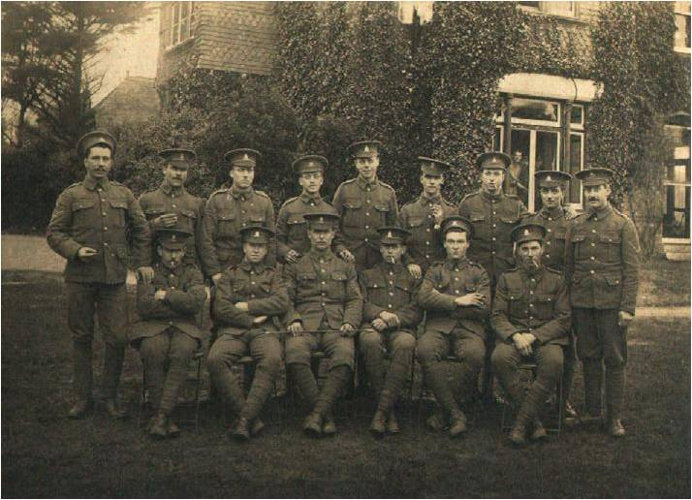
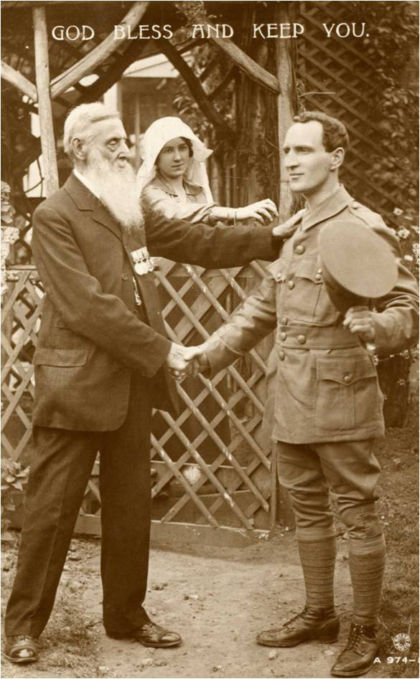
Success of Recruitment
Within one week 10,000 Canadians had volunteered.
They volunteered not only as soldiers, but also as engineers, medics, and construction workers.
Wealthy Canadians donated money and military supplies.

Slide 10
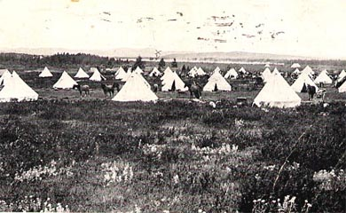
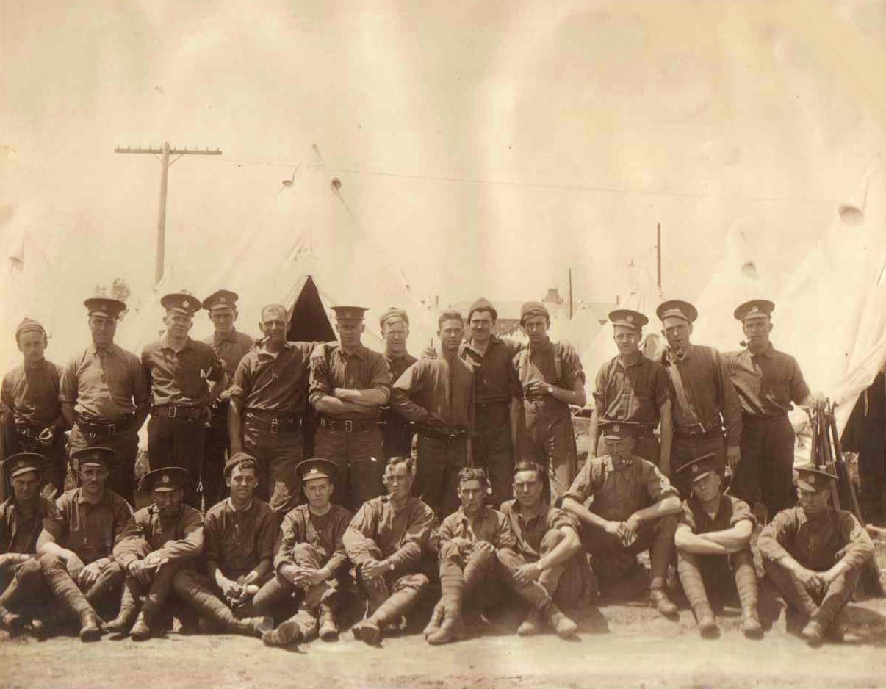
Training the Troops
Hughes set up military training camps at Valcartier, Quebec.
Over 30,000 troops were trained here before being sent to Britain for further training.

Slide 11
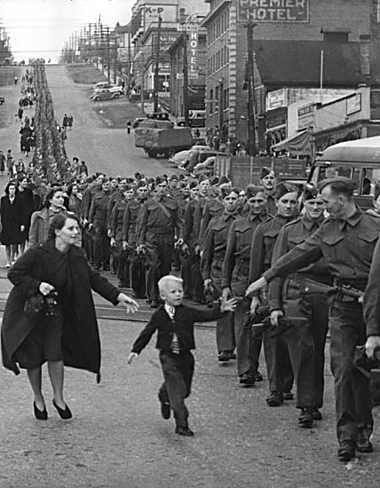
Canadian Troops leaving for Europe

Slide 12
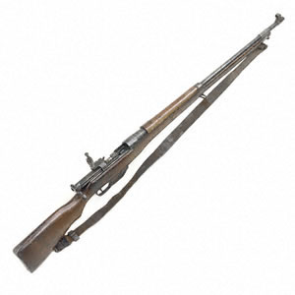
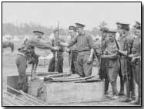
Sam Hughes and the Ross Rifle
The Ross Rifle was a good sharp shooting rifle, but once in battle the rifle would become clogged with mud.
Hughes continued to insist that the rifle was fit for battle.
He was eventually fired by Prime Minister Borden.

Slide 13
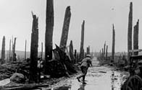
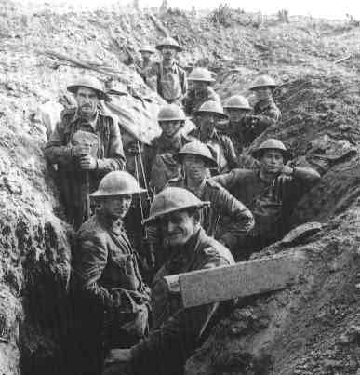
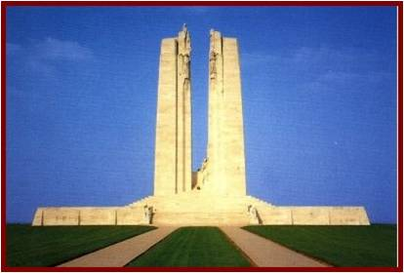
In Battle
In Europe the Canadian troops fought together, but were under the command of a British General named Julian Byng.
The glorious victories they had imagined soon were replaced with the awful realities of war.

