Slide 1
Outline
CNN 10
Constitutional Monarch
Political Parties
The Federal System
The Executive Branch
Classwork

Slide 2
Canada is a …
The Government obeys the people.
The People have the power and rule.
Democracy
And a
Federal State
And also a
A Constitutional Monarchy
That uses the
Parliamentary System
To give Canadians
Responsible Government
Canada has many different levels of Govt.
They all share power with each other
Canada has a Queen. Her power is symbolic (not real).
We have a constitution – a document that protects our rights.
We elect people to represent us in Government (Parliament)

Slide 3
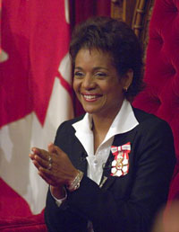
Constitutional Monarchy
☺
Our Constitutional Monarch is Queen Elizabeth II.
The Monarch is currently the head of our state. They have little or no power, but perform more of a symbolic role.
They are responsible for appointing the Governor General.
The Governor General is responsible for representing Canada in many situations.
Her Excellency the Right Honourable Michaëlle Jean

Slide 4
The Governor General is appointed by the monarch on the advice of the Canadian parliament.
The Governor Generals responsibilities include: the opening of parliament
  Giving royal assent to laws.
  Greeting officials
  Giving out awards
The Governor General’s role is purely symbolic
☺

Slide 5

The Party System
☺
A political party is a group of people that represent the citizens of Canada at a Federal level. They have common beliefs and ideas and plans of how to govern.
A common set of beliefs is called an ideology.
Political parties may be active through all levels of government. They can choose how active they are and at what level.

Slide 6

Representative Democracy
☺
Canada is a Democracy. This means that the people govern the nation.
Individual citizens give their power to an elected representative who acts on their behalf.
By voting we choose who will best represent our beliefs and interests. The elected representative is accountable to the voter.

Slide 7
The Federal System
☺
A system of government that is responsible for handling decisions made on behalf of all Canadian Citizens.
A federal system was created in order to assure the equality among provinces and also to create a consistent national policy followed by all Canadians.

Slide 8
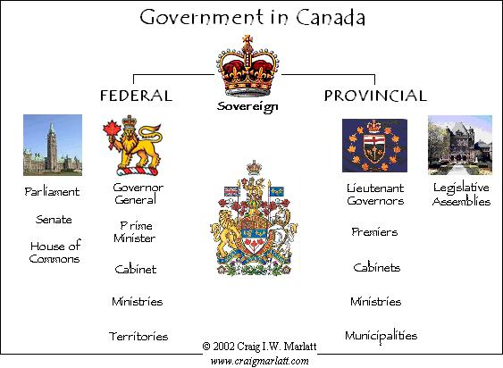
Levels of Government

Slide 9
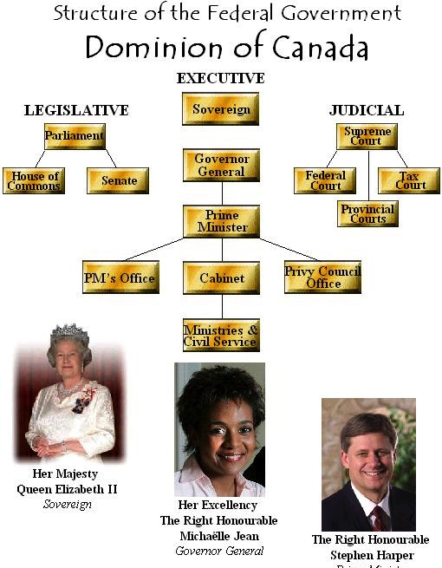

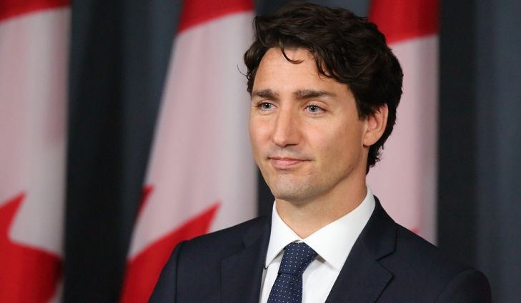
Prime Minister
Justin Trudeau
Her Right Honorable
Governor General of Canada
Julie Payette

Slide 10
The Prime Minister recommends people to the Governor General to be appointed to the Cabinet (35 Ministries they Oversee)
Minister of Public Safety and Emergency Preparedness
Minister of Veterans Affairs
Minister of Crown-Indigenous Relations
Minister of Innovation, Science and Economic Development
Minister of Finance
Minister of Transport

Slide 11
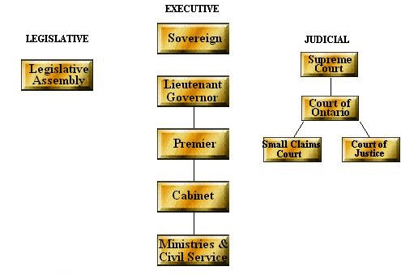

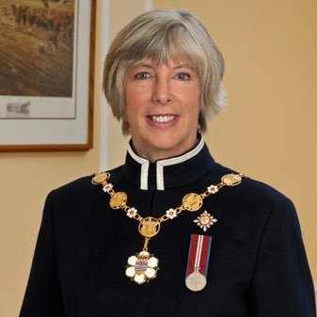
Structure of the Provincial Government
Province of British Colombia
Judith Guichon
Lieutenant Governor of B.C.
John Horgan
Premiere of B.C.

Slide 12
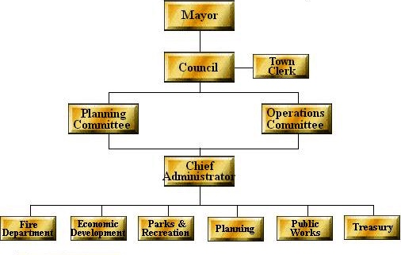
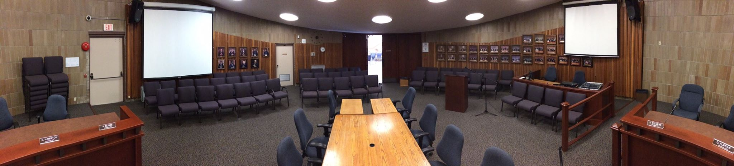

Structure of the Municipal Government
Municipality of Mission, British Colombia
Honorable Mayor – Pam Alexis

Slide 13
Federal System
☺
Three levels of government:
  Federal (most power)
  Provincial
  Municipal
All levels of government can make laws, but the Federal government prevails when the laws are in conflict.
Residual Powers – Decision making not in the 1867 constitution given to the Federal government. (Example – Internet, Air Traffic Control)

Slide 14
The Executive Branch
☺
The executive branch of Canada is composed of three elements – the symbolic, political and permanent - that work together as the government.
The symbolic executive is composed of the Queen, who is the legal head of state of Canada, and her representatives, who fulfill the monarch's daily duties in Canada.

Slide 15
The political executive is the leading element of the executive branch. The Prime Minister is the head of government. This includes their Cabinet.
The permanent executive is the body of professional civil servants who manage and administer the government's policies.
☺

Slide 16
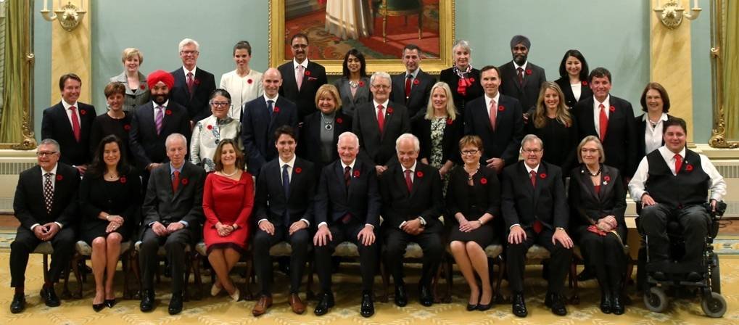
☺
Can. Fed. Cabinet 2018
The executive branch has two distinct roles to play in governing the country:
• to decide on the need for new laws and to introduce new laws
• to enforce a law once it is passed

Slide 17
Classwork
Please finish the Charter of Rights and Freedoms.

