Slide 1
Outline
CNN 10
Terminology: Aboriginal, First Nation, Metis and Inuit.
Mythbusters
Time Immemorial – Origin Stories

Slide 2
What is meant by the term Aboriginal?

Slide 3
Aboriginal People ☺
An umbrella/all-encompassing term that refers in Canada to people who identify as Inuit, Metis or First Nations/Native.
First Peoples and Indigenous are also umbrella terms.

Slide 4
Aboriginal People ☺
Aboriginal people are the indigenous peoples of Canada/North America - the descendants of the original inhabitants of this continent.
Indigenous means "native to the area."

Slide 5
Aboriginal People ☺
The Canadian Constitution recognizes three groups of Aboriginal people — First Nations (“Indians”), Métis and Inuit.
These are three separate peoples with unique heritages, languages, cultural practices and spiritual beliefs.

Slide 6
Aboriginal People ☺
Aboriginal peoples are made up of diverse groups living across the country.
1,400,685 people identified an Aboriginal identity in 2011, representing 4.3% of the total Canadian population.

Slide 7
Aboriginal People
The largest numbers of Aboriginal people live in Ontario and the western provinces (Manitoba, Saskatchewan, Alberta, and British Columbia).
Aboriginal people make up the largest shares of the population of Nunavut and the Northwest Territories.

Slide 8
What is meant by the term Indigenous?

Slide 9
Indigenous Peoples ☺
An umbrella/all-encompassing term that refers in Canada to people who identify as Inuit, Metis or First Nations/Native.
First Peoples and Indigenous are also umbrella terms.

Slide 10
What is meant by the term First Nations?

Slide 11
First Nations People ☺
A term that came into common usage in the 1970s to replace the word "Indian" which many people found offensive/derogatory/inappropriate.
Although the term First Nation/Native is widely used, no legal definition of it exists.

Slide 12
First Nations People ☺
Among its uses, the term "First Nations peoples" refers to the “Indian” peoples in Canada, both Status and non-Status.
There are apparently legal reasons for the continued use of the term “Indian.”

Slide 13
First Nations People ☺
Such terminology is recognized in the Indian Act, Section 35 of the Constitution Act, and is used by the Government of Canada when making reference to this particular group of Aboriginal people.

Slide 14
First Nations People
Status Indian =
A person who is registered as an First Nations (“Indian”) under the Indian Act.
The act sets out the requirements for determining who is an “Indian” for the purposes of the Indian Act.

Slide 15
First Nations People
Non-Status Indian =
An First Nations (“Indian”) person who is not registered as an “Indian” under the Indian Act.

Slide 16
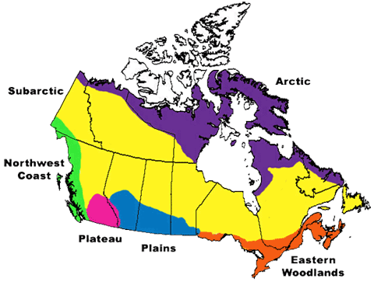

Slide 17
First Nations People ☺
In 2011, 851,560 people identified as a First Nations person, representing 60.8% of the total Aboriginal population and 2.6% of the total Canadian population.

Slide 18
First Nations People ☺
In 2011, 637,660 First Nations people reported being Registered Indians, representing 74.9% of all First Nations people, 45.5% of the total Aboriginal population and 1.9% of the total Canadian population.

Slide 19
First Nations People ☺
There are more than 600 First Nations/Indian bands (614 actually) in Canada (for example, Musqueam Indian Band, in British Columbia, Sturgeon Lake First Nation, in Alberta, and Atikamekw of Manawan, in Quebec) and over 60 Aboriginal languages reported by First Nations people – an indication of the diversity of First Nations people across the country.

Slide 20
What is meant by the term Métis?

Slide 21
Métis People ☺
People of mixed First Nation and European ancestry who identify themselves as Métis, as distinct from First Nations people, Inuit or non-Aboriginal people.
The word Métis is French for "mixed blood.”

Slide 22
Métis People ☺
The Canadian Constitution recognizes Métis people as one of the three Aboriginal peoples.
The Métis have a unique culture that draws on their diverse ancestral origins, such as Scottish, French, Ojibway and Cree.

Slide 23
Métis People ☺
The Métis originated in the mid-1800s in the Red River district of what is now known as Manitoba.
Historically, the term Métis applied to the children of French fur traders and Cree women in the Prairies and of English and Scottish traders and Dene women in the North.

Slide 24
Métis People ☺
Today, the term is used broadly to describe people with mixed First Nations and European ancestry who identify themselves as Métis, distinct from Indian people, Inuit or non-Aboriginal people.

Slide 25
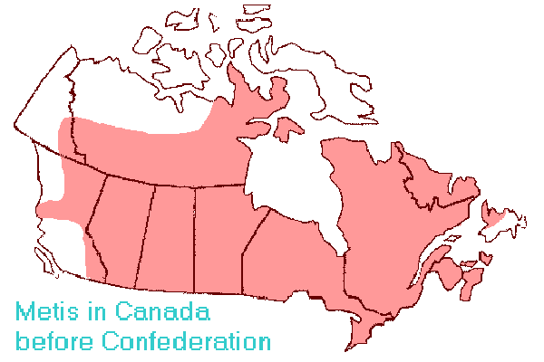

Slide 26
Métis People
In 2011, 451,795 people identified as Métis.
They represented 32.3% of the total Aboriginal population and 1.4% of the total Canadian population.

Slide 27
What is meant by the term Inuit?

Slide 28
Inuit People ☺
The Aboriginal people of Arctic Canada.
The word means "people" in the Inuit language — Inuktitut (Note: “Eskimo” is an outdated and inappropriate term for Inuit)
The singular of Inuit is Inuk.

Slide 29
Inuit People ☺
All Inuit live in four main areas that span from the NWT to Labrador which they call Inuit Nunaat (mean “Inuit Homeland”).
The Inuit live primarily in Nunavut, the Northwest Territories and northern parts of Labrador and Quebec.

Slide 30
Inuit People ☺
They have traditionally lived above the tree line in the area bordered by the Mackenzie Delta in the west, the Labrador coast in the east, the southern point of Hudson Bay in the south and the High Arctic islands in the north.

Slide 31
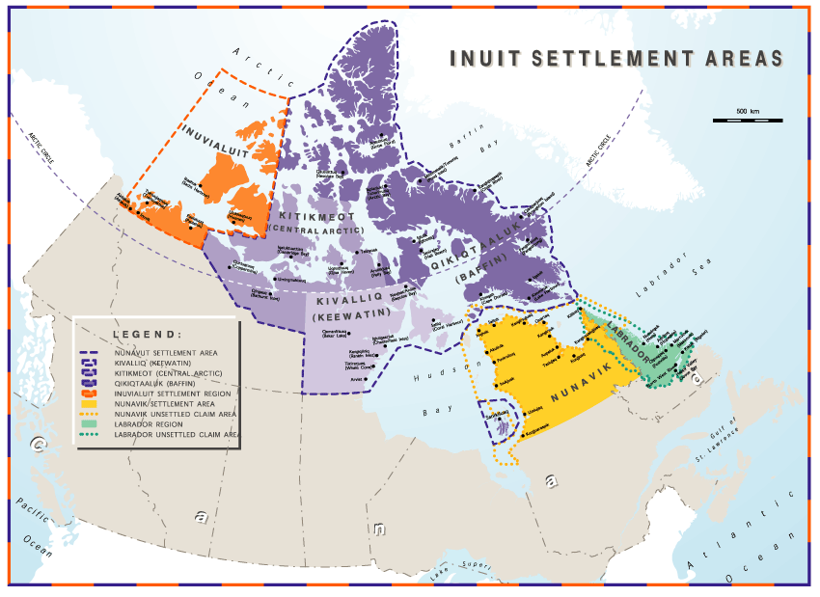

Slide 32
Inuit People ☺
Inuit in Canada have a unique culture, core knowledge and beliefs.
Many Inuit live within their distinct homeland.

Slide 33
Inuit People
In 2011, 59,445 people identified as Inuit.
They represented 4.2% of the total Aboriginal population and 0.2% of the total Canadian population.

Slide 34
Quick Quiz☺
Aboriginal is . . .
an all-encompassing term that includes Inuit, First Nations/Natives (Indians), and Métis.

Slide 35
Quick Quiz☺
"First Peoples" is also . . .
an all-encompassing term that includes Inuit, First Nations (Indians) and Métis.

Slide 36
Quick Quiz☺
Aboriginal and First Nations are NOT . . .
interchangeable terms = they do not have the same meaning; do not relate to the same peoples.

Slide 37
Quick Quiz☺
"Aboriginal" and "First Peoples" ARE . . .
interchangeable terms = "First Peoples" is also an all-encompassing term that includes Inuit, First Nations and Métis.

Slide 38
Quick Quiz☺
Inuit is the . . .
contemporary term for "Eskimo“ – not a commonly used term today.

Slide 39
Quick Quiz☺
First Nation is the . . .
contemporary term for "Indian“ – many find this term offensive/ inappropriate.

Slide 40
Quick Quiz☺
Inuit are "Aboriginal" or "First Peoples", but are not . . .
"First Nations" - Inuit are not First Nations, except the Innu are a First Nations group located in northeastern Quebec and central Labrador; they are represented by the Innu Nation.

Slide 41
Aboriginal Peoples Population: Young + Growing

Slide 42
The Aboriginal Population is Young ☺
The Aboriginal population is the fastest growing population in Canada and has the most youth.
Aboriginal children aged 14 and under made up 28.0% of the total Aboriginal population and 7.0% of all children in Canada.
Non-Aboriginal children aged 14 and under represented 16.5% of the total non-Aboriginal population.

Slide 43
The Aboriginal Population is Young ☺
Aboriginal youth aged 15 to 24 represented 18.2% of the total Aboriginal population, and 5.9% of all youth in Canada.
Non-Aboriginal youth accounted for 12.9% of the total non-Aboriginal population.

Slide 44
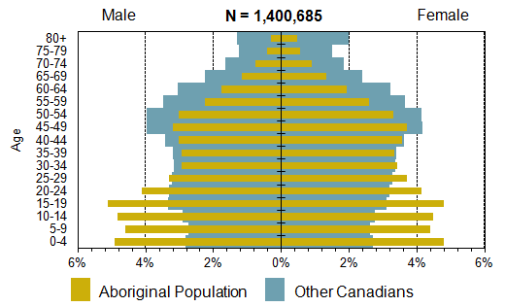
What do you notice in this Population Pyramid?

Slide 45
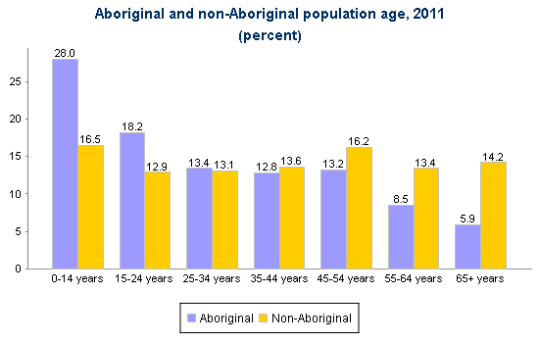
What do you notice in this Bar Graph?

Slide 46
Where do Aboriginal people live in Canada?

Slide 47
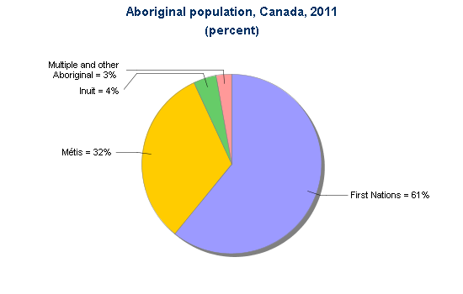
Population of Aboriginal Peoples in Canada

Slide 48
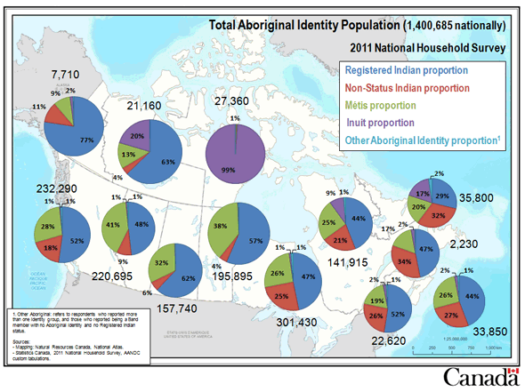
Total Population Distribution

Slide 49
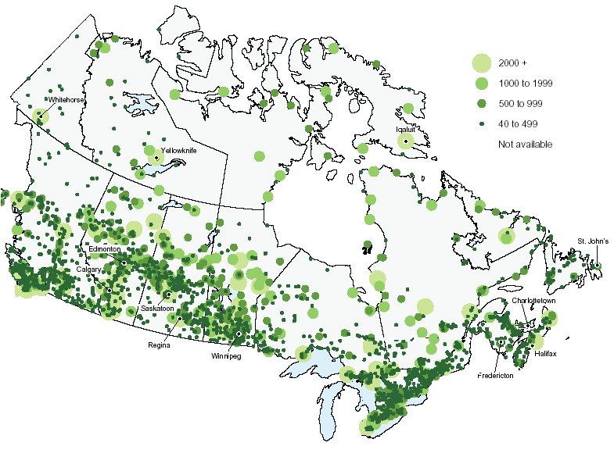
Population Distribution

Slide 50
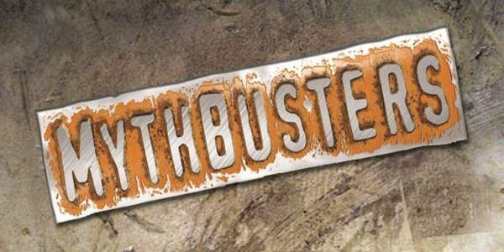

Slide 51
Indigenous students receive free post-secondary education True or False?
False
Only “Status-Indians” are eligible to receive post-secondary funding.
Non-Status, Inuit, Metis – receive nothing.
- post-secondary education funding is part of the legal and constitutional obligation of the federal government. (Set out by the BNA Act/The Indian Act/The Constitution)
- Each Band receives funding from the Cdn. Govt. then must decide who amidst their group can go to post-secondary.
- Ex: Leq’A:mel received $148,731 in 2013 for Education.
- Not Everyone Gets to go.
- Priority is 18 year old (Secondary) Graduates.
- Currently across Canada there are over 10,000 FN people waiting for funding.

Slide 52
Indigenous Peoples living on reserves get free housing True or False?
False
The Canada Mortgage and Housing Corporation (CMHC) offers assistance programs to help Status-Indians obtain access to rental-housing.
The Bands own all the houses on the Reserve; ‘Status Holders’ then lease/rent from the Band.
You cannot sell the house; because you don’t own the house or the land – meaning you never build up equity in your home (The value doesn’t increase)
Current Housing Shortage on Reserves: 38,000 – 53,000; grows by 2200 houses per year in Canada.

Slide 53
Outline
CNN 10
Origin Stories – Time Immemorial
Turtle Island
Raven and the First People

Slide 54
Since time immemorial
Indigenous Presence: Origins

Slide 55
Aboriginal Origins ☺
Indigenous Peoples have been in North America since time immemorial.

Slide 56
Aboriginal Origins ☺
Time immemorial is a phrase meaning time extending beyond the reach of memory, record, or tradition, indefinitely ancient, "ancient beyond memory or record".

Slide 57
Aboriginal Origins ☺
First Peoples have many stories that carry knowledge from ancestors into the present day.
Many of these stories are origin stories about how the world began or how things in the world changed.

Slide 58
Aboriginal Origins ☺
Oral history can be defined as the recording, preservation and interpretation of historical information, based on the personal experiences and opinions of the speaker.

Slide 59
Aboriginal Origins ☺
Oral history often takes the form of eye-witness evidence about past events, but can include folklore, myths, songs and stories passed down over the years by word of mouth.

Slide 60
Aboriginal Origins
In the origin stories told by different Indigenous Peoples across Canada, Sky Woman, Glooscap, Sedna, Nanabush or Raven create the world, or change it into the world known to human beings.

Slide 61
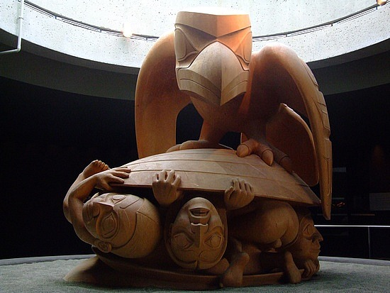
Indigneous Origins
Raven and the First People

Slide 62
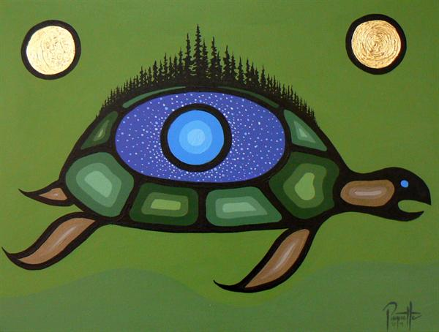
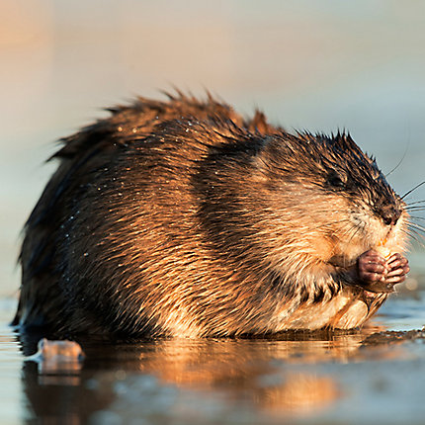
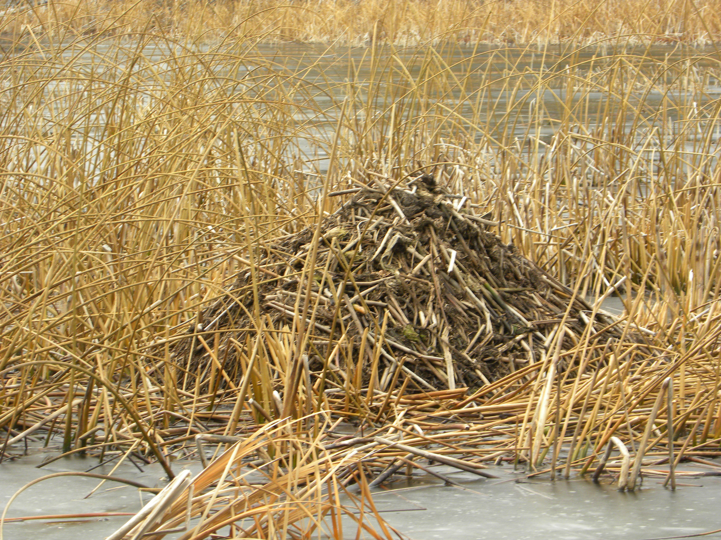
Indigenous Origins
The Creation Story = Turtle Island

Slide 63
Other “Stories” ☺
Many scientists (anthropologists, archeologists) disagree on where the First People came from or how they got to North America.
Scientists know that First Nations and Inuit Peoples have lived in what is now Canada for 12,000+ years because they found bones and artifacts.
Yet many scientists now believed that some of the First Peoples have been here much longer than that. . . since time immemorial.

Slide 64
Other theories: Migration ☺
For several years scientists believed that the ancestors of all North American First Nations crossed over on foot from Asia at the end of the last ice age about 12,000 years ago.
At that time North America and Asia were joined, and what is now the bottom of the Bering Sea between Russia and Alaska was dry land, (a “land bridge”) because sea levels were much lower than they are now = The Bering/Beringia Land Bridge Theory.

Slide 65
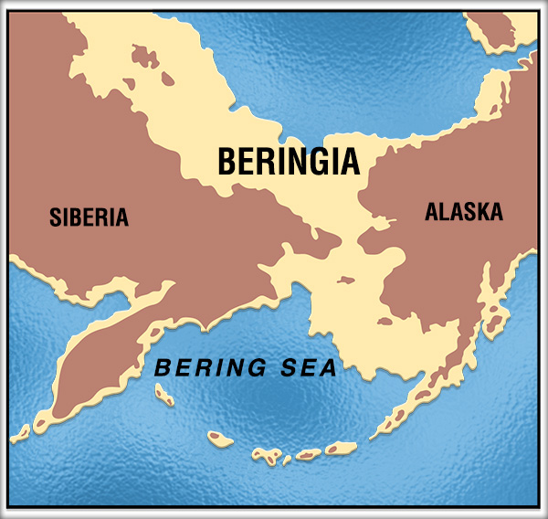

Slide 66
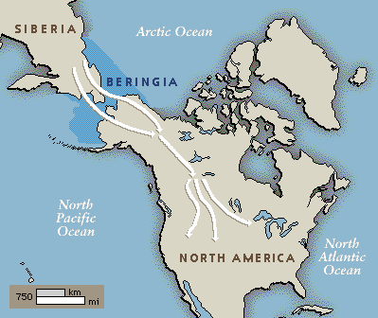

Slide 67
Other theories: Migration
The theory is that nomadic hunting people followed the big animals (moose, deer, elk, buffalo) for food, and eventually moved south and spread out as the ice sheets melted back; then they evolved different cultures to suit different environments.

Slide 68
Other theories: sea routes
Scientists speculate that the ancestors of First Nations people may have come to North America from several different parts of Asia and Polynesia, following several different routes, and maybe over the frozen Atlantic from Europe 6,000 years earlier than the Pacific during the last Ice Age.

Slide 69
Other theories: both
Still others may have crossed the ice fields that once connected Europe and North America.
The Inuit, who live in the high Arctic, were probably the last to arrive.

Slide 70
What is the significance of the scientific theories of first peoples migration to north America?
What could lie under these idea?

Slide 71
Immigrants too?!
But how did First Nations get to the Americas if they have not always been here?
Superiority complex – Europeans looked down on First Nations: “primitive.” with no technology or organized culture.

Slide 72
Immigrants too?!
Identify First Nations as “immigrants” too = no claim to land/rights.

Slide 73
Immigrants too?!
Europeans colonizing North America = land + resource acquisition.
Few, in the past, wanted to credit First Peoples with the ability to use boats or that they have been here since time immemorial.

Slide 74
mythology
Every tribe/nation in North America has a slightly different creation story, but they all are the same in one regard: they state that they have always been.

Slide 75
mythology
Few First Nations (only one group – Coast Salish) have a mythology about Beringia - it is a belief system a point of view constructed by other peoples.

Slide 76
The stories
We still do not “know” how the First Peoples came to North America (or if indeed they did – where always here) but we do have their creation stories which are a version of the truth/the truth.

