Slide 1
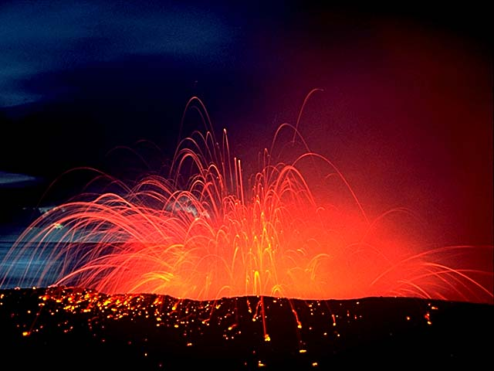
Oh Hot Damn…

Slide 2
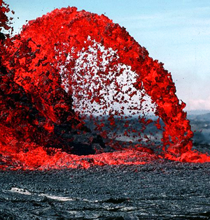
What is a volcano?
☺
Volcano: an opening in Earth’s crust through which molten rock, rock fragments, and hot gases erupt.

Slide 3
What’s that Red Molten Rock called?
☺
It depends on the location.
If it’s located inside the earth’s crust, it is called magma.
If it’s located outside the earth’s crust, on the surface, it is called lava.

Slide 4
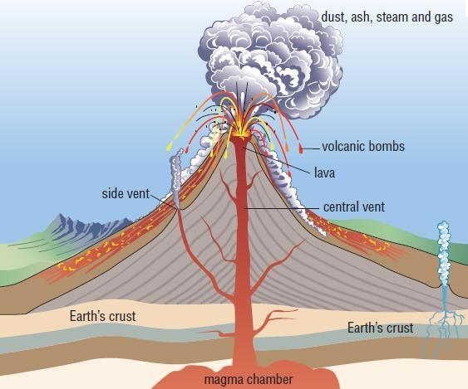
☺

Slide 5
Where do volcanoes occur?
☺
Most form along plate boundaries ….
1. in subduction zones (one plate sinks under another) (B.C. Coast)
2. over hot spots
3. where plates are pulling apart

Slide 6
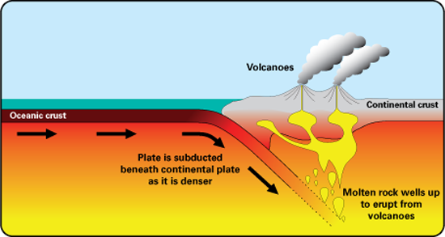
How do they form

Slide 7
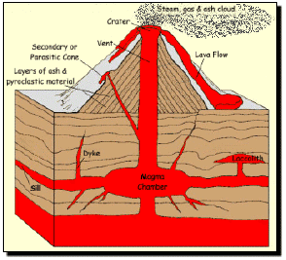
The Inner workings of the Volcano
Important
Magma is Inside the Earth
When Magma exits the Aesthenosphere it becomes Lava

Slide 8
How do they form
☺
Divergent Plates
As the plates split apart, magma from the asthenosphere comes up into the lithosphere.
Convergent Plates
As the plates collide together, one is heavier than the other and is pushed underneath.
This forms large cracks in the earth’s surface which allow for magma to flow into.
Overtime magma will push up through these cracks and form a volcano.
Hot Spots
Occur at random hot spots on the earth’s surface.

Slide 9
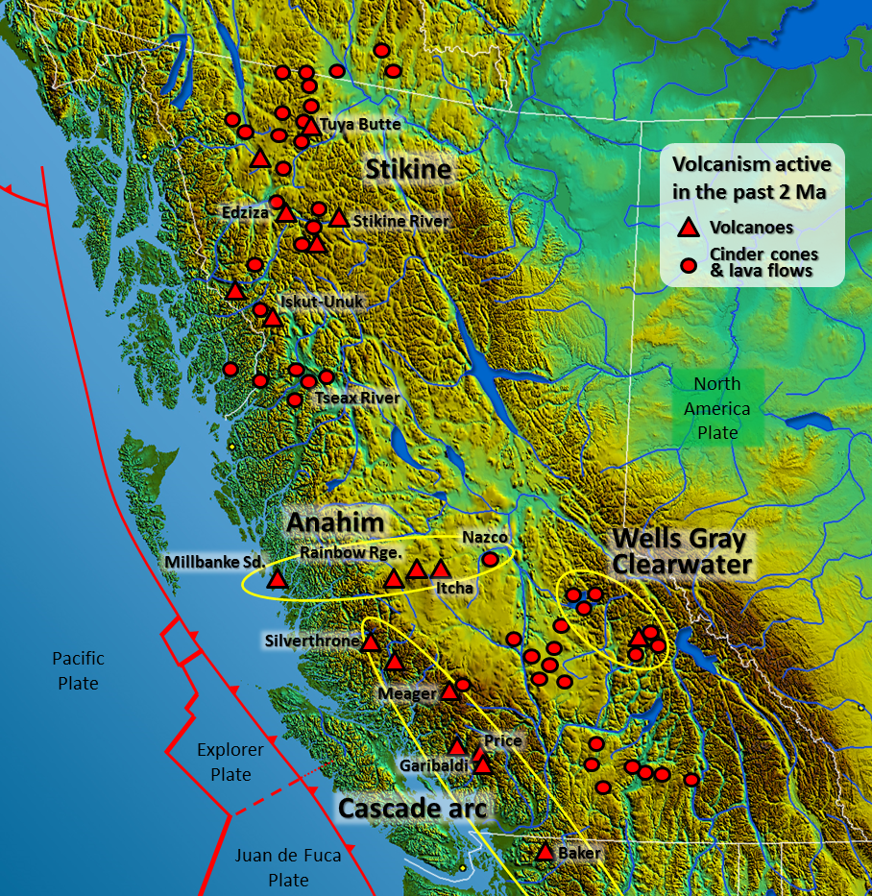
Coast of
B.C.

Slide 10
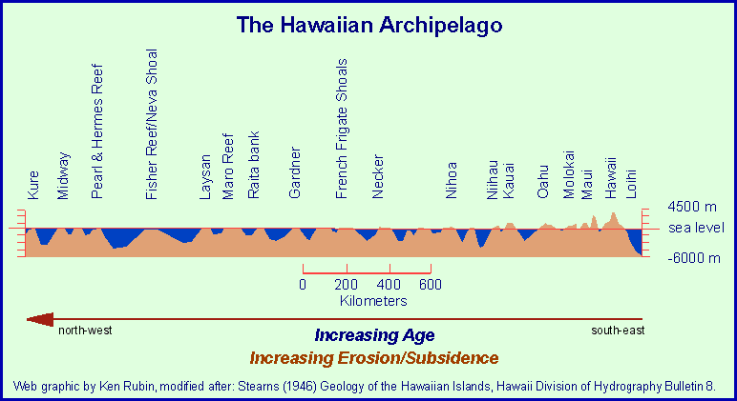
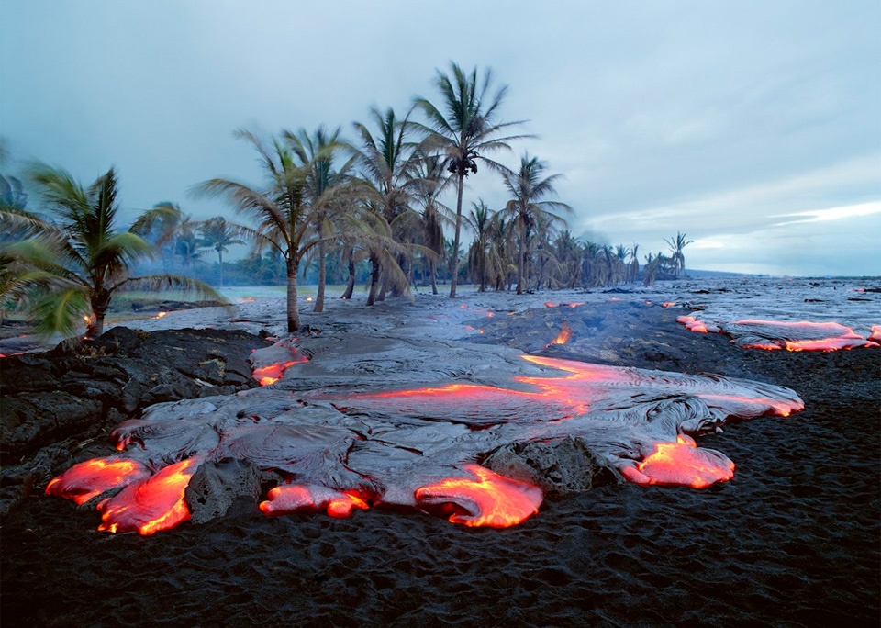
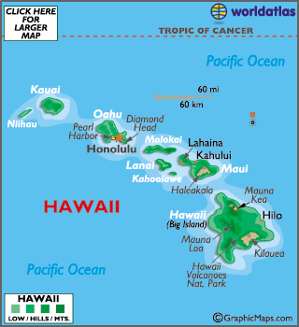
Hawaii

Slide 11
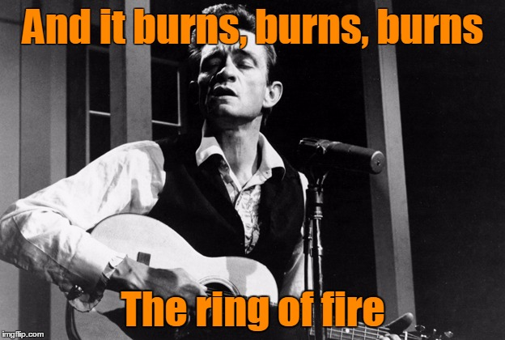
The Ring of Fire

Slide 12
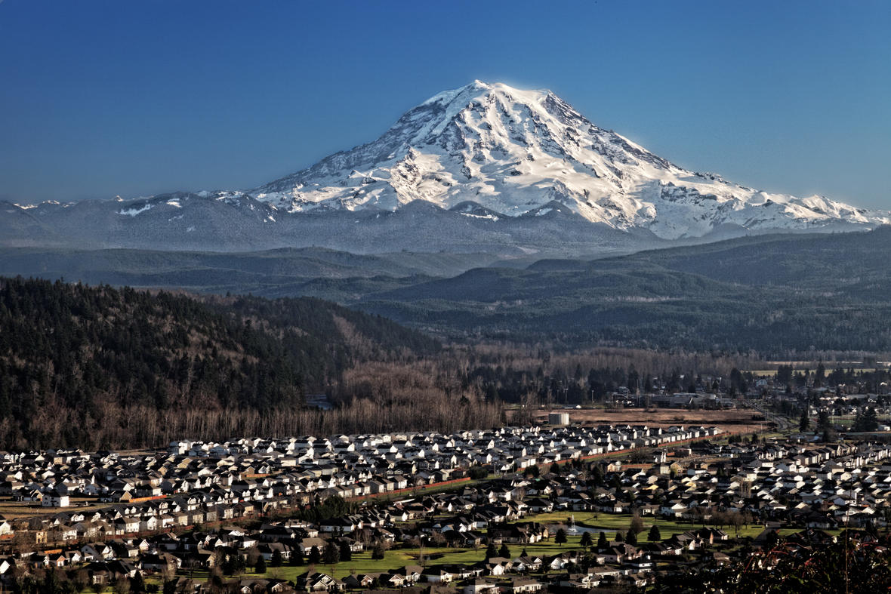
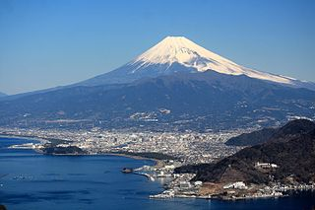
The Ring of Fire
☺
The majority of Volcanoes are located along the Ring of Fire.
Here the Pacific Plate collides with the North American plate in the West, and the Eurasian Plate in the West.

Slide 13
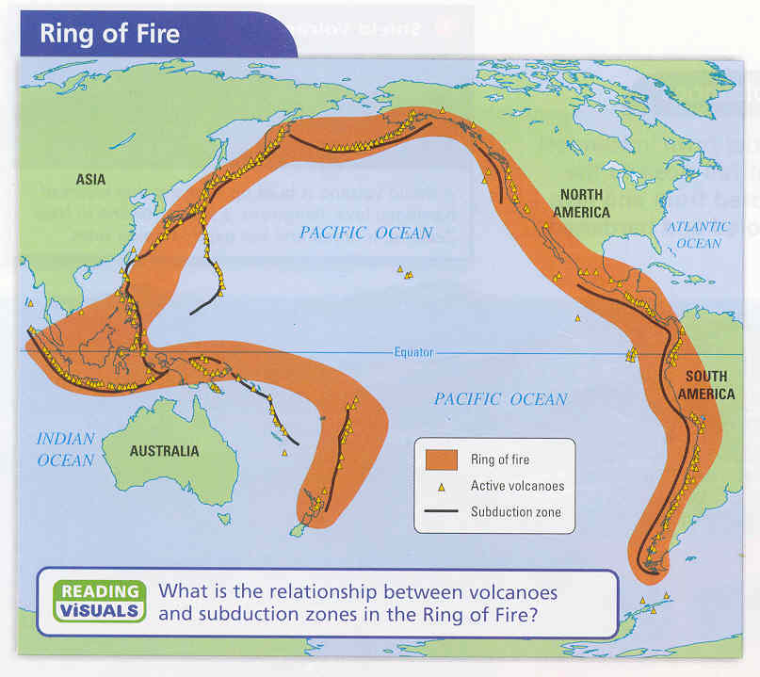

Slide 14
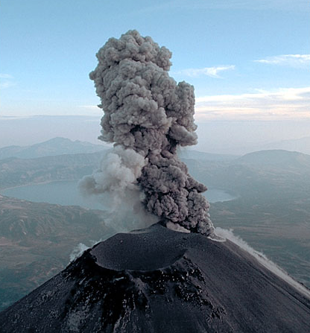
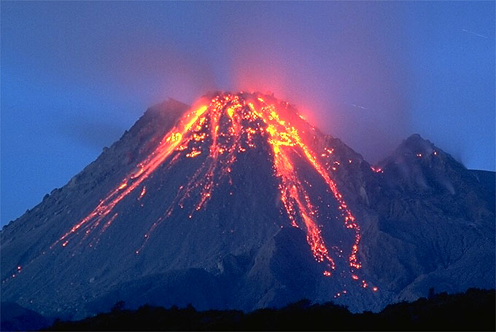
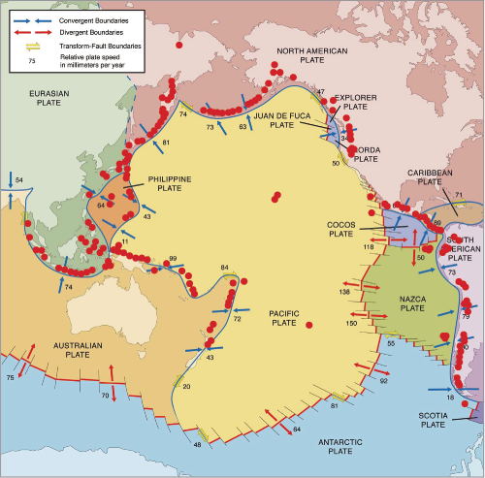
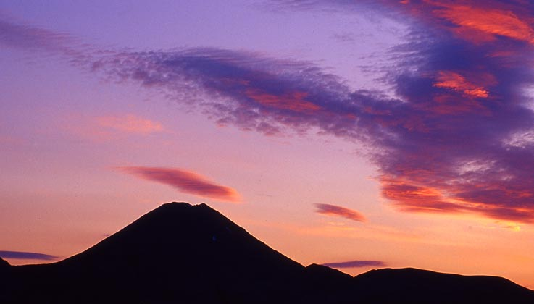
Pacific Ring of Fire
Volcanism is mostly focused at plate margins
Notes:
This map shows the margins of the Pacific tectonic plate and surrounding region. The red dots show the location of active volcanism. Notice how the majority of the volcanism is focused in lines along the plate boundaries? For this region this area is known as the “Pacific Ring of Fire”.
But why are all of the volcanoes located at the plate margins?

Slide 15
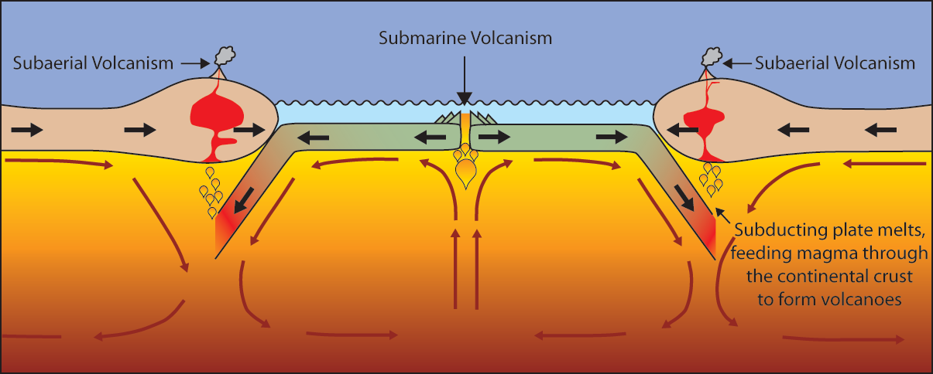
Volcanoes are formed by:
Subduction 2.Rifting 3.Hotspots
☺
Notes:
Volcanoes can be formed in three ways:
Via subduction. The subducting slab dehydrates to form new melt that will rise through the crust to be erupted at the surface.
Via rifting. When two plates pull apart magma rises, producing volcanic eruptions at the surface.
At “Hotspots”….hotspot do not necessarily occur along a plate boundary. So hotspot volcanoes can form in the middle of tectonic plates….Click for example.

Slide 16
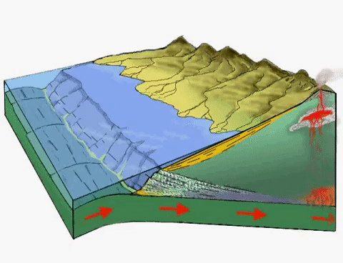
A Sub-duction Zone forms when one plate is lighter than the other and goes underneath the heavier plate.
☺

Slide 17
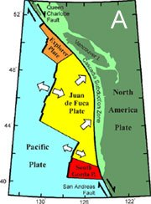
Along B.C. the Juan de Fuca Plate, the Explorer Plate collide with the North American Plate

Slide 18
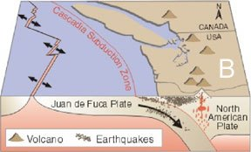

Slide 19
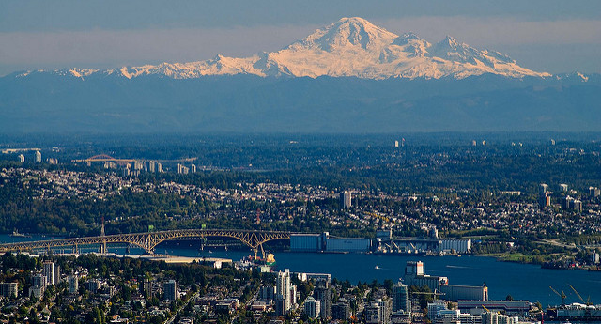
Forms Volcanoes
Mount Baker, WA

Slide 20
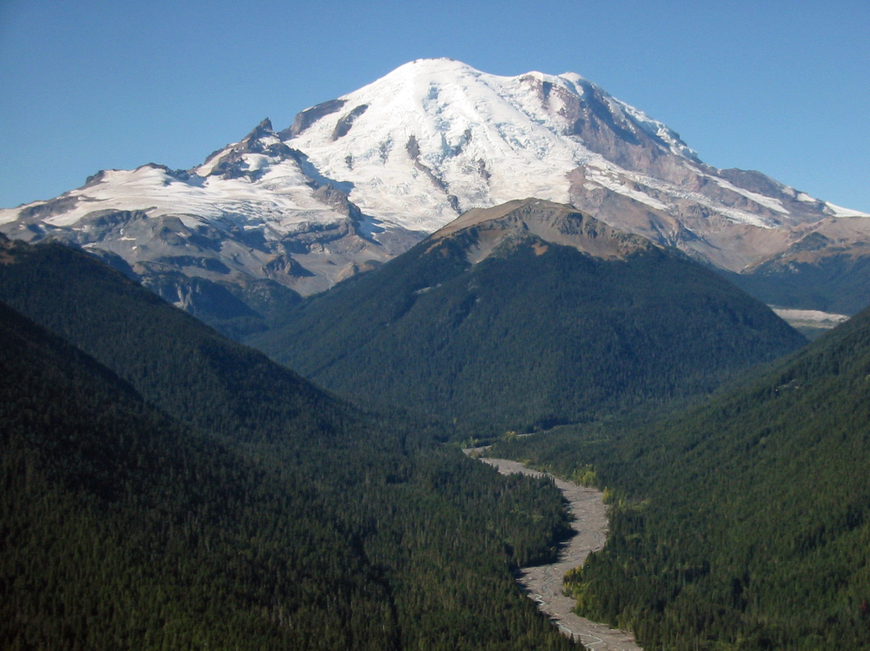
Forms Volcanoes
Mount Rainier

Slide 21
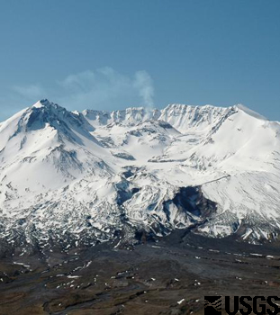
Forms Volcanoes
Mount Saint Helens

Slide 22
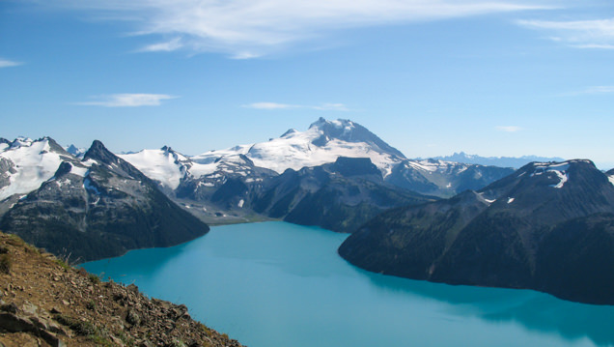
Forms Volcanoes Google Earth
Mount Garibaldi, Squamish, BC

Slide 23
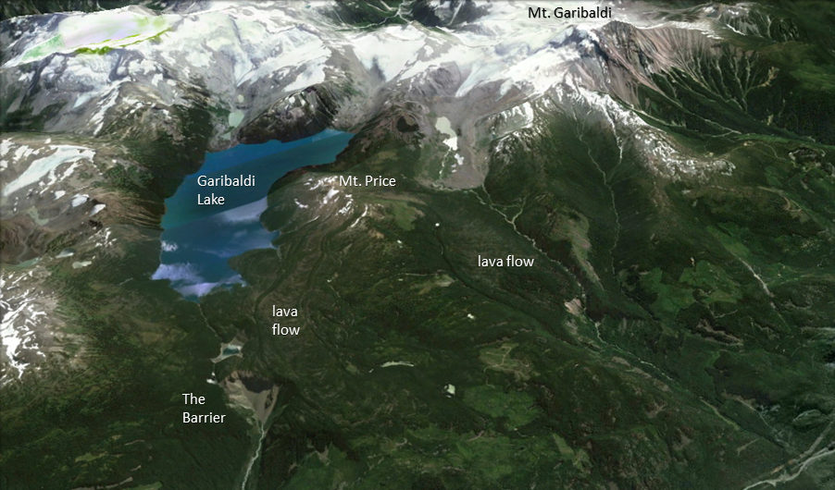

Slide 24
Pacific Ring of Fire
Hotspot volcanoes
Notes:
Hotspot volcanoes in the middle of the Pacific plate.
Can anyone guess where they are?
Answer: Hawaii

Slide 25
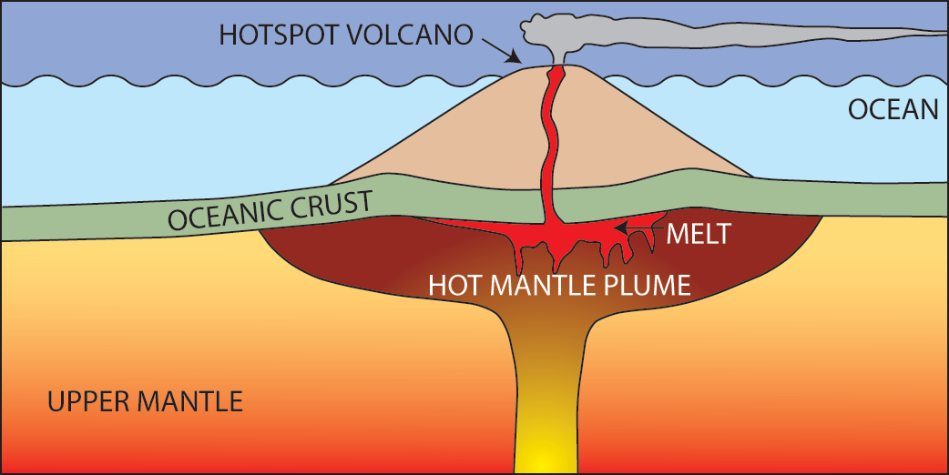
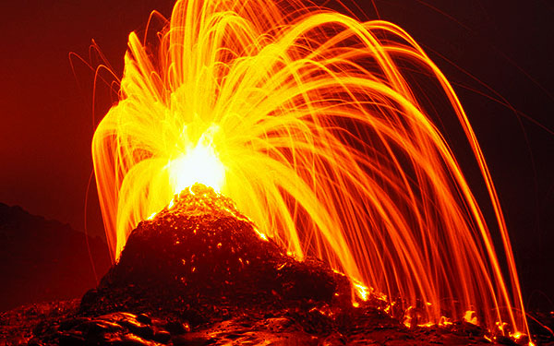
☺
What are Hotspot Volcanoes?
Hot mantle plumes breaching the surface in the middle of a tectonic plate
Example:
The Hawaiian Island Chain
Notes:
Firstly, what are hotspot volcanoes and how do they form?
A hotspot is a location on the Earth's surface that has experienced active volcanism for a long period of time.
The source of this volcanism is a mantle plume of hot mantle material rising up from near the core-mantle boundary through the crust to the surface (see left diagram).
A mantle plume may rise at any location in the mantle, and this is why hotspot volcanoes are independent from tectonic plate boundaries.
The Hawaiian island chain are an example of hotspot volcanoes (see right photograph).

Slide 26
Workbook
I would like you to begin working on your workbook.
If you need any assistance please ask ☺

Slide 27
Outline
CNN 10
Review
Finish Volcanoes
Work on Volcanoes Activity Workbook
Volcanoes Workbook due October 10th

Slide 29
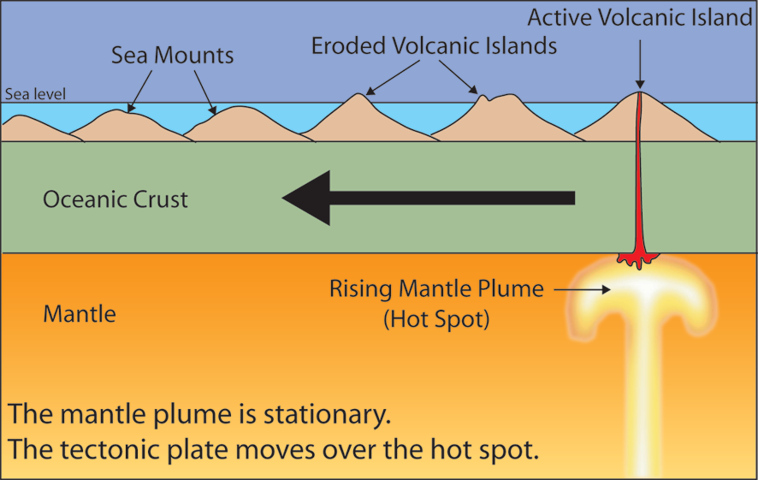
The tectonic plate moves over a fixed hotspot forming a chain of volcanoes.
The volcanoes get younger from one end to the other.
Notes:
Hotspot’s commonly form volcanic island chains (like the Hawaiian islands). These result from the slow movement of a tectonic plate over a FIXED hotspot.
Persistent volcanic activity at a hotspot will create new islands as the plate moves the position of the “old” volcanic island from over the hotspot.
Therefore at one end of the island chain you see the youngest, most active volcanic islands (directly over the hotspot) and along the island chain the extinct volcanoes become older and more eroded (see diagram).
This way geologists can use hotspot volcano chains to track the movement of the tectonic plate through time.

Slide 30
Rift Volcanoes
☺
Rift volcanoes form when magma rises into the gap between diverging plates. They thus occur at or near actual plate boundaries.

Slide 31
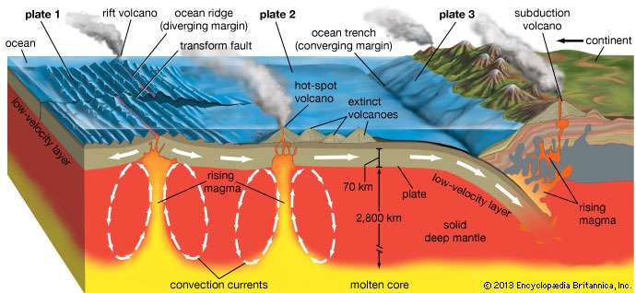

Slide 32
What determines how explosive an eruption is?
☺
Water Vapor: more water=bigger explosion
Trapped gases (water and CO₂):
Easy escape (low pressure)=quiet eruption
Difficult to escape (high pressure)=explosive/violent eruption
Magma Type:
Balastic (thin) =quiet eruption
Granitic/Andestic (thick)=violent eruption
**NOTE: A Pyroclastic flow is a fast moving mixture of water, gases and ash that can be deadly

Slide 33
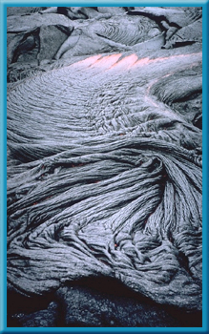
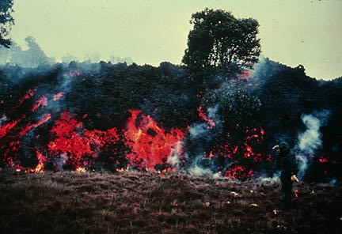
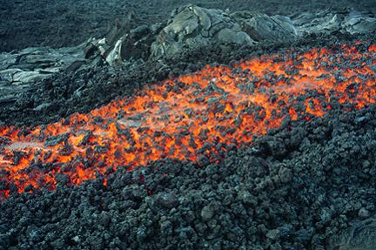
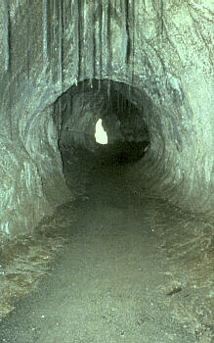
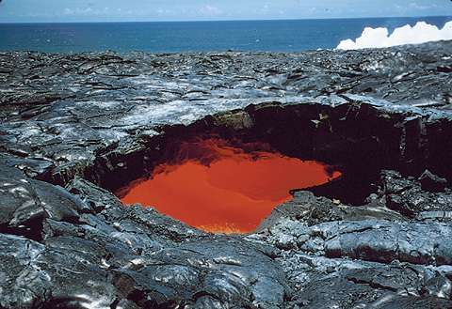
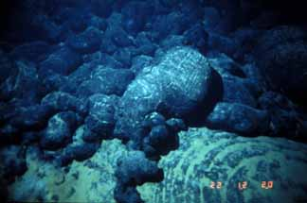
Magma Composition Basaltic
As pahoehoe (pa-HOY-hay) lava cools, it forms a ropelike structure.
☺
rock structures shaped like tubes, balloons, or pillows.
Volcanoes with basaltic lava produce:
underwater pillow lava formations
If the same lava flows at a lower temperature, a stiff, slowly moving aa (AH-ah) lava forms.

Slide 34
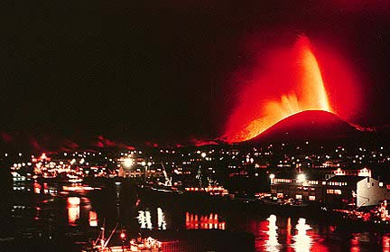
Magma Composition Basaltic Examples
You can find volcanoes with basaltic lava
Hawaiian Volcanoes, including
Kilauea
Before and After
Mona Loa
Iceland
Heimaey
Hekla

Slide 35
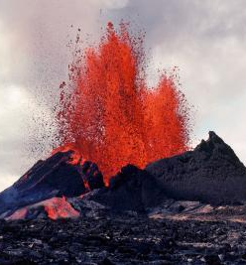
2. Granitic Lava
☺
Also known as Rhyolitic Lava.
Fast moving.
Usually form a composite cone volcano.
Violent eruptions including pyroclastics.

Slide 36
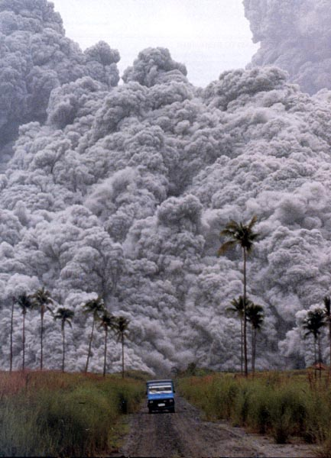
Direct measurements of pyroclastic flows are extremely dangerous!!!
Notes:
A truck carrying volcanologists and a film crew attempting to out run a pyroclastic flow in Indonesia….the pyroclastic flow was traveling at about 25-30 meters per second…..they made it….just!

Slide 37
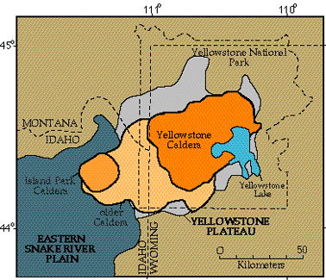
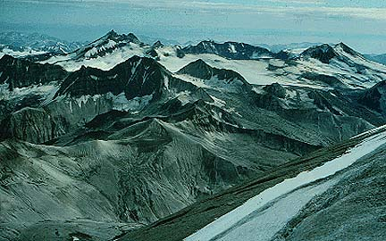
Magma Composition 2. Granitic Lava
“If it had erupted in a populated area…"The magnitude of the eruption can perhaps be best realized if one could imagine a similar outburst centered in New York City. All of Greater New York would be buried under from ten to fifteen feet of ash; Philadelphia would be covered by a foot of gray ash and would be in total darkness for sixty hours; Washington and Buffalo would receive a quarter of an inch of ash, with a shorter period of darkness. The sound of the explosion would be heard in Atlanta and St. Louis, and the fumes noticed as far away as Denver, San Antonio, and Jamaica."
Some examples of granitic volcanoes are
Yellowstone Caldera
It is a super voclano!
Katmai, Alaska
Last eruted in 1912.

Slide 38
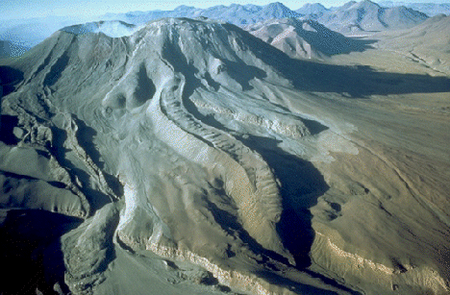
3. Andesitic Lava
☺
Slow moving lava.
Forms large columns/blocks.

Slide 39
Lascar Volcano, Chile
Notes:
Lascar Volcano, Chile

Slide 40
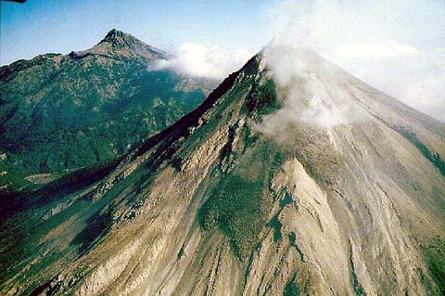

Slide 41
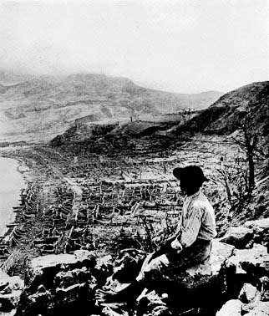
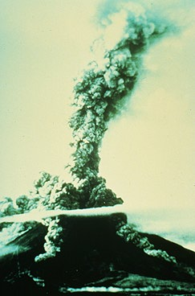
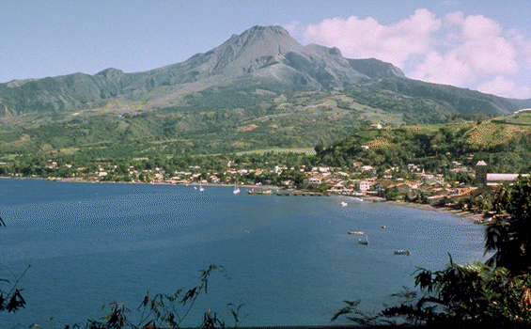
Magma Composition Andesitic Lava
Mount Pelee, Martinique
Famous for the May 8, 1902 eruption which killed 29,000 people and destroyed the city of St. Pierre. This is the largest number of causalities for a volcanic eruption this century.
Mayon, Phillipines
It is the most active volcano in the Philippines. Since 1616, Mayon has erupted 47 times.
It’s 1814 eruption killed 1,600.

Slide 42

Classwork
Work on the following:
Plate Tectonics Workbook
Volcano Workbook

Slide 43
Outline
CNN 10
VOLCANOE’S GO BOOM
Types of Volcanoes
QUICK FACTS
Classwork –
Begin working on Benefits/Hazards
Begin working on the Webquest

Slide 44
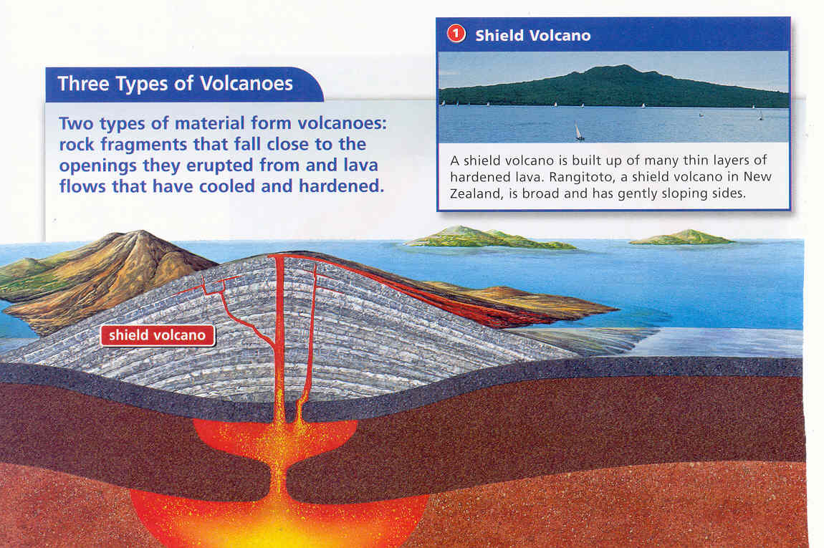
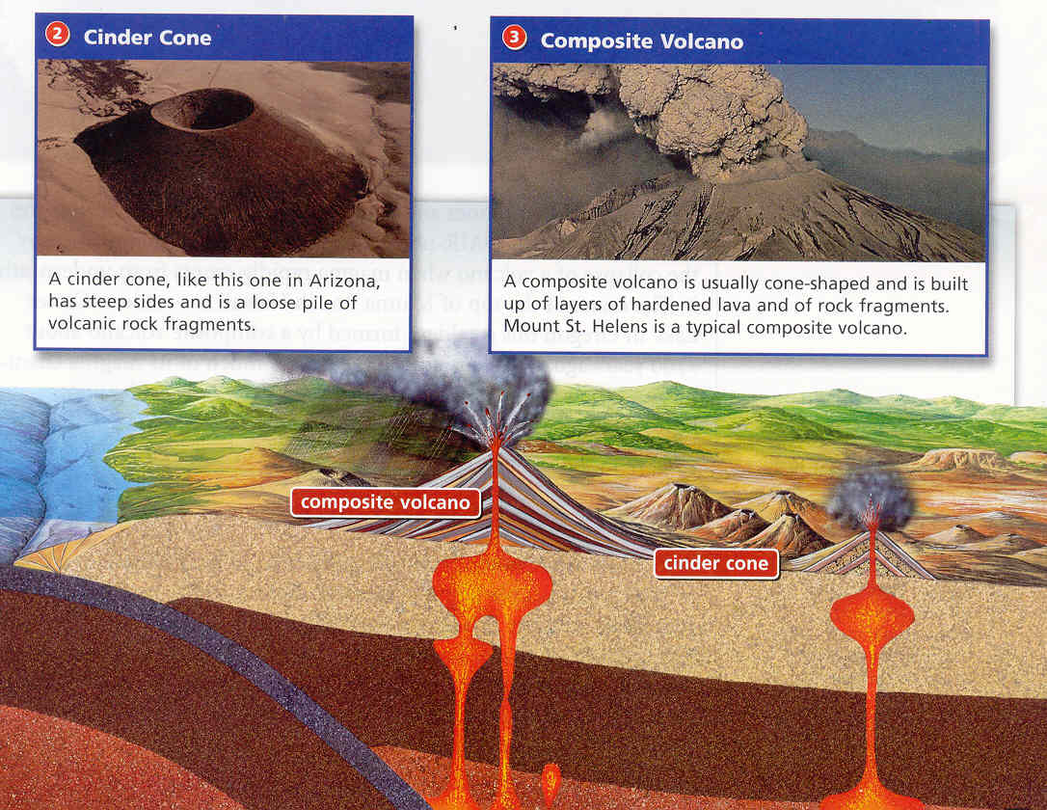
3 Basic Volcano shapes
The shape and size are determined by the type of magma feeding it.

Slide 45
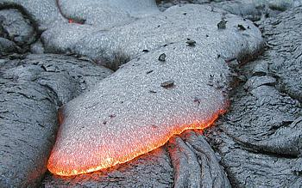
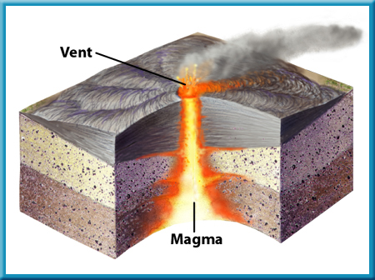

1. Shield Volcano
☺
Formed by quiet eruptions
Slow-moving lava flows
Basaltic lava builds up in flat layers
Largest with gently sloping sides
Ex: Mauna Kea-Hawaiian Islands

Slide 46

Example of Shield Volcano
☺
Mauna Loa
Mt. Kilauea
Probably one of the world’s most active volcanoes.
The eruption of Kilauea Volcano that began in 1983 continues at the cinder-and-spatter cone of Pu`u `O`o
Mt. Kilauea
Picture from http://www.britannica.com/eb/art-89176/Hawaiis-Kilauea-is-an-active-volcano

Slide 47

2. Cinder Cone Volcano
☺
Caused by explosive eruptions
Granitic lava thrown high into the air
Lava cools into different sizes of volcanic material called tephra
Steep-sided, loose slopes

Slide 48




Slide 49


Example Cinder Cone Volcano
Parícutin Volcano in Mexico is a great example of a cinder cone volcano.

Slide 50

Paracútin
On February 20, 1943, a Mexican farmer noticed that a hole in his cornfield that had been there for as long as he could remember was giving off smoke.
Throughout the night, hot glowing cinders were thrown high into the air.
In just a few days, a cinder cone several hundred meters high covered his cornfield.

Slide 51

3. Composite Volcano
☺
A mix of the other two types
Quiet or violent
Basaltic or granitic
Steep or gentle slopes
Layers of tephra

Slide 52


Slide 53



Example of Composite Volcano
Mount St. Helen’s
Erupted in 1980
57 fatalities
Over 7000 big game animals perished
4 billion board feet of timber (enough to build about 300,000 two-bedroom homes) destroyed
Destroyed 27 bridges, nearly 200 homes. Blast and lahars destroyed more than 185 miles of highways and roads and 15 miles of railways.

Slide 54


Example of Composite Volcano
Mount Pinatubo
Erupted in 1991
Killed 847 people
184 people injured
10, 000 home destroyed and another 5,000 were damaged.
The ash cloud took one year to spread around the globe, reducing global temperatures. This resulted in
Floods in 1993 along the Mississippi River
Drought in Africa in 1993
The US had its 3rd wettest & coldest winter on record.

Slide 55


Example of Composite Volcano
Krakatau
One of the most violent eruptions in recent times occurred on an island in the Sunda Straits near Indonesia in August of 1883.
Krakatau, a volcano on the island, erupted with such force that the island disappeared.

Slide 56


Example of Composite Volcano Krakatau
Killed 36,000 people most were killed by a giant tsunami
Destroyed 160 villages
Fine ashes from the eruption were carried by upper level winds as far away as New York City
Volcanic dust lowered global temperatures for five years, this caused
Ruptured eardrums of people 64-164km away.
Could be heard from 3000 miles away – travelled around the earth 4 times.

Slide 57
Scientists monitor volcanoes.
☺
Scientists monitor volcanoes to look for warning signs that an eruption may be coming. Warning signs include:
Earthquakes
Changes in the tilt of the ground
Rising temperatures of openings
Changes in volcanic gases being tested.

Slide 58

Both shield and composite volcanoes can form features called calderas, a huge crater formed by the collapse of the volcano when magma rapidly erupts from underneath it.

Slide 59

How does a Caldera Form?
A) A Volcano’s pressure starts to build up
B) The Volcano releases large amounts of Lava
C) As the Lava is released, the pressure decreases and the volcanic mountain begins to collapse, forming a concave shape in the center of the volcano.
D) The center of the volcanic mountain may begin to fill with water and form a lake.
☺

Slide 60

Crater Lake in Oregon State should actually be called Caldera Lake

Slide 61

Volcanoes Affect Earth’s Land, Air, and Water

Slide 62
Materials From Volcanic Eruptions Affect Earth
Land | Air | Water
Lava | Poisonous Gases* | Hot Springs
Volcanic Ash* | Adds to Acid Rain | Geysers
Landslides (can cause tsunamis) | Haze | Fumaroles
Mudflows | Lower Temperature | Deep –Sea Vents
*These can get in the jet stream and affect the weather around the world for months or years
☺

Slide 63

Classwork
- Begin the Hazards and Benefits section of the Volcano Workbook
- Begin the Web-quest

Slide 64
Outline
CNN 10
Yellowstone Super Volcano
Mount Saint Helens
Pyroclastic Flows
Classwork Time

Slide 65


Yellowstone National Park, Wyoming

Slide 66
Yellowstone Film
Super-Volcano
3 Eruptions
2.1 Million years ago (6000x greater than M.SH)
1.2-1.3 Million years ago (700x greater than M.SH)
610-640,000 years ago (2500x greater than M.SH)
Crater is 1500 square miles in area, or 3884.98 square kilometers.

Slide 67


Slide 68

Greater Vancouver = 2700 Square Km’s

Slide 69


Yellowstone
Check out how large some of the lava flows were from the Yellowstone Volcano!!!

Slide 71


Slide 72


Geyser
Fumarole

Slide 73


Deep-Sea Vent
Hot Spring

Slide 74
G. Life Cycle of a Volcano
☺
Active- one that is erupting or has shown signs that it may erupt in the near future
Dormant- volcano to awaken in the future and become active
Extinct-dead volcano; not likely to erupt again

Slide 75

Mount Saint Helens, WA, USA
May 18th, 1980 – Film of Eruption

Slide 76


Slide 77
Keith outruns a Volcano
5.1 Magnitude Earthquake unleashed this Landslide at 8:30am, May 18th

Slide 78

Mount Saint Helens, WA, USA
May 18th, 1980 – Mount Saint Helens erupted.
Ash fell in 11 states, and rose up 24km in the air.
Mudslides reached as far as 80km to the SW.

Slide 79

The Ash fallout Range from the Eruption

Slide 80


Slide 81


Slide 82


Slide 83


Slide 84

Spirit Lake

Slide 85

Time-Lapse

Slide 86


Volcanic Hazards
Pyroclastic flow
Lahars/Mud flows
Pyroclastic fall
Lava flow
Noxious Gas
Earthquakes
Courtesy of www.swisseduc.ch
Notes:
There are many hazards associated with volcanic eruptions: see list. (these are presented in turn in following slides)

Slide 87

Pyroclastic Flow
For example, eruption of Vesuvius in 79 AD destroyed the city of Pompeii
Notes:
Perhaps the biggest hazard are pyroclastic flows. As mentioned earlier these are hot, fast moving, high particles concentration flows of gas, rock and ash (something you don’t want to get in the way of!).
A famous historic example of an explosive eruption that produced devastating pyroclastic flows was the 79AD eruption of Mt Vesuvius in Italy that buried the ancient Roman city of Pompeii…

Slide 88


Pompeii (79AD)
On August 24, 79AD Mount Vesuvius literally blew its top, erupting tonnes of molten ash, pumice and sulfuric gas miles into the atmosphere. Pyroclastic flows flowed over the city of Pompeii and surrounding areas.
Notes:
On August 24, 79AD Mount Vesuvius literally blew its top, erupting tonnes of molten ash, pumice (volcanic rock that contains many vesicles/bubbles) and sulfuric gas miles into the atmosphere.
The photo on the left shows a more recent eruption of Vesuvius, but this is the kind of thing people living in Pompeii would have seen at the time. The photo on the right shows the remains of an inhabitant of Pompeii with the Vesuvius volcano in the background.
Pyroclastic flows reached the city of Pompeii and surrounding areas, devastating everything in it’s path…

Slide 89


Pompeii (79AD)
Pyroclastic flows of poisonous gas and hot volcanic debris engulfed the cities of Pompeii, Herculaneum and Stabiae suffocating the inhabitants and burying the buildings.
Notes:
Pyroclastic flows of poisonous gas and hot volcanic debris engulfed the cities of Pompeii, Herculaneum and Stabiae suffocating the inhabitants and burying the buildings.
The people and animals of Pompeii died in their sleep or trying to evacuate the town. If you visit Pompeii today you can see their remains…

Slide 90


Pompeii (79AD)
The cities remained buried and undiscovered for almost 1700 years until excavation began in 1748. These excavations continue today and provide insight into life during the Roman Empire.
Notes:
These ancient cities remained buried and undiscovered for almost 1700 years until excavation began in 1748. These excavations continue today and as entire cities are preserved as they were on the day in 79AD when they were hit by the pyroclastic flows from Vesuvius, they provide a uniquely preserved snapshot of Roman life and culture.

Slide 91


Mt Peleé, Martinique (1902)
An eruption of Mt Peleé in 1902 produced a pyroclastic flow that destroyed the city of St. Pierre.
before
after
Notes:
Another example of the destructive power of pyroclastic flows occurred on the island of Martinique in the West Indies, when an eruption of Mt Pelee produced a pyroclastic flow that completely destroyed the city of St Pierre (see the before and after photos).
The force of the pyroclastic flow swept all the buildings, inhabitants and anything else in it’s path into the ocean. Some portion of the pyroclastic flow actually traveled over the ocean surface for several kilometres to burn ships that were moored in the harbor.

Slide 94

29,000 people died…. Only 2 survived! Why?
Notes:
Presenter: Ask the audience where they think the safest place to survive a pyroclastic flow might be….? Consider the fact that everything above ground was flattened and transported into the ocean.
Answer: Prison (read the story below).
The only other known survivor in St. Pierre became a minor celebrity. He was a husky 25-year-old roustabout named Louis-Auguste Cyparis, locally known simply as "Samson". In early April, Samson was put in jail for wounding one of his friends with a cutlass. Towards the end of his sentence, he escaped from a labouring job in town, danced all night, and then turned himself into the authorities the following morning. For this, he was sentenced to solitary confinement for a week in the prison's dungeon. On May 8, he was alone in his dungeon with only a small grated opening cut into the wall above the door. While waiting for his breakfast, his cell became dark and he was overcome by intense gusts of hot air mixed with ash that had entered through the grated opening. He held his breathe while experiencing intense pain. After a few moments, the heat subsided. He was severally burned, but managed to survive for four days before he was rescued by people exploring the ruins of St. Pierre. After he recovered, he received a pardon and eventually joined the Barnum & Bailey Circus, where he toured the world billed as the "Lone Survivor of St. Pierre.” **CLICK TO VIEW CIRCUS ADVERTISEMENT AND PHOTO OF PRISON CELL**
Another man (a local shoe maker) believed to have been in an elevated position on the outskirts of town when the pyroclastic flow hit. He therefore missed the full force of the eruption and somehow made his way through the burning wreckage to safety.
There were other survivors on the outskirts of the town and in some of the ships moored in the harbor. Mercifully, death came quickly to those that died. Some may have died by the sheer force of the blast, but most died within a few seconds after inhaling the burning fumes and ash of the pyroclastic flow. The throats and lungs of most of the dead were seared and their bodies badly burned.
The most common cause of death in people hit by a pyroclastic flow is drowning…fluid in lungs after burns.

Slide 95
How do pyroclastic flows cause devastation?
Notes:
We have seen the effect of pyroclastic flows entering a town. But what are the exact processes that cause the damage?

Slide 96


Pyroclastic Flow - direct impact
Courtesy of www.swisseduc.ch
Notes:
The direct force of a pyroclastic flow traveling at 10’s of metres per second and carrying boulders as large as houses is extremely damaging.
On the volcanic island of Montserrat in the West Indies (top photos), metre-scale blocks of volcanic rock when embedded 10’s of centimetres into concrete walls by the force of the passing pyroclastic flow. The top right hand photograph shows steel reinforcement bars that were once in the wall of a house bent in the direction of the passing flow (from right to left of screen).
As we previously saw, the entire city of St Pierre in Martinique was swept into the ocean.

Slide 98
The Power of a Blast
A Nuclear Bomb will have wind speeds of 200km/hr – 1000km/hr
It can be as hot as 150 Million degrees Ferenheit
A Pyroclastic Flow can go anywhere from 100km/hr – 700km/hr.
It can be as hot as 1000 degrees Ferenheit (1800 C)
Watch it MELT

Slide 99





Pyroclastic Flow - burial
Notes:
The debris left behind from a passing pyroclastic flow can bury structures.
These example are from a 1997 eruption of the Soufrière Hills volcano on Montserrat. The pyroclastic flows produced buried the capital city of Plymouth. The white clock tower in the top photo was on the top of the town hall, which used to stand several storeys above street level.

Slide 100

Pyroclastic Flow - burns
Notes:
Pyroclastic flows have temperatures commonly in excess of 400 degrees Celsius. Hot enough to burn forests and wooden structures.
Here we see burnt trees after an eruption from Mt St Helens in the USA.

Slide 101



Pyroclastic Fall
Ash load
Collapses roofs
Brings down power lines
Kills plants
Contaminates water supplies
Respiratory hazard for humans and animals
Notes:
Moving on from pyroclastic flows, there are other hazards associated with volcanic eruptions. Such as Pyroclastic Fall:
An explosive eruption will produce an eruption column of hot gas, ash and debris ejected kilometres into the air. As this debris falls back down to the ground it can cause a lot of damage.
Like too much snow on a roof, too much ash raining down from an eruption column can cause the roof to collapse.
Ash loading on power lines will cause them to fall.
As little as 1 centimetre of ash accumulated on the leaves of a plant will stop it from being able to photosynthesize and therefore the plant will die.
Lots of fine ash falling in lakes, rivers and water reservoirs will cause contamination making it unfit to drink, or to live in if you are a fish etc.
Very fine ash particles, if inhaled by humans, can cause extensive damage to the lungs causing a respiratory disease called silicosis.

Slide 102


Pyroclastic Flow - lahars
Hot volcanic activity can melt snow and ice
Melt water picks up rock and debris
Forms fast flowing, high energy torrents
Destroys all in its path
Notes:
What is a Lahar?
‘Lahar’ is an Indonesian term that describes a hot or cold mixture of water and rock fragments flowing down the slopes of a volcano and (or) river valleys.
Heavy rain after an eruption or hot volcanic activity melting snow and ice will provide a large volume of water that will flow down the sides of the volcano. This water picks up the newly erupted material forming fast flowing torrents of water, mud, ash, rock and debris.
Lahars can flow great distances and be very destructive. The bottom photo shows a lahar knocking down a concrete bridge.

