Slide 1
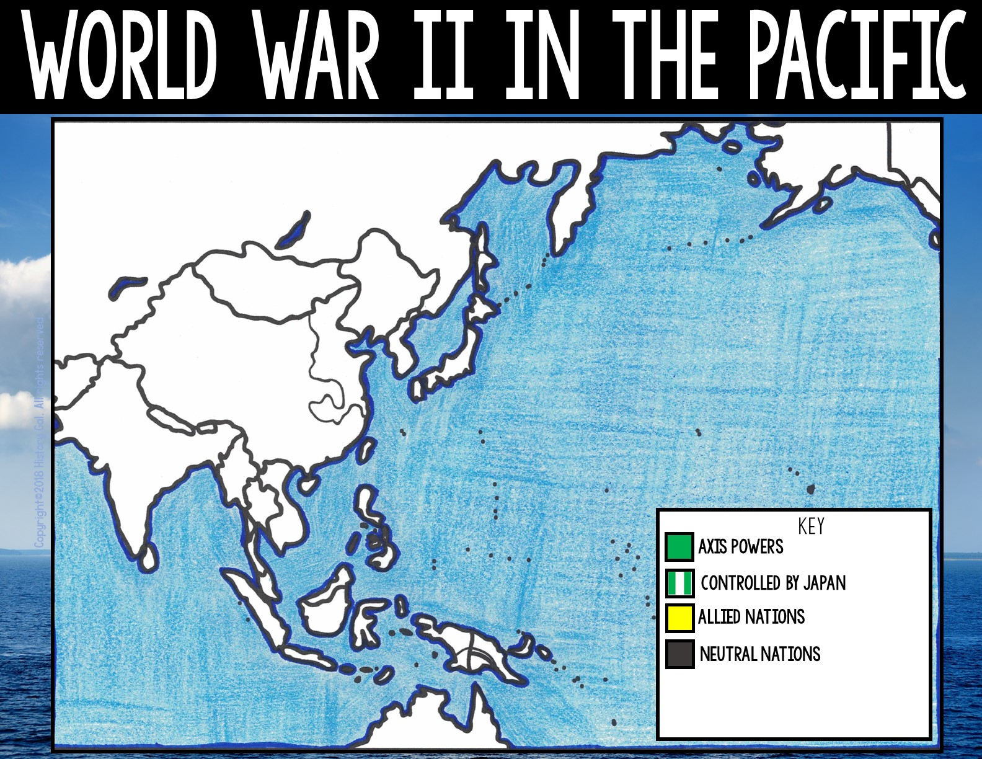

Slide 2
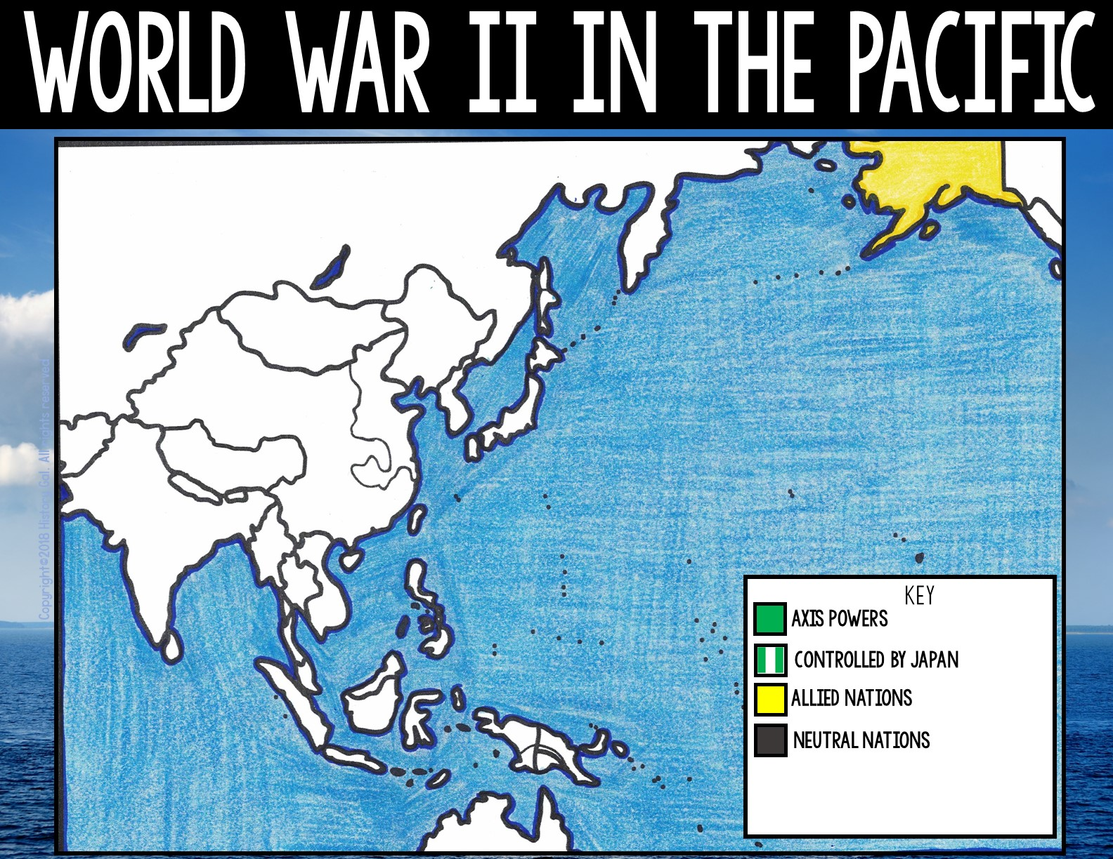
ALASKA
(U.S. Territory)

Slide 3
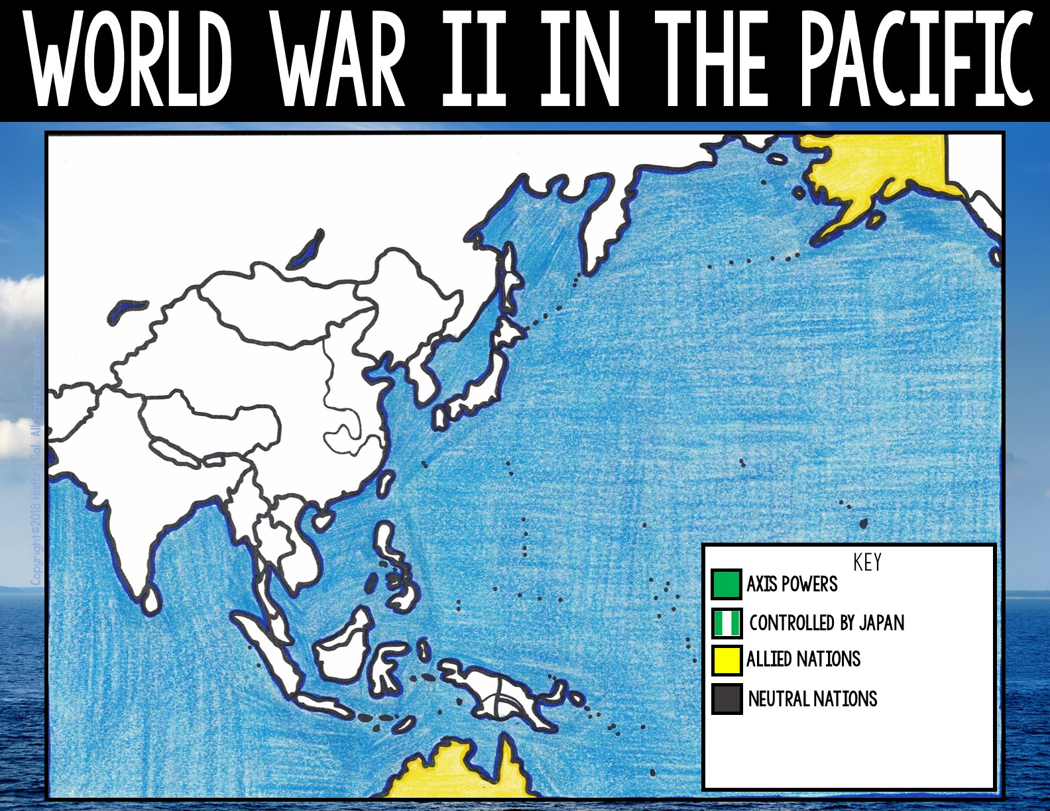
ALASKA
(U.S. Territory)
AUSTRALIA

Slide 4

ALASKA
(U.S. Territory)
BHUTAN
AUSTRALIA

Slide 5

ALASKA
(U.S. Territory)
BHUTON
BORNEO
(British Territory)
AUSTRALIA

Slide 6

ALASKA
(U.S. Territory)
BHUTON
BURMA
BORNEO
(British Territory)
AUSTRALIA

Slide 7
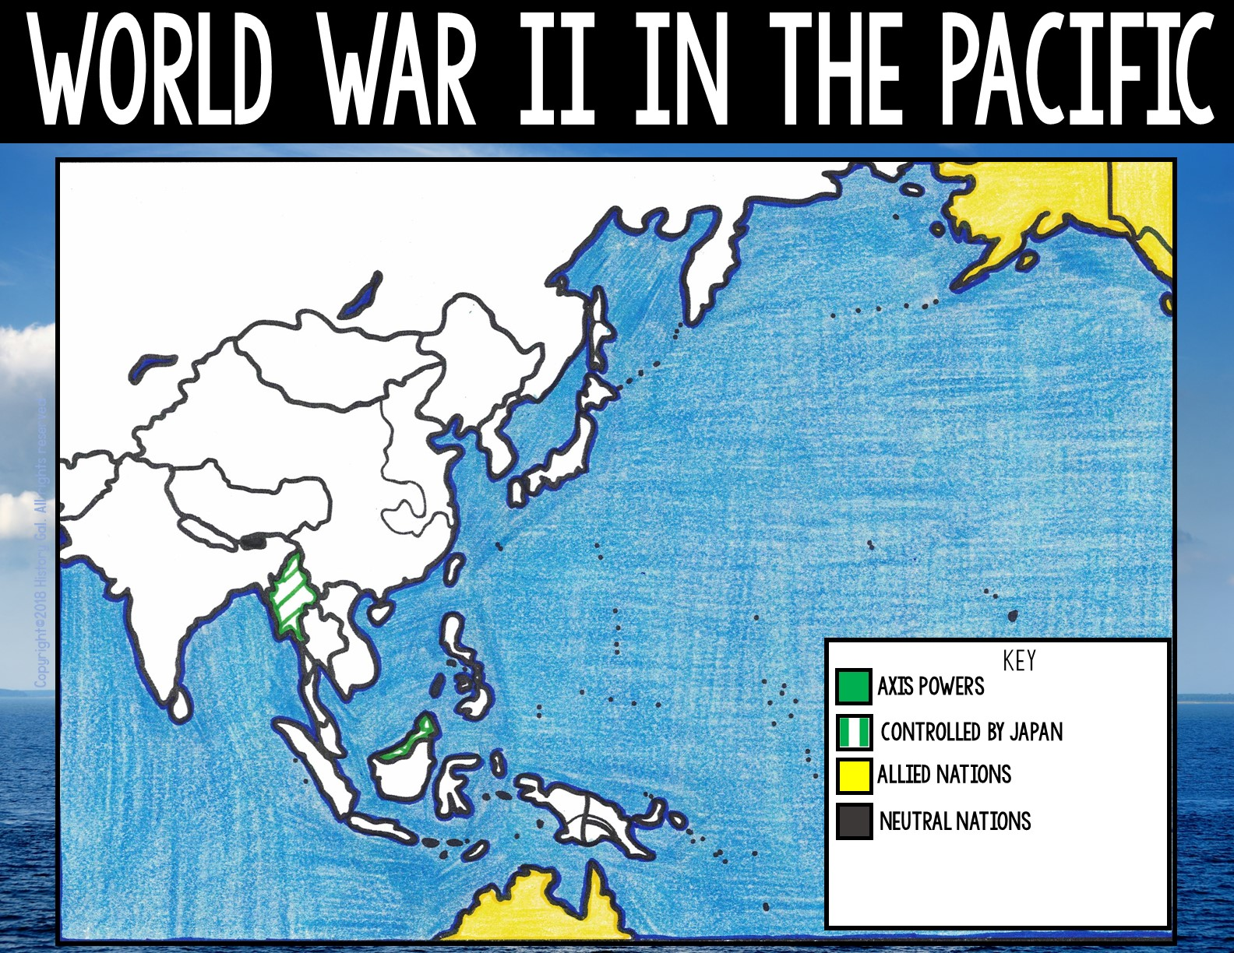
ALASKA
(U.S. Territory)
CANADA
BHUTON
BURMA
BORNEO
(British Territory)
AUSTRALIA

Slide 8
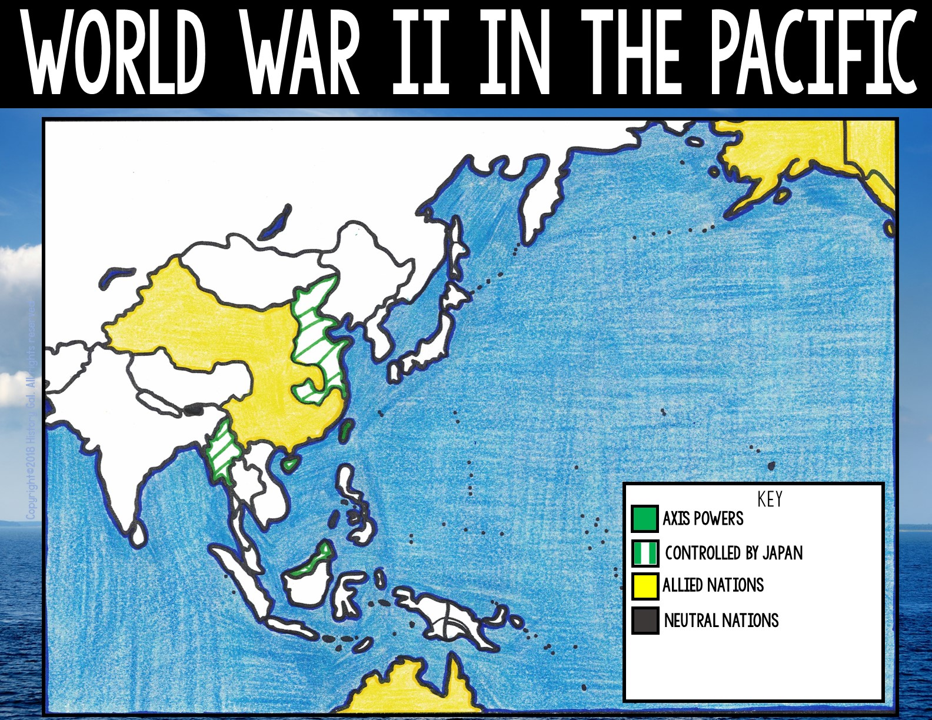
ALASKA
(U.S. Territory)
CANADA
CHINA
JAPANESE CONTROLLED CHINA
BHUTON
BURMA
BORNEO
(British Territory)
AUSTRALIA

Slide 9
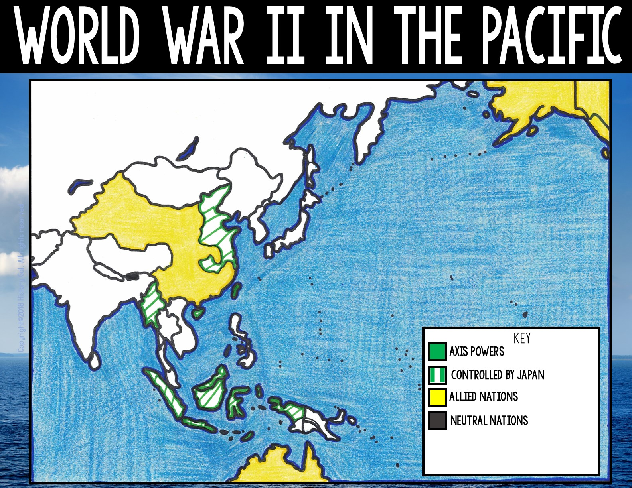
ALASKA
(U.S. Territory)
CANADA
CHINA
BHUTON
BURMA
BORNEO
DUTCH EAST INDIES
(British Territory)
AUSTRALIA

Slide 10

ALASKA
(U.S. Territory)
CANADA
CHINA
BHUTON
BURMA
FRENCH INDOCHINA
BORNEO
(British Territory)
DUTCH
EAST INDIES
AUSTRALIA

Slide 11
ALASKA
(U.S. Territory)
CANADA
CHINA
BHUTON
HAWAII
BURMA
(U.S. Territory)
FRENCH INDOCHINA
BORNEO
(British Territory)
DUTCH
EAST INDIES
AUSTRALIA

Slide 12
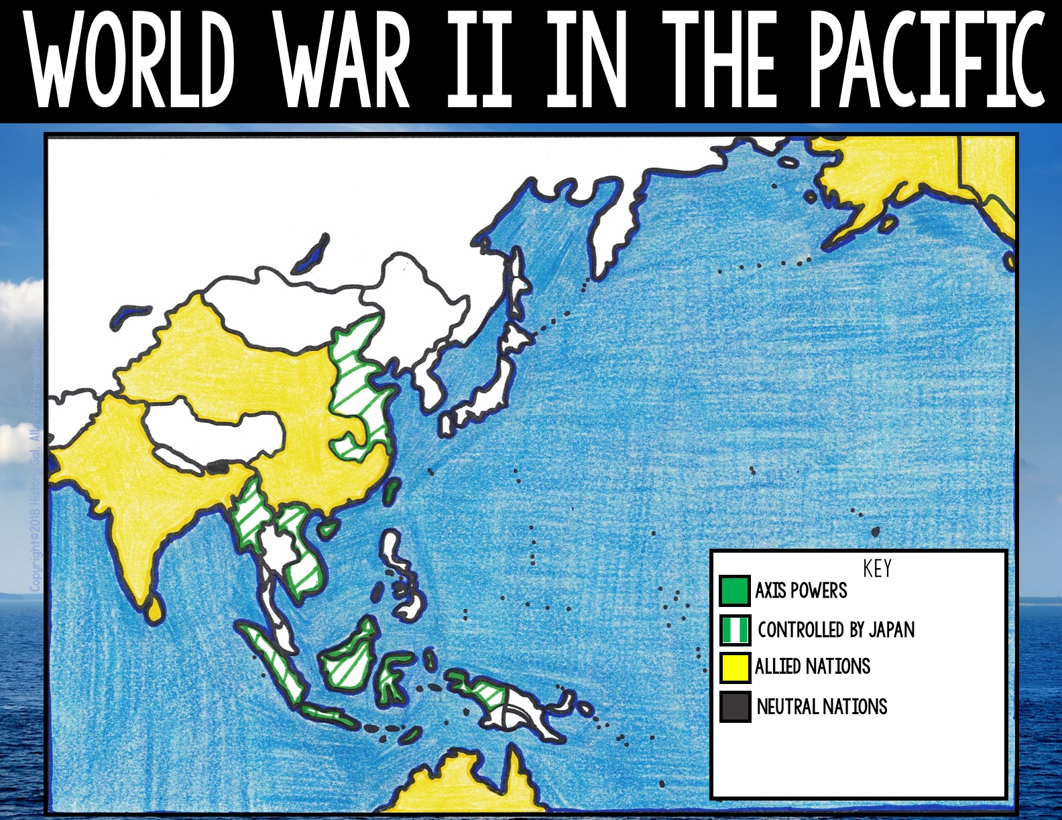
ALASKA
(U.S. Territory)
CANADA
CHINA
BHUTON
INDIA
HAWAII
BURMA
(U.S. Territory)
(British Territory)
FRENCH INDOCHINA
BORNEO
(British Territory)
DUTCH
EAST INDIES
AUSTRALIA

Slide 13
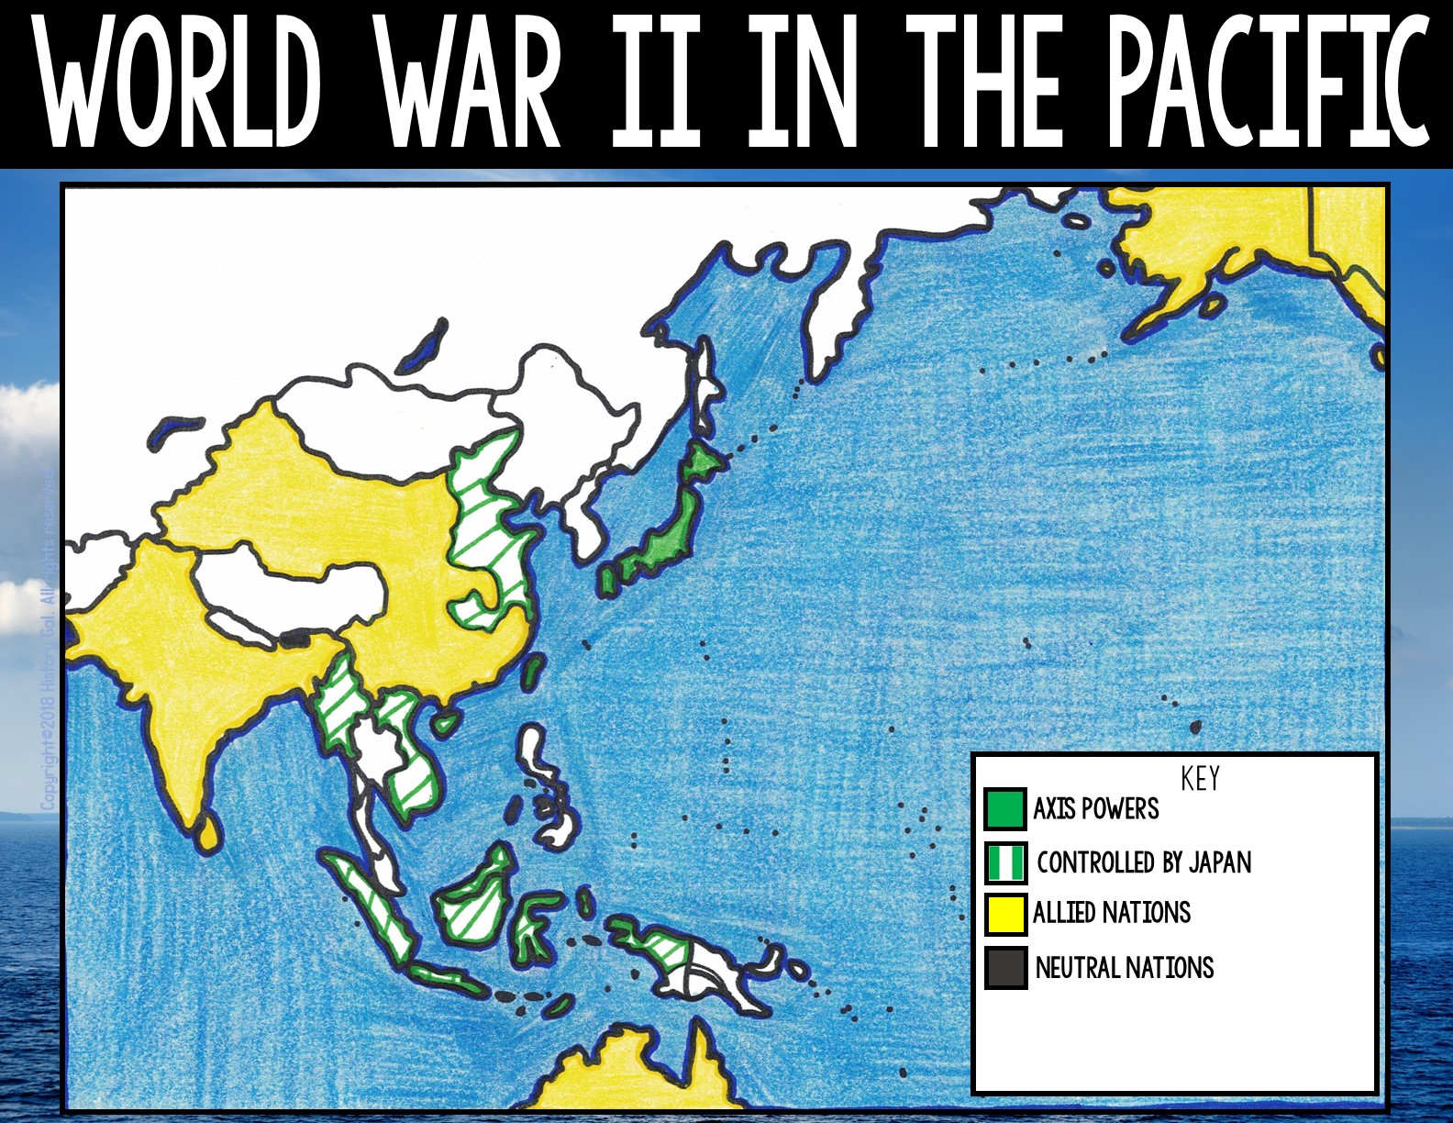
ALASKA
(U.S. Territory)
CANADA
CHINA
JAPAN
BHUTON
INDIA
HAWAII
(British Territory)
BURMA
(U.S. Territory)
FRENCH INDOCHINA
BORNEO
(British Territory)
DUTCH
EAST INDIES
AUSTRALIA

Slide 14
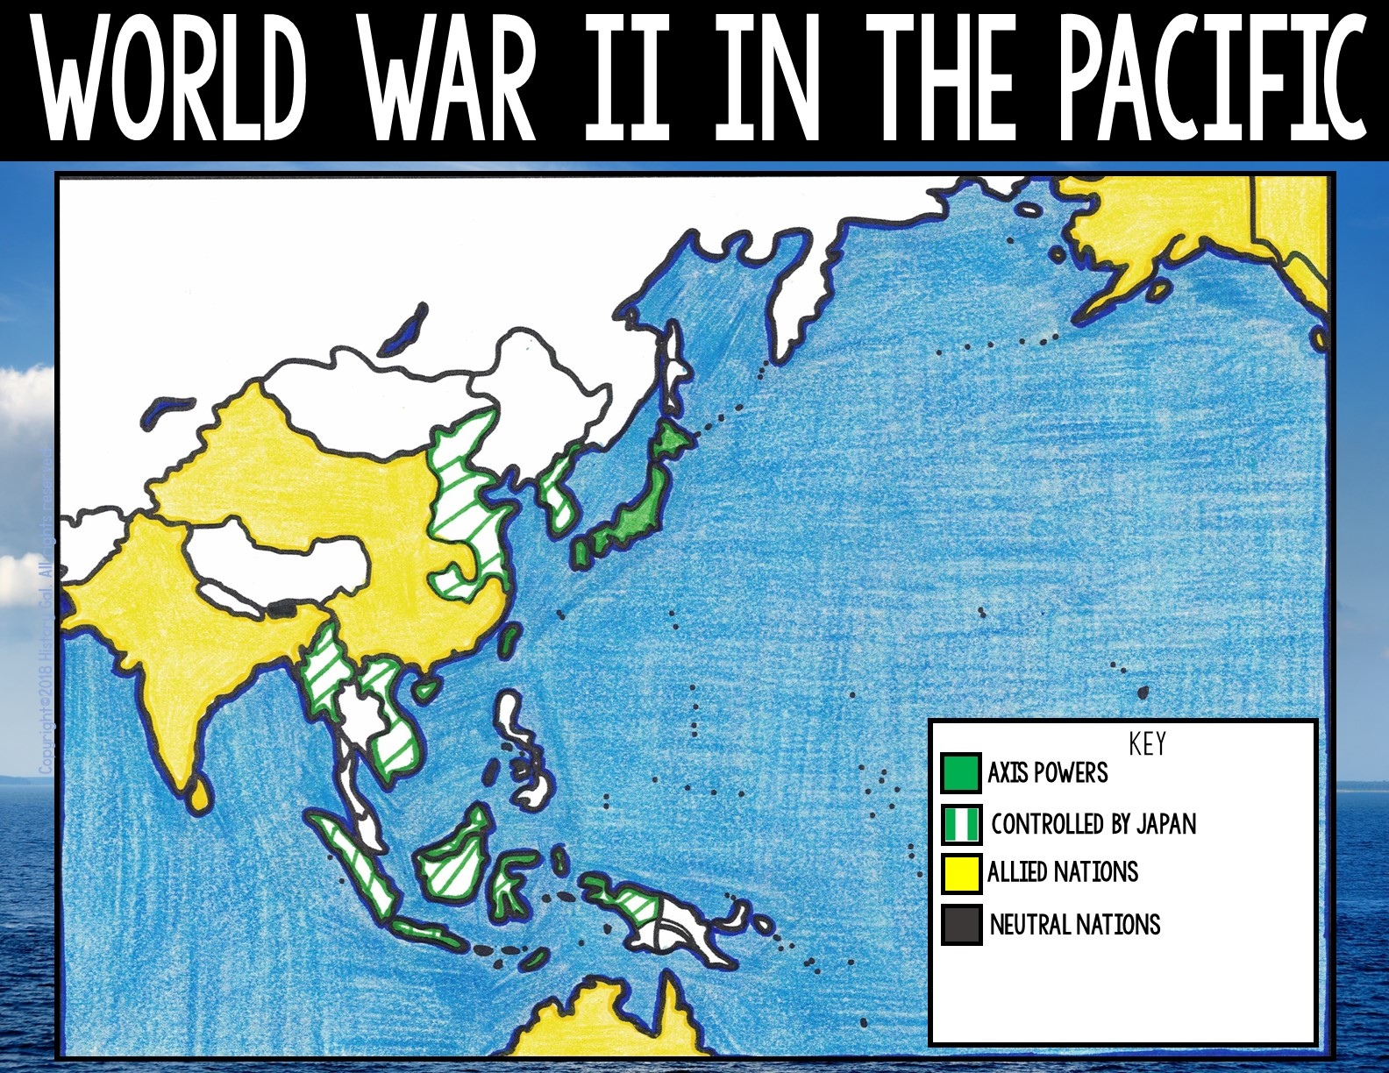
ALASKA
(U.S. Territory)
CANADA
KOREA
CHINA
JAPAN
BHUTON
INDIA
HAWAII
(British Territory)
BURMA
(U.S. Territory)
FRENCH INDOCHINA
BORNEO
(British Territory)
DUTCH
EAST INDIES
AUSTRALIA

Slide 15
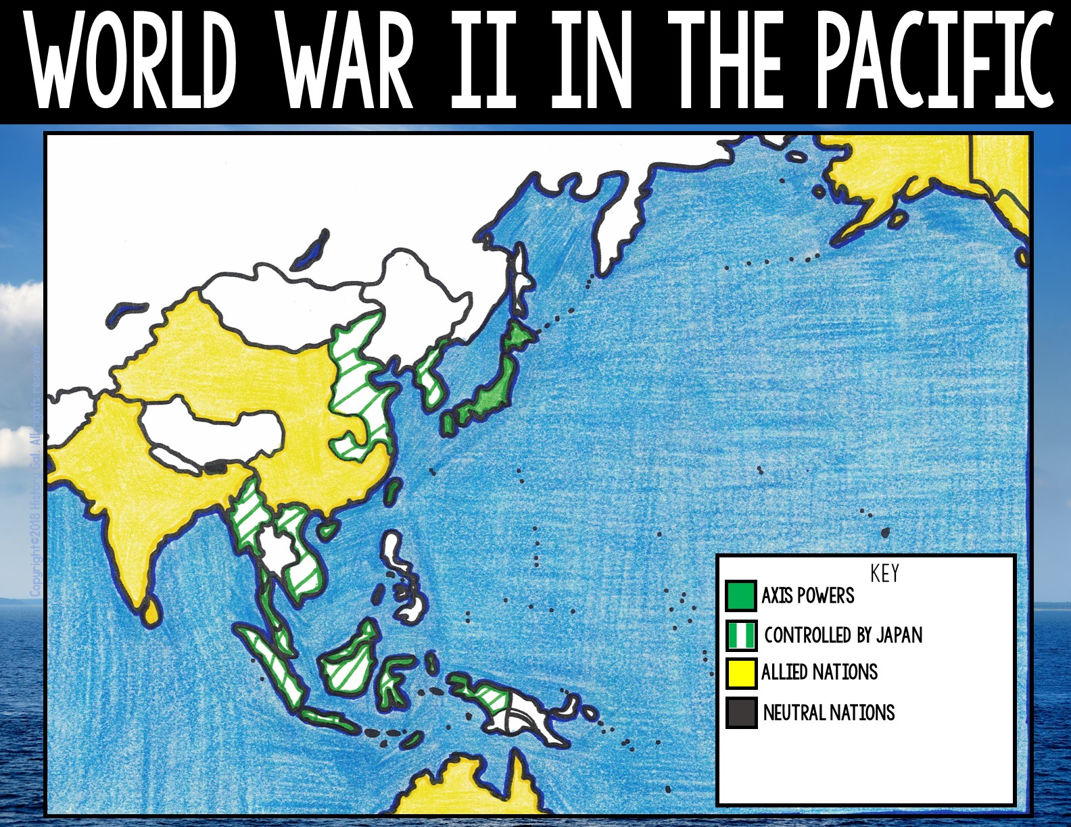
ALASKA
(U.S. Territory)
CANADA
CHINA
KOREA
JAPAN
BHUTON
INDIA
HAWAII
(British Territory)
BURMA
(U.S. Territory)
FRENCH INDOCHINA
MALAYA
BORNEO
(British Territory)
DUTCH
EAST INDIES
AUSTRALIA

Slide 16

ALASKA
(U.S. Territory)
MANCHURIA
CANADA
CHINA
KOREA
JAPAN
BHUTON
INDIA
HAWAII
(British Territory)
BURMA
(U.S. Territory)
FRENCH INDOCHINA
MALAYA
BORNEO
(British Territory)
DUTCH
EAST INDIES
AUSTRALIA

Slide 17
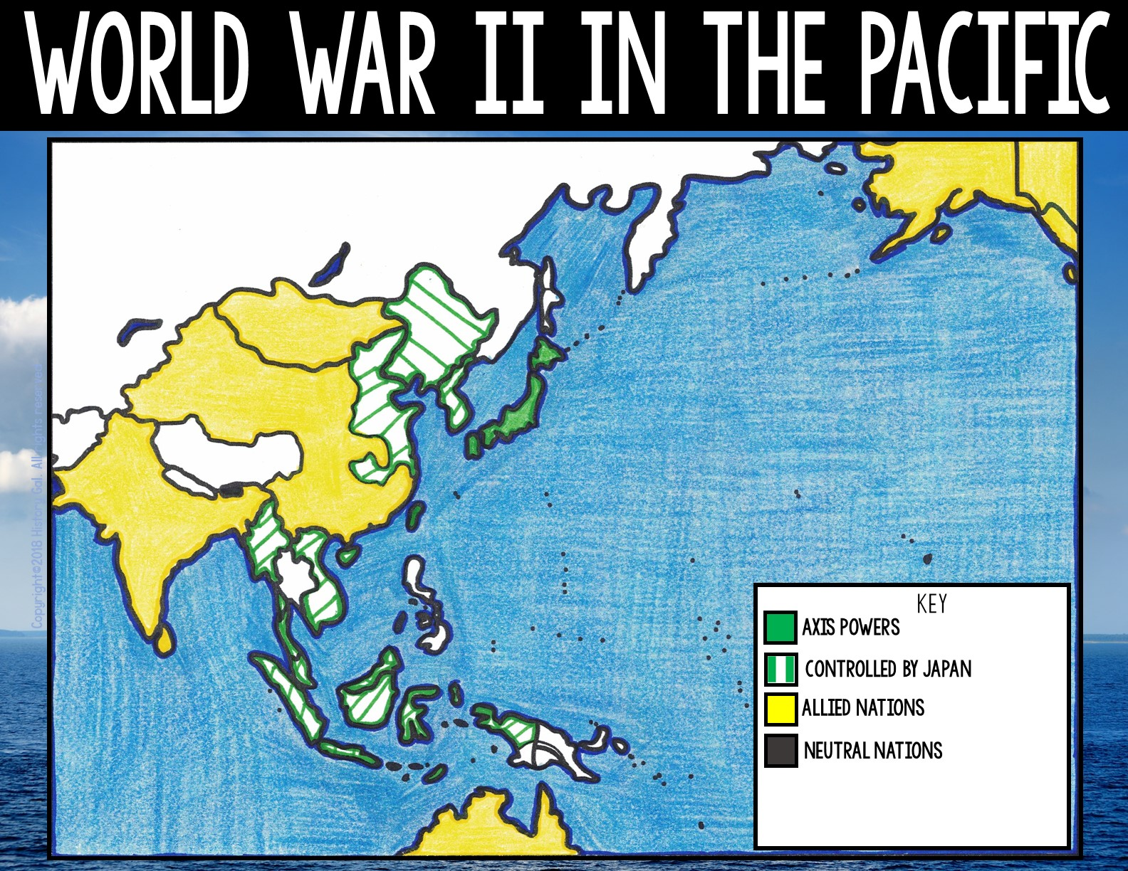
ALASKA
(U.S. Territory)
MONGOLIA
CANADA
MANCHURIA
CHINA
KOREA
JAPAN
BHUTON
INDIA
HAWAII
(British Territory)
BURMA
(U.S. Territory)
FRENCH INDOCHINA
MALAYA
BORNEO
(British Territory)
DUTCH
EAST INDIES
AUSTRALIA

Slide 18

ALASKA
(U.S. Territory)
CANADA
MONGOLIA
MANCHURIA
NEPAL
JAPAN
CHINA
KOREA
BHUTON
INDIA
HAWAII
(British Territory)
BURMA
(U.S. Territory)
FRENCH INDOCHINA
MALAYA
BORNEO
(British Territory)
DUTCH
EAST INDIES
AUSTRALIA

Slide 19

ALASKA
(U.S. Territory)
CANADA
MONGOLIA
MANCHURIA
CHINA
KOREA
JAPAN
NEPAL
BHUTON
INDIA
HAWAII
(British Territory)
BURMA
(U.S. Territory)
FRENCH INDOCHINA
MALAYA
BORNEO
(British Territory)
NEW GUINEA
(U.S. and Australian Territories)
DUTCH
EAST INDIES
AUSTRALIA

Slide 20
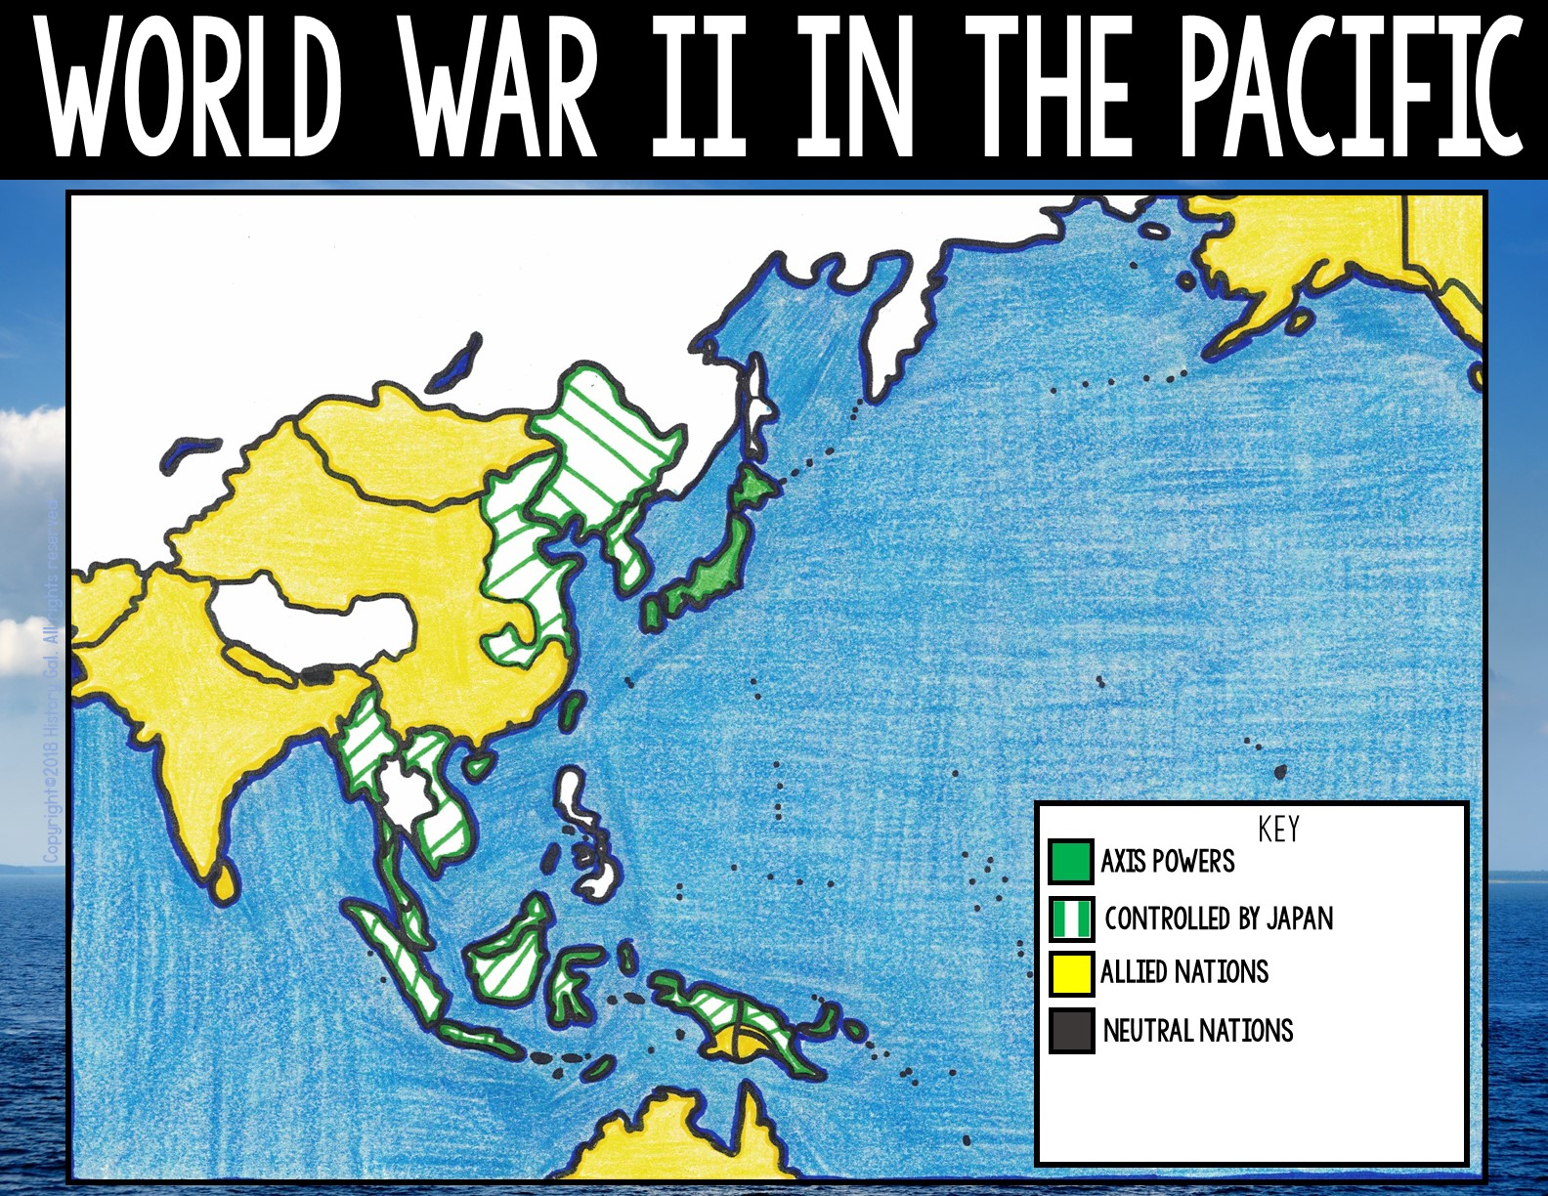
ALASKA
(U.S. Territory)
CANADA
MONGOLIA
PAKISTAN
MANCHURIA
CHINA
KOREA
JAPAN
NEPAL
BHUTON
INDIA
HAWAII
(British Territory)
BURMA
(U.S. Territory)
FRENCH INDOCHINA
MALAYA
BORNEO
(British Territory)
NEW GUINEA
(U.S. and Australian Territories)
DUTCH
EAST INDIES
AUSTRALIA

Slide 21
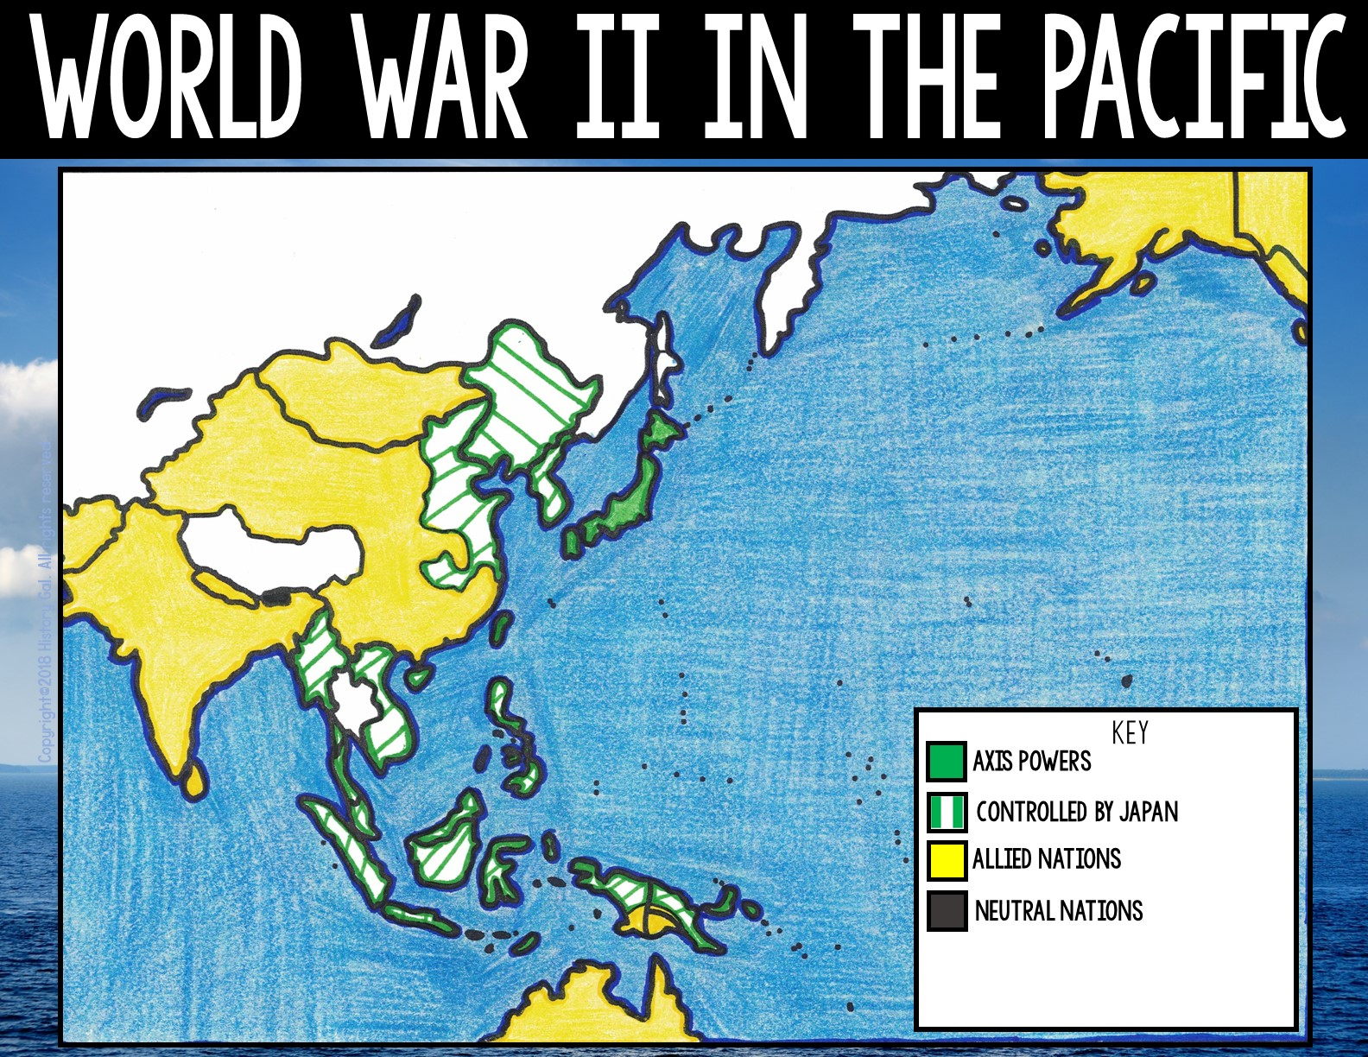
ALASKA
(U.S. Territory)
CANADA
MONGOLIA
PAKISTAN
MANCHURIA
CHINA
KOREA
JAPAN
NEPAL
BHUTON
INDIA
HAWAII
(British Territory)
BURMA
(U.S. Territory)
FRENCH INDOCHINA
PHILIPPINES
MALAYA
(U.S. Territory)
BORNEO
(British Territory)
NEW GUINEA
(U.S. and Australian Territories)
DUTCH
EAST INDIES
AUSTRALIA

Slide 22
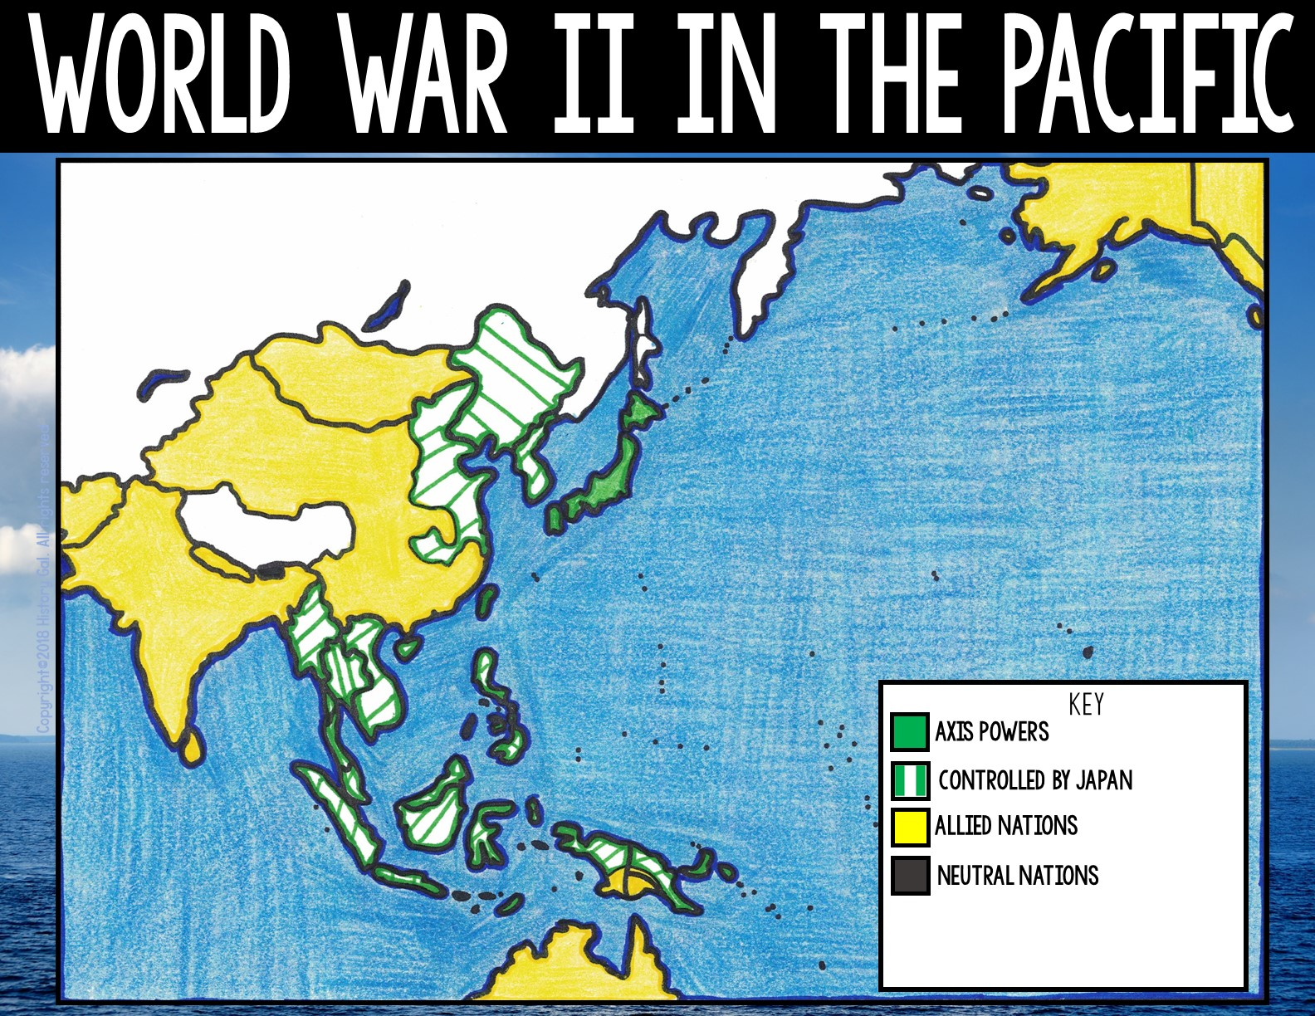
ALASKA
(U.S. Territory)
CANADA
MONGOLIA
PAKISTAN
MANCHURIA
CHINA
KOREA
JAPAN
NEPAL
BHUTON
INDIA
HAWAII
(British Territory)
BURMA
(U.S. Territory)
FRENCH INDOCHINA
THAILAND
PHILIPPINES
MALAYA
(U.S. Territory)
BORNEO
(British Territory)
NEW GUINEA
(U.S. and Australian Territories)
DUTCH
EAST INDIES
AUSTRALIA

Slide 23
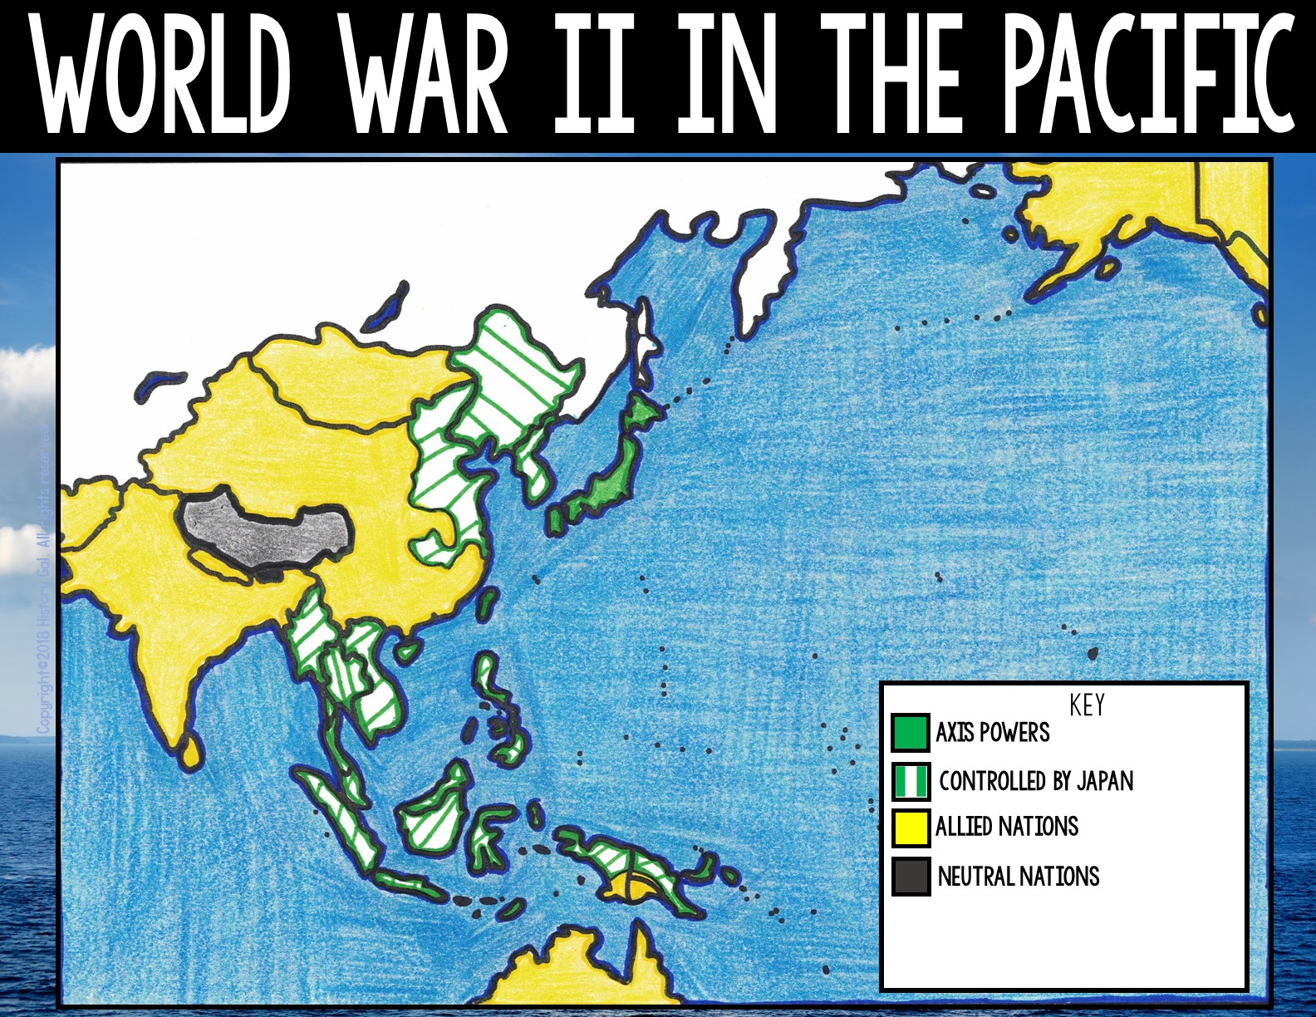
ALASKA
(U.S. Territory)
CANADA
MONGOLIA
PAKISTAN
MANCHURIA
CHINA
KOREA
JAPAN
NEPAL
TIBET
BHUTON
INDIA
HAWAII
(British Territory)
BURMA
(U.S. Territory)
FRENCH INDOCHINA
THAILAND
PHILIPPINES
MALAYA
(U.S. Territory)
BORNEO
(British Territory)
NEW GUINEA
(U.S. and Australian Territories)
DUTCH
EAST INDIES
AUSTRALIA

Slide 24
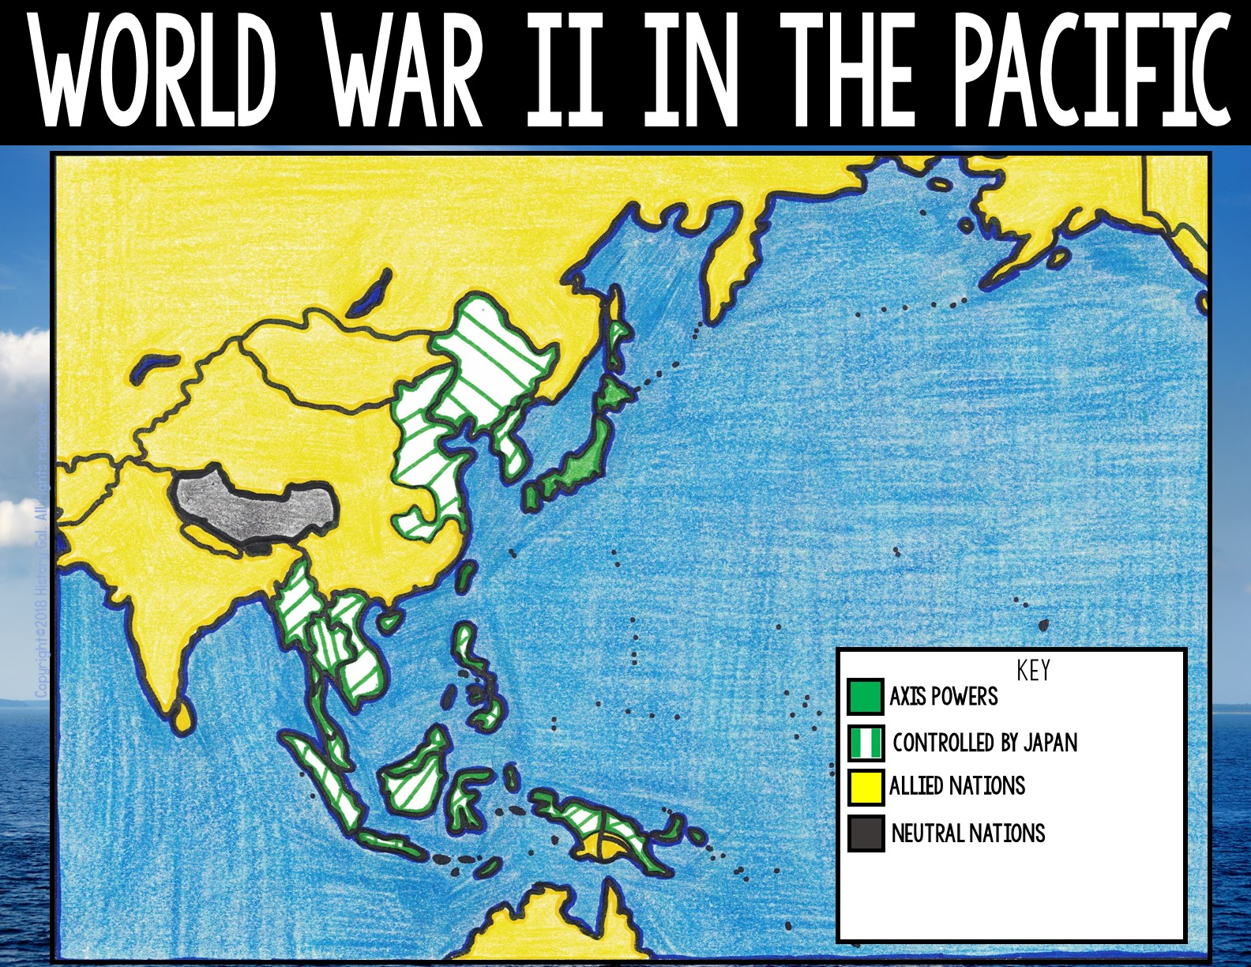
ALASKA
USSR
(U.S. Territory)
CANADA
MONGOLIA
PAKISTAN
MANCHURIA
CHINA
KOREA
JAPAN
NEPAL
TIBET
BHUTON
INDIA
HAWAII
(British Territory)
BURMA
(U.S. Territory)
FRENCH INDOCHINA
THAILAND
PHILIPPINES
MALAYA
(U.S. Territory)
BORNEO
(British Territory)
NEW GUINEA
(U.S. and Australian Territories)
DUTCH
EAST INDIES
AUSTRALIA

Slide 25
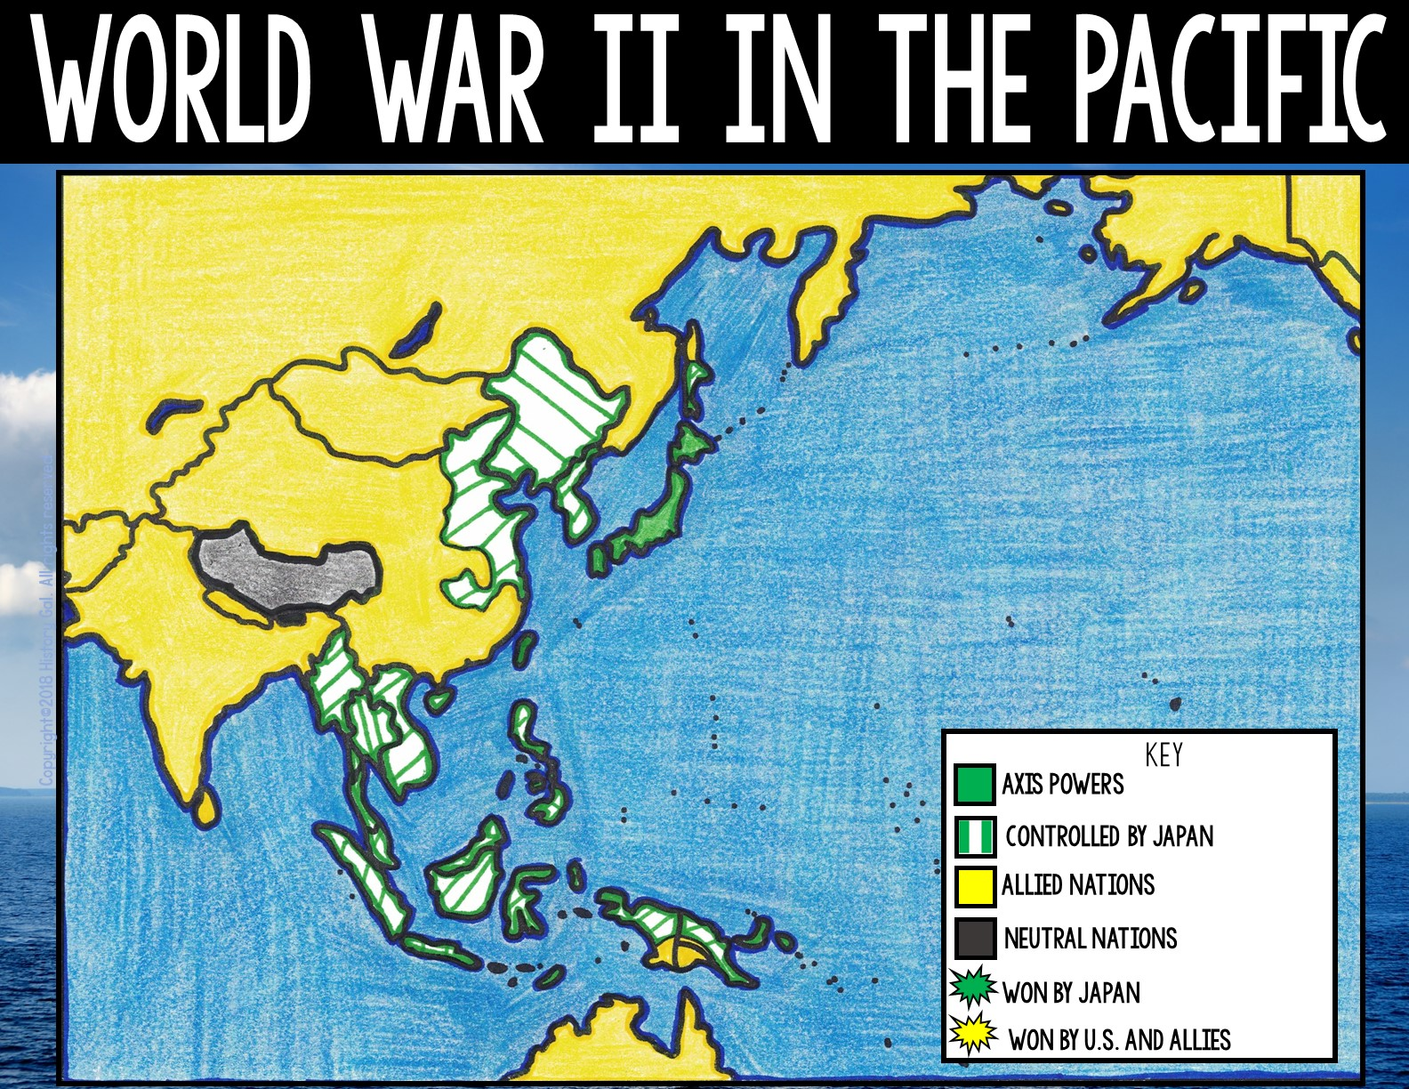
ALASKA
USSR
(U.S. Territory)
December 7, 1941 – ATTACK ON PEARL HARBOR (Hawaii):
The Japanese surprise attack on the U.S. naval base in Pearl Harbor was a Japanese victory and led to the U.S. entrance into World War II.
CANADA
MONGOLIA
PAKISTAN
MANCHURIA
CHINA
KOREA
JAPAN
NEPAL
TIBET
BHUTON
Attack on Pearl Harbor
Pearl Harbor- The Attack
INDIA
HAWAII
(British Territory)
BURMA
(U.S. Territory)
FRENCH INDOCHINA
THAILAND
PHILIPPINES
MALAYA
(U.S. Territory)
BORNEO
(British Territory)
NEW GUINEA
(U.S. and Australian Territories)
DUTCH
EAST INDIES
AUSTRALIA

Slide 26
ALASKA
USSR
(U.S. Territory)
*By 1941, the Japanese controlled most of the Pacific islands. Instead of trying to fight Japan on all of the islands, the Allies used a strategy called Island Hopping or Leapfrogging. They bypassed islands heavily fortified by the Japanese and concentrated on islands that were not as heavily defended and would support the drive to reach Japan.
CANADA
MONGOLIA
PAKISTAN
MANCHURIA
CHINA
KOREA
JAPAN
NEPAL
TIBET
BHUTON
INDIA
HAWAII
(British Territory)
BURMA
(U.S. Territory)
FRENCH INDOCHINA
THAILAND
PHILIPPINES
MALAYA
(U.S. Territory)
BORNEO
(British Territory)
NEW GUINEA
(U.S. and Australian Territories)
DUTCH
EAST INDIES
AUSTRALIA

Slide 27
ALASKA
USSR
(U.S. Territory)
May 4 - 8, 1942 – BATTLE OF CORAL SEA:
This was the first battle between Japanese and American aircraft carriers. Even though the battle resulted in the loss of the USS Lexington, it is considered a strategic victory for the Allies since it was the first time the Japanese advance was stopped.
CANADA
MONGOLIA
PAKISTAN
MANCHURIA
CHINA
KOREA
JAPAN
NEPAL
TIBET
BHUTON
INDIA
HAWAII
(British Territory)
BURMA
(U.S. Territory)
FRENCH INDOCHINA
USS Lexington
Battle of Coral Sea
Pearl Harbor
THAILAND
PHILIPPINES
MALAYA
(U.S. Territory)
BORNEO
(British Territory)
NEW GUINEA
(U.S. and Australian Territories)
DUTCH
EAST INDIES
AUSTRALIA

Slide 28
ALASKA
USSR
(U.S. Territory)
June 4 - 7, 1942 – BATTLE OF MIDWAY:
The United States broke the Japanese code and were able to learn Japan’s plans for the battle. Caught off guard, the Japanese lost 4 fleet cruisers and a heavy cruiser weakening their overall naval strength. The battle stopped the advancement of the Japanese Imperial Navy, making it a major turning point in the War in the Pacific.
CANADA
MONGOLIA
PAKISTAN
MANCHURIA
CHINA
KOREA
JAPAN
NEPAL
TIBET
BHUTON
INDIA
HAWAII
(British Territory)
BURMA
(U.S. Territory)
FRENCH INDOCHINA
Pearl Harbor
THAILAND
PHILIPPINES
MALAYA
(U.S. Territory)
BORNEO
(British Territory)
NEW GUINEA
(U.S. and Australian Territories)
DUTCH
EAST INDIES
Battle of Midway
Coral Sea
AUSTRALIA

Slide 29
ALASKA
USSR
(U.S. Territory)
Attu
CANADA
MONGOLIA
Kiska
In June 1942, Japan captured Attu and Kiska (part of Alaska’s Aleutian Islands). U.S. troops with help from the Canadians regained the islands during the May 11-30, 1943 BATTLE OF ATTU and the August 15, 1943 BATLLE OF KISKA (the only causalities on Kiska were a result of friendly fire since the Japanese had abandoned the island a few weeks earlier).
PAKISTAN
MANCHURIA
CHINA
KOREA
JAPAN
NEPAL
TIBET
BHUTON
INDIA
Midway
HAWAII
(British Territory)
BURMA
(U.S. Territory)
FRENCH INDOCHINA
Pearl Harbor
THAILAND
PHILIPPINES
MALAYA
(U.S. Territory)
BORNEO
(British Territory)
NEW GUINEA
(U.S. and Australian Territories)
Attu
Aleutians in WWII
DUTCH
EAST INDIES
The Forgotten WWII Battle
Coral Sea
AUSTRALIA

Slide 30
ALASKA
USSR
(U.S. Territory)
Attu
CANADA
Kiska
Aug 7, 1942 – Feb 9, 1943: BATTLE OF GUADALCANAL (Solomon Islands):
This battle was the first major Allied offensive in the Pacific. Allied troops eventually forced the Japanese to evacuate the island.
MONGOLIA
PAKISTAN
MANCHURIA
CHINA
KOREA
JAPAN
NEPAL
TIBET
BHUTON
INDIA
Midway
HAWAII
(British Territory)
BURMA
(U.S. Territory)
FRENCH INDOCHINA
Battle of Guadalcanal
Pearl Harbor
THAILAND
PHILIPPINES
MALAYA
(U.S. Territory)
BORNEO
(British Territory)
NEW GUINEA
(U.S. and Australian Territories)
DUTCH
EAST INDIES
Coral Sea
AUSTRALIA

Slide 31
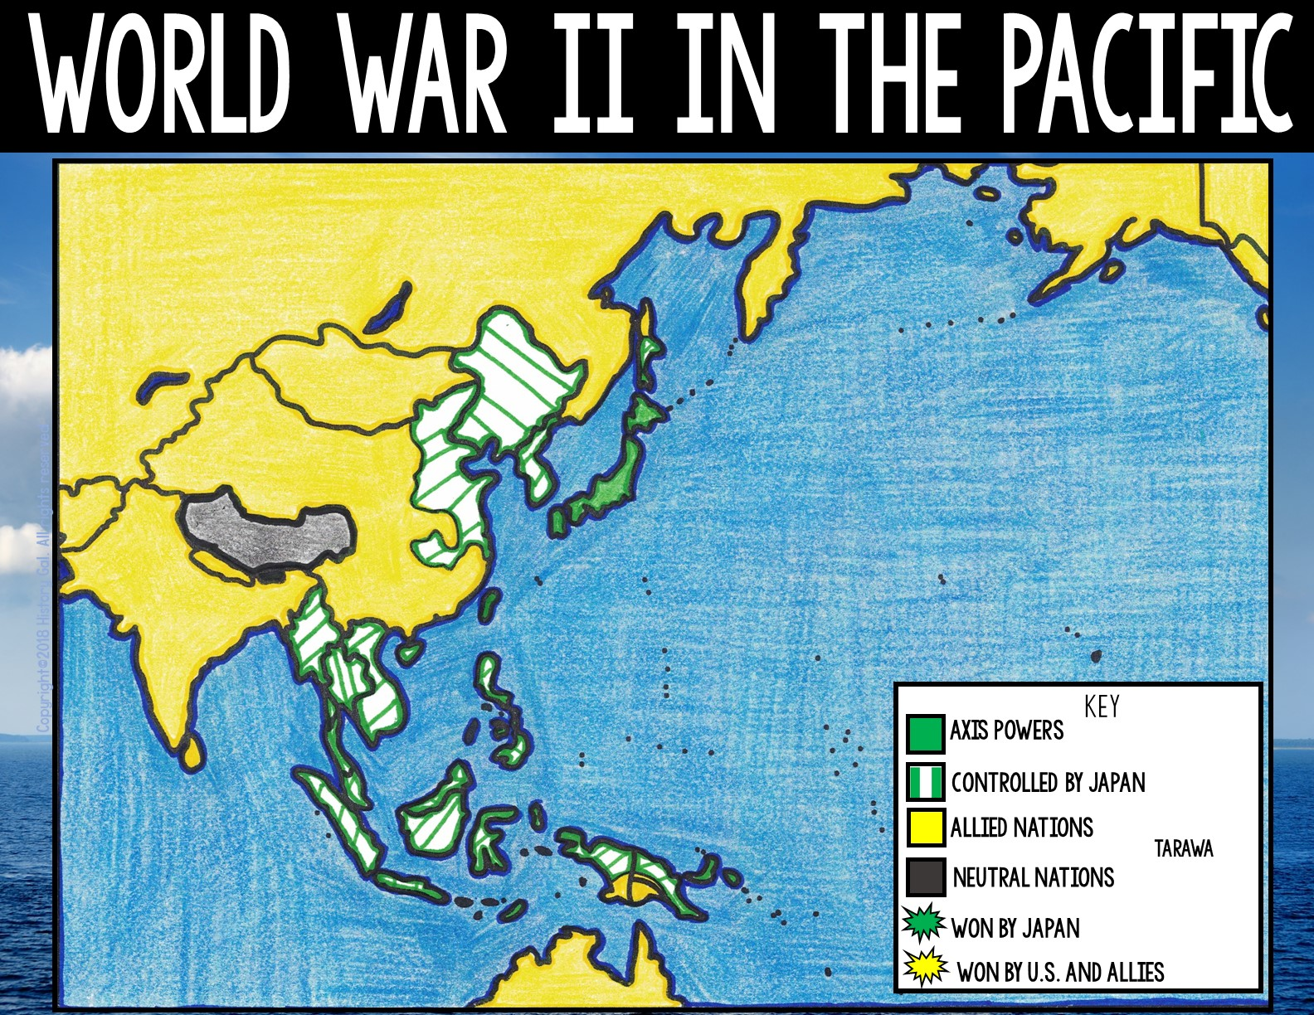
ALASKA
USSR
(U.S. Territory)
Attu
CANADA
MONGOLIA
Kiska
Nov. 20 - 23, 1943: BATTLE OF TARAWA (Gilbert Islands):
This difficult and bloody battle was an Allied victory.
PAKISTAN
MANCHURIA
CHINA
KOREA
JAPAN
NEPAL
TIBET
BHUTON
INDIA
Midway
HAWAII
(British Territory)
BURMA
Tarawa
(U.S. Territory)
FRENCH INDOCHINA
Pearl Harbor
THAILAND
PHILIPPINES
MALAYA
(U.S. Territory)
BORNEO
(British Territory)
NEW GUINEA
(U.S. and Australian Territories)
DUTCH
EAST INDIES
Guadalcanal
Coral Sea
AUSTRALIA

Slide 32
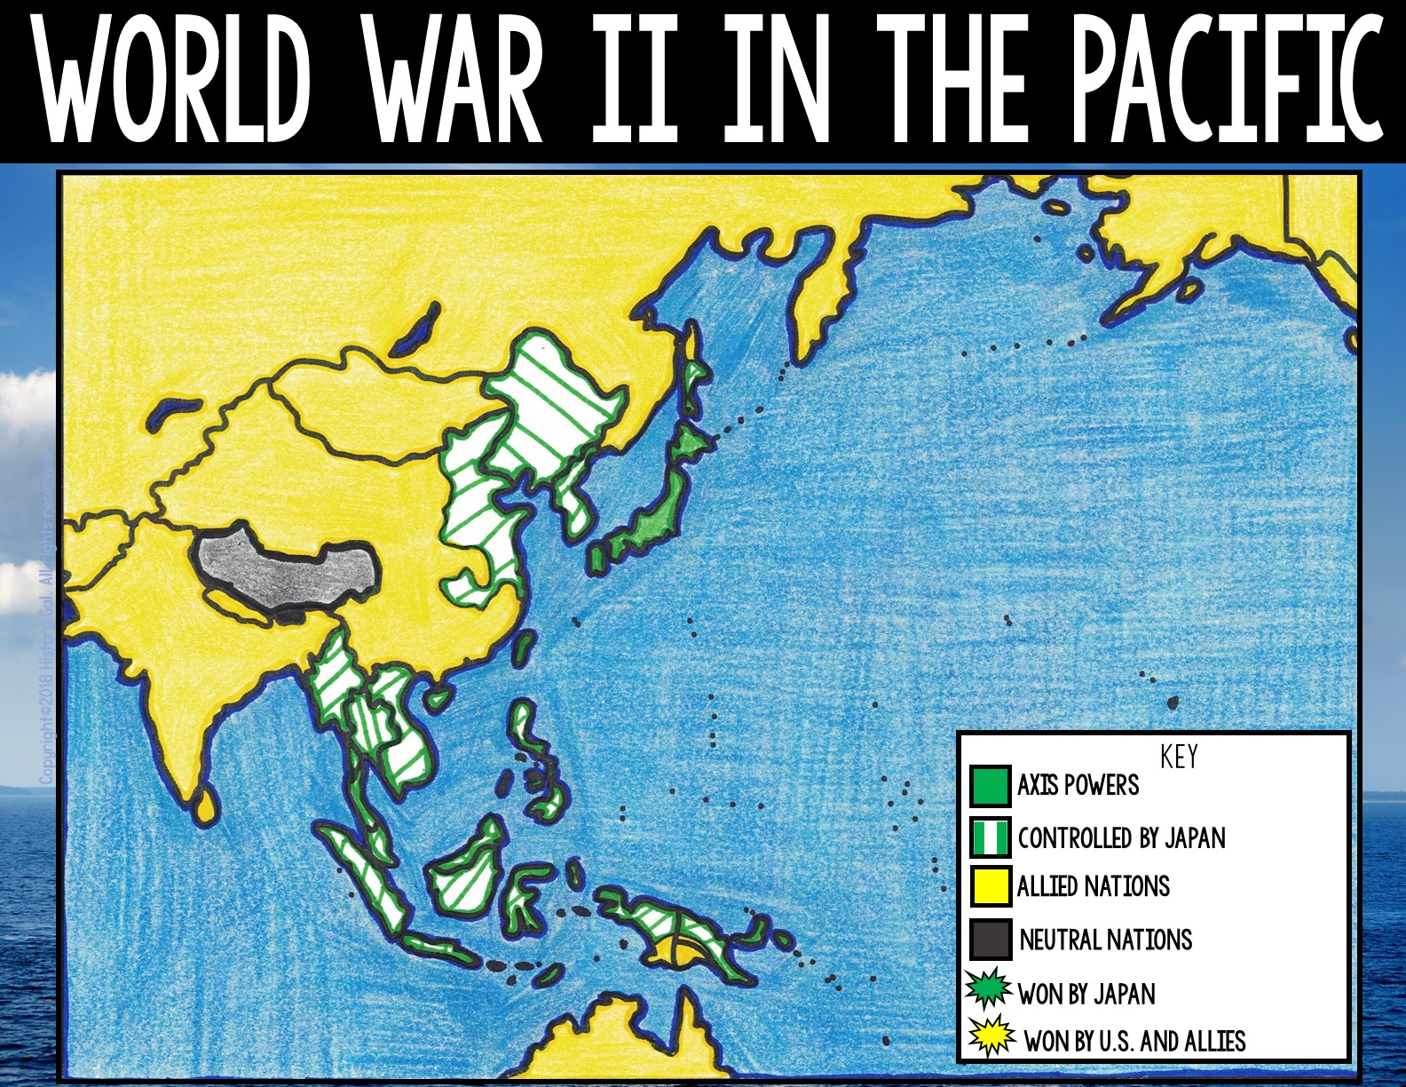
ALASKA
USSR
(U.S. Territory)
Attu
CANADA
MONGOLIA
Kiska
June 15 – July 9, 1944: BATTLE OF SAIPAN (Mariana Islands) –
The U.S. invasion of the island resulted in an Allied victory.
PAKISTAN
MANCHURIA
CHINA
KOREA
JAPAN
NEPAL
TIBET
BHUTON
INDIA
Midway
HAWAII
BURMA
Battle of Saipan
(British Territory)
(U.S. Territory)
FRENCH INDOCHINA
Pearl Harbor
PHILIPPINES
THAILAND
(U.S. Territory)
MALAYA
BORNEO
(British Territory)
NEW GUINEA
Tarawa
(U.S. and Australian Territories)
DUTCH
EAST INDIES
Guadalcanal
Coral Sea
AUSTRALIA

Slide 33

ALASKA
USSR
(U.S. Territory)
Attu
CANADA
MONGOLIA
Kiska
July 21– Aug 10, 1944: BATTLE OF GUAM (Mariana Islands) -
The U.S. liberated the island from the Japanese.
PAKISTAN
MANCHURIA
CHINA
KOREA
JAPAN
NEPAL
TIBET
BHUTON
Midway
HAWAII
INDIA
BURMA
Battle of Guam
(British Territory)
(U.S. Territory)
FRENCH INDOCHINA
Pearl Harbor
THAILAND
PHILIPPINES
Saipan
(U.S. Territory)
MALAYA
BORNEO
(British Territory)
NEW GUINEA
Tarawa
(U.S. and Australian Territories)
DUTCH
EAST INDIES
Guadalcanal
Coral Sea
AUSTRALIA

Slide 34
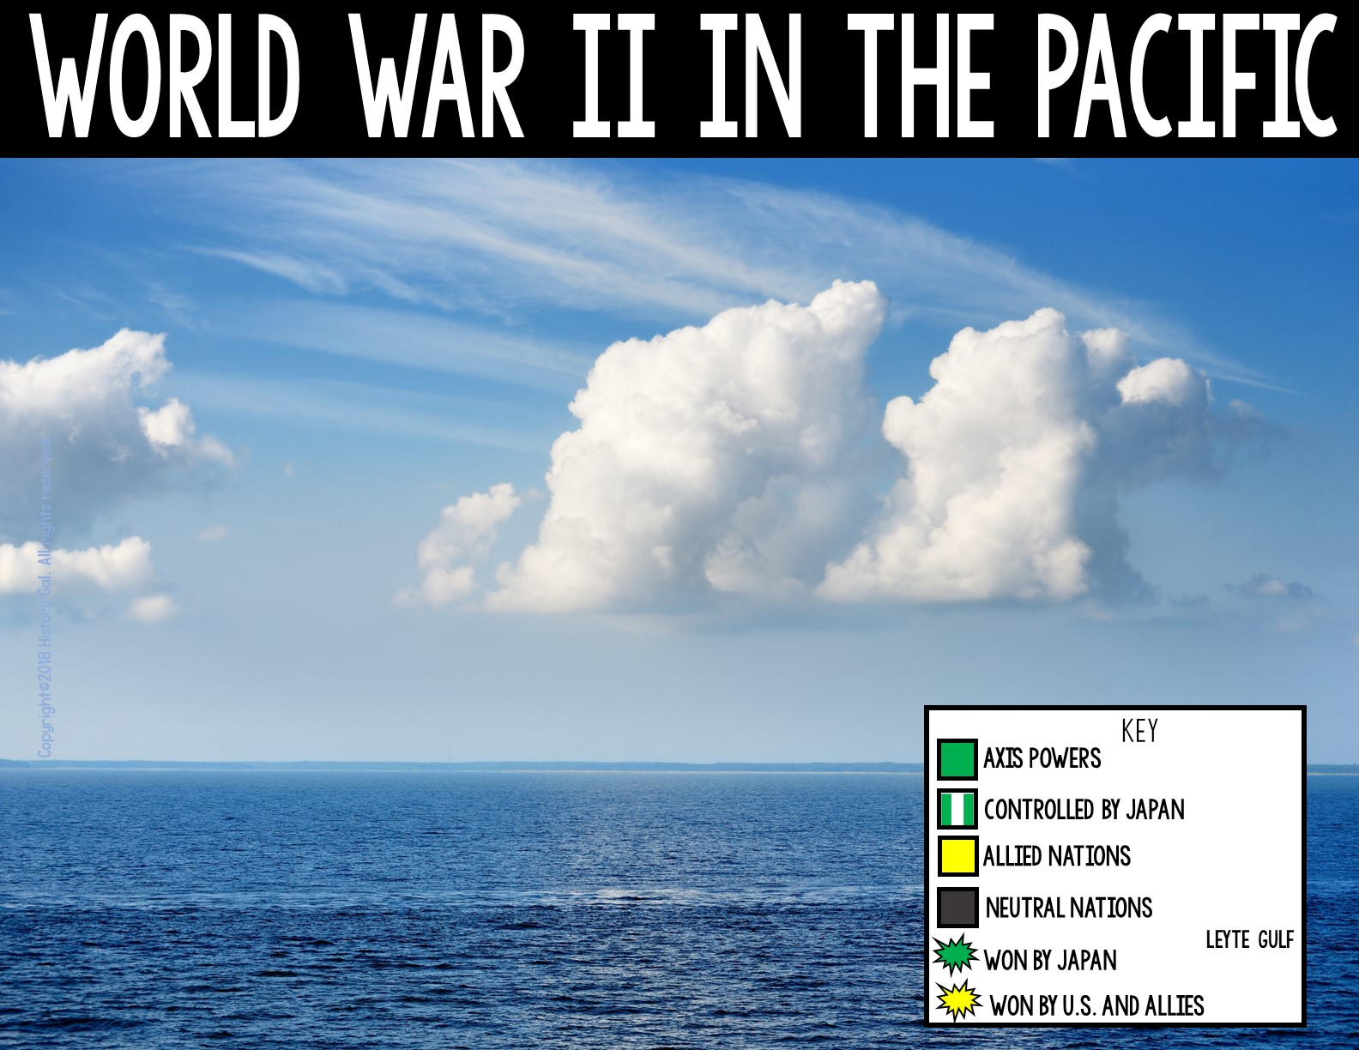
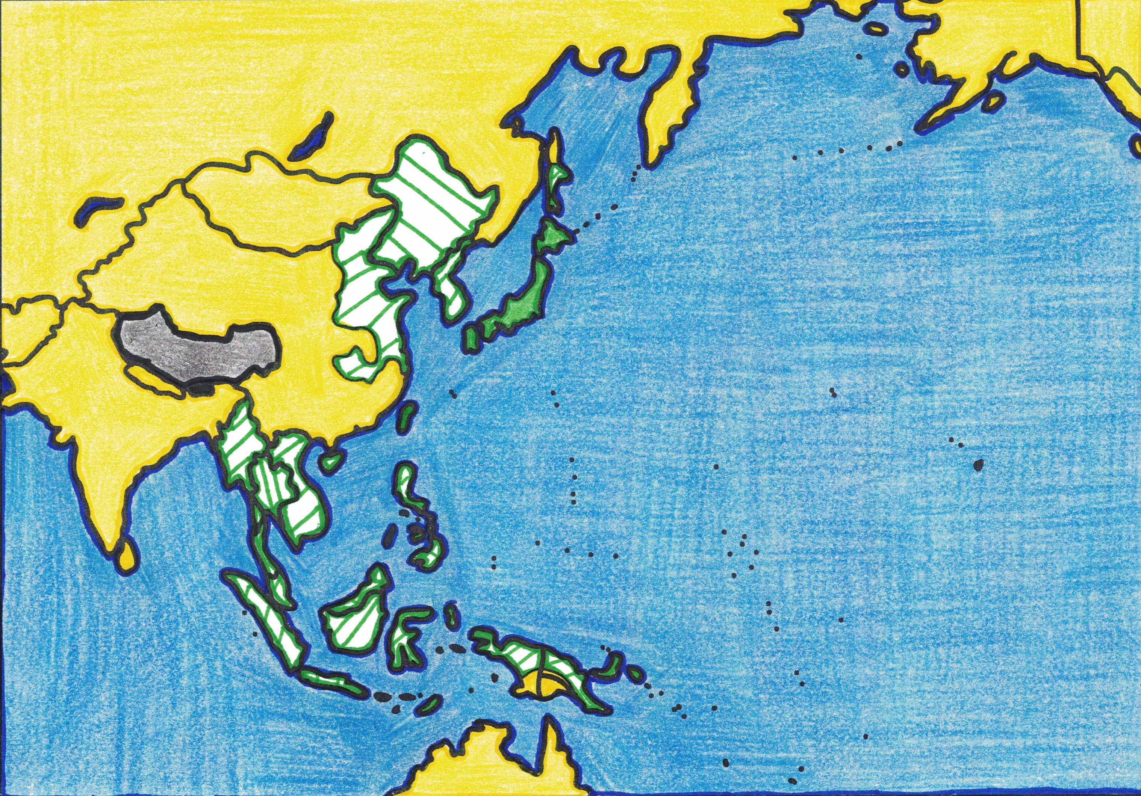
ALASKA
USSR
(U.S. Territory)
October 23 - 26, 1944: BATTLE OF LEYTE GULF –
This was one of the largest naval battles in world history. The combined American and Australian forces defeated the Japanese and crippled a significant portion of the Japanese fleet.
Attu
CANADA
MONGOLIA
Kiska
PAKISTAN
MANCHURIA
CHINA
KOREA
JAPAN
NEPAL
TIBET
BHUTON
INDIA
Midway
HAWAII
BURMA
Battle of Leyte Gulf
(British Territory)
(U.S. Territory)
FRENCH INDOCHINA
Pearl Harbor
PHILIPPINES
THAILAND
(U.S. Territory)
Saipan
MALAYA
Guam
BORNEO
(British Territory)
NEW GUINEA
Tarawa
(U.S. and Australian Territories)
DUTCH
EAST INDIES
Guadalcanal
Coral Sea
AUSTRALIA

Slide 35

ALASKA
Feb. 19 – March 26, 1945 BATTLE OF IWO JIMA (Japanese Volcano Islands) –
American forces fought against the heavily fortified Japanese occupied island and, ultimately, won
USSR
(U.S. Territory)
Attu
CANADA
MONGOLIA
Kiska
PAKISTAN
MANCHURIA
CHINA
KOREA
JAPAN
Iwo Jima
NEPAL
TIBET
BHUTON
INDIA
Midway
HAWAII
(British Territory)
BURMA
(U.S. Territory)
FRENCH INDOCHINA
Pearl Harbor
PHILIPPINES
THAILAND
(U.S. Territory)
Saipan
MALAYA
Guam
Leyte Gulf
BORNEO
(British Territory)
NEW GUINEA
Tarawa
(U.S. and Australian Territories)
DUTCH
EAST INDIES
Guadalcanal
Coral Sea
AUSTRALIA

Slide 36
ALASKA
USSR
(U.S. Territory)
Attu
CANADA
MONGOLIA
Kiska
PAKISTAN
MANCHURIA
CHINA
KOREA
JAPAN
NEPAL
TIBET
BHUTON
INDIA
Iwo Jima
Midway
HAWAII
(British Territory)
BURMA
(U.S. Territory)
FRENCH INDOCHINA
Pearl Harbor
April 1 – June 22, 1945 - BATTLE OF OKINAWA –
In one of the bloodiest battles of the war (and the last major battle), American and British forces defeated the Japanese forces on Okinawa. Allied control of Iwo Jima and Okinawa meant that the Allies were in bombing distance of Japan.
PHILIPPINES
THAILAND
(U.S. Territory)
Saipan
MALAYA
Guam
Leyte Gulf
BORNEO
(British Territory)
NEW GUINEA
Tarawa
(U.S. and Australian Territories)
DUTCH
EAST INDIES
Guadalcanal
Coral Sea
Battle of Okinawa
AUSTRALIA

Slide 37
ALASKA
USSR
(U.S. Territory)
Attu
CANADA
MONGOLIA
Kiska
PAKISTAN
MANCHURIA
CHINA
KOREA
JAPAN
NEPAL
TIBET
BHUTON
Hiroshima
Nagasaki
INDIA
Iwo Jima
HAWAII
Okinawa
BURMA
August 6 - 9, 1945 – BOMBING OF HIROSHIMA AND NAGASAKI –
The United States dropped an atomic bomb on the Japanese city of Hiroshima on August 6 and another atomic bomb on Nagasaki on August 9. The Japanese surrendered on August 15, 1945.
(British Territory)
(U.S. Territory)
FRENCH INDOCHINA
Pearl Harbor
PHILIPPINES
THAILAND
(U.S. Territory)
Saipan
MALAYA
Guam
Leyte Gulf
BORNEO
(British Territory)
NEW GUINEA
Tarawa
(U.S. and Australian Territories)
DUTCH
EAST INDIES
Guadalcanal
Coral Sea
Bombing of Hiroshima and Nagasaki
Newsreel
Dropping the Bomb
Iconic V-J Kiss
AUSTRALIA

Slide 38
ALASKA
USSR
(U.S. Territory)
Attu
CANADA
MONGOLIA
Kiska
PAKISTAN
MANCHURIA
CHINA
KOREA
JAPAN
NEPAL
TIBET
BHUTON
Hiroshima
Nagasaki
INDIA
Iwo Jima
HAWAII
Okinawa
(British Territory)
BURMA
(U.S. Territory)
FRENCH INDOCHINA
Pearl Harbor
PHILIPPINES
THAILAND
(U.S. Territory)
Saipan
MALAYA
Guam
Leyte Gulf
BORNEO
(British Territory)
NEW GUINEA
Tarawa
(U.S. and Australian Territories)
DUTCH
EAST INDIES
Guadalcanal
Coral Sea
AUSTRALIA

