Slide 1
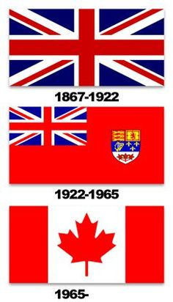
THE HISTORY OF CANADA

Slide 2
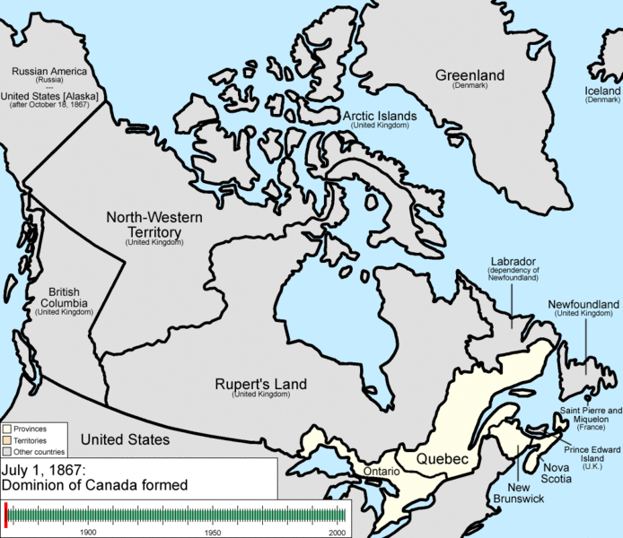

Slide 4
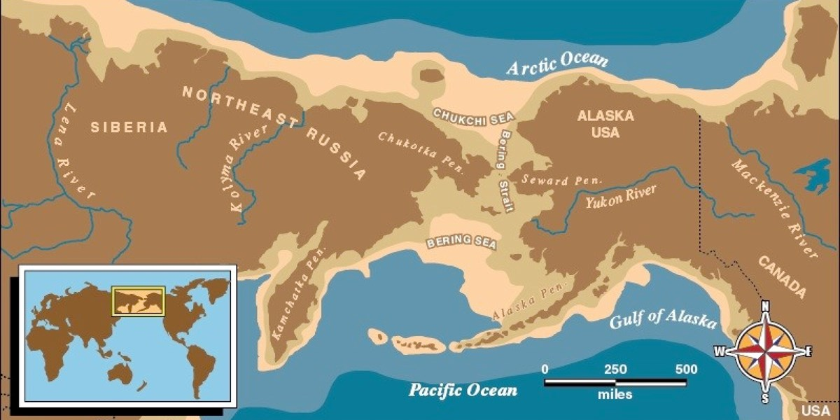
Pre Colonization
Around 50,000 – 17,000 years ago there was an Ice Age.
The Ice spread across the continents forming ‘Land Bridges’
One of these Bridges went between Russia and Alaska.

Slide 5
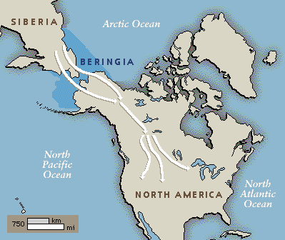
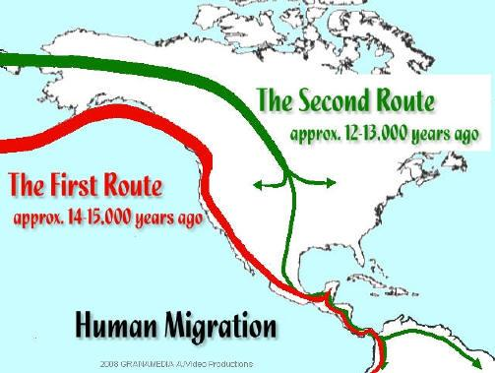
The Beringia Theory
Archaeologist and Scientists hypothesize that about 20,000-15,000 years ago Nomadic Tribes crossed the Bering Sea over the Beringia Land Bridge.
They were following the migration of Mastodons, Deer, and Buffalo.

Slide 6
The Records are low…
There are only a few archaeological sites which have been discovered in Canada and the United States that support this time-frame for people coming to America.
Bluefish Caves, Yukon
Old Crow Flats, Yukon
Q: Why might it be difficult for Archaeologist to find sites from back then?

Slide 7
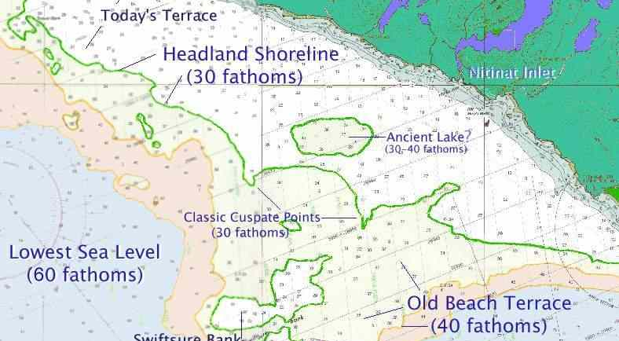

Slide 8
1 Fathom = 6 Feet.
30 Fathoms = 180 Feet
40 Fathoms = 240 Feet

Slide 9
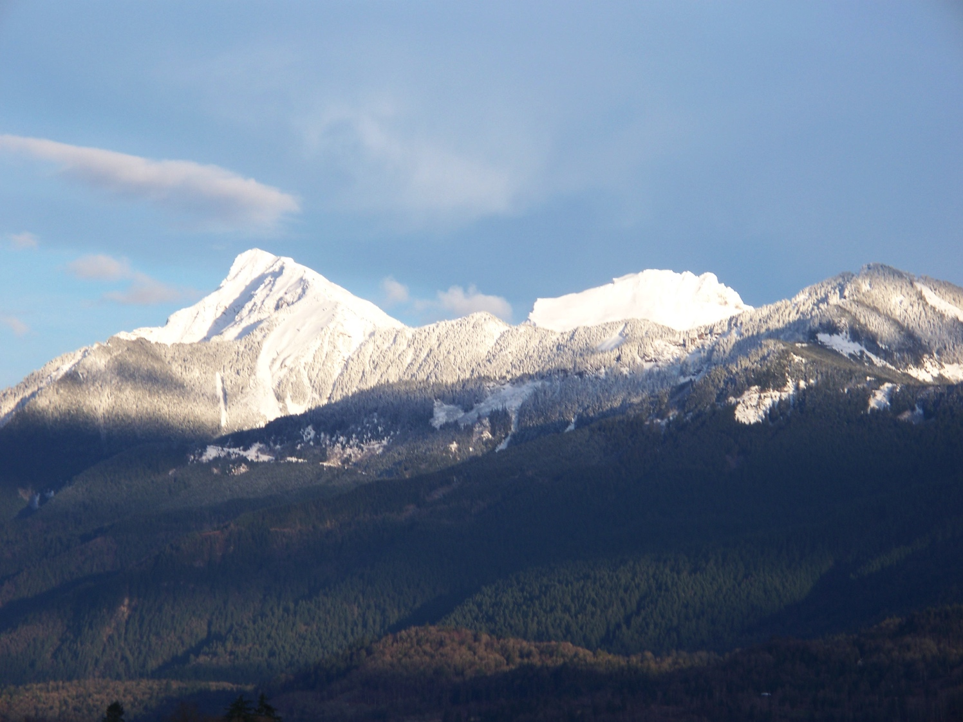
Above
Below

Slide 10
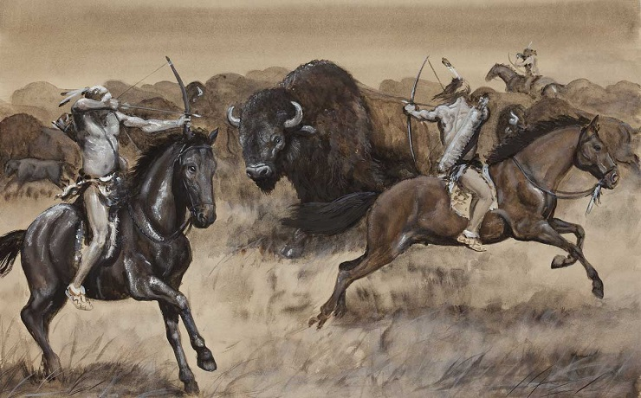
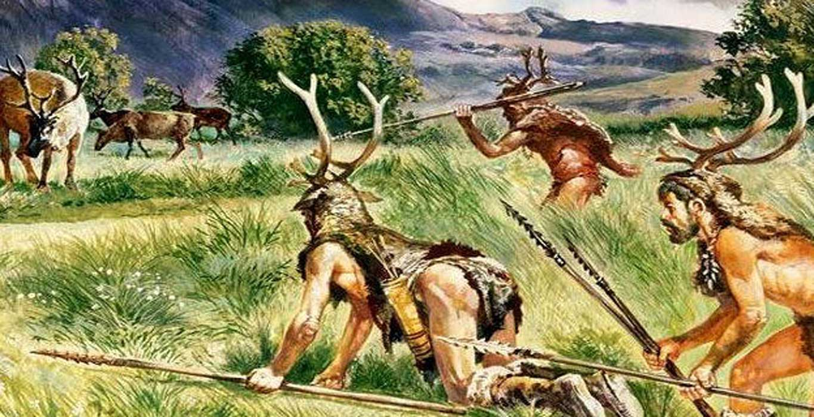
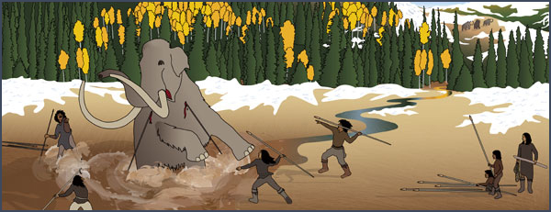
Hunters
These are the first people who arrived in North America
As Nomads they followed herds of game (animals)

Slide 11
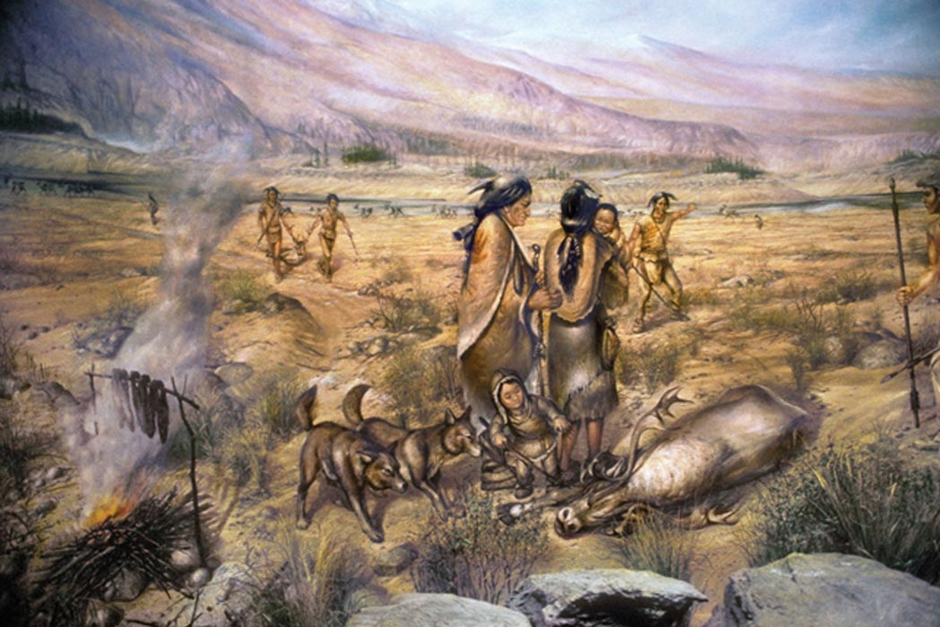
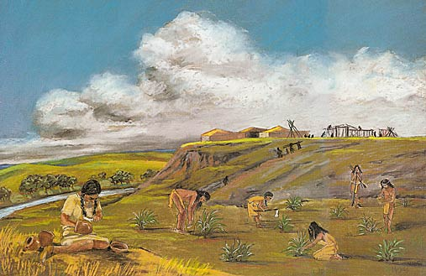
Hunter-Gatherers
As large animals began to disappear, hunter began to
Look to different food sources.
They began to fish, hunt small game animals, gather seeds, nuts and berries.

Slide 12
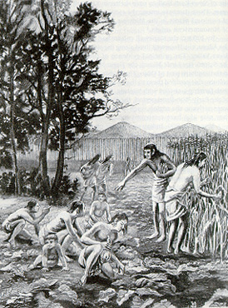
Farmers
Over time, Hunter-Gatheres learned more about the flora and fauna, the seasonal temperatures and climate, and the land and seasons, they began to develop techniques for planting and growing crops.
They tamed animals, planted crops and developed advanced agricultural systems.
These people began to build permanent villages and civilization emerged.

Slide 13
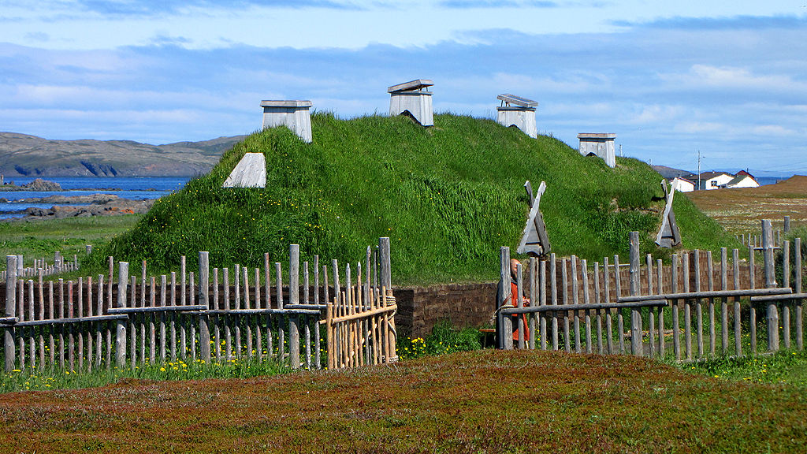
Arrival of Europeans
990-1050 CE – L’anse aux Meadows

Slide 14
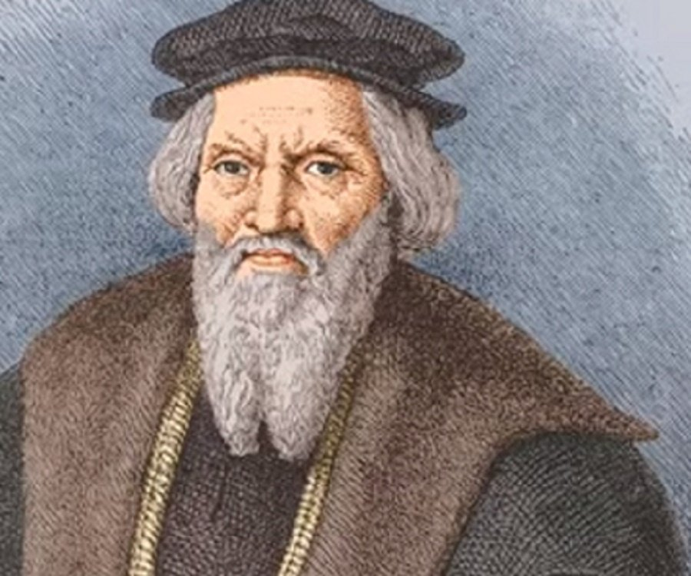
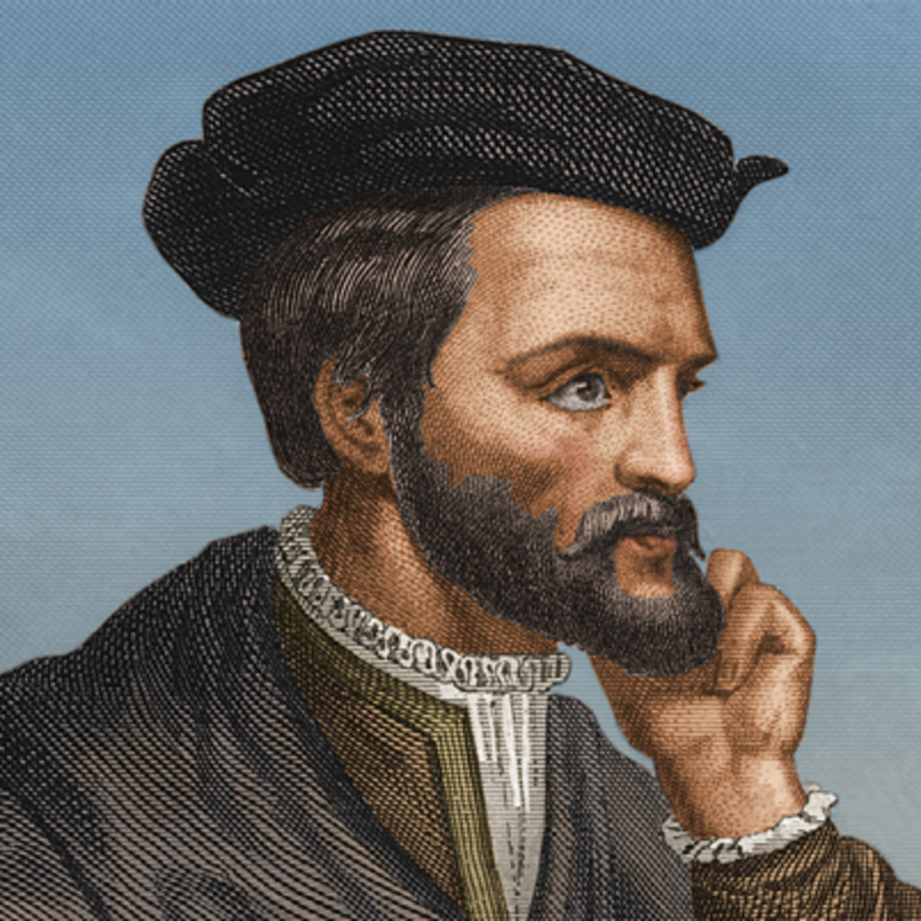
Early Explorers – Northwest Passage
The Northwest Passage was a trade
route to Asia
John Cabot - 1497
Jacques Cartier - 1534

Slide 15
Newfoundland
In 1497, explorer John Cabot, sailed from England to Canada’s east coast.
Cabot claimed the area of land for England and named it “Newfoundland”.
He was looking for a sea route to Asia, but instead found a land full of massive forests and an abundance of fish.

Slide 16
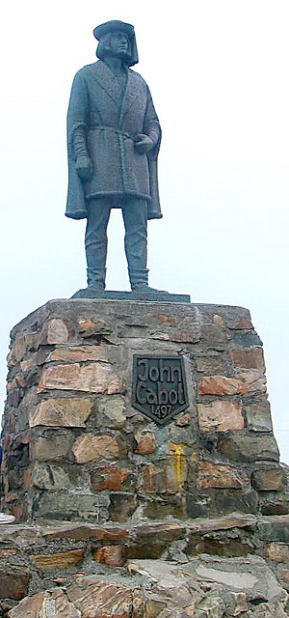
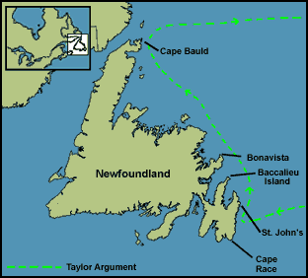

Slide 17
France
In 1534, explorer Jacques Cartier sailed up the St. Lawrence River.
Cartier claimed the land for France named it “New France”.

Slide 18
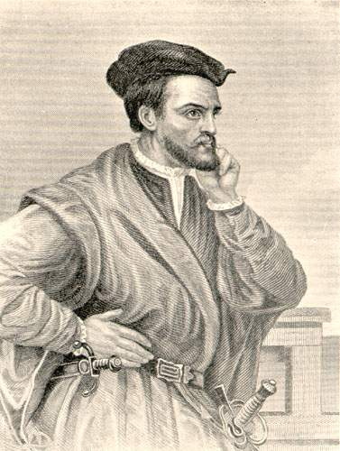
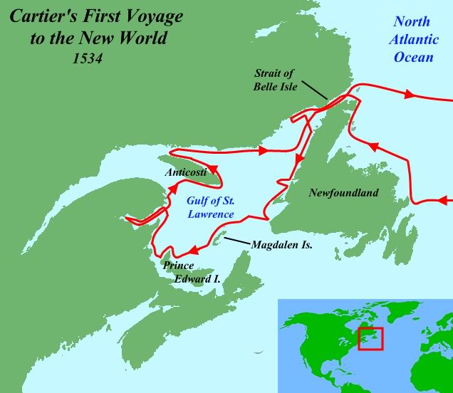

Slide 19
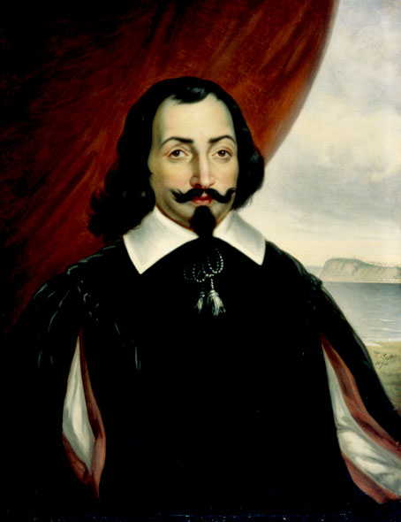

Slide 20
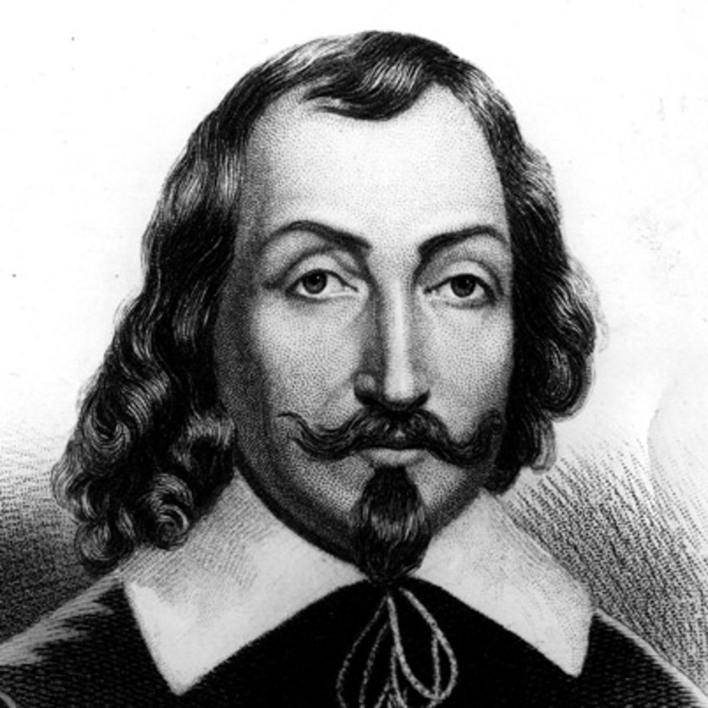
The founding of New France
Jacques Cartier failed to establish a colony in New France
In 1607, Samuel de Champlain came from France to establish a colony at Port Royale
It was not successful
In 1608, de Champlain returned to establish a colony called Quebec (where Stadacona was)

Slide 21
Fur Trade
In 1608, Samuel de Champlain built the first permanent French settlement in the New World (called Quebec).
Many settlers moved inland to trap animals because hats made of beaver fur were in high demand in Europe.
Fur trading with the Indians became a profitable business and the French quickly established more trading posts along the St. Lawrence River.

Slide 22
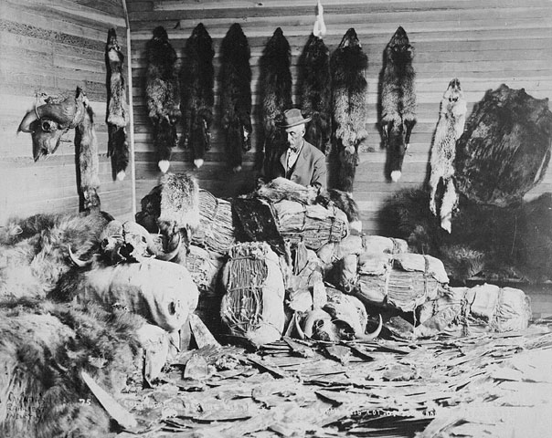
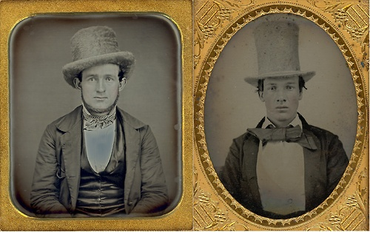

Slide 23
Picking sides
Samuel de Champlain quickly picked sides in the ongoing wars between various aboriginal groups.
He allied with the Algonkians and Montagnais against the Iroquois.
The Algonkians and Montagnais were both nomadic hunter-gatherers from the forest that would travel to gather furs
The Iroquois were settled farmers who lived in fortified villages and had sophisticated political organization where all five tribes could come together as one democratic confederacy in times of need

Slide 24
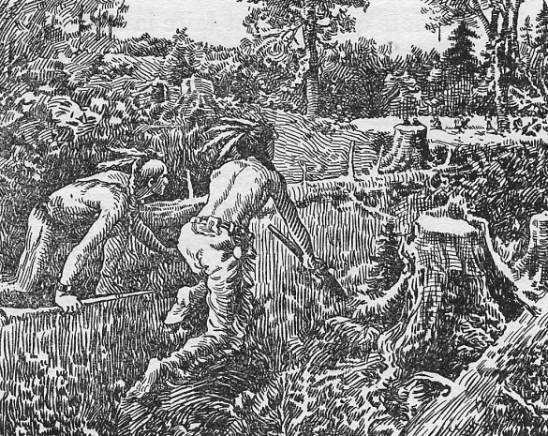
Aboriginal Warfare
The Algonkians and Montagnais often would fight pitched battles by burning down a field or a settlement’s walls
The Iroquois preferred to fight guerilla warfare – that is, hiding and ambushing their enemy
The first battle between the French/Algonkians and the Iroquois was won by the French alliance because the Iroquois were not used to firearms

Slide 25
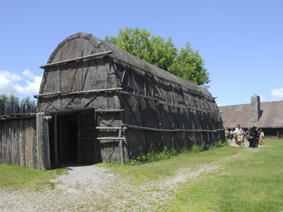
Shifting Alliances
Champlain formed an alliance with the Hurons, who were an agricultural people related to the Iroquois
The Hurons provided many furs for Champlain
Some converted to Christianity
The Montagnais and Algonkians were not happy that the French allied with their competitors and they captured Champlain
He was eventually released

Slide 26
Continuing War
Relations between the Iroquois and the French continued to be bad
The Iroquois allied themselves with the English
They launched raids on New France
The British and New England had four major wars with New France
The Iroquois grew increasingly powerful and looked to eliminate their rivals

Slide 27
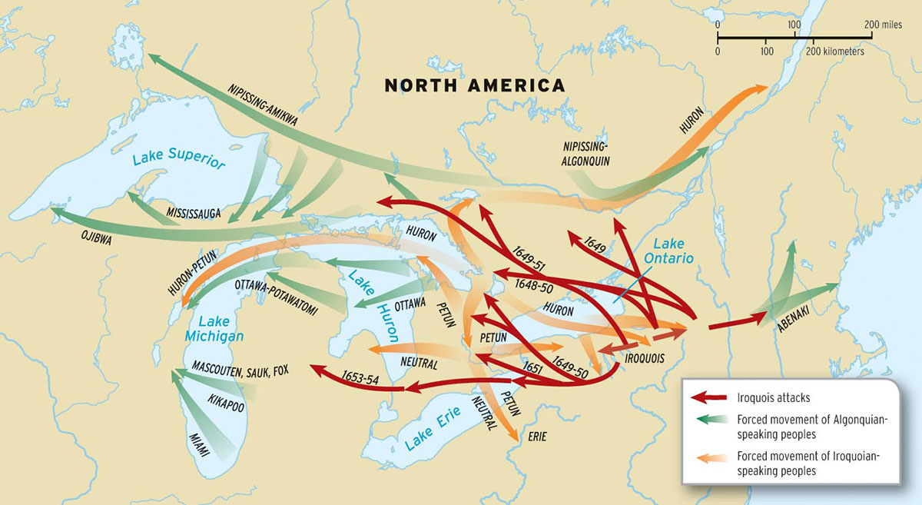

Slide 28
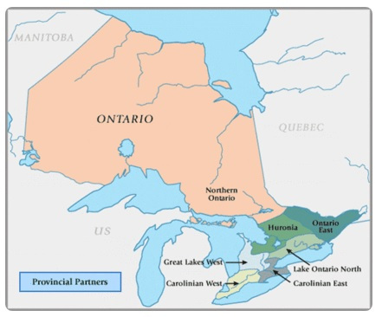

Slide 29
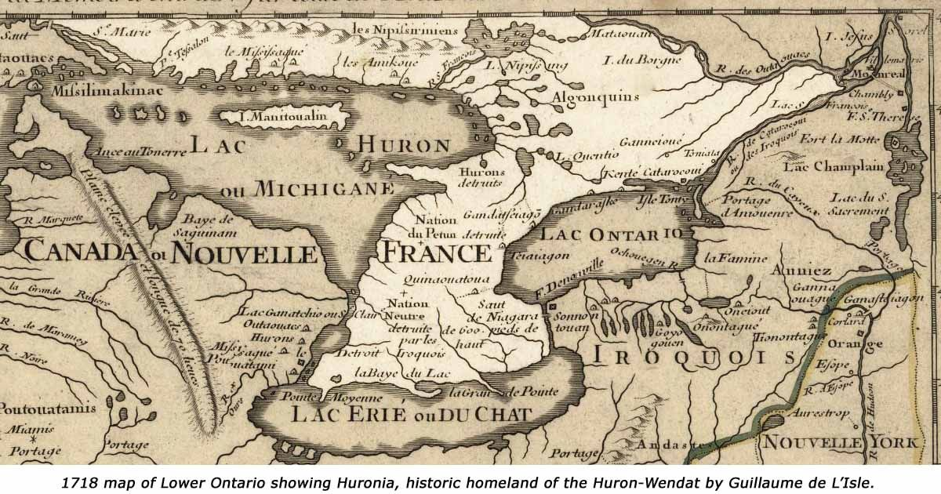

Slide 30
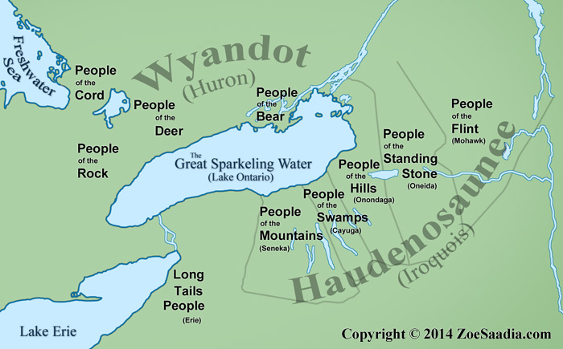

Slide 31
Genocide of the Hurons
Contact with Europeans caused approximately half their population to die
In 1649 and 1650, the Iroquois attacked Huronia and gradually destroyed the country
Most of the men were killed and the women were taken as captives
Surviving Hurons fled to New France or what is now Michigan, USA
The Iroquois now had strong control of fur trade routes
In 1661, the French sent an army which defeated the Iroquois and guarded the French fur trade
The Iroquois would continue as staunch British allies

Slide 32
New France
The French called their territory “New France” and soon fur traders were joined by French farmers, merchants, and missionaries from the Catholic Church.
They brought with them French laws, traditions, and religion.
France wouldn’t let anyone move to New France who was not Catholic.

Slide 33
New France
New France grew to include much of eastern Canada and the central US.
It soon became an important part of the French empire, providing timber, fish, furs, and other valuable resources.

Slide 34
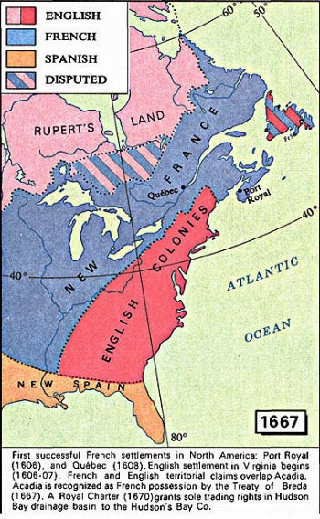

Slide 35
Classwork
Please come grab a copy of the two worksheets for today.
Arrival in Canada
The Fur Trade
You will also need a Crossroads Textbook

Slide 36
Classwork
Please finish any missing assignments for Term 3.
Please submit ‘Arrival in Canada’ and ‘The Fur Trade’ if you have everything else submitted for Term 3.

Slide 37
Classwork
If you’re done the project, I recommend that you take the two handouts and get started on them.
Arrival of Settlers
Exploration
You will need a Crossroads Textbook to do the work.

Slide 38
Quick Review
Jacques Cartier visits Newfoundland in 1534, 1535-36, 1541-42
1608-1609 – Samuel de Champlain establishes a Colony at Tadoussac (Montreal)
The Colony is based around the Fur Trade.

Slide 39
Review
Champlain allies himself with the Algonquians and Montanais and fights the Iroquois.
Eventually the French will side with the Huron; the British with the Iroquois.
The Iroquois will attempt to commit Genocide to the Huron and will take over the Fur Trade.
The French will send their army to defend the fur trade routes.

Slide 40
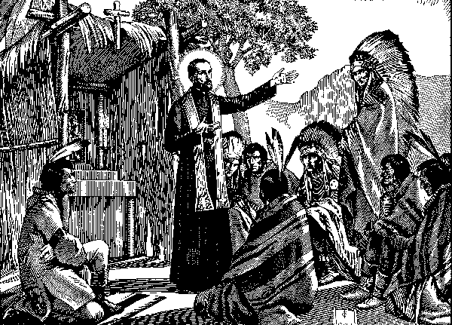
Jesuit Missions
Catholic Missionaries called Jesuits went to North America to convert the natives to Catholicism
They were sent by the king of France, Louis XIII
They lived among Aboriginal nations and tribes such as the Hurons, learned their ways and converted some to Christianity

Slide 41
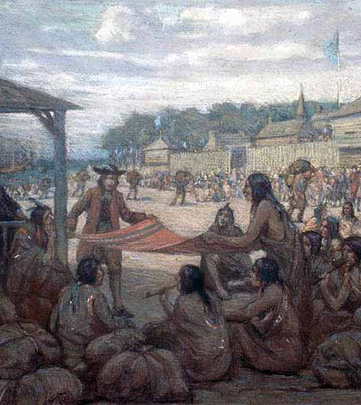
The Coureurs de Bois
The coureurs de bois were French explorers and traders, looking for furs and the Northwest Passage
They tried to go to the source of the furs to beat the Iroquois monopoly on the fur trade

Slide 42
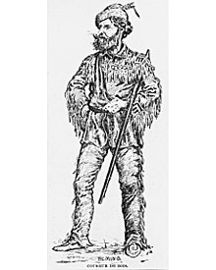
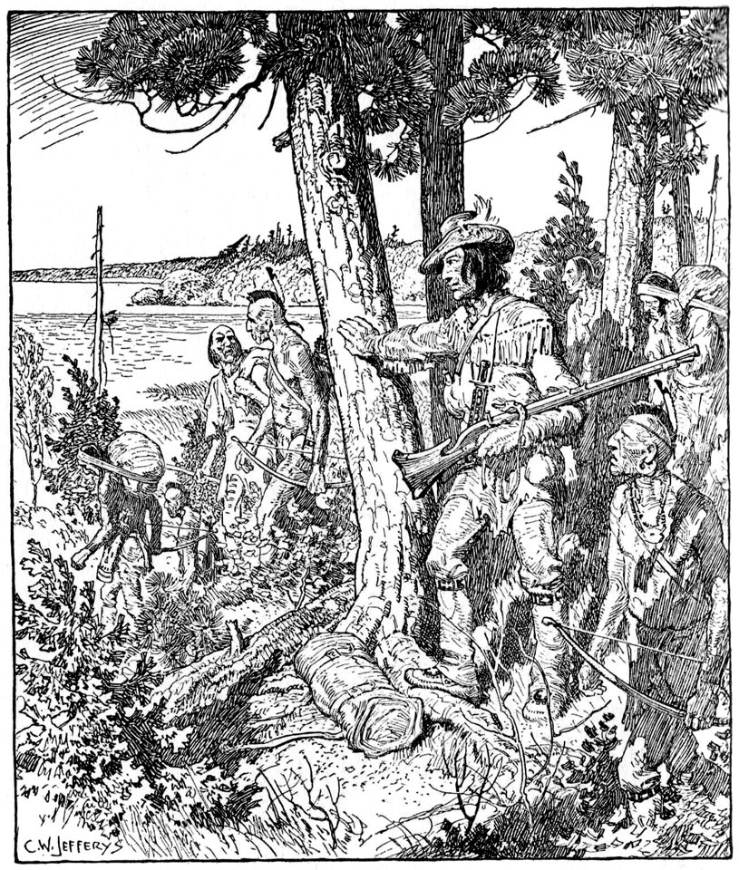

Slide 43
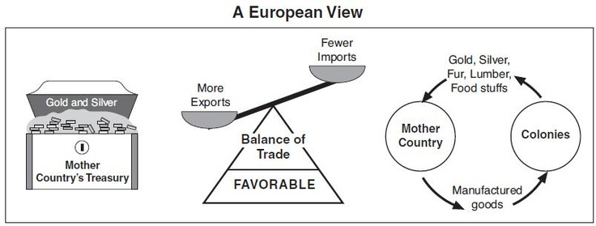
Mercantilism
French King Louis XIV wanted to make New France stronger in order to strengthen his empire
European imperial powers used the Mercantilism economic model
They would buy raw materials from their colonies and sell it back to the colony as a manufactured good.

Slide 44
Establishing a Strong Colony
To break Iroquois control of the fur trade, Louis sent 1,100 soldiers to attack the Iroquois
The Iroquois sued for peace
France established a seigneurial system, like in feudal France
Louis decided to send women instead of having French traders intermarry with the native peoples (which was Champlain’s plan)
They were called Les Filles du Roi (The King’s Daughters)
They were often orphans or poor

Slide 45
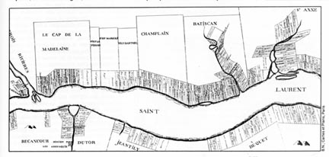
Life in New France
Seigneurs (Lords) were given thin pieces of land
Habitants (peasant farmers) could live on the land and pay rent to the seigneur
Generally, the habitants were better off than peasants in France
There was usually plenty of food and work
There were still few people in New France
There were only 3,215 people in 1666

Slide 46
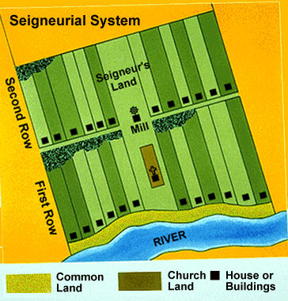

Slide 47
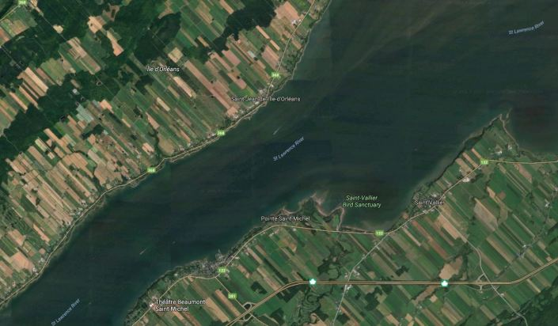

Slide 48
Women in New France
Women had few rights in both France and New France: they couldn’t own property, sue or be sued, or carry on a business without her husband’s consent
Often women would work in the family business, taking care of things while the husband was away fur trading
Women worked on the farms along side men

Slide 49
British in Canada
England saw New France’s success and wanted their share of Canada’s rich natural resources.
British explorers moved west into Canada’s prairies and on to the foothills of the Rocky Mountains.
The British also colonized the region south of New France.

Slide 50
French & Indian
War
Soon, both France and England wanted control of the resources in North America.
To protect their resources, the French built several military forts from Canada all the way down to the Gulf of Mexico.
Some of these forts were built on land claimed by Great Britain, and in 1754, a battle at one of the forts marked the beginning of the French & Indian War.

Slide 51
French & Indian
War
The war involved Great Britain and the Iroquois Indians versus France and the Huron Indians.
France ultimately lost the war and Great Britain conquered New France in 1754.
New France officially came under British control when it was forced to sign the Treaty of Paris in 1763.

Slide 52
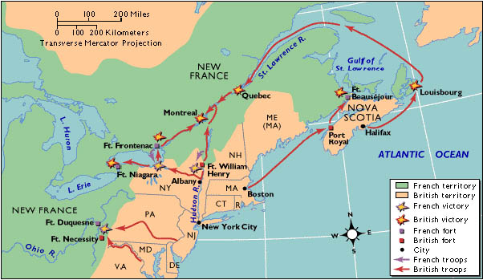

Slide 53
American Revolution
In 1776, Americans gained independence from Great Britain.
This initiated a huge cultural change in Canada.
Americans who did not believe in independence left America and moved to Quebec (New France).
These people were called “Loyalists” because they were loyal to Great Britain.
As a result, Quebec began to have people who spoke English as well as French.

Slide 54
Quebec Act
Many Loyalists did not want to live among French-speaking Canadians.
Cultural differences between the English speakers & French speakers sparked many conflicts.
In 1774, the British government passed the Quebec Act.

Slide 55
Quebec Act
The British allowed the French to stay in Quebec, but continued to control the region.
The Quebec Act guaranteed the French the right to maintain their culture (language, religion, traditions).

Slide 56
Results
It gave French Canadians in Quebec the right to continue practicing the Catholic religion and allowed French civil law.
Loyalists were irritated with the new political & cultural power of the French.
They could not own land or have representation in Quebec’s government.
The differences among the two groups eventually led to a re-division of the country.

Slide 57
Division of
Canada
In 1791, the British government drew new boundaries in Canada, dividing Quebec into two colonies.
Each colony was ruled by a British governor.
Most of the French people lived in “Lower Canada” and most of the British people lived in “Upper Canada”.

Slide 58
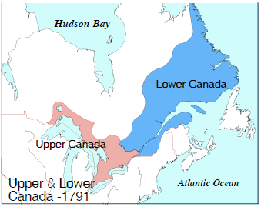

Slide 59


Slide 60
HBC
Hudson’s Bay Company: Est in 1670 by Two French Traders w/ the assistance of Prince Rupert.
Given a Royal Charter in 1670.
Granted Exclusive Trading Rights of the Hudson’s Bay Watershed.

Slide 61
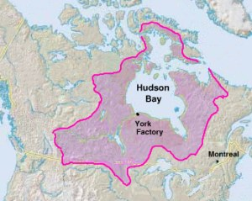

Slide 62
NWC
North West Company: Est in 1779, by Montreal Fur Traders.
Defied the Royal Charter.
Pushed West of Hudson’s Bay Watershed to find furs.

Slide 63
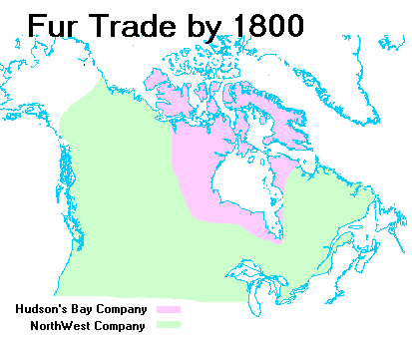

Slide 64
Classwork
Begin HBC and NWC Pkg
Begin Arrival of Settlers / Explorers
You will need a Crossroads Textbook

Slide 65
Good Morning!
Outline for Today
Alexander Mackenzie the Explorer
The War of 1812
The Merger of the HBC + NWC
Life in Upper Canada + Lower Canada
The 1837 Rebellions in U.C/L.C.
The Durham Report
The Act of the Union (1840)

Slide 66
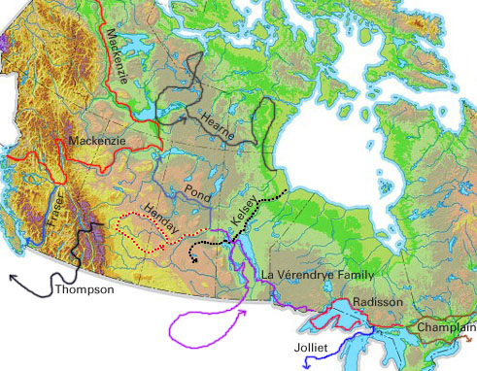

Slide 67
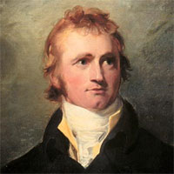
Alexander Mackenzie
In 1793, Alexander MacKenzie (NWC) crossed the continent and came out at the Bella Coola River along the Pacific.
Discovered 12 years before the Lewis and Clarke Expedition

Slide 68
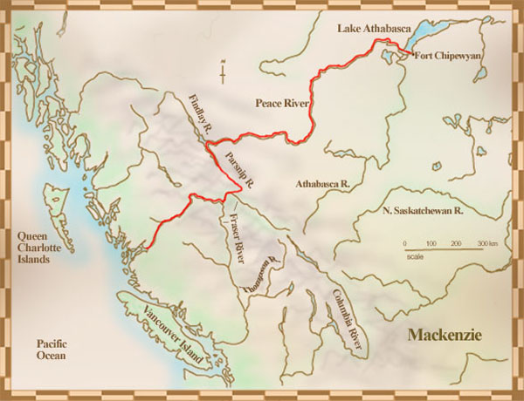

Slide 69
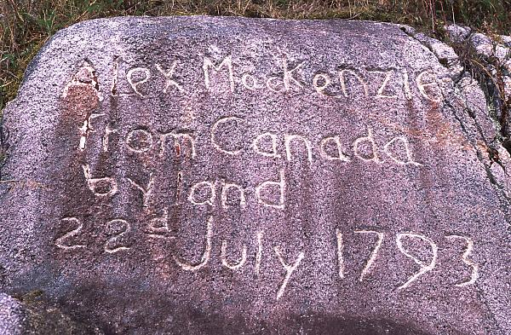

Slide 70
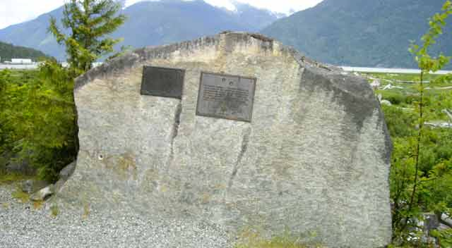
Mackenzie Cairn at Bella Coola

Slide 71
Red River Settlement
In 1811, HBC sold 74 Million Acres (300,000 square km’s) in the Red River Valley to Lord Selkirk (majority shareholder)
Lord Selkirk desired to have a space for Scottish immigrants coming to the new world.
This area was important for the NWC Trade routes.

Slide 72
Resentment
Fur Traders and Settlers did not get along.
Why might this be?
When Settlers came into an area it was often for farming, which meant that the area had to be cleared of trees, brushes, etc.
This would often result in removing the habitat for animals, which negatively affected the fur trade.

Slide 73
Tension’s Grow
Not only was this problematic for the Fur Traders in the Red River Valley, but more so for the indigenous people living their.
The Red River Valley is home to the Metis (European/Indigenous ancestry).
This will lead to later problems for Western Expansion.

Slide 74
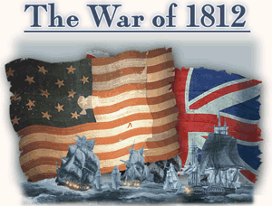

Slide 75
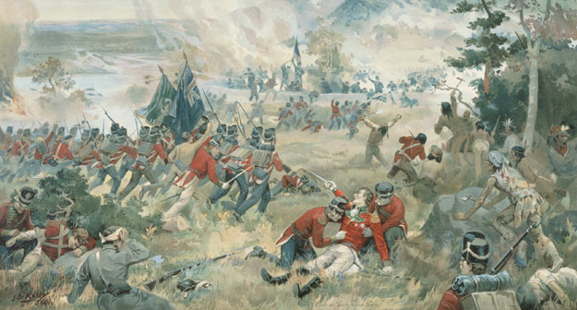
In 1812 the British are at War again with the United States in the ‘War of 1812’
Britain places a blockade on France (Napoleonic Wars)
They stop American Ships from Trading with France.
They ‘impress’ american sailors into the British Navy.
The British were also supplying Aboriginals with weapons and supplies to attack the Americans in the Frontier.
June 18th, 1812 – War is declared.

Slide 76

The HOUSE is on FIRE….
June 18th, 1814

Slide 77
War of 1812
During this war, the French and British worked together against the United States, who tried to invade Canada.
The war resulted in a draw, but it defined the US-Canadian border and increased a sense of Canadian nationalism.
Both French Canadians and English Canadians joined to protect their land—they were more united than ever before.

Slide 78

Following the War
Settlers FLOOD into Upper Canada (Ontario) for cheap farming land.
Lower Canada (Quebec) attracts many American and Scottish Immigrants.
Maritimes continue building ships, harvesting fish,
HBC continues to expand westward.

Slide 79
Upper Canada
Underdeveloped and remote – few roads. Forests are very dense.
Settlers cleared the land but limited to 1 hectare per year – it would take a family 20+ years to clear a 25 hectare (1 city block) piece of land.
Social Life – visit your neighbors, attend church.

Slide 80
Immigrants Experience
Romanticized ads in Europe about life in Canada
Crossing the Atlantic – very expensive, took more than a month to cross. Most did not have bathroom facilities, disease was prevalent.
Many settlers were coming from Britain (England, Ireland and Scotland)

Slide 81
Merger
In 1821, the NWC and HBC merged together forming the HBC.
The HBC gained all the voyaguers and fur trader routes west of the Hudson’s Bay.
The NWC gained the direct port access of furs to England via the Hudson’s Bay.

Slide 82



Galactic Empire of Fur
© Brain Wrinkles

Slide 83


Slide 84
Colonial Government
Oligarchy – power in the hands of a small group of rich and influential men.
Governor – appointed by Britain – was supposed to control the oligarchy but ruled according to their wishes.
Legislative Assembly – voted I members by land owning men.
Governor and Oligarchy could veto any law or regulation proposed by the L.A.

Slide 85
Discontent in UC
Robert Goulay surveys farmers and years of discontent over Gov’t and land practices in UC. Draws up a list of grievances and a petition and the gov’t arrests him and sends him out of the country.
William Lyon Mackenzie openly criticizes gov’t and the Family Compact. Eventually becomes leader of the reform movement in UC.

Slide 86
Unrest
French Canadians and English Canadians realized that they hated being under British rule.
They thought that Great Britain was too far away to understand their economic and political needs.
Colonists were unhappy with being governed by the British and began to rebel in 1837.

Slide 87
Unrest in LC
French had never adjusted to British Conquest.
France is governed by the ‘Chateau Clique’ – an Oligarchy of English Merchants and Ex-Army Officers
80,000 English speakers vs. 420, 000 French Speakers in LC.

Slide 88
French Canadian Isolation
French felt they were the minority
French Canadians;
Feared immigration from English speaking Britain.
Didn’t like the challenging of seigneurial system by offering land to new settlers.
Felt discriminate because of language, culture and ideas.
So a group of people who are unequally taxed, discriminated against in society, and have a lack of power in Govt will …..

Slide 89
REBELLION in Lower Canada
Led by Louis Joseph Papineau’s 92 Resolution to spark change in Lower Canada, rebellion soon breaks out.
The Rebellion is short lived.

Slide 90

Durham Report
British Government sent Lord Durham to investigate the situation.

Slide 91
Province of Canada
Great Britain did not want to repeat what happened with the American Revolution.
Great Britain set up a government where the Canadian colonists governed themselves, except in matters of foreign trade, treaties, and defense.

Slide 92
1840 – Act of Union
Abolished Lower and Upper Canada (Now, Canada West/East)
United the two colonies into one.
Created the Province of Canada.
*The French did not support the Union.

Slide 93
1846 – Treaty of Washington
Treaty between the United States and Britain.
Established the 49th parallel as the boundary for the U.S.
HBC moved their headquarters from Fort Vancouver (WA) to Fort Victoria (BC)

Slide 94


Slide 95
Classwork
Please continue working on the 6 H/O’s
Arrival in Canada
Fur Trade
HBC
NWC
Arrival of Settlers
Exploration

Slide 96

Let’s Focus on BC

Slide 97

Colony of British Columbia

Slide 98

George Vancouver
1757 - 1798
British Officer in the Royal Navy
Explored the Pacific Coastal regions of Alaska, British Columbia, Washington and Oregon.
Places named after him:
Vancouver Island
Vancouver, BC
Vancouver, WA
Mount Vancouver AK/YK
Mount Vancouver, NZ

Slide 99

Discovery

Slide 100



George Vancouver Named many things on his Journey
Notes:
Mount Baker – Koma Kulshan
Mount Rainier - Talol, Tacoma, or Tahoma
Mount St. Helens – Lawetlat’la

Slide 101
The Challenges of Historians
Mount Baker was known to Indigenous People as ‘Koma Kulshan’ for thousands of years.
The Spanish explorer, Gonzalo Lopes Hernan named it ‘ Great Mount Caramel ‘
George Vancouver renamed it ‘Mount Baker’ for his 3rd Lieutenant Joseph Baker.
Reclamation = going back to the original name.

Slide 102
Colony of British Columbia
Began as a fur trading colony.
Following the Treaty of Washington, split into two colonies:
Vancouver Island Colony
Mainland Colony

Slide 103

Simon Fraser
1776 - 1872
Employed by the North West Company
By 1805, Simon Fraser was put in charge of all operations west of the Rockies.
1808 – explored the ‘Fraser River’
Established Fort George (Prince George)

Slide 104
Simon Fraser
1776 - 1872
Received much assistance from Aboriginal Groups along the journey.
Fraser did encounter hostility from the Musquem people in Vancouver, as well as the Kwantlen people who chased him to Hope

Slide 105

David Thompson
1770 - 1857
Fur Trader, Surveyor and Map-Maker.
He travelled over 90,000 kilometers.
Mapping 4.9 Million Sqaure Kilometers.

Slide 106

1811 Excursion along the
Columbia River

Slide 107

Fraser (L) – Thompson (R) River Confluence

Slide 108

Simon Fraser dedicated the Thompson River to explorer David Thompson

Slide 109


Slide 110
1858 – Gold Rush
Following the California Gold Rush of 1849, BC had its own Gold Rush.
In 1858, Gold was discovered in the Thompson Region

Slide 111


Slide 112


Slide 113

1858 – Gold Rush
Notes:
Barkerville

Slide 114
Barkerville
Named after ‘Billy Barker’ who discovered Gold here in 1861.
Over 37,500 ounces were pulled out of this location.
Population of 5,000 people.
3,000 of them were Chinese Immigrants.

Slide 115

In 1868, Barkerville burnt down

Slide 116
Barkerville
In 1868, Barkerville burnt down.
Within 6 weeks, over 90 buildings were re-constructed.
Declined to a small village in the late 1930’s.

Slide 117

1858 – Gold Rush
Notes:
Barkerville

Slide 118
Gold Rush
The Influx of Emigrants/Immigrants to the BC brought with it a need to implement laws, infrastructure and town sites (Yale, Hope, Fort Langley).
Originally our capital was at New Westminster.

Slide 119
Classwork
Please continue working on the 6 H/O’s
Arrival in Canada
Fur Trade
HBC
NWC
Arrival of Settlers
Exploration

Slide 120
Quick Review
Canada today was originally - Upper Canada and Lower Canada
In 1837 Rebellions led to Lord Durham coming over in 1838 and filing a report.
In 1840 – Act of the Union – LC + UC = Province of Canada.

Slide 121
History of B.C.
BC founded by the NWC Co and explorers –
Simon Fraser,
Alexander Mackenzie,
David Thompson
George Vancouver.
Started out as a Fur Trading Colony – until 1858 when…
Gold is discovered.

Slide 122

1862

Slide 123
2 become 1
August 6th, 1866 – Vancouver Island and Mainland BC joined together to form the Colony of British Columbia.
The Capital was moved to present day Victoria.
Notes:
Barkerville

Slide 124
Why Confederation Now?
Threat of an American Takeover
From 1861 – 1865 – America is involved in a Civil War.
The British Sided with the South.
Americans purchased Russia in 1867 ($7.2 Million)
Settlers were moving close to the Red River Settlement
The Gold Rush in BC Brought with it a ton of of settlers into the area.
Manifest Destiny – Control all of North America.

Slide 125
What would you do?
Do you believe the threat of an American take over was a legitimate concern?
If you were a leader in Upper/Lower Canada, would you have pushed for confederation? Or be happy remaining a British Colony?

Slide 126
Other Factors
Fenian Raids
Irish trying to get back at the British.
Equal Representation
Upper and Lower Canada have the same amount of representatives = deadlock votes.
Need for a Railway
Defense/Trade

Slide 127
British North
America Act
In 1867, the British North America Act created the Dominion of Canada.
This meant that Canada was an independent, self-governing nation, but still part of the British empire.
The new country had four provinces: Quebec, Ontario, New Brunswick, and Nova Scotia.
BC Joins in 1871.

Slide 128

Notes:
John A. Macdonald, Canada’s First Prime Minister – 10$ Bill
Sir. George Etienne Cartier

Slide 129


Slide 130
Joining Canada
1867 – Ontario, Quebec, New Brunswick, Nova Scotia
1870 – Manitoba, Northwest Territories
1871 – British Columbia
1873 – P.E.I.
1898 – Yukon
1905 – Alberta, Saskatchewan
1949 – Newfoundland and Labrador
1999 - Nunavut

Slide 131
Expansion
The British North America Act allowed each region to sell goods more easily to one another.
This improved trade helped Canada’s economy.
Canada’s leaders desired to expand the new country from the Atlantic to the Pacific, so they bought land from the Hudson’s Bay Company.

Slide 132

Rupert’s Land Act 1868
Purchased for 300,000 British Pounds – worth 27 Million in 2010.

Slide 133
Treaties
Under the Royal Proclamation Act of 1763 Canada is responsible for the well-being of the Indigenous People.
Between 1871 – 1877 – 7 Treaties were created between Canada and the Indigenous peoples.
In exchange for the land, Canada promised cash payments, fishing/hunting tools, farming supplies, etc.

Slide 134

Treaties

Slide 135
Relocation
Government officials thought the purchase would be a simple process, but problems occurred with the native peoples.
Eventually the First Nations (Inuit) agreed to relocate to reservations in what is now called Nunavut.
In 1886, the Transcontinental Railroad was built on the Inuit’s former land.

Slide 136

Louie Riel
Please come grab a copy of the Reading

Slide 137
Red River Rebellion
The Metis in the Red River Area (Manitoba) were not happy about the purchase of Rupert’s land to Canada. They feared losing their land.
The Metis formed their own provisional government to negotiate terms for joining the confederation.
This would eventually create the Province of Manitoba.

Slide 138
Louie Riel
Louie Riel emerged as a spokesman for the Metis.
Riel alongside some Militants seized Upper Fort Garry and held prisoners.
One was Thomas Scott, an English Settler who opposed the formation of a government in Manitoba.
He would be executed by firing squad.

Slide 139
Outrage in the East
People in Ontario were outraged at the death of Thomas Scott.
In 1870, Manitoba joined as a Province.
Riel and some Metis fled further West to Alberta and Saskatchewan.

Slide 140

Northwest Rebellion - 1885
Series of Battles between the Metis and the Federal Government.
The Metis were unsuccessful.
Louis Riel was Hanged on November 16th, 1885.
In 1992 Louis Riel was recognized for his contribution to Canada in building a nation.
Louis Riel

Slide 141
Classwork
Please continue working on the 6 H/O’s
Arrival in Canada
Fur Trade
HBC
NWC
Arrival of Settlers
Exploration

Slide 142
C.P Railway
The following are provisions given to the Railway by the Canadian Government.
$25 Million in Cash
25 Million Acres of land (belt along the railway)
$37 Million to cover the cost of Surveys
20 Year Monopoly on Transportation.

Slide 143

Chinese Immigrants
To complete construction of the Railway over 15,000 Chinese Immigrants were brought in.

Slide 144


Slide 145


Slide 146

© Brain Wrinkles

Slide 147

Most Expensive Section – $300,000 for 1 Mile of Track

Slide 148


Slide 149
Growth
People could now easily travel across Canada from the Atlantic Ocean to the Pacific Ocean.
Other provinces and territories joined the union over the years as settlement moved west over the railroad system.
Today, the country consists of ten provinces and three territories.

Slide 150


Slide 151


Slide 152
Test on Friday May 11th
Part 1 – Definitions
10 Definitions, you choose 5.
Part 2 – Map of Canada
Label all the Provinces, Hudson’s Bay, Atlantic Ocean + Pacific Ocean
Part 3 – Narrative of Canada
71 Fill in the Blank

