Slide 1

“The Most Dangerous Game” by Richard Connell

Slide 2
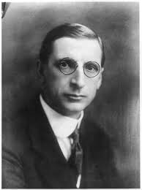
Meet the author!
Richard Connell is the author of “The Most Dangerous Game”
Son of newspaper owner
Newspaper editor
Joined the military
Wrote over 200 short stories as well as screen plays and novels

Slide 3
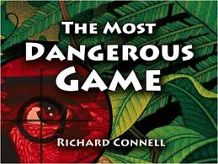
Before Reading

Slide 4
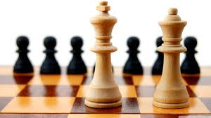
What are the definitions of a game?
A pastime/activity played for amusement and fun. (Noun)
2. A form of play or sport, especially a competitive one played according to rules and decided by skill, strength, or luck. (Noun)
3. Animals hunted for sport. (Noun)

Slide 5
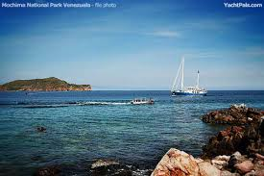
Irony: When the outcome of what is expected is contrary to what actually happens.
Look at the title “The Most Dangerous Game” what is ironic about this title? What is the mood created? How is it created?

Slide 6
What skills would you need to escape a deadly game?
Self to Text Connection: Have you ever read a book/watched a movie that involved the character(s) playing a deadly game?

Slide 7
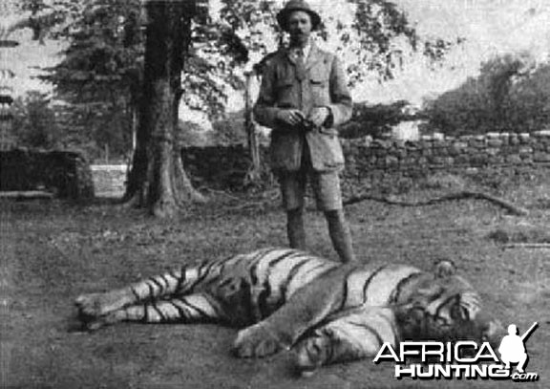
Setting: 1920s on a lush island called Ship Trap
Unfortunately, hunting large game for sport was common among the wealthy upper class and royalty…this lead to endangered species and the near extinction of many species.

Slide 8
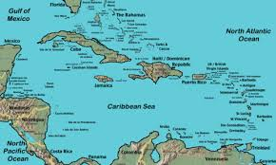
Setting: The time and place in which the story takes place.
Ship Trap Island
The setting is an unidentified island called Ship Trap Island in the Caribbean Sea. Why do you think it is called Ship Trap?

Slide 9
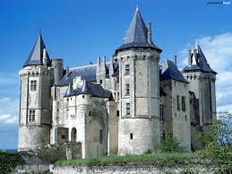
Chateau
cha·teau
SHaˈtō/
noun
a large French country house or castle.

Slide 10
Format for the Plot Diagram
Climax-- point where the protagonist changes
Falling action -- one statement about what leads to the end of the conflict
Rising Action -- three statements that summarize the story
Resolution -- the end of the conflict
Conflict -- struggle between opposing forces
Complication—event that prevents the conflict from being resolved
Exposition --introduces the characters, background and setting

Slide 11
Characterization
The method an author uses to develop a character.
Direct: The author directly states the character traits.
Indirect: The author develops the character through the thoughts, actions and words of the character and interactions with other characters

Slide 12
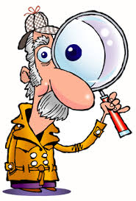
Foreshadowing
Clues given by the author
that contribute to the
development of the plot.

Slide 13
Conflict: Struggle(s) between the characters and opposing forces.
Internal Conflict
External Conflict
An internal struggle between a character and him/herself
Emotional/Choices/Guilt
Character vs. Self
An outside struggle between a character and an opposing force.
Another character, society, God/gods, supernatural, fate
Character vs. character
Character vs. nature
Character vs. Society
Chatacter vs. God (gods)
Character vs. Fate
Character vs. supernatural

Slide 14
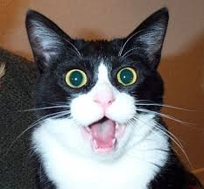
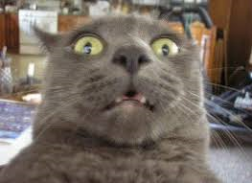
Suspense
Suspense is the anxiety or dread you feel about what will happen next in a story.
Suspense makes you want to keep reading— especially to see what happens to the characters.

Slide 15
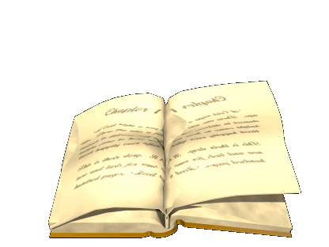
During Reading
Strategies:
Make predictions constantly
2. Look for clues that hint towards the plot (foreshadowing)
3. Be on the look out for four traps (setting/plot)
4. Notice character development (characterization)
5. Summarize each part of the plot diagram (plot)

Slide 16
After Reading
Use adjectives from the story to describe General Zaroff’s home.
Why does General Zaroff “let Rainsford go in the beginning of the game?”
How does Rainsford view about animals change from the beginning to the end?
What is the resolution?
Why does General Zaroff hunt humans?

Slide 17
https://www.youtube.com/watch?v=Zy_iqP2WHZg Most Dangerous Game Movie Trailer
Based on the movie trailer, what differences and similarities can you note?

