Slide 2
Since time immemorial
Indigenous Presence: Origins

Slide 3
Aboriginal Origins ☺
Indigenous Peoples have been in North America since time immemorial.

Slide 4
Aboriginal Origins ☺
Time immemorial is a phrase meaning time extending beyond the reach of memory, record, or tradition, indefinitely ancient, "ancient beyond memory or record".

Slide 5
Aboriginal Origins ☺
First Peoples have many stories that carry knowledge from ancestors into the present day.
Many of these stories are origin stories about how the world began or how things in the world changed.

Slide 6
Aboriginal Origins ☺
Oral history can be defined as the recording, preservation and interpretation of historical information, based on the personal experiences and opinions of the speaker.

Slide 7
Aboriginal Origins ☺
Oral history often takes the form of eye-witness evidence about past events, but can include folklore, myths, songs and stories passed down over the years by word of mouth.

Slide 8
Aboriginal Origins
In the origin stories told by different Indigenous Peoples across Canada, Sky Woman, Glooscap, Sedna, Nanabush or Raven create the world, or change it into the world known to human beings.

Slide 9
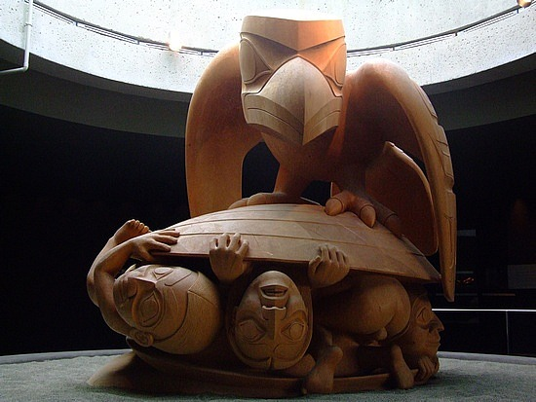
Indigneous Origins
Raven and the First People

Slide 10
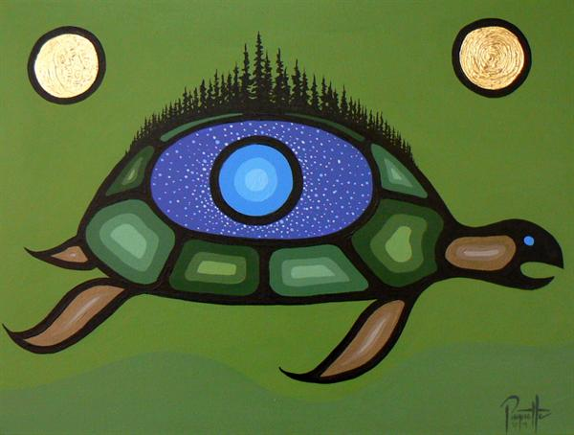
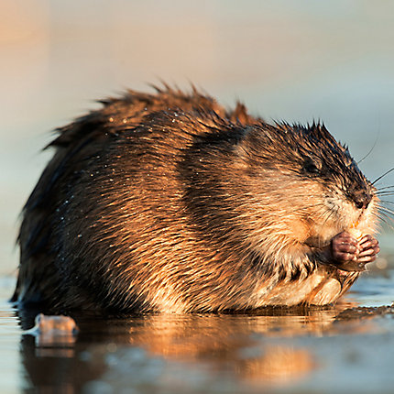
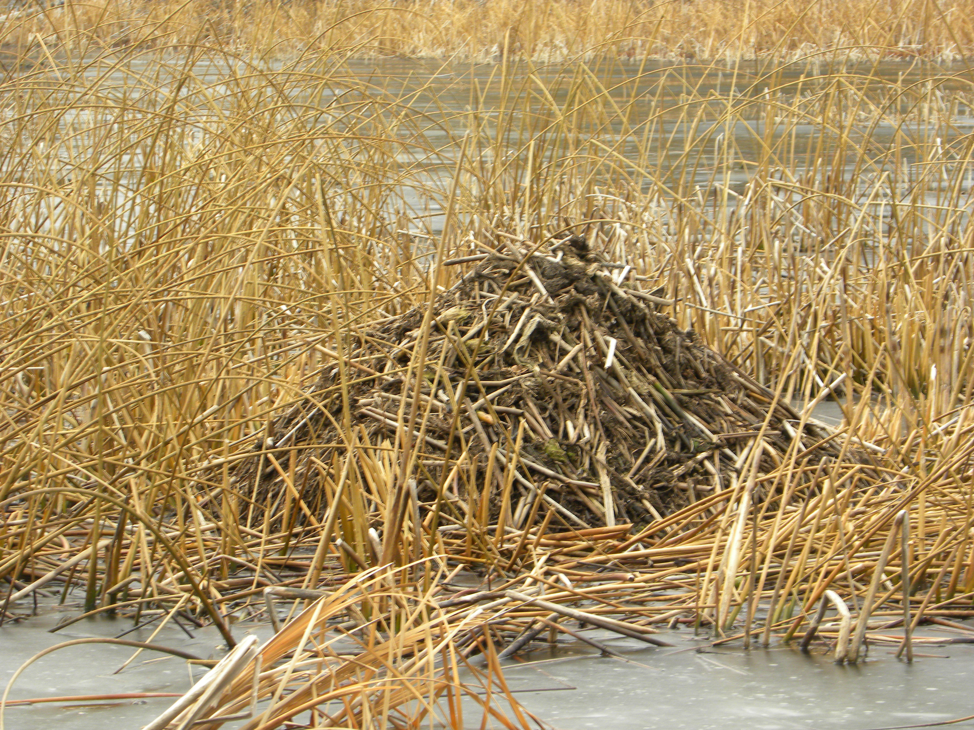
Indigenous Origins
The Creation Story = Turtle Island

Slide 11
Other “Stories” ☺
Many scientists (anthropologists, archeologists) disagree on where the First People came from or how they got to North America.
Scientists know that First Nations and Inuit Peoples have lived in what is now Canada for 12,000+ years because they found bones and artifacts.
Yet many scientists now believed that some of the First Peoples have been here much longer than that. . . since time immemorial.

Slide 12
Other theories: Migration ☺
For several years scientists believed that the ancestors of all North American First Nations crossed over on foot from Asia at the end of the last ice age about 12,000 years ago.
At that time North America and Asia were joined, and what is now the bottom of the Bering Sea between Russia and Alaska was dry land, (a “land bridge”) because sea levels were much lower than they are now = The Bering/Beringia Land Bridge Theory.

Slide 13
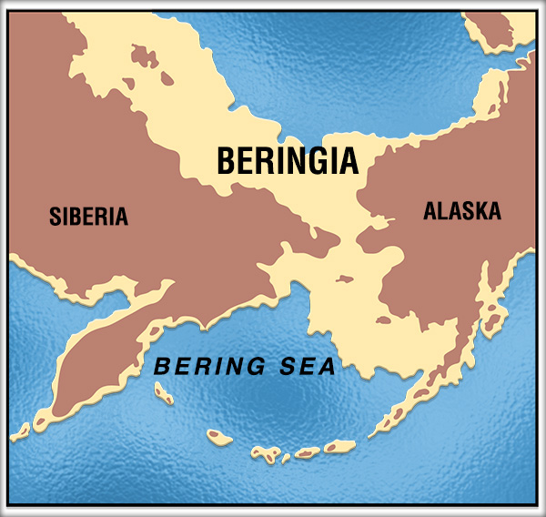

Slide 14
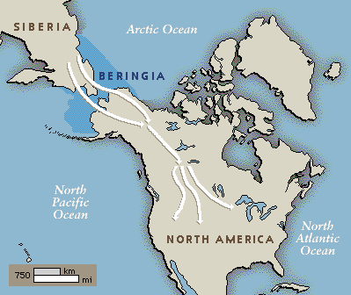

Slide 15
Other theories: Migration
The theory is that nomadic hunting people followed the big animals (moose, deer, elk, buffalo) for food, and eventually moved south and spread out as the ice sheets melted back; then they evolved different cultures to suit different environments.

Slide 16
Other theories: sea routes
Scientists speculate that the ancestors of First Nations people may have come to North America from several different parts of Asia and Polynesia, following several different routes, and maybe over the frozen Atlantic from Europe 6,000 years earlier than the Pacific during the last Ice Age.

Slide 17
Other theories: both
Still others may have crossed the ice fields that once connected Europe and North America.
The Inuit, who live in the high Arctic, were probably the last to arrive.

Slide 18
What is the significance of the scientific theories of first peoples migration to north America?
What could lie under these idea?

Slide 19
Immigrants too?!
But how did First Nations get to the Americas if they have not always been here?
Superiority complex – Europeans looked down on First Nations: “primitive.” with no technology or organized culture.

Slide 20
Immigrants too?!
Identify First Nations as “immigrants” too = no claim to land/rights.

Slide 21
Immigrants too?!
Europeans colonizing North America = land + resource acquisition.
Few, in the past, wanted to credit First Peoples with the ability to use boats or that they have been here since time immemorial.

Slide 22
mythology
Every tribe/nation in North America has a slightly different creation story, but they all are the same in one regard: they state that they have always been.

Slide 23
mythology
Few First Nations (only one group – Coast Salish) have a mythology about Beringia - it is a belief system a point of view constructed by other peoples.

Slide 24
The stories
We still do not “know” how the First Peoples came to North America (or if indeed they did – where always here) but we do have their creation stories which are a version of the truth/the truth.

Slide 25
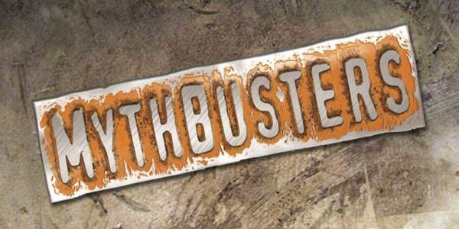

Slide 26
Myth: Aboriginals can do what they want with their reserve lands and resources
False
  Canadian Govt. passed laws allowing the government to expropriate portions of reserve lands to provide for public utility rights of ways (railways, transmission lines and highways).
  Don’t need First Nations Consent.
  Don’t need to Compensate them.
  Ex: Sumas Lake, Abbotsford

Slide 27
Myth: Aboriginals can do what they want with their reserve lands and resources
False
  Canadian Govt. passed laws allowing the government to expropriate portions of reserve lands to provide for public utility rights of ways (railways, transmission lines and highways).
  Don’t need First Nations Consent.
  Don’t need to Compensate them.
  The Mineral Rights (Oil, Gas, Gold, Copper) found on Reserve Land is owned by the Government (unless stated in a treaty).

Slide 28
Myth: Reservations are Enormous and Never Change in Size
False
  Canada is 9.985 Million Square Kilometers in Size.
  Reservations make up 0.2%
  Reserves are not Traditional Territory.
  Ex: Sumas Lake

Slide 29
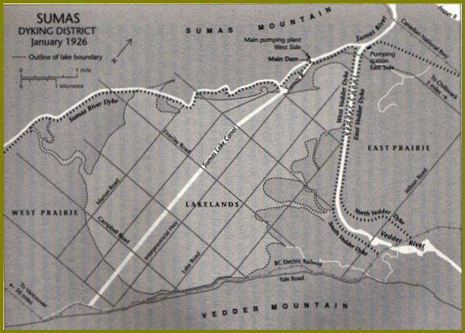
Sumas Lake 1920’s

Slide 30
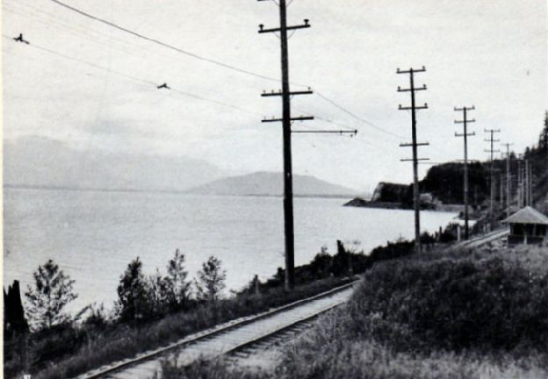
Sumas Lake 1920’s

Slide 31
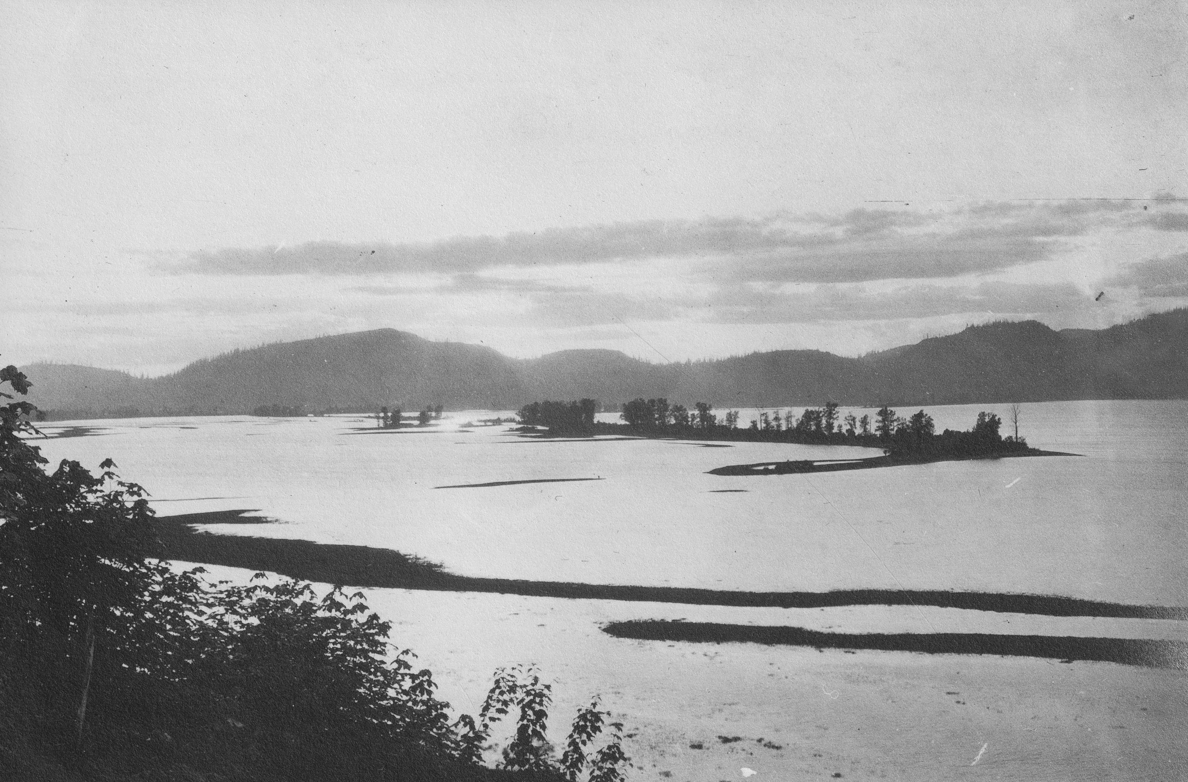
Sumas Lake 1920’s

Slide 32
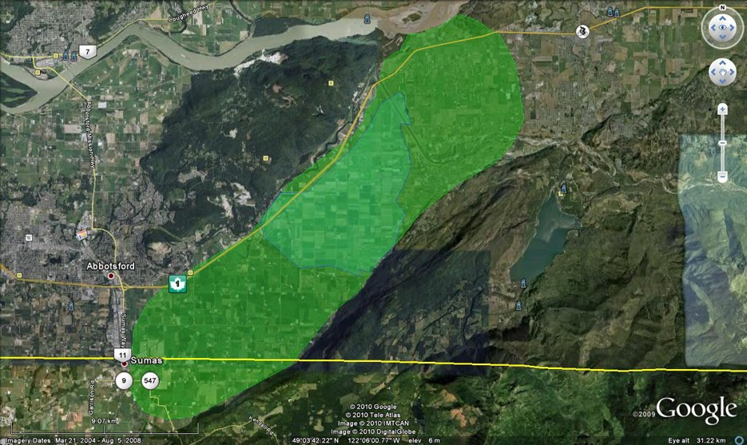
Sumas Lake – 33,000 Acres

Slide 33
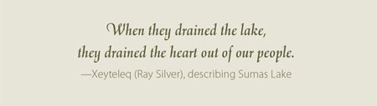
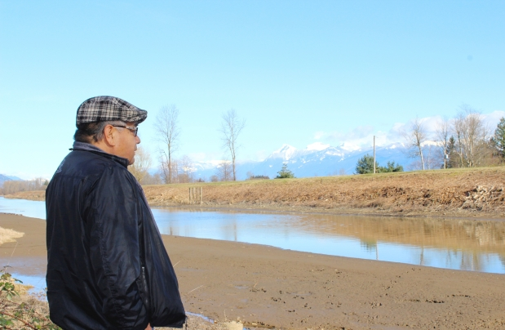

Slide 34
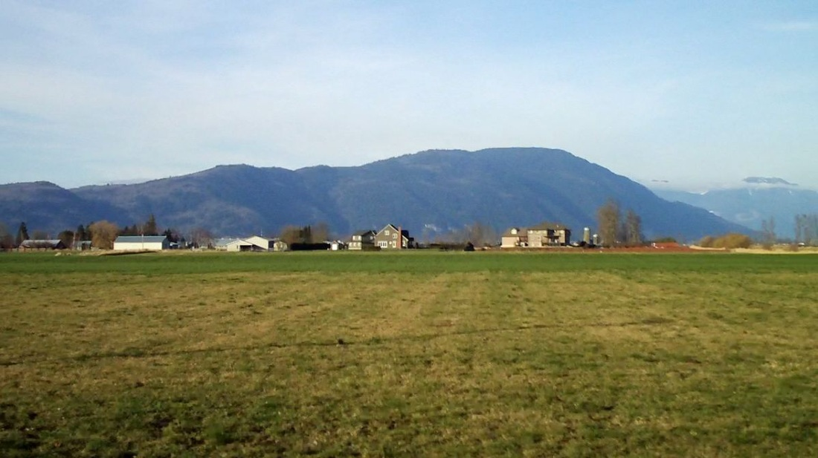
Sumas Lake Today

Slide 35
Origin Story Activity
Step 1 - Google “First Nations Origin Stories”
  Step 2 - Visit a few of the sites.
  Step 3 – Answer the Questions Below on a separate piece of paper.
Where did this Origin Story, originate? Whose Tribe/Band/People does it belong to?
Summarize the Origin Story → Explain what happens, who is involved, what does it lead to?
Create a Venn Diagram illustrating how it relates to the two stories we discussed in class. (What’s similar/different)
Opinion Question: Should we compare/contrast origin stories? What benefit/harm can come of this?

Slide 36
Origin Story Search Results that I found Useful!
Native Creative Myths: Native Creative Stories
Canada Museum of History
Creation/Migration/Origin Stories

