Slide 1
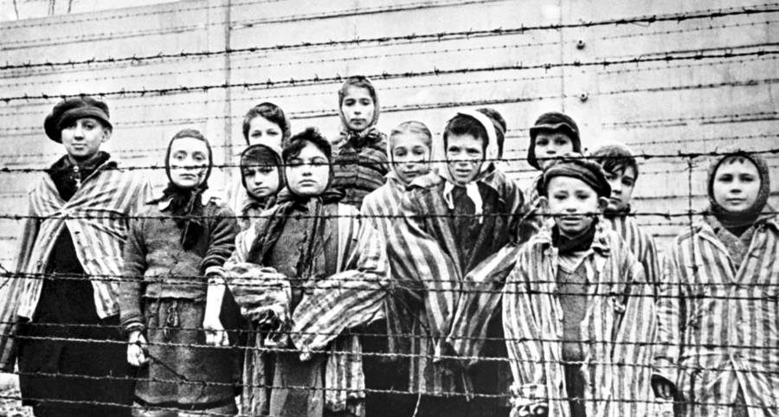
The Holocaust

Slide 2
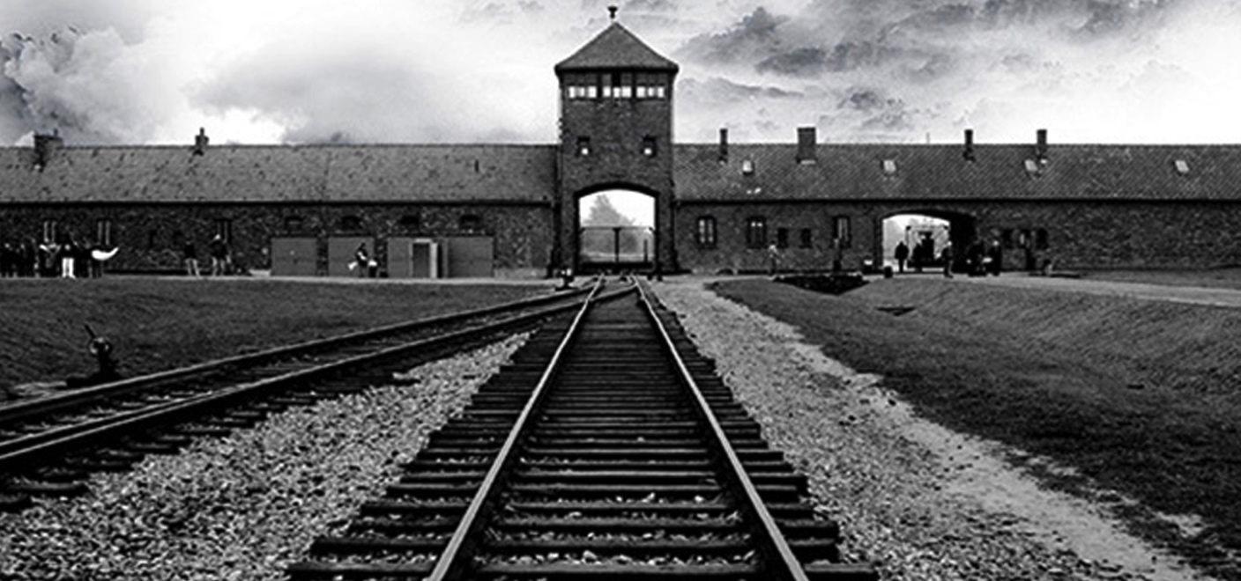
Between 1933 and 1945, the German government led by Adolf Hitler and the Nazi Party carried out the systematic persecution and murder of Europe’s Jews. This genocide is now known as the Holocaust.

Slide 3
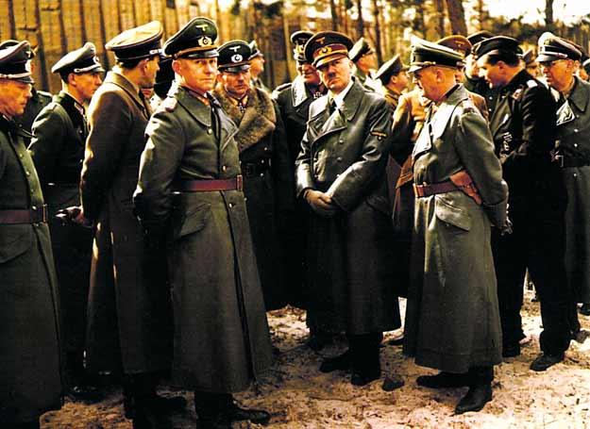
Nazi Leadership

Slide 4
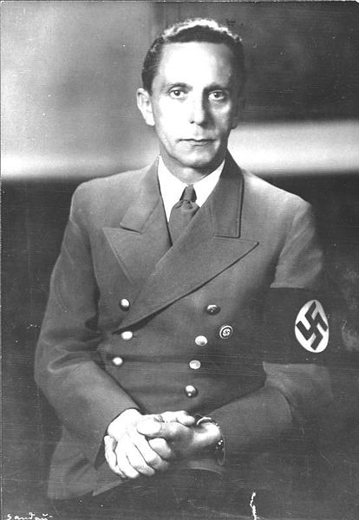
Dr. Joseph Goebbels
Propaganda Minister for the Nazi Regime.
He encouraged book burnings to promote censorship.

Slide 5
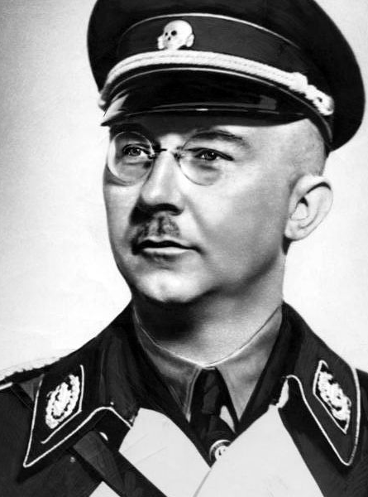
Heinrich Himmler
Leader of the SS – the Nazi’s secret police
Created death squads to find enemies of the state.
One of the men responsible for the death camps.

Slide 6
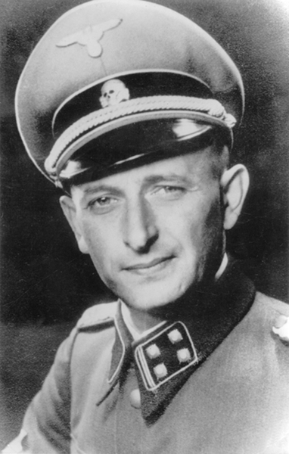
Adolf Eichmann
SS member
He was responsible for the logistics of moving Jews from Ghettos to concentration camps.

Slide 7
Timeline of Restrictions on Jewish People
April 1st 1933 – Boycott of Jewish Businesses
April 7th 1933 – Jewish people not allowed to work in the civil service or practice law.
April 25th 1933 – Jewish people are restricted from enrolling in school to make room for German borne children.
May 10th 1933 – Book burnings begin, over 20,000 books are burned at the University of Berlin which are deemed “un-German” in Spirit.

Slide 8
Timeline of Restrictions on Jewish People
July 31st 1933 – Over 30,000 people are in concentration camps.
September 29th 1933 – Jews are forbidden from owning Farms.
May 17th 1934 – Jews are no longer allowed health insurance.
May 31st 1935 – Jews are banned from the German Armed Forces

Slide 9
Timeline of Restrictions on Jewish People
September 15th 1935 – “Nuremberg Laws” passed. Jews are not allowed the following
Jewish people lose citizenship and all rights in Germany.
Forbidden for Jews to marry non-Jews.
Forbidden to display the German Flag
Forbidden to hire German girls of child bearing age to work in Jewish homes/establishments.
November 14th 1935 – Jewish people denied voting rights. Discharge of all civil service employees.
Notes:
The German churches began to collaborate with the Nazi party to identify who was a Christian and who was not.

Slide 10
Timeline of Restrictions on Jewish People
January 26th 1937 – Jews are forbidden from working in any office in Germany.
April 26th 1938 – All Jews must register their households and assets with the German government.
July 14th 1938 – Evian Confenrence is held to decide where to send Jewish immigrants. A newspaper headline reads
“Jews for sale at a bargain price- - who wants them? No one.”
Notes:
The German churches began to collaborate with the Nazi party to identify who was a Christian and who was not.

Slide 11
Timeline of Restrictions on Jewish People
July 23rd 1938 – Jews living in Germany must apply for identity cards.
September 12th 1938 – Jewish people are forbidden from attending public cultural events.
Notes:
The German churches began to collaborate with the Nazi party to identify who was a Christian and who was not.

Slide 12
Timeline of Restrictions on Jewish People
November 9th-10 1938 – Kristallnacht (Night of Broken Glass) occurs in Germany and Austria. Jewish homes and shops are burned.
30,000 Jewish men are sent to concentration camps.
267 Synagogues are destroyed.
7500 Jewish shops are burned/looted
The Jewish people must pay for their own repairs.
Notes:
The German churches began to collaborate with the Nazi party to identify who was a Christian and who was not.

Slide 13
Timeline of Restrictions on Jewish People
November 15th 1938 – All Jewish students are expelled from German schools.
September 1st 1939 – Jews may not be outside after 8pm in the winter, 9 pm in the summer.
November 23rd – 1939 – Polish Jews are required to wear a star of David when in Public.
Notes:
The German churches began to collaborate with the Nazi party to identify who was a Christian and who was not.

Slide 14
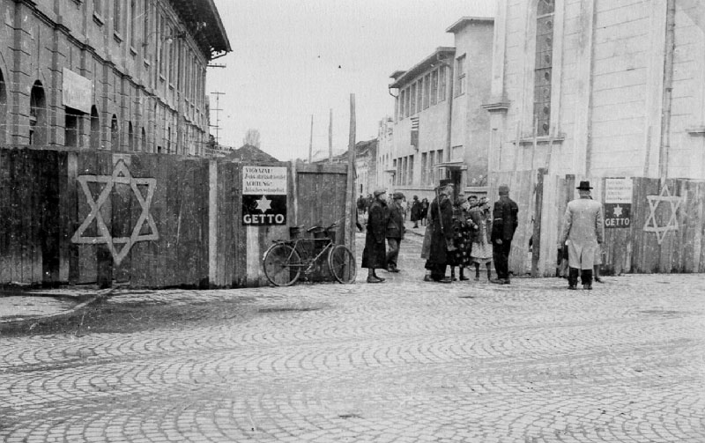
Jewish Ghetto’s
From 1939 to 1942 – Jewish people are rounded up and put into Ghettos.

Slide 15
What is a Jew?
Descendants of Abraham- Old Testament
Forerunner to Christianity- Jews Split, some stay Jews, others follow Christ
Or a person who converts to the Jewish Religion
Jews had lived in Europe for over 2,000 yrs

Slide 16
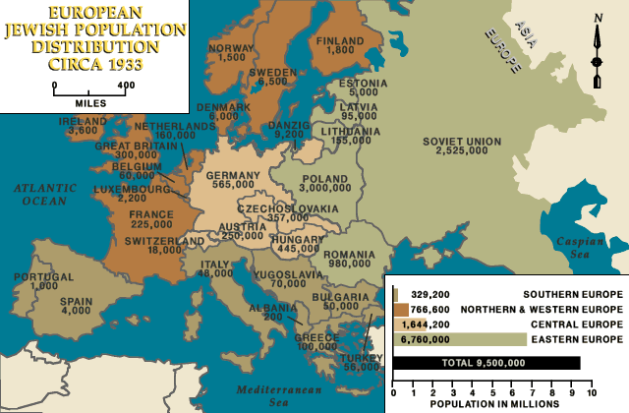
Jewish Pop. Distribution in 1933

Slide 17
Why the Holocaust was different.
Totally Involving- Every realm of society became entangled in murder
Not Barbaric- Advanced technical and scientific means, assembly line techniques
Legitimate- Approved by state authorities and legally carried our by public officials
Indifference- Most people turned away

Slide 18
Anti-Semitism
Anti-Semitism- ideologically motivated hostility toward Jews, Jewish individuals or Jewish culture as Jews.
Roots- Christian hostility towards Jews for the murder of Jesus
Early Church stirs this up every year at Easter
Crusades against Muslims in Jerusalem and Jews along the way
Jews become money lenders, led to resentment
Jews blamed for Black Death
Enlightenment thinkers also dislike Jews, Voltaire
Dreyfus Affair in 1896

Slide 19
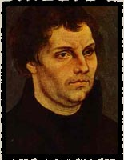
Anti-Semitism, cntd.
Martin Luther - “We are at fault for not slaying them!”
“..Let me give you my honest advice. First, their synagogues or churches should be set on fire, and whatever does not burn up should be covered or spread over so that no one may ever be able to see a cinder of it. And this ought to be done for the honor of God and Christianity.”

Slide 20
Hitler’s Ideas
All others were inferior, especially Jews, Slavs, Poles, Gypsies, Homosexuals, Jehovah's Witnesses, handicapped, mentally retarded, etc
Jews were parasites living within society, working to destroy it
Germans should protect racial purity
World-struggle between peoples for existence
A people is a distinct ethnic-biological group
No mixing or you will have decay and become corrupt, that will lead to extinction
Germans were the master race→ Aryans

Slide 21
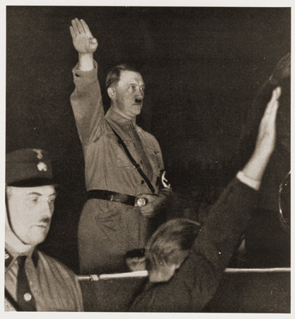
Hitler Comes to Power
1-30-1933- Hitler named Chancellor
4-31-1933- Boycott of Jewish Businesses
4-7-1933- Jews fired from civil service
Jan 1934- Sterilization of abnormal

Slide 22
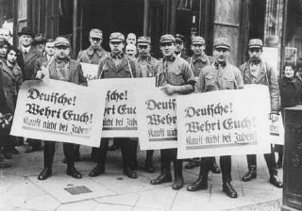
“Germans! Defend yourselves! Do not buy from Jews!”

Slide 23
Propaganda
After Hitler and the Nazis took over the next step was to win allegiance and unite the people behind his rule.
Germans could unite in their hatred and fear of Jews.
Hitler and the Nazis used propaganda- ideas, facts, or allegations spread deliberately to further one's cause or to damage an opposing cause

Slide 24
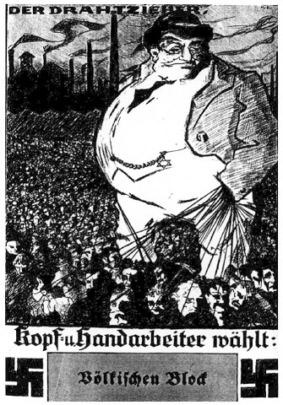
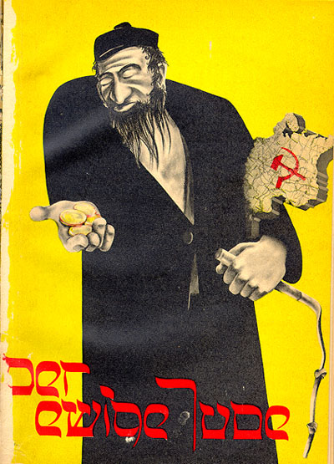
Propaganda

Slide 25
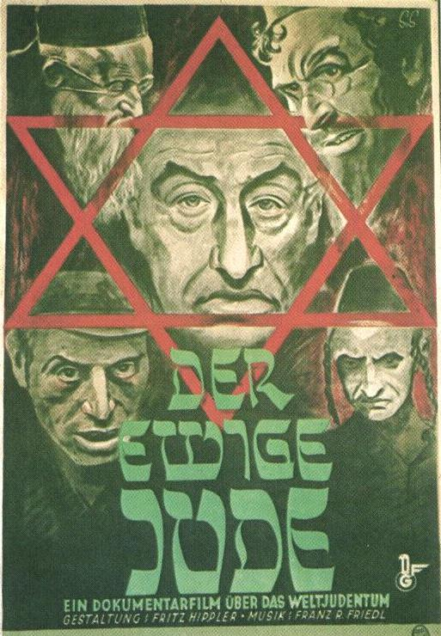
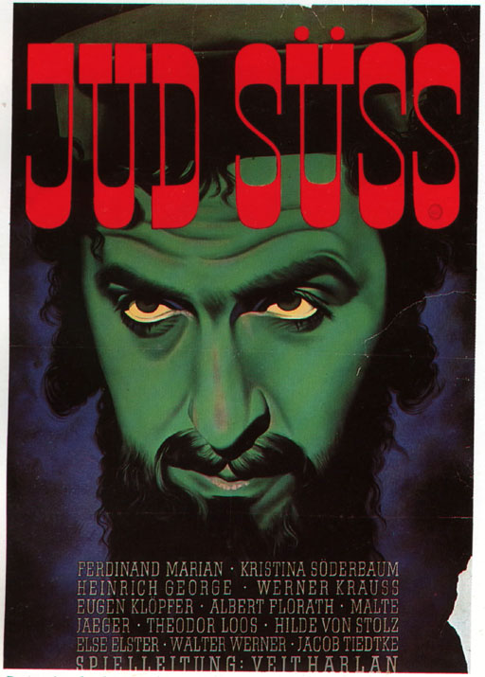
Propaganda

Slide 26
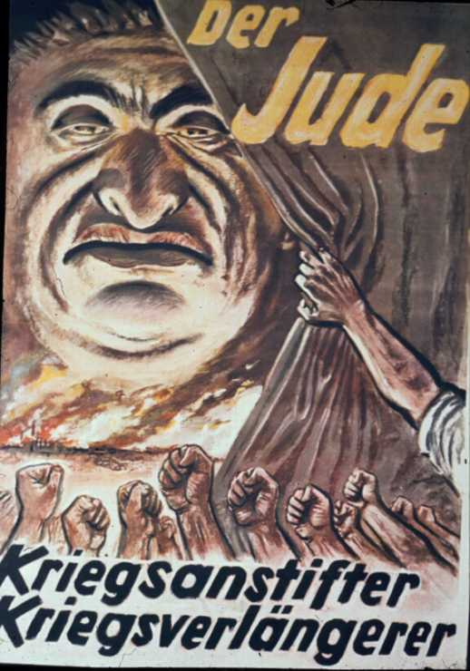
"The Jew: The inciter of war, the prolonger of war."

Slide 27

Beer Coaster- “Whoever buys from a Jew is a traitor to his people.

Slide 28
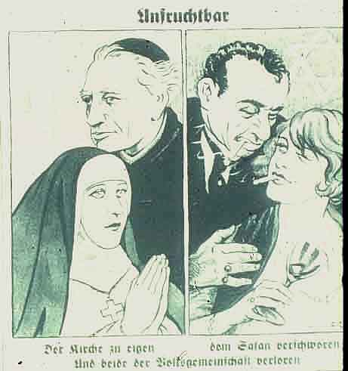
Unfruitful “They belong to the church, she belongs to Satan. Both are lost to the German race."

Slide 29
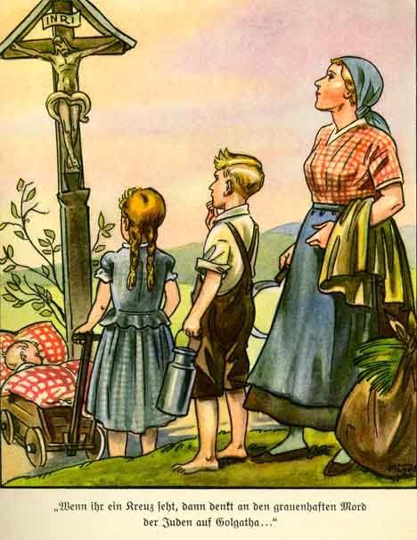
'Children, look there! The Man who hangs on the Cross was one of the greatest enemies of the Jews of all time. He knew the Jews in all their corruption and meanness. Once He drove the Jews out with a whip, because they were carrying on their money-dealings in the Church. He called the Jews: killers of men from the beginning. By that He meant that the Jews in all times have been murderers. He said further to the Jews: Your father is the Devil! Do you know, children, what that means? It means that the Jews descend from the Devil. And because they descend from the Devil they can but live like devils. So they commit one crime after another.' 'Because this Man knew the Jews, because He proclaimed the truth to the world, he had to die. Hence the Jews murdered Him. They drove nails through His hands and feet and let Him slowly bleed.

Slide 30
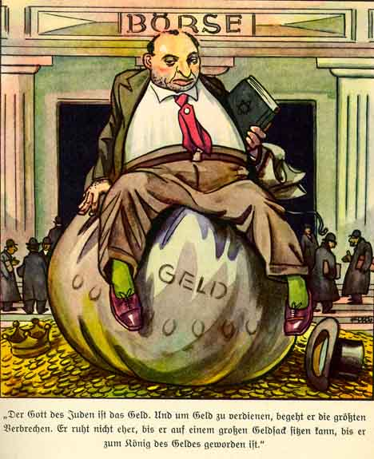
“The God of the Jews is money. To earn money, he commits the greatest crimes. He will not rest until he can sit on a huge money sack, until he has become the king of money.”

Slide 31
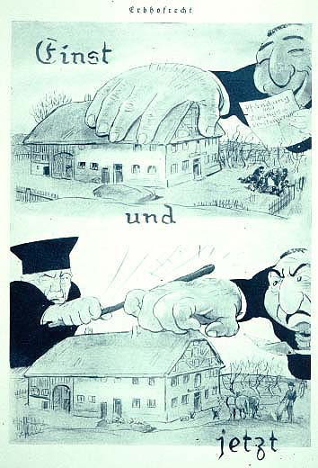
Then and Now

Slide 32
Quotes from Anti-Semitic Writings
The goal of the Jew is to make himself the ruler of humanity. Wherever he comes, he destroys works of culture. He is not a creative spirit, rather a destructive spirit.
How has the Jew subjugated the peoples?
With money. He lent them money and made them pay interest. Thousands and thousands of Germans have been made wretched by the Jews and been reduced to poverty. Farmers whose land had been in the family for more than 100 years were driven from their land because they could not pay the interest.
Jewry undermines every people and every state that it infiltrates. It feeds as a parasite and a culture-killing worm in the host people.
Just like rats, the Jews 2000 years ago moved from the Middle East to Egypt

Slide 33
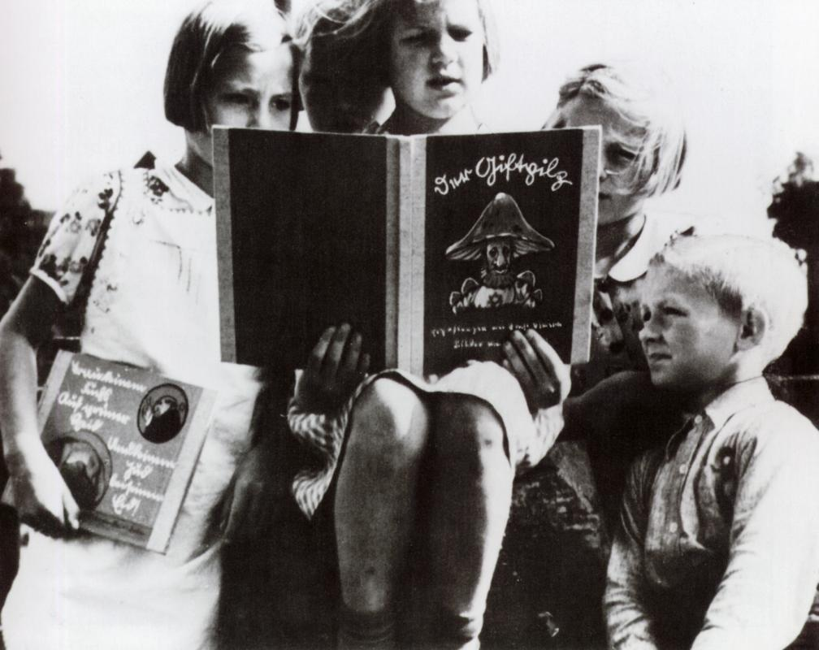
“The Poison Mushroom”

Slide 34
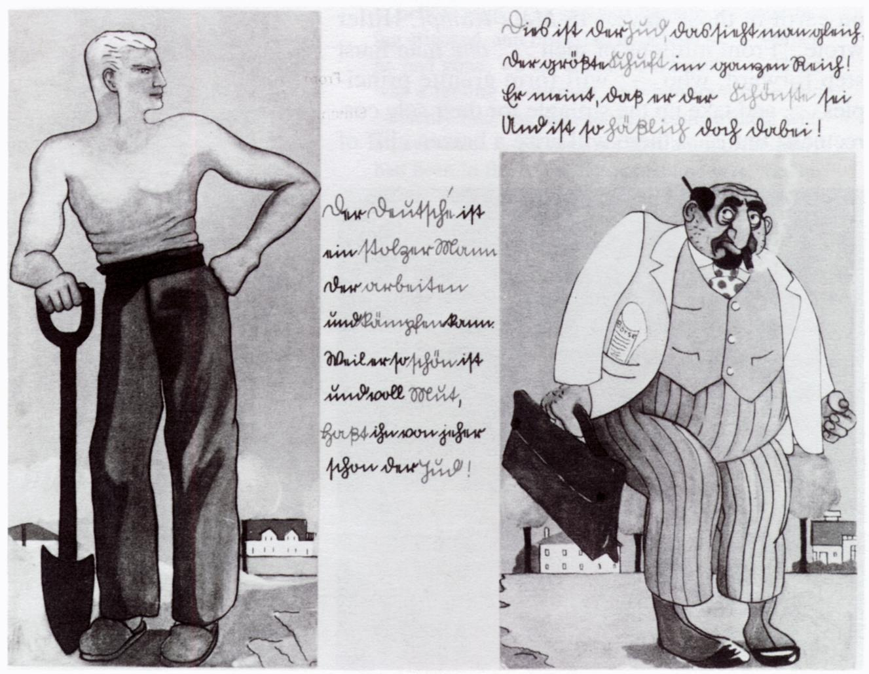
German Schoolbook

Slide 35
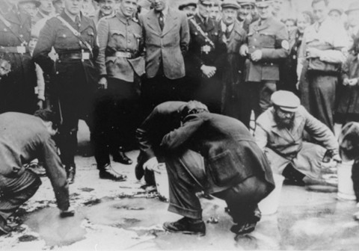
Propaganda led to horrific actions by many Germans. Jews forced to scrub pavement.

Slide 36
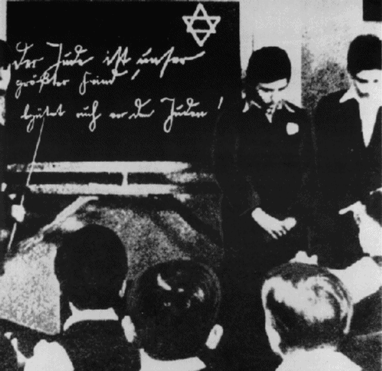
“The Jew is our greatest enemy! Beware of the Jew!”

Slide 37
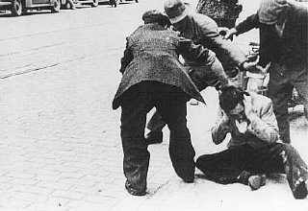
The beating of a Jew

Slide 38
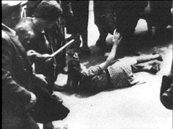
The beating of a Jewish woman

Slide 39
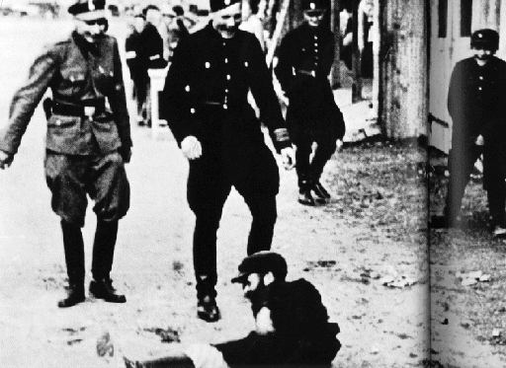
German soldiers brutalize a Jew in Poland

Slide 40
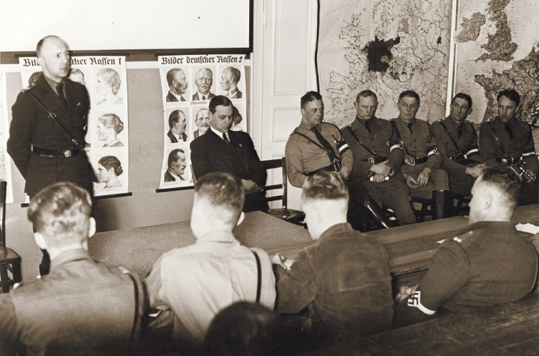
Hitler idealized the Nordic Race, what he called the Aryan Race – blonde haired, blue eyed people and felt they were superior to other races.

Slide 41
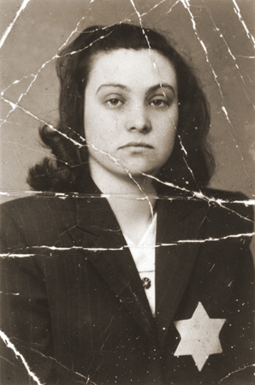
1935- Nuremberg Race Laws
Jews stripped of citizenship, no rights
Marriage of Jews and Germans forbidden, (sex also)
Who was a Jew- anyone with at least one Jewish grandparent had no rights
Germans take over Jewish businesses
Jews forced to wear Star of David

Slide 42
The Holocaust
In 1935, any public servant ie (teacher, scientiest, lawyer, doctor, or government official) that did not agree with the Nazis were arrested and sent to prison.
Why do you think the Nazis target these people first?
Each of these people were educated and had leadership skills which would have been useful for creating resistance movements.

Slide 43
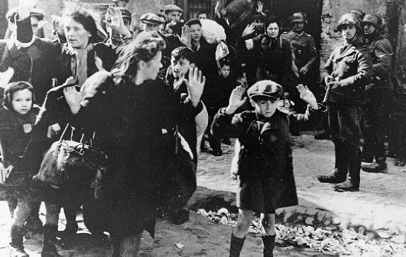
FEAR

Slide 44
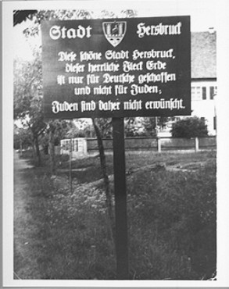
Anti-Semitic Signs
“City of Hersbruck. This lovely city of Hersbruck, this glorious spot of earth, was created only for Germans and not for Jews. Jews are therefore not welcome.”

Slide 45
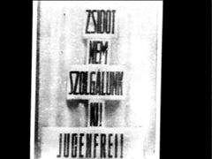
We don’t serve Jews here!

Slide 46
Kristallnacht- The Night of the Broken Glass, Nov. 9, 1938
Herchel Grynspzan’s parents deported to Poland
He retaliated and shot a German Embassy worker in Paris
Nazis use this as an excuse to persecute Jews all over Germany
Major shift in NAZI ideology→ Hatred to Action
Herchel Grynspzan’s parents deported to Poland
He retaliated and shot a German Embassy worker in Paris
Nazis use this as an excuse to persecute Jews all over Germany
Major shift in NAZI ideology→ Hatred to Action

Slide 47
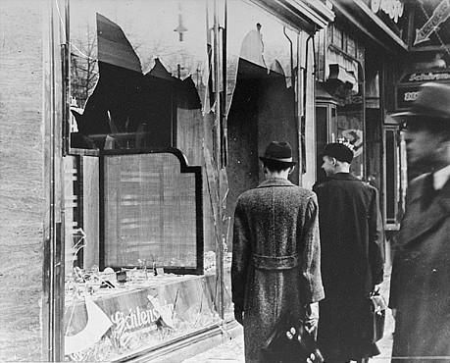
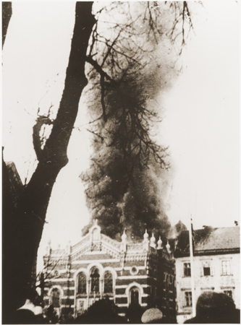
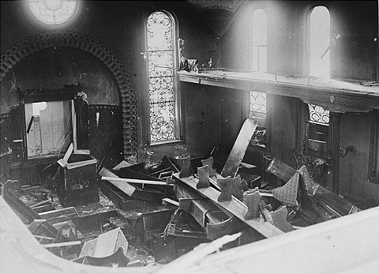
Kristallnacht

Slide 48
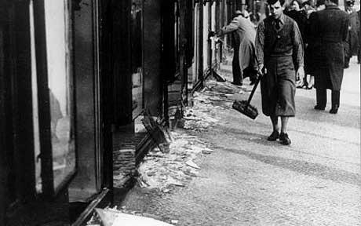
A local shopkeeper cleans up broken glass from the night before.

Slide 49
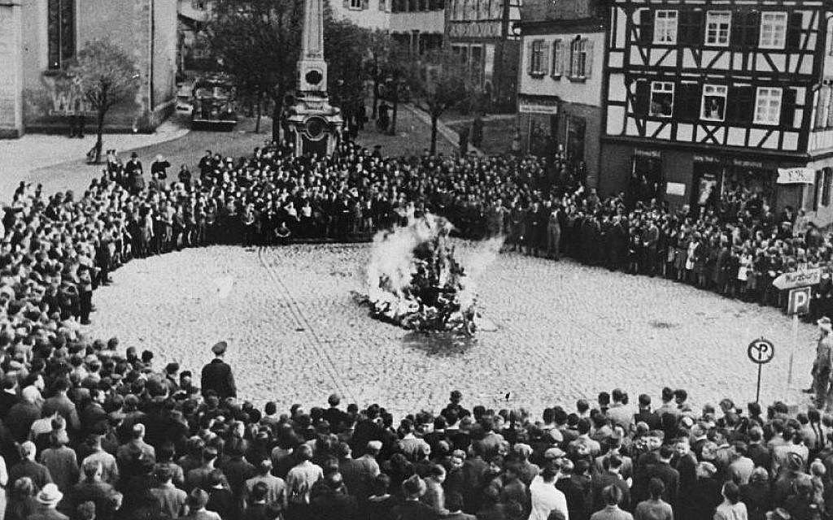
Book Burning

Slide 50
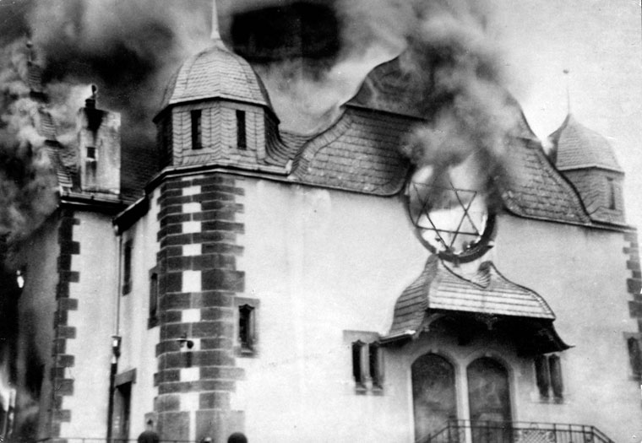
A Synagogue burning after Krystallnacht

Slide 51
Read a copy of Kristallnacht: The Beginning of the Holocaust

Slide 52
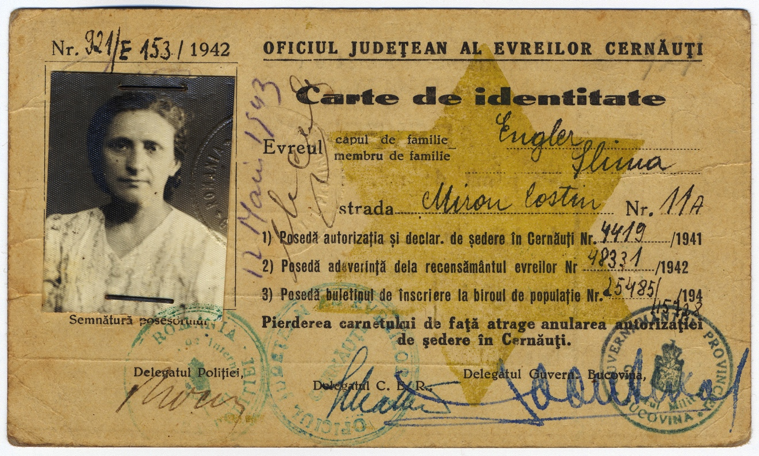
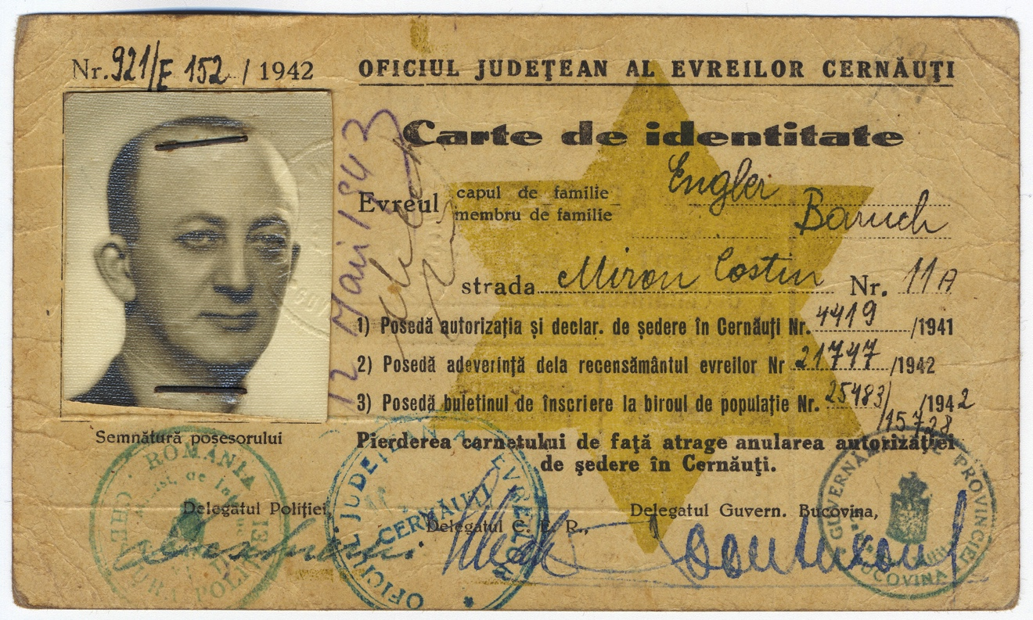
The Holocaust
In July of 1938, a law was passed forcing Jews to carry identification cards with a “J” signifying that they were Jewish.
This law went into effect on January 1, 1939.

Slide 53
The Holocaust
1939:
All Jews were now forced to hand over their valuables, must identify themselves by wearing a star of David at all times in public, and had restrictive curfews.
1940-1944
All German-Jews were deported from Germany to Poland and put into major cities in Ghettos. These Ghettos were often enclosed in using fencing, walls and were heavily guarded. The largest was the Warsaw Ghetto in Poland, housing over 400,000 Jews in a 3.4 square km area.

Slide 54
The Flood of Refugees
Jews realize the situation isn’t going to improve
Many fled, most stayed
Most countries didn’t want the Jews
U.S took 100,000, but wanted no more
Famous Jews also flee
Albert Einstein
Sigmund Freud

Slide 55
Murder of the Handicapped
Oct. 1939- Hitler empowers selected German doctors to grant a “mercy killing” to “patients considered incurable”
Called T-4 program
3 medical “experts” decide life or death for patients in psychiatric institutions, hospitals, and homes for chronically ill patients
Used starvation, gassing, lethal injection, etc.
The bodies were then cremated
This was practice for the extermination of Jews
Many Nazis “get experience” during the killing of Handicapped

Slide 56
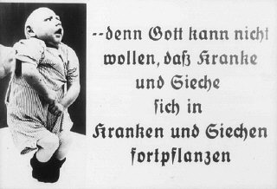
Propaganda
"...because God cannot want the sick and ailing to reproduce."

Slide 57
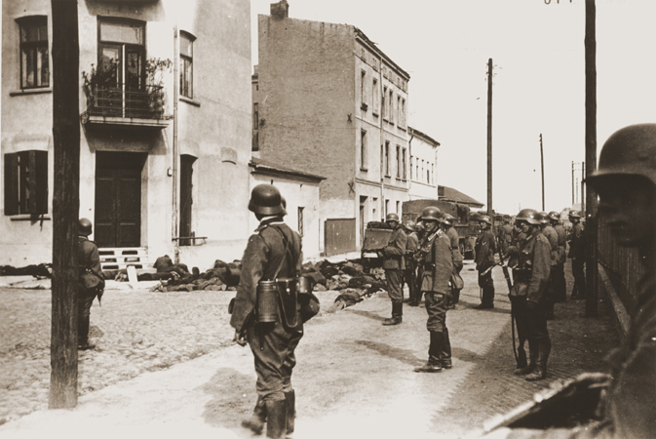
The War Begins
Sep. 1, 1939- Germany invades Poland
Hitler wants Lebensraum-living space for the German people
By May 1941 most of Europe was under Nazi control
Nazis now able to try and eliminate Jews under the cover of war

Slide 58
Eastern Europe
Jews in Eastern Europe forced to live in ghettos- captive city-states, holding pens for a subjugated population with no rights
Most ghettos were fenced off.
Starvation, shortages of supplies, disease, lack of heat and water, all lead to a high mortality rate.
Most famous ghettos- Warsaw, Lodz, Krakow, Lublin, and Minsk
Ghettos ran by Jewish Councils appointed by Nazis

Slide 59
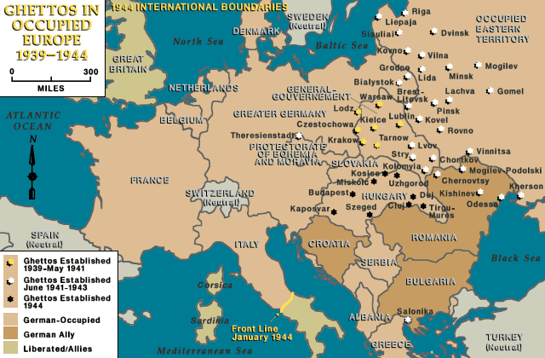

Slide 60
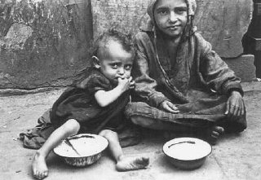
Warsaw Ghetto
Over 400,000 living in cramped conditions
Nov. 16, 1940- Ghetto sealed, nothing in or out
1941- 1 in 10 died in the ghetto
1941- Avg. 184 Calories a day
Smuggling was needed just to stay alive

Slide 61
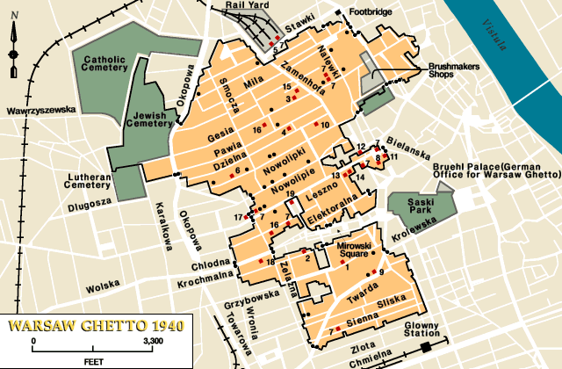
30% of Warsaw’s pop., 2% of land

Slide 62
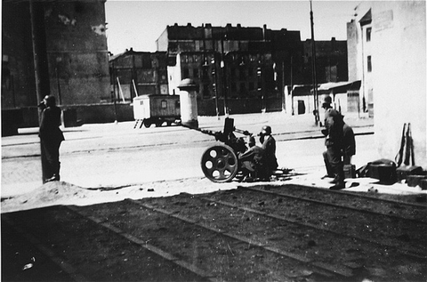
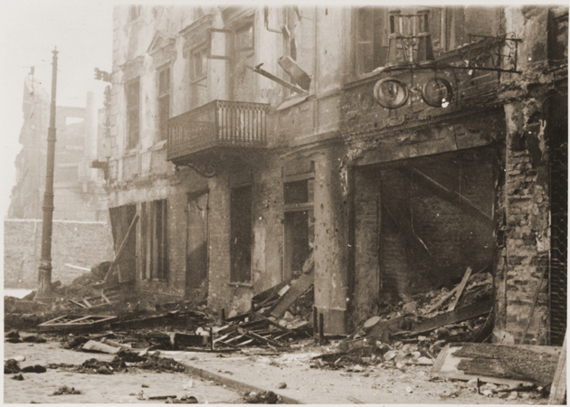
Warsaw Ghetto Uprising April 19, 1943- May 16, 1943
Warsaw Jews get news of mass murder at Treblinka
Jews were outgunned, but were able to hold out for 28 days
7,000 Jews Shot, many committed suicide, the rest were deported.

Slide 63
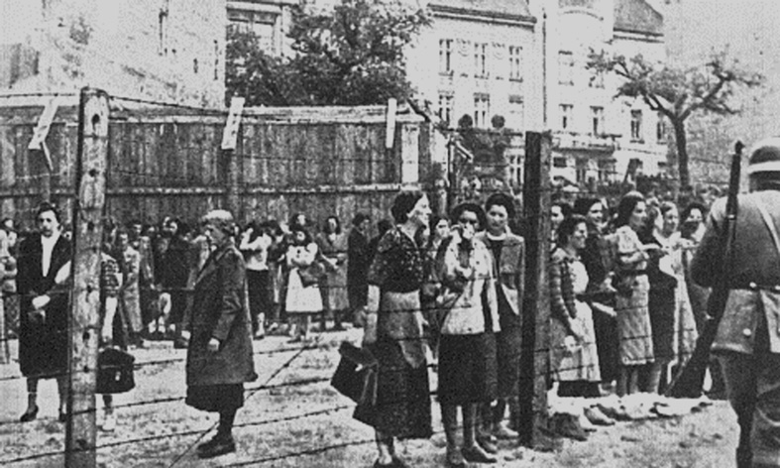
Jewish Ghetto’s were often sectors of a city that had been gated, walled, or fenced off.

Slide 64
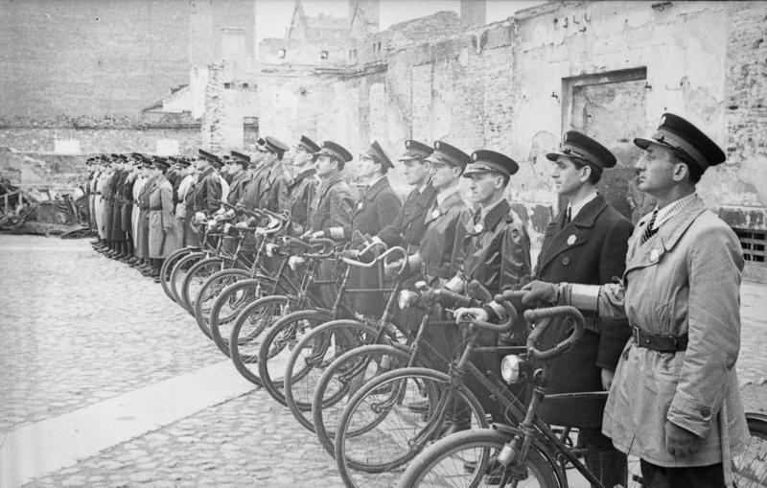
Jewish police in the Warsaw Ghetto

Slide 65
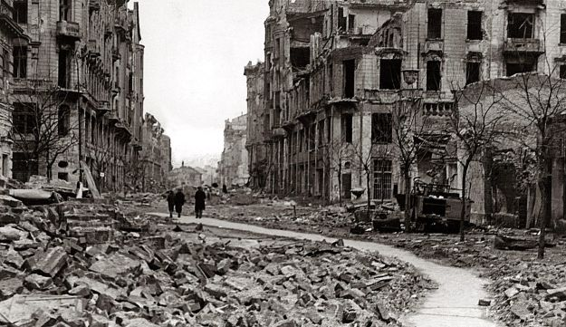
The Warsaw ghetto had been heavily destroyed by Germans bombing

Slide 66

Germans would often leave the corpses of a Jewish person they had killed in public as a fear tactic to keep people in line.

Slide 67

SS Troops burning the Warsaw Ghetto in 1943

Slide 68

Deportation of Jewish People from Warsaw

Slide 69
Warsaw Ghetto Video Mapping the Holocaust
Video –
The Ghetto
https://encyclopedia.ushmm.org/content/en/animated-map/the-warsaw-ghetto
The Holocaust
https://encyclopedia.ushmm.org/content/en/animated-map/the-holocaust

Slide 70
Resistance
Obstacles to Resistance
Superior power of the Germans
“Collective Responsibility”
Isolation of Jews and Lack of Weapons
Secrecy and deception of deportations
Unarmed Resistance
Underground newspapers and radios
Acts of Sabotage
Smuggling
Underground Couriers

Slide 71

Invasion of Russia
June 22, 1941
Over 100 divisions and 3,550 tanks
Within 37 miles of Moscow by November
Eventually get bogged down

Slide 72


Schutzstaffel- Defense Squadron
Led by Heinrich Himmler
Founded in 1925 as Hitler’s personal bodyguards
Grows to over 250,000 by ’39
Elite Nazi soldiers
Had to prove racial purity back to 1700’s
General SS dealt with racial matters
Other SS groups were mixed in with army or put in charge of death camps

Slide 73
Einsatzgruppen
Mobile Killing Squads
NO DEPORTATIONS IN RUSSIA- Kill them where they live
Used primarily in the USSR
Kill any Jew in the territory taken by the German Army
Made up of SS Troops and German Police officers
Jews rounded up in the center of town
Marched to outskirts of town
Jews forced to dig ditches
Shoot Jews, fill ditches
Repeat

Slide 74


Slide 75

Einsatzgruppen
3,000 men in Einsatzgruppen
Mostly “normal” educated men
Some asked to be relieved, many went along
Officers would get the troops drunk so they could go through with it
Problem was that it was too personal
1.2 Million Killed

Slide 76


Slide 77


Slide 78

Children led to execution.

Slide 79


Einsatzgruppen

Slide 80

Einsatzgruppen

Slide 81

Hanging of Jews

Slide 82

Burning Bodies

Slide 83
The Wannsee Conference The Decision to Kill All Jews
Until 1939 the basic aim of the Nazis was to get Jews to emigrate
Germany acquires Poland and Austria- 2.2 Million more Jews
Emigration not the answer
All Einsatzgruppen activities were planned in advance
Some Jews could be killed, but no plan to kill all
Only a few of the killing centers were operational at this time

Slide 84
The Wannsee Conference The Decision to Kill All Jews
January 20, 1942- Wannsee Conference
Nazis formed a plan for the “Final Solution to the Jewish Problem”
Many programs would be involved including Department of Justice, Foreign Ministry, Gestapo, SS, Police, Race and Resettlement Office, etc.
Top Nazi leaders spoke about “methods of killing”
No one present opposed the idea
Murders were intentional and premeditated
The goal of these programs was death
No political or territorial purpose

Slide 85

Adolph Eichmann
Head of Nazi Security Police (SD) and Gestapo
In charge of Einsatzgruppen
Chief executor of Anti-Jewish policies
Convened the Wannsee Conference
Fled to Argentina
Captured by Mossad
Executed in 1962

Slide 86
Western Europe
1st- Jews Classified
2nd- Civil liberties restricted and property taken
3rd- Fired from “public” jobs and Jewish businesses taken over
4th- Isolated and forced to wear the Star of David
5th- Deported to Death or Labor Camps in Poland
Fate of Jews differed from country to country
Depended on degree of Nazi control, history of Jews in the region and behavior of local population

Slide 87
Deportations
After the decision was made to kill Jews and camps were built, the deportations started
Jews rounded up and placed on cattle cars for “resettlement to the East.”
Told to take belongings. This would lessen panic
Cattle cars were sweltering in the summer and frigid in the winter
Smell of death, urine, feces, vomit, sweat, etc.
Very few stops for water, food, or medical treatment
If they died there would be less to deal with later

Slide 88

Round-Up

Slide 89

Loading the Train

Slide 90


Slide 91

Death Camps

Slide 92

Unloading the Trains
Dead pulled off train and burned
Those unable to walk are sent directly to death
Walkers face 1st “selektion”
Pregnant, Young, Old, Sick, etc., sent to death

Slide 93
Arrival at the Camp
Dead, Walkers, and Non-Walkers have to surrender their valuables
Those who make it through “selektion” are then worked to death
“Selketions” are regular, had to prove your keep
Non-Walkers and those who didn’t make it through “selektion” are sent to the showers
Hair and Gold fillings removed
Cremation or burial

Slide 94

Jewelry of the Dead

Slide 95

Working at the Seimen’s factory.

Slide 96

Extermination Camps
Chelmno- 1st death camp opened in 1941. Used specially designed vans to gas people
Treblinka- Open for 14 months, over 800,000 dead. ONLY 30 known survivors

Slide 97
Extermination Camps
Sobidor- 200,000 to 250,000 dead. Used CO. ONLY 50 known survivors
Belzec- 600,000 dead Jews and Gypsies
Majdanek- 500,000 dead, many poles
Auschwitz/Birkenau- Largest Camp.
Over 1.1 Million dead.
At the peak of the killing process over 12,000 a day died here
Virtual Tour

Slide 98

Medical Experiments
Jews used as guinea pigs.
Nazi’s perform “medical experiments” on kids and adults alike.
Did research on hypothermia, altitude, infectious diseases, etc.

Slide 99

Hypothermia Experiment

Slide 100

Victims

Slide 101

Auschwitz Electric Fence

Slide 102

Auschwitz

Slide 103

Zyklon B
Nazis look for the cheapest, most efficient way to kill
Start to use Zyklon B an insecticide
Could kill 2,000 in 30 min.

Slide 104

Crematorium
After the Jews were gassed, their bodies were burned.

Slide 105
Death Marches
During the winter of 1944/45, the Nazis knew the war was lost.
Most Nazis try to conceal the crimes by leaving no witnesses
Nazis force thousands of Jews to march in the dead of winter to avoid being captured by the Russians.
During these death marches Jews are murdered or left where they lay.
Many die from the cold, lack of food and exhaustion.
Easy, cheap way for the Nazis to get rid of the Jews

Slide 106

Death Marches

Slide 107

Death Marches

Slide 108

Liberation

Slide 109

Liberation
Soviets reach Majdanek on July 23, 1944.
No prisoners, but 80,000 shoes

Slide 110

Liberation
Many Americans don’t believe Soviet pictures and stories, thought it was Communist propaganda
SS tried to conceal other camps, but can’t hide all evidence

Slide 111


Liberation of Auschwitz
Jan 27, 1945- Soviets enter Auschwitz
Find 348,820 suits,
836,255 women’s coats,
7 tons of hair.

Slide 112

Liberators saw troubling sights

Slide 113


Slide 114

The Lucky Ones??

Slide 115

Death Trains

Slide 116

Death Trains

Slide 117

Death Trains

Slide 118

Tattooed Victims

Slide 119

Shrunken head of a prisoner

Slide 120


Slide 121

German citizens forced to dig graves.

Slide 122

German citizens forced to bury corpses.

Slide 123

Voices of Conscience
Raul Wallenberg- Swedish Diplomat “ I simply cannot understand why a man can be persecuted because he is a different religion than mine.”
Issued Jews Swedish Passports
Hounded German’s to let Jews go at the end of WWII
Threatened, Car rammed, etc.
Eichmann- “Accidents do happen, even to neutral diplomats.”
Saved around 100,000 Jews

Slide 124

Oskar Schindler
German industrialist
Saved 1,300 Jews by having them work in his factory
Eventually “bought” them to save them from extermination

Slide 125

Oskar Schindler
At Yad Vashem the Israeli national institute for the Holocaust commemoration, Oskar Schindler stands next to the tree planted in his honor.
Jerusalem, 1970

Slide 127


Slide 128
The Cost of the Holocaust
Soviet Union- 500, 000
Poland- 2.9 Million
Germany- 510,000
Austria- 230,000
Czechoslovakia- 340,000
Hungary- 300,000
Romania- 700,000
Belgium- 18,000
Greece- 93,000
Yugoslavia- 66,500
Bulgaria- 41,000
Italy- 23,000

Slide 129
Aftermath of the Holocaust

Slide 130
A Survivor’s Prayer
I have asked many questions for which there are no answers And I have even cursed my life thinking I could not endure the pain.
But a flame inside refused to die. I could not throw away What had been ripped away from so many.
In the end I had to choose life. I had to struggle to cross the bridge between the dead and the living. I had to rebuild what had been destroyed. I had to deny death Another victory.
I have lived dear God in a world gone mad and I have seen evil unleashed beyond reason or understanding.
I was with them. We drank from the same bitter cup.
I hid with them Feared with them, Struggled with them And when the killing was finally done I had survived while millions had died. I do not know why

