Slide 1
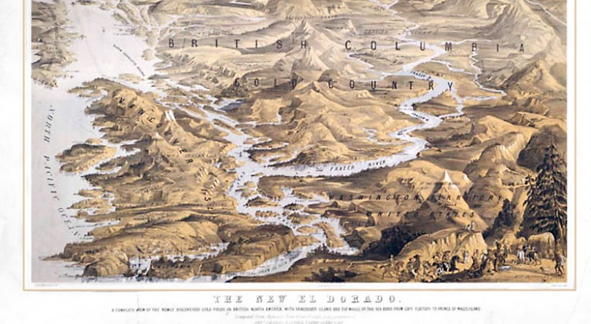
Chapter 5 The Colonial Era ,1849–1871

Slide 2
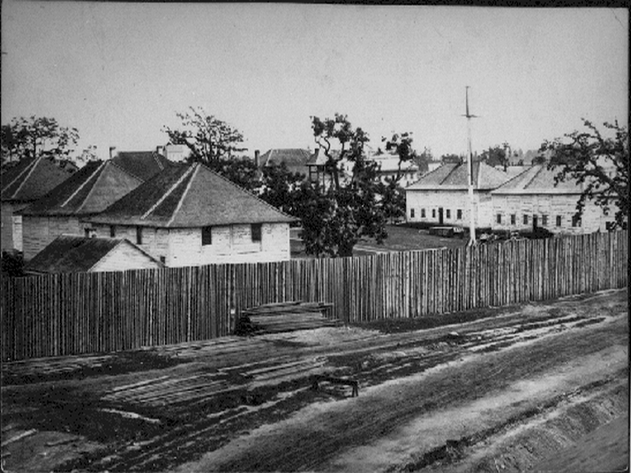
Chapter 5 The Colonial Era ,1849–1871
Fur Traders in B.C. were not concerned about laws and regulations; they cared only about business.
In the 1840’s though, the British Govt. began to place more direct control over this territory.
Fort Victoria - 1843

Slide 3
First Nations Voices
"...they are playing with the rocks, down at the beach at having a nice time...They're gathering these nice yellow rocks.”
~ Elder Annie York, Nlaka'pamux (in reference to gold panners) (p. 81)

Slide 4
Chapter 5 Colonial Precedents – Background
France originally Colonized Eastern Canada
In 1759, France lost on the “Plains of Abraham” to the British and gave over control.
The British then consolidated their policies towards their colonies in a document known as “The Royal Proclamation of 1763”
This document established the relationship between the Crown and First Nations.
Britain recognized FN people as being their own “Nation within a Colony”
Settlers and Colonials, not allowed to settle on FN land until their Govt. had made agreements about the land. ie: transferring the ownership of Land from FN to Britain.
This document also established the guiding principles for creating treaties with FNs.

Slide 5
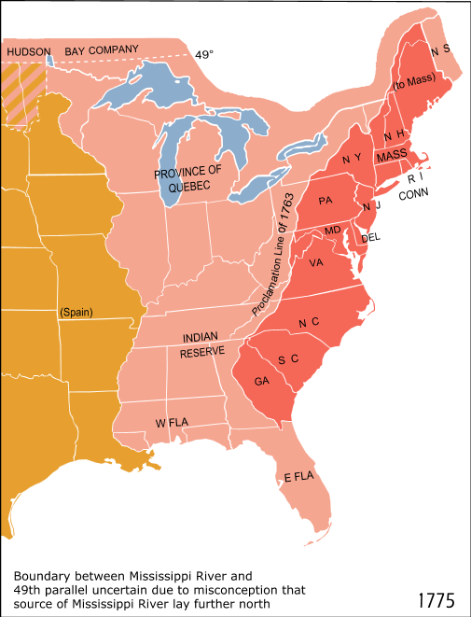
The Royal Proclamation

Slide 6
Chapter 5 Colonial Precedents – Background
Please come get a copy of the Royal Proclamation of 1763 (Blackline Master 5-1).
Summarize the 4 highlighted areas into your own, more modern, words (write the 4 summarized points on the back of the handout).

Slide 7
Chapter 5 Assignments
Using Google/Textbook, Mark the following:
Major Gold Rush Mining Towns
Hope
Yale
Boston Bar
Lytton
Spence’s Bridge
Ashcroft
Cache Creek
Lillooet
Pemberton
Kamloops
Clinton
70 Mile House
100 Mile House
150 Mile House
Alexandria
Quesnel
Cottonwood
Wells
Barkerville
Richfield
Prince George
Transportation Routes
The Cariboo Road
Douglas Trail by Water through Harrison Lake to Lillooet
Notes:
HMS Raven, 1856

Slide 8
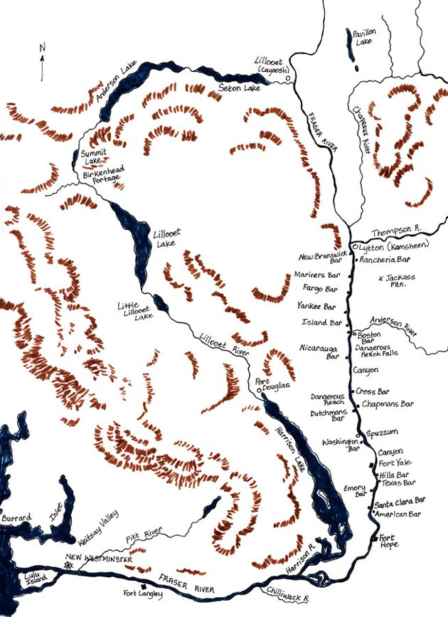
Douglas Road through Harrison Lake

Slide 9
Chapter 5 Assignments􏰛􏰃􏰝􏰉􏰒􏰉􏰓􏰊
Please come grab a copy of Blackline Masters 5-2 – Blank Map of B.C.
Using Google/Textbook, Mark the following:
Major Gold Rush Mining Towns
https://www.bcmag.ca/33-british-columbia-gold-rush-towns/
Transportation Routes
https://www.thecanadianencyclopedia.ca/en/article/fraser-river-gold-rush
https://www.thecanadianencyclopedia.ca/article/cariboo-gold-rush
https://www.hellobc.com/road-trips/gold-rush-trail/
Notes:
HMS Raven, 1856

Slide 10
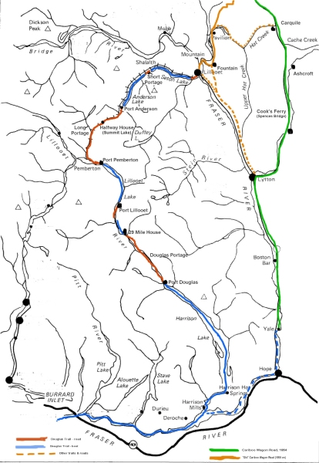
Green = Cariboo Wagon Road – 1864
Light Brown = Old Cariboo Wagon Road
Blue = Douglass Trail (Water)
Brown = Douglas Trail (Land)
Notes:
HMS Raven, 1856

Slide 11
Classwork
Complete Journal Prompt #6
Complete the First Encounter Poem
Complete Ch. 1-4 Questions.
Complete + Hand in the Project
(Local Geography: Mission, B.C.)
Begin working on Chapter 5 assignments in the package booklet.

Slide 12
Outline
CNN 10
From Fur Trade to Gold Rush
The Hanging Judge
The Laurier Memorial

Slide 13
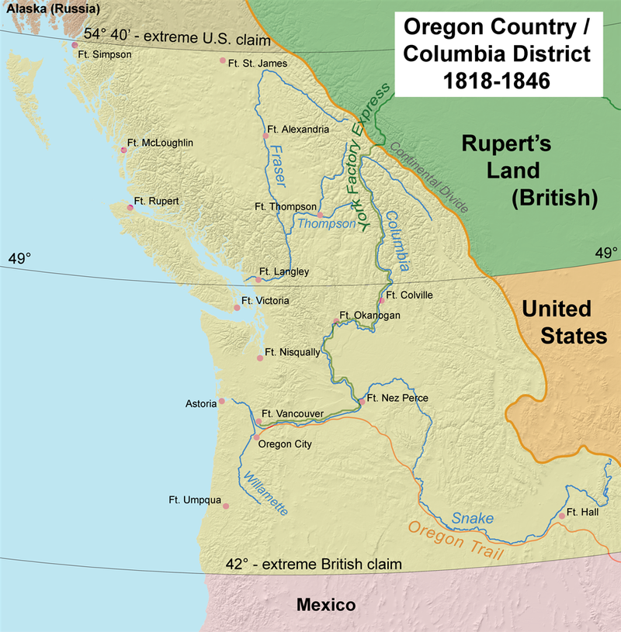
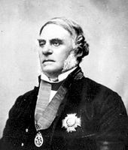
Chapter 5 From Fur Trade to Gold Rush
In the 1840’s, Westward expansion by the United States, forced the HBC to move their headquarters from Vancouver, WA to Fort Victoria, on Vancouver Island.
“Fifty Four Forty or Fight”
Prince Rupert: 54° 18' N
Britain now needed to forestall the Americans, and created the Colony of Vancouver Island in 1849.
HBC was given a 10 year lease to run the colony until 1859.
They appointed James Douglass to Governor.

Slide 14
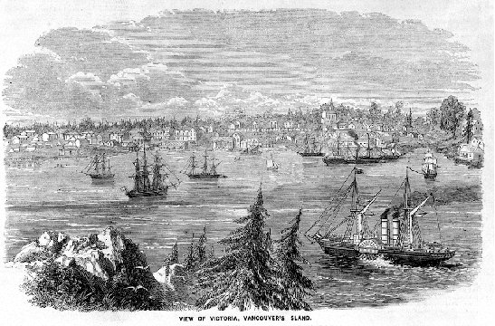
Chapter 5 From Fur Trade to Gold Rush
The Colony of Vancouver Island was established without negotiating with FN people, a direct violation of the Royal Proclamation of 1763.
The colony continued to trade in furs, but moved over to minerals such as coal and gold.
The Kwakwa-ka’wakw and the Snuney-muxw showed the HBC the source of these two minerals on their land.
Soon the HBC created a mineral divisions, constructed mining camps at two ports: Nanaimo and Fort Rupert

Slide 15
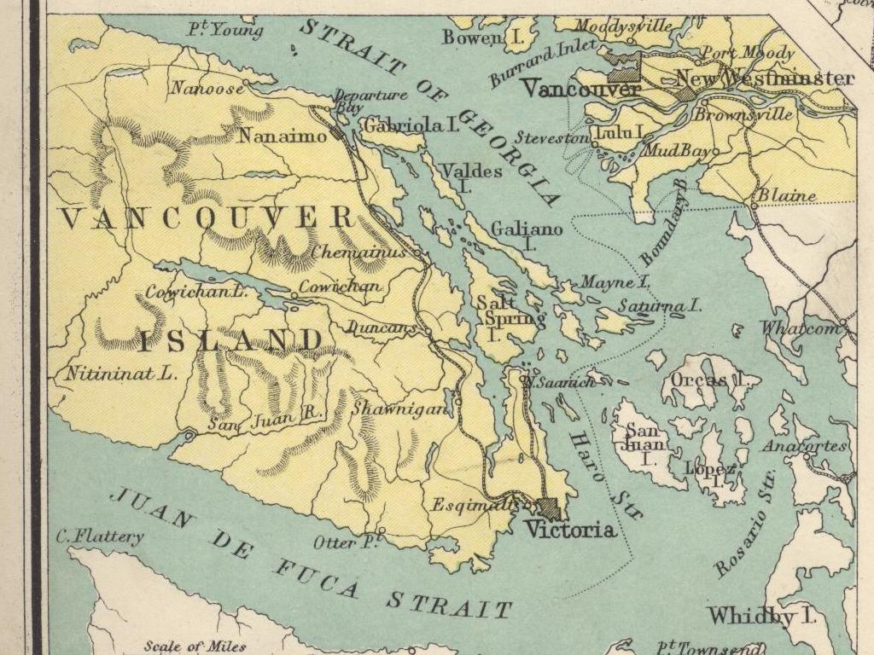
Chapter 5 From Fur Trade to Gold Rush

Slide 16
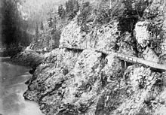
Chapter 5 From Fur Trade to Gold Rush
During the 1850’s FN people along the Fraser continued to trade with the HBC in small quantities of Gold.
Douglas tried to keep the discovery of gold a secret, due to problems that had occurred in California in 1849.
By 1858, 1,000’s of miners made their way into the Fraser River watershed area.

Slide 17
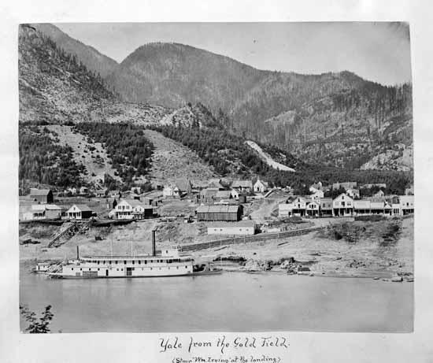
Chapter 5 From Fur Trade to Gold Rush

Slide 18
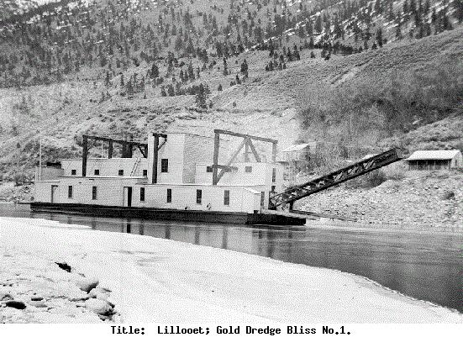
Chapter 5 From Fur Trade to Gold Rush

Slide 19
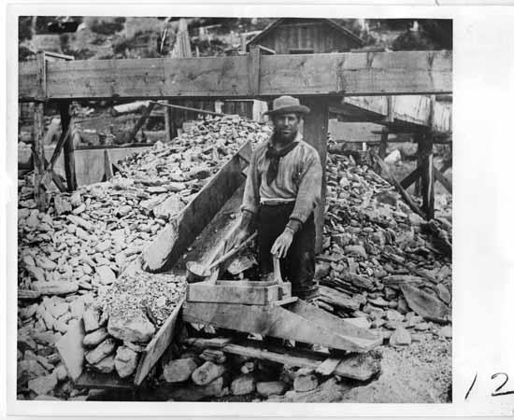
Chapter 5 From Fur Trade to Gold Rush

Slide 20
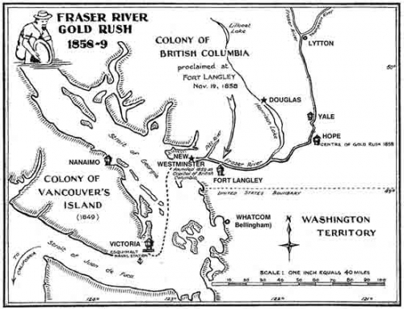
Chapter 5 From Fur Trade to Gold Rush

Slide 21
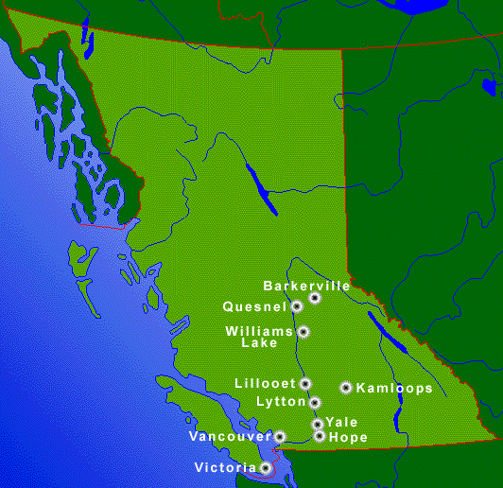
The Gold Rush Route
The Fraser River

Slide 22
Chapter 5 From Fur Trade to Gold Rush
The Stó:lø referred to these people as Xwelitem, “Hungry People/Starving People” – indicating that many were malnourished/unprepared for life in B.C.
These miners made enormous wagon trails, moving from site to site in search of Gold, often erecting towns overnight once gold was discovered.
This large movement of people disrupted FN land/resource use

Slide 23
Chapter 5 From Fur Trade to Gold Rush
FN joined in and became miners too, but were often harassed by Foreign Miners.
Douglas did not want the lawlessness that he saw in California happening in the British territory.
The British Govt. decided to create a 2nd Colony on the Mainland, and put its headquarters at New Westminster.
The gold rush branched off the Fraser/Cariboo, into the Stikine, Omineca, Peace, Kamloops and Leech Rivers.
British Columbia was being fully explored during this time.

Slide 24
The Gold Rush
The miners frequently ignored traditional First Nations use of the rivers and valleys they passed through.
They often destroyed, if not disturbed, the environment showing no respect for First Nations.

Slide 25
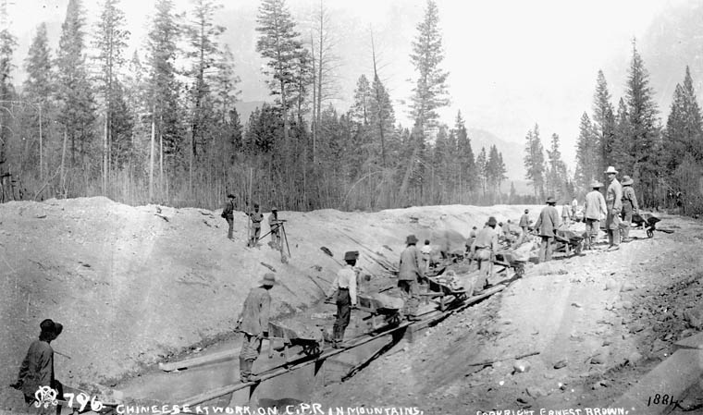

Slide 26
The Gold Rush
In 1910, the Secwepemc, Nlaka’pamux, and Okanagan chiefs made a presentation to the Prime Minister of Canada, Sir Wilfred Laurier.
This document today is known as the Laurier Memorial.
The document traced the history of these Nations interactions with the newcomers (during and after the gold rush) and put forth their request for the recognition of Aboriginal rights.
Nothing was done as Laurier lost the election of 1911.

Slide 27
Please read the Wilfred Laurier Memorial
1) According to the letter, who are the “real whites” and what was their relationship like with the FN people?
2) How did this relationship change with the Gold Rush?
3) In the final paragraph, what is it that the FN are displeased about?

Slide 28
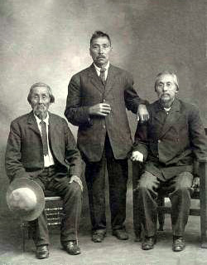
Secwepemc, Nlaka’pamux, and Okanagan chiefs

Slide 29
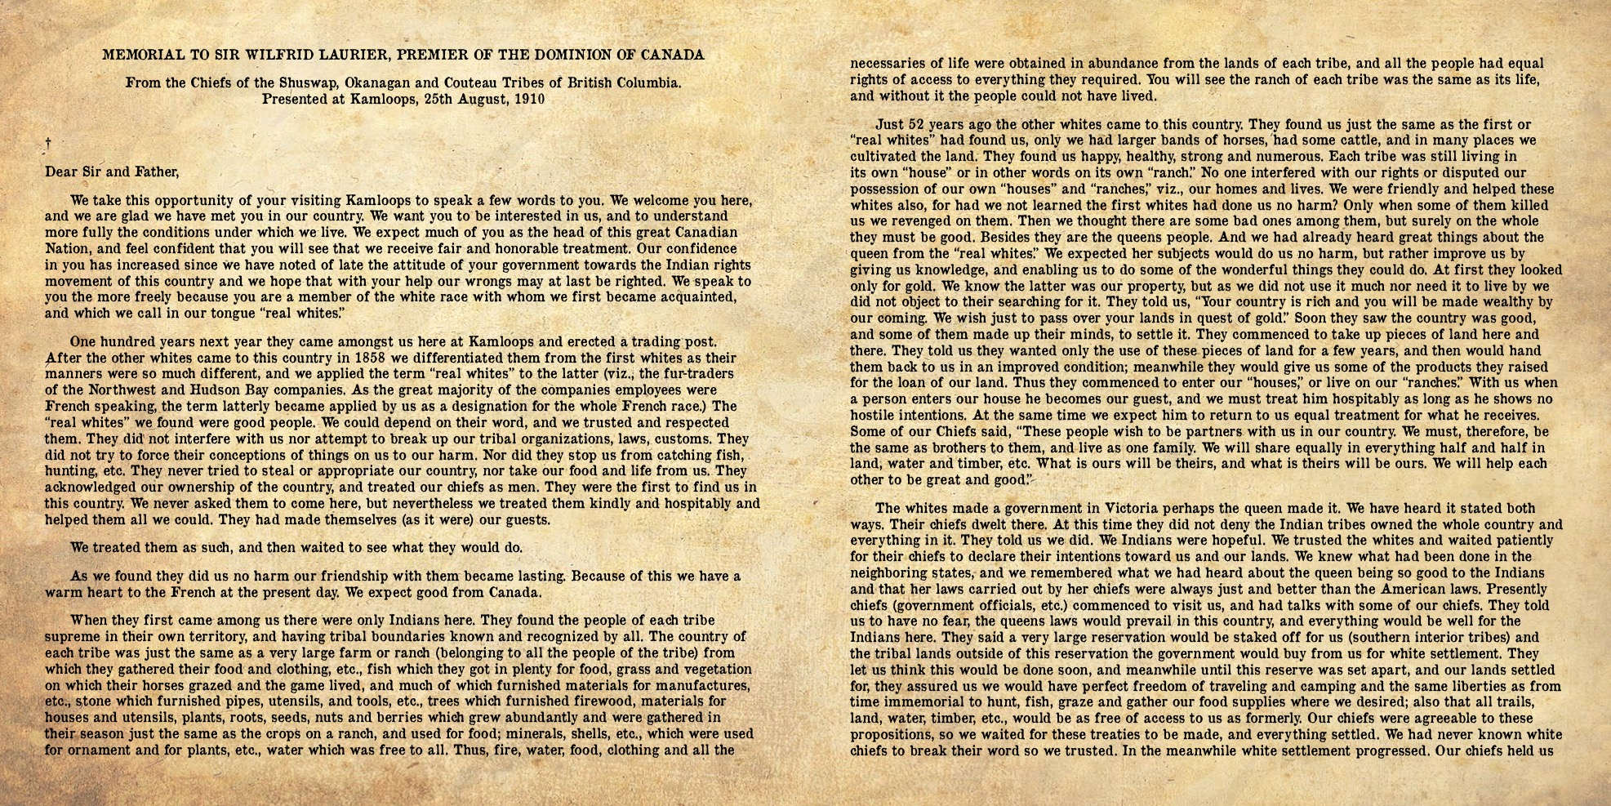
Come grab a copy of the Laurier Memorial

Slide 30
Outline
CNN 10
The Hanging Judge
The Douglas Treaties
Gunboat Justice
Journal Prompt #6

Slide 31
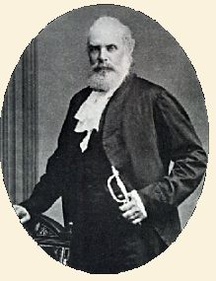
The Hanging Judge
Chief Justice Matthew Begbie played an important role in administering colonial policies to ensure that British justice prevailed in the two colonies.
Begbie involved First Nations in the judicial decisions.
In 1860, he convicted a white man, William Marshall based off the testimony of a First Nations man who had been assaulted by Marshall.
Begbie conducted several trials in the Aboriginal Language
He allowed First Nations to swear oaths on sacred objects in place of a Bible.

Slide 32
Chapter 5 Colonial Policies ☺
As Colonial Governor, from 1851 to 1864 James Douglas had power over the lives and lands of FN people.
He was given clear instruction to follow British Colonial Policy, to recognize Aboriginal title to the land and negotiate treaties.
Between 1850 and 1854, Douglas signed 14 treaties known as the “Douglas Treaties” covering 927 Square Kilometers of Land around Victoria, Saanich, Sooke, Nanaimo and Port Hardy.
FN land was surrendered “entirely and forever” in exchange for cash, clothing or blankets.
The chiefs were able to keep existing village sites, to hunt on unoccupied land, and carry on their fishing.

Slide 33
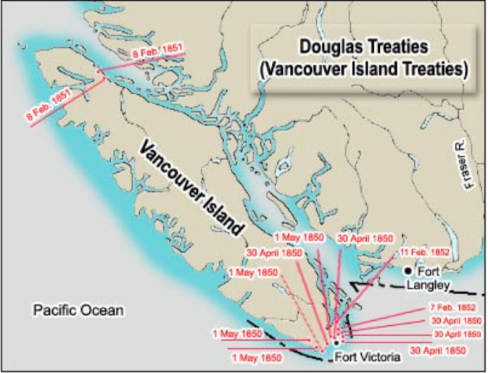
Chapter 5 Douglas Treaties

Slide 34
Chapter 5 Colonial Policies
In 1854, Douglas’ views changed.
His views changed due to London’s changing views.
The New Colonial Secretary, Sir Edward Lytton, wanted to create model communities based on English country villages.
Douglas agreed and thus began the process of creating Reserves in B.C.
He now believed that treaties were useless, and the only way to preserve Indian culture was to put them on reserves, so he began creating “Indian Reserves”
Reserves = Land set aside by the Crown for First Nations; lawn is owned by the crown + the people are wards of the government.
A ward = a person under the care of a guardian/state.

Slide 35
Outline
CNN 10
Colonial Policies under Douglas/Trutch
Gunboat Justice
Time in class to work on
Laurier Memorial Summary
Douglas Treaties Questions
Wednesday – Will explore the Chilcotin War

Slide 36
Review
What is the name of the Treaties established on Vancouver Island between 1850-1854 called?
What was often exchanged between FN communities and Europeans in these treaties?
Why did James Douglas eventually give up on creating “treaties” and switch to “Reservations”?

Slide 37
Chapter 5 Colonial Policies
Land would be given to the FN people, but owned by the Crown.
FN were encourage to Pre-empt land (Claim land by Homesteading) like foreigners.
Douglas fought hard to defend Land rights for FN people – he saw them as equal to British immigrants, giving them the right to vote in elections.
However, he ignored Aboriginal Title – leaving successors to believe it did not exist.
He also left the impression that each family should be allotted 10 acres on a reserve.

Slide 38
Chapter 5 Colonial Policies
Joseph Truth succeeded Douglas for administering FN policies in B.C.
He stated that the FN of B.C. had never owned the land.
“The title of the Indians in the fee of the public lands, or any portion thereof…had never been acknowledged by Government but, on contrary, is distinctly denied.”
This view was held by many Settlers, that the land was empty.
This gave way to the belief that Aboriginal Title never existed, Treaties were irrelevant, and Reserves were a generous gift to FN people.
B.C.’s colony quickly removed the rights of FN people to pre-empt land, limited reserves to 10 acres of land per family.

Slide 39
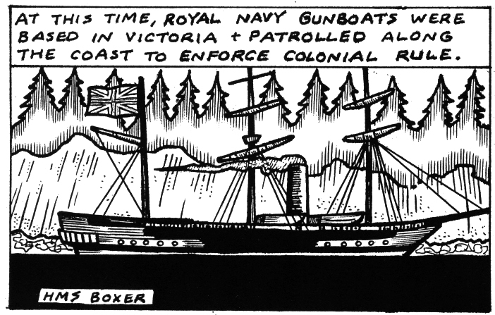
Chapter 5 Gunboat Justice
Britain's Navy was stationed along the West Coast of B.C. out of Esquimalt on Vancouver Island.
Here were stationed “gunboats”, sailing-ships and steamships armed with cannons.
Whenever a FN person committed a crime (Murder), people would cry out “Send out the gunboats!”

Slide 40
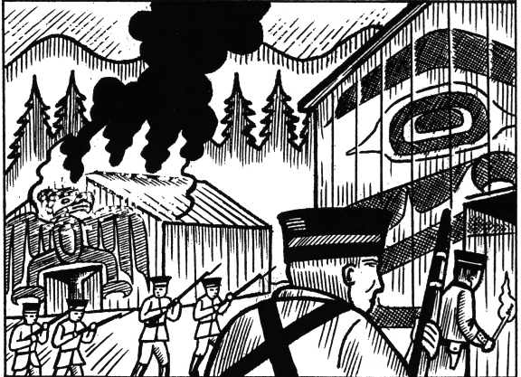
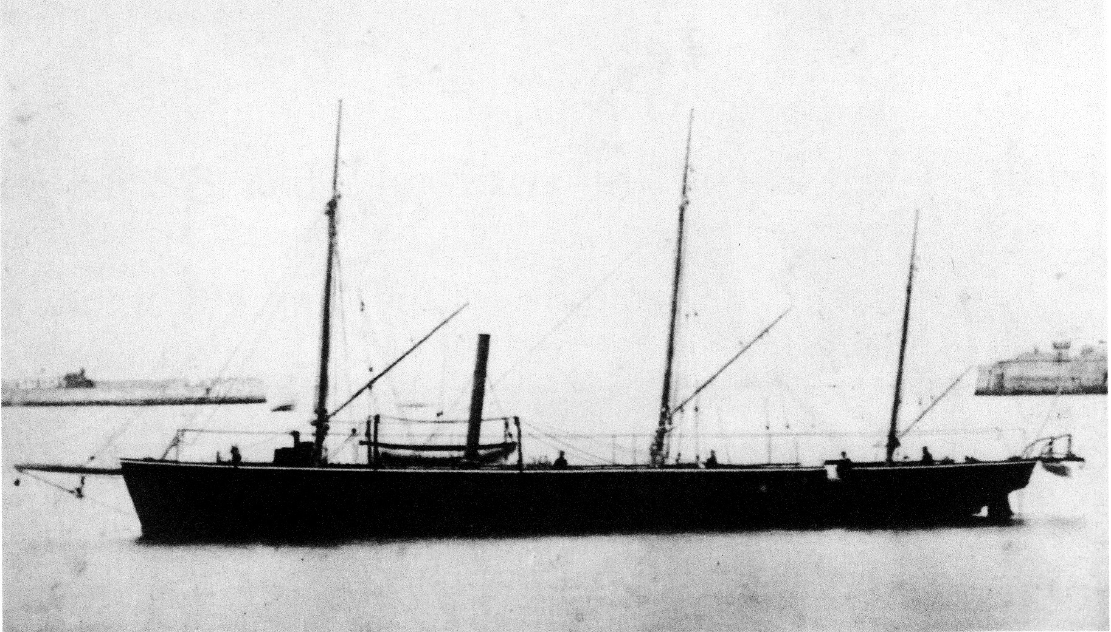
Chapter 5 Gunboat Justice
The Navy would arrive at the Village and anchor outside of it.
They would attempt to arrest the person who had committed the crime.
If they resisted/refused to be given up, they sent in the Marines, to take hostages and destroy canoes.
If the person still refused, the Navy would threaten to burn/destroy the village.
14 Incidents occurred where the Royal Navy was called, 8 of which ended with the Village being destroyed.
HMS Raven, 1856
Notes:
HMS Raven, 1856

Slide 41
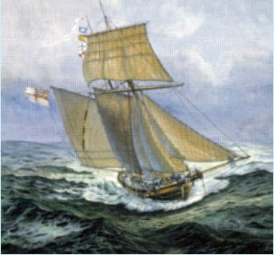
Gun Boat Justice
The most disastrous was in 1864 when 9 villages of the Nuu-chah-nulth were destroyed along with 64 canoes.
This heavy handed form of “justice” left the targeted community with a sentence of their own = with their houses destroyed, they were forced to disperse, often to live with relatives in other villages.
Also, without canoes, they could not harvest food and other resources they needed for survival.

Slide 42
Classwork
All assignments are due by November 7 @ 3pm.
Please finish the following items:
First Encounters Poem
Royal Proclamation Summaries
Laurier Memorial Responses

Slide 43
Please read the Wilfred Laurier Memorial
1) According to the letter, who are the “real whites” and what was their relationship like with the FN people?
2) How did this relationship change with the Gold Rush?
3) In the final paragraph, what is it that the FN are displeased about?

Slide 44
Outline
CNN 10
The Chilcotin War

Slide 45
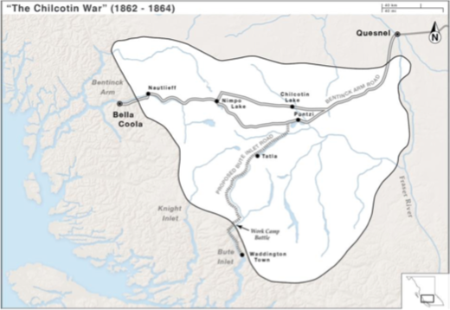
The Chilcotin War

Slide 46
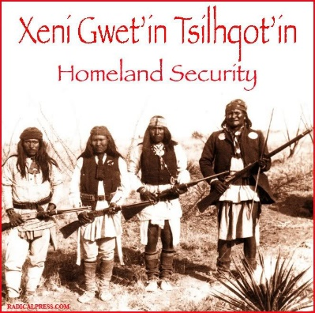
The Chilcotin “War” or Massacre?
The Chilcotin War or the Bute Inlet Massacre is often forgotten in the history of BC.
Some say it was not a war but a massacre.
Whatever it is called, this resistance was the sad result of the melding of the social, political and economic realities of the colonial years.

Slide 47
The Chilcotin “War” or Massacre?
The events began with the discovery of gold in the Cariboo in 1858.
People began to flood into the region, one brought smallpox with him, setting off an epidemic in 1862.
The Tsilhqot’in Nation who lived in this Region of the Cariboo, had little contact with Europeans; they did not participate in the fur trade.
When more miners came they were tolerated and the Tsilhqot’in traded with them and guided for the newcomers.

Slide 48
The Chilcotin “War” or Massacre?
The Tsilhqot’in were devastated by the smallpox epidemic in 1862 = hundreds died in weeks leaving villages virtually empty except for dead bodies.
Making matters worse, two businesspeople took the discarded blankets, which had wrapped the dead, and sold them, unwashed, to other Tsilhqot’in starting another outbreak.
About half to two-thirds of the Tsilhqot’in population died in 1862 and 1863.

Slide 49
The Chilcotin “War” or Massacre?
At the same time, another businessperson, Alfred Waddington, was permitted via a colonial license to build a wagon road in the Cariboo; First Nations were not consulted, informed, or compensated.
These two events sparked the Chilcotin “War” in the spring of 1864.
The Tsilhqot’in asked for work in exchange for muskets and food; they were treated badly by the foreman, William Brewster.

Slide 50
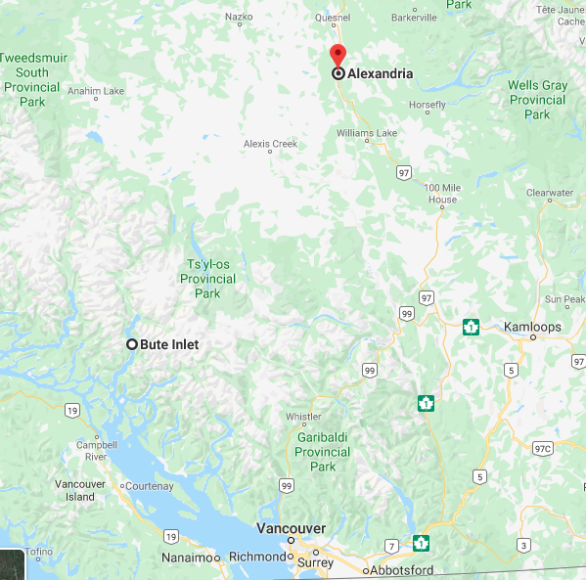




Slide 51
The Chilcotin “War” or Massacre?
After winter break, Brewster discovered that their store of flour had been taken from their Homathko River camp.
He questioned the Tsilhqot’in, took down their names and threatened them with death via smallpox, these acts frightened the people.
News of this encounter lead the Tsilhqot’in Chief, Lhatsas’in (Klatsassan), in 1864 to defend his territories and stop Europeans from crossing Tsilhqot’in land without paying compensation.

Slide 52
The Chilcotin “War” or Massacre?
What followed, as per the colonial society’s viewpoint, were unbelievable acts of unprovoked and savage violence.
Yet, another perspective sees these actions as a series of strategic attacks conducted according to the practices of warfare.
Lhatsas’in (Klattasine) and about 12 warriors carried out 3 attacks on the Homathko River construction camp; 13 men were killed including Brewster.
Two more attacks in Chilcotin country killed 5 British including one rancher.

Slide 53
The Chilcotin “War” or Massacre?
European settlers saw this as unprovoked and unwarranted, while the Tsilhqot’in were resisting invasion, defending their land and culture.
Frederick Seymour, the new governor, felt compelled to take quick action and send out two military groups; Seymour went with them.
One troop went eastward from the coast via Bella Coola and the other went westward from the Cariboo.

Slide 54
The Chilcotin “War” or Massacre?
From June to August nearly 200 colonial troops searched for the men they called murders.
Finally, a message was sent to Chief Lhatsas’in (Klattasine) to meet with Seymour without fear; the Tsilhqot’in believed they were going to negotiate a peace settlement.
Chief Lhatsas’in and 6 other Tsilhqot’in chiefs arrived at the meeting place unarmed.
Instead of being received as equals they were seized, handcuffed, and transported to Quesnel.

Slide 55
The Chilcotin “War” or Massacre?
At the end of September 1864, they were sentence to death by hanging by Justice Begbie.
5 chiefs would be hanged in Quesnel and the 6th would be hanged in New Westminster.
The death toll was unbelievable: hundreds of Tsilhqot’in dead from disease, fifteen Europeans killed, and 6 chiefs hanged.
The Tsilhqot’in peoples remember even if we do not.

Slide 56
The Chilcotin “War” or Massacre?
In 1993, Judge Anthony Sarich wrote a report commissioned by the government of British Columbia, of an inquiry into the relationship between the Aboriginal community in British Columbia and the justice system.
As a result of the recommendations in the report, the Attorney General apologized for the hanging of the Chilcotin chiefs and provided funding for an archaeological investigation to locate their graves.

Slide 57
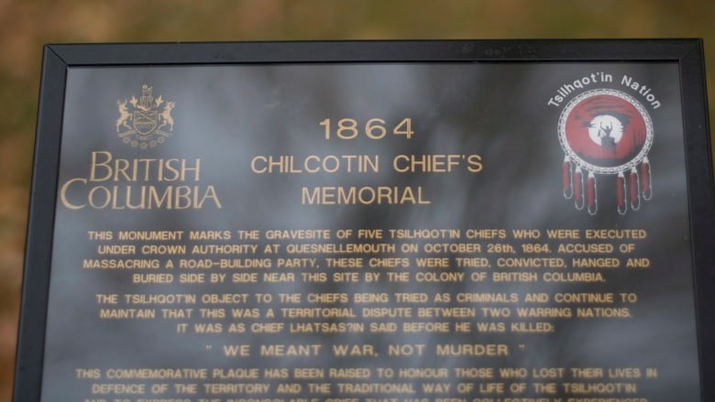
The Chilcotin “War” or Massacre?
In 2014, the British Columbia government exonerated the Chilcotin leaders.
Premier Christy Clark stated, "We confirm without reservation that these six Tsilhqot'in chiefs are fully exonerated for any crime or wrongdoing.”

Slide 59
Chapter 5 Colonial Policies
Please come grab a copy of the Venn-Diagram for Douglass and Trutch.

Slide 60
Assignment #6 – Chilcotin War
Please come grab a copy of the Chiltotin War.
Use pages 84-85 in the textbook to research and gain an understanding of the conflict. Use the information from these pages to complete steps 1-4 in the outline!

Slide 61
Resource Links
Apology to the Chilcotin Chiefs - https://www.youtube.com/watch?v=FXCsxf4-EPE
Tsilhqot'in First Nation granted B.C. title claim in Supreme Court ruling - https://www.youtube.com/watch?v=z4D85H7lQxE
We Meant War, not Murder: Continuing the Work of our Chilcotin War Chiefs of 1864/65
https://www.youtube.com/watch?v=FmYyZQKmjlM
Federal Government’s Exoneration Speech to Tsilhqot’in and the 6 Chiefs
https://www.youtube.com/watch?v=9wDeq3JQcxs
Tsilhqot’in Response to Federal Government’s exoneration speech
https://www.youtube.com/watch?v=FCh9VhUMSzI

Slide 62
Journal Prompt #7
Is the colonial history of B.C. merely something that happened long ago, or does it have meaning for us today? Describe at least one way that colonial history might have had an effect on your life today.

Slide 63
Outline
CNN 10
Writing a Report
Journal Prompt #7
Classwork
Chilcotin War Report

Slide 64
Writing a Report
Writing a Report is fairly easy – You’re simply answering questions under their subheadings.
For the Chilcotin War you have 4 Subheadings.
What is War?
Investigate the Background?
Disease
Gold Rush
World Views/Colonial Policies
Summarize the Events
Summarize all the events that led to the Chilcotin War
Decisions
Offer your opinion using the evidence.
Is it a war? A massacre? Something else?

Slide 65
Journal Prompt #7
Question:
What impacts/changes did the fur trade, gold rush, and colonial governments have on the lives of Indigenous peoples in BC?
How did these impacts/changes affect the relationship between indigenous peoples and the Colonial Government in BC?
If you were governor of BC in the 1800s, would you have done anything differently with regards to your treatment and actions towards the Indigenous Peoples? Explain

Slide 66
Outline
Canada takes Control of FN
Indian Act of 1876
Indian Act Assignment

Slide 67
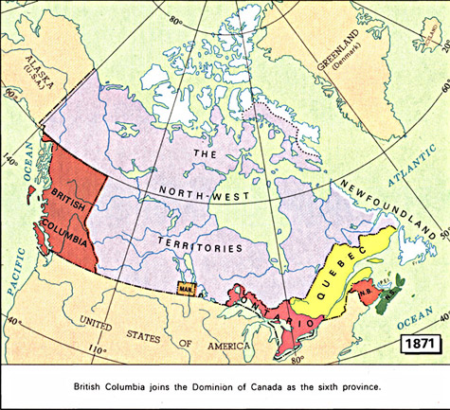
Chapter 6 Canada Takes Control, 1871–1911

Slide 68
Chapter 6 Joining Canada
Canada became a Country in 1867, and came under the British North American Act (BNA Act) which is now known as the Constitutional Act of 1867.
This policy continued to discriminate against FN people by enforcing government control into two levels:
Federal – Govt. Controlled “Indian Affairs” = governance over FN communities/lives.
Provincial – Govt. controlled land and natural resources = fishing, hunting, trapping, logging, mining, etc.
Ignored FN resource management
Determined lands for reservations.
Q: Why might this be an issue?

Slide 69
Chapter 6 Joining Canada
BC is still a colony at this point, under the leadership of Joseph Trutch who is anti-FN people. anti-FN land claims, anti-Royal Proclamation promises, etc.
BC wanted to join Canada, because running the colony was expensive, and Europeans were outnumbered by FN people.
Trutch who negotiated our entry into confederation, wanted to omit FN people from the negotiations.
The Federal Govt. insisted FN people be included and Section 13 was added (read pg. 92)

Slide 70
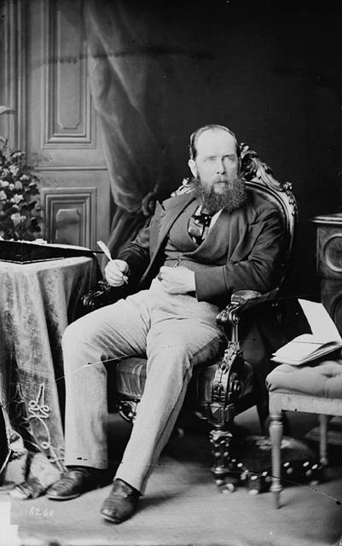
Joseph Trutch

Slide 71
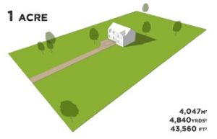
Chapter 6 Joining Canada
The Federal Govt. (F.G.) insisted FN people be included and Section 13 was added.
F.G. assumed treaties negotiated as in Ontario – each FN family in Ontario received 80 acres of land.
Terms of Union made no mention of Aboriginal Title to land or need for treaties to be negotiated.
Land reservations to be parceled out as before (Vague)
10 Acres of land given to FN families in B.C.
An Acre is about 18 Tennis Courts/1 Football Field

Slide 72
Chapter 6 Joining Canada
B.C. joins Canada in 1871
Joseph Trutch becomes the provinces first Lieutenant-Governor
Dr. Israel Powell is the first superintendent of Indian Affairs for B.C.
He divides the province into regions called “agencies”
Each region/agency is run by an “Indian Agent” who overseas that territory.
Powell also must determine how much reserve land has been allocated for FN people, and must continue to allocate land for FN people.
He found himself “stuck in the middle” of the two governments.
Ex: 1873 – Ottawa says each family should receive 8 Acres per Member; B.C. says they’re willing to go from 10-20 acres per family of 5, (4 acres per family member) – BUT – they never do.
1870’s Treaty 1-7 signed in prairies, allocating 160 acres per family – FN people are hopeful in B.C. they will get this deal.

Slide 73
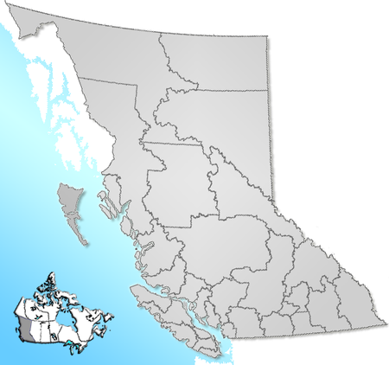

Slide 74
Chapter 6 The Indian Act
In 1867, the Department of Indian Affairs (D.I.A) is created.
Their job is to create policies to govern FN life.
In 1876, they created the Indian Act – this document combined federal/provincial laws into one act – including lands, Indian status, local governance.
This act gave power to the Federal Government to control the lives of FN communities.
defined who were “Status Indians”
Wards of the state – treated as children in need of parental care (Federal Govt.)
before 1951, not deemed as “people” under law and denied certain rights
Provided reserve land and specified who was to live on the reserves
exercises considerable control on those living on reserves
dictate when and where children attended school.

Slide 75
Chapter 6 The Indian Act
How did the Canadian Government decide who was an “Indian”?
Excerpt from “The Indian Act, 1876”
“3. The term "Indian" means
First. Any male person of Indian blood reputed to belong to a particular band ;
Secondly. Any child of such person ;
Thirdly. Any woman who is or was lawfully married to such person:
4. The term "non-treaty Indian" means any person of Indian blood who is reputed to belong to an irregular band, or who follows the Indian mode of life, even though such person be only a temporary resident in Canada.
Prior to 2016, ‘Status Indians” meant “FN people whose band/tribe had made a treaty with the Crown”, “Non-Status Indians” meant “FN people who either a) didn’t belong to a band, or b) their band/tribe had not made a treaty with the Crown”

Slide 76
Band vs. Irregular Band
1. The term "band" means any tribe, band or body of Indians who own or are interested in a reserve or in Indian lands in common, of which the legal title is vested in the Crown, or who share alike in the distribution of any annuities or interest moneys for which the Government of Canada is responsible ; the term "the band" means the band to which the context relates ; and the term "band," when action is being taken by the band as such, means the band in council.
The term "irregular band" means any tribe, band or body of persons of Indian blood who own no interest in any reserve or lands of which the legal title is vested in the Crown, who possess no common fund managed by the Government of Canada, or who have not had any treaty relations with the Crown.

Slide 77
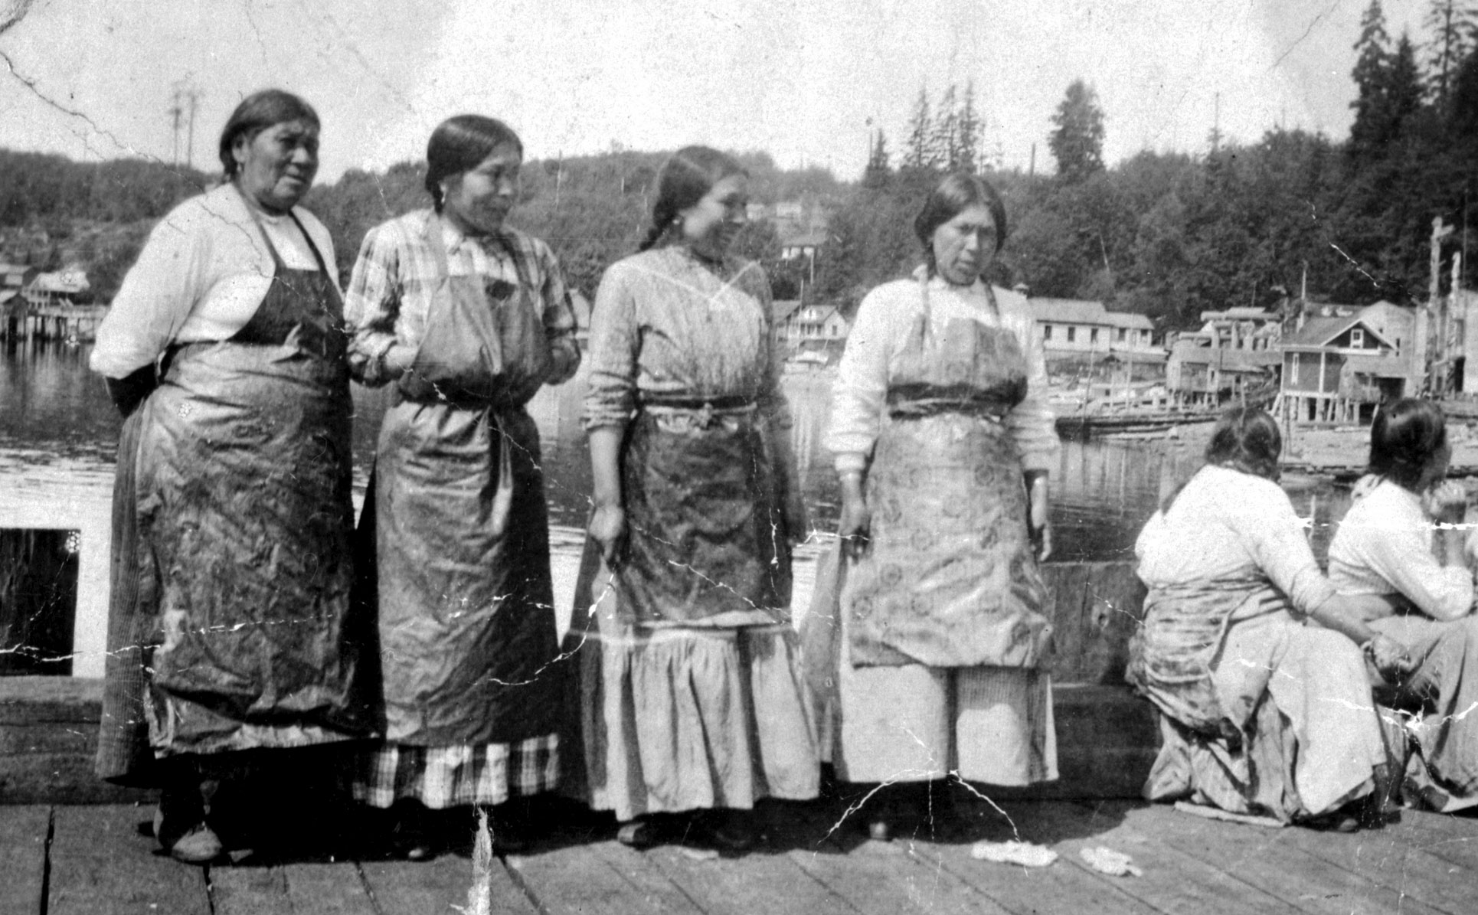
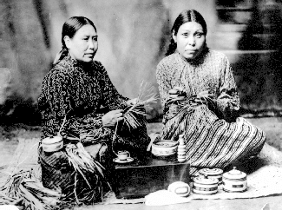
Chapter 6 The Indian Act
How were FN women treated according to the Indian Act?
Provided that any Indian woman marrying anyone other than an Indian or a non-treaty Indian shall cease to be an Indian in any respect within the meaning of this Act.

Slide 78
Chapter 6 The Indian Act
The Indian Act decided who could live on Reserve Lands
It created discriminatory laws regarding alcohol use
Crime to own or consume alcohol
Crime to sell alcohol to Status Indians
Only served to push use of alcohol underground
Dictate structure of local government
Modeled after Euro-Cdn. (elected town council)
Government formed by band council led by chief councilor
Ignored traditional forms of governance
Traditionally leadership was hereditary – born into it.
Originally 100 clauses – now close to 200 with amendments
Some benefits to aboriginal people, but outweighed by discriminatory and oppression embedded in Act.

Slide 79
Chapter 6 The Indian Act Assignment
Please come grab a copy of the “Indian Act” assignment.
You may work with a partner for this assignment.

Slide 80
Outline
CNN 10
Indian Reserves
Early Resistance

Slide 81
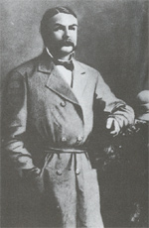
Chapter 6 The Indian Reserves
Indian Reserves: Not permitted to own land because wards of state
Shocked because:
Always had stewardship of land
Had willingly shared land with newcomer
“I want you to live in my territory. I have a big country, big enough for all of us. I have plenty of everything, enough for all of us, for our children and for our children’s children.” – Chief Pelka-mu-Lox, Okanagan
Some did not understand until surveyors arrived
Reserves meant to be temporary
Until assimilated into mainstream
1st Indian Reserve Commisioner – G.M. Sproat
Sympathized with FN
2nd – Peter O’Reilly (Trutch’s brother-in-law)
Immediately reduced size of reserves
Met with resistance and call for treaties

Slide 82
Indian Reserves
This Government does not desire to see apportioned any unnecessarily large Reserves such as would interfere with the progress of white Settlement . . .
Instructions to Indian Reserve Commissioner Alexander McKinley, 1876

Slide 83
Indian Reserves
Mr. O’Reilly came in 1881 to lay off reserves, and we were surprised at this; and he measured off just a small piece, which he said was for us; but it was too small, not large enough for us, not enough for us to live on, only a little from our houses; we told how much we wanted, but he only shook his head. Only a small part of what he measured is good. My heart is sick, and so are all our people, because the land is so large outside of what he measured for us, and our berry trees, our salmon streams, and our hunting grounds are in this land that is taken from us. These are not in what Mr. O’Reilly measured for us . . . I want to see the Government do right by us, and the officers to treat us all alike, not help one village different from another, and then we shall have confidence in their work. We want sufficient land for ourselves, to be our own; we do not want it as a reserve; and give us a treaty, and something for the outside, our hearts will then be satisfied.
Statement of George Gibson, Naas River November 19, 1888

Slide 84
Chapter 6 Early Resistance
From the beginning, FN resisted alienation of land and protested loss of rights
mostly peaceful and non-violent
organized communities
early protests followed pattern
communities meet and discuss action
strongest speakers to go to politicians and present case
reported back to communities
sometimes requested help from local missionaries
greater command of English language in spoken and written word

Slide 85
Chapter 6 Early Resistance
The earliest protests were from the Sto:lo people of the Fraser
50 chiefs and 100’s of other FN presented petition to Indian Superintendent in New Westminster (loss of land/decrease of reserves)
made Ottawa realize treaties not signed in BC, but relationship with BC fragile, so ignored petition
Nisga’a and Tsimshian earliest to take action against reserve surveyors and Indian Agents
fought for recognition of title
protests based on traditional ideas of ownership and land stewardship
support from colonizers
1881 delegation to Victoria (Nisga’a)
1885 delegation to Ottawa(Tsimshian)
1886 joined forces to meet Govt.
Govt finally agreed to set up Royal Commission but ultimately did not settle land claims or title

Slide 86
Chapter 6 Early Resistance
Please come grab a copy of Blackline Master 6-1
“Early Resitance”
I want you to explore how FN people have resisted in the pass.
You may use Google to help with this but we have seen examples in our textbook up until this point.

Slide 87
Outline
CNN 10
The Potlatch
State and Church Education
Kitsilano
Test – Tuesday November 19th

Slide 88
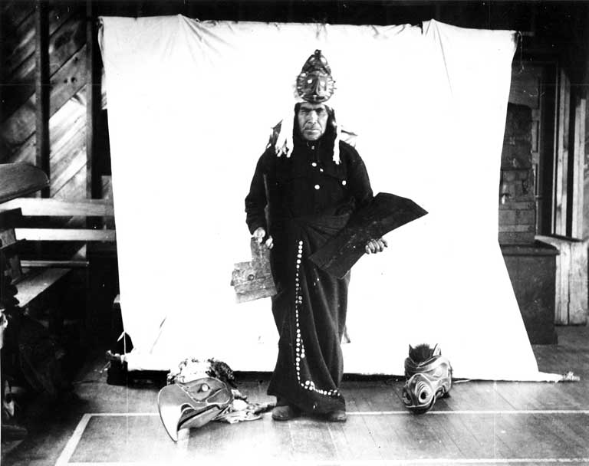
Chapter 6 The Potlatch – Circles Unbroken
KWAXALANUKWAME', ODAN,
CHIEF JOHNNY DRABBLE

Slide 89
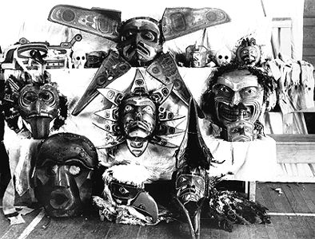
Chapter 6 The Potlatch
POTLATCH BANNED ORIGINAL DOCUMENTS (99) Section 3, The Indian Act
Every Indian or other person who engages in or assists in celebrating the Indian festival known as the “Potlatch” or in the Indian dance known as the “Tamanawas” is guilty of a misdemeanour, and shall be liable to imprisonment for a term of not more than six nor less than two months in any gaol or other place of confinement; and any Indian or other person who encourages, either directly or indirectly, an Indian or Indians to get up such a festival or dance, or to celebrate the same, or who shall assist in the celebration of same is guilty of a like offense, and shall be liable to the same punishment.

Slide 90
Chapter 6 Potlatch Banned
Indian Act not as successful as hoped in assimilating First Nations
1884 banned potlatch
amendment made to ban potlatch and other customs involving dance and singing
potlatch central to political, economic, social and spiritual life = banning parliament, libraries, banks and churches
many communities ignored law
some continued on other forms
1895 strengthened the law
illegal to wear ceremonial articles or dance in public
Q: What were the government’s intentions in banning the potlatch?

Slide 91
Chapter 6 Potlatch Banned
Let’s read Blackline Masters 6-3
Q: What roles does the potlatch serve, according to Chief Maquinna’s letter?

Slide 92
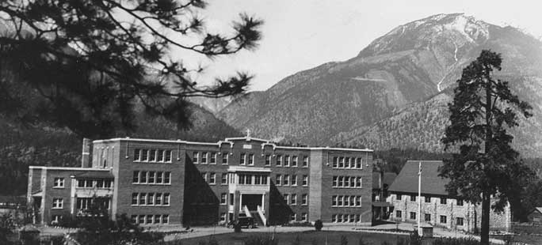
Chapter 6 State and Church Education
One of main tools of colonialism was education
values and language taught to youngest generation
more effective => take out of home environment and into foreign environment
Education system was partnership between Dept. of Indian Affairs and Christian churches
most reserve communities aligned with major Christian denomination
some schools a distance away – residential
St. Georges Residential School
Lytton B.C.

Slide 93
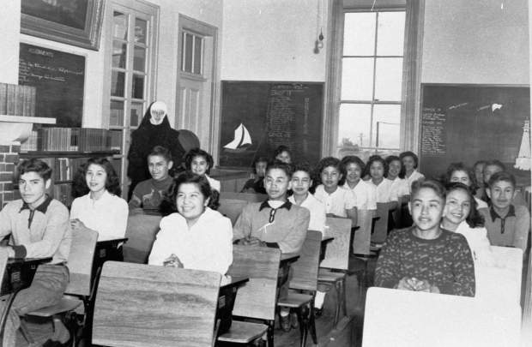
Chapter 6 State and Church Education
given little opportunity to learn beyond basics
class half day
applying skills – cleaning, laundry, maintaining institution and producing food
Enforced use of English
not allowed to use own language – often physically punished
Not all to residential schools – some community schools
not allowed to go to public schools until amendment in Indian Act 1951

Slide 94
Chapter 6 State and Church Education
Residential schools not successful
didn’t assimilate First Nations people
some positive experiences
learned some job skills
created extraordinary social problems for several generations
lost language and normal childhood
loneliness, regimentation and institutionalization left terrible memories
some physical, mental, and sexual abuse
As Long as the Rivers Flow A novel capturing a First Nations family’s last summer together before the children are taken away to residential school.

Slide 95
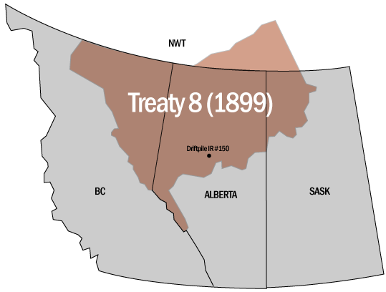
Chapter 6 Treaty 8
TREATY 8
Govt. BC argued any Aboriginal right extinguished with confederation, but agree to treaty in Peace River region 1899
Fed govt. negotiated treaties 1-7 in prairies 1870-77
Peace River occupied by Dunne-za, Sekani, Dene-thah, Chipewyan, and Cree
Life altered by fur trade
Fur-bearing animals depleted by 1880s
Yearly income from previous treaties would prevent starvations

Slide 96
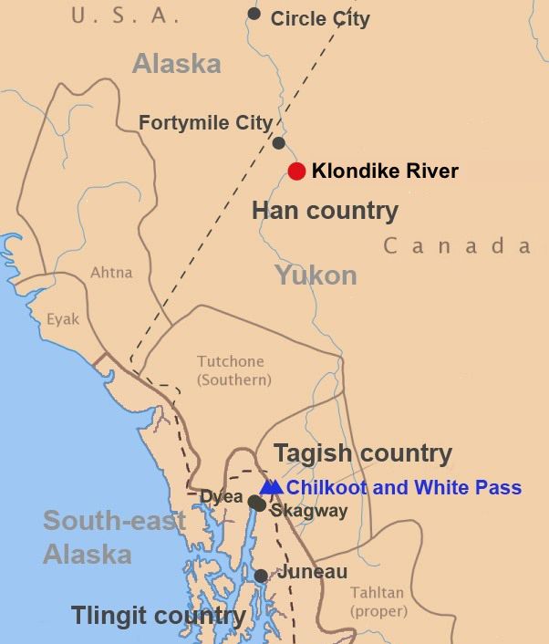
Chapter 6 Treaty 8 – 1897 Klondike Gold Rush
Chilkoot Pass

Slide 97
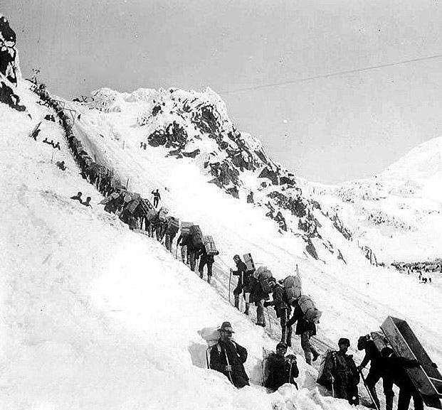
Chapter 6 Treaty 8 – 1897 Klondike Gold Rush
Chilkoot Pass

Slide 98
Chapter 6 Treaty 8
1897 Klondike gold rush brought in miners to area
some miners complete disregard for First Nations
affected trap-lines (destroyed them)
some First Nations retaliated
by 1898, obvious something needed to be done before more violence or “Indian War”
May 1898, 500 First Nations set up blockade, not to move until treaty signed
BC land was given to fed government as part of railway deal
original intention had not been for treaty/reserve use
BC remained silent so that BC could maintain the stance that Aboriginal title did not exist

Slide 99
Chapter 6 1911 Victoria Conference
One of 1st attempts to unite First Nations was formation of Indian Tribes of the Province of BC 1909
also formed was Committee of Friends of Indians by ministers and other non-Aboriginal
March 1911 conference in Victoria
discuss important issues and meet premier Richard McBride
Rev. Tate of CRI presented draft of petition
Haida representative Peter Kelly spoke for need to make own statements
Met with McBride who would not consider Aboriginal title and told them to direct legitimate grievances to fed govt.
At same time, BC govt. was buying two pockets of reserve land – Nass Valley and Kitsilano

Slide 100
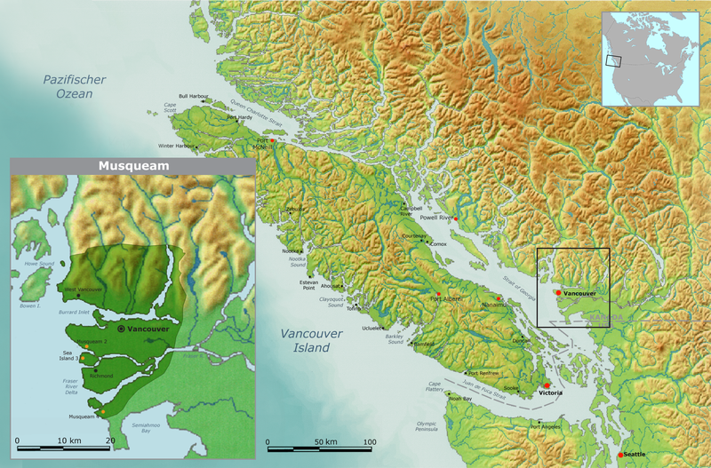

Slide 101
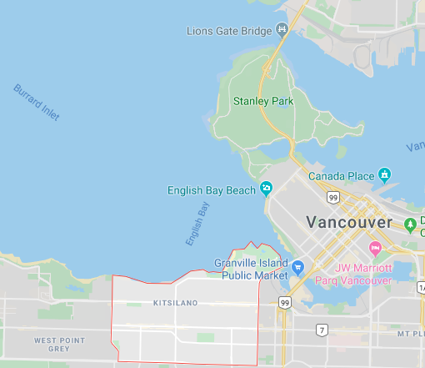

Slide 102
Kitsilano Indian Reserve
The Kitsilano Indian Reserve originally sat, at there ancestral village near False Creek.
There Reserve was 80 acres
80 Acres is equivalent to 50 Square Blocks on the Eastern US = 50 x 50 Street Blocks
80 Acres is equivalent to 12.5 Square Street blocks on Western US
= 12.5 x 12.5 Street Blocks.

Slide 103
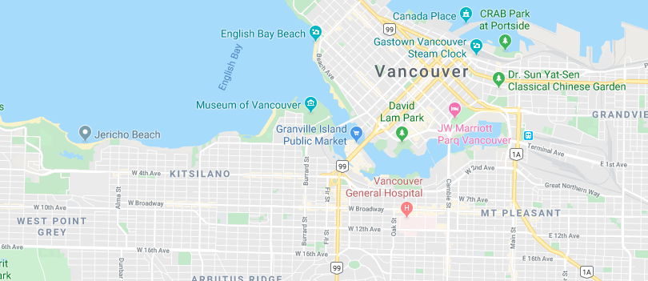

Slide 104
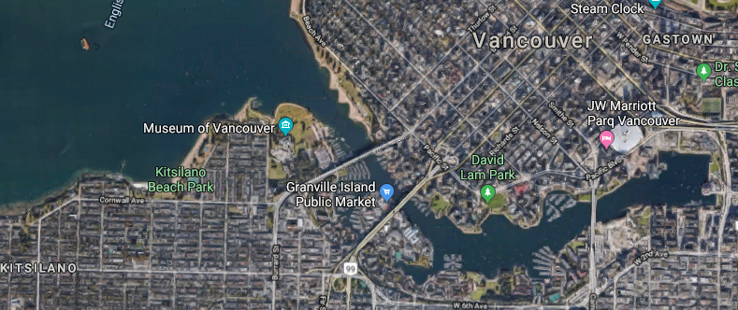

Slide 105
Kitsilano
In 1911, the Federal government amended the Indian Act to legalize the unsettling of reserves that “situated wholly or partly within an incorporated town or city having a population of [more] than eight thousand”, without the need for consent from the reserve's residents (5-6).
As “reserves in more densely populated areas early on became ‘coveted’ by newcomers, who sought to wrest [the Indigenous population] away by licit or illicit means” (3).
Subsequently, both Provincial and Federal governments began the “unsettling of reserves” process, which was the “emptying” of the reserves that “became a source of nuisance and an impediment to progress”, or, in other words, the government unsettled reserves for growing cities and potential business ventures

Slide 106
Kitsilano
Eventually the Kitsilano Reserve was emptied and the land was lost.
The Squamish Nation formally surrendered much of its reserve holdings to the Federal Govt in 1946.
They were kicked out by the Provincial Govt.
Given two days to pack up; put unto barges.
Their homes burned.
This land was expropriated by the CPR.
CPR then sold the land to individuals/developers.
Vancouver Museum
Planetarium
Molson Brewery
Vanier Park
The land was suppose to be returned to the Squamish People.
Squamish People took them to court.
In 2002, they won, and the CPR gave them land close to the Burrard Street Bridge – 4.7 HA or 11.6 acres.

Slide 107
Classwork
Ch. 4-5-6 Questions
First Encounters Poem
Wilfred Laurier Memorial Questions
“Indian Act” Questions
Chilcotin War Project

Slide 108
Please read the Wilfred Laurier Memorial
1) According to the letter, who are the “real whites” and what was their relationship like with the FN people?
2) How did this relationship change with the Gold Rush?
3) In the final paragraph, what is it that the FN are displeased about?

Slide 109
Outline
CNN 10
Journal Prompt #8
Classwork - ☺

Slide 110
Journal Prompt #8
Define “What is Education?” from your perspective.
Create a Venn-Diagram - Compare/Contrast – Traditional Education for FN (Pg. 52-53 (Ch.3) to Residential Schools Education (Ch.6 + own knowledge)
Visit the Website - http://wherearethechildren.ca/en/stories/ - Watch one of the stories from a survivor and answer the following questions.
Who’s video did you watch?
Tell me about this person – describe them, where they’re from, when they were sent to the school, what school they attended.
What are some of the feelings this person has about their experience at the Residential School? (Talk about their daily life, routine, experiences, etc.)
Opinion → What impact might these feelings have on their personal lives as adults?

