Slide 1
Outline
CNN 10
Stewardship/Sustainability
Film

Slide 2
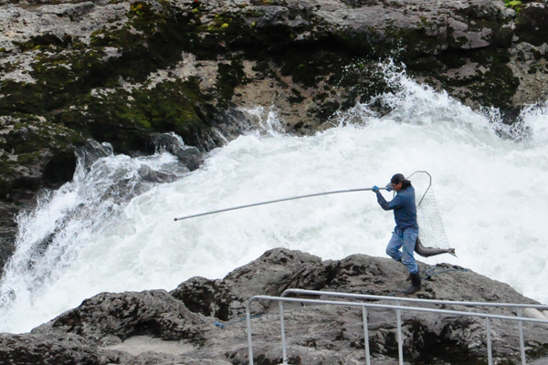
Chapter 2 Living on the Land
Notes:
First Nations Man fishes in Moricetown BC, along the Bukley River.

Slide 3
Chapter 2 Living on the Land
What is meant by the concept of stewardship?
What is meant by the term of sustainability?
How is the land treated?
What is a need vs. a want?
How do traditional Indigenous values about the land differ from non-Indigenous values?
Notes:
First Nations Man fishes in Moricetown BC, along the Bukley River.

Slide 4
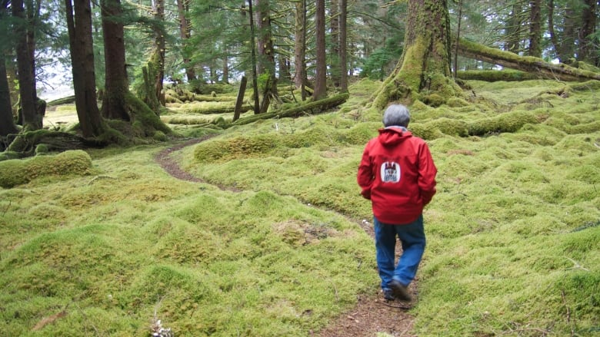
Stewardship
What is meant by the term “stewardship?”

Slide 5
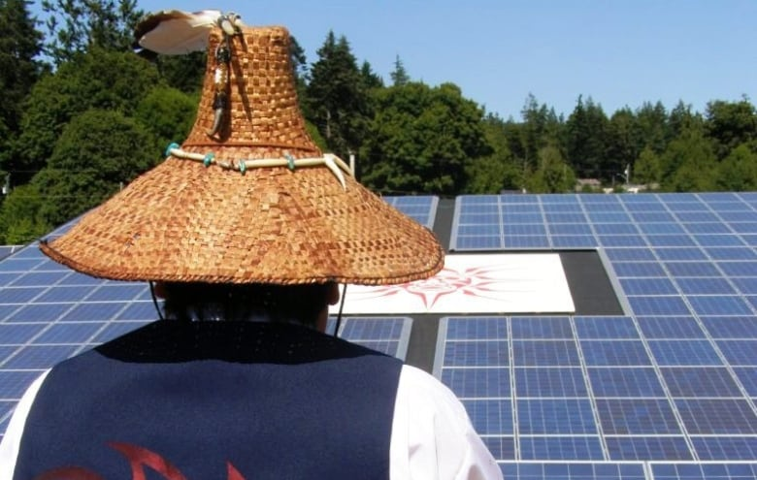
Sustainability
What is meant by the term sustainability?

Slide 6
Resource Management/Stewardship: Aboriginal Fishing Strategy
The Aboriginal Fishing Strategy (AFS) is the federal government’s response to the Sparrow Decision (Ch.9), which defined Aboriginal peoples’ rights to fish for food and for social and ceremonial purposes and sets out the necessity of consulting with Aboriginal groups when their fishing rights might be affected. This Department of Fisheries and Oceans (DFO) program is intended to provide for the effective management and regulation of the Aboriginal fishery and ensure that the Aboriginal right to fish is respected through negotiation of mutually acceptable and time-limited fisheries.

Slide 7
Traditional Ecological Knowledge
Indigenous Knowledge and Science

Slide 8
Meaning via TEK and Science
People understand the world in many ways.
Two ways of bringing meaning to the world are Traditional Ecological Knowledge and Science.

Slide 9
Meaning via TEK and Science
Western science has been the dominant way of making decisions about the environment.

Slide 10
Meaning via TEK and Science
More and more, however, modern society is learning that the vast knowledge and experience Indigenous people have with their land and resources are extremely valuable.
This knowledge and experience is called Traditional Ecological Knowledge (TEK).

Slide 11
What is Traditional Ecological Knowledge (TEK)?

Slide 12
Meaning via TEK and Science
Each First Nation holds a unique body of information deeply rooted in its experience with the lands, waters, fish, plants, and wildlife in its territories.
Each cultural group transforms the plants and animals around them into food, clothing, shelter, medicine, and tools.

Slide 13
Meaning via TEK and Science
The ways in which they do this make them distinct from one another.
The knowledge is holistic and integrates spiritual and moral beliefs and values.

Slide 14
Meaning via TEK and Science
This large body of information, referred to as Traditional Ecological Knowledge (TEK), is made up of knowledge, practices, and beliefs about the relationship of plants, animals, and people with one another and the environment.
It has been handed down from generation to generation over thousands of years.

Slide 15
Meaning via TEK and Science ☺
First Nations people have always had knowledge and strategies which allow them to survive in a balanced relationship with their natural and cultural environments.

Slide 16
Meaning via TEK and Science ☺
As with other aspects of culture, this knowledge is dynamic = it is always going through a process of experimentation, innovation, and adaptation as conditions change.

Slide 17
Meaning via TEK and Science ☺
Traditional knowledge is much more than the identification of plants and animals, or a description of their behaviour.
The reason it is called ecological knowledge is because it understands how plants and animals interact in the environment.

Slide 18
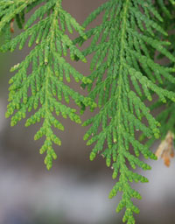
Can you identify what this picture is of?

Slide 19
Meaning via TEK and Science ☺
It is practical knowledge which can be used to predict and to make important decisions in a number of vital areas, including reliable food supply, sustainable resource management, human and animal health, and education.

Slide 20
What was (is) Traditional Ecological Knowledge Education like?

Slide 21
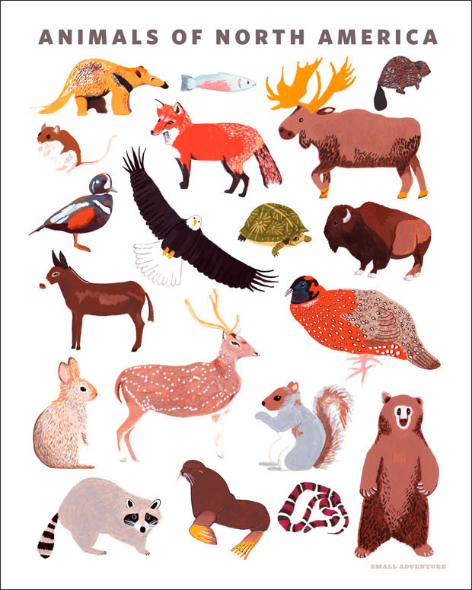
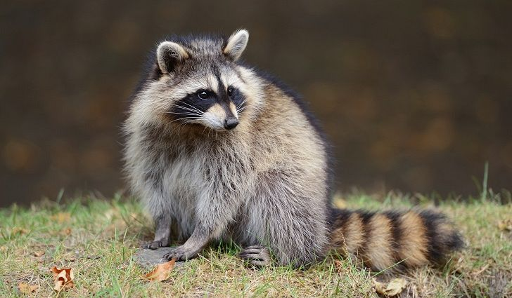
Education in TEK ☺
Traditionally, children were trained from an early age to be aware of and respect plants and animals and the environment they lived in.

Slide 22
Education in TEK ☺
This meant learning not only how to hunt, fish, gather and process food and materials, but also how to understand the behaviour and roles of other species in the ecosystem, and how to successfully interact with them in sustainable ways.

Slide 23
Education in TEK ☺
This knowledge was not taught in a school.
It was passed down by Elders through oral histories, songs, and hands-on training.
As people matured, they built on the teachings of their childhood through observation, experience, and spiritual interaction with the land.

Slide 24
What is Traditional Ecological Knowledge like Today?

Slide 25
TEK Today ☺
Traditional Knowledge helped sustain First Nations cultures for thousands of years, so it is no surprise that it is being used to help in modern society.
Many people recognize the importance of TEK, especially in sustainable resource management, and are beginning to use the knowledge and values in programs such as fisheries and forestry.

Slide 26
TEK Today ☺
Western science usually tries to understand complex ecological systems by breaking the whole down into parts and examining them separately.
This allows us to learn a great deal about the parts, but it may be impractical in trying to understand the complexity of the system as a whole.

Slide 27
TEK Today ☺
Traditional knowledge, on the other hand, is less interested in the separate pieces.
It looks at the land and resources holistically.

Slide 28
What kind of Research is being done on Traditional Ecological Knowledge?

Slide 29
Researching Traditional Ecological Knowledge
Because it is largely an oral tradition, TEK has not been systematically recorded.
Work is being done as First Nations prepare their land claims to make sure this knowledge does not disappear.
Also, wildlife management groups are beginning to incorporate information into their plans and practices.

Slide 30
Researching Traditional Ecological Knowledge ☺
Western scientists and First Nations have begun working together to integrate TEK with scientific methodology.
These two ways of understanding nature are often different, but both have a great deal to offer one another.
Research techniques focus on interviewing Elders and compiling their oral histories for future generations.

Slide 31
Researching Traditional Ecological Knowledge ☺
Maps are created as a way of recording information visually.
Recording interviews is not enough to preserve traditional knowledge, however.
This knowledge can only really come through merging experience with the teachings of others = experience is crucial for keeping the knowledge living, and preserving the way of life from which it comes.

Slide 32
Q: How is TEK different from Science?
TEK | Science
Qualitative (Quality/Experience) | Quantitative (Statistics/Math)
Observations are made/experienced by the people. | Scientific Method (Hypothesis/Experiments)
Data is passed down from the Elders, through Oral Stories/Traditions | Specialized Researchers collect the Data

Slide 33
Example of TEK – Creating a Map
“Areas of interest might include grave sites, old home sites, culturally modified trees (CMT), areas of rare or medicinal plants, important wildlife areas, fish spawning beds, berry harvesting areas and so on. The results of the research provide the First Nations with data they can use in forest management consultations.”
http://www.nafaforestry.org/forest_home/documents/Brubacher-McGregor1998.pdf

Slide 34
Example of TEK – Creating a Map
Proposed logging developments (cut-blocks, logging roads and so on) are over-laid on the TUS maps.
Areas that are identified as of potential concern are then investigated in the field by a crew from the Huu-ay-aht Natural Resources Department.
This field crew then reports its findings to the Chief and Council, who, in consultation with the Natural Resources Department identify appropriate management approaches.
Rather than having an absolute veto over logging activities, the First Nation sees their arrangement as one of “joint stewardship,” based upon negotiation.
Depending upon the significance of the sites identified through the TUS, the Huu- ay-aht may attempt to have an area protected from logging activity or it may negotiate an exchange of areas of moderate concern for economic opportunities
http://www.nafaforestry.org/forest_home/documents/Brubacher-McGregor1998.pdf

Slide 35
Traditional Ecological Knowledge
Please come grab a copy of the ‘Traditional Ecological Knowledge’ Reading

Slide 36
Outline
Strength of TEK video.
Stewardship Video

Slide 37
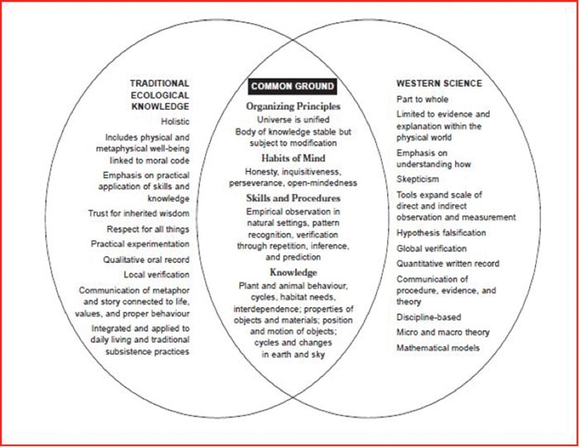
TEK
Q: What is the strength of combining TEK and Western Science?

Slide 38
Stewardship + Sustainability
“Since Time Immemorial”: How Indigenous People Are Reviving Traditional Stewardship
https://vimeo.com/200720195

Slide 39
Reading: Teaching of the Elders TEK
As we do the reading, look for the following elements:
Interpreting Animal Behavior
Applying knowledge to technology
Environmental relationships
Spiritual beliefs

Slide 40
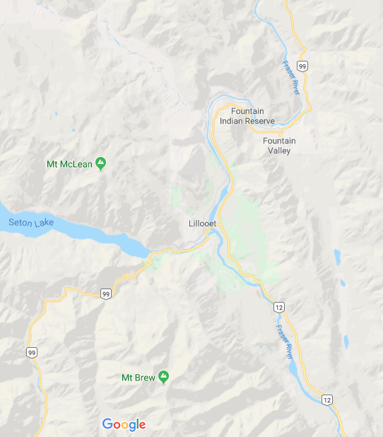
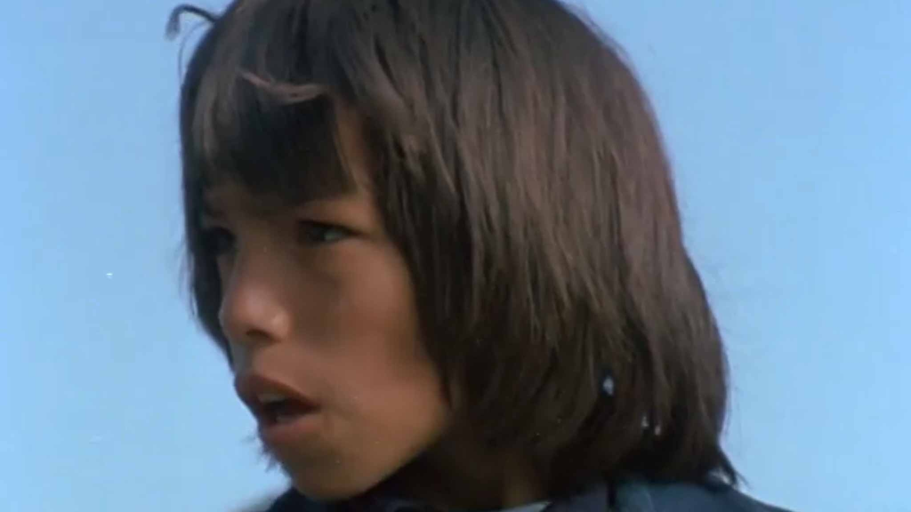
Kevin Alec

Slide 41
Outline
CNN 10
Living on the Land
Resources
Fishing
Hunting

Slide 42
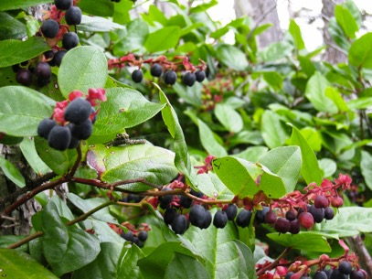
Chapter 2 Living on the Land
Even though First Nations groups are unique, there are similar characteristics and cultural aspects they share.
Stewardship is something that all First Nations cultures carry out.
The resources First Nations gather are more than just food/materials; they are gifts.
First Nations often are grateful/thankful towards these gifts.
Notes:
First Nations Man fishes in Moricetown BC, along the Bukley River.

Slide 43
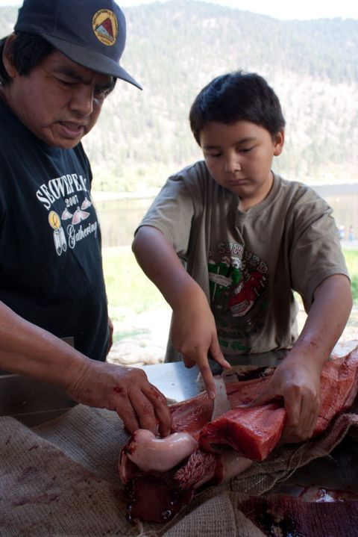
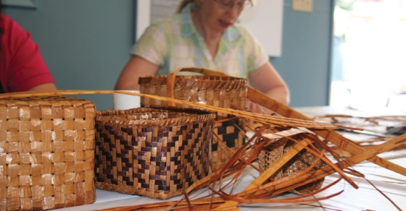
Chapter 2 Harvesting Resources ☺
Due to the many diverse regions in B.C., there is an abundance of different resources throughout our province.
The need for different technologies were developed over centuries to harvest and process these resources.
Notes:
Student at Okanagan School, learning about Traditional methods of filleting fish.

Slide 44
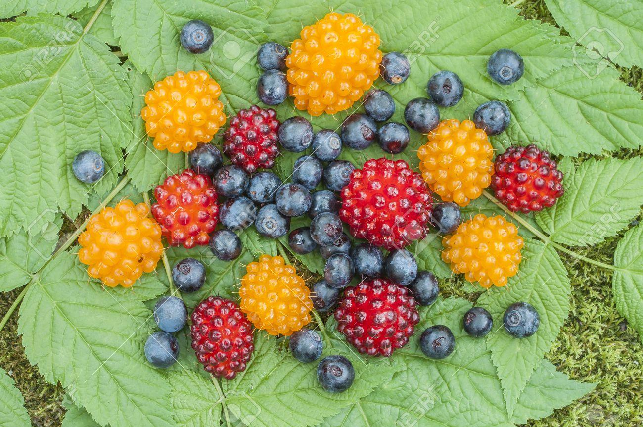
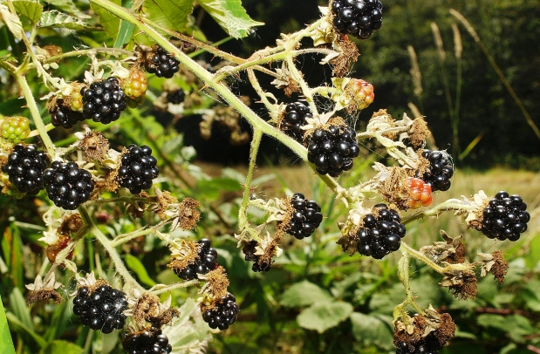
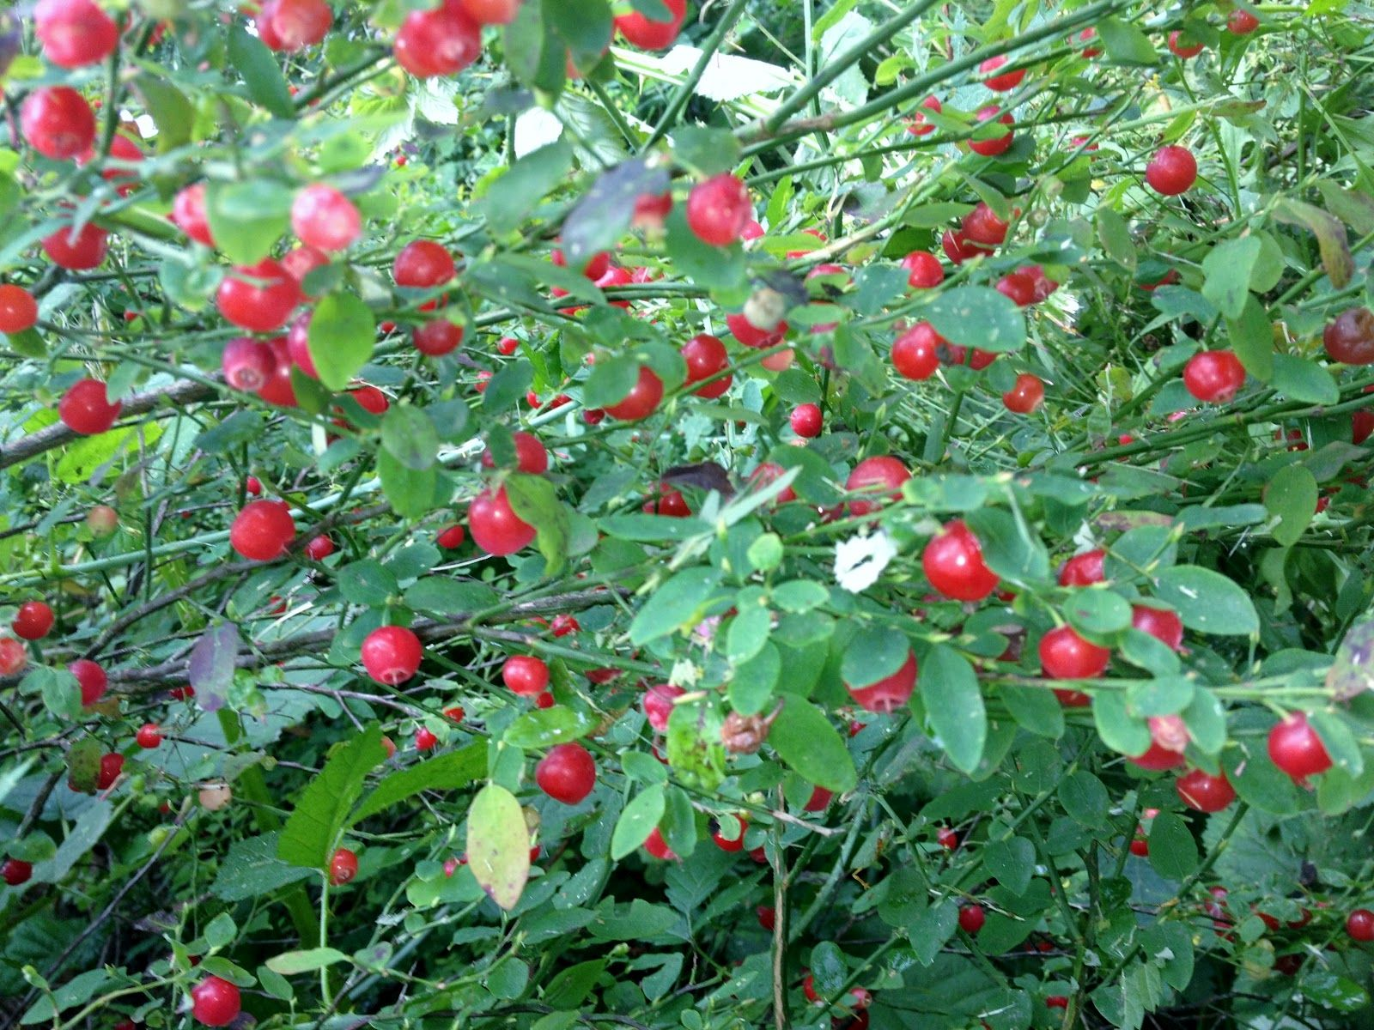
Chapter 2 Plants (pg. 36) ☺
Plants are important for First Nations daily, ceremonial and spiritual life.
Provided food, medicine, tools, dyes, containers, fuel (oil) and fiber.
Controlled Burning Australia California
Harvesting Cedar
Harvesting plants/berries, is always a spiritual practice.

Slide 45
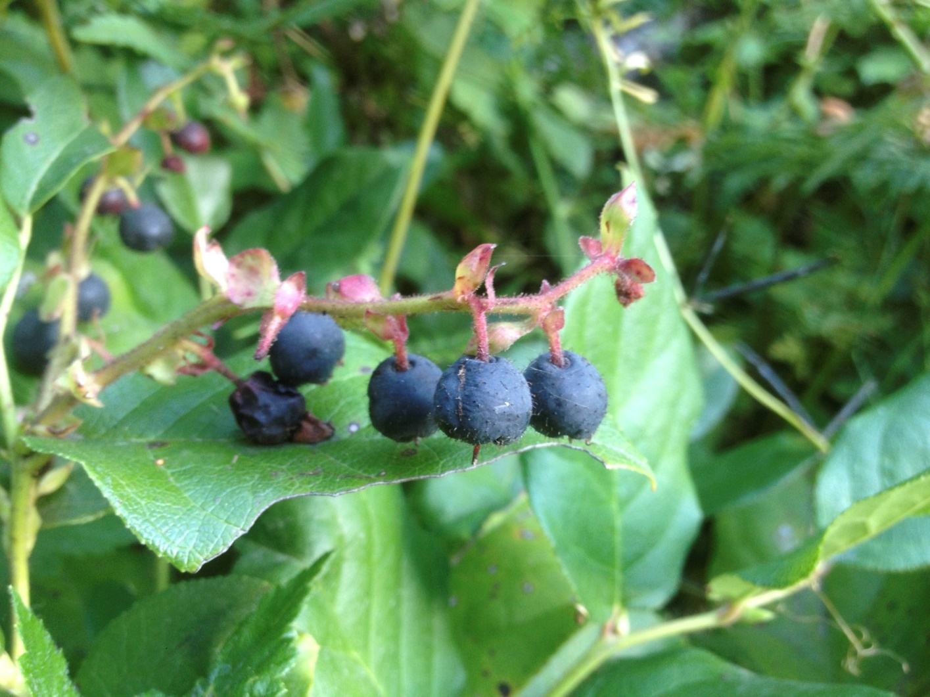
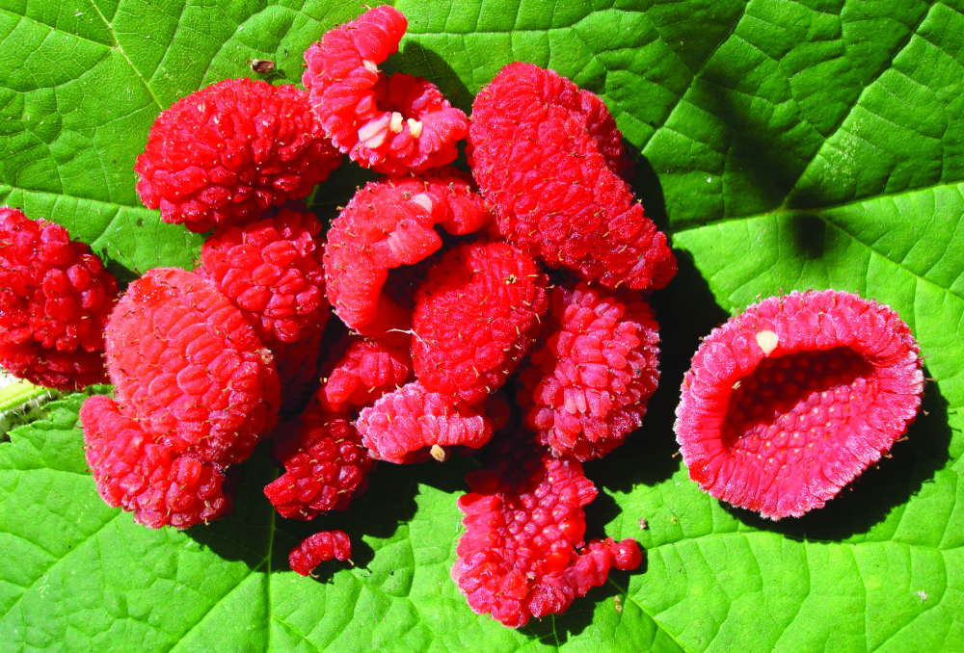

Slide 46
Chapter 2 Nature and Spirituality
Dave Elliot, Saanich
My people never killed a tree unnecessarily. Once in a while the need was so great they would cut a tree. When this had to happen they would speak to the tree. It had a sacred name. Every living thing had a sacred name—streams, lakes, trees, flowers, birds, everything. When your need was great you had no choice. You would stand before the tree and talk to it and tell the tree how sorry you were to take its life. When we took the life of a tree, we used every scrap, every shred right down to the last bit. We used it all. It was wrong to waste something that had been provided for us by this intelligence we didn’t quite understand.

Slide 47
Journal #4
1) What have you learned this week in regards to First Nations Stewardship of the land?
2) What practices do you think we could implement in our daily lives to live more sustainably?

Slide 48
Outline
CNN 10
Fishing Techniques

Slide 49
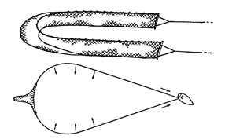
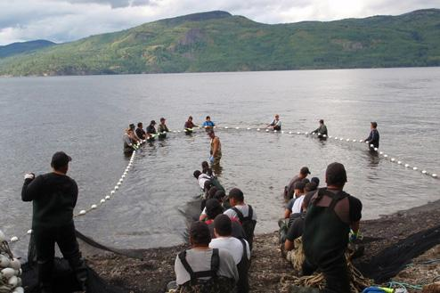
Chapter 2 Fishing Techniques: Beach Seines ☺
Many Skills Required to Catch Fish
Understanding Tides, Winds, Currents, Seasons, Animals.
Some caught out at sea via canoes/nets.
Many caught in the intertidal zone using the following:
Beach Seines & Fish Traps

Slide 50
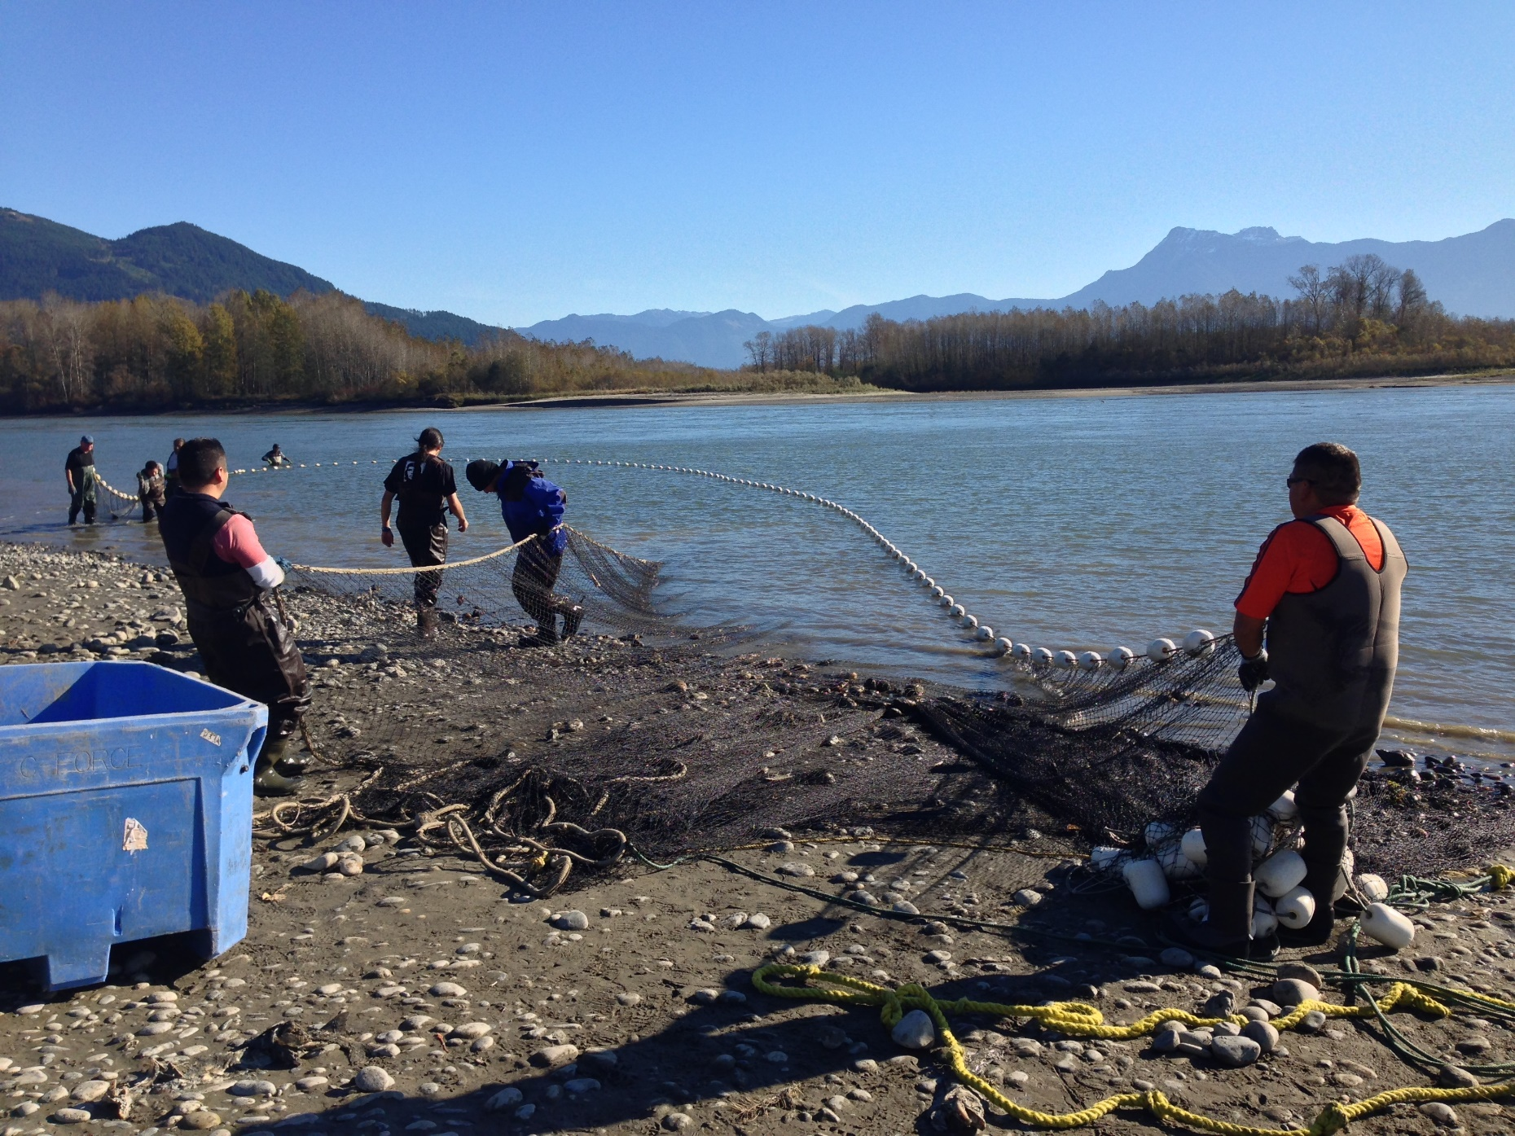

Slide 51
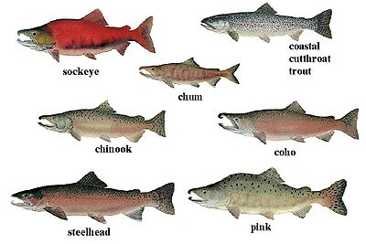

Slide 52
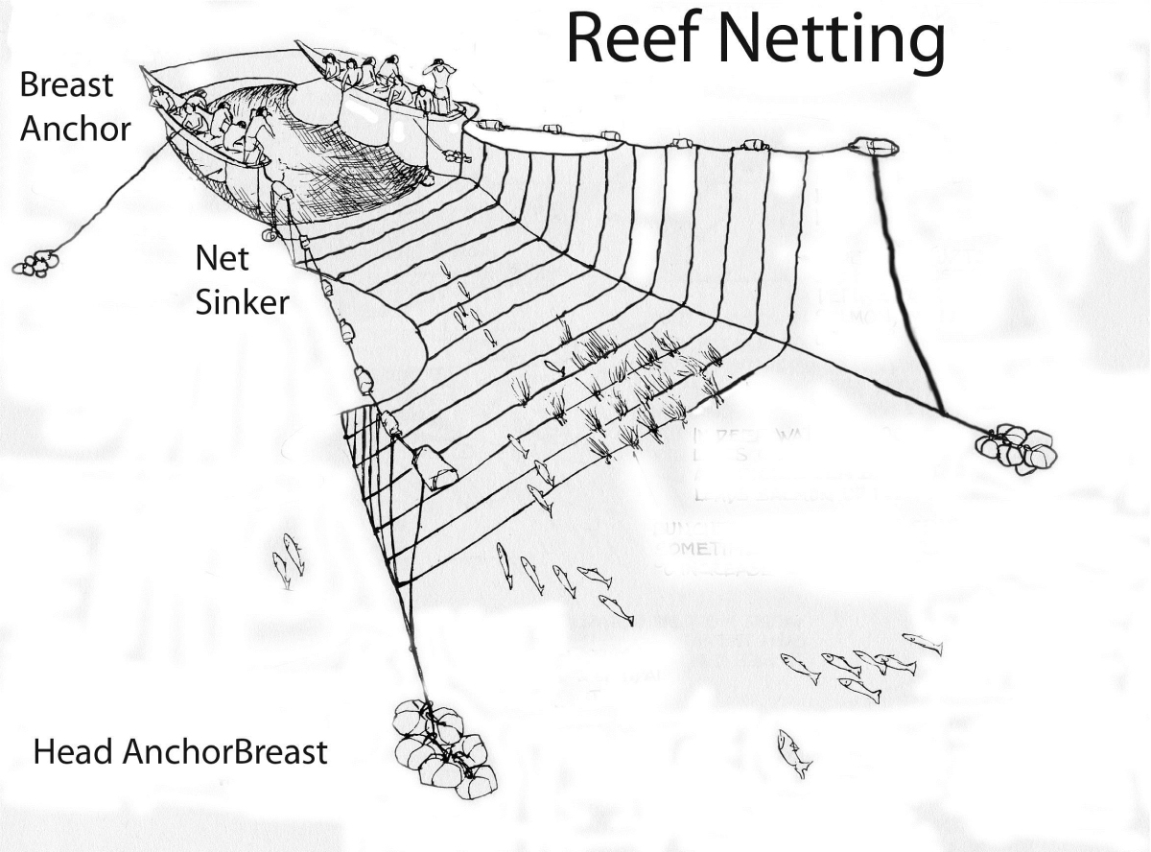
Chapter 2 Fishing Techniques: Beach Seines
Shore
Canoe
Canoe
Kelp Bed

Slide 53
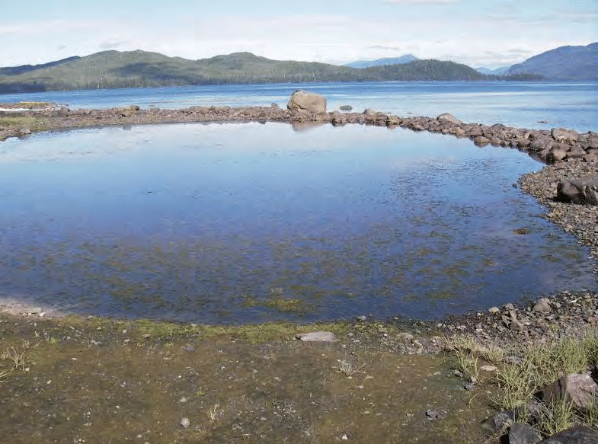
Chapter 2 Fishing Techniques: Stone Traps
At River Mouths, First Nations constructed stone traps

Slide 54
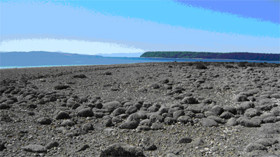
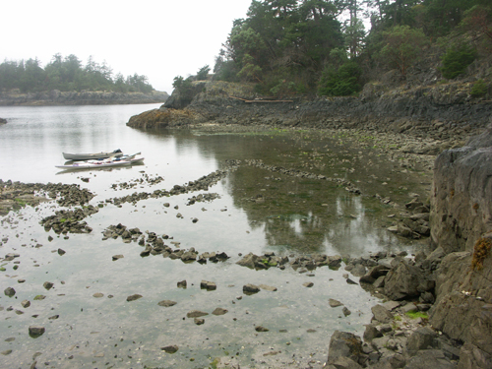
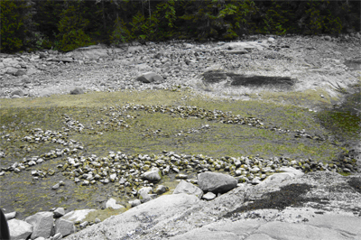

Slide 55
Stone Traps – River Mouth
Capilano River Coho Salmon Stone Traps - Squamish Nation
https://www.youtube.com/watch?v=iuseR1aYsDc
4:46 mins

Slide 56
Chapter 2 Fishing Techniques ☺
As the Salmon progressed up the River, First Nations would use the following techniques:
Fishing Weirs
Basket Traps
Dip Nets
Spears
Gill Nets
Torch Lighting

Slide 57
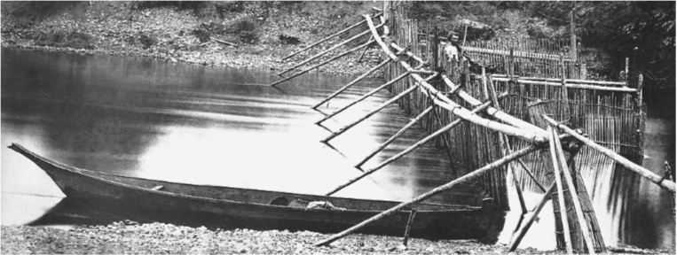
Chapter 2 Fishing Techniques: Fishing Weirs

Slide 58
Tools used for accessing resources
Bernice's Cub at the Nakina River Weir – near Atlin Lake – Tlingit First Nation
https://www.youtube.com/watch?v=Ab8Wnrh-wQM

Slide 59
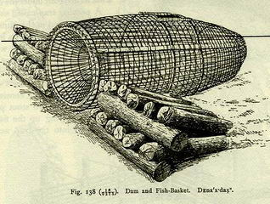
Chapter 2 Fishing Techniques: Basket Traps

Slide 60
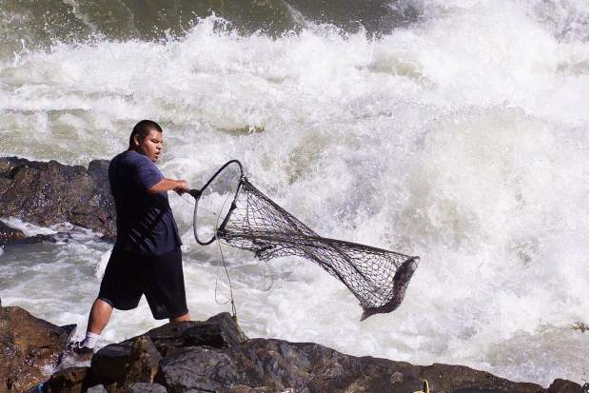
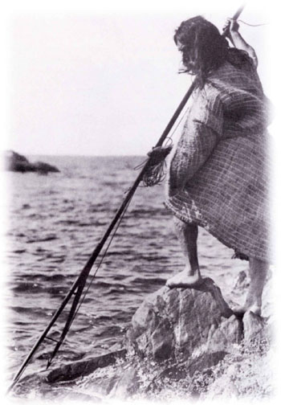
Chapter 2 Fishing Techniques: Dip Nets & Spears

Slide 61
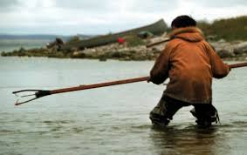

Slide 62
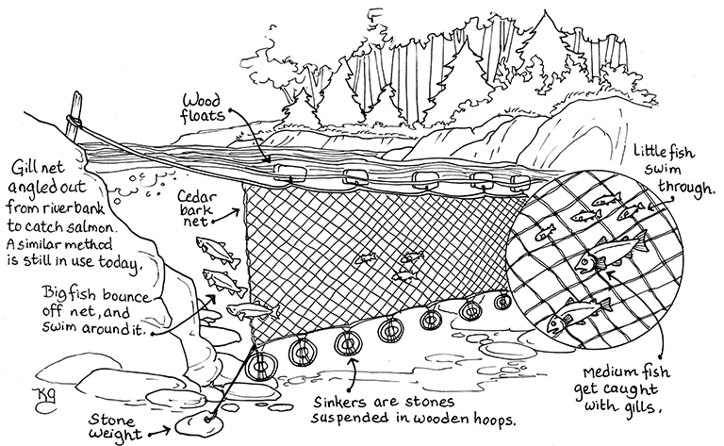
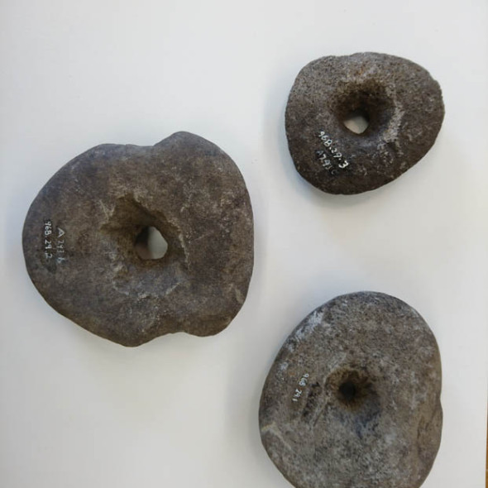
Chapter 2 Fishing Techniques: Gill Nets

Slide 63
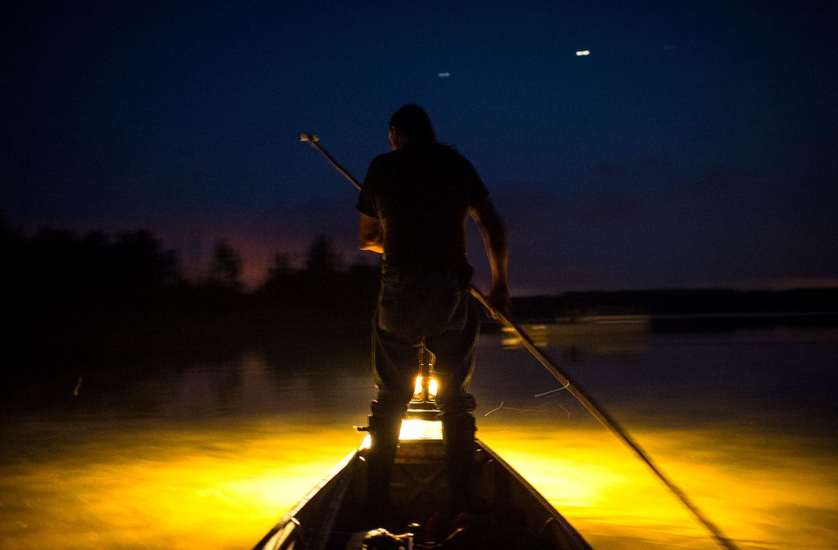
Chapter 2 Fishing Techniques: Torch Lighting

Slide 64
Chapter 2 Hunting ☺
Hunters were prominent in all Regions of B.C., in each First Nation Tribe.
They developed incredible tracking skills, and noise mimicking sounds.
From Bow and Arrow, to Encircling the animal, to Corralling them, and using Deadfalls – First Nations people inhabited great creativity to hunt these animals.

Slide 65
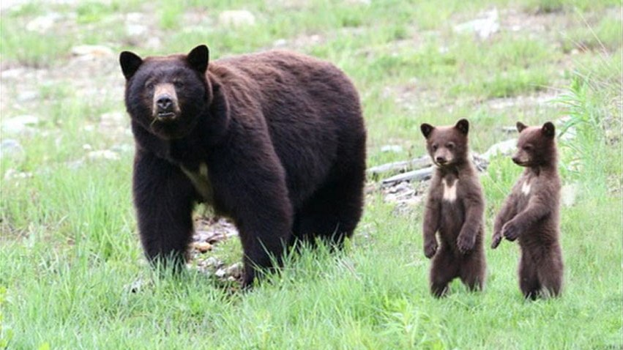

Slide 66
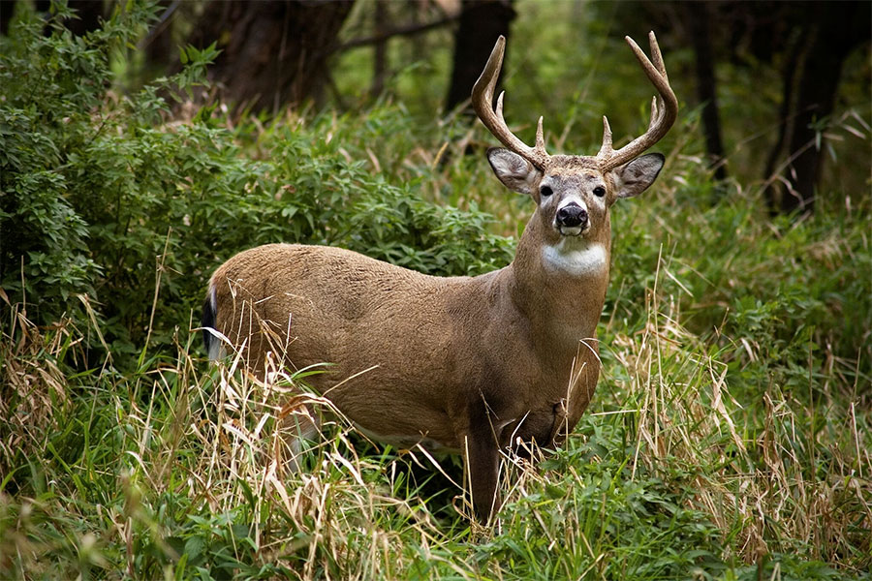

Slide 67
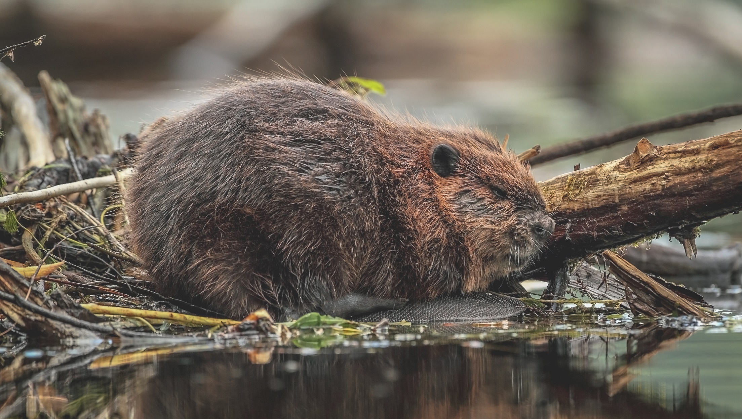

Slide 68
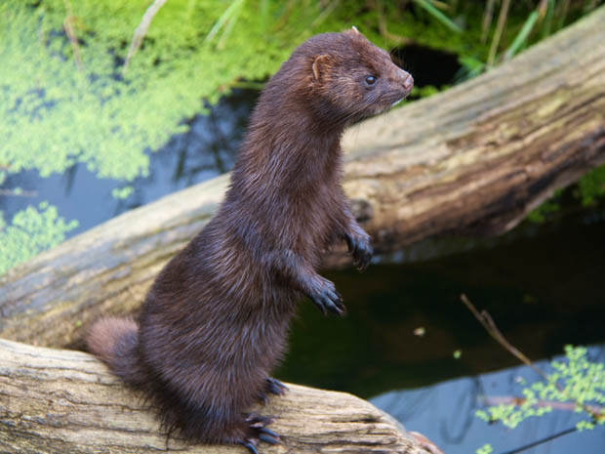
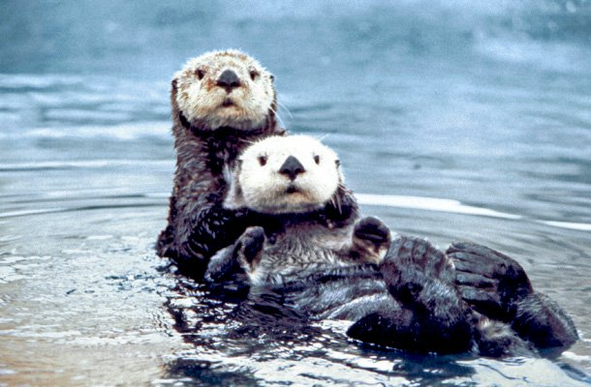

Slide 69
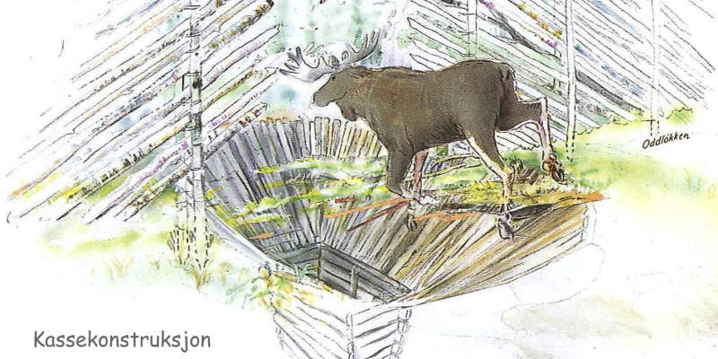
Chapter 2 Pit Fall

Slide 70
Deadfall Traps
Log Deadfall
https://www.youtube.com/watch?v=UdE0PwGPQR4
4:18 mins

Slide 71
Chapter 2 Preservation of Resources ☺
Due to B.C.’s cold climate, many First Nations Tribes were unable to Hunt/Fish during the Winter Months.
This in turn led to the need to preserve the resources they had acquired during the spring, summer and fall.
Cedar was weaved into baskets, hats, masks, or carvings.
Meat and Salmon was often either dried (sun/wind) or smoked
The resources were then put into either Bentwood Boxes (South) and Raised Caches/Underground Pits (North)

Slide 72
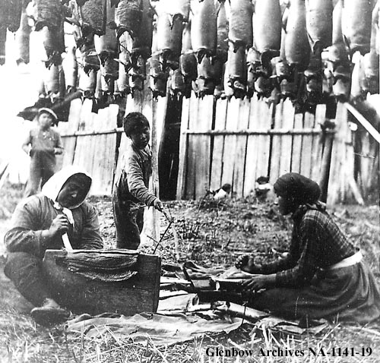
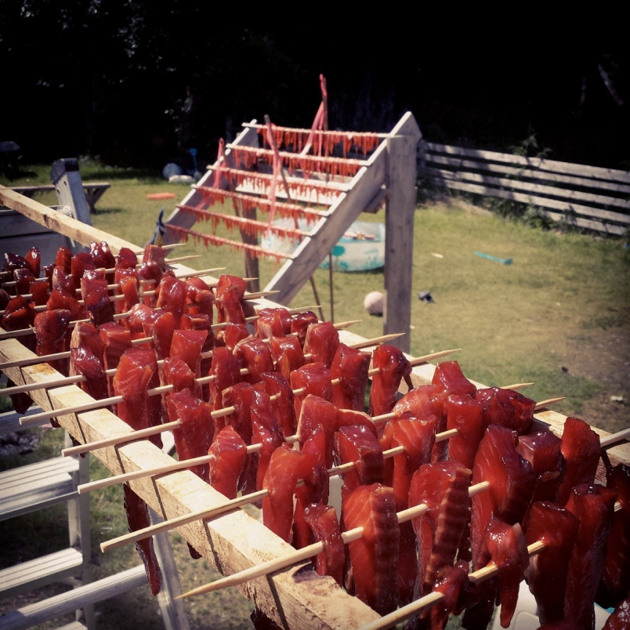

Slide 73
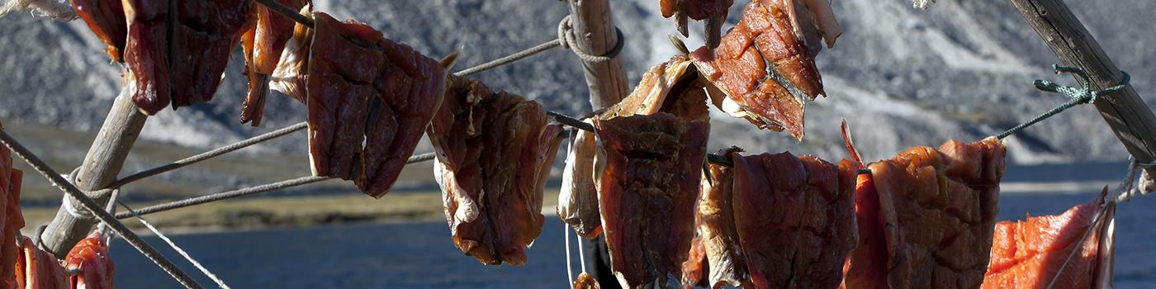

Slide 74
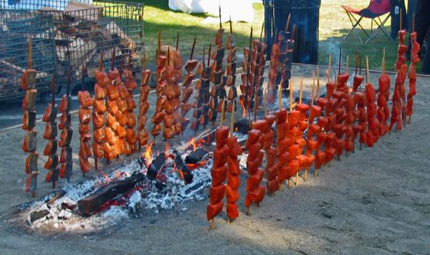
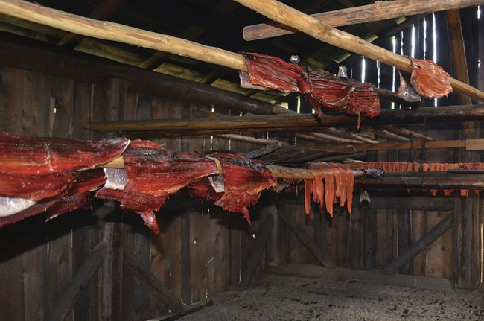

Slide 75
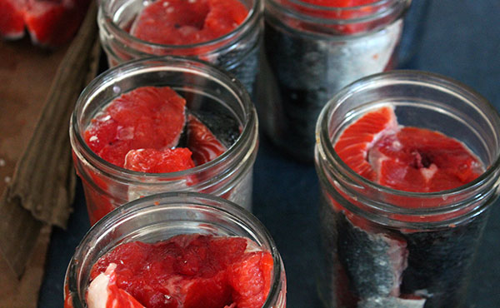
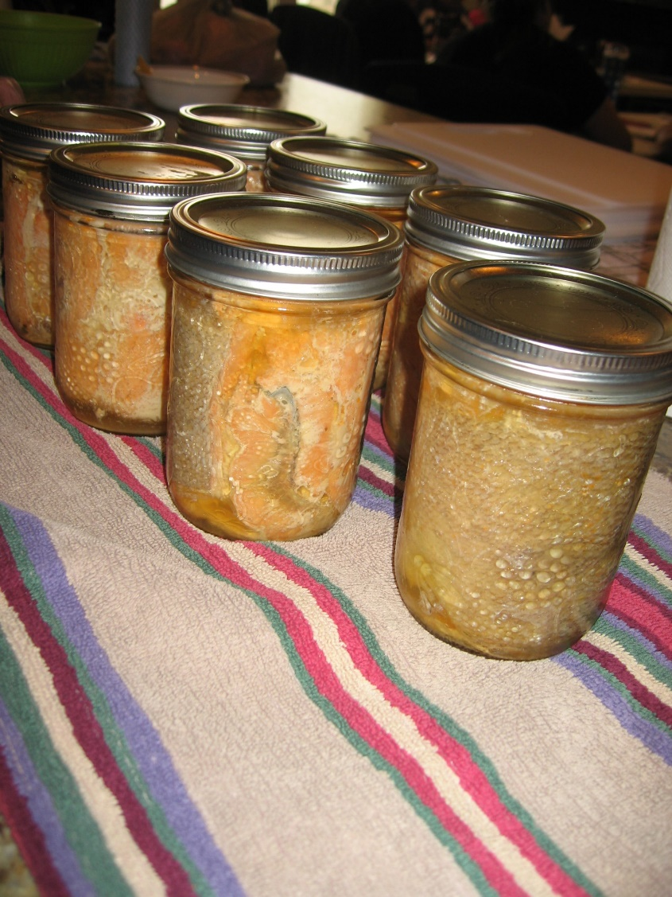

Slide 76
Outline
CNN 10
Indigenous Issues – Leader Debate 2019 (1:49)
Indigenous Artifacts
Seafood Gardens
Herring
Tanning – Video (17mins)
Classwork

Slide 77
Tools used for accessing resources
What are seafood gardens? How where they created/maintained by Coastal First Nations?

Slide 78
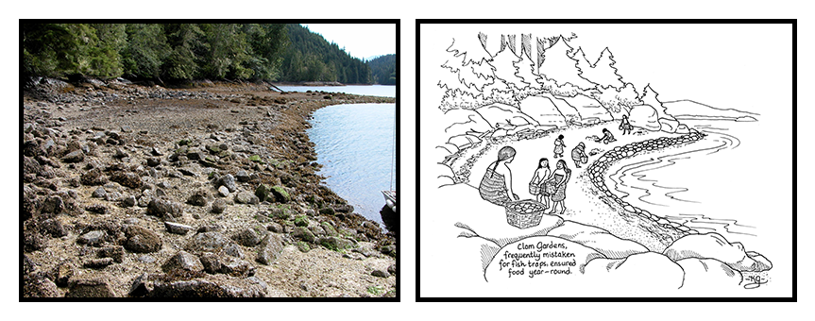

Slide 79
Clam Gardens
Clam Gardens – Learning Together – Gulf Islands National Park Reserve
https://www.youtube.com/watch?v=22Nytmxw2Z8
https://www.youtube.com/watch?v=j2wPVx4sCN0
3:26 mins

Slide 80
B.C. First Nations work to restore ancient seafood farms
When the tide rolls out, First Nations elders and youth scramble down the beach to restore ancient seafood farms that helped feed their ancestors for millennia.
http://www.vancouversun.com/technology/first+nations+work+restore+ancient+seafood+farms/11792123/story.html

Slide 81
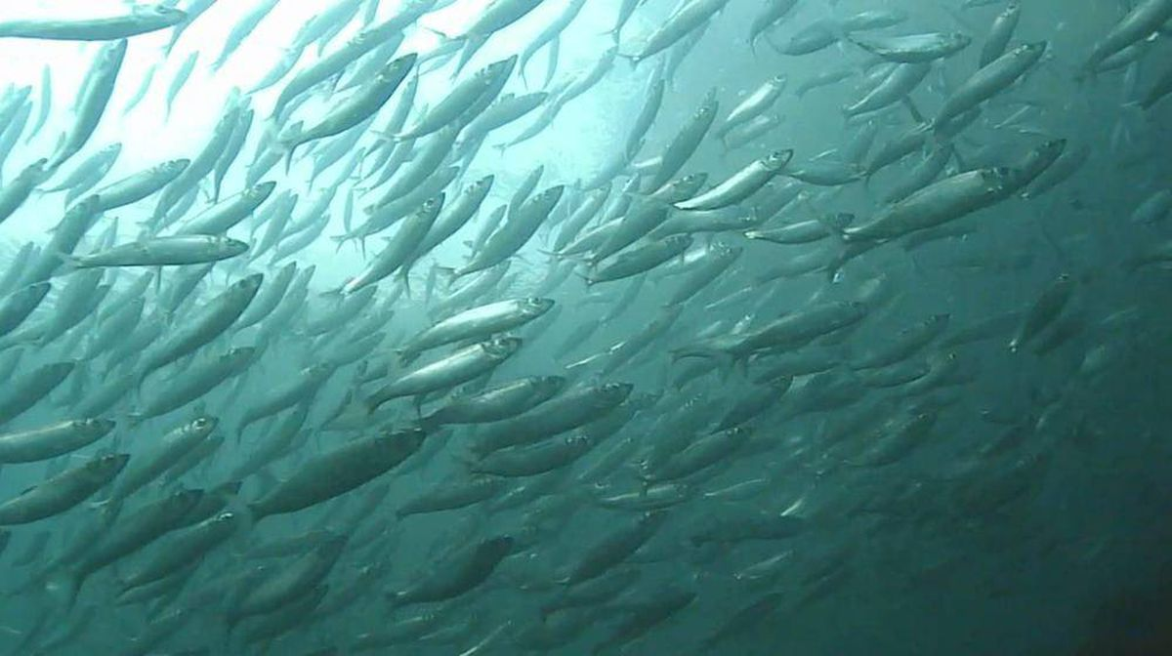
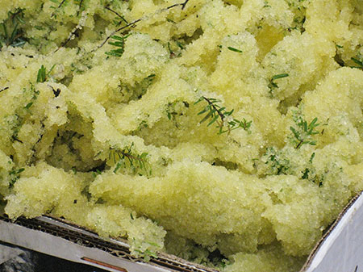
What is herring row?
What is the process of harvesting/farming herring row?

Slide 82


Slide 83
“Traditional Harvest of Spawn on Hemlock Trees” by Mark Wunsch
Pacific Herring
https://vimeo.com/93050927
2:23 mins

Slide 84



What is oolichan/eulachon/ooligan/hooligan?
What was the oolichan fishery?
How was oolichan used by Coastal First Nations?

Slide 85
Ooligan fishing camp
Ooligan – Haisla First Nation
https://www.youtube.com/watch?v=uq6KZzQHr2Q
4:34 mins

Slide 86


Below left is a Musqueam woman using a spindle whorl Below right is a Coast Salish Loom
Coast Salish Spindle Whorl

Slide 87


Chapter 2 Hides ☺
Hides were always utilized in First Nations communities for clothing, drums, footwear and cord.
Tanning is a difficult process, requiring skill, knowledge, and patience.

Slide 88

Chapter 2 Hides ☺
“Traditionally, when you make something for the first time you give it away because the gift you received was the knowledge of how to make more.”
Notes:
Squamish BC

Slide 89
Classwork
Please Finish and Submit the Following Items
Stations Activity
Intro Questions
Ch. 1 Questions
Ch. 2 Questions
T’Lina the Rendering of Wealth
Origin Stories
Project (Due 18th of October)

Slide 90
Outline
CNN 10
Textiles and Baskets
Housing/Shelters
Transportation
Resource Usage
Film on Cedar → 26 mins.

Slide 91
Chapter 2 Textiles and Baskets ☺
Plant fibers were woven into clothing, mats, and baskets.
Used to make twine, cord and ropes.
This role was often performed by women in communities.
If a resource was more challenging to come by (ex: Mountain Goat wool) it had more prestige.
On the Coast, they would use the fiber from a stinging nettle plant, twisting it to make it into a net.

Slide 92
Chapter 2 Making Tools and Household Goods ☺
Tool making occurred in the winter months.
Both men and women worked on making them.
All parts of a resource were utilized; nothing went to waste.
Moose
Hide is tanned.
Antlers used for handles/imitate other moose.
Bones fashioned into tools.
Sinew (fat) turned into thread.
Constructed Bentwood boxes.

Slide 93
Importance of Cedar to Coastal First Nations
This video is a product of CWF's July 2014 Summer Institute, which was held in Tofino B.C.
https://www.youtube.com/watch?v=qnQIPjHt2Zs
3:26 mins

Slide 94
Tools used for accessing resources
What type of tool was/is used to chop/carve trees on the coast? What did/does it look like?

Slide 95


Slide 96


Slide 97


Slide 98
Tools used for accessing resources
What types of shelters were created on the coast? What resources were they created from?

Slide 99
Chapter 2 Shelters ☺
Different Architectural buildings were created in the Summer then the Winter.
In the summer months, houses has to be light and portable, as FN were constantly moving around.
In the winter months, houses has to be strong and durable to protect from winter storms.
In the Southern Interior created Pit Houses
On the Coast: Created Longhouses.
One Coast Salish house was 450m long.
That’s 0.45km!

Slide 100



Slide 101


Slide 102


Slide 103



Slide 104
Creating a Shelter ☺
Coastal people built longhouses or big houses using large cedar planks.
Distinct styles were used in different areas.
Haida
6 beams that projected from the roofs
Most other types used two roof-beams
Side planks forming the wall were placed vertically in the north and horizontally in Coast Salish territory to be able to add extensions
The longhouse was named and decorated with a crest with the extended family living under one roof.

Slide 105


Coast Architecture
Q: Which one is Coast Salish and Which one is Haida?

Slide 106
Tools used for accessing resources
What modes of transportation were created on the coast? What resources were they created from? How were they used?

Slide 107
Chapter 2 Transportation ☺
Most FN walked in the Interior.
In 1700, the Spanish introduced horses to the region.
FN began creating trails; building bridges (pg 44)
Created snowshoes to travel in the winter.
Notes:
Hagwilget people across the Bulkley River.

Slide 108


Slide 109



Slide 110



Slide 111

Transportation – Grease Trails

Slide 112

Chapter 2 Transportation ☺
Along the coast FN created Canoes, made of cedar.
In the interior, FN created canoes made out of birch, cottonwood, cedar, or pine.
Skin canoes were also used.
A frame of light wood was covered with the skins of caribou or moose, sewn with sinew, and sealed to make it watertight.
Notes:
Hagwilget people across the Bulkley River.

Slide 113
Managing the Resources
“Spirituality, in Aboriginal discourse, is not a system of beliefs that can be defined like a religion; it is a way of life in which people acknowledge that every element of the material world is in some sense infused with spirit, and all human behaviour is affected by, and in turn has an effect in a non-material, spiritual realm.”
- 1996 Report of the Royal Commission on Aboriginal Peoples (pg 45)
What do you understand about this statement? Are there any examples we have read about?
Let’s look at ‘First Nations Voices’ – Dave Elliot page 36

Slide 114
Managing the Resources ☺
Months were named after a seasonal activity or the actual resource gathered
Eg. Salmonberry Month was June
Spiritual ceremonies often celebrated the arrival of resources
Some were quite simple – eg. Showing thanks
Some were quite complex – like the First Salmon ceremony of the St’at’imc people (pg 45)
Why would ceremonies like the example have been so complex?

Slide 115
Managing the Resources ☺
The ways resources were administered varied from place to place
Bands were permitted to share territories but generally the territory was held by a particular band and permission was asked
Hereditary Chiefs were responsible for the safety of their groups
But they required support from resource-use units (look back at the Kwakwaka-wakw case study in chapter 1)
Decisions made by consensus through a council or elders and chiefs
All members contributed to the common good of the group
What is the strength of this type of system?

Slide 116

Chapter 2 Case Study The Dunne-za: Hunters and Dreamers
Please come grab a copy of the Ch. 2 Questions

Slide 117
The Story of Cedar
Sechelt Arts Fest 2015
https://www.youtube.com/watch?v=WIcT9Jx0T7g
26:00 mins

Slide 118

Chapter 2 Let’s Try Some Stuff ☺

Slide 119
Orange Shirt Day – September 30th
Please Visit the website: http://www.orangeshirtday.org/phyllis-story.html Make sure to read Phyllis-Story.
Visit Global News https://globalnews.ca/news/3777664/orange-shirt-day/
In your Journals answer this question:
Why should all Canadian’s know about the history of the Canadian Government’s and the various churches’ creation of Residential schools?
Are ‘shirt days’ an effective way to bring awareness to issues? Why or Why not?

