Slide 2
Outline
CNN 10
Living on the Land
Resources
Fishing
Hunting

Slide 3
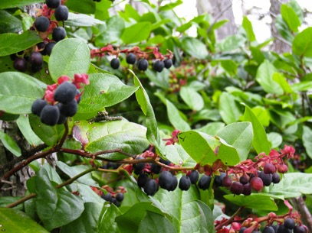
Chapter 2 Living on the Land
Even though First Nations groups are unique, there are similar characteristics and cultural aspects they share.
Stewardship is something that all First Nations cultures carry out.
The resources First Nations gather are more than just food/materials; they are gifts.
First Nations often are grateful/thankful towards these gifts.
Notes:
First Nations Man fishes in Moricetown BC, along the Bukley River.

Slide 4
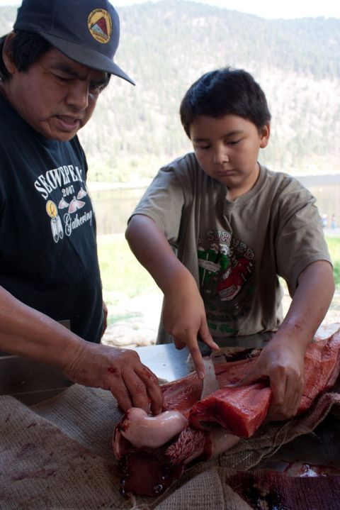
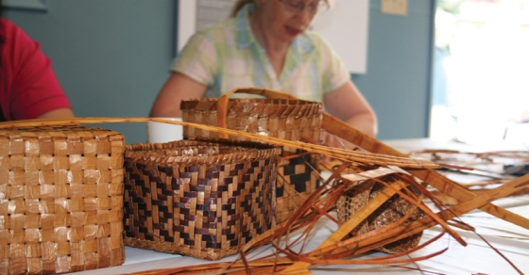
Chapter 2 Harvesting Resources ☺
Due to the many diverse regions in B.C., there is an abundance of different resources throughout our province.
The need for different technologies were developed over centuries to harvest and process these resources.
Notes:
Student at Okanagan School, learning about Traditional methods of filleting fish.

Slide 5
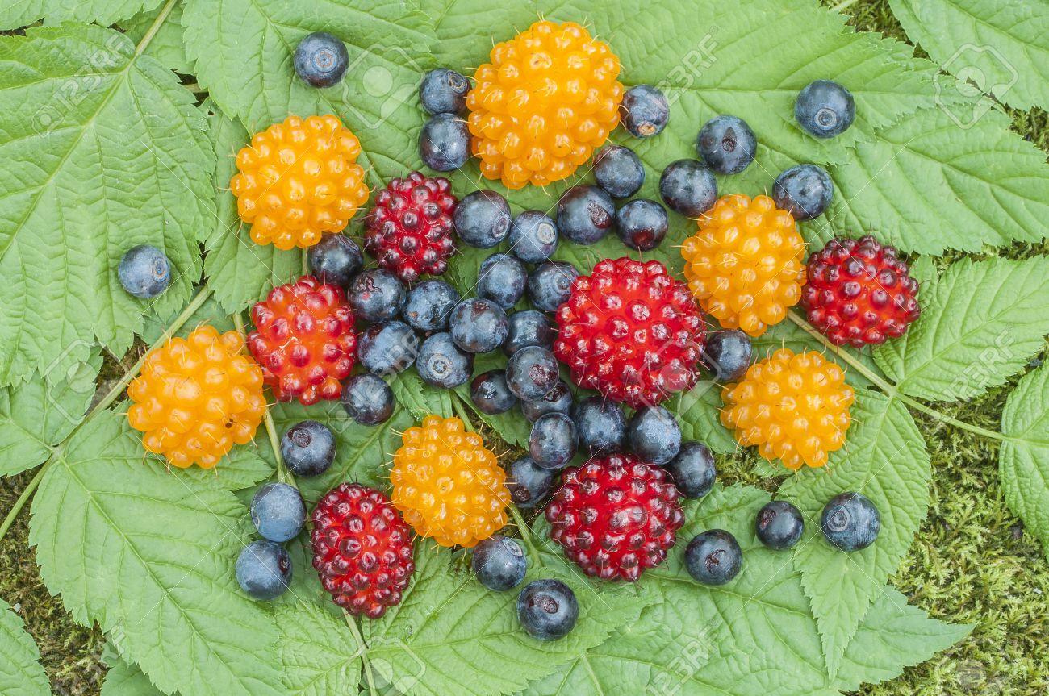
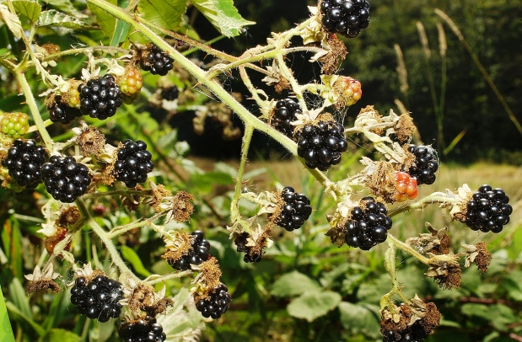
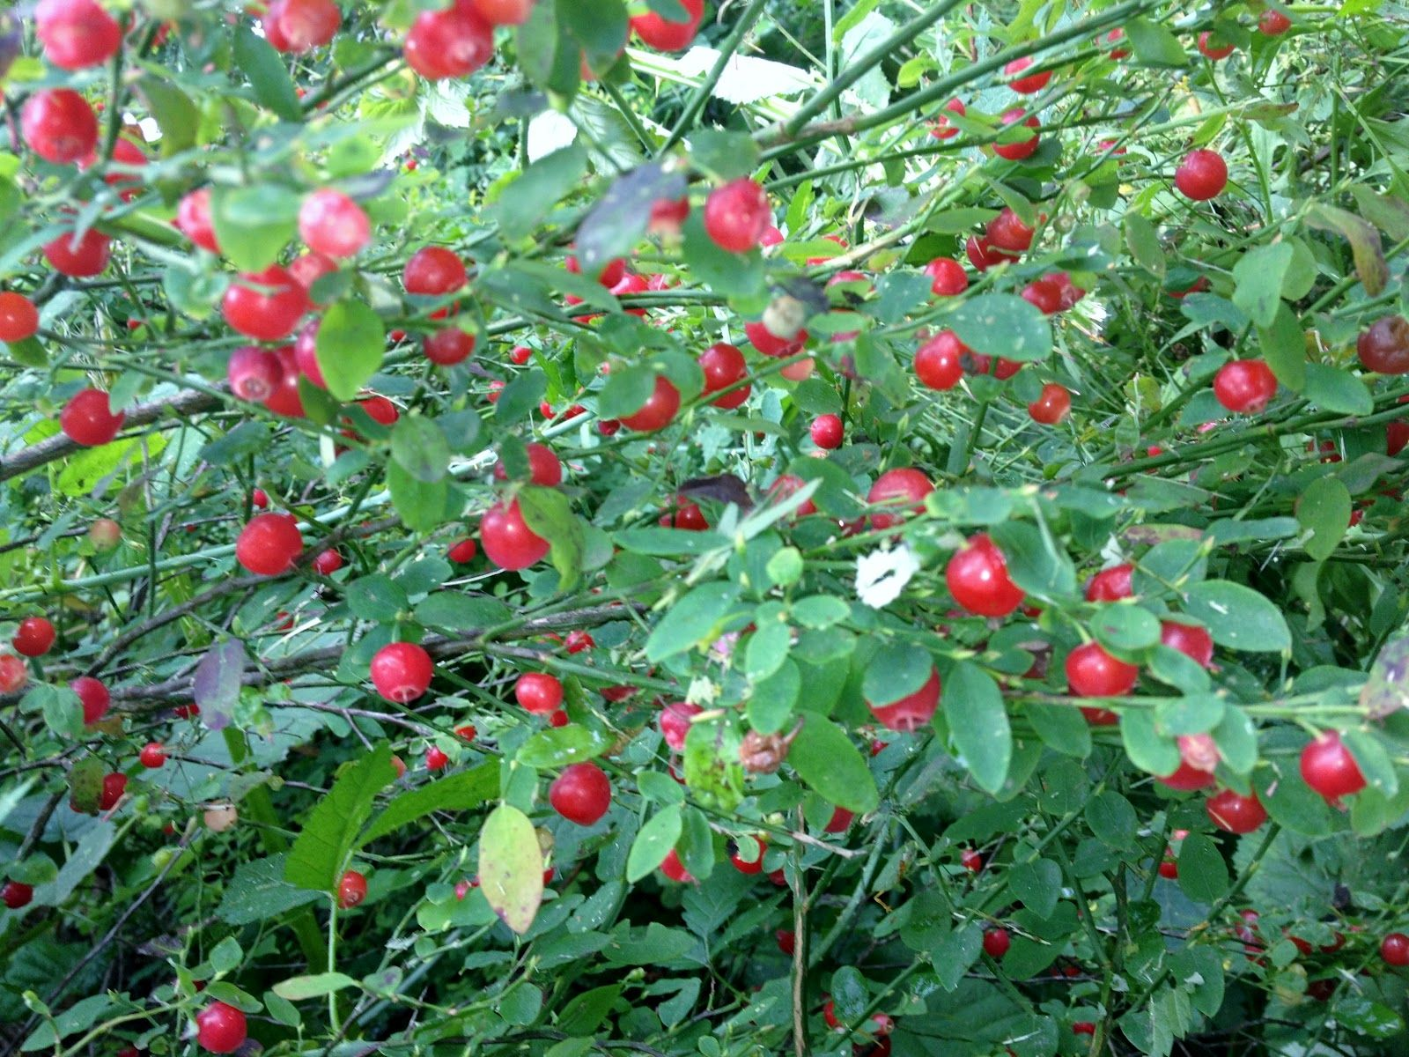
Chapter 2 Plants (pg. 36) ☺
Plants are important for First Nations daily, ceremonial and spiritual life.
Provided food, medicine, tools, dyes, containers, fuel (oil) and fiber.
Controlled Burning Australia California
Harvesting Cedar
Harvesting plants/berries, is always a spiritual practice.

Slide 6
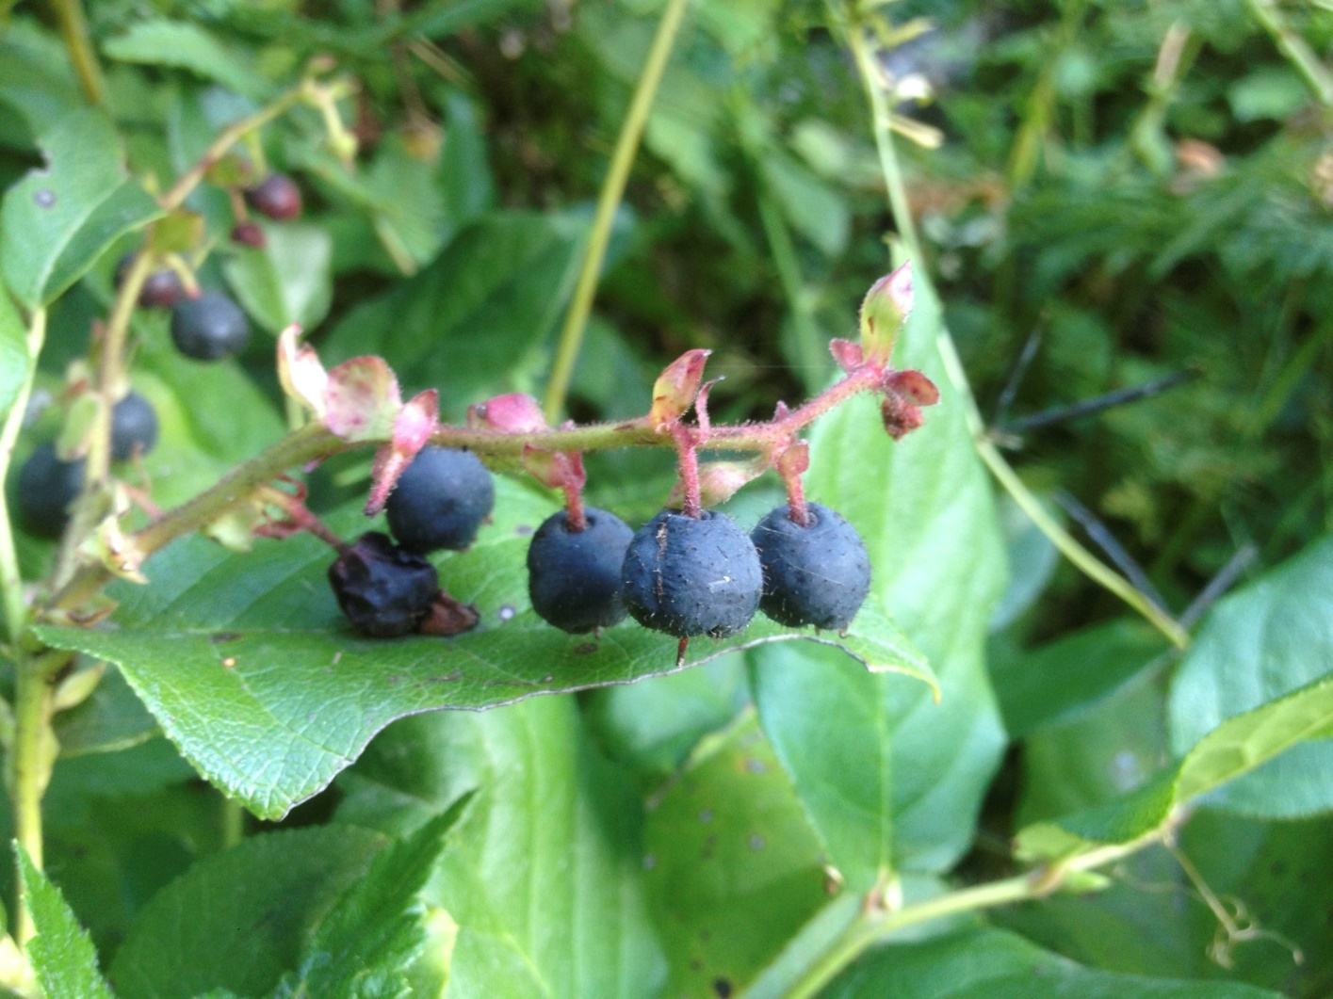
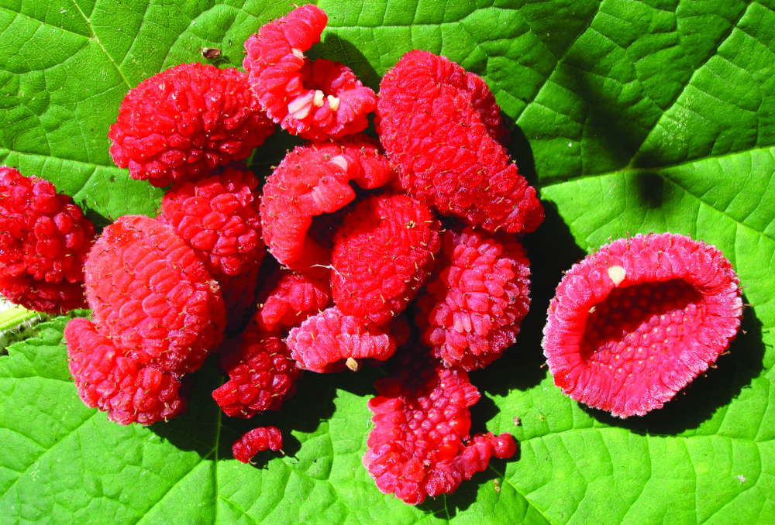

Slide 7
Chapter 2 Nature and Spirituality
Dave Elliot, Saanich
My people never killed a tree unnecessarily. Once in a while the need was so great they would cut a tree. When this had to happen they would speak to the tree. It had a sacred name. Every living thing had a sacred name—streams, lakes, trees, flowers, birds, everything. When your need was great you had no choice. You would stand before the tree and talk to it and tell the tree how sorry you were to take its life. When we took the life of a tree, we used every scrap, every shred right down to the last bit. We used it all. It was wrong to waste something that had been provided for us by this intelligence we didn’t quite understand.

Slide 8
Journal #4
1) What have you learned this week in regards to First Nations Stewardship of the land?
2) What practices do you think we could implement in our daily lives to live more sustainably?

Slide 9
Outline
CNN 10
Fishing Techniques

Slide 10
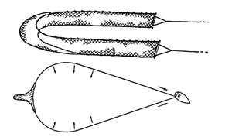
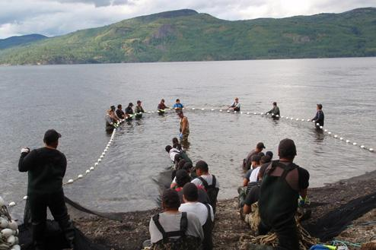
Chapter 2 Fishing Techniques: Beach Seines ☺
Many Skills Required to Catch Fish
Understanding Tides, Winds, Currents, Seasons, Animals.
Some caught out at sea via canoes/nets.
Many caught in the intertidal zone using the following:
Beach Seines & Fish Traps

Slide 11
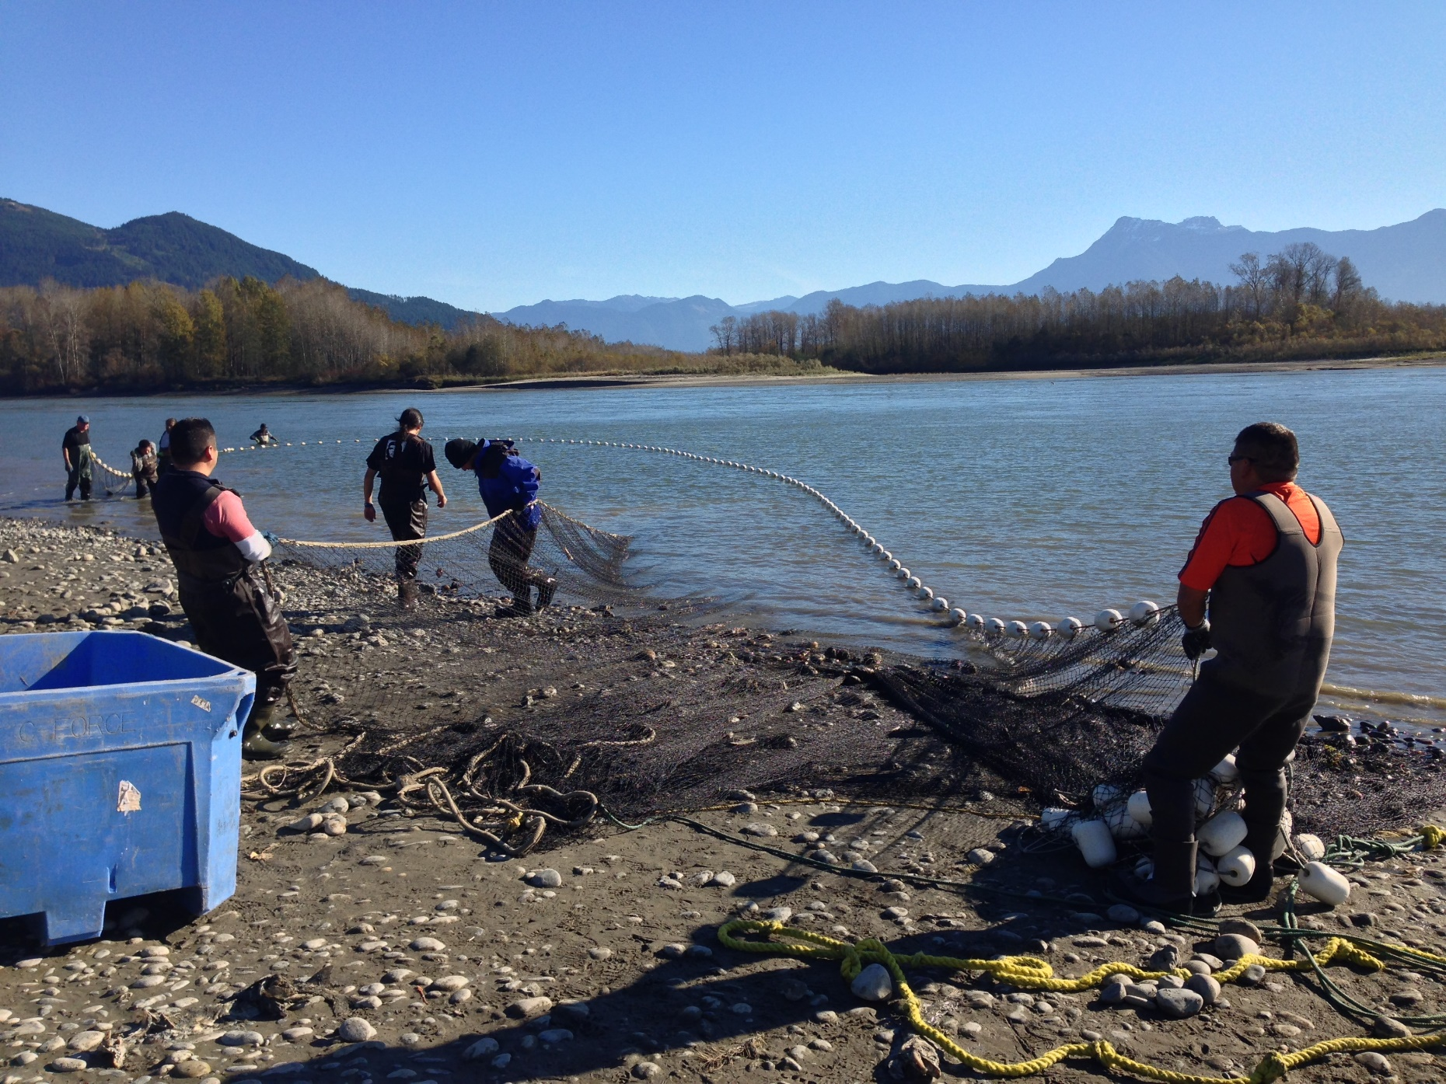

Slide 12
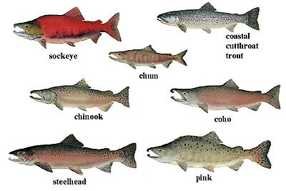

Slide 13
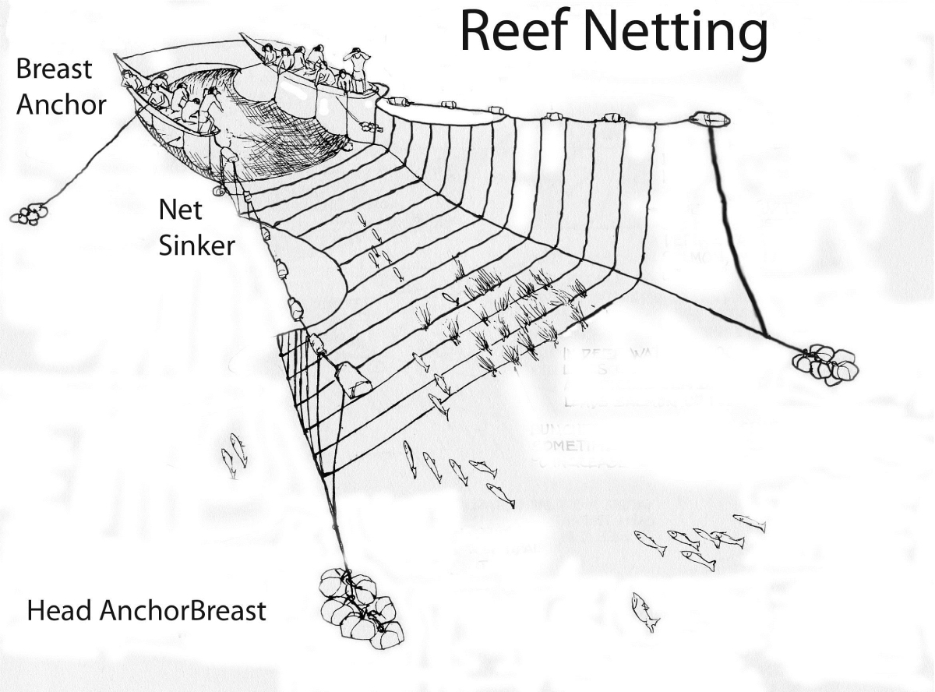
Chapter 2 Fishing Techniques: Beach Seines
Shore
Canoe
Canoe
Kelp Bed

Slide 14
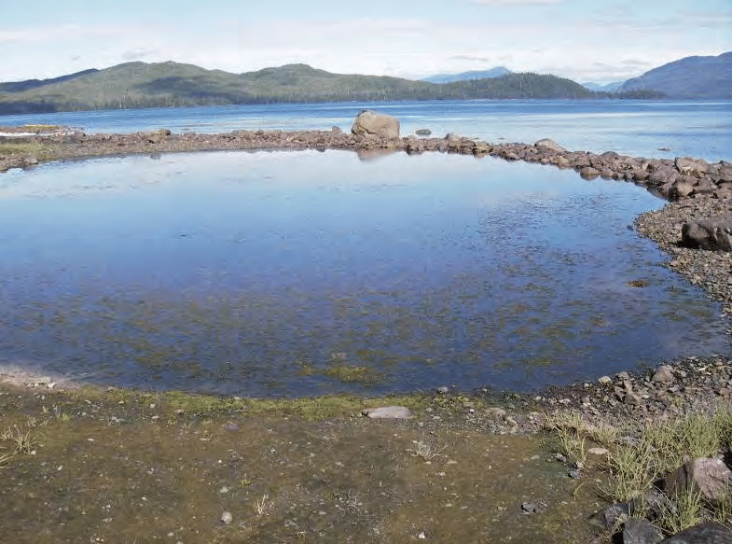
Chapter 2 Fishing Techniques: Stone Traps
At River Mouths, First Nations constructed stone traps

Slide 15
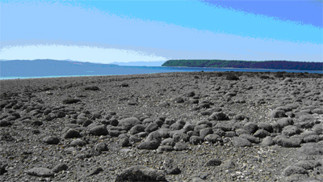
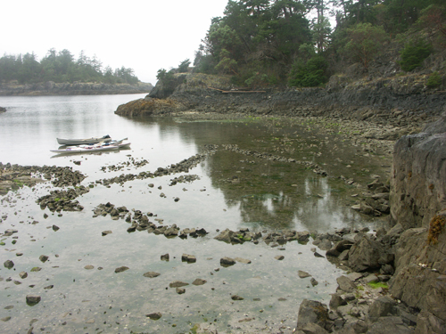
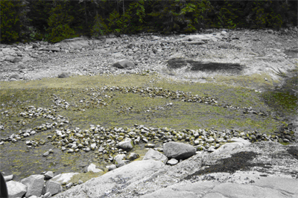

Slide 16
Stone Traps – River Mouth
Capilano River Coho Salmon Stone Traps - Squamish Nation
https://www.youtube.com/watch?v=iuseR1aYsDc
4:46 mins

Slide 17
Chapter 2 Fishing Techniques ☺
As the Salmon progressed up the River, First Nations would use the following techniques:
Fishing Weirs
Basket Traps
Dip Nets
Spears
Gill Nets
Torch Lighting

Slide 18
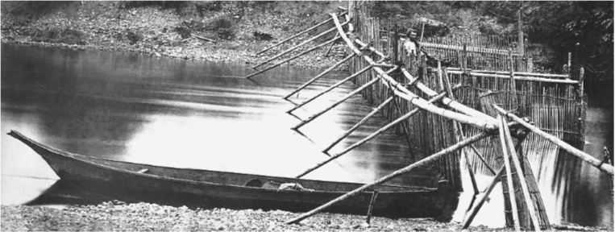
Chapter 2 Fishing Techniques: Fishing Weirs

Slide 19
Tools used for accessing resources
Bernice's Cub at the Nakina River Weir – near Atlin Lake – Tlingit First Nation
https://www.youtube.com/watch?v=Ab8Wnrh-wQM

Slide 20
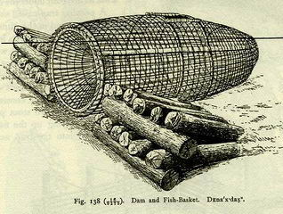
Chapter 2 Fishing Techniques: Basket Traps

Slide 21
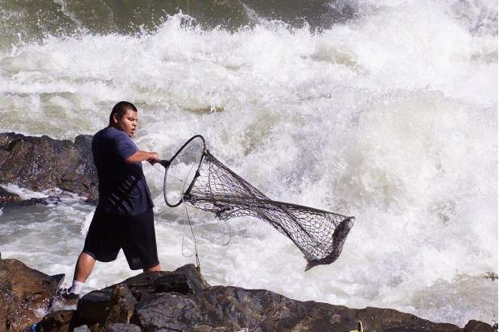
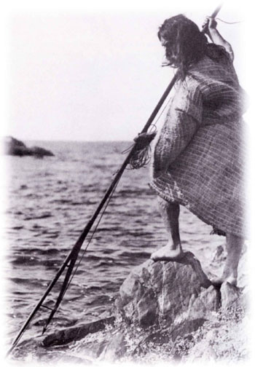
Chapter 2 Fishing Techniques: Dip Nets & Spears

Slide 22
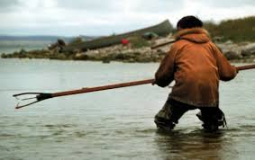

Slide 23
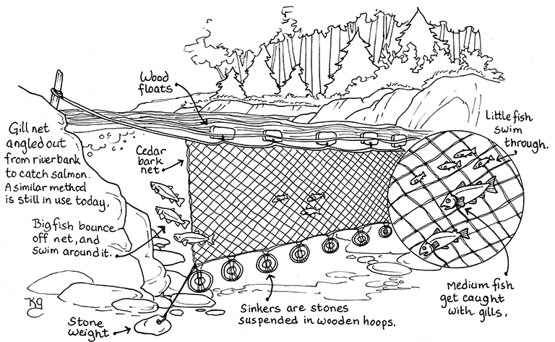
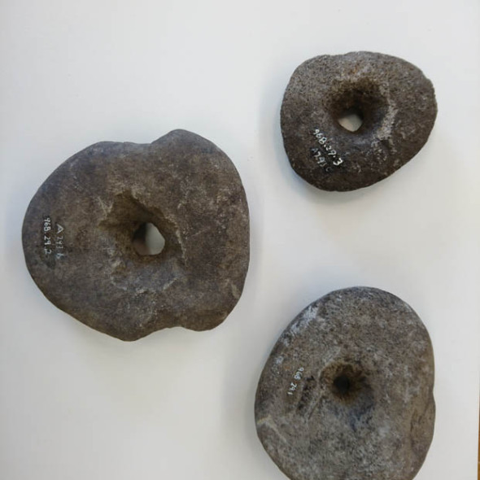
Chapter 2 Fishing Techniques: Gill Nets

Slide 24
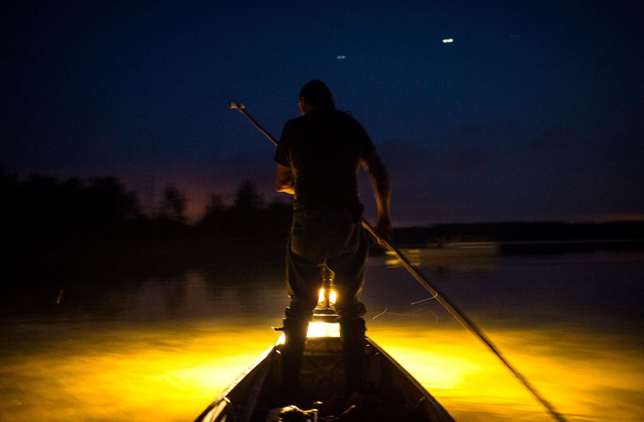
Chapter 2 Fishing Techniques: Torch Lighting

Slide 25
Chapter 2 Hunting ☺
Hunters were prominent in all Regions of B.C., in each First Nation Tribe.
They developed incredible tracking skills, and noise mimicking sounds.
From Bow and Arrow, to Encircling the animal, to Corralling them, and using Deadfalls – First Nations people inhabited great creativity to hunt these animals.

Slide 26
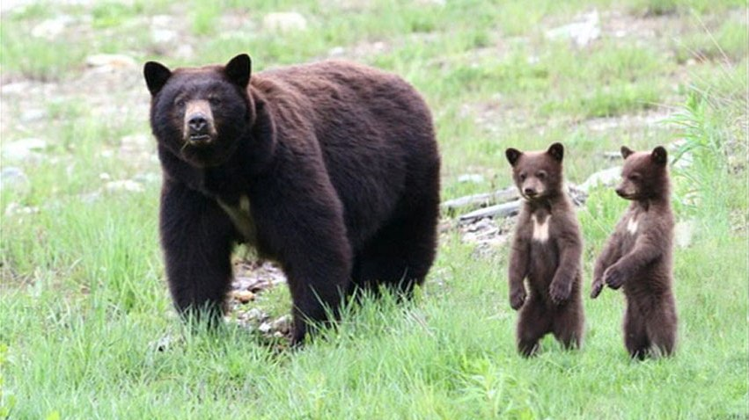

Slide 27
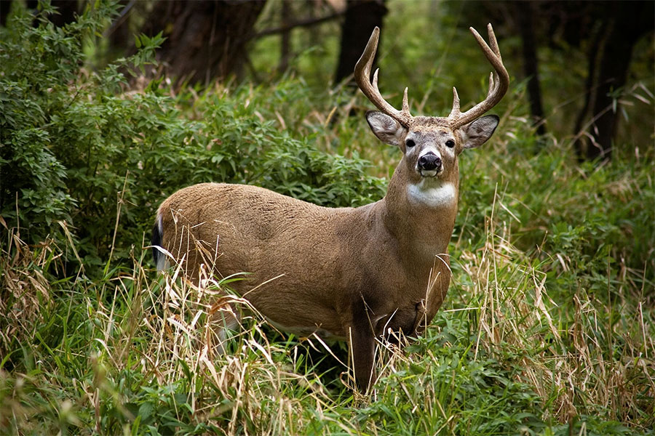

Slide 28
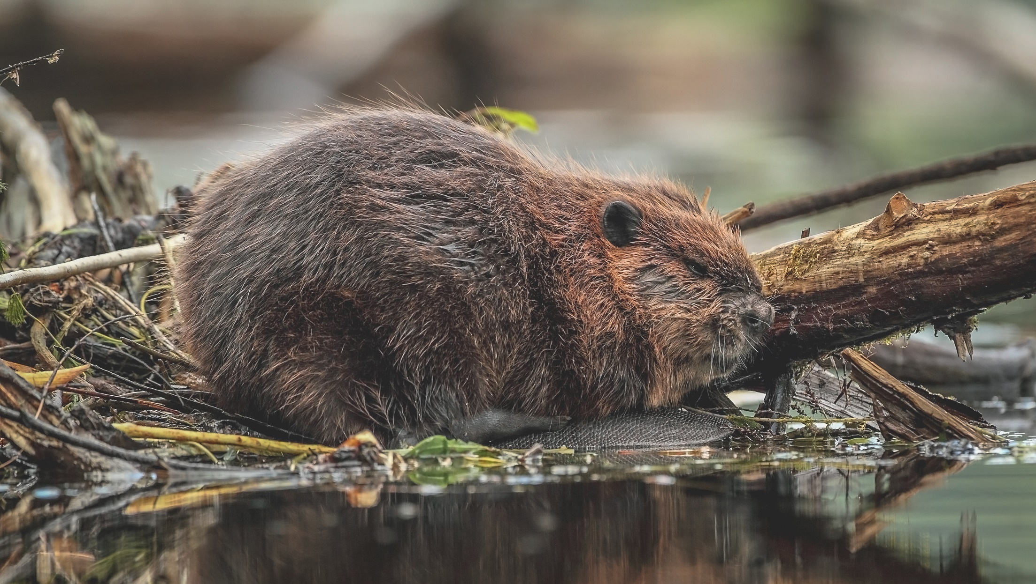

Slide 29
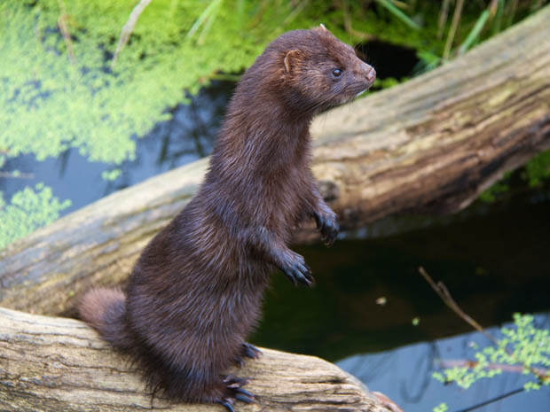
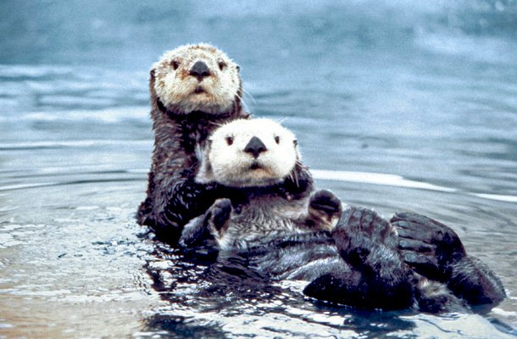

Slide 30
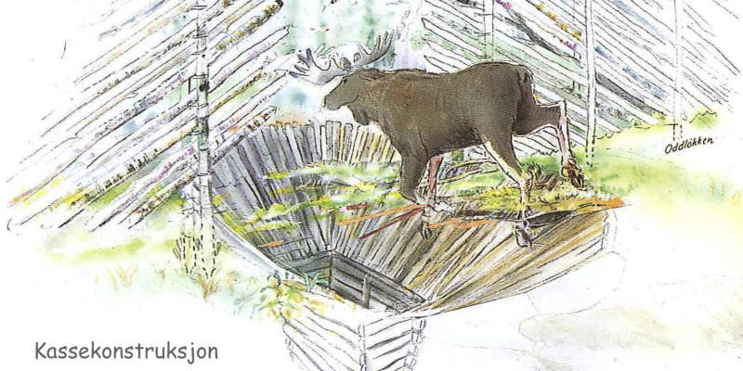
Chapter 2 Pit Fall

Slide 31
Deadfall Traps
Log Deadfall
https://www.youtube.com/watch?v=UdE0PwGPQR4
4:18 mins

Slide 32
Chapter 2 Preservation of Resources ☺
Due to B.C.’s cold climate, many First Nations Tribes were unable to Hunt/Fish during the Winter Months.
This in turn led to the need to preserve the resources they had acquired during the spring, summer and fall.
Cedar was weaved into baskets, hats, masks, or carvings.
Meat and Salmon was often either dried (sun/wind) or smoked
The resources were then put into either Bentwood Boxes (South) and Raised Caches/Underground Pits (North)

Slide 33
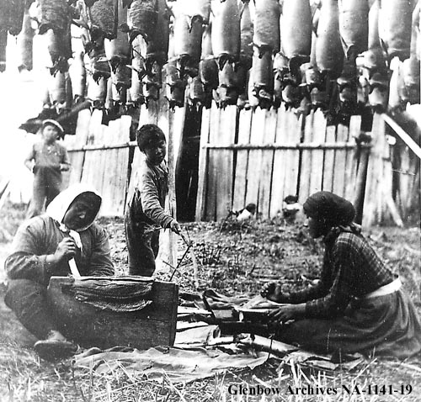
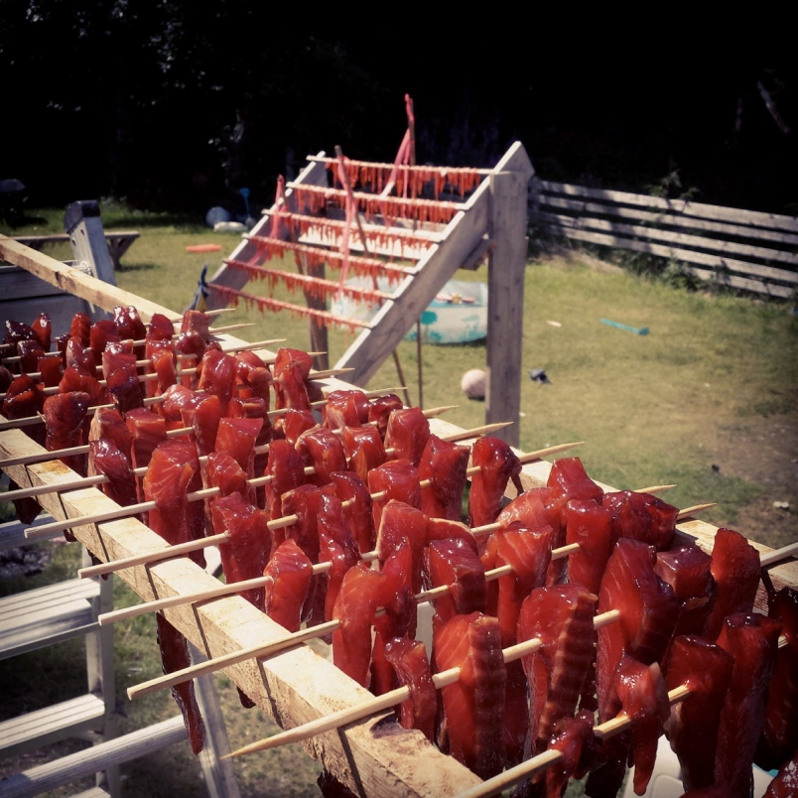

Slide 34
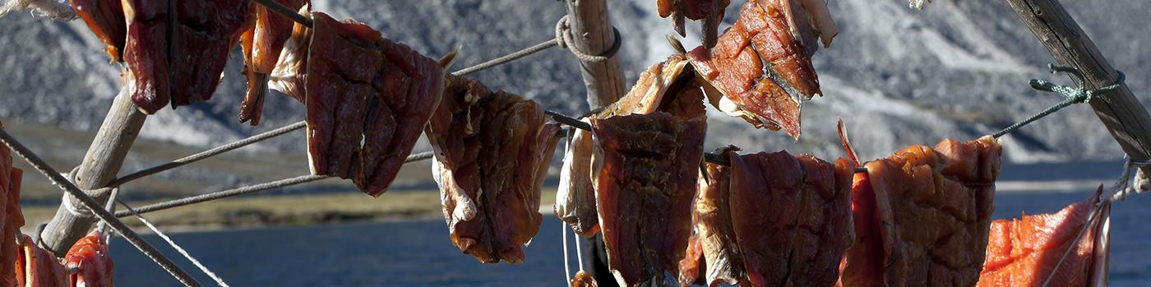

Slide 35
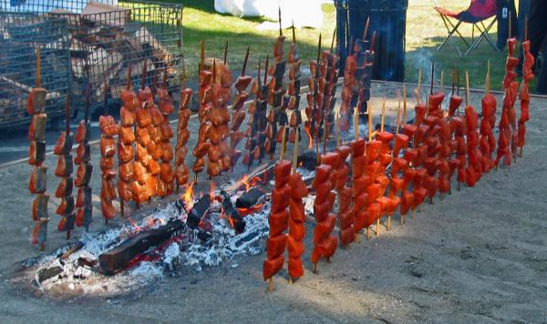
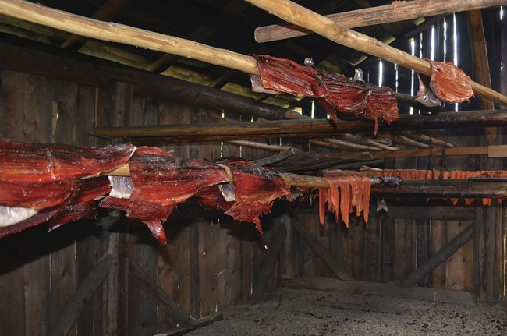

Slide 36
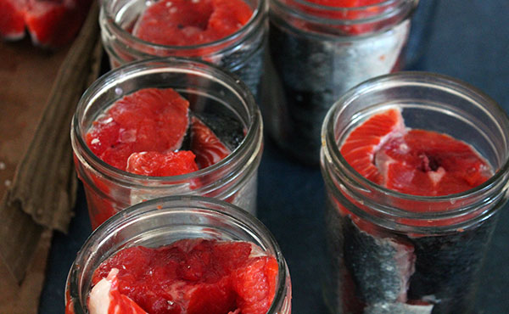
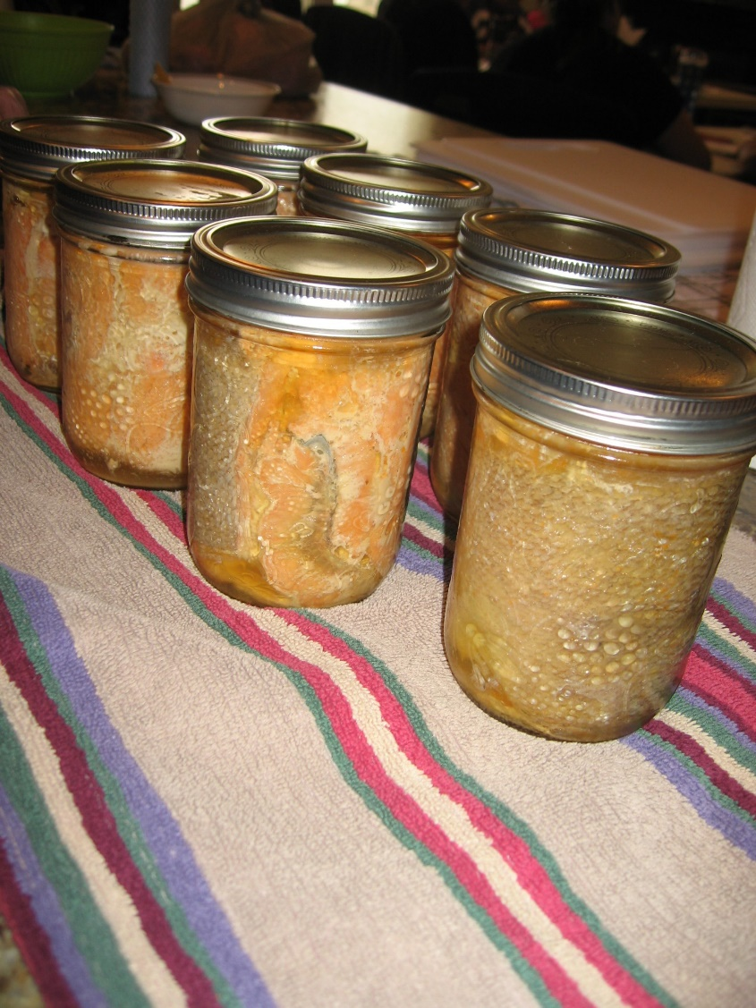

Slide 37
Tools used for accessing resources
What are seafood gardens? How where they created/maintained by Coastal First Nations?

Slide 38
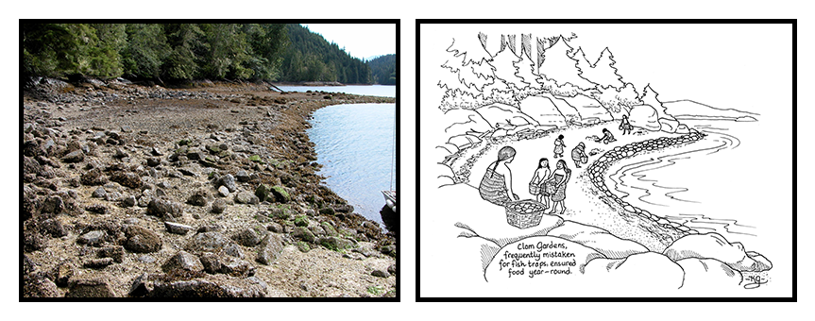

Slide 39
Clam Gardens
Clam Gardens – Learning Together – Gulf Islands National Park Reserve
https://www.youtube.com/watch?v=22Nytmxw2Z8
https://www.youtube.com/watch?v=j2wPVx4sCN0
3:26 mins

Slide 40
B.C. First Nations work to restore ancient seafood farms
When the tide rolls out, First Nations elders and youth scramble down the beach to restore ancient seafood farms that helped feed their ancestors for millennia.
http://www.vancouversun.com/technology/first+nations+work+restore+ancient+seafood+farms/11792123/story.html

Slide 41
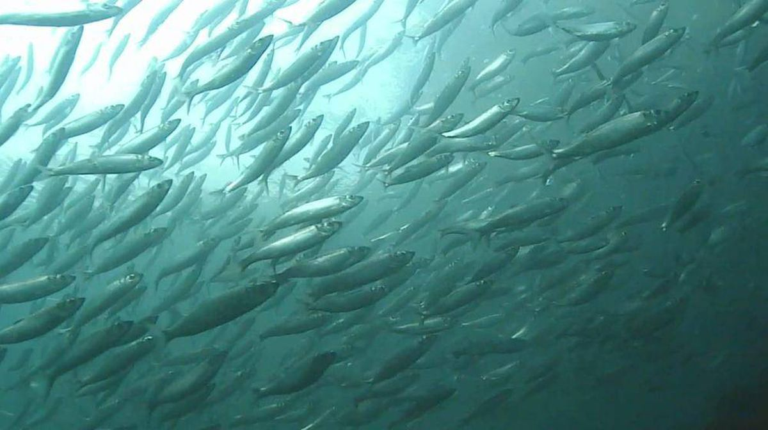
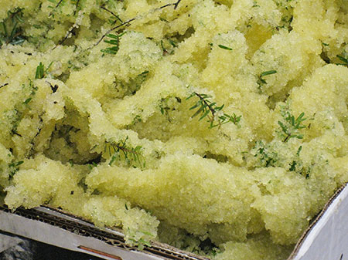
What is herring row?
What is the process of harvesting/farming herring row?

Slide 42
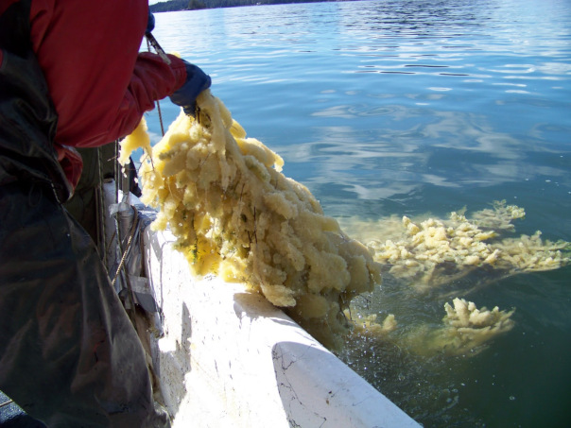

Slide 43
“Traditional Harvest of Spawn on Hemlock Trees” by Mark Wunsch
Pacific Herring
https://vimeo.com/93050927
2:23 mins

Slide 44
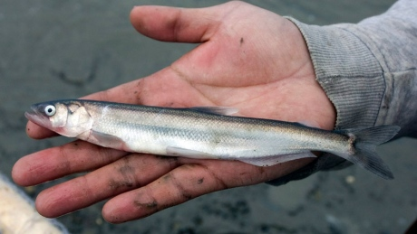
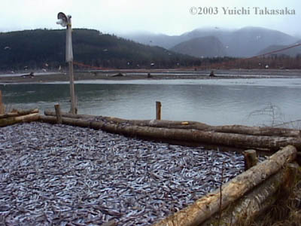
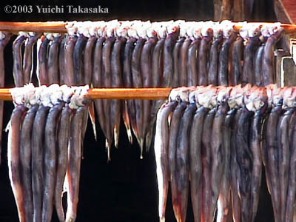
What is oolichan/eulachon/ooligan/hooligan?
What was the oolichan fishery?
How was oolichan used by Coastal First Nations?

Slide 45
Ooligan fishing camp
Ooligan – Haisla First Nation
https://www.youtube.com/watch?v=uq6KZzQHr2Q
4:34 mins

Slide 46
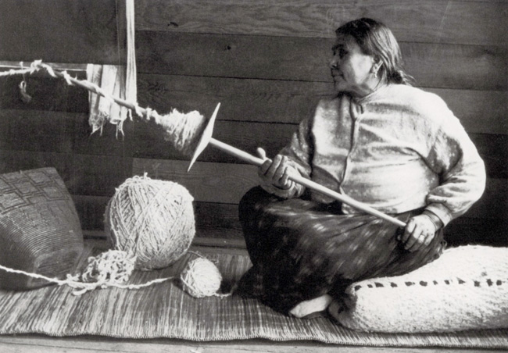
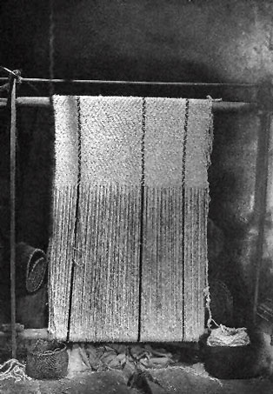
Below left is a Musqueam woman using a spindle whorl Below right is a Coast Salish Loom
Coast Salish Spindle Whorl

Slide 47
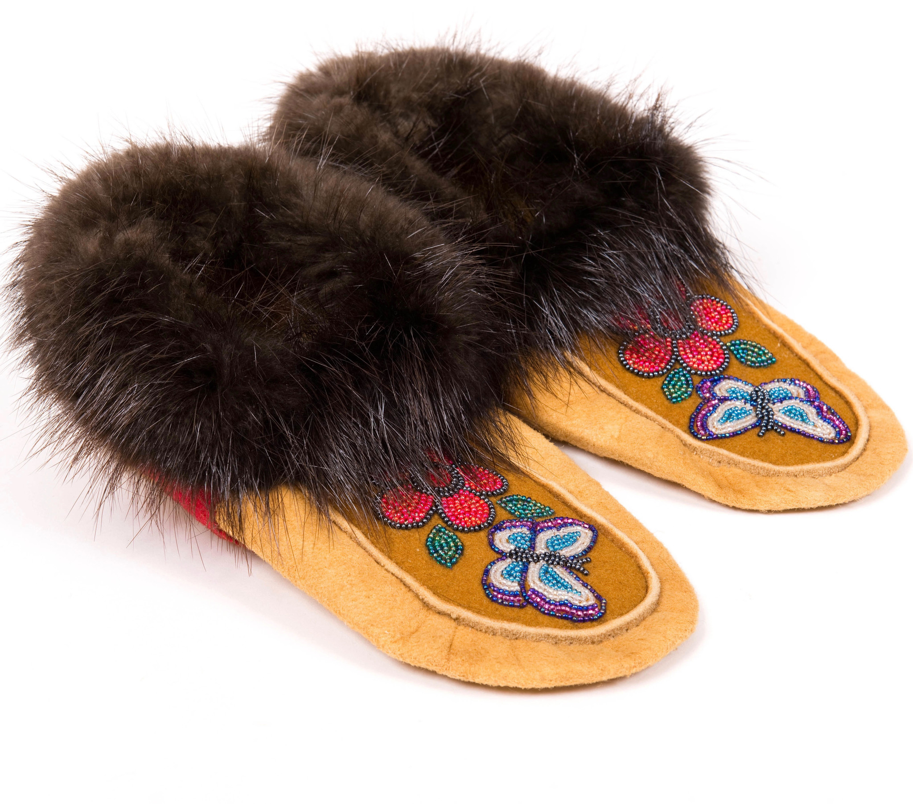
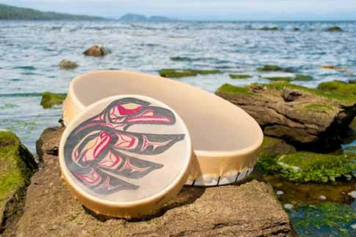
Chapter 2 Hides ☺
Hides were always utilized in First Nations communities for clothing, drums, footwear and cord.
Tanning is a difficult process, requiring skill, knowledge, and patience.

Slide 48
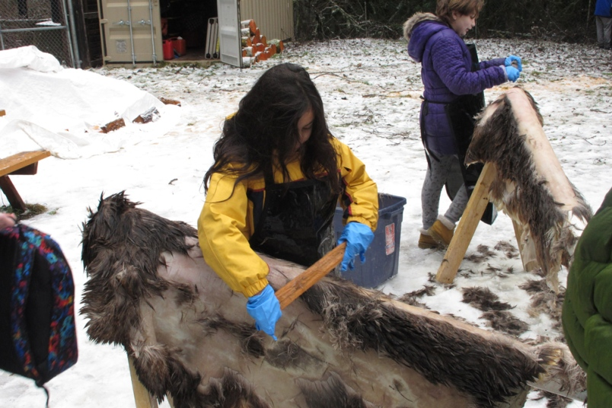
Chapter 2 Hides ☺
“Traditionally, when you make something for the first time you give it away because the gift you received was the knowledge of how to make more.”
Notes:
Squamish BC

Slide 49
Chapter 2 Textiles and Baskets ☺
Plant fibers were woven into clothing, mats, and baskets.
Used to make twine, cord and ropes.
This role was often performed by women in communities.
If a resource was more challenging to come by (ex: Mountain Goat wool) it had more prestige.
On the Coast, they would use the fiber from a stinging nettle plant, twisting it to make it into a net.

Slide 50
Chapter 2 Making Tools and Household Goods ☺
Tool making occurred in the winter months.
Both men and women worked on making them.
All parts of a resource were utilized; nothing went to waste.
Moose
Hide is tanned.
Antlers used for handles/imitate other moose.
Bones fashioned into tools.
Sinew (fat) turned into thread.
Constructed Bentwood boxes.

Slide 51
Importance of Cedar to Coastal First Nations
This video is a product of CWF's July 2014 Summer Institute, which was held in Tofino B.C.
https://www.youtube.com/watch?v=qnQIPjHt2Zs
3:26 mins

Slide 52
Tools used for accessing resources
What type of tool was/is used to chop/carve trees on the coast? What did/does it look like?

Slide 53


Slide 54


Slide 55


Slide 56
The Story of Cedar
Sechelt Arts Fest 2015
https://www.youtube.com/watch?v=WIcT9Jx0T7g
26:00 mins

Slide 57
Tools used for accessing resources
What types of shelters were created on the coast? What resources were they created from?

Slide 58
Chapter 2 Shelters ☺
Different Architectural buildings were created in the Summer then the Winter.
In the summer months, houses has to be light and portable, as FN were constantly moving around.
In the winter months, houses has to be strong and durable to protect from winter storms.
In the Southern Interior created Pit Houses
On the Coast: Created Longhouses.
One Coast Salish house was 450m long.
That’s 0.45km!

Slide 59



Slide 60


Slide 61


Slide 62



Slide 63
Creating a Shelter ☺
Coastal people built longhouses or big houses using large cedar planks.
Distinct styles were used in different areas.
Haida
6 beams that projected from the roofs
Most other types used two roof-beams
Side planks forming the wall were placed vertically in the north and horizontally in Coast Salish territory to be able to add extensions
The longhouse was named and decorated with a crest with the extended family living under one roof.

Slide 64


Coast Architecture
Q: Which one is Coast Salish and Which one is Haida?

Slide 65
Tools used for accessing resources
What modes of transportation were created on the coast? What resources were they created from? How were they used?

Slide 66

Chapter 2 Transportation ☺
Most FN walked in the Interior.
In 1700, the Spanish introduced horses to the region.
FN began creating trails; building bridges (pg 44)
Created snowshoes to travel in the winter.
Notes:
Hagwilget people across the Bulkley River.

Slide 67


Slide 68



Slide 69



Slide 70

Transportation – Grease Trails

Slide 71

Chapter 2 Transportation ☺
Along the coast FN created Canoes, made of cedar.
In the interior, FN created canoes made out of birch, cottonwood, cedar, or pine.
Skin canoes were also used.
A frame of light wood was covered with the skins of caribou or moose, sewn with sinew, and sealed to make it watertight.
Notes:
Hagwilget people across the Bulkley River.

Slide 72
Managing the Resources
“Spirituality, in Aboriginal discourse, is not a system of beliefs that can be defined like a religion; it is a way of life in which people acknowledge that every element of the material world is in some sense infused with spirit, and all human behaviour is affected by, and in turn has an effect in a non-material, spiritual realm.”
- 1996 Report of the Royal Commission on Aboriginal Peoples (pg 45)
What do you understand about this statement? Are there any examples we have read about?
Let’s look at ‘First Nations Voices’ – Dave Elliot page 36

Slide 73
Managing the Resources ☺
Months were named after a seasonal activity or the actual resource gathered
Eg. Salmonberry Month was June
Spiritual ceremonies often celebrated the arrival of resources
Some were quite simple – eg. Showing thanks
Some were quite complex – like the First Salmon ceremony of the St’at’imc people (pg 45)
Why would ceremonies like the example have been so complex?

Slide 74
Managing the Resources ☺
The ways resources were administered varied from place to place
Bands were permitted to share territories but generally the territory was held by a particular band and permission was asked
Hereditary Chiefs were responsible for the safety of their groups
But they required support from resource-use units (look back at the Kwakwaka-wakw case study in chapter 1)
Decisions made by consensus through a council or elders and chiefs
All members contributed to the common good of the group
What is the strength of this type of system?

Slide 75

Chapter 2 Case Study The Dunne-za: Hunters and Dreamers
Please come grab a copy of the Ch. 2 Questions

