Slide 1

Silent Reading

Slide 2
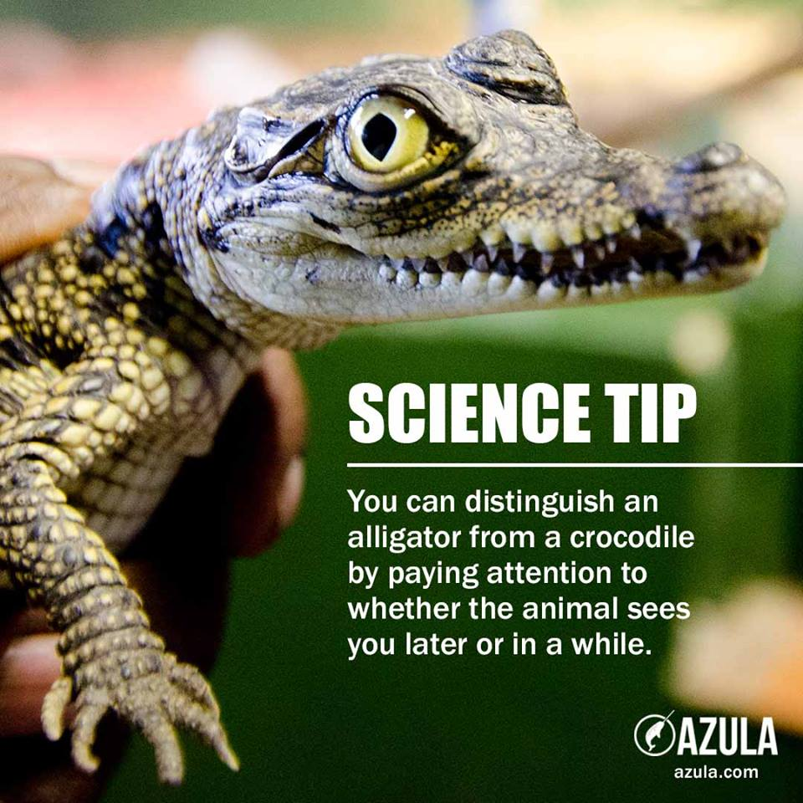
Silent Reading for 8 Minutes

Slide 3
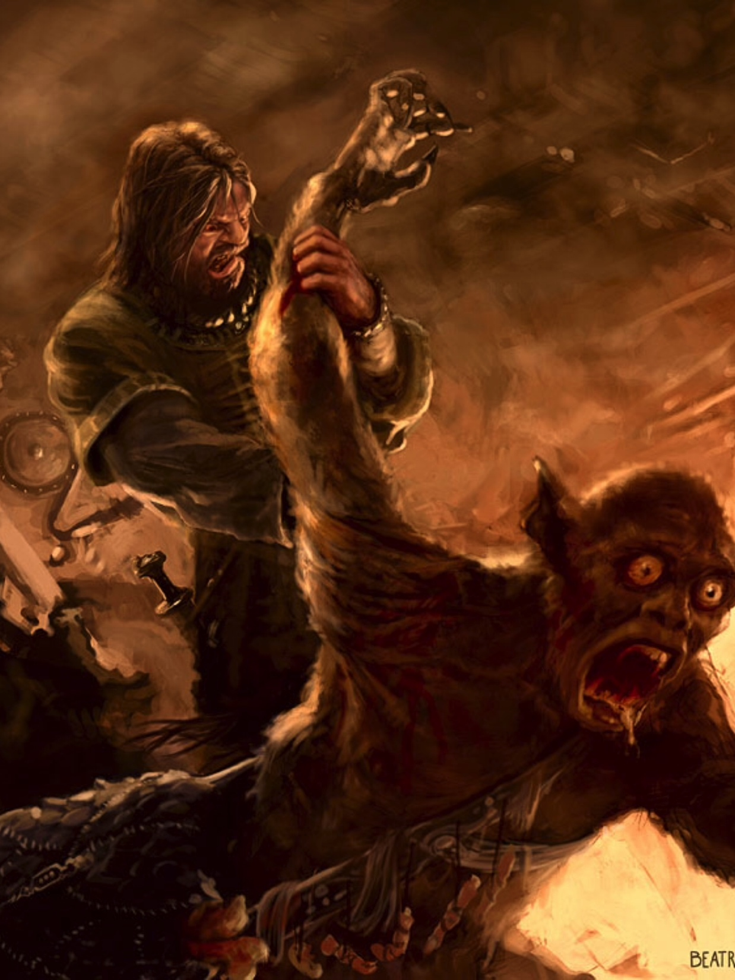
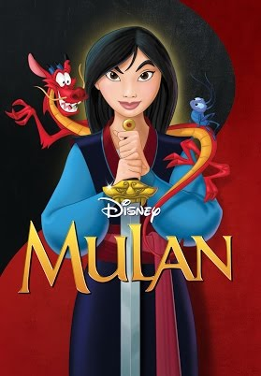
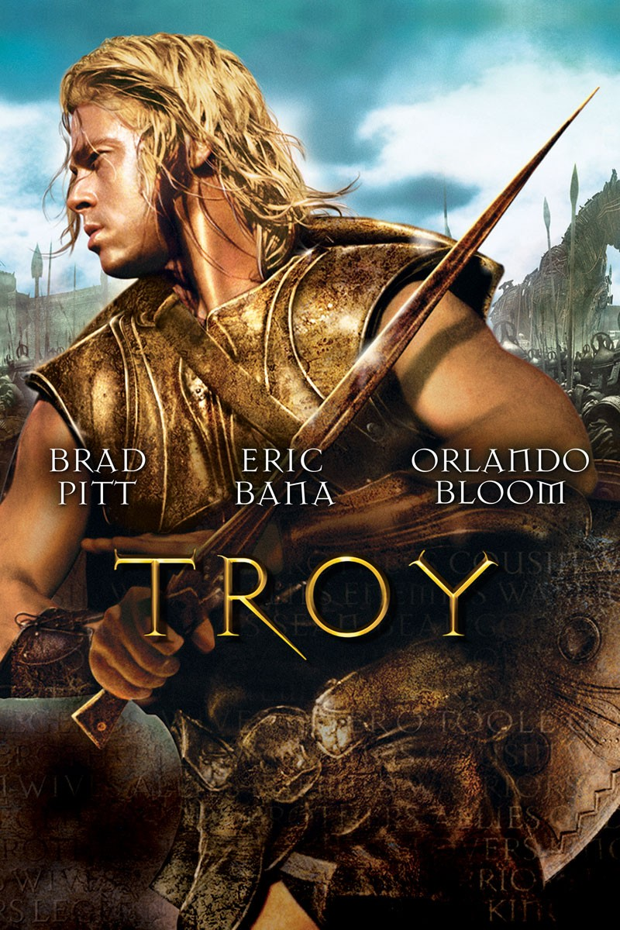
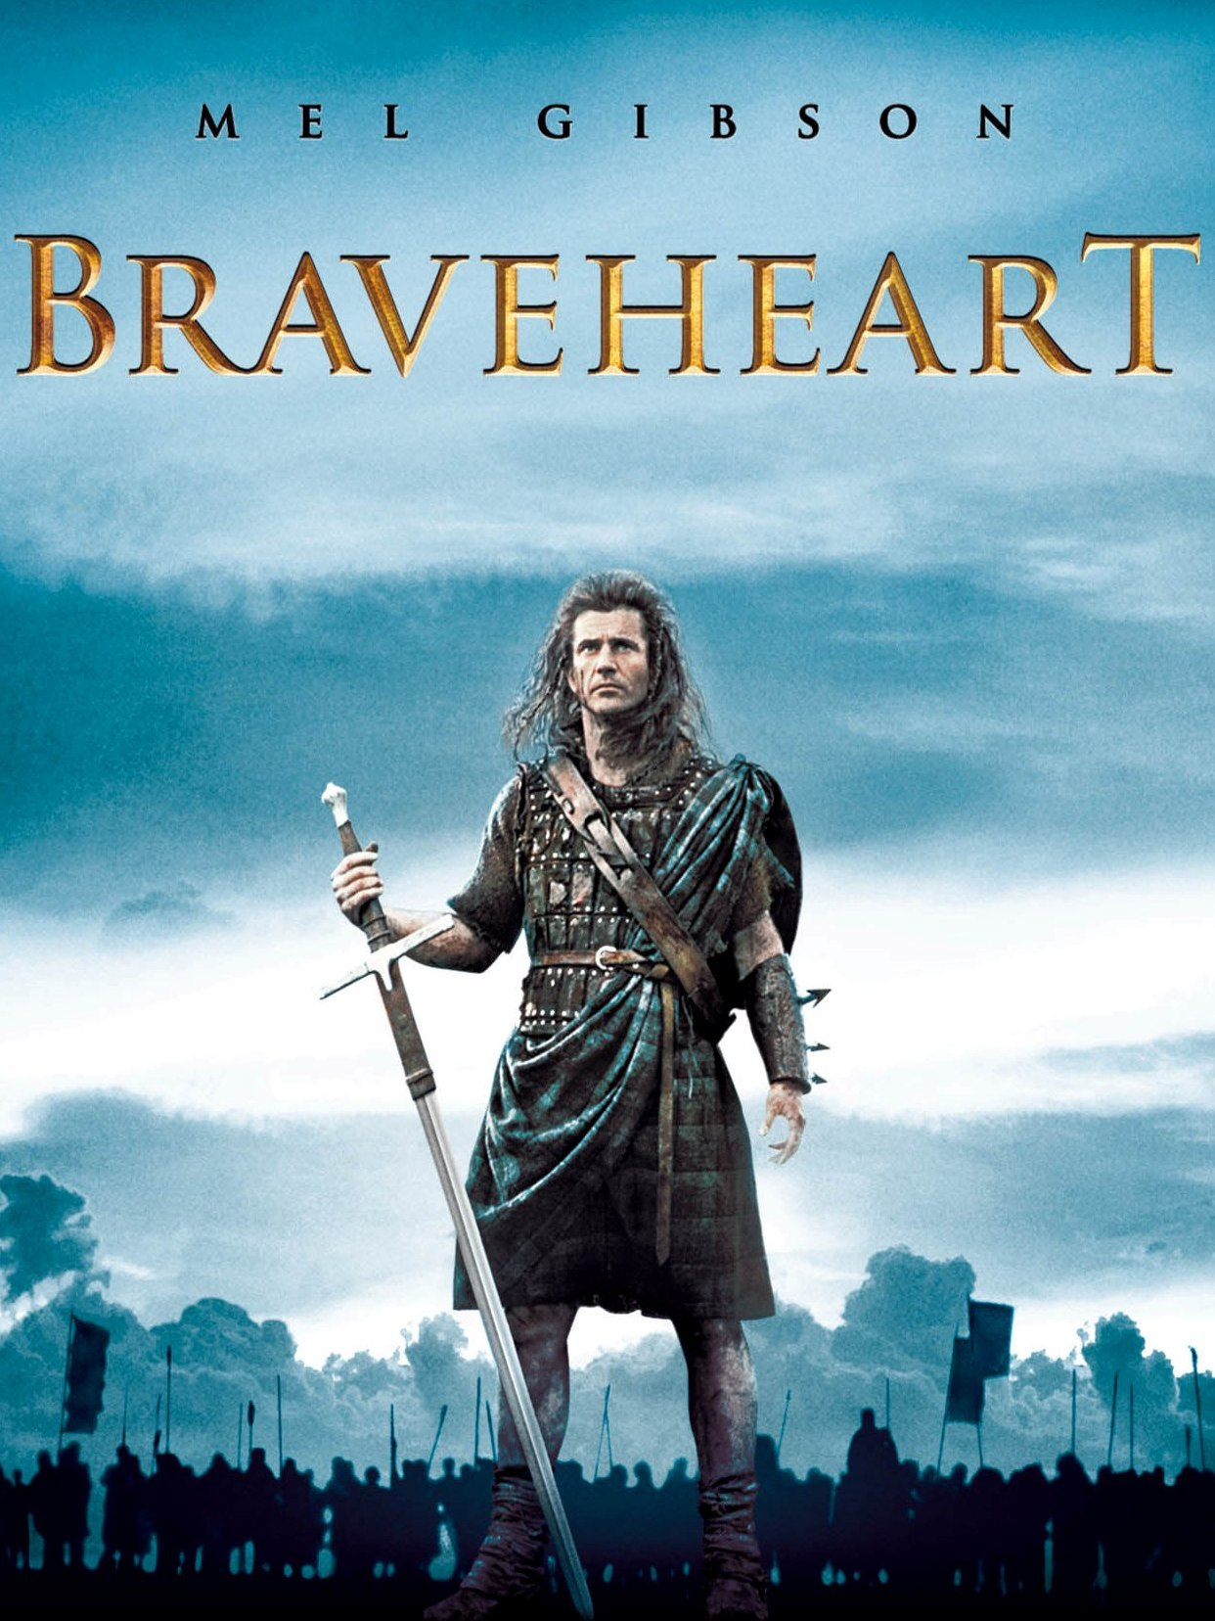

Slide 4


Slide 5
Poetry
For the purposes of this activity, I swear off the words “rhyme scheme,” “iambic pentameter,” “onomatopoeia,” and all their hellish corollaries.
If I am caught attempting to “analyze” a poem, I will stand on my desk and squawk like a Cornish game hen.
I may talk about a poem.
I may say nothing about a poem.
I may vomit after I read a poem, but not on Mr. Koe or any of his belongings.
I may read a poem aloud.
I may read a poem silently.
If I don’t like a poem, I may stop reading at any time.
I will do my best to ‘ENDURE’ this activity.

Slide 6
POETRY GALLERY WALK
First, you will walk around and familiarize yourself with the poems.
While reading, music will be playing. It should be silent, as though you are walking around an art museum.
Second, you will be given the “Poetry Gallery Walk” handout. Please use this as you walk around.
ENJOY this experience. ☺

Slide 7
Poem
On the back of your page you just did. I would like you to create a short-poem.
You can pick the subject or Theme of the Poem, but it must be at least 4 lines long and rhyme.
ABBA, AABB, AAAB, BAAA.

Slide 8
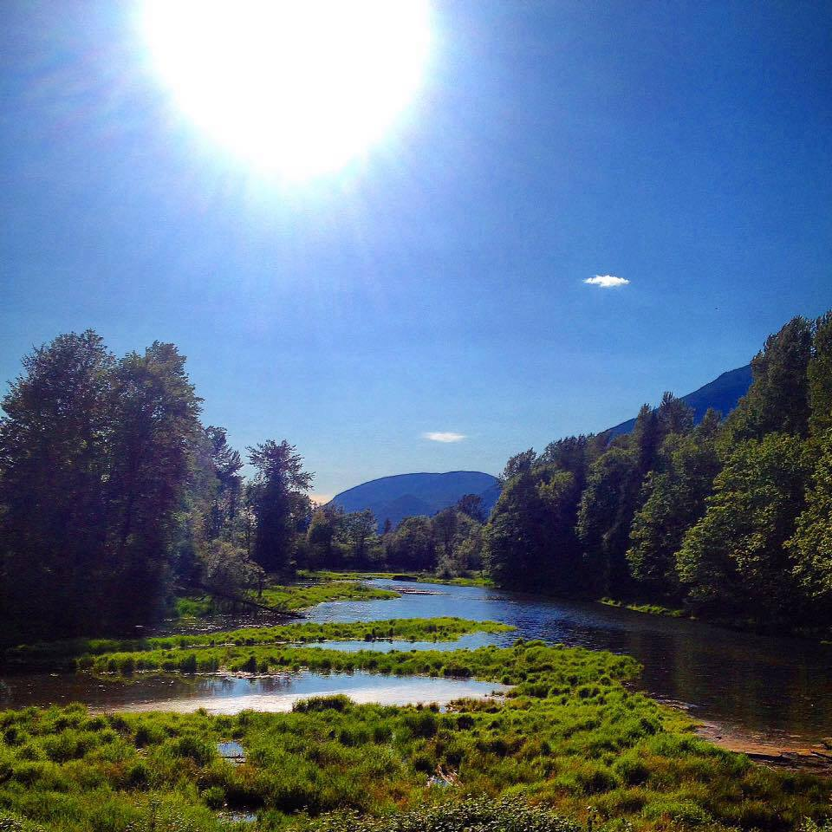
Silent Reading

Slide 9



Slide 10
Poetic Devices
Match all the definitions to their words.
You can either Google the terms/devices to find a definiton.
Some can be found in the ‘Inside Poetry Book’ near the Back under ‘Poetic Terms’
. I want you to find an example for it, in the ‘Inside Poetry book.
Write out the page number, the title of the poem, and the device you found in it.
You can do this with a partner – max 2 people in a group.

Slide 11
Alliteration
The repetition of consonant sounds at the beginnings of words.

Slide 12

“While I
nodded,
Nearly
napping,
suddenly
there came a tapping…”
Poe’s “The Raven”
Alliteration

Slide 13
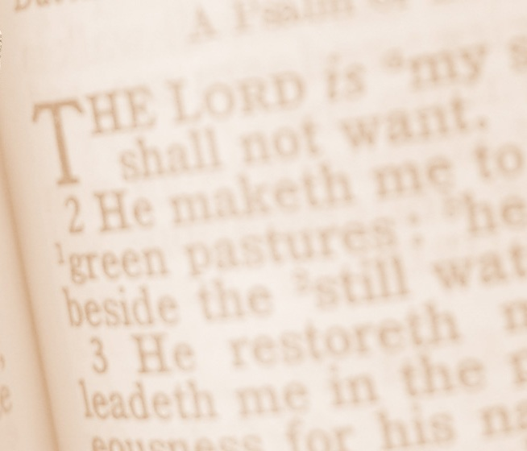


A reference to literature or historical figure, place, or event.

Slide 14
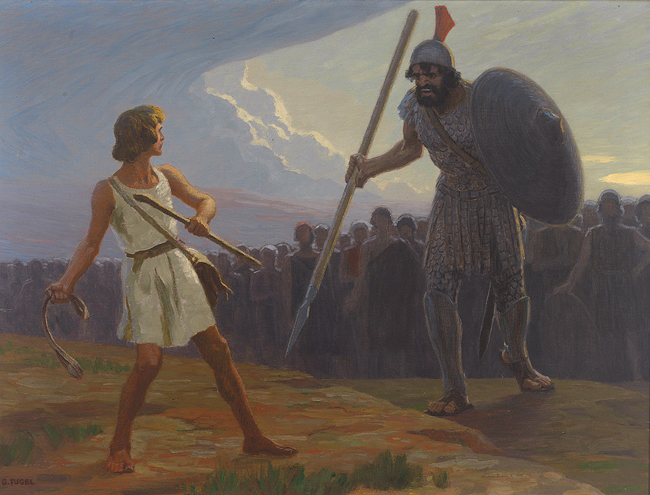
The teams competed in a David and Goliath struggle.
--Reference to Bible

Slide 15
Assonance
The repetition of similar vowel sounds followed by different consonant.

Slide 16

Assonance
“Hey soul sister, ain't that mister mister on the radio, stereo The way you move ain't fair you know Hey soul sister, I don't wanna miss a single thing you do
-Train
tonight.”

Slide 17
Ballad
A story/narrative in poetic form.
A form or verse often set to MUSIC

Slide 18

William Wordsworth

Slide 19
Consonance
The repetition of consonant sounds that are preceded by different vowel sounds.

Slide 20
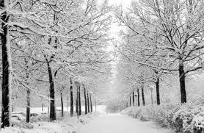

Consonance
’T was sooner when the cricket went Than when the winter came, Yet that pathetic pendulum Keeps esoteric time."
- Emily Dickinson

Slide 21
Diction
The Author’s specific word choice
Shaped his muscles
Becomes
Forged his muscles

Slide 22
Diction
“It was the best of times, it was the worst of times, it was the age of wisdom, it was the age of foolishness, it was the epoch of belief, it was the epoch of incredulity, it was the season of Light, it was the season of Darkness, it was the spring of hope, it was the winter of despair.”
By using, “It was…” people get a better understanding of the “age”

Slide 23
Enjambment
When a line ends without a pause or any punctuation, and continues unto the next line.

Slide 24
Enjambment
Miss Susie had a stemboat,
The steamboat had a bell.
Miss Susie went to heaven
And the steamboat went to Hell-
O, operator,
Please give me number nine
And if you disconnect me
I’ll kick your be-
‘hind the ‘frigerator…

Slide 25
Free Verse
Poetry that does not rhyme, no measureable meter…

Slide 26
Peace and Quiet by Nadya Phillips
Peace is …
When you are outside on a nice warm day.
With a cold glass of yellow lemonade.
Slurp, Slurp, Slurp.
Feeling the warm sun on my back,
Rubbing my hands through the wet green grass,
Listening to the birds singing a distance away
Quiet…
Now that’s PEACE!
Free Verse

Slide 27



A comparison (implied or direct) between two basically different things. Is not introduced with the words “like” or “as”.

Slide 28
Direct
Implied
Art is not a mirror to reflect the world, but a hammer with which to shape it.
--Vladimir Mayakovsky
"Art washes away from the soul the dust of everyday life." — Pablo Picasso
Art is compared to cleansing solution.

Slide 29
Meter
The measured arrangement of sounds/beats in a poem, including the poet’s placement of emphasis and the number of syllables per line.

Slide 30
Meter
You may write me down in history,
With your bitter, twisted lies,
You may trod me in the very dirt
But still, like dust, I’ll rise.
Syllable Meter = 9,7,9,7

Slide 31
Onomatopoeia
The use of words whose sounds suggest the sounds made by objects or activities.

Slide 32
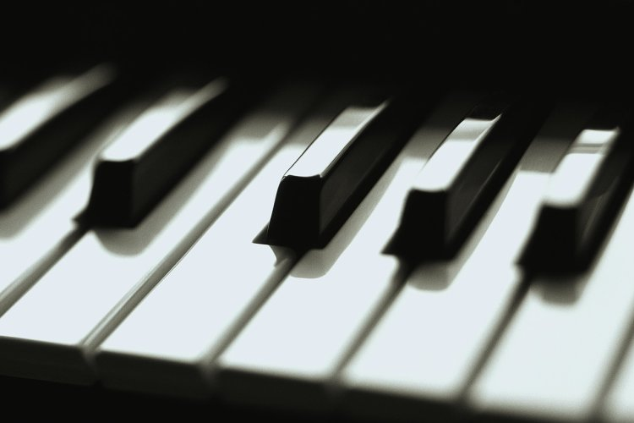
Onomatopoeia
Thump, thump, thump, went his foot on the floor.
He played a few chords then he sang some more—
--Langston Hughes
From “The Weary Blues”

Slide 33
Rhythm
The recurrence of stressed and unstressed sounds in poetry. Depending on how sounds are arranged, the _____ of a poem may be fast or slow, choppy or smooth.

Slide 34
Iambic
Two syllabels, the first of which is unstressed, the second is stressed.
ComPUTE, disPEL, aGREE

Slide 35
Trochee
Two syllabels, the first of which is stressed, the second is unstressed.
DOU-ble, DOU-ble, TOIL and TROU-BLE; FI-re BURN and CAL-dron, BUB-ble

Slide 36
Rhythm

Slide 37

A direct comparison between two basically different things, introduced by the words “like” or “as”.

Slide 38

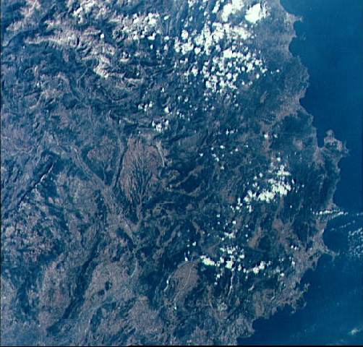
“The late afternoon sky bloomed in the window for a moment like the blue honey of the Mediterranean .”
--from The Great Gatsby
F. Scott Fitzgerald
Fitzgerald compares the color of the late
afternoon sky to the color of the Mediterranean sea.

Slide 39
Stanza
A unified group of lines in poetry. This is often marked by spacing between sections of the poem.

Slide 40
Stanza
Couplet: aa, bb,
Tercet: aaa, aba
Quatrain: aaaa, aabb, abab

Slide 41
Acquainted with the Night by Robert Frost
‘I have been one acquainted with the night.
I have walked out in rain – and back in rain.
I have outwalked the futhest city light.
I have looked down the saddest city lane.
I have passed by the watchman on his beat.
And dropped my eyes, unwilling to explain.

Slide 42
SYMBOL/SYMBOLISM
Something concrete, such as an object, action, character, or scene that stands for something abstract such as a concept or an idea.

Slide 43
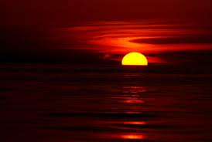
SYMBOL/SYMBOLISM
“Do not go gentle into that good night
Rage, Rage against the dying of the light”
--Dylan Thomas
Both phrases are symbols that stand for death.

Slide 44
Theme
The main idea or underlying meaning of a literary work.

Slide 45

Theme
“Don’t judge a man until you’ve walked a mile in his shoes.”
--Atticus, To Kill a Mockingbird

Slide 46
TONE
This is the attitude a writer has towards a subject or audience.
Formal, informal, serious, comic, sarcastic, sad, etc.

Slide 47
TONE
‘All the trees all died. They were orange trees. I don’t know why they died, they just died. Something wrong with the soil possibly or maybe the stuff we got from the nursery wasn’t the best. We complained about it…’
The School by Donald Barthelme

Slide 48
VERSE
‘A single line of poetry’
Two types:
Free Verse
- No meter, no end rhymes.
Blank Verse (always Iambic Pentameter)
- Metrical, but unrhymed.

Slide 49
VERSE
‘A single line of poetry’
‘I wandered lonely as a cloud,
That floats on a high o’er vales and hills,
3. When all at once I saw a crowd,
4. A host, of golden daffodils;
By Williams Wordsworth

Slide 50

Are Song Lyrics a Form of Poetry?

Slide 51
Annotate
When we annotate
Highlight words you don’t understand
Questions you have about the text
Write out the Rhyme Scheme (AA, AB, ABA, etc…)
Count Syllables in a line.
Circle words that are impactful
Look at what your friends are questioning or writing and discuss it.

Slide 52
Classwork
Answer questions 1-8 on a separate piece of a paper.
You will need to refer to your terms guide for assistance.
If you have any questions or need a hand please come see me.

Slide 53
Other Terms

Slide 54

A broad comparison between two basically different things that have some points in common.

Slide 55
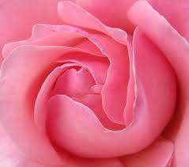

“What's in a name? that which we call a rose By any other name would smell as sweet; So Romeo would, were he not Romeo call'd, Retain that dear perfection which he owes Without that title.”
-Shakespeare
\
Shakespeare’s Romeo and Juliet
--spoken by Juliet to explain that a person’s name is not indicative of his/her character.
Notes:
This phrase was uttered by Juliet. She uses this phrase as an analogy to Romeo's surname, that is "Montague". And this very name happens to be the name of her family enemy. However, this does not tarnish the noble qualities which Romeo has in him. So by making the statement, Juliet tried to project the fact that even if a rose is called a cactus, it would still smell sweet.

Slide 56

A great exaggeration to emphasize strong feeling.

Slide 57
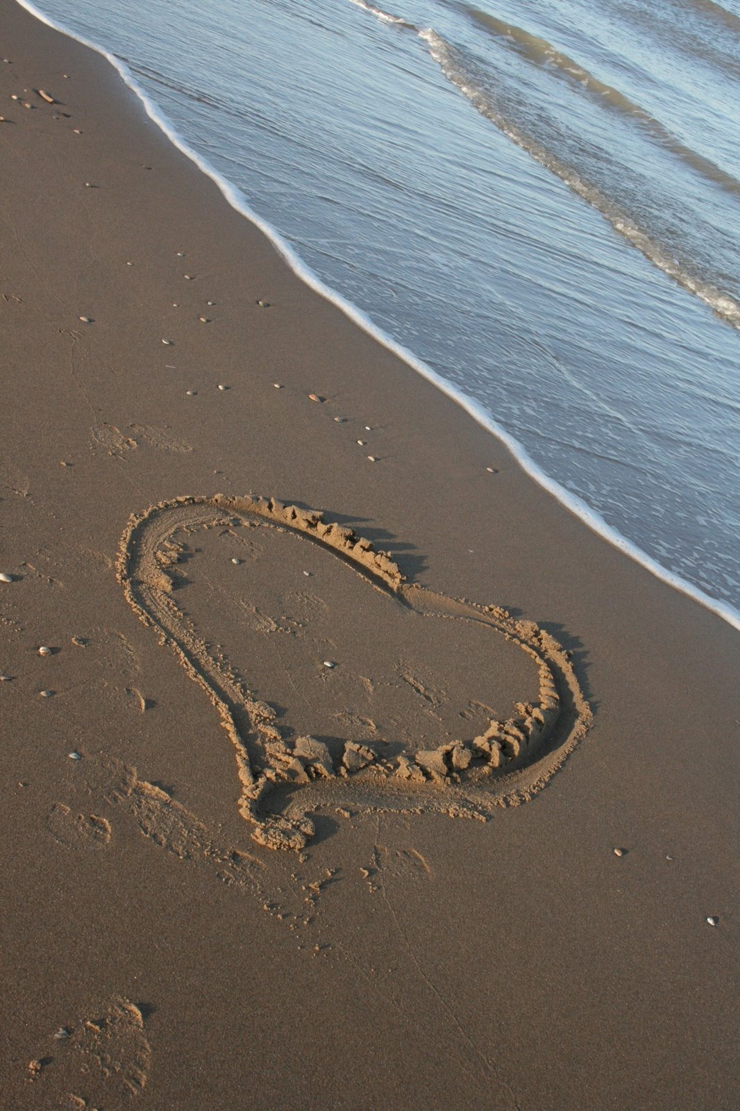
“And I will love you still, my Dear, ‘Til all the seas go dry.”--Robert Burns

Slide 58

Human characteristics are given to non-human animals, objects, or ideas.

Slide 59
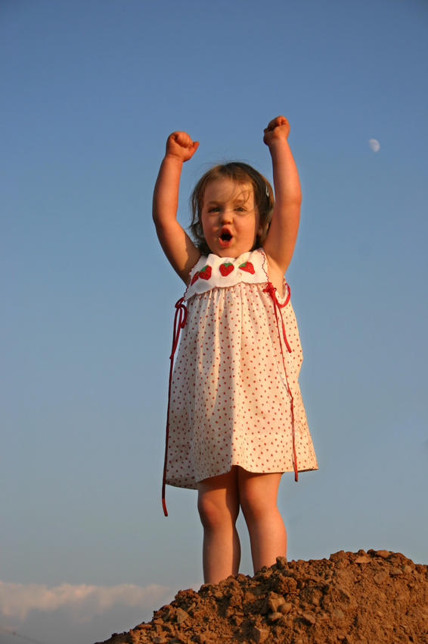
“The light lingered about the lonely child, as if glad of such a playmate…”
from The Scarlet Letter
Nathaniel Hawthorne

Slide 60

An absent person or inanimate object is directly spoken to as though they were present.

Slide 61
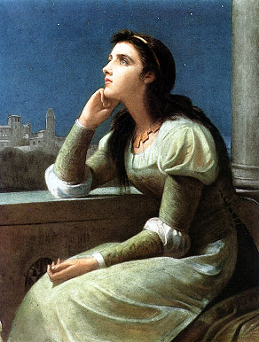
Juliet:
“Oh, Romeo, Romeo,
Wherefore art thou, Romeo?”
--William Shakespeare

Slide 62
More
From Kiss
“Beth”
“Beth, I hear you callin' But I can't come home right now Me and the boys are playin' And we just can't find the sound
Just a few more hours And I'll be right home to you I think I hear them callin' Oh, Beth what can I do? Beth what can I do?”

Slide 63

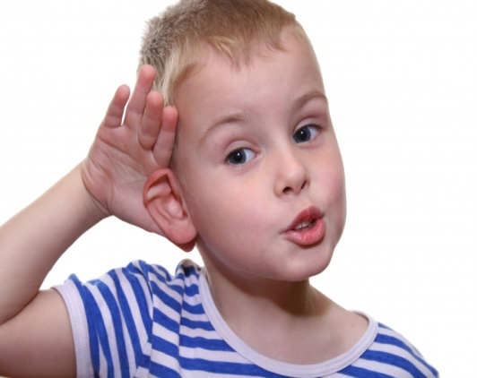
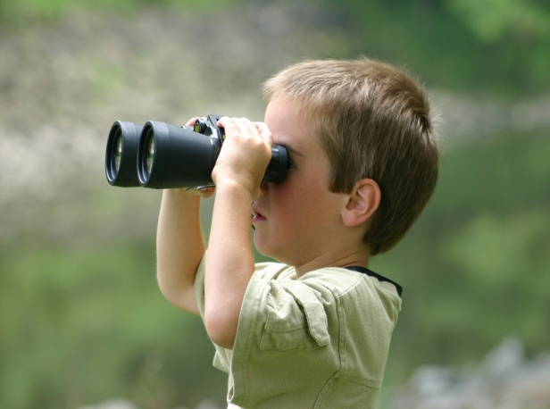
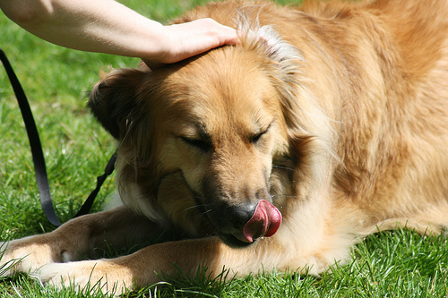
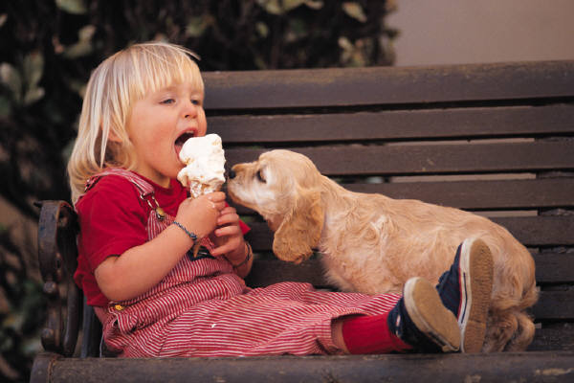
Smell
Imagery
Hearing
The use of concrete details that appeal to the five senses.
Touch
Taste
Sight

Slide 64

Imagery
“The Pond”
Cold, wet leaves floating on moss-colored water.
And the croaking of frogs—
Cracked bell-notes in the twilight.
--Amy Lowell

Slide 65
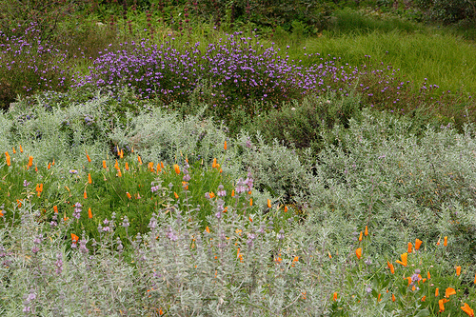

A seemingly self-contradictory statement that still is true.

Slide 66
“‘Men work together,’ I told him from the heart, ‘Whether they work together or apart.’”
– from “The Tuft of Flowers” by Robert Frost

Slide 67
Repetition
The repeating of a sound, word, or phrase in a given literary work.

Slide 68
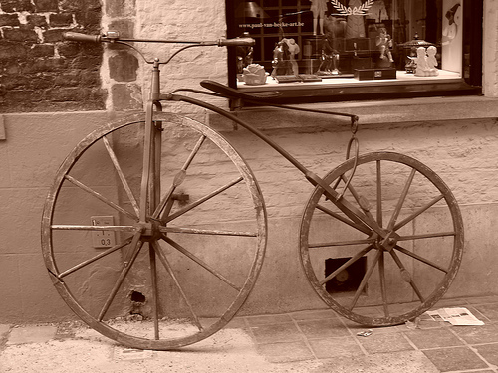
Repetition
--from “Bicycle Race”
by Queen
I want to ride my bicycle
I want to ride my bike
I want to ride my bicycle
I want to ride it where I like.

Slide 69
End Rhyme
The repetition of identical sounds at the ends of lines of poetry.

Slide 70
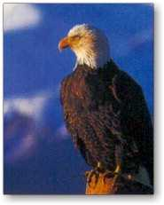
End Rhyme
“He clasps the crag with crooked hands
Close to the sun in lonely lands”
from “The Eagle”
Alfred Lord Tennyson

Slide 71
INTERNAL RHYME
The repetition of identical sounds within a line of poetry.

Slide 72
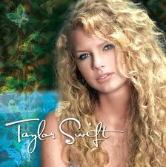
INTERNAL RHYME
I’ll be strong, I’ll be wrong, oh but life goes on
“I’m alone, on my own, and that’s all I know
I’m just a girl, trying to find a place in This world.”
--Taylor Swift

Slide 73
Mood
The overall atmosphere or prevailing emotional feeling of a work.

Slide 74
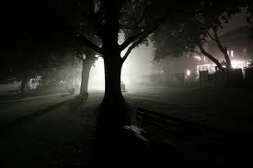
Mood
Setting and diction often help define the mood.
Once upon a midnight dreary, while I pondered weak and weary…

Slide 75
IRONY
A contrast between what is said and what is meant or when things turn out differently than expected.

Slide 76
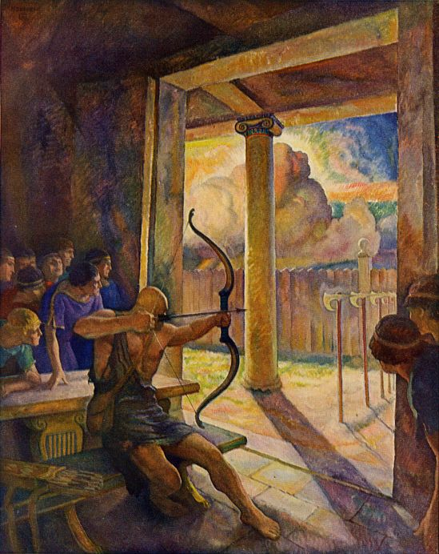
IRONY
y
Antinous refers to Odysseus’ bow as “the bow that will seal our fate.” This is true, but the fate ends up being death.

Slide 77
Foreshadowing
Hints given to the reader of what is to come.

