Slide 1

Canada Eh? Politics and Government

Slide 2
Outline for this Unit
Day 1 - Canadian Identity
Day 2/3 - Government Intro + Terms + Webquest
Day 4 - Political Spectrum/Political Groups
Day 5 – Democracy
Day 6 - Canada’s Government – 3 Levels
Day 7 - Charter of Rights and Freedoms
Day 8 - Elections
Day 9 – Laws
Day 10 – Test ;)

Slide 3
Goals for this Unit
1) You’ll be able to identify factors that contribute to your personal, regional and national identity.
2) You’ll be able to name and identify major/minor political parties in Canada and understand their basic political views.
3) You’ll understand how the Government of Canada functions at the Municipal, Provincial and Federal level.

Slide 4
If you have ever talked about…
The Dress Code. (Winter is Coming!)
Smoking.
Drinking.
Dating.
Anything that involves your opinion, beliefs, values, etc.
Then you have talked about POLITICS.

Slide 5
Politics
☺
Your POLITICS are your beliefs about how a country ought to be governed.
Your POLITICS are your beliefs about how people should act/behave in society.

Slide 6
Driving Question
☺
What shapes our identity?
Both at
The Individual Level
&
The National Level
&
How does our identity shape our political views?

Slide 7
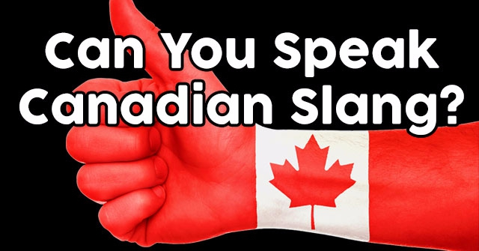
Canadian Slang
Let’s take a gander at some Canadian Slang eh? Be a Keener, and just Give’r on this assignment!

Slide 8
Canadian Slang
C
K
A
I
B
J
L
F
G
E
H
D
If you scored between…
1-3 → You need to grab a double-double and head to the nearest rink for some Slang lessons there.
4-6 → Just keep Give’er bud.
6-9 → Put on that Canadian Tuxedo with Pride.
9-12 → Oh, you’re a CANUCK!

Slide 9

Food for Thought

Slide 10

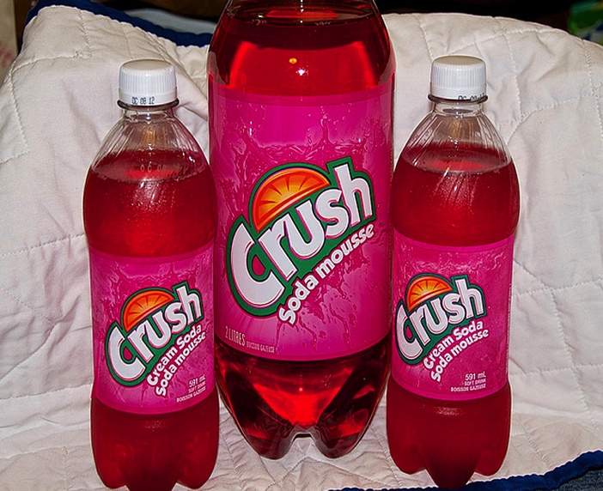
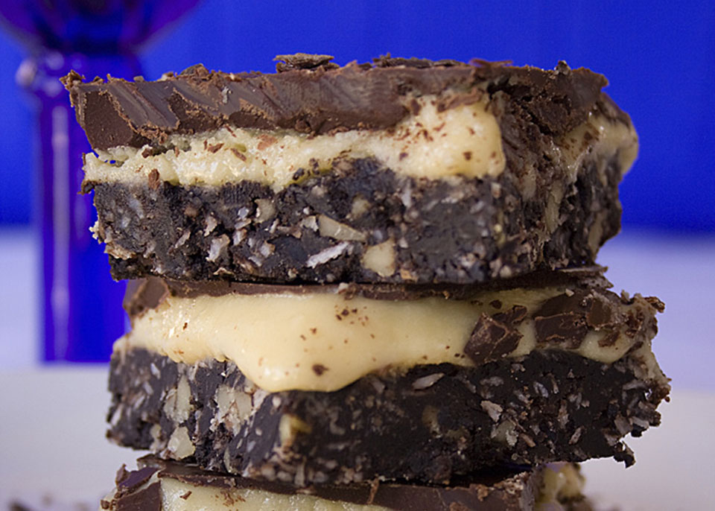
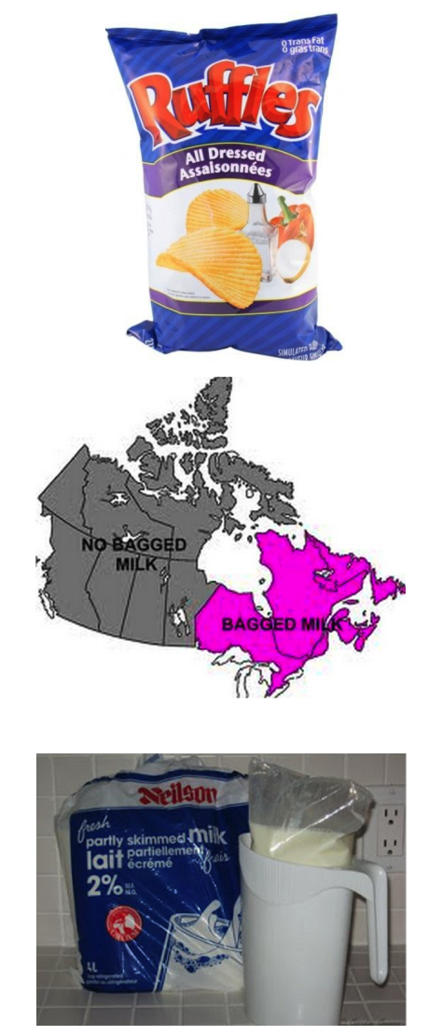



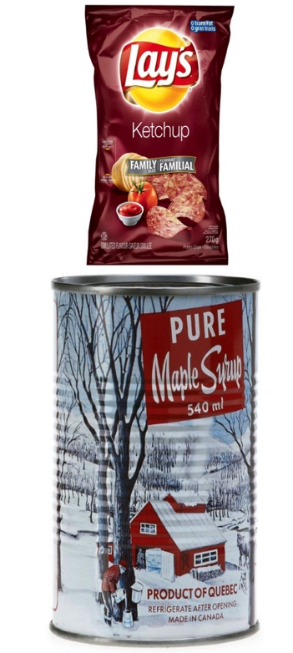
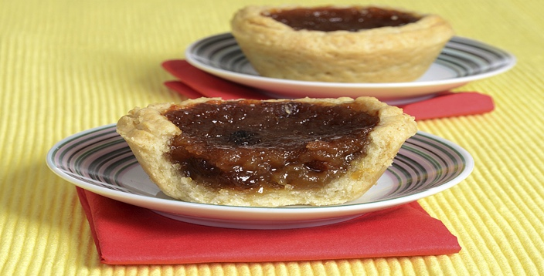
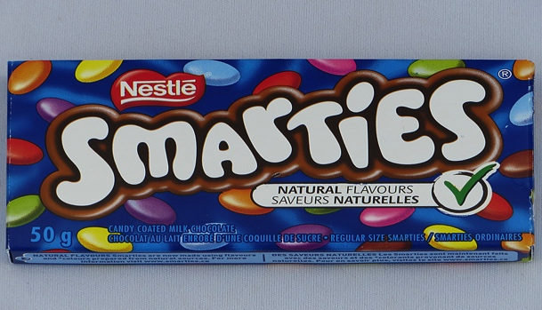
Food for Thought

Slide 11
Say what…
So far I’ve suggested two things that shape us:
1) Language
2) Food
These help to form the basis of our Culture.

Slide 12

Kahoot

Slide 13
Kahoot
What else am I suggesting helps to shape Canadians?
Knowledge about our History

Slide 14
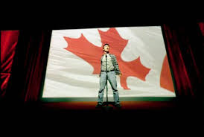
Canadian Identity
What makes someone a Canadian?
What are some of the
Canadian Stereotypes you’ve heard?
List a few in the section below.

Slide 15
Vocabulary
☺
Beliefs: something one accepts as being true/real; a firmly held opinion.
Values: principle or standard of behavior; what’s important in life. (ex: kind, honest, caring, thoughtful)
Ideologies: a system of ideas/beliefs.
Culture: the ideas, customs, and social behavior of a particular group or society.

Slide 16
The beauty of politics…☺
As we go through this unit we are each exploring our own beliefs, values and ideas about the world we live in and how we each think it should be run.

Slide 17
Canadian Identity
Let’s begin working on Task 1 in your Package Booklet.

Slide 18
Canadian Identity
Please fill out the answer for each of the questions.
When you’re done – Put your Answer to each question on one of the stick notes (5 in total).
Then go and post them next to the section in the classroom where they belong.
(ex: 1 with 1)

Slide 19
Canadian Identity
1) As you go around the class, I want you to write 2 responses of what others have said.

Slide 20
1
Screen
2
Mr. Koe’s Desk
5
3
4

Slide 21
1
Screen
2
Mr. Koe’s Desk
5
3
4

Slide 22
1
Screen
2
Mr. Koe’s Desk
5
3
4

Slide 23
1
Screen
2
Mr. Koe’s Desk
5
3
4

Slide 24
1
Screen
2
Mr. Koe’s Desk
5
3
4

Slide 25
Canadian Identity
Please fill out Column 3.

Slide 26
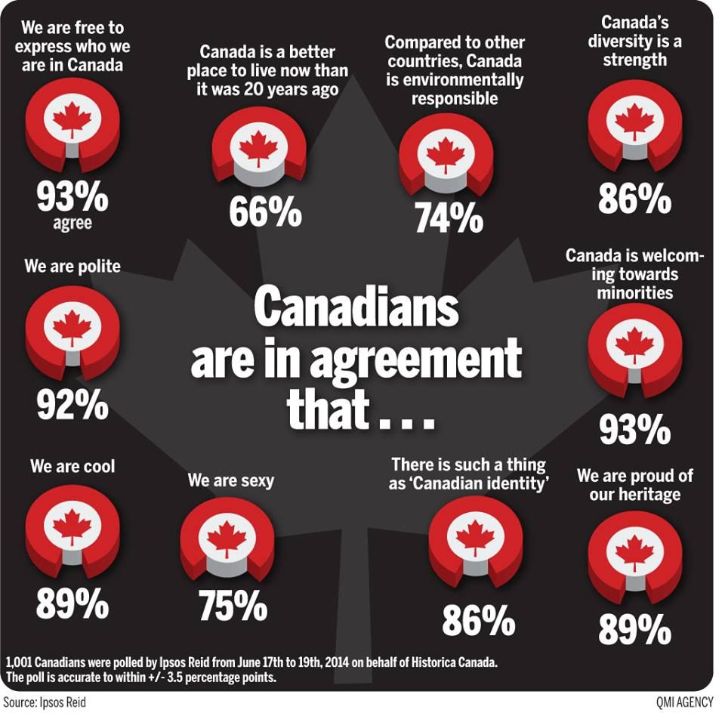

Slide 27
Canadian Identity ☺
Each of us constructs what it means to be Canadian!
Based on things like:
where we live
our age
our gender
our religion
our family composition
our financial situation
our education
Because each of these things can change over time; your understanding of Canadian identity can change over time too.

Slide 28
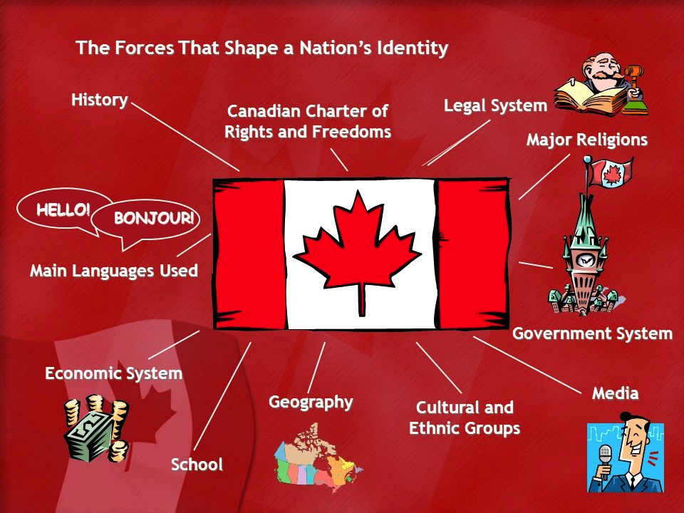
Canadian Identity

Slide 29
Personal Identity Iceberg
What we can see!
Gender
Age
Line of Visibility
Ethnicity
Social Status
Physical
Abilities
Religion
Wealth
Heritage
Learning Syles
Beliefs
Values
Life Experience
Perspective
What is underneath!
Sexual
Orientation
Talents
Political Views

Slide 30
Canadian Identity Iceberg
What we can see!
Immigrated to Canada
Born in Canada
Line of Visibility
History of our Nation
Languages – English/French
Beliefs
Values
Ethnic Diversity
What is underneath!
Physical Environment
Knowledge
People

Slide 31
Think about it…☺
If our Identity is shaped by our Beliefs and Values, which is shaped by our Physical Environment – Which is different for every town or region in a Province – is there really a National Identity as Canadians?

Slide 32
Connecting it to you…
Ideas
Beliefs and Values
Ideologies/Identity
Politics
Next day:
Will begin to explore different Political Ideologies.

Slide 33
Classwork = Activities
For the Duration of Class, I would like you to work on the following:
Task 3 + Activities

Slide 34
Outline
CNN 10
What is the purpose of Government

Slide 35

What is the purpose of Government?

Slide 36
Government Introduction
The Need for Government
Since the beginning of civilization there has been an inherent need for some type of social order.
One of the earliest types of government was the monarchy. This type of government involves the rule by one person (man) through divine right (God’s rule).
The power in this type of government is passed through heredity.

Slide 37
This type of government was not truly in the best interests of the people. As a result in many countries;
England (1215),
France (1789),
Russia (1917),
A new type of government developed - Democracy (rule by the people).
There are two main types of democracy:
Direct - when every person plays an active part in the decision making process.
Indirect -when a group of people elects one person to represent them in government

Slide 38
Types of Government throughout History.
Monarchy:
Constitutional Monarch:
Parliamentary Democracy:
Consensus:
Autocracy:
Republic:
Democracy:
Theocracy:

Slide 39
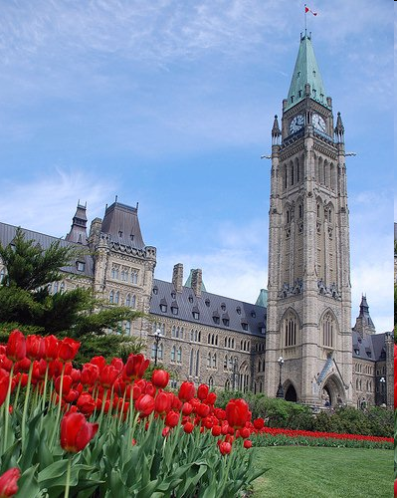
Political Spectrum

Slide 40
What you’ll be able to do after this lesson.
Explain to someone the political spectrum.
Identify different beliefs and where they align on the political spectrum.
Have a sense of your own beliefs, values and where they are on the political spectrum.

Slide 41
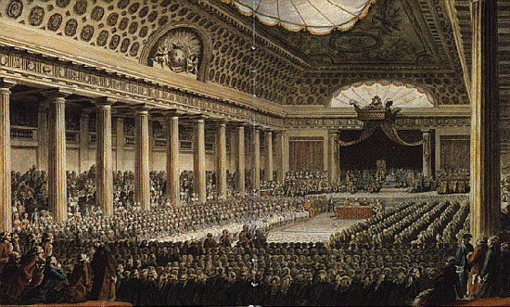
What’s the connection between the French Revolution and the Political Spectrum?

Slide 42
French Revolution created the Political Spectrum
Left
(Peasants)
Right
(Wealth/Church)
King
(Center)
Left = CHANGE
Right = TRADITION

Slide 43
The Political Spectrum
☺
What is the Political Spectrum:
The Political Spectrum is a way of putting political ideologies and political parties on a line. It is a useful tool for political analysis.
The center is associated with the democratic form of government.
The extreme ends of the line on both the right and the left are totalitarian.

Slide 44
Political Ideology
☺
Definition: common set of beliefs or ideas of an individual, or group.

Slide 45
Political Spectrum Chart
☺
Left Wing | Centre | Right Wing
-more liberal | - can take either side | -more conservative
-support change in order to improve welfare of all citizens | -tradition is important but change is supported if most people want it | -tradition is important and change should be treated with caution
-government should play a larger role in people's lives (Ex. social services) | -government should play a role only if it improves the lives of citizens | -government should play a smaller role in people’s lives
-law and order are important to protect rights of all citizens fairly and equally | -law and order are important to encourage and protect right of individuals | -emphasis of law and order to protect society and its traditions
-more freedom to individuals and less power to police |  | -less freedom to individuals and more power to police

Slide 46
Two Ways to Classify Groups
Linear Political Spectrum:
The Larger Political Spectrum
Radical Moderate Radical
Left Wing Centre Right Wing
Communism Socialism Capitalism Fascism
Government owns and controls the land and the means of production.
Government owns and controls key industries while allowing some private enterprise.
Government plays a minimal role in directing the economy. Private corporations enjoy many freedoms.
Government allows free enterprise but only when it furthers the goals of the state (the gov’t).

Slide 47
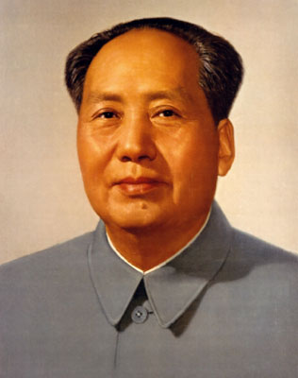
The Larger Political Spectrum
Radical Moderate Radical
Left Wing Centre Right Wing
Communism Socialism Capitalism Fascism

Slide 48
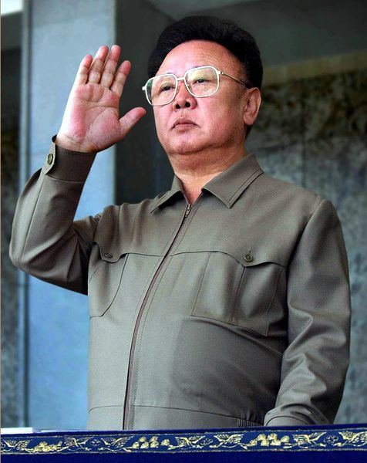
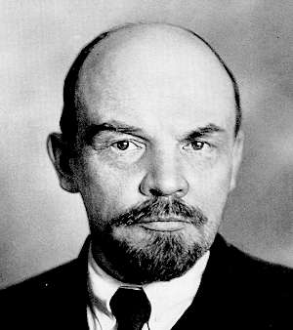
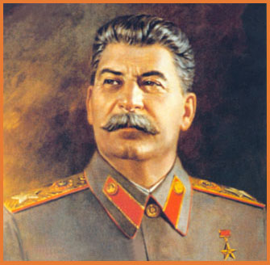
The Larger Political Spectrum
Radical Moderate Radical
Left Wing Centre Right Wing
Communism Socialism Capitalism Fascism

Slide 49
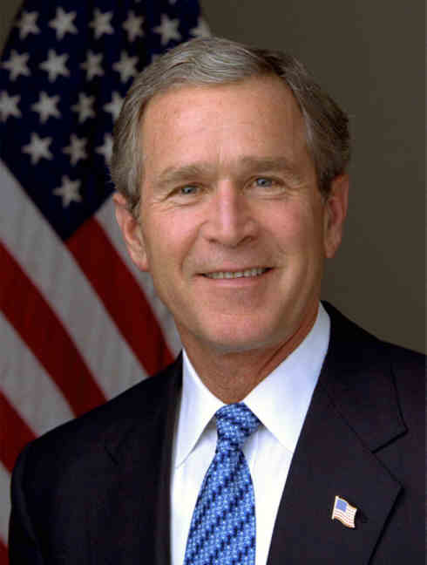
The Larger Political Spectrum
Radical Moderate Radical
Left Wing Centre Right Wing
Communism Socialism Capitalism Fascism

Slide 50
The Larger Political Spectrum
Radical Moderate Radical
Left Wing Centre Right Wing
Communism Socialism Capitalism Fascism

Slide 51
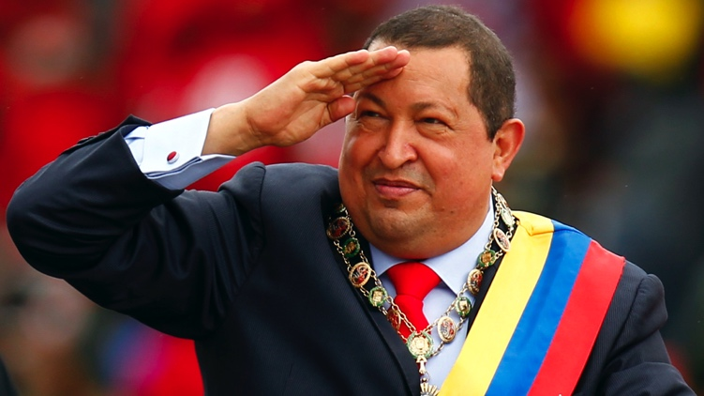
The Larger Political Spectrum
Radical Moderate Radical
Left Wing Centre Right Wing
Communism Socialism Capitalism Fascism

Slide 52
The Larger Political Spectrum
Radical Moderate Radical
Left Wing Centre Right Wing
Communism Socialism Capitalism Fascism

Slide 53
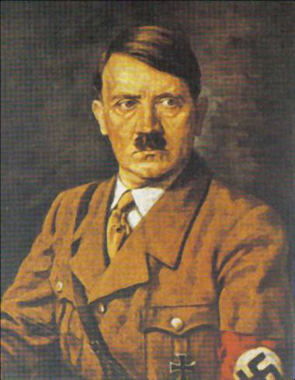
The Larger Political Spectrum
Radical Moderate Radical
Left Wing Centre Right Wing
Communism Socialism Capitalism Fascism

Slide 54
The Larger Political Spectrum
Radical Moderate Radical
Left Wing Centre Right Wing
Communism Socialism Capitalism Fascism

Slide 55
Canada’s Political Spectrum
Communism
Socialism
Democratic Socialism
Capitalism
Fascism
The Canadian Political Spectrum
Reform/
Canadian Alliance
(Recently joined Conservatives)
NDP
Liberals
Conservatives

Slide 56
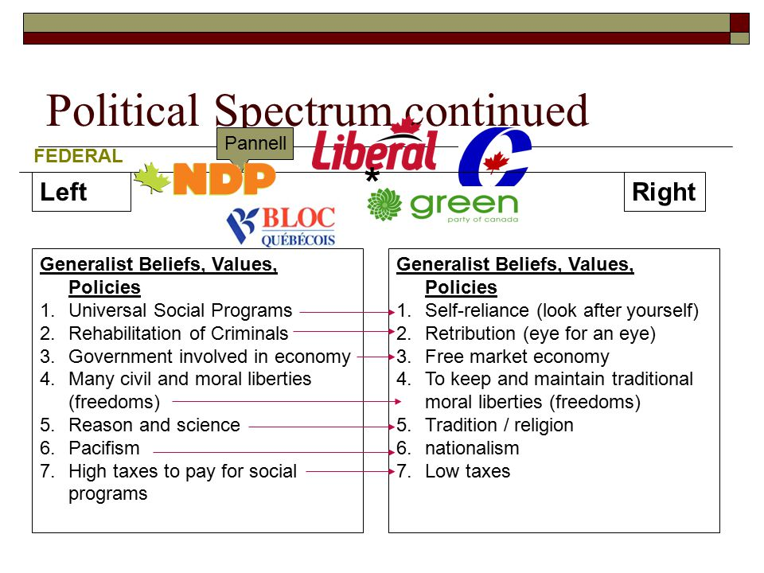

Slide 57
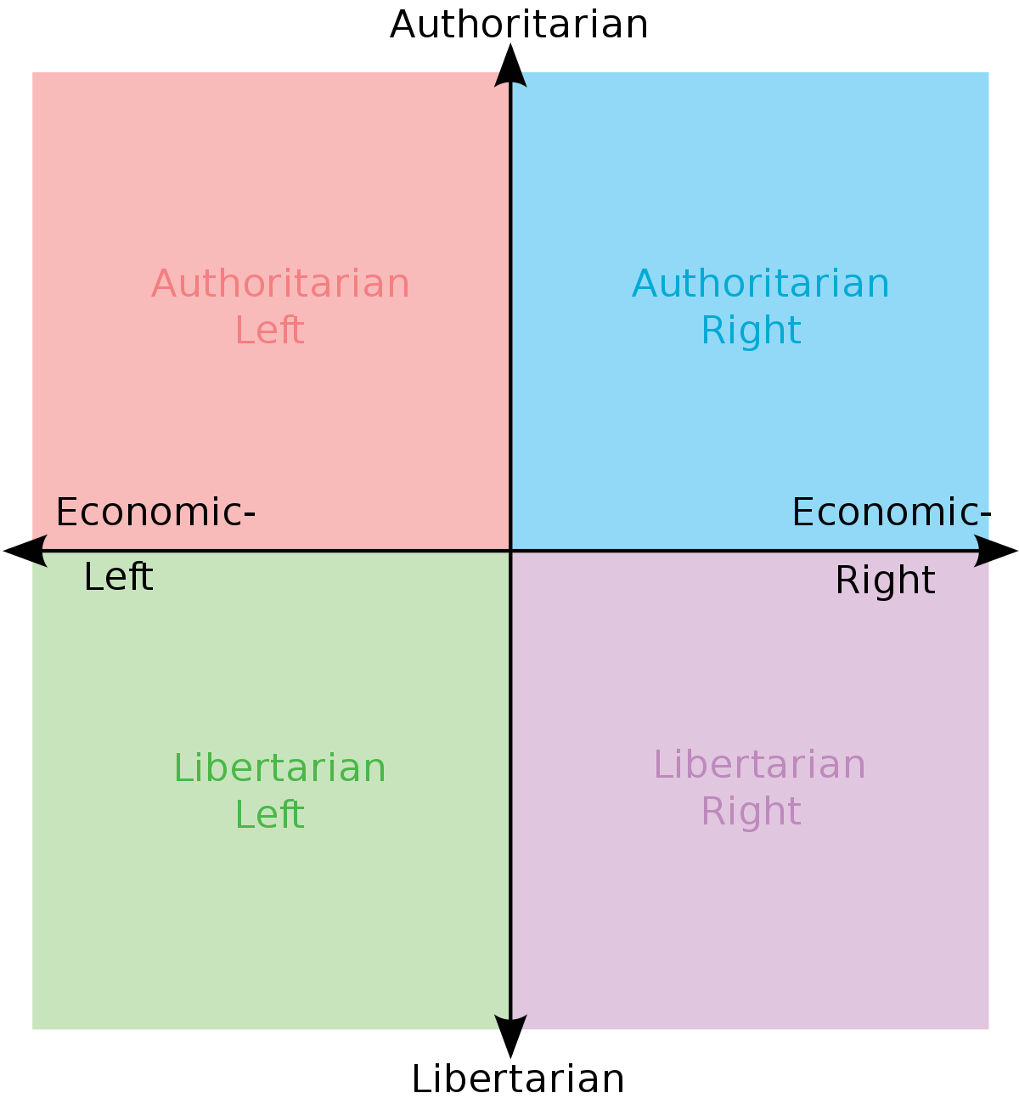
Two Ways to Classify Politics
1) Two Dimensional: Political Compass

Slide 58
Two Ways to Classify Politics
1) Two Dimensional: Political Compass
X-AXIS is how much involvement
You believe the Government should have in
Economic matters.
LEFT = MORE (Communism/Collectivisation)
RIGHT = LESS (Capitalism/Free-Market)
X-Axis
X-Axis

Slide 59
Two Ways to Classify Politics
1) Two Dimensional: Political Compass
Y-AXIS is how much involvement
you believe the Government should have in
Social Issues.
Authoritarian = Government should decide what is right
Libertarian = People decide for themselves and respect others rights to do the same.
Y-Axis
Y-Axis

Slide 60
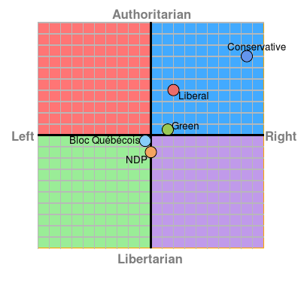

Slide 61
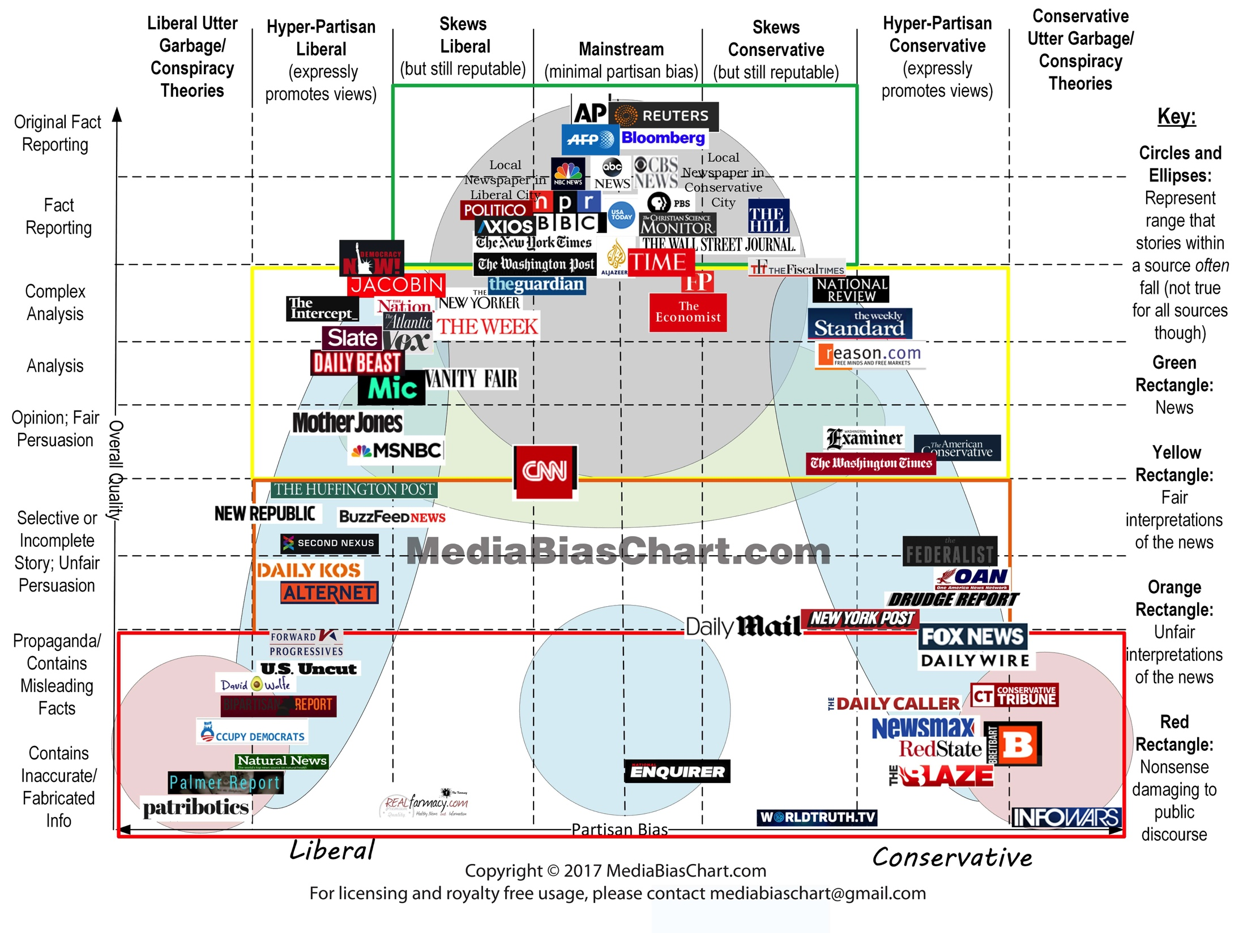

Slide 62
The Political Spectrum
Totalitarian
Democratic
Totalitarian

Slide 63
Totalitarianism
☺
Definition: a state regulates nearly every aspect of public and private life.
Found at the extreme ends of the political spectrum on both the right and the left.
The state exercises total control in this form of government.
The individual exists to serve the state.
Communism (far left) and Fascism (far right) of the political spectrum.

Slide 64
The Political Spectrum (left)
Supports economic equality, change and progress in society
Socialism and the Social Democratic parties are located on the left inside and around the circle
The extreme left is associated with Communism

Slide 65
The Political Spectrum (The Left Wing)
Communism
Socialism

Slide 66
Communism
Definition: a theory or system of social organization in which all property is owned by the community and each person contributes and receives according to their needs.
Found at the far left of the Political Spectrum.
The state exercises control over the economy.
The government decides what to make and how much to make.
Often run by a single authoritarian political party.
The individual exists to serve the state.
The goal is to have equality amongst all citizens.

Slide 67
Socialism
Definition: a theory or system of social organization in which production, distribution, and exchange should be owned or regulated by the community as a whole and distributed according to productivity.
Found at the middle left of the Political Spectrum.
The state exercises limited control over the economy.
The government + people decides what to make.
Often run by a single authoritarian political party/democratic party.
The individual exists to serve the state and himself.
The goal is to have more equality amongst citizens.
The goal is to have more equality amongst citizens.

Slide 68
Environmentalism
Definition: Environmentalism is a social movement/ideology that is concerned with protecting the environment.

Slide 69
Feminism
Definition: Feminism is a political movement, ideology and social movement
that are striving for a common goal: to establish and achieve political, economic, and social gender equality.
Campaigning for Women’s Rights which include:
Voting, holding public office, to work
To own property, to receive an education
To earn fair wages or equal pay, to have maternity leave
To have equal rights within marriage.
To protect women from rape/sexual harassment/violence

Slide 70
The Political Spectrum (Centre to Right Wing)
Liberalism
Fascism
Conservatism

Slide 71
The Political Spectrum (right)
Supports tradition and opposes change in society.
The extreme right is associated with Fascism.
Because the beliefs of conservatism and liberalism are democratic they are located inside the circle.

Slide 72
Conservatism
Definition: Groups that are committed to traditional values and ideas with opposition to change or innovation. Politically these views favor free enterprise, private ownership and conservative ideas.
Found at the right of the Political Spectrum.
The state exercises limited to no control over the economy.
The economy decides what to make and how much to make.
Often run by a democratic system – multi party system.
The individual exists to serve himself.
The goal is to have competition amongst all citizens.

Slide 73
Capitalism
Definition: An economic and political system in which a country’s trade and industry are controlled by owners for profit, rather than by the state.
Found at the far right of the Political Spectrum.
The state exercises limited to no control over the economy.
The economy decides what to make and how much to make; always an over abundance.
Often run by a democratic system – multi party system.
The individual exists to serve himself.
The goal is to have competition amongst all citizens.

Slide 74
Authoritarianism
The enforcement or advocacy of strict obedience to authority at the expense of personal freedom.
No Constitution to Protect People’s Rights.
Often a single person/party rules the State.
Examples in History: Dictators, Absolute Monarchies, Fascism.

Slide 75
Fascism
☺
Definition: Fascism is a form of government that stresses a one-party dictatorship. It is anti-democracy.
The aim is to prepare the country for armed-conflict and to respond to economic difficulties.
Historically they are racist – aim for racial purity.
Work Closely with Corporations and Economic Elites.

Slide 76
The Political Spectrum
Radical Moderate (Liberalism) Radical
Left Wing Centre Right Wing
Communism Socialism Capitalism Fascism
Government owns and controls the land and the means of production.
Government owns and controls key industries while allowing some private enterprise.
Government plays a minimal role in directing the economy. Private corporations enjoy many freedoms.
Government allows free enterprise but only when it furthers the goals of the government.

Slide 77
Political Spectrum Quiz
https://canada.isidewith.com/political-quiz
Please visit the above website and conduct the test that is provided.
Once you have completed it – Put your Test Results in the Workbook.
Begin working on ‘Foundations of Government’ at the Back fo your Workbook

Slide 78
(Multi) Party System
Party system means that Canada has several political parties.
Is this the same as United States?
A political party is a group of people who have common beliefs, ideas and plans about the best way to govern a country.
Political ideology – Is based on a common set of beliefs.

Slide 79





Party System Canada’s major political parties

Slide 80











Minor Parties

Slide 81
Outline
CNN 10
Political Web-quest

Slide 82
Political Webquest
For the Remainder of Class,
I would like you to work on this
Political Webquest.
You can also use this time to
Finish up the ‘Foundations of Government’
In your work package from last day.

Slide 83
Outline
CNN 10
Political Spectrum Line – Review
Discussion on “Hot Topics Canada”
Making Informed Opinions.
Classwork

Slide 84
The Political Spectrum
Radical Moderate (Liberalism) Radical
Left Wing Centre Right Wing
NDP
Conservatives
Communism Socialism Capitalism Fascism
Green Party
Liberals
Change
Tradition

Slide 85
Prior to the Activity
It should be noted that these beliefs are not mandatory to hold to be on one side of the political spectrum or the other; rather these are traditionally held beliefs for both groups.
If you’re interested – visit
https://www.studentnewsdaily.com/conservative-vs-liberal-beliefs/

Slide 86
Ideologies: Which side of the spectrum to these beliefs belong?
Marijuana should be legalized.
Abortion should be illegal.
The Death Penalty should be re-instated.
L’aissez Faire Government/Business Model.
Public Education for all; no Privatized Schools.
Euthanasia should be legalized. A person has the right to choose.
Climate Change has not been scientifically proven.
All Citizens should have the right to bear arms.
Health Care is a Basic Right.
Only Legal Immigrants should enter the country.
The Government has the right to use eminent domain (seizure of private property with payment) to accomplish their goals.
Oppose Same Sex-Marriage.
Higher Taxes on the Wealthy.
Support Welfare for Low-Income Families.

Slide 87
Hot Topic Issues
What is your stance on Abortion?
Should Canada raise the Federal Minimum Wage?
Should Teachers be allowed to carry a gun at school?
Should Students who use Mace/Bear Spray be convicted as Adults (ex: Assault with a Weapon)
Should every 18 year old citizen be required to serve one year in the military?
Should Canada legalize all drugs?
Should immigrants be deported if they commit a major crime?
Should we allow for Fracking in Canada?
Should the Federal Govt pay for Tuition at college/university for a four year degree?
Should teachers be required to wear body cameras?

Slide 88
What is your Stance on Abortion?
Pro-Choice
People should have the right to choose whether to get an abortion done.
Pro-Life
Abortion is immoral and should never be done.
What would a person argue for?
Freedom of Choice
My body, my decision
What about Rape? Incest?
A fetus isn’t a human being.
What would a person argue for?
It’s wrong to kill an innocent child.
A fetus should have the same rights as a human being.
Abortion can leave emotional scars for the rest of your life.

Slide 89
Should Canada Raise the Federal Minimum Wage?
Pro’s
Con’s
Raises living standards for impoverished workers
Reduces Gender/Racial income inequality.
Potential for Layoffs/unemployment.
Increase in High-School Drop out Rate
Encourages Automation Processes vs. Human Processes

Slide 90
Should Teachers be allowed to carry Guns at School?
Pro’s
Con’s
To keep the students safe.
It might be a deterrent for criminals.
Use-Rubber Bullets.
There could be accidents.
Students could get their hands on it.
You may not know enough about a person’s background to get that information.

Slide 91
Should Students who use Mace/Bear Spray be convicted as Adults (ex: Assault with a Weapon)
Pro’s
Con’s
It sets a tone that this type of behavior is unacceptable in society.
Teenagers don’t always think of the consequences of their decision.
They could have felt threatened and used it in self-defense.

Slide 92
Should every 18 year old citizen be required to serve one year in the military?
Pro’s
Con’s
Canada would have a strong military presence.
We would all learn self-defense and combat training.
We would all behave more respectfully, obey authority, etc.
It would cost Canadian Tax-payers a fortune.
It would be challenging for some people and impose on their personal freedoms.

Slide 93
Should Canada legalize all drugs?
Pro’s
Con’s
Increased Tourism.
Legalization might lower the price, resulting in less theft.
Street Justice would be lowered.
Police/Court could be freed up.
Impaired drivers would increase.
Physical Abuse might increase.
Mental Health cases might increase.
People might become highly addicted, lose their employment, etc.

Slide 94
Should immigrants be deported if they commit a major crime?
Pro’s
Con’s

Slide 95
Should we allow for Fracking in Canada?
Pro’s
Con’s

Slide 96
Should the Federal Govt pay for Tuition at college/university for a four year degree?
Pro’s
Con’s

Slide 97
Should teachers be required to wear body cameras?
Pro’s
Con’s

Slide 98
Classwork
Please submit the following assignments:
Canada Eh? 3 Questions Worksheet
Canada Eh? 3 Activities
Foundations of Govt Webquest

Slide 99
Outline
CNN 10
Key Issues in Government
Why do we have a Government?
Classwork
Tomorrow
Charter of Rights and Freedoms

Slide 100

Issues
Why do we need government?
What can government do?
What types of government exist in Canada today?
How does decision making occur at the federal, provincial, and local levels of government?

Slide 101
Government Introduction
The Need for Government
Since the beginning of civilization there has been an inherent need for some type of social order.
Monarchy
This type of government involves the rule by one person (man) through divine right (God’s rule).
The power in this type of government is passed through heredity.

Slide 102
This type of government was not truly in the best interests of the people. As a result in many countries; England (1215), France (1789), Russia (1917), a new type of government developed - Democracy (rule by the people).
There are two main types of democracy:
Direct - when every person plays an active part in the decision making process.
Indirect -when a group of people elects one person to represent them in government

Slide 103
In Canada we have a system of representative democracy that provides an efficient and effective mechanism for running the country
The government in Canada protects individual rights and freedoms, maintains infrastructure, and deals with other countries.

Slide 104
The Purpose of Government
Government is an organized system of decision making that gives individuals and a nation as a whole a sense of order and security.
The government makes laws and carries them out. It allows people to maintain their sense of individual freedom.

Slide 105
The Constitution of Canada
Our set of rules for various levels of government to follow in decision making.
Our Constitution contains a written and unwritten part.
The unwritten constitution is based on traditions from the past. Most of these traditions are based on the British pattern of parliamentary government.
Ex: Prime Minister

Slide 106
Our Constitution
There are 3 main parts to the written component of our constitution.
The Constitution Act 1867. This describes the authority, parts, and functions of parliament.
The Charter of Rights and Freedoms. This describes the basic rights and freedoms all Canadians have.
The Amending Formula. This sets out ways that the constitution can be changed.
7/50 Formula.
Supreme Court - Unanimous

Slide 107
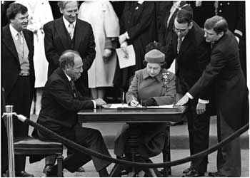
Queen Elizabeth II and Prime Minister Pierre Trudeau signing the Constitution on April 17, 1982.

Slide 108
Explore the Charter of Rights and Freedoms
We are going to explore the Charter of Rights and Freedoms today.
After-words we will answer some questions.
Please visit:
https://laws-lois.justice.gc.ca/eng/const/page-15.html

Slide 109
Outline
CNN 10
Constitutional Monarch
Political Parties
The Federal System
The Executive Branch
Classwork

Slide 110
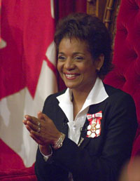
Constitutional Monarchy
☺
Our Constitutional Monarch is Queen Elizabeth II.
The Monarch is currently the head of our state. They have little or no power, but perform more of a symbolic role.
They are responsible for appointing the Governor General.
The Governor General is responsible for representing Canada in many situations.
Her Excellency the Right Honourable Michaëlle Jean

Slide 111
☺
The Governor General is appointed by the monarch on the advice of the Canadian parliament.
The Governor Generals responsibilities include: the opening of parliament
Giving royal assent to laws.
Greeting officials
Giving out awards
The Governor General’s role is purely symbolic

Slide 112

The Party System
☺
A political party is a group of people that represent the citizens of Canada at a Federal level. They have common beliefs and ideas and plans of how to govern.
A common set of beliefs is called an ideology.
Political parties may be active through all levels of government. They can choose how active they are and at what level.

Slide 113

Representative Democracy
☺
Canada is a Democracy. This means that the people govern the nation.
Individual citizens give their power to an elected representative who acts on their behalf.
By voting we choose who will best represent our beliefs and interests. The elected representative is accountable to the voter.

Slide 114
The Federal System
☺
A system of government that is responsible for handling decisions made on behalf of all Canadian Citizens.
A federal system was created in order to assure the equality among provinces and also to create a consistent national policy followed by all Canadians.

Slide 115
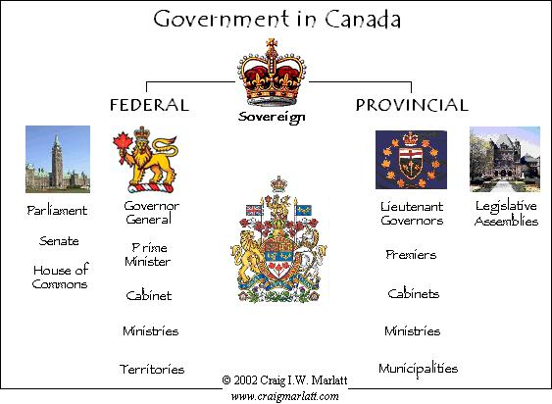
Levels of Government

Slide 116
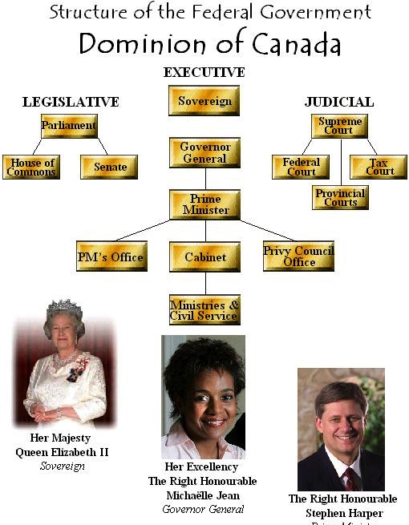
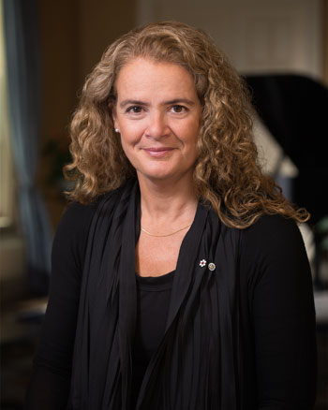
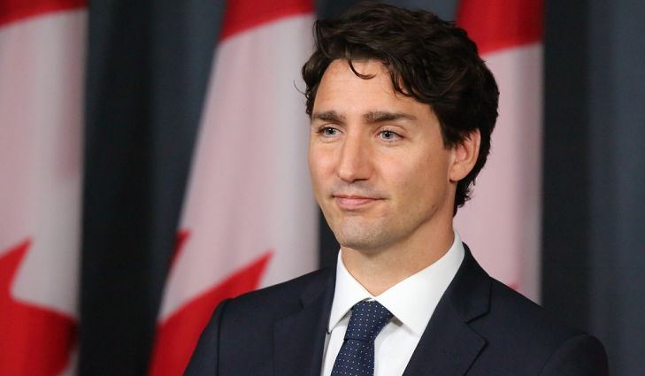
Prime Minister
Justin Trudeau
Her Right Honorable
Governor General of Canada
Julie Payette

Slide 117
The Prime Minister recommends people to the Governor General to be appointed to the Cabinet (35 Ministries they Oversee)
Minister of Public Safety and Emergency Preparedness
Minister of Veterans Affairs
Minister of Crown-Indigenous Relations
Minister of Innovation, Science and Economic Development
Minister of Finance
Minister of Transport

Slide 118
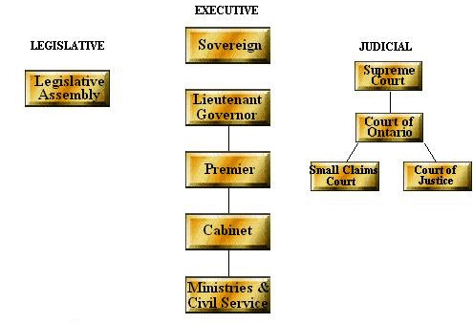
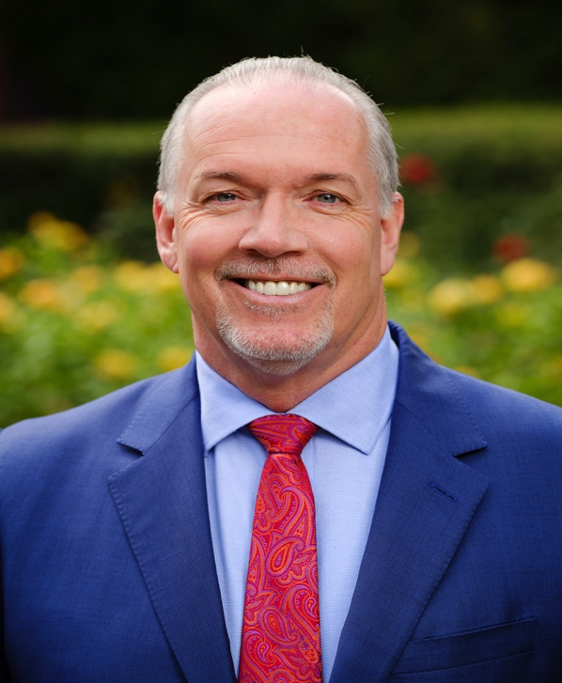
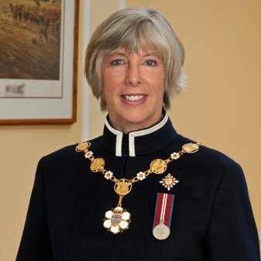
Structure of the Provincial Government
Province of British Colombia
Judith Guichon
Lieutenant Governor of B.C.
John Horgan
Premiere of B.C.

Slide 119
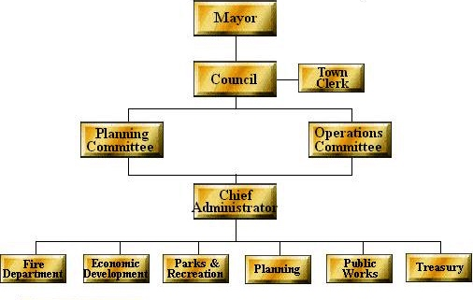
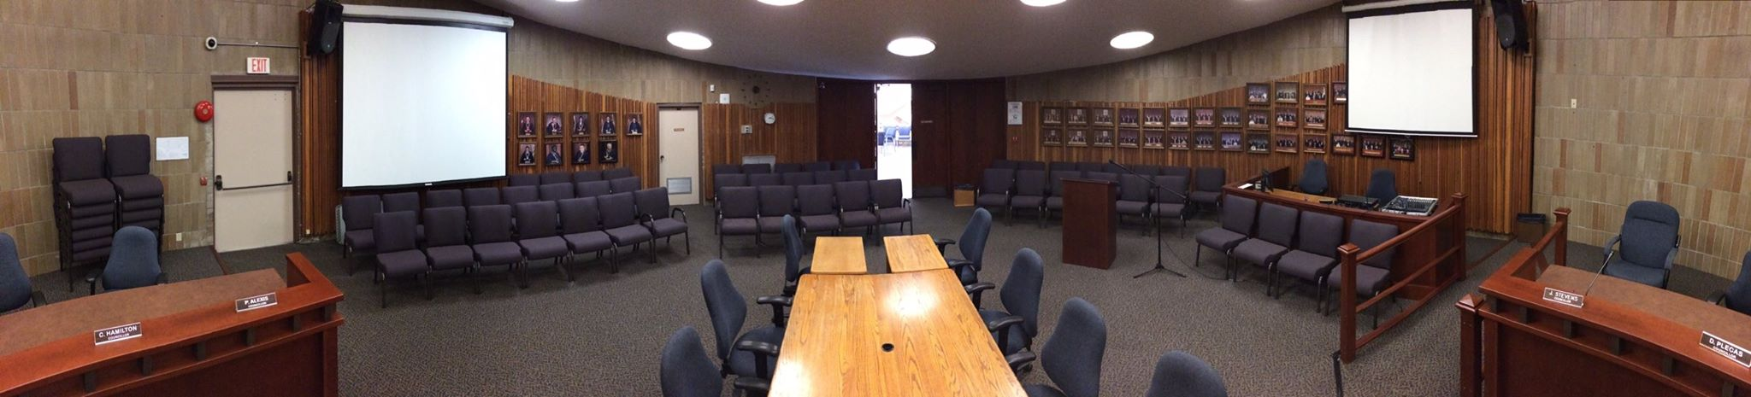
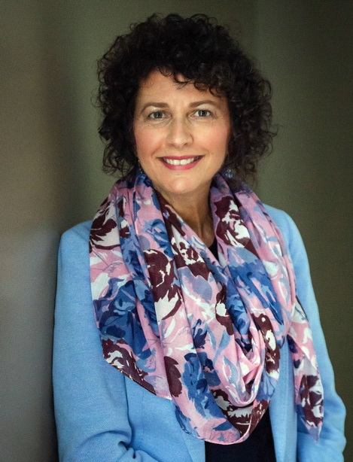
Structure of the Municipal Government
Municipality of Mission, British Colombia
Honorable Mayor – Pam Alexis

Slide 120
Federal System
☺
Three levels of government:
Federal (most power)
Provincial
Municipal
All levels of government can make laws, but the Federal government prevails when the laws are in conflict.
Residual Powers – Decision making not in the 1867 constitution given to the Federal government. (Example – Internet, Air Traffic Control)

Slide 121
The Executive Branch
☺
The executive branch of Canada is composed of three elements – the symbolic, political and permanent - that work together as the government.
The symbolic executive is composed of the Queen, who is the legal head of state of Canada, and her representatives, who fulfill the monarch's daily duties in Canada.

Slide 122
The political executive is the leading element of the executive branch. The Prime Minister is the head of government. This includes their Cabinet.
The permanent executive is the body of professional civil servants who manage and administer the government's policies.
☺

Slide 123
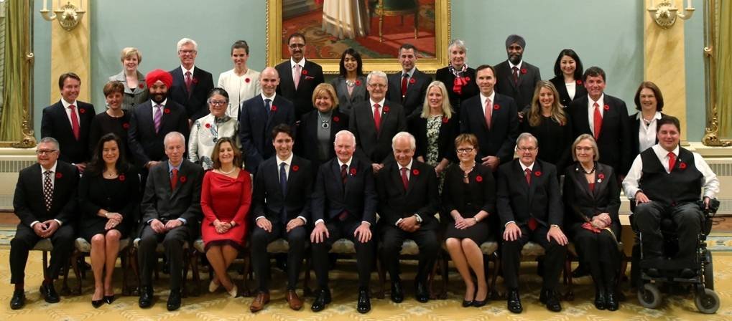
☺
Can. Fed. Cabinet 2018
The executive branch has two distinct roles to play in governing the country: • to decide on the need for new laws and to introduce new laws • to enforce a law once it is passed

Slide 124
Classwork
Finish the Political Spectrum
Finish the Foundations of Government
Finish the Charter of Rights and Freedoms.
Begin the Minority Government - Workbook

Slide 125
Outline
CNN 10
Notes on Government
Classwork

Slide 126
Executive Branch
Governor General
Prime Minister
The Cabinet

Slide 127

Governor General
- The Governor General is the Queen’s representative in Canada.
The Queen appoints the Governor General on the advice of the Prime Minister.
- The Governor General usually serves for five years.
- One of the most important roles of the Governor General is to ensure that Canada always has a Prime Minister.
- The Governor General acts on the advice of the Prime Minister and Cabinet.
- The duties of the Governor General include the following: summoning, opening and ending sessions of Parliament; reading the Speech from the Throne; giving Royal Assent to bills; signing state documents; and dissolving Parliament for an election.

Slide 128
Prime Minister
☺
The leader of the political party with the most elected MP’s in the House of Commons is asked by the Governor General to become Prime Minister.
Has the most power in the government.
Picks the Cabinet, Senators and the Governor General.
Decides when to call an election.
Must call an election at least every 5 years.
No limit on time served as Prime Minister.

Slide 129
The Cabinet
☺
Made up of elected MP’s from the House of Commons.
Chosen by the Prime Minister.
Each MP will be a Minister for a Department in the Federal Government.
Example: Defence, Fisheries, Finance etc.
Cabinet solidarity – means showing full support for the Prime Minister.

Slide 130
Legislative Branch
House of Commons (Lower House)
Senate (Upper House)
Governor General
These three parts of government make up Parliament

Slide 131
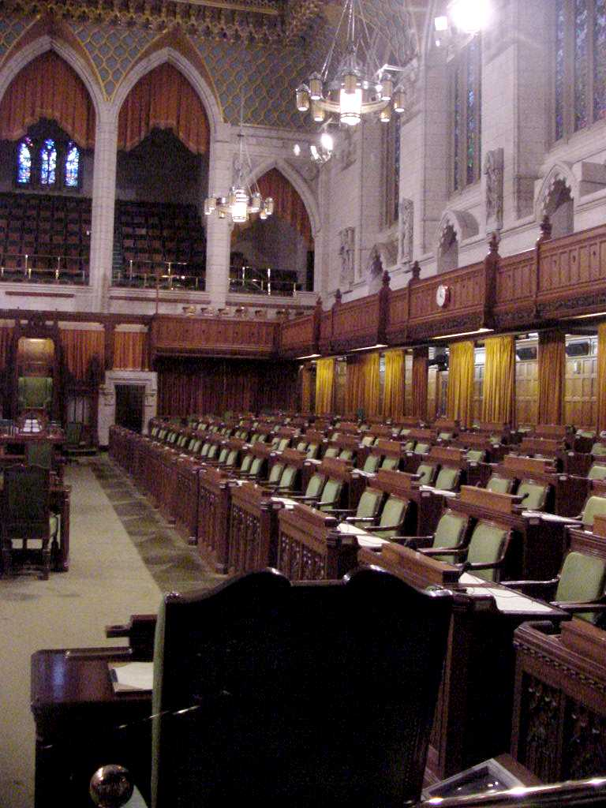
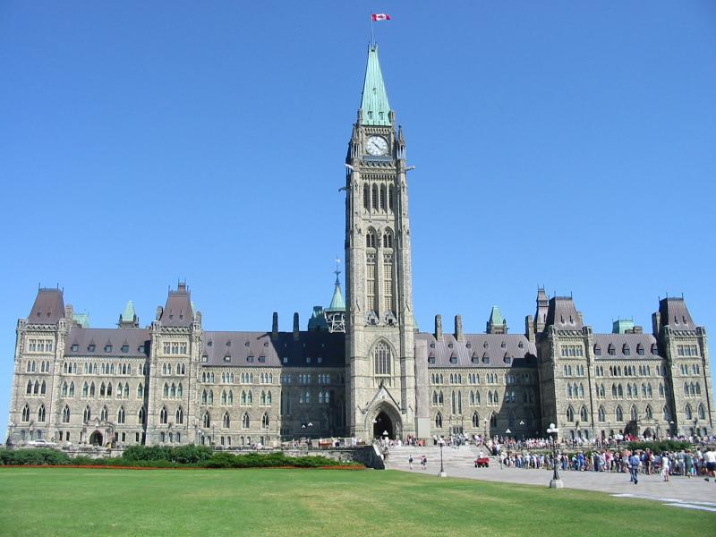
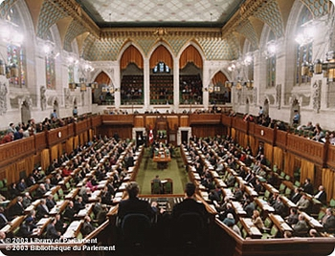
The Legislative Branch
☺
The House of Commons is where critical issues of Canada are debated. It is the law making body in Canada

Slide 132
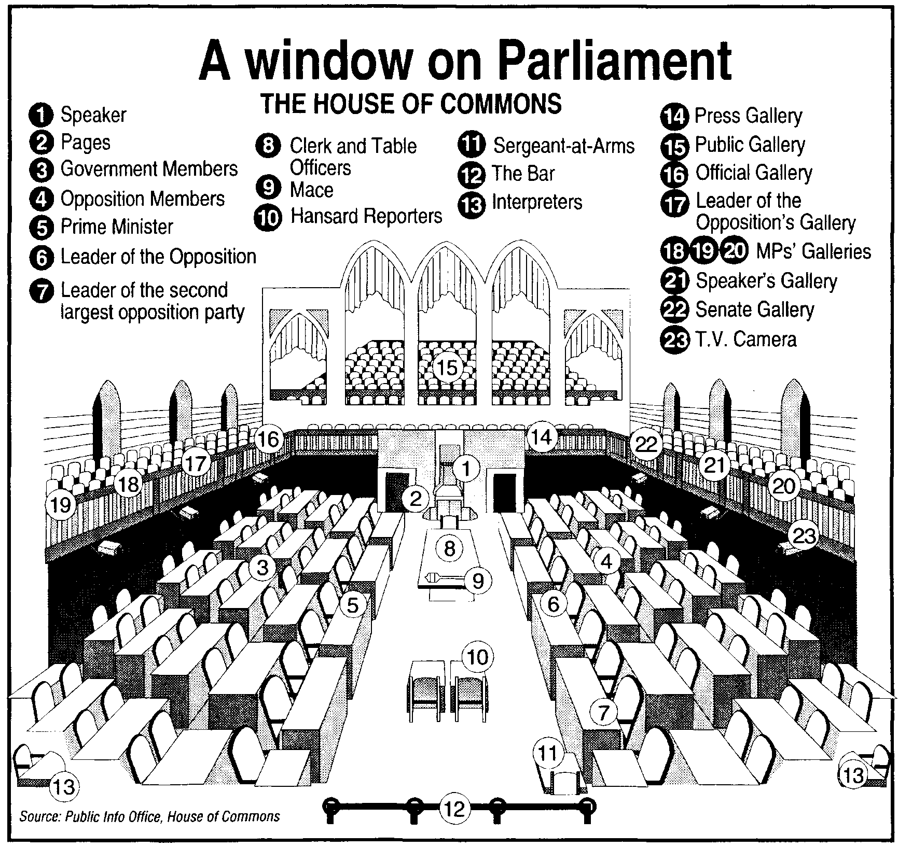

Slide 133
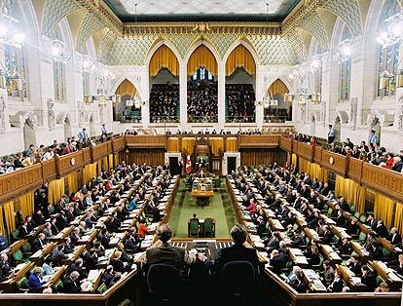
House of Commons

Slide 134
☺
The House of Commons
The House of Commons is the major law-making body in Parliament.
MP’s devote most of their time to debating and voting on bills. The Chamber is also a place where Members represent constituents’ views, discuss national issues and call on the government to explain its actions.
In each of the country’s 338 constituencies, or ridings, the candidate who gets the most votes is elected to the House of Commons, even if he or she gets less than half of the total votes.
Seats in the House of Commons are distributed roughly in proportion to the population of each province and territory.
Every province or territory must have at least as many Members in the Commons as it has in the Senate.

Slide 135
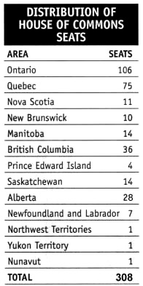

Slide 136
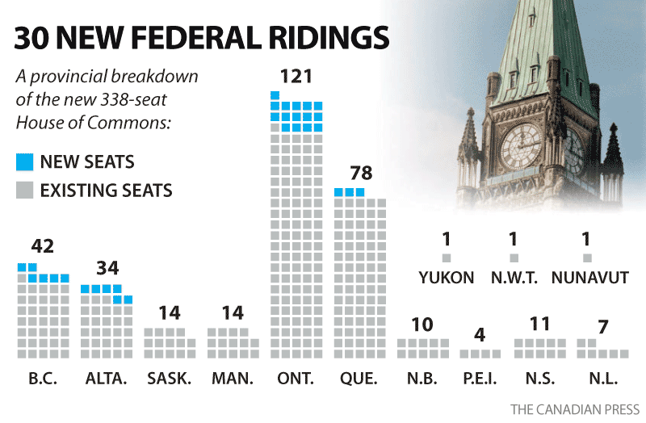

Slide 137
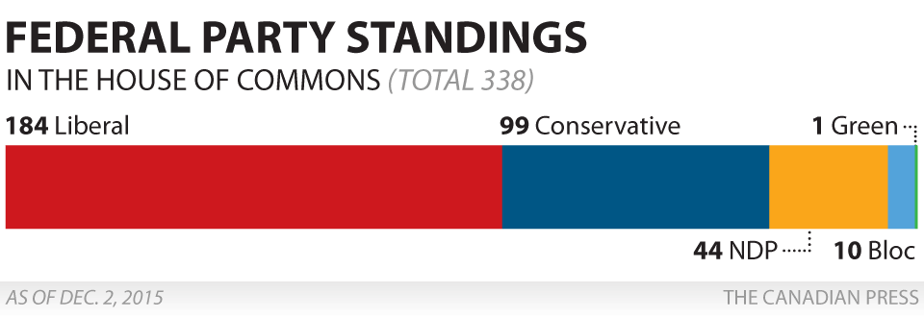

Slide 138
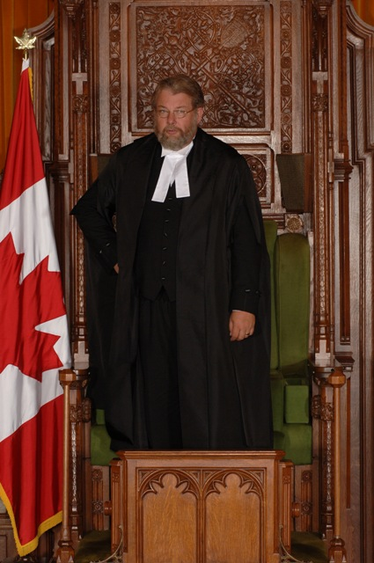
The Speaker
☺
The Speaker presides over the House of Commons and ensures that everyone respects its rules and traditions.
The Speaker must be impartial and apply the rules to all Members equally.
The Speaker is an MP, elected by secret ballot by the other MP’s.
The Speaker never participates in debate, only votes in case of a tie.

Slide 139
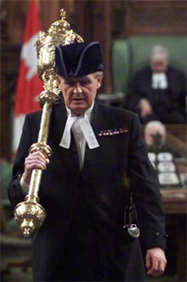
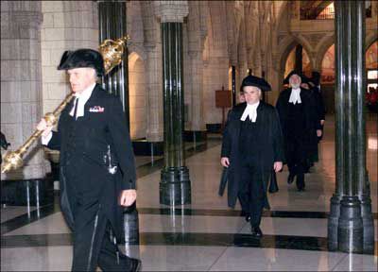
Sergeant at Arms
☺
The sergeant-at-arms is a senior official of the House of Commons
Responsible for the security and building services of the House of Commons.
The sergeant-at-arms is appointed.
The sergeant-at-arms carries the mace, the symbol of the authority of the House, in the parade into the House of Commons chamber.

Slide 140
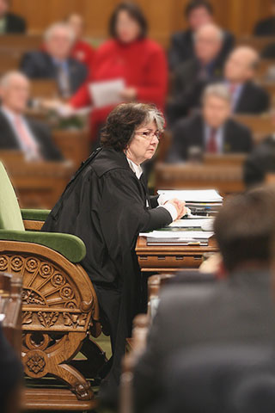
Clerk
☺
The Clerk is responsible for maintaining records of the proceedings of the House and for keeping custody of these records and other documents in the possession of the House.

Slide 141
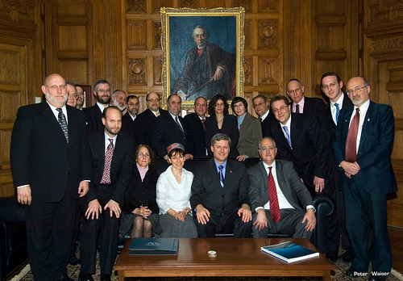
Caucus
☺
Each political party having elected representatives holds private meetings called a caucus.

Slide 142
Hansard
☺
Hansard is a “thing” not a person.
Hansard is a written record of the debates in the House of Commons.
The name comes from Luke Hansard, a man who recorded the House proceedings in Britain in the 1800s.
Today the House is recorded with a video and then written in the Hansard.

Slide 143
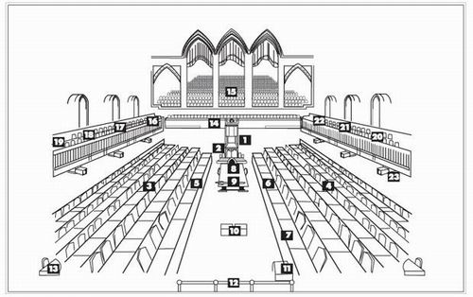
1. Speaker 2. Pages 3. Government Members 4. Opposition Members* 5. Prime Minister 6. Leader of the Official Opposition 7. Leader of the 2nd Opposition 8. Clerk and Table Officers 9. Mace 10. Hansard Reporters 11. Sergeant-at-Arms 12. The Bar
13. Interpreters 14. Press Gallery 15. Public Gallery 16. Official Gallery 17. Leader of the Opposition’s Gallery 18. Members’ Gallery 19. Members’ Gallery 20. Members’ Gallery 21. Speaker’s Gallery 22. Senate Gallery 23. T.V. Cameras

Slide 144

Senate

Slide 145


☺
The Senate
The Senate studies, amends and either rejects or approves bills passed by the House of Commons. It can also introduce its own bills, except those to spend public money or impose taxes. No bill can become law until it has been passed by the Senate.

Slide 146
☺
Senators also study major social, legal and economic issues through their committee work.
One of the duties of the Senate is to represent the interests of Canada’s regions, provinces, territories and minority groups.
Seats in the Senate are distributed to give each major region of the country equal representation.
The Senate has 105 members.
Senators are appointed by the Governor General on the recommendation of the Prime Minister and hold office until age 75.

Slide 147


Slide 148


Slide 149

Canadian Senators

Slide 150


The Judicial Branch
☺
The Judicial branch of government consists of the Supreme Court and the federal judges of Canada. The Supreme Court of Canada is the highest court in our nation. It interprets the meaning of the laws and our constitution, and it acts as a court of last appeal. The members of the Supreme court are appointed by Parliament.

Slide 151

Structure of the Judicial Branch

Slide 152
Provincial Governments
☺
Executive Branch – Modeled after the federal system, this branch holds the positions of Lieutenant Governor, Premier, Cabinet, and Public Service
Provincial Executive
Lieutenant
Governor
Premier
Cabinet
Public
Service

Slide 153

Provincial Governments
☺
Legislative Branch – Modeled after the House of Commons. Provincial bills become law the same way Federal ones do. However there is no Provincial Senate.

Slide 154

Provincial Governments
☺
The Judicial Branch – Provincial courts exist to settle disputes and to try those charged with breaking laws. Each province has a Supreme Court.

Slide 155
Local Government
☺
Like the provincial and federal governments the municipalities are broken into executive and legislative branches of government.
Local governments do not have a judicial branch.
The mayor, councilors, and alderpersons are all elected representatives and are accountable to those who elect them.

Slide 156
DIVISION OF POWERS: FEDERAL, PROVINCIAL, AND MUNICIPAL
☺
Federal Powers
Defence
Regulation of trade and commerce
Citizenship
Taxation
Currency and coins
Native peoples and Native reserves
Postal service
Patents and copyrights
Marriage and divorce
Navigation and shipping
Fisheries
Criminal law and federal penitentiaries

Slide 157
☺
Provincial Powers
Education
Hospitals and charities
Licences (e.g., driving and fishing)
Private property and civil law
Direct taxation (e.g., income tax and sales tax)
Management of natural resources (e.g., rests and electrical energy)
Local public works (e.g., roads and canals)
Courts and the administration of justice
Local (municipal) government

Slide 158
☺
Municipal Powers
Water and sewer service
Public transit
Fire and police protection and ambulance service
Licensing and inspection (e.g., houses)
Street lights, sidewalks, and local roads
Public health services
Recreation facilities
Libraries
Animal Control

Slide 159
Consensus Based Governance
First Nations Based
Sechelt, N.W.T, Nunavut, etc.
All MLA run as Independents
They meet and elect a Speaker, Premier and individual cabinet ministers.
Majority carries the vote.

Slide 160
Classwork
Finish the Political Spectrum
Finish the Foundations of Government
Finish the Charter of Rights and Freedoms.
Begin ‘4 Features of Government’ Mini Quiz
Begin the Minority Government - Workbook

Slide 161
Outline
CNN 10
How a Bill becomes a Law
Government Project
Classwork

Slide 162
How a Bill becomes a Law

Slide 163
The basics
The process begins when an idea is discussed and approved by the Cabinet, then made into a bill.
This “idea” is proposed to make the lives of Canadians better in hopes that it will pass and be signed

Slide 164
The lawmaking process starts with a bill- a proposal to create a new law or to change an existing one.
Most bills considered by Parliament are public bills (concern matters of the public)
ie: taxes and spending
Health and other social programs
Defense and the environment

Slide 165
A bill can be introduced in the House of Commons (C-bills) or the Senate (S-bills)
Most public bills get their start in the Commons
A bill goes through certain formal stages in each house which include a series of three “readings” during which parliamentarians debate the bill
There are four (4) things than can be done to a bill
1. Can be passed
2. Can be amended
3. Can be delayed
4. Can be defeated

Slide 166
How a bill becomes a law at the Federal level
Before we begin: the bill is introduced to the House of Commons (338 elected MP’s)
First Reading: The bill is “read” for the first time without debate and printed. Members have a chance to read its terms.
Second Reading: The principle of the bill is debated. The bill is then voted on in the House of Commons and sent to a parliamentary committee.

Slide 167
Committee Stage: A committee hears witnesses, examines the bill in detail, clause by clause, and submits a report with or without amendments. Necessary changes in wording are made.
Report Stage: Additional amendments to the bill may be moved, debated and voted on.

Slide 168
Third Reading: The bill is debated a final time and voted on by the House of Commons. It is either accepted or rejected at this stage.
Message: The bill is sent to the other House, where the process starts again from first reading.

Slide 169
The bill is now at the Senate…
Once the bill passes through the House of Commons, the process starts over again at the Senate (105 appointed senators)
First Reading: Bill is introduced by a brief statement and no debate
Second Reading: Reason for bill is explained. The bill is debated on principles, its strengths, weaknesses; may be changed

Slide 170
Committee of the Whole (senate): Examines bill clause by clause, makes changes and improvements. Bill is voted on
Third Reading :Usually brief debate. Bill is voted on. Senate can stop a bill but rarely does because Senators not elected. May send bill back to the House

Slide 171
Royal Assent
The bill becomes an act of Parliament when the Governor-General gives it Royal Assent by signing it. The bill is now law.

Slide 172
What is “Royal Assent”?
In this final stage of the legislative process, the three elements of Parliament assemble to take part in the ancient tradition, rich in symbolism, by which a bill becomes law. A representative of the Sovereign, sometimes the Governor General but more often a judge of the Supreme Court of Canada acting as a deputy of the Governor General, enters the Senate chamber and takes a seat on the dais. The senators are in their seats. The Usher of the Black Rod calls members of the House of Commons to the Senate…

Slide 173
Led by their Speaker, the members of the House of Commons gather at the rear of the Senate chamber. The parliamentarians of both houses, by their presence, give witness to the fact that Canadians request of the Sovereign that the bill be made a law and consent to being governed by it. The title of the bill is read aloud, the representative of the Sovereign nods to signify assent, and the bill becomes law…

Slide 174
A bill that becomes law may come into force on the day of royal assent or on some later day provided for in the bill. The bill is sent to Government House for signature at a later date. The signed original is finally placed in the archives of the Clerk of the Senate who is also the Clerk of the Parliaments.

Slide 175
Amending legislation
The Senate plays a key role in amending bills passed by the House of Commons. Senators have the expertise to put a bill “under the microscope” and examine it in detail, and the Senate timetable is flexible enough to allow longer periods of study. The end product is a more effective and long-lasting piece of legislation.
When a bill is amended, the aspects of the bill usually get closer scrutiny by the government, media, or both.

Slide 176
Defeating bills
Canada’s constitution gives either house of Parliament the power to defeat proposed legislation sent to it by the other house.
This is called the “veto” power.
Senators rarely veto a bill as they are not elected

Slide 177
Delaying bills
The Senate can also delay a bill, or decide not to act on it.
Without being formally rejected, a delayed bill dies at the end of the session.
In some cases, the Senate can delay a bill in order to give it more careful scrutiny and to draw greater public attention to the issue at hand.

Slide 178
Classwork
Finish the Political Spectrum
Finish the Foundations of Government
Finish the Charter of Rights and Freedoms.
Begin ‘4 Features of Government’ Mini Quiz
Begin the Minority Government - Workbook

Slide 179
Test Review
The Political Spectrum and where groups fit on it.
Ideologies + Beliefs + Views
Left always wants Change + Individual Freedom
Right always wants Tradition + Limit Individual Rights
Canada’s 3 Branches of Government (Executive, Legislative, Judicial), what their duties are and powers.
Municipal Government + Powers
Lower House (MP’s = 308/338)
Upper House (Senators = 105)
How a Bill becomes Law in Canada (Introduction, Readings)
The Charter of Rights and Freedoms – 1982 – What it is, how it benefits Canadians.

Slide 180
Political Films
Carbon Tax
Ethics
Balancing the Budget

