Slide 1
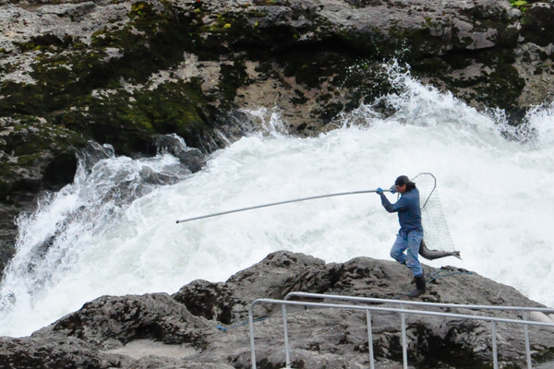
Chapter 2 Living on the Land
Notes:
First Nations Man fishes in Moricetown BC, along the Bukley River.

Slide 2
Chapter 2 Living on the Land
What is meant by the concept of stewardship?
What is meant by the term of sustainability?
How is the land treated?
What is a need vs. a want?
How do traditional Indigenous values about the land differ from non-Indigenous values?
Notes:
First Nations Man fishes in Moricetown BC, along the Bukley River.

Slide 3
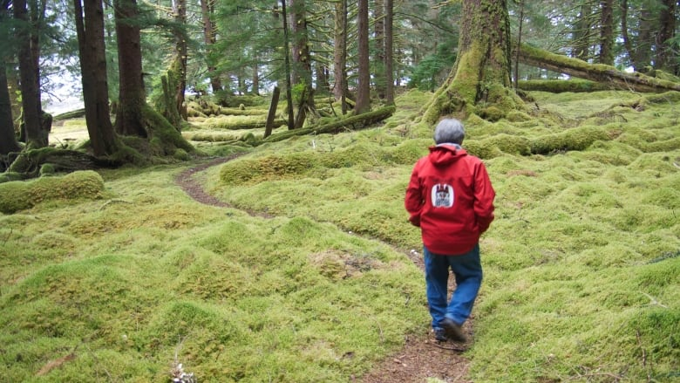
Stewardship
What is meant by the term “stewardship?”

Slide 4
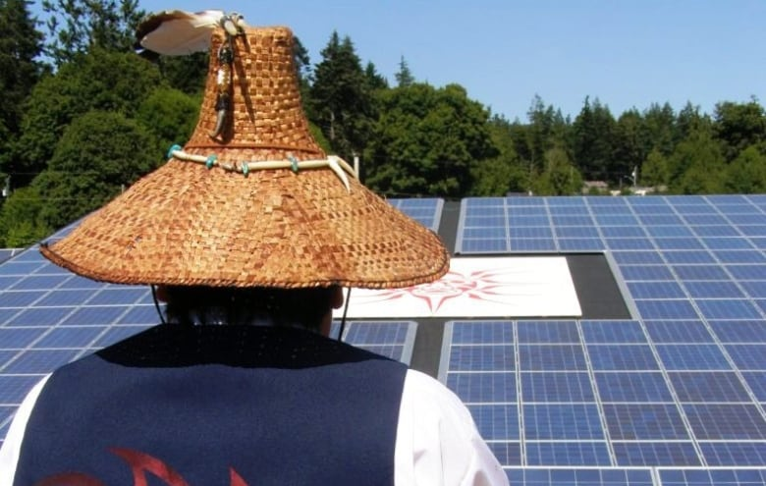
Sustainability
What is meant by the term sustainability?

Slide 5
Resource Management/Stewardship: Aboriginal Fishing Strategy
The Aboriginal Fishing Strategy (AFS) is the federal government’s response to the Sparrow Decision (Ch.9), which defined Aboriginal peoples’ rights to fish for food and for social and ceremonial purposes and sets out the necessity of consulting with Aboriginal groups when their fishing rights might be affected. This Department of Fisheries and Oceans (DFO) program is intended to provide for the effective management and regulation of the Aboriginal fishery and ensure that the Aboriginal right to fish is respected through negotiation of mutually acceptable and time-limited fisheries.

Slide 6
Traditional Ecological Knowledge
Indigenous Knowledge and Science

Slide 7
Meaning via TEK and Science
People understand the world in many ways.
Two ways of bringing meaning to the world are Traditional Ecological Knowledge and Science.

Slide 8
Meaning via TEK and Science
Western science has been the dominant way of making decisions about the environment.

Slide 9
Meaning via TEK and Science
More and more, however, modern society is learning that the vast knowledge and experience Indigenous people have with their land and resources are extremely valuable.
This knowledge and experience is called Traditional Ecological Knowledge (TEK).

Slide 10
What is Traditional Ecological Knowledge (TEK)?

Slide 11
Meaning via TEK and Science
Each First Nation holds a unique body of information deeply rooted in its experience with the lands, waters, fish, plants, and wildlife in its territories.
Each cultural group transforms the plants and animals around them into food, clothing, shelter, medicine, and tools.

Slide 12
Meaning via TEK and Science
The ways in which they do this make them distinct from one another.
The knowledge is holistic and integrates spiritual and moral beliefs and values.

Slide 13
Meaning via TEK and Science
This large body of information, referred to as Traditional Ecological Knowledge (TEK), is made up of knowledge, practices, and beliefs about the relationship of plants, animals, and people with one another and the environment.
It has been handed down from generation to generation over thousands of years.

Slide 14
Meaning via TEK and Science ☺
First Nations people have always had knowledge and strategies which allow them to survive in a balanced relationship with their natural and cultural environments.

Slide 15
Meaning via TEK and Science ☺
As with other aspects of culture, this knowledge is dynamic = it is always going through a process of experimentation, innovation, and adaptation as conditions change.

Slide 16
Meaning via TEK and Science ☺
Traditional knowledge is much more than the identification of plants and animals, or a description of their behaviour.
The reason it is called ecological knowledge is because it understands how plants and animals interact in the environment.

Slide 17
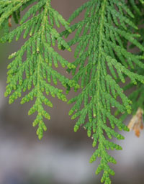
Can you identify what this picture is of?

Slide 18
Meaning via TEK and Science ☺
It is practical knowledge which can be used to predict and to make important decisions in a number of vital areas, including reliable food supply, sustainable resource management, human and animal health, and education.

Slide 19
What was (is) Traditional Ecological Knowledge Education like?

Slide 20
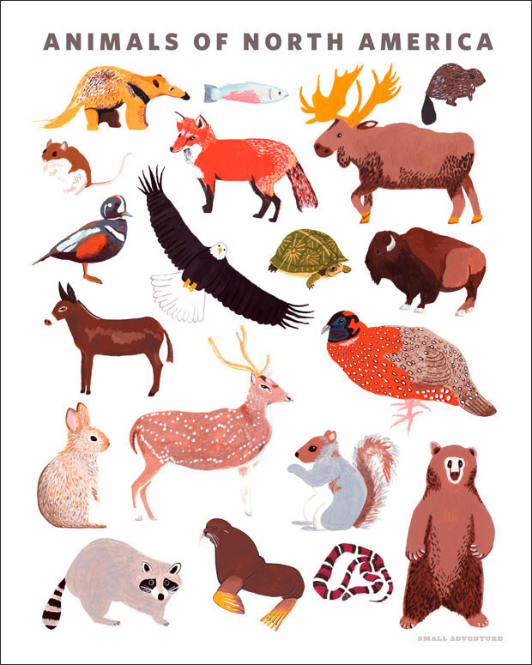
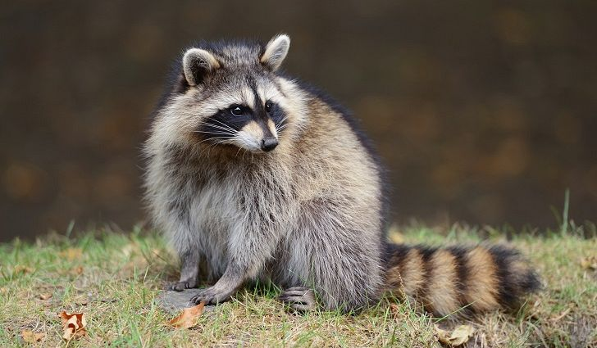
Education in TEK ☺
Traditionally, children were trained from an early age to be aware of and respect plants and animals and the environment they lived in.

Slide 21
Education in TEK ☺
This meant learning not only how to hunt, fish, gather and process food and materials, but also how to understand the behaviour and roles of other species in the ecosystem, and how to successfully interact with them in sustainable ways.

Slide 22
Education in TEK ☺
This knowledge was not taught in a school.
It was passed down by Elders through oral histories, songs, and hands-on training.
As people matured, they built on the teachings of their childhood through observation, experience, and spiritual interaction with the land.

Slide 23
What is Traditional Ecological Knowledge like Today?

Slide 24
TEK Today ☺
Traditional Knowledge helped sustain First Nations cultures for thousands of years, so it is no surprise that it is being used to help in modern society.
Many people recognize the importance of TEK, especially in sustainable resource management, and are beginning to use the knowledge and values in programs such as fisheries and forestry.

Slide 25
TEK Today ☺
Western science usually tries to understand complex ecological systems by breaking the whole down into parts and examining them separately.
This allows us to learn a great deal about the parts, but it may be impractical in trying to understand the complexity of the system as a whole.

Slide 26
TEK Today ☺
Traditional knowledge, on the other hand, is less interested in the separate pieces.
It looks at the land and resources holistically.

Slide 27
What kind of Research is being done on Traditional Ecological Knowledge?

Slide 28
Researching Traditional Ecological Knowledge
Because it is largely an oral tradition, TEK has not been systematically recorded.
Work is being done as First Nations prepare their land claims to make sure this knowledge does not disappear.
Also, wildlife management groups are beginning to incorporate information into their plans and practices.

Slide 29
Researching Traditional Ecological Knowledge ☺
Western scientists and First Nations have begun working together to integrate TEK with scientific methodology.
These two ways of understanding nature are often different, but both have a great deal to offer one another.
Research techniques focus on interviewing Elders and compiling their oral histories for future generations.

Slide 30
Researching Traditional Ecological Knowledge ☺
Maps are created as a way of recording information visually.
Recording interviews is not enough to preserve traditional knowledge, however.
This knowledge can only really come through merging experience with the teachings of others = experience is crucial for keeping the knowledge living, and preserving the way of life from which it comes.

Slide 31
Q: How is TEK different from Science?
TEK | Science
Qualitative (Quality/Experience) | Quantitative (Statistics/Math)
Observations are made/experienced by the people. | Scientific Method (Hypothesis/Experiments)
Data is passed down from the Elders, through Oral Stories/Traditions | Specialized Researchers collect the Data

Slide 32
Example of TEK – Creating a Map
“Areas of interest might include grave sites, old home sites, culturally modified trees (CMT), areas of rare or medicinal plants, important wildlife areas, fish spawning beds, berry harvesting areas and so on. The results of the research provide the First Nations with data they can use in forest management consultations.”
http://www.nafaforestry.org/forest_home/documents/Brubacher-McGregor1998.pdf

Slide 33
Example of TEK – Creating a Map
Proposed logging developments (cut-blocks, logging roads and so on) are over-laid on the TUS maps.
Areas that are identified as of potential concern are then investigated in the field by a crew from the Huu-ay-aht Natural Resources Department.
This field crew then reports its findings to the Chief and Council, who, in consultation with the Natural Resources Department identify appropriate management approaches.
Rather than having an absolute veto over logging activities, the First Nation sees their arrangement as one of “joint stewardship,” based upon negotiation.
Depending upon the significance of the sites identified through the TUS, the Huu- ay-aht may attempt to have an area protected from logging activity or it may negotiate an exchange of areas of moderate concern for economic opportunities
http://www.nafaforestry.org/forest_home/documents/Brubacher-McGregor1998.pdf

Slide 34
Traditional Ecological Knowledge
Please come grab a copy of the ‘Traditional Ecological Knowledge’ Reading

Slide 35
Outline
Strength of TEK video.
Stewardship Video

