Slide 2
Outline
CNN 10
Read Pages 8-15 together.
Note Taking for this Intro.
Haida Gwaii Totem Poles
Two Activities:
Drawing
Intro Questions

Slide 3
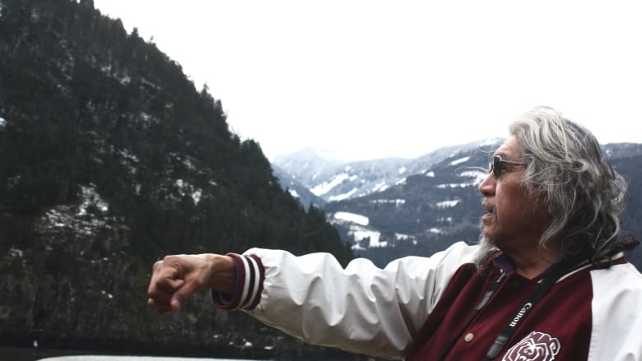
Intro: The Voice of the Land is our Language
Notes:
Sonny McHalsie, a local elder and Sto:lo knowledge keeper.

Slide 4
Reading – Pg. 8-15

Slide 5
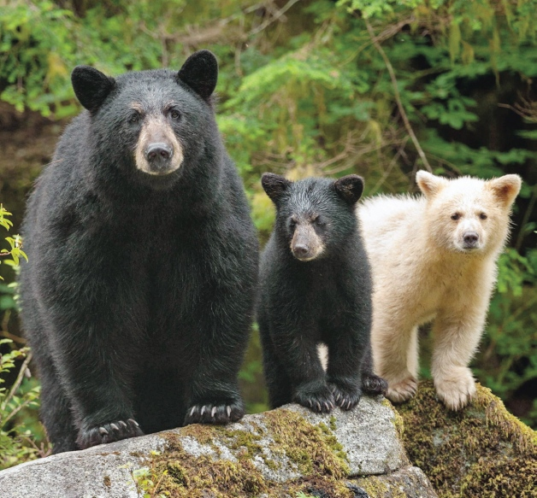
Spirit Bear Stewardship, Spirituality, and the Land

Slide 6
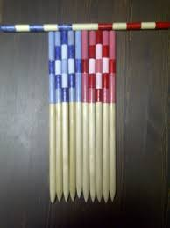
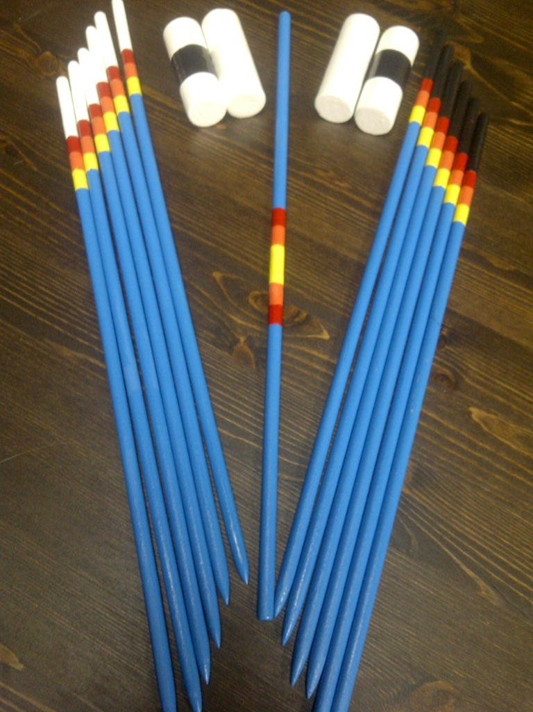
Lahal (Bone Game)
https://www.youtube.com/watch?v=_BBHge8wzR0
Notes:
Sonny McHalsie, a local elder and Sto:lo knowledge keeper.

Slide 7
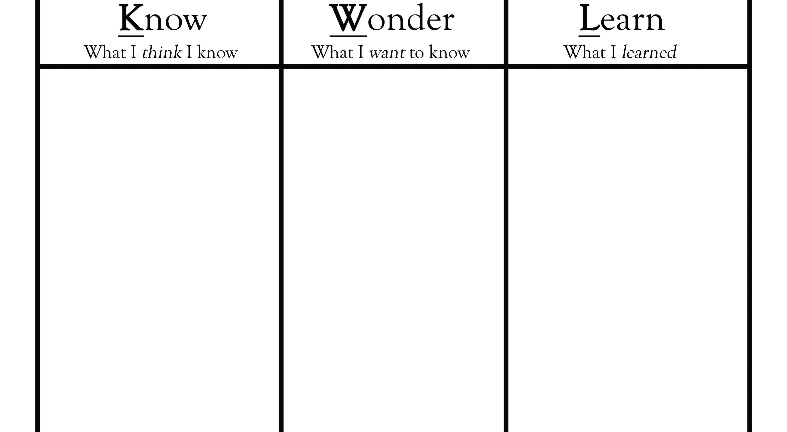
K.W.L – Come grab a copy.
What are some of the main characteristics of societies of First Nations in BC?

Slide 8
Drawing Topics
Choose any two of the following headings and draw an illustration/image for it. Be sure to include a caption that illustrates your understanding of the topic.
Introduction to the Voice of the Land
Governance
Spirituality
Cross-Cultural Protocols
Conflict Resolution
Stewardship of the Land

Slide 9
Classwork
Finish Stations Activity
Finish ‘Origin Story’ Assignment
Begin working on Intro-Drawing Assignment
Begin working on Intro-Questions
Begin working on Totem Poles Research

Slide 10
Myth: Indigenous People Don’t Pay Taxes in Canada
False
Only Status-Indians don’t pay taxes.
If they live on the Reserve; no taxes.
If they live off the Reserve; taxes.
If they work on the Reserve; no taxes.
If they work off the Reserve; taxes.
If they purchase stuff on the Reserve; no taxes
If they purchase stuff off the Reserve; taxes. (unless it’s being delivered to the reserve)
Inuit, Metis and Non-Status all pay taxes.

Slide 11
Outline
CNN 10
World Views
Haida Gwaii Totem Poles
Story of the Haida (6 min Video)
Haida Totem Pole Carving (5 min Video)
Classwork!!!!

Slide 12
Acceptable or Un-Acceptable
I’m going to show you a series of statements.
I simply want you to tell me whether they are acceptable or un-acceptable based on our world-view in North America.

Slide 13
Acceptable or Un-Acceptable: Tipping a Waiter/Waitress
In North-America: Acceptable – It’s actually considered rude sometimes to not tip.
In Asia: Un-Acceptable – It’s considered rude to leave a tip, as workers are paid to do their job and don’t need extra incentive.

Slide 14
Acceptable or Un-Acceptable: Giving the Thumbs-Up
In North-America: Acceptable – It’s just giving validation to a person for something they did good.
In the Middle East, Latin America, West Africa, Russia and Greece: It’s like giving someone the Middle Finger.

Slide 15
Acceptable or Un-Acceptable: Opening a Present Immediately
In North-America: Acceptable – It’s expected because the gift giver wants to see your reaction.
In China and India: It’s unacceptable – opening a present in front of someone makes you look greedy.

Slide 16
Acceptable or Un-Acceptable: Eating an Entire Meal
In North-America: Acceptable – shows you enjoyed the meal provided.
In China, Russia, the Philippines, and Thailand: Unacceptable – it signifies you’re still hungry, and the host failed to give you enough food (making them feel ashamed)

Slide 17
What is a World View?
Making sense of our world
How Do We Make Sense Of Our World?

Slide 18
Through Our World View ☺
Largely it is through our world view, the combination of personal and social understandings which we have of reality.
World view is like an invisible set of rules, behaviors, and experiences that help us understand how the world works.
A worldview is the basic perspective we use to understand the world around us and our experience of it.

Slide 19
World View: Not Realized or Articulated ☺
All of us live out of a worldview perspective, even if we do not realise it, or are unable to articulate it if asked.
What indicates our worldview is not necessarily how we react to individual events or specific situations, but the overall pattern or character of our lifestyle.

Slide 20
How Do We Learn About Our World View?

Slide 21
Learning from Culture, Family + Community ☺
We learn much of our world view from the culture we live in, from our family and significant people in our communities.
We build our attitudes, values, and norms of behaviour based on what we learn through things such as social interaction, languages, food, customs, gestures, rewards, and punishments.

Slide 22
The Lens + Meaning ☺
Through the lens of our world view, we make judgments about people based on how they act and what they say.
Even though we may not be aware of it, the meaning we get from what people do and say is culturally based.

Slide 23
Culture: Our Norm + Difference ☺
Cultural differences may cause us to misinterpret simple things like the nodding of a head, hand gestures, or making eye contact.
In some cultures, direct eye contact when you are speaking to someone is a sign of honesty and openness, while in other societies it is seen as disrespectful.

Slide 24
Cultural Expression = Understandings or Assumptions? ☺
The context of cultural expressions is important in understanding them.
Often we make assumptions about other people based on our world view, but if our assumptions are wrong, misunderstandings may arise.

Slide 25
What Happens When We Do Not Accept Or Understand Other World Views?

Slide 26
Other Viewpoints Exist: Beware of Ethnocentrism
Sometimes, if we do not take into account other viewpoints, we may act in a biased or prejudiced way.
Problems occur when people hold the mistaken belief that their world view is the only correct view, or that it is better than others. This is called ethnocentrism.
Ex: Colonialism

Slide 27
Prejudice, Stereotypes, Racism . . .
Out of an ethnocentric viewpoint can grow cultural stereotyping, where we tend to look at people from other cultures in superficial and simplistic ways.
Often, this develops into negative attitudes about people from other groups.

Slide 28
The Roots of Conflict: Awareness Needed
Throughout history, ethnocentrism and cultural stereotyping have been at the root of many conflicts between individuals and groups.
By becoming aware of our own world view, and understanding the cultural context of people with other world views, we can learn to value the rich diversity of cultures.

Slide 29
How Are World Views Connected To Our Basic Beliefs?

Slide 30
World View + Basic Beliefs ☺
World views deal with basic beliefs, not just any belief (an acceptance that a statement is true or that something exists; trust, faith, or confidence in someone or something).

Slide 31
Our Beliefs ☺
Our basic beliefs emerge whenever we enquire about concrete issues in life:
What do you say to someone who has had a death in their family?
Why do innocent people suffer?

Slide 32
Our Beliefs
What should we do about famine, war or genocide?
What is acceptable in terms of sexuality (your feelings about sex)?
What is acceptable in terms of nudity?
What is acceptable in terms of inequality?

Slide 33
How might our worldview affect specific areas?
Roles – How are they created? How does this apply to Gender?
Rituals or Superstition – When is something considered to be “true/real” vs. “made-up/phony”
Social Class and Status – How do we judge someone to be popular? How do we classify people in our society?
Work – Who works? How much time do we spend working? When is it un-acceptable to work?
Time – How does it dictate our lives?

Slide 34
Two World-Views
Western
First Peoples
Scientific/Written Record
There is one truth; based on science.
The land is a resource we should develop and extract.
Time is Linear: months, years, etc.
Humans are most important in the world.
Wealth is beneficial for the individual.
Spirituality/Oral Story
There are multiple truths; based on experiences.
The Land is Sacred.
Time is Cyclical: Seasons/Events.
Humans are not the most important in the world.
Wealth is beneficial for the community.

Slide 35
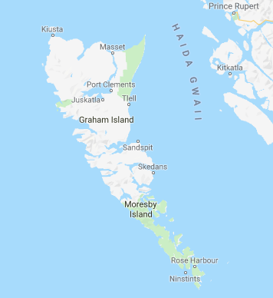
Haida Gwaii
Use to be called the “Queen Charlottes” or “The Charlottes”
June 3rd, 2010 – Reconciliation Act renamed it.
Haida Gwaii translates to “Island of the People”
Over 150 islands make up this Archipelago.
Some of the oldest First Nations sites in Canada, dating back 13,000 years ago.
Notes:
Sonny McHalsie, a local elder and Sto:lo knowledge keeper.

Slide 36
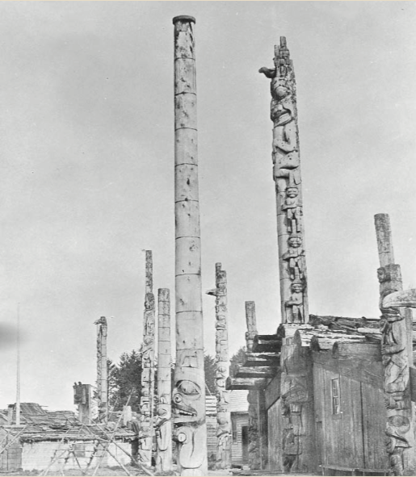
Haida Gwaii, Totem Poles https://indigenousfoundations.arts.ubc.ca/totem_poles/
What is the purpose of the Totem Pole?
What do the symbols represent?
How many types are there?
Explain the process of carving a totem pole, including selection.
Notes:
Sonny McHalsie, a local elder and Sto:lo knowledge keeper.

