Slide 1
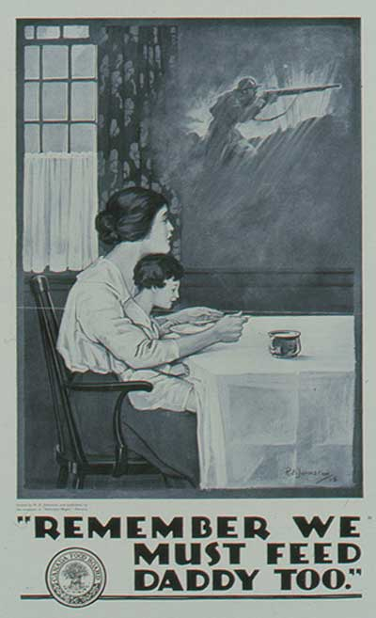
On the Home Front
The Contributions of Canadians

Slide 2

“Total War”
World War One would affect not only soldiers fighting on the battlefields, but also those in Canada on the “home front.” It was a “Total War.”
“Total War” refers to the involvement of everyone and everything in the war effort.
Every Canadian was asked to contribute in whatever way they could.

Slide 3
The War Effort
Soldiers
Homes
The war effort was much more than just soldiers fight on the battle field. The contributions on the home front were integral to success.
Government

Slide 4
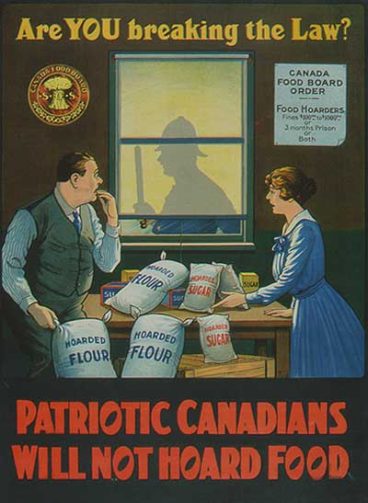
Canadians Contribute
Ways that Canadians contributed to the war effort:
Victory Gardens
All extra produce shipped overseas
Little meat, butter, sugar, or bread in diet.
Fundraisers
Women work in the factories
Care packages for soldiers
Canadian crops help feed the soldiers overseas

Slide 5
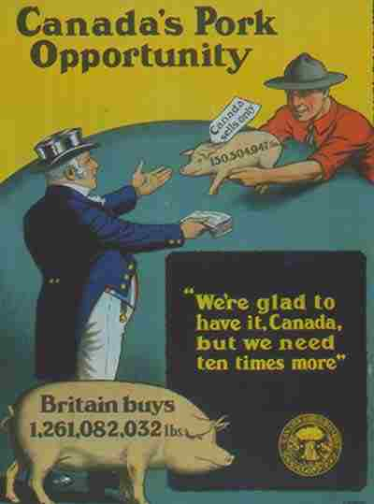
High Demand for Canadian Food
There was great demand for Canadian crops:
Russian wheat exports to Europe stopped
France and Belgium’s farmlands were occupied by Germans.

Slide 6
Production of War Materials
In 1914 Canada had one munitions factory. By the end of the war there were over 600 factories producing munitions.
Over 250, 000 Canadians would work in these factories many of which were women.
However, there was suspicion of profiteering.
Definition: increasing the price for a product during a difficult time
Joseph Flavelle was named head of the new Imperial Munitions Board to regulate production and stop profiteering.

Slide 7
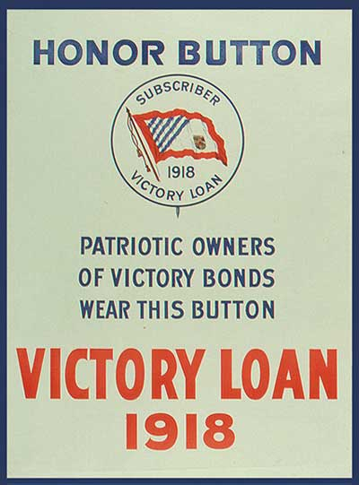
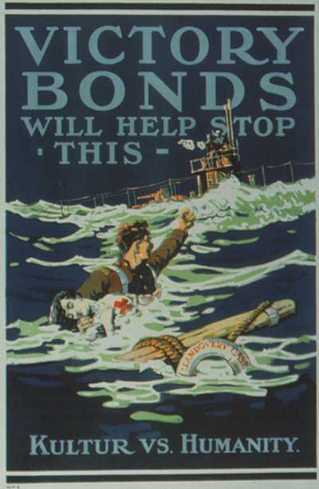
Paying for the war
Cost for Canada:
1918 ($439 million p.a.)
The following helped pay for the costs of the war:
New Taxes: personal income and business income
Victory Bonds: Canadian citizens leant money to the government and were paid back with interest after the war.

Slide 8
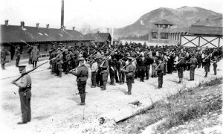
The War Measures Act
The War Measures Act is a temporary law that gives the government more power to protect and defend the nation in times of war.
Actions taken:
Censorship imposed
Enemy Aliens monitored
Police given more powers
Internment Camp

Slide 9
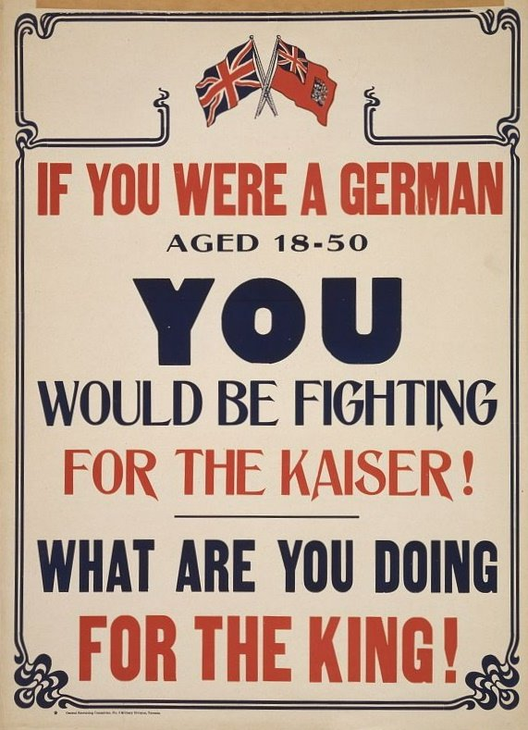
Enemy Aliens
Definition: Immigrants from an enemy country living within Canada.
Treatment of “Enemy Aliens:”
8500 in labour camps
Poorly fed, hard work and poorly clothed
Businesses boycotted
Homes and businesses vandalized

Slide 10
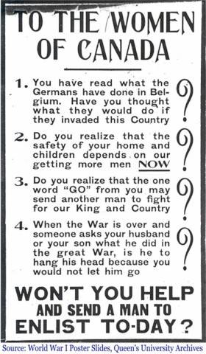
Conclusions
Life at home in Canada drastically changed during the war.
Whether you were a mother, wife, daughter or son your day-to-day life was altered.
The war effort was much more than just the soldiers fighting in Europe. The contributions of Canadians at home was integral to victory.

Slide 11
Resources
Collections Canada
Warmuseum.ca
Firstworldwar.com

