Slide 1
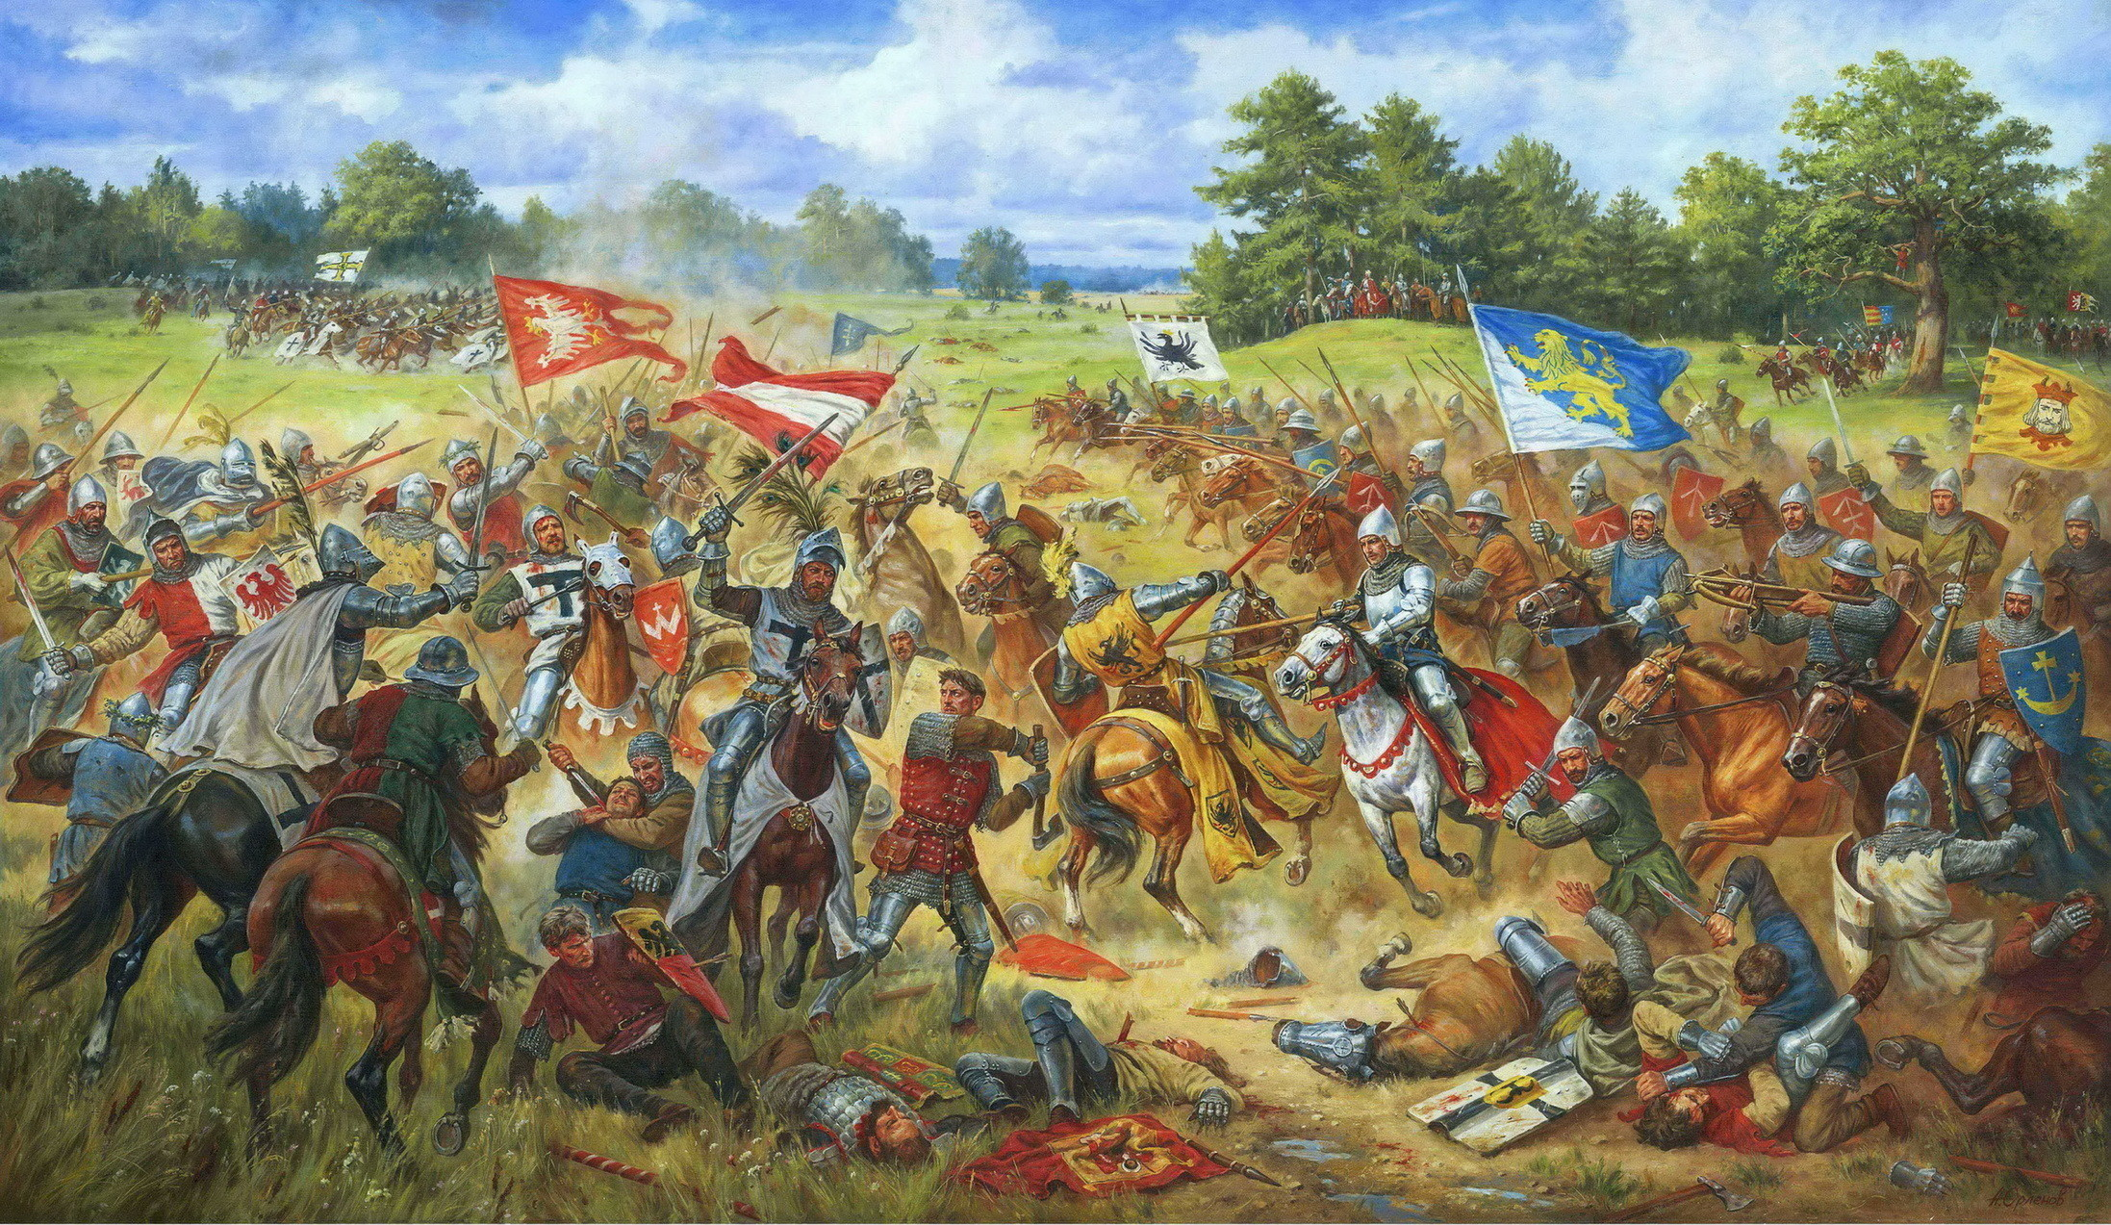
The Middle Ages

Slide 2
L2 – Overview: Becoming a Knight
How to become a knight
Introduction to the Journals - Creative Writing
Pathways Textbook (If there’s time) ☺

Slide 3
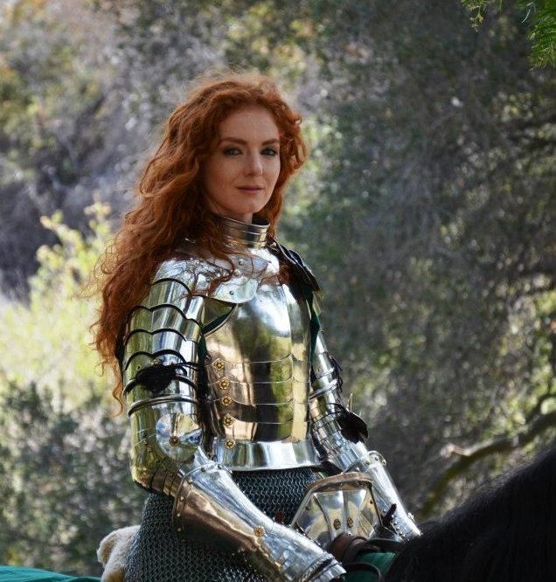
Who could become a Knight?
Women
1149 – Barcelona, Spain – Women are given the privileges of a knight for fighting against the Moors.
1223 – Order of the glorious Saint Mary – granted knighthood to women.
Check it out ☺

Slide 4
bECOMING A kNIGHT ☺
The Right Connections – It was expensive!
You would need to buy armor, a horse, and train.
Anyone could be a knight, but most knights came from noble families.
Upbringing
Stay at home till age 7
Learn good manners and begin to understand the role of chivalry, honor, and servitude
Attend tournaments and hear stories about other knights.

Slide 5
bECOMING A kNIGHT ☺
Page
Sent to the home of a Noble
Also referred to as a Varlet, “little vassal”
Duties include: being a waiter, cleaning clothes and dressing your noble.
You would sleep at the end of your master’s bed.

Slide 6
bECOMING A kNIGHT ☺
Page
The young page would receive an education being taught religion, manners, riding, hunting, hawking and strategic games such as backgammon and chess.
Training
Wooden Horse
Piggy Back Attack

Slide 7
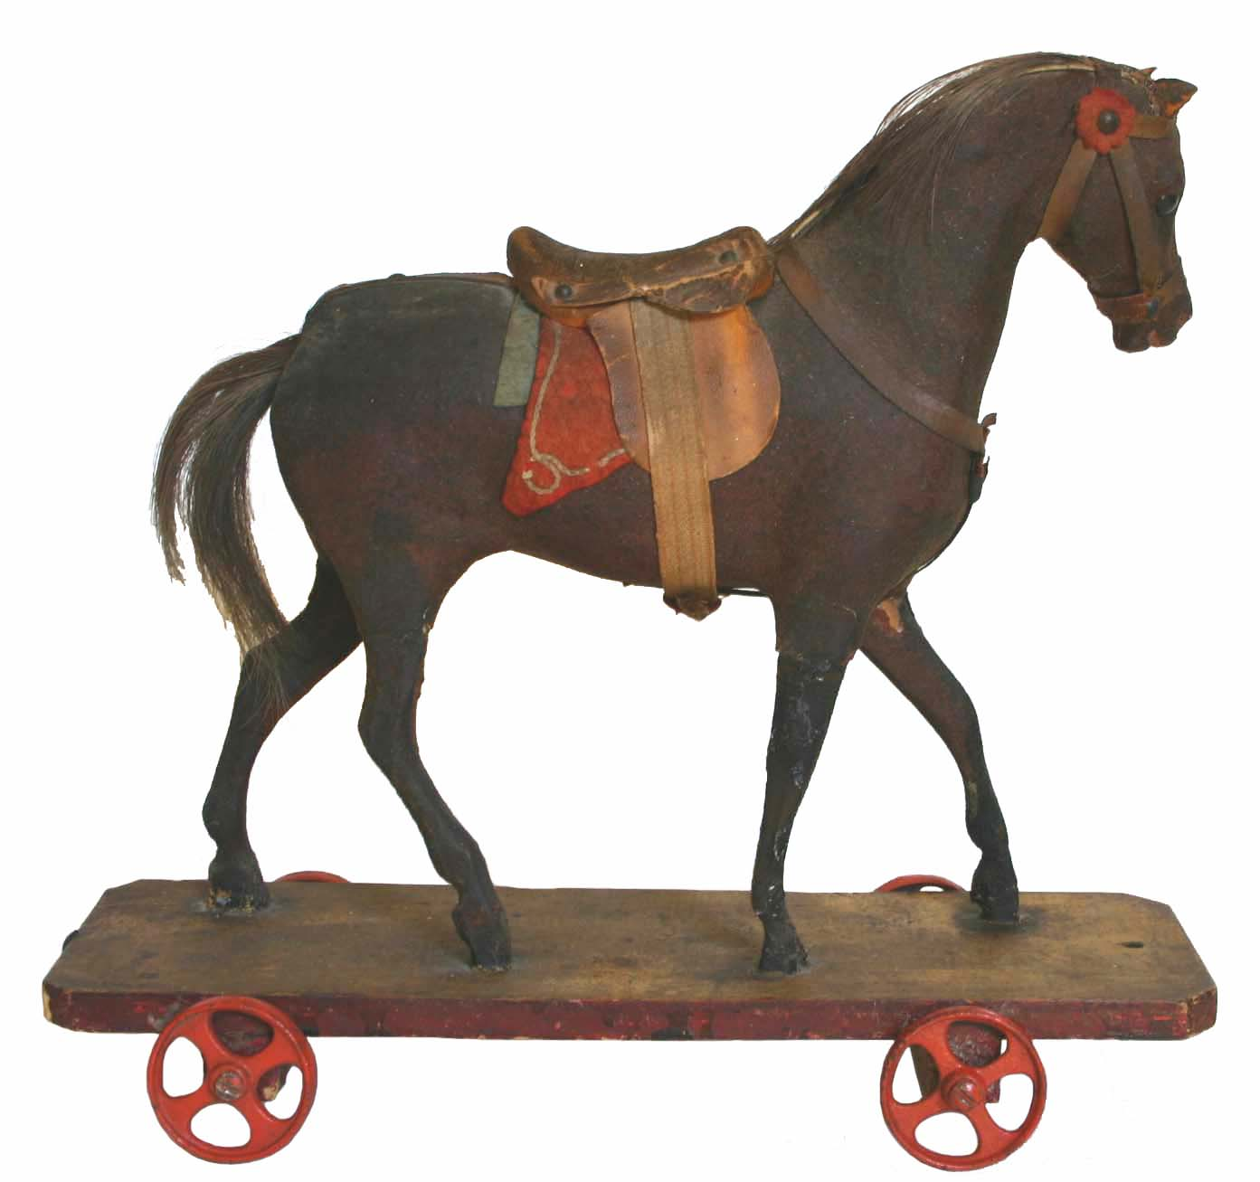
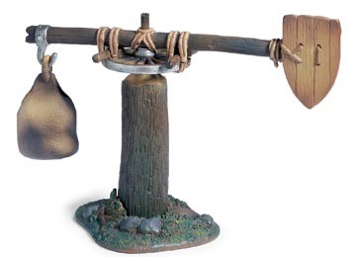

Slide 8
bECOMING A kNIGHT ☺
Squire
Age 14 you begin your training for 7 years.
The duties of a Squire were to learn about Chivalry, the rules of Heraldry, horsemanship and practice the use of weapons and the skills required of a Knight.
It was also their duty to enter into the social life of the castle and learn courtly etiquette, jousting, music and dancing
Squires would accompany their knights on the battlefield.

Slide 9
Becoming a KNIGHT ☺
Knights
After 14 years of training you would go through one last step – Accolade.
An accolade is the bestowing of knighthood through the touching of a sword upon a persons shoulder often done at a ceremony.
You would also be given an oath

Slide 10
Knight Oath
“Be without fear in the face of your enemies. Be brave and upright that God may love thee. Speak the truth always, even if it leads to your death. Safeguard the helpless and do no wrong - that is your oath. Rise a Knight!"
– Kingdom of Heaven

Slide 11
Knight Oath
Be loyal through your actions and words, and serve every man as best you are able. Seek the company of good men; hearken to their words and remember them. Be humble and courteous wherever thou go, boasting not nor talking too much, neither be dumb altogether. Look to it that no lady or damsel be disappointed by the way you treat her, nor any woman of any quality. And if you fall into company where men speak with disrespect of any woman, show by gracious words that it pleaseth you not, and depart.

Slide 12
jOURNAL aSSIGNMENT
Students will create their own journal based on a character they have created and will write in their journal each day as different events, concepts, ideas occur (Becoming a squire, a page, a knight, going to tournament, going on crusade, the black plague, etc.) In the end, students will submit their journals to be marked for authenticity, accuracy and detail to assess whether they have understood the life of their character during this time. The journals will be marked using a rubric.

Slide 13
cRITERIA FOR jUDGEMENT
Student has created a character through which to view the High Middle Ages. This will include:
Giving the character a name
Giving the character an occupation
Giving the character a family (or friends or co-workers)
Including background information about the character’s daily life, values, and beliefs.

Slide 14
Criteria for Judgment Cont’d
Journal has 10 entries.
Each entry is between 1 to 3 paragraphs.
Each entry displays historical accuracy based on classroom, textbook, or individual research.
Each entry illustrates the character’s point of view.

Slide 15
Journal
I want you to go write in your journal ☺

Slide 16
STOP!
Go get your
PATHWAYS TEXTBOOK!!!!

Slide 17
L3 - Overview
Silent Reading
Review
Knight’s Oath
Pathways Textbook
Quiz Review

Slide 18
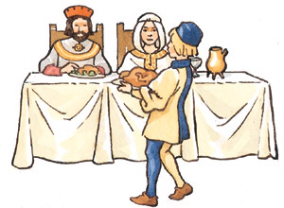
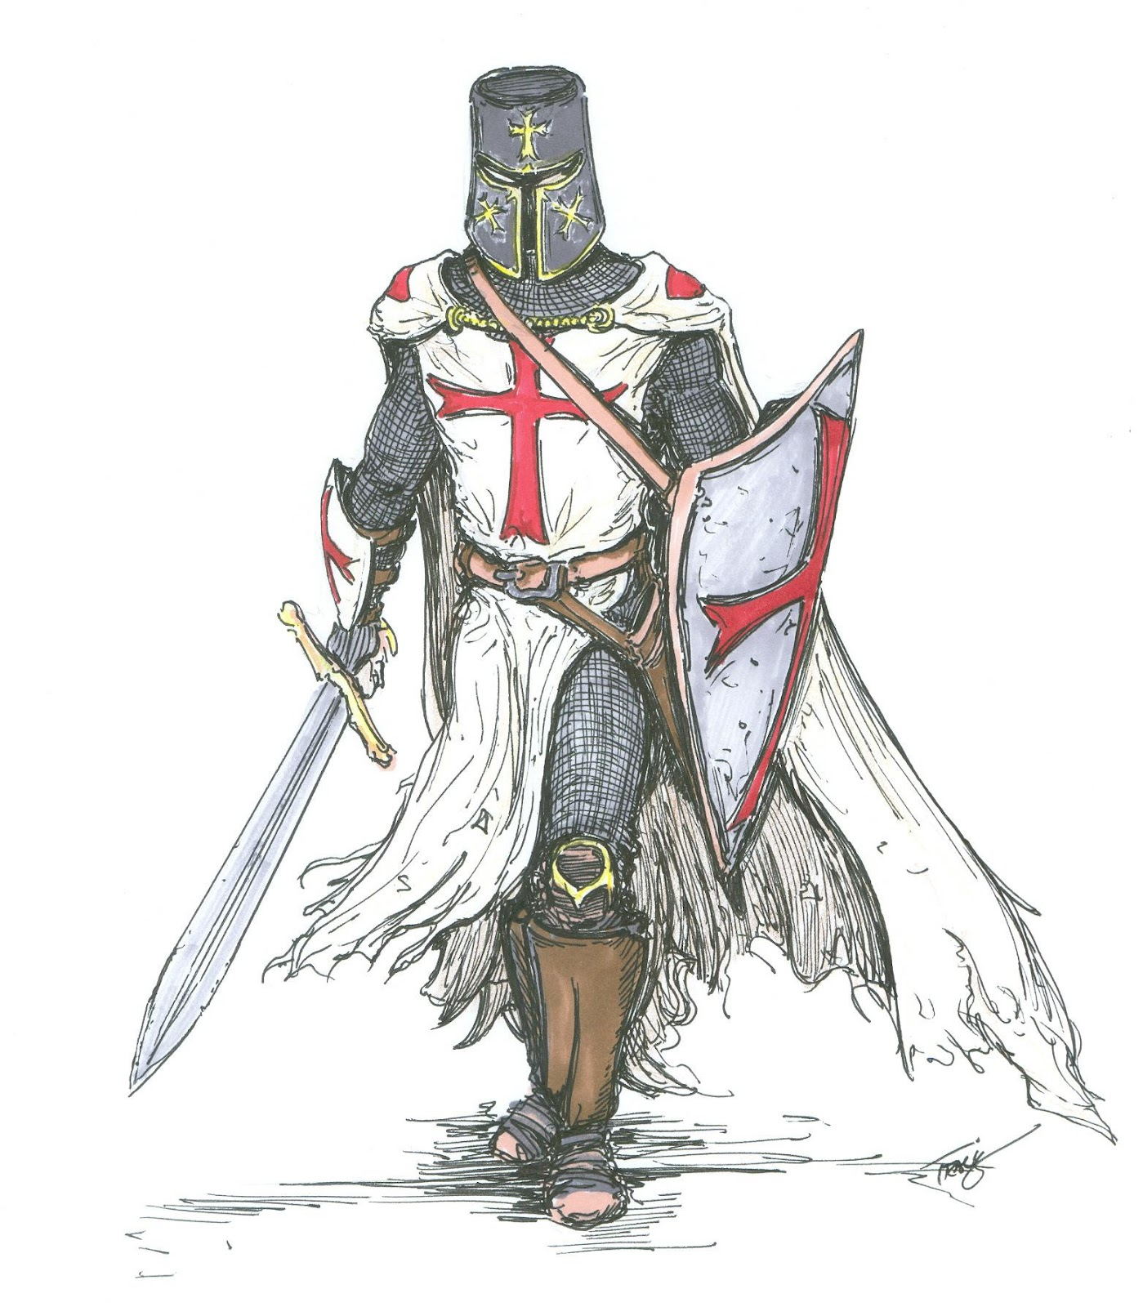
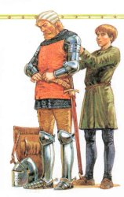
3
1
2

Slide 19
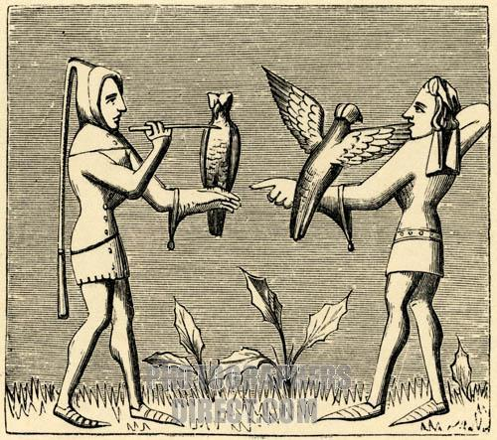
WHAT IS THIS CALLED?

Slide 20
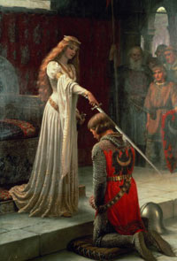
wHAT IS THE cEREMONY cALLED?

Slide 21
Knight Oath
Be loyal through your actions and words, and serve every man as best you are able. Seek the company of good men; listen to their words and remember them. Be humble and kind wherever you go, neither bragging nor, nor talking too much, or acting foolish. Look to it that no lady or girl be disappointed by the way you treat her, nor any woman of any quality. And if you fall into company where men speak with disrespect of any woman, show by gracious words that it pleaseth you not, and depart.

Slide 22
oUR sCHOOLS
We Respect:
Self, by accepting and valuing ourselves for who we are.
Others, by accepting and valuing others for who they are.
Learning, by seeking and valuing opportunities to learn.
Environment, by protecting and conserving our surroundings.
Safety, by thinking before acting.

Slide 23


Slide 24
Let’s Create our own Oath!
What is a need in our community?
Either with our family, our friends, in our school, in our town?
What can we do to help?
I will…

Slide 25
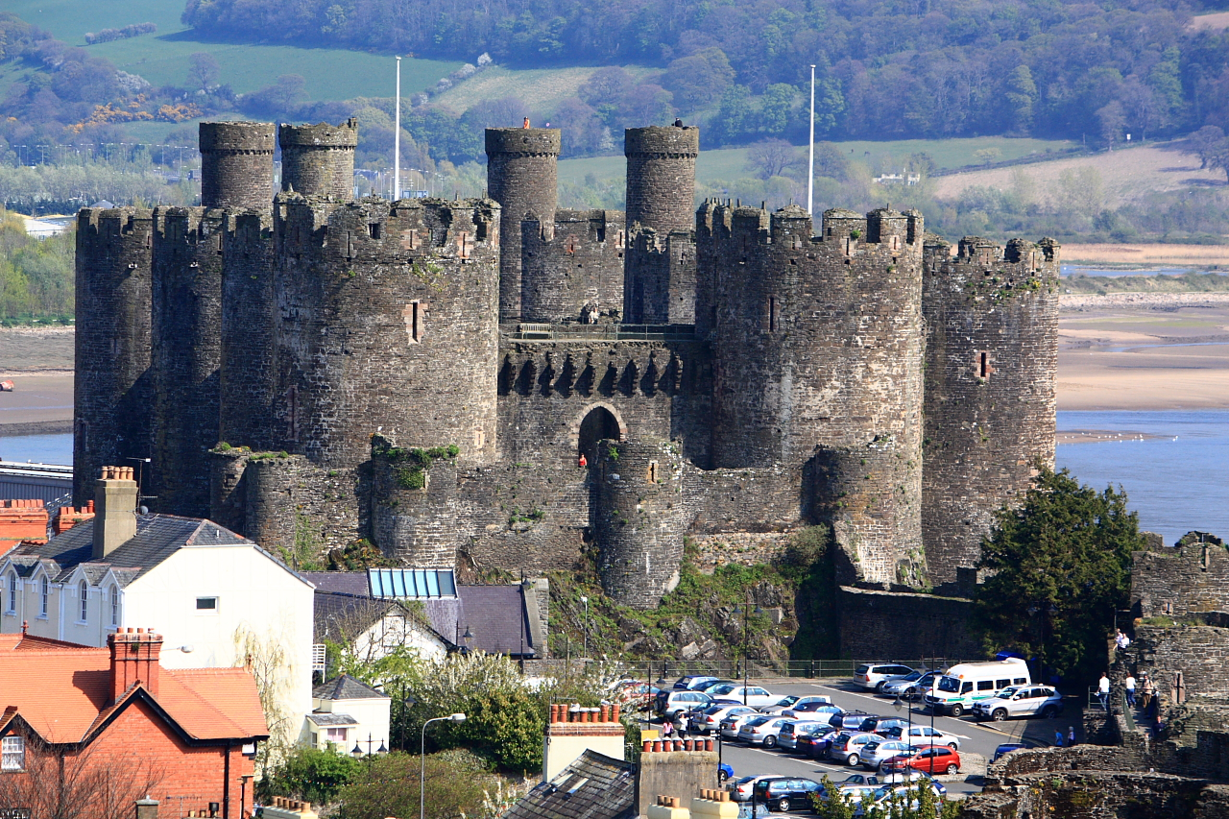
Conwy Castle

Slide 26
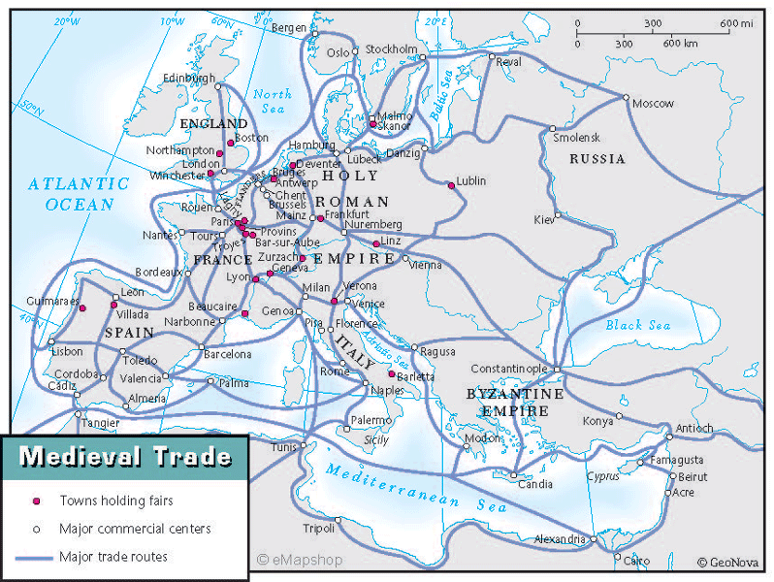

Slide 27
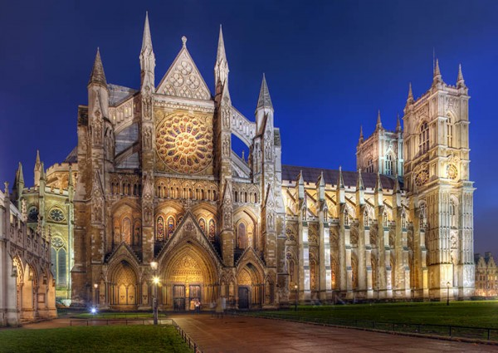
Westminster Abbey

Slide 28
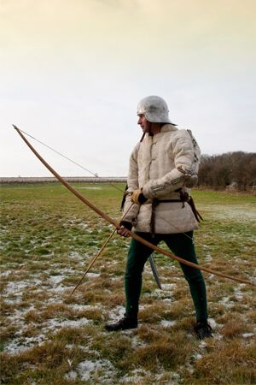
English Longbow

Slide 29
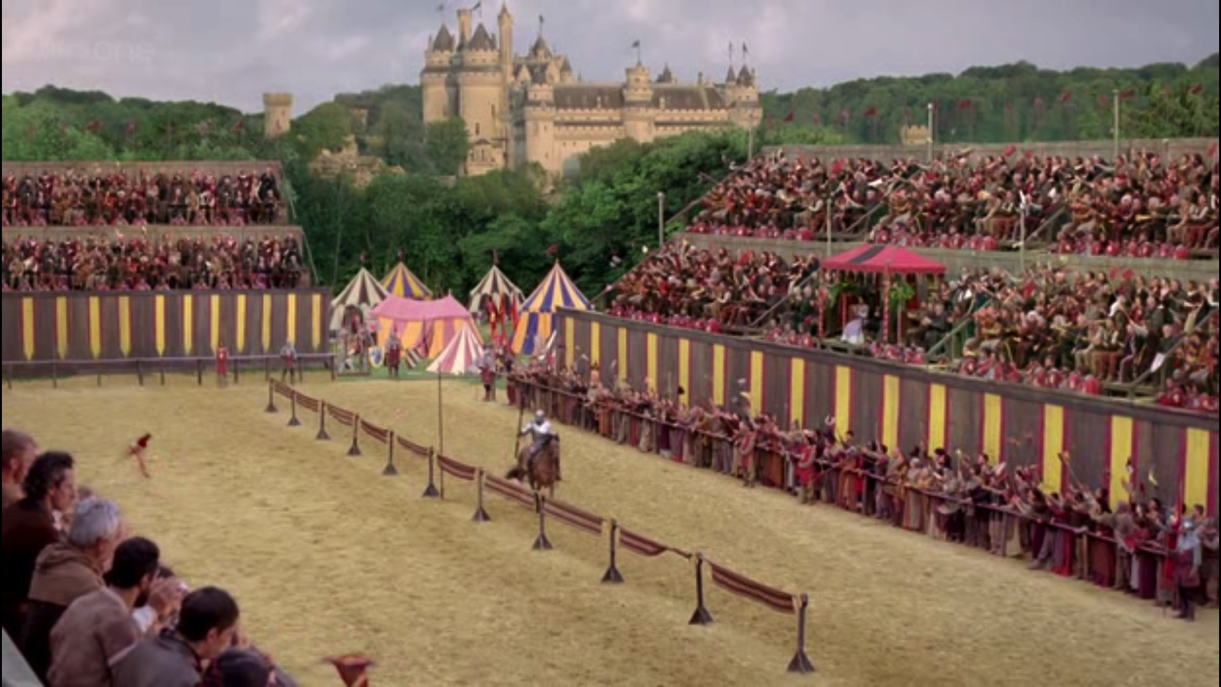
The Jousting Lists

Slide 30
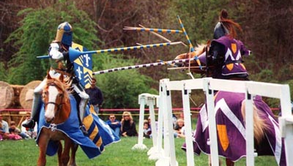
Jousting

Slide 31
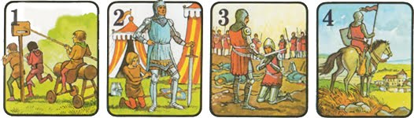
Stages to becoming a knight

Slide 32
Pathways Textbook
Read Pages 141-143 in your Pathways Textbook, and answer the questions on the handout provided.
Please use a separate piece of paper to answer your questions. (Write your name at the top ☺)
Use full sentences.
Do not use “he, she, them, or it” – be specific about who you’re referring to.

Slide 33
Brain Break
Opposite Sides - Movement is critical to learning.
Stand Up!
Try blinking with your right eye while snapping the fingers of their left hand. Repeat this with the left eye and right hand.
If you’ve mastered this – Try tapping your left foot, while blinking your left eye, and snapping your finger on your right hand.
Switch it up, speed it up!

Slide 34
Go over the ANSWERS
Please take out your worksheet, we are going to go over the answers.

Slide 35
L3 - Overview
Silent Reading!
Watch 3 Movie Clips
Finish our Pathways Textbook Reading
Finish our ‘History of Knights Handout’
Journal Writing

Slide 36
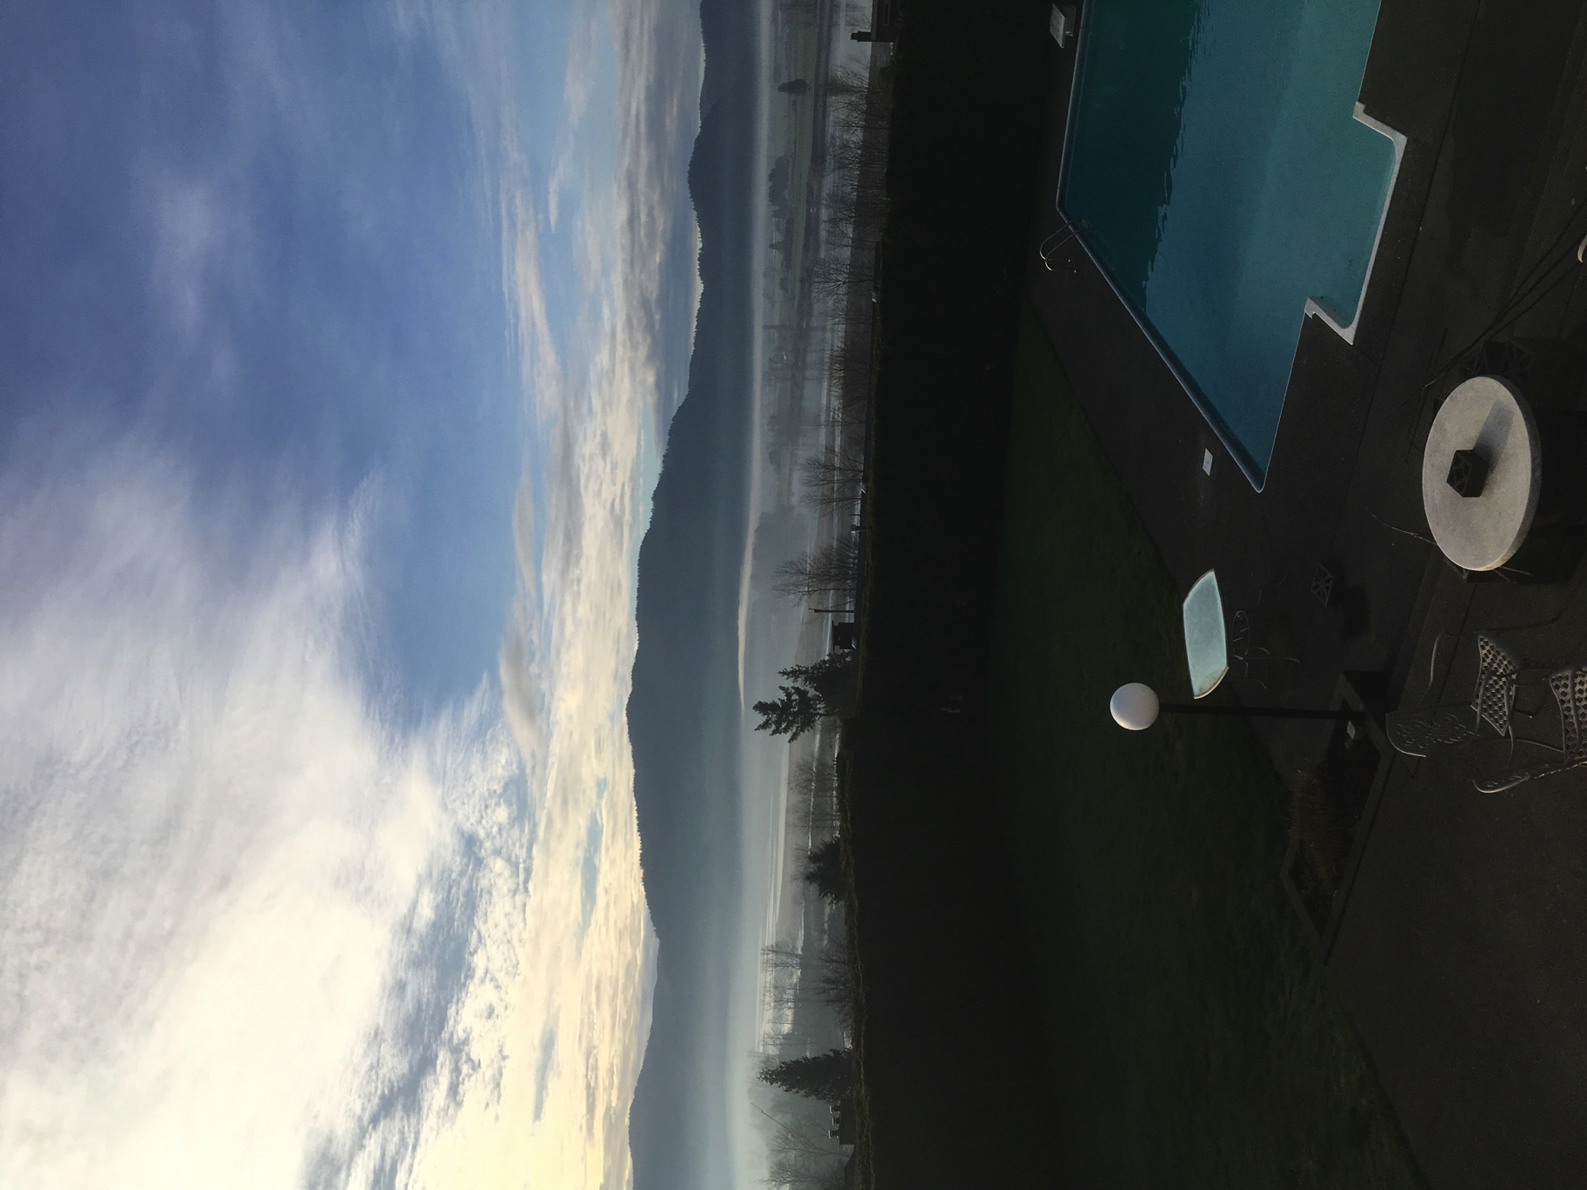

Slide 37
Moviessssss!
Putting on a Knights Armor
Sewing Chain Mail
Forging a weapon

Slide 38
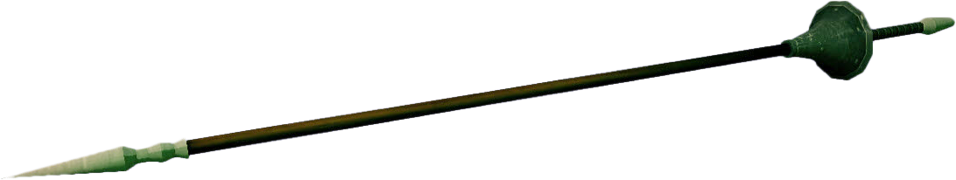
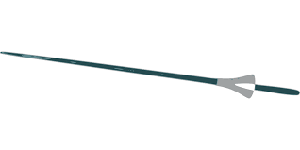
Lance

Slide 39
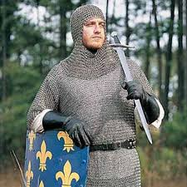
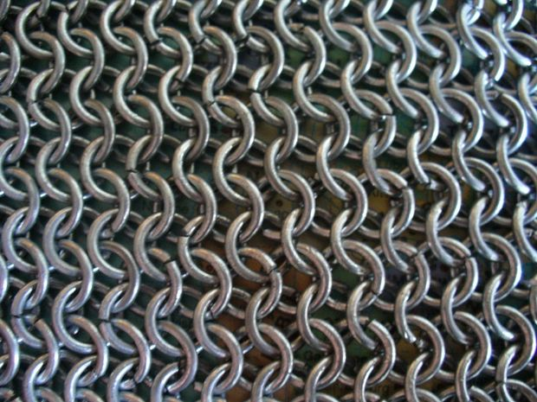
Chain Mail

Slide 40
History of Knights handout
Using the “Knights, Armor, Weapons and Chivalry” handout, answer the questions on a separate piece of paper.
Please write your name at the top of the page.
Answer in full sentences.
Do not use he, she, them or it.

Slide 41
L3 – Overview: Heraldry
Silent Reading
Power-point on Heraldry
Pathways Textbook – Pg 144
Creative Writing – Journal

Slide 42
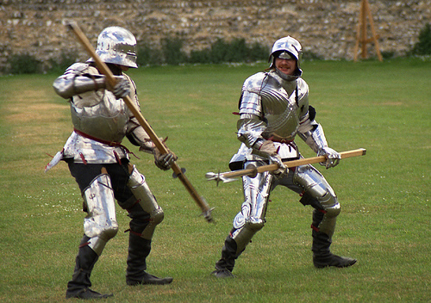
Who’s WHO?

Slide 43
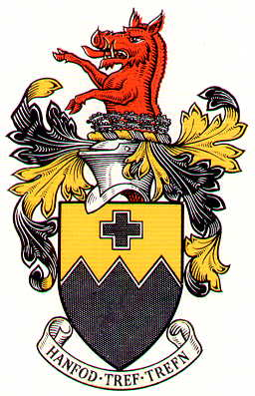
Heraldry ☺
Heraldry
is a system of identification that developed during the Middle Ages in order to help identify fully armored knights on the battle and tournament field.

Slide 44
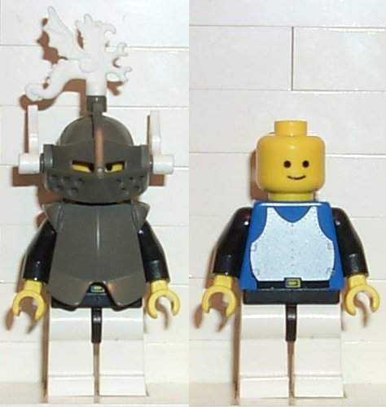
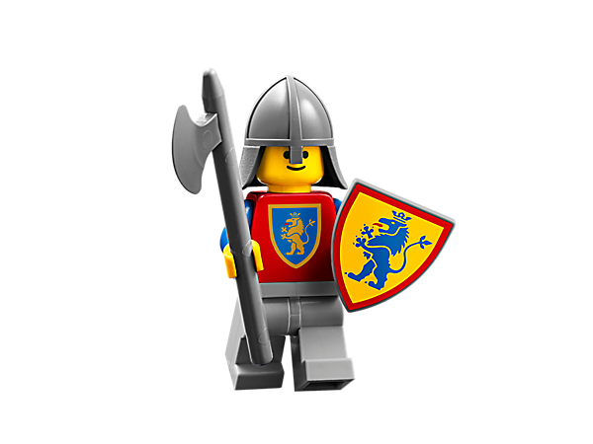
Who’s Who?

Slide 45

Heraldry
During the Middle Ages people couldn’t read.
Invented HERALDRY.
Heraldry was a design with a short saying.
It was a way of bragging about your family traits.

Slide 46
Heraldry
DESIDERANTES MELIOREM PATRIAM
They desire a better country
A MARI USQUE AD MARE
He shall have dominion from sea to sea and from the river unto the ends of the earth

Slide 47
Classwork
Turn to page 144 in your Pathways Textbook.
Read Page 144 in your Pathways Textbook.
Using the handout, “Heraldry” answer the questions provided on a separate piece of paper.
Answer using full sentences.
No using: he, she, them or it.

Slide 48
L4 – oVERVIEW lIFE OF A KNIGHT
Silent Reading
Chalkboard Splash
Life in the Middle Ages
Life as a Knight
Journal Entry #4 – Life of a Knight

Slide 49
 | Middle Ages | Today
We live in… | Houses, Castles, Estates | Houses, Apartments
We eat… | Bread, Mutton, Chicken, Deer, Fruit, Vegetables. | Wherever we want, whenever we want.
We work… | On our farm, as a blacksmith, in a village. | Telecommunications, Inter Companies, etc.
We entertain | Plays, Tournaments, Carnivals | On our Phone, Movies, etc.
We communicate | News came about often at Church, or through messengers | On our phones, or the internet

Slide 50
Things that Didn’t exist
No electricity
No Phones
No Computers
No Internet
No Fridges
No Restaurants
No Cars or Planes
No Showers
No Grocery Stores
No Laundry Facilities
No Television
No place to take out books
No Clothing Stores
No Convenience Stores

Slide 51
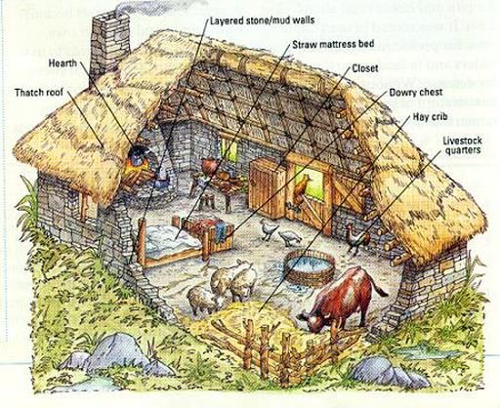

Slide 52
L4: Overview: The Life of a Knight ☺
Clothing
Under their armor, the knights wore padding to ease the pain of wearing such heavy metal.
In the early years, knights wore chain mail. These were metal chains linked together. It took about five years to make body armor out of mail.

Slide 53
L4: Overview: The Life of a Knight ☺
Clothing
The covering for their chests and arms weighed between 20 and 30 pounds and sometimes had up to 200,000 rings. In the later years, knights wore full metal armor.
The helmets that knights wore had eyeholes (usually slits in the metal) and breathing holes so the knights could get sufficient air.

Slide 54
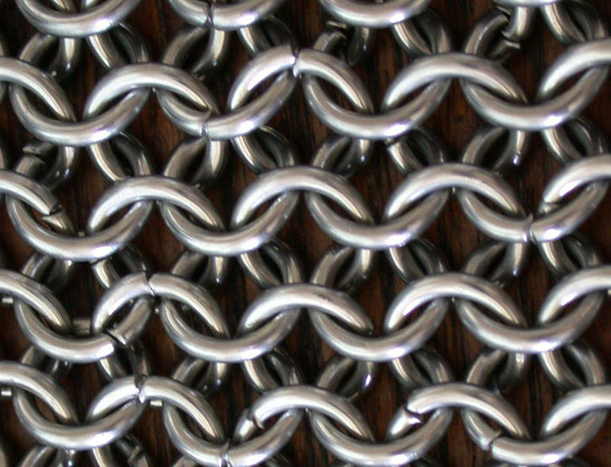
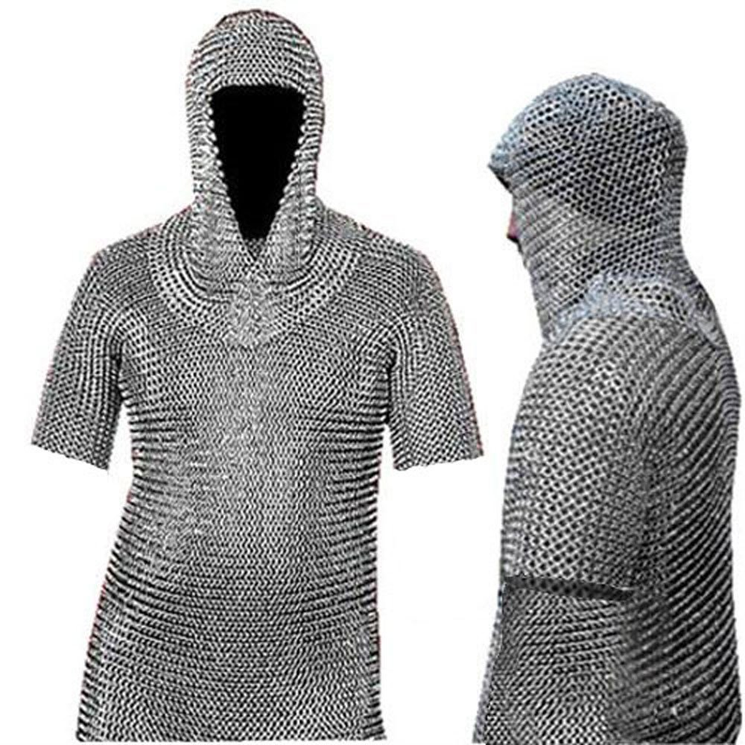
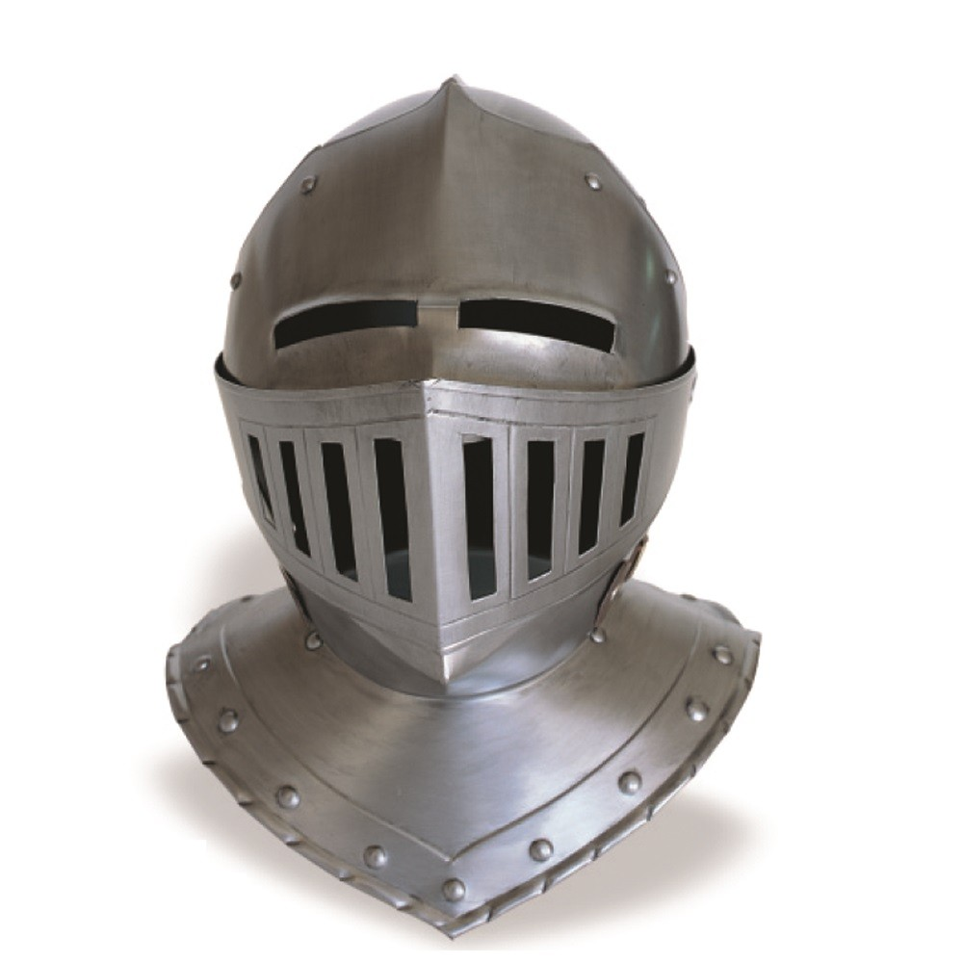
Chain Mail Armor

Slide 55
L4: Overview: The Life of a Knight☺
Clothing
Shields were made of wood or metal and generally had the knight’s family seal shown on it to help identify him.
The sword was the major weapon of the knight and weighed about 21⁄2 to 3 pounds. It was worn on his left side and fastened around his waist.

Slide 56
L4: Overview: The Life of a Knight☺
Clothing
The other weapons that a knight used were a knife (worn on the right side) and a lance (a long spear used while on horseback). Metal axes, battle hammers and maces (a long metal or wooden pole with a heavy end used for clubbing an opponent) were introduced when armor became too strong to penetrate with a sword.

Slide 57
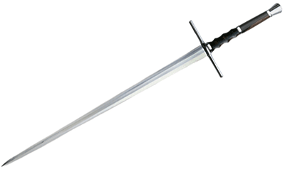
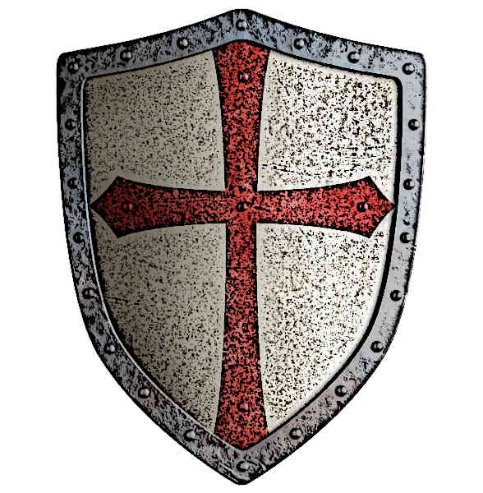
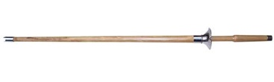
Knight Weapons
Sword
Shield
Lance

Slide 58
The Life of Adventure ☺
Knights would often travel the land.
Going to Festivals, Tournaments, and even battles.
They would also go on quests throughout their lifetime.

Slide 59
The Life of a Knight☺
Chilvalry – 1170 CE
Live to serve their king and their country
Avoid lying, cheating, or torture
Believe in justice for all
Respect women
Avenge wrongs
Link

Slide 60
Classwork
Finish Questions on Heraldry using your Pathways Textbook, Page 144.
Finish your Coat of Arms in your Journal.
Finish Journal Entry #3 and #4

Slide 61
This Week
Finish First Knight
Hand in Questions for First Knight
Tournament Notes
Entry in Journal for Tournaments

Slide 62
Overview
D BLOCK –
Catch up on Missing Assignments
B Block
Finish Video

Slide 63
L5 – Overview: Tournaments
Notes (but only the ones in BOLD) ☺
Creative Writing
Preparing for our Tournament – April 18th

Slide 64
oRIGINS
Began around the 10th Century.
As military exercises and melee became more common, knights began to want to hone and demonstrate their skills in a less chaotic and more focused exhibit.
The tournaments developed into organized, competitions for matched individuals and became a sport that was often played by knights and watched by others.

Slide 65
The Medieval Tournaments
A Medieval Tournament was a series of mounted and armored combats, fought as contests, in which a number of combatants compete and the one that prevails through the final round or that finishes with the best record is declared the winner and is awarded the prize.

Slide 66
The Medieval Tournaments
I. Source of Entertainment
Tournaments were imported from France to England during the 12th century and formed an important element of Medieval military and social life.
Roger of Hoveden an English chronicler, who was employed by King Henry II, described tournaments as "military exercises carried out, not in the spirit of hostility but solely for practice and the display of prowess".

Slide 67
The Medieval Tournaments
I. Source of Entertainment
Medieval tournaments were a great form of medieval entertainment! Tournaments were enjoyed by both commoners and Nobles.
A rich noble would sponsor a tournament and supply the purse for the prizes.

Slide 68
The Medieval Tournaments
I. Source of Entertainment
The contests in the tournament were fought with blunted swords or lances. However there were still many casualties, as many as 10% were injured, and there were also fatalities. The number of fatalities dropped as the tournaments became better regulated. Medieval physicians were always at hand during the tournaments.

Slide 69
Rules of the Joust
1.Only nobles may compete in the joust
2.Competitors must have their own horse and armor
3.Up to 3 lances may be used in one match
4.Only the squire can talk to the knight during the joust
5.Knocking your opponent off the horse ends the match
6.Winners may choose to take the loser’s armor or horse, or claim another prize

Slide 70
Quintain Jousting
In quintain jousting, the knight aimed his lance at a fake wooden target on a pole which sometimes revolved. If he hit the target inaccurately or slowly, a sand bag would swing around and hit him

Slide 71
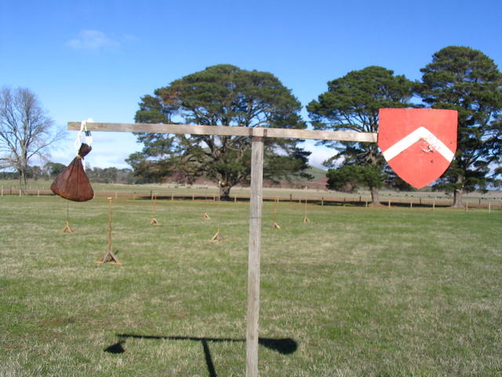

Slide 72
Ring Jousting
In ring jousting, or tilting, a knight would attempt to spear small rings on the tip of his lance. These rings were some- times hung on cords, posted on stanchions, or tossed in the air.

Slide 73
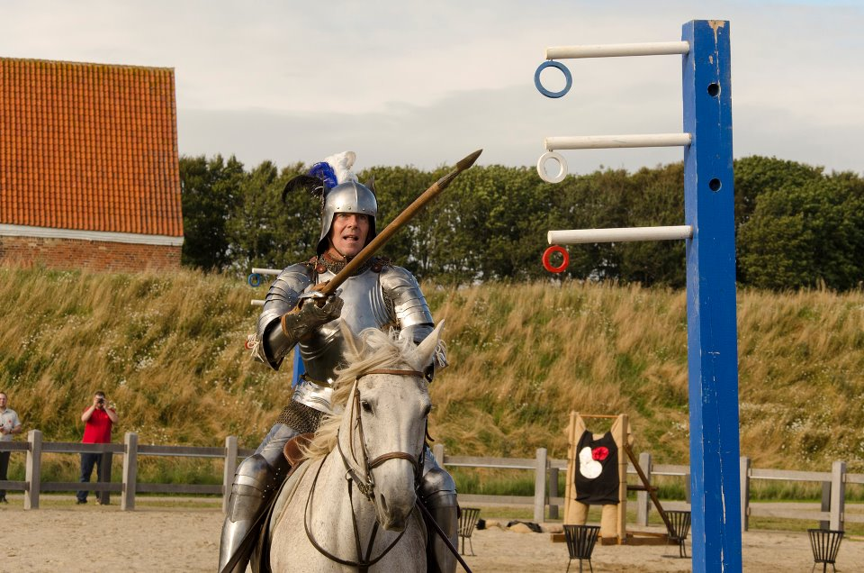

Slide 74
FUN FACT!
In the early 1400s, a low partition wall between the two opponents was added to the individual joust. The knights would go back and ride at each other again and again until a winner was announced. The partition wall was primarily added to reduce injury for the horses.

Slide 75
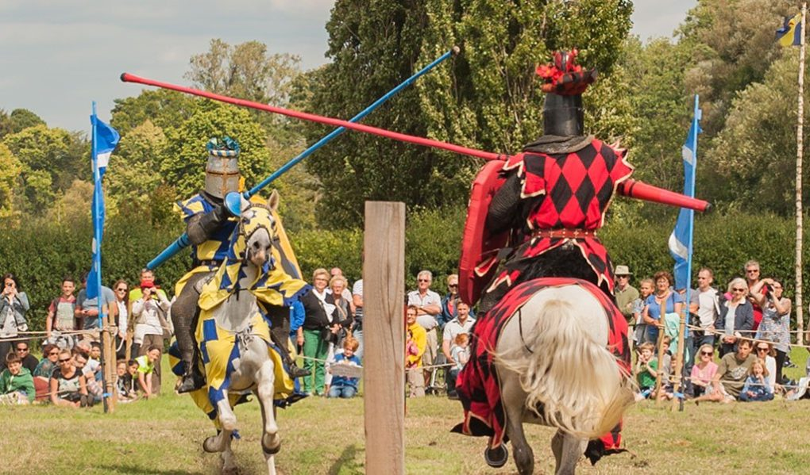

Slide 76
Did you know!
Battle was just as dangerous for the horse as it was for the rider, so horses sometimes had armor as well (more weight to carry!). Attacking the horse while jousting, however, was considered unfair play.

Slide 77
The Horse
Horses were very important for medieval combat. They helped knights tire less quickly and were necessary for attacks with the lance. Special horses were bred for knights, because they had to be exceedingly strong with incredible stamina.

Slide 78
A Good Horse
Carry a knight and his heavy armor without tiring
Travel for long periods of time, still with a heavy load
Gallop quickly for strikes during battle
Stay steady as the knight braced attacks or received blows
Remain calm enough to perform in front of cheering crowds during jousts and tournaments

Slide 79
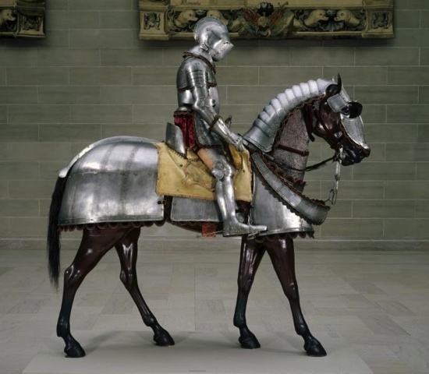

Slide 80
Evolution of Armor
The most common jousting body armor during the 13th and early 14th centuries was iron chainmail.
Though chainmail could protect a knight from puncture wounds, he could still be very badly bruised by even blunt jousting weapons.
As a result of this weakness, most knights switched to plate armor later in the 14th century.

Slide 81
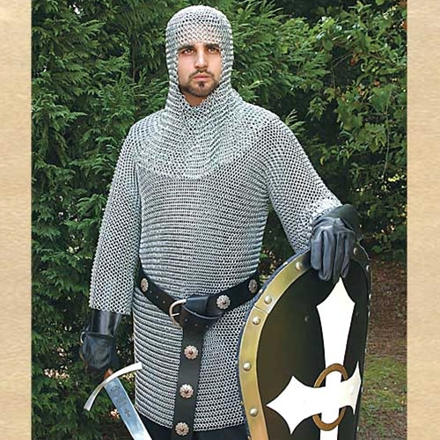
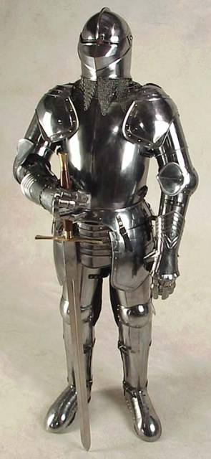
Chain Mail
Plate Armor

Slide 82
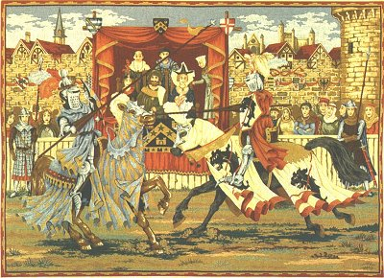

Slide 83
The Medieval Tournaments
I. Source of Entertainment
Knights would fight as individuals but there would also be team events. The events of the tournament were the joust, the melee, and fighting on foot. The Tournaments were the favorite sport of Medieval Knights. The tournaments kept the knight in excellent condition for the role he would need to play during warfare.

Slide 84
Status of Knights
Jousting in medieval tournaments became so popular that it even influenced the status of knights! Showing their skills in tournaments with big crowds could either make or break a knights reputation.

Slide 85
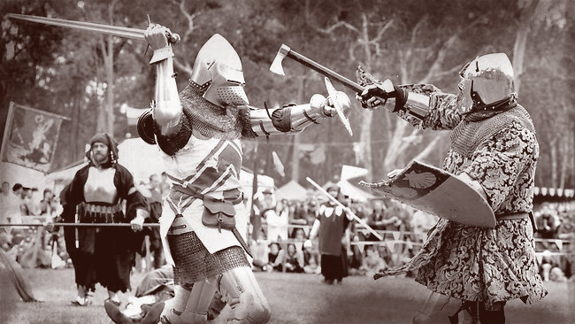

Slide 86
The Medieval Tournaments
II. The Different Types of Combat
There were different types of Medieval Tournaments, joust or melees, which each had a different type of combat method.
Joust a plaisance Tournament –
A series of elimination jousts over several days and an overall winner would be determined. Each Knight would run the lists three times with each opponent
Pas d'armes or passage of arms Tournament –
A Knight would send out a proclamation that he would take on all challengers at a specific time and place.

Slide 87
The Medieval Tournaments
II. The Different Types of Combat
Melee a pied Tournament
Teams of knights fighting on foot
Melee a cheval Tournament
Teams of knights fighting on horseback

Slide 88
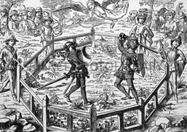

Slide 89
The Medieval Tournaments
III. Regulating the Medieval Tournaments - The Statute of Arms
The number of injuries and fatalities that occurred during early medieval tournaments had to be regulated. Early tournaments were wild affairs - copious alcohol was consumed and many tournaments ended with the pillage, rape, and slaughter of local villagers! Valuable Knights were killed and injured at tournaments.

Slide 90
The Medieval Tournaments
III. Regulating the Medieval Tournaments - The Statute of Arms
In 1292 the "Statute of Arms for Tournaments" was ordained "at the request of the earls and barons and of the knighthood of England" which provided new laws for tournaments. The Statute of Arms ordained that no pointed weapons should be used - they should be blunted, tournaments had to be properly organized and only authorized combatants were allowed to carry arms.

Slide 91
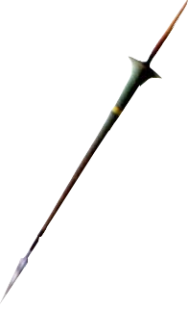
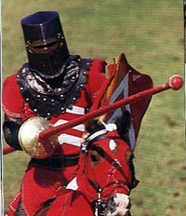

Slide 92
The Medieval Tournaments
IV. The Location
The Medieval Tournaments lasted over several days. As the tournaments became more organized, so did the event itself. The location of the tournament would be allocated by the sponsor. The sponsor was often a rich noble who would finance the prize. The tournament would therefore be located on a field near to the nobles’ castle and local village.

Slide 93
The Medieval Tournaments
IV. The Location
The Lists were the designated area for jousting fenced off in the centre of the field. Wooden bench seats were sometimes erected but usually villagers sat on the ground in view of the lists. The Nobles sat in the galleries - pavilions erected to provide shelter. The whole area would be blazoned with color and the tents and blazons of the Knights. Even the horses were draped in flowing cloth, called a caparison, which was patterned according to its owner's heraldic signs.

Slide 94
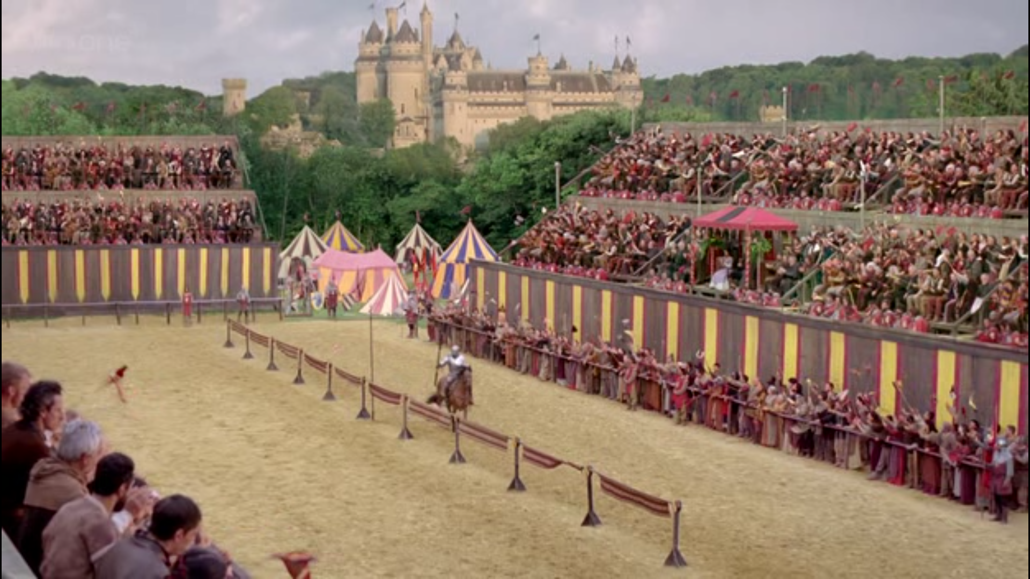
The Lists

Slide 95
The Medieval Tournaments
V. The Kippers and the Spoils!
Medieval tournaments were a good source of revenue for a successful Knight. If they were lucky they would claim the champion's prize money. But at early tournaments they were also allowed, as was the right of a knight, to seize the armour and weapons of a fallen adversary during the tournament. (Later the tournaments were governed by pomp, ceremony and chivalric conduct and this right was waived.)

Slide 96
The Medieval Tournaments
V. The Kippers and the Spoils!
To claim the armour and weapons the knight employed a vassal, serf or peasant, as his 'Kipper'. A Kipper was expected to collect the 'Spoils of Combat'. The word 'Kipper' originated from the Scandinavian word 'Kippa' which means to snatch or to seize. The weapons and armour was expensive and a fallen knight would not give them up easily. The Kipper was therefore armed with blunt but heavy clubs with which they could knock the unfortunate Knight into an unconscious state!

Slide 97
Rewards ☺
A knight could receive several rewards if he was a good jouster. Very frequently, if a knight won a joust he would re- ceive his opponent’s horse or armor. The winning knight might also be able to hold the losing knight ransom on pa- role, and the losing knight would have return to his estates to raise money for the winning knight.

Slide 98
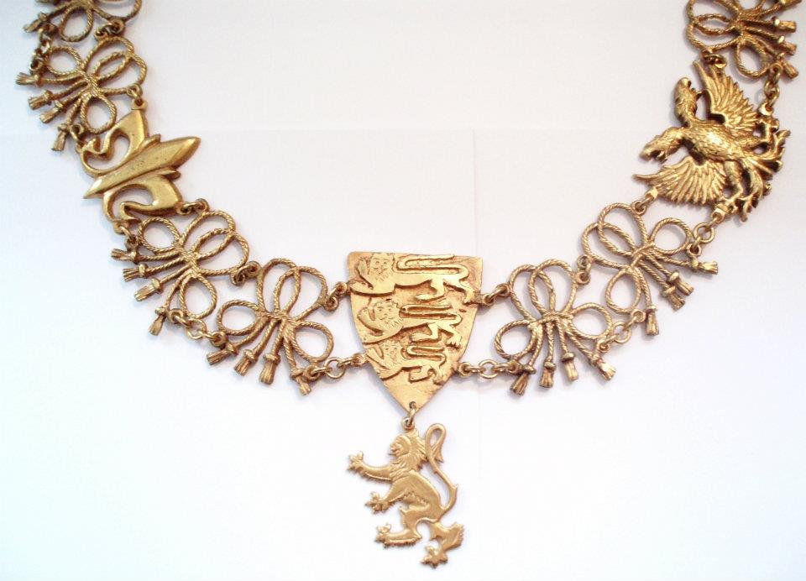
pRIZES

Slide 99
The Medieval Tournaments
VI. The Ladies Favours, Courtly Love and the Chivalric Code!
Ladies attended Medieval tournaments, watching the exploits of the men during the day and attending the feasts and banquets in the evening. The rise of the ideals of courtly love was dominated by the concept that honor should be done to a lady by her champion.

Slide 100
The Medieval Tournaments
The Rules of Courtly Love allowed a Knight to express his admiration even for married ladies. Knights begged "tokens" from ladies, and were presented with "favours" such as a veil, ribbon, or the detachable sleeve of a ladies dress. These 'favours' would be displayed by the Knight attached to his arm, his helm or tied to his lance. The lady thereby showed her favour to the knight who would dedicate his performance at the tournament to the lady.

Slide 101
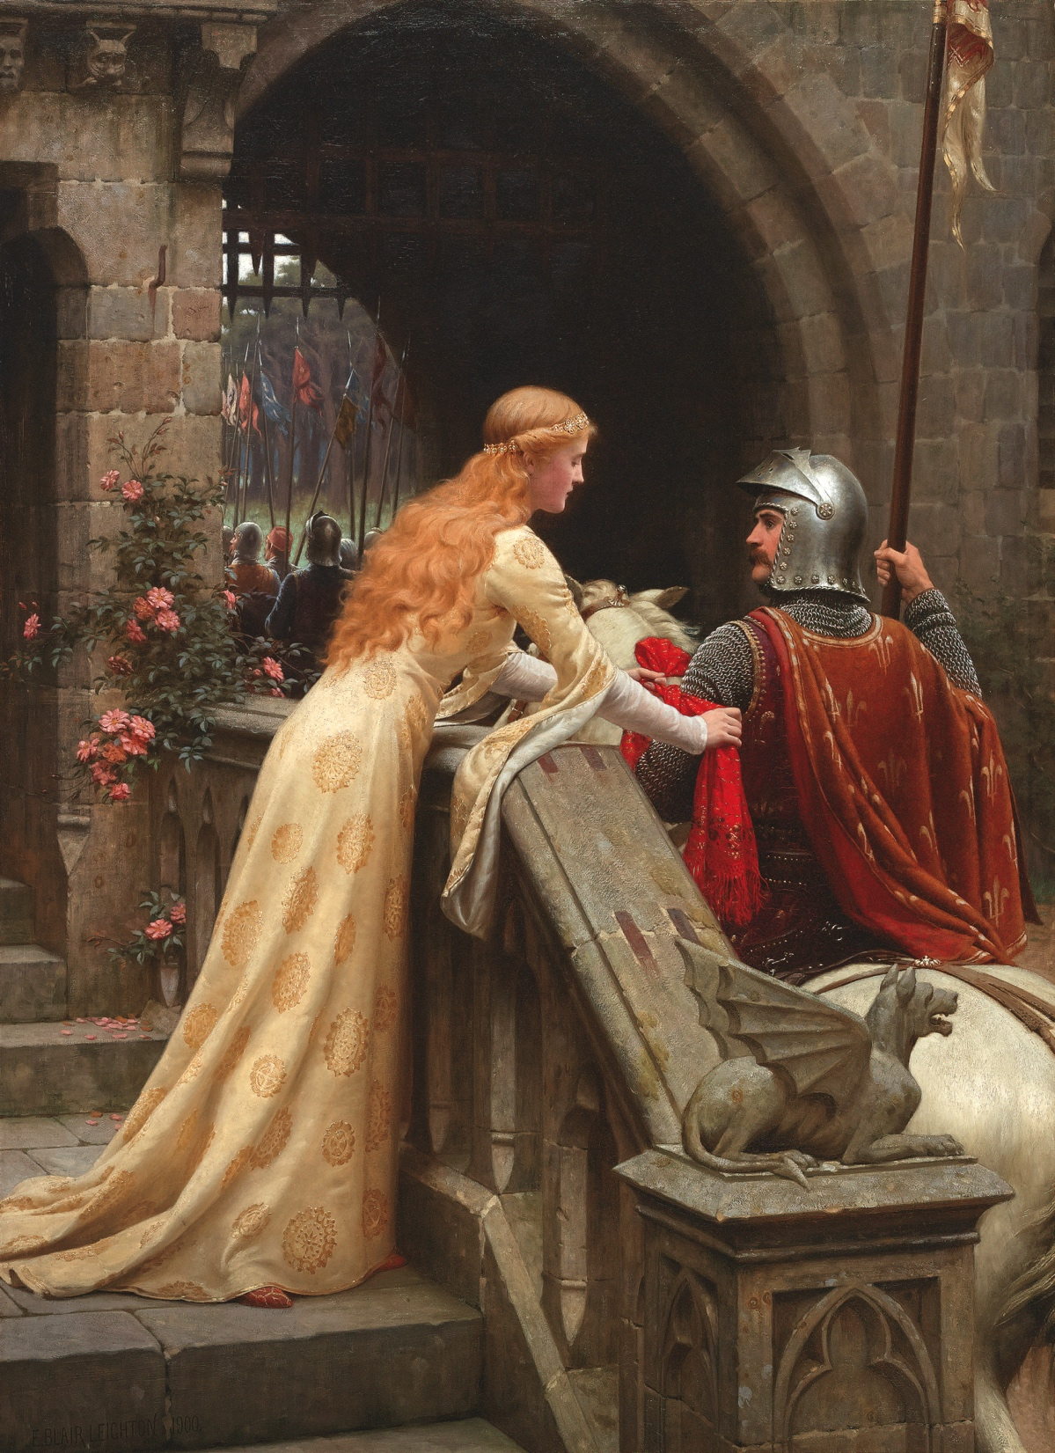
A lady offers her ribbon

Slide 102
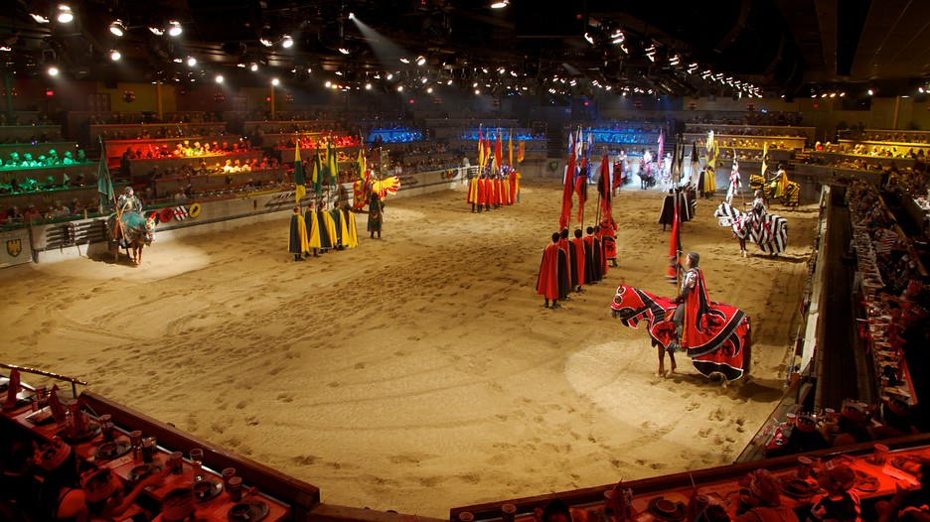
Medieval Times

Slide 103
classwork
Work on Journal Entry #6 - Tournaments

Slide 104
L6 – Overview: Castles
SILENT reading ☺
A Special Day
Types of Castles
Parts of a Castle
Where, Why and Who
Creative Writing: Your First Castle

Slide 105
5 types of Castles
Wooden Palisade
Motte and Bailey
Norman Keep
Concentric Castle
Royal Castle

Slide 106
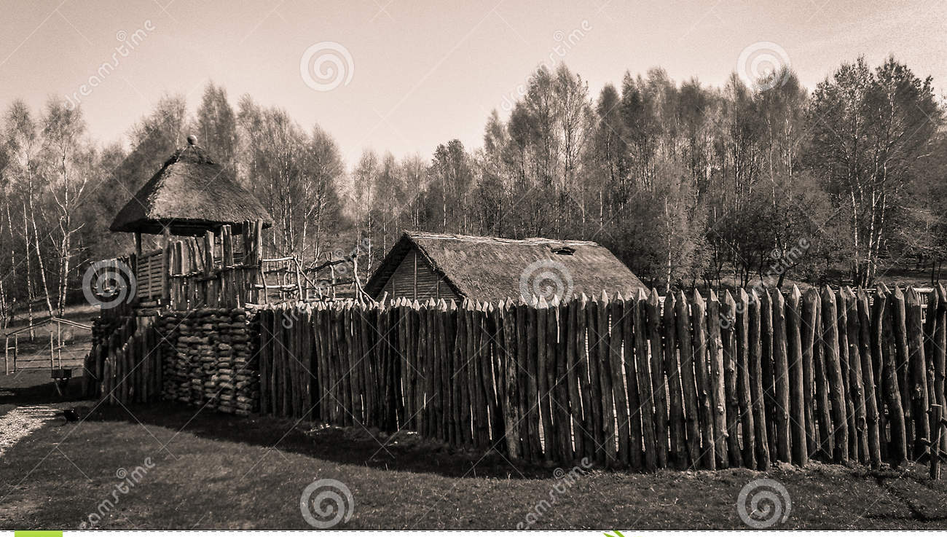
Wooden Palisade

Slide 107
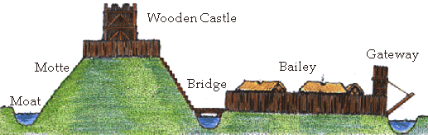
mOTTE AND bAILEY

Slide 108
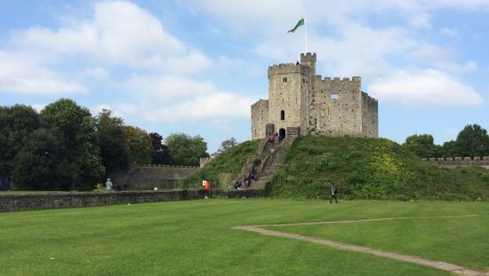
mOTTE AND bAILEY

Slide 109

Shell Keep

Slide 110


nORMAN kEEP
Headingham Castle, 1140

Slide 111

Concentric Castle

Slide 112


Slide 113

Neuschwanstein Castle

Slide 114
Parts of a Castle ☺
Moat - A moat was a defensive ditch dug around the castle. It could be filled with water and there was typically a drawbridge across it to get to the castle gate.
Keep - The keep was a large tower and the last place of defense in a castle.
Curtain Wall - The wall around the castle which had a walkway on it from which defenders could fire arrows down onto attackers

Slide 115
Parts of a Castle ☺
Arrow Slits - These were slits cut into the walls that allowed archers to shoot arrows at attackers, but remain safe from return fire.
Gatehouse - The gatehouse was built at the gate to help reinforce the castle defenses at its weakest point.
Battlements - Battlements were at the tops of castle walls. Generally they were cut out from walls allowing defenders to attack while still being protected by the wall.

Slide 116

pARTS OF A cASTLE

Slide 117

bATTLEMENTS

Slide 118
Where, What, Who? ☺
Where were they located?
Often located on a hill overlooking the area, or built on a spring.
What were they made of?
Made from wood then stone.
Who lived in them?
Kings, Queens, and Nobility

Slide 119
Siege ☺
Often time people would attack your castle, this was known as laying Siege
Siege’s could go on for days to years.
The attacker would use siege weapons to break down the walls, or the morale of the people inside.
Beehives, poisonous snakes, manure, animal carcasses, even human bodies.

Slide 120

Siege Weapons

Slide 121
Siege wEAPONS
Perrier
Trebuchet
Siege Towers
Battering Ram
Building a Castle

