Slide 1
Outline
CNN 10
Living on the Land
  Resources
    Fishing
    Hunting

Slide 2
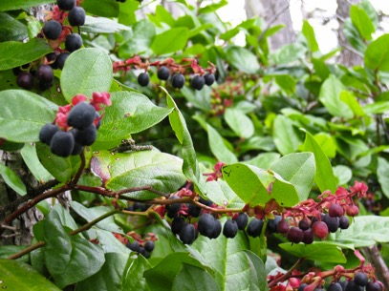
Chapter 2
Living on the Land
Even though First Nations groups are unique, there are similar characteristics and cultural aspects they share.
Stewardship is something that all First Nations cultures carry out.
The resources First Nations gather are more than just food/materials; they are gifts.
First Nations often are grateful/thankful towards these gifts.
Notes:
First Nations Man fishes in Moricetown BC, along the Bukley River.

Slide 3
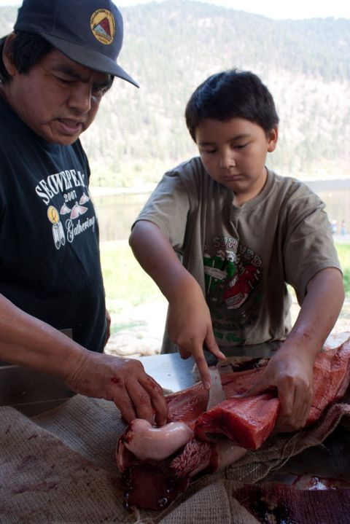
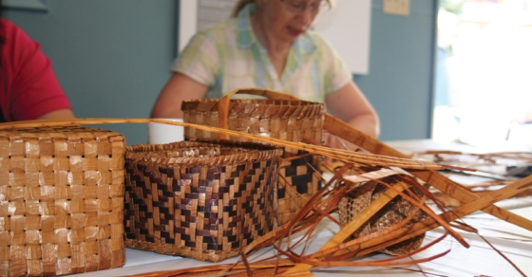
Chapter 2
Harvesting Resources ☺
Due to the many diverse regions in B.C., there is an abundance of different resources throughout our province.
The need for different technologies were developed over centuries to harvest and process these resources.
Notes:
Student at Okanagan School, learning about Traditional methods of filleting fish.

Slide 4
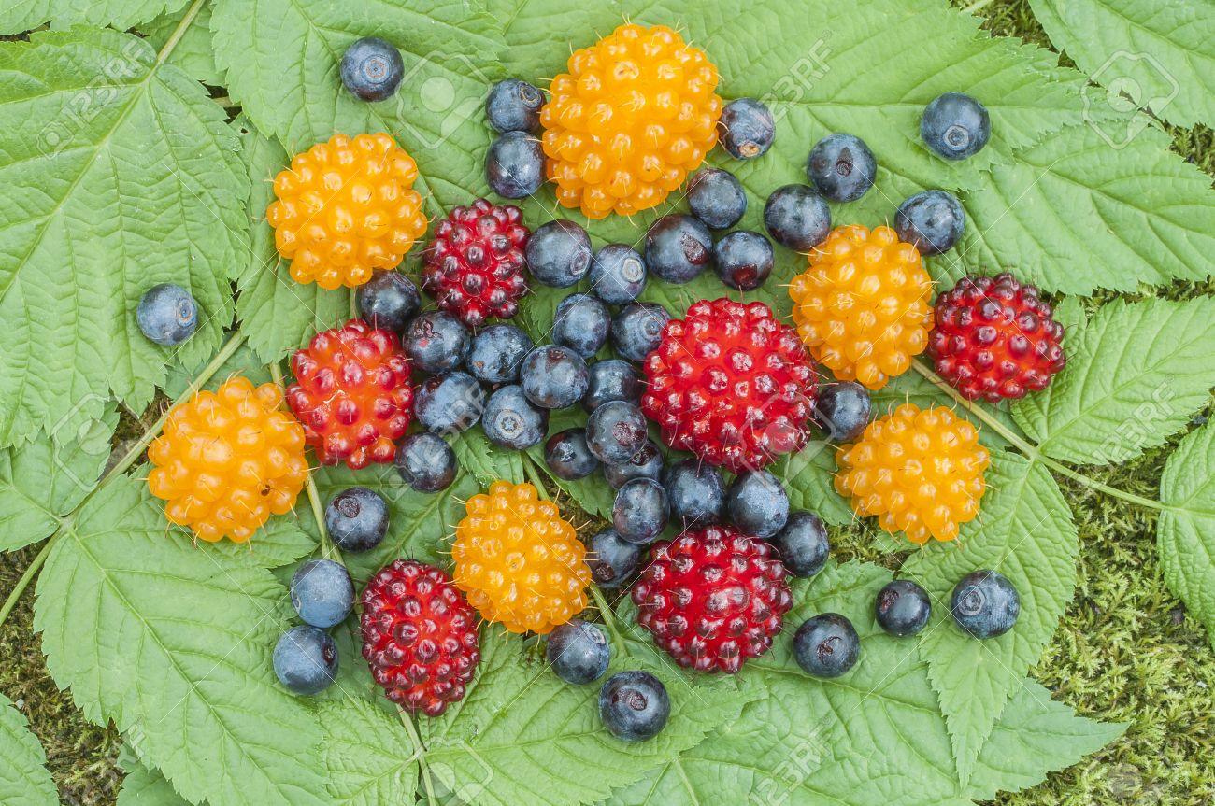
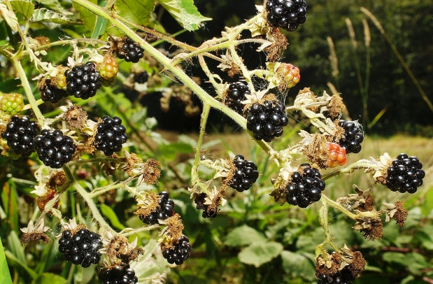
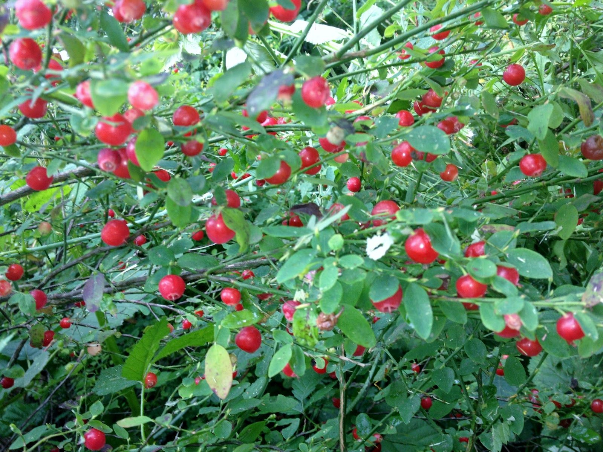
Chapter 2
Plants (pg. 36) ☺
Plants are important for First Nations daily, ceremonial and spiritual life.
Provided food, medicine, tools, dyes, containers, fuel (oil) and fiber.
Controlled Burning Australia California
Harvesting Cedar
Harvesting plants/berries, is always a spiritual practice.

Slide 5
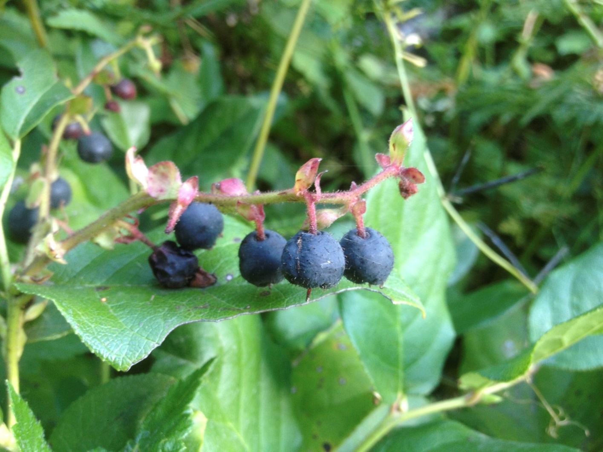
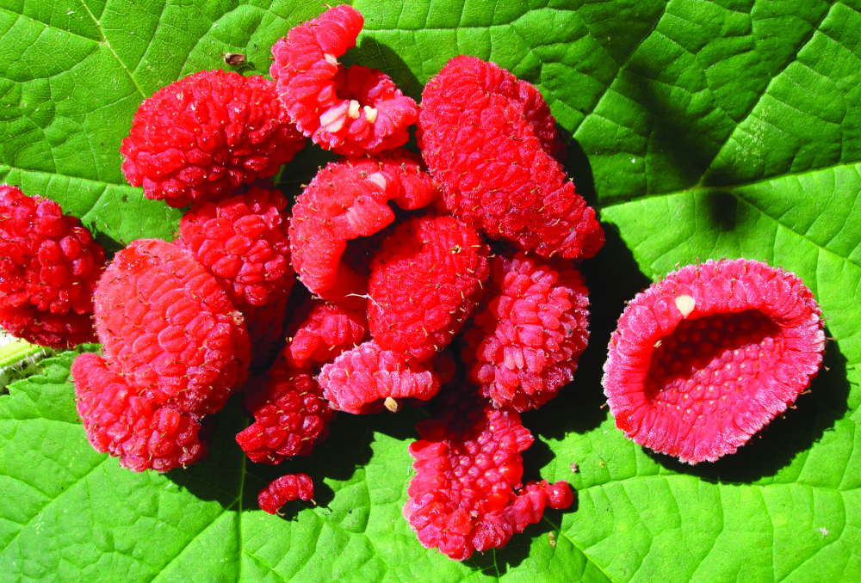

Slide 6
Chapter 2
Nature and Spirituality
Dave Elliot, Saanich
My people never killed a tree unnecessarily. Once in a while the need was so great they would cut a tree. When this had to happen they would speak to the tree. It had a sacred name. Every living thing had a sacred name—streams, lakes, trees, flowers, birds, everything. When your need was great you had no choice. You would stand before the tree and talk to it and tell the tree how sorry you were to take its life. When we took the life of a tree, we used every scrap, every shred right down to the last bit. We used it all. It was wrong to waste something that had been provided for us by this intelligence we didn’t quite understand.

