Slide 2
Outline
CNN 10
Chapter 3

Slide 3
Chapter 3
Sharing the Land and Resources
Imagine what our lives would be like if we had no money to purchase items we did not make.
Would you be able to survive if you and your family had to produce everything you needed to live?
Create an extensive list – illustrating what you would need to produce.
How would you get items you could not produce?

Slide 4
Chapter 3
Sharing the Land and Resources ☺
What does it mean to “barter”?
Barter is the direct exchange of goods or services without an intervening medium of exchange or money; exchanges occur according to established rates of exchange or through bargaining.

Slide 5
Chapter 3
Sharing the Land and Resources ☺
What is an economy? Give some examples from today.
Economy is the state of a region in terms of their production and consumption of goods and services.
What do you think First Nations economies may have been like in the past?
Making weapons/tools, nets, tanning furs, hides, preparing meats/fish.

Slide 6
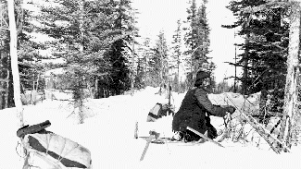
Chapter 3
Sharing the Land and Resources ☺
FN of BC were self-sufficient; using resources in their territories to produce goods.
FN are not isolationists – they traded with neighboring villages to obtain products not found in their territory.

Slide 7
Chapter 3
Trade Economies ☺
FN in BC are believed to have been the most active/expert traders in North America.
Much of the trade came about do to the wealth created by the Salmon Harvest.
Products were often re-purposed: A cedar tree would be made into a canoe, or basket – increasing its value.
The most precious commodity for many was the Oolican Grease.
Why is it that Oolichan Grease (fat) might be important to those in the interior?

Slide 8
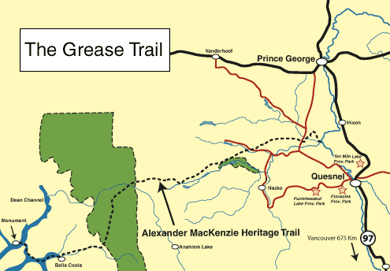
Chapter 3
Trade Economies

Slide 9
Chapter 3
Trade Economies ☺
The trails for Oolichan became known as Grease trails, and were about 6 feet wide and well maintained.
It is these trails that early explorers to B.C. like Alexander Mackenzie, used on his traverse to the Pacific.
Much of the goods traded in B.C. made its way out to other regions of Canada and the United States.

Slide 10
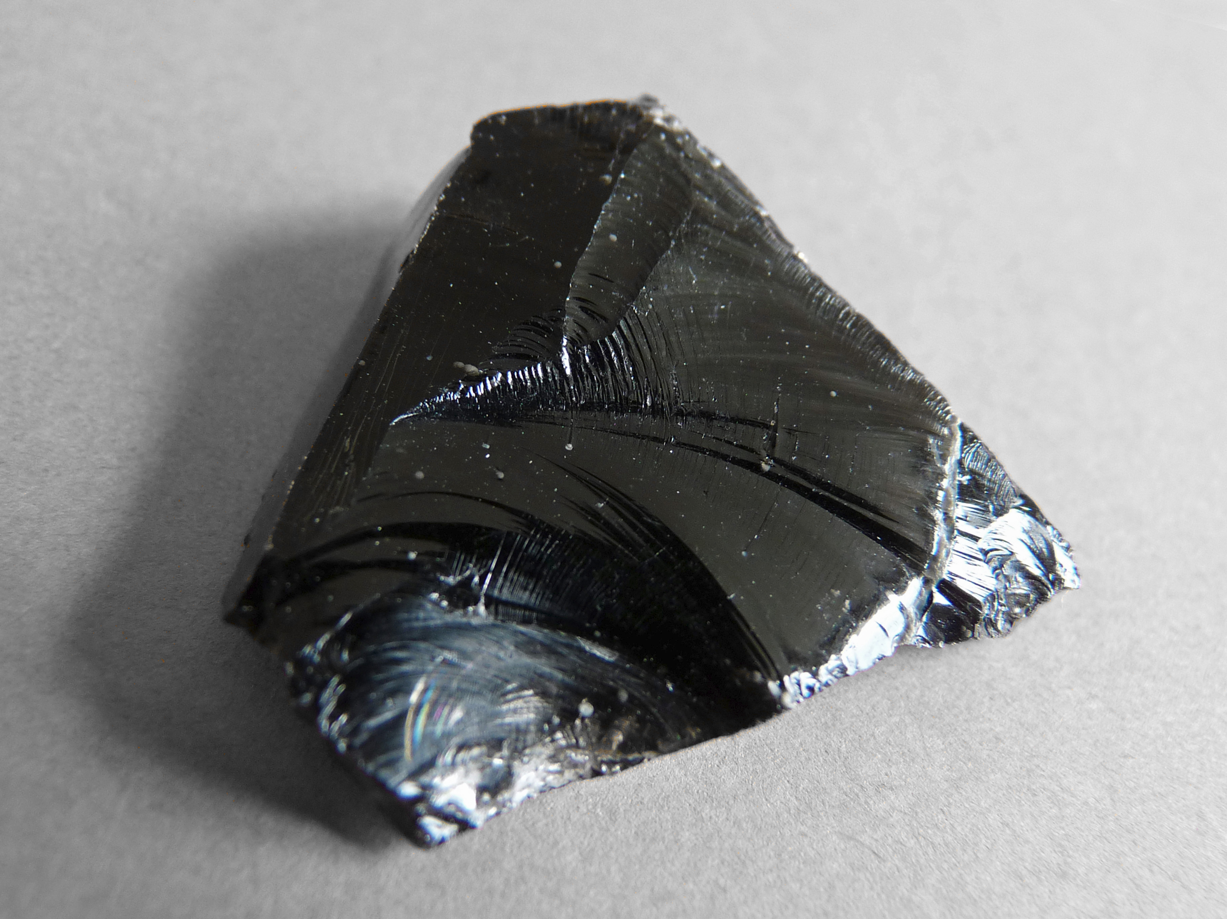
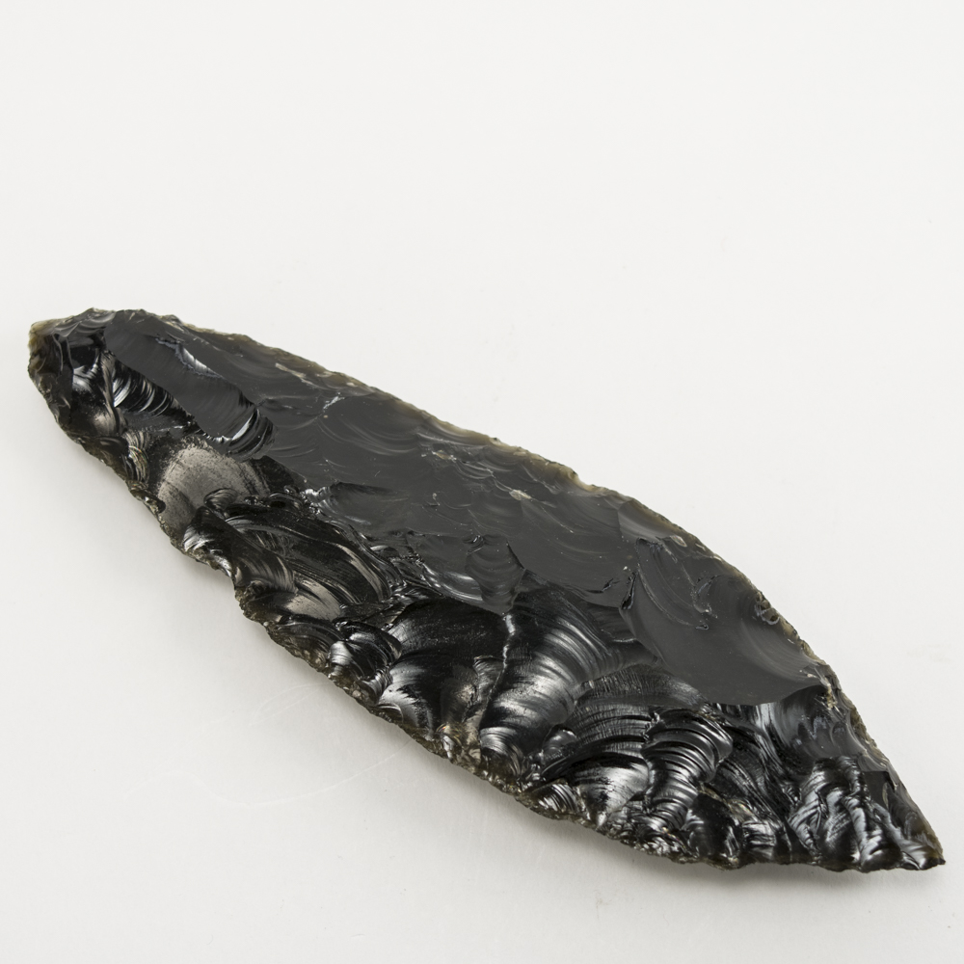
Chapter 3
Trade Economies ☺
A unique trade good was Obsidian.
Obsidian is a glass like volcanic rock, highly prized for it’s sharp edges which made it ideal as a cutting tool.
Placed into an antler, or a wooden handle an individual could easily procure a knife.
Only three main sources of Obsidian available to FN in B.C.
  One is Mount Ediziza in the Tahltan Territory
  Anahim Peak in the Ulkatcho
  Third is in Oregon

Slide 11
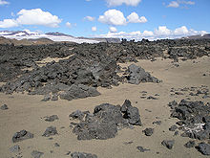
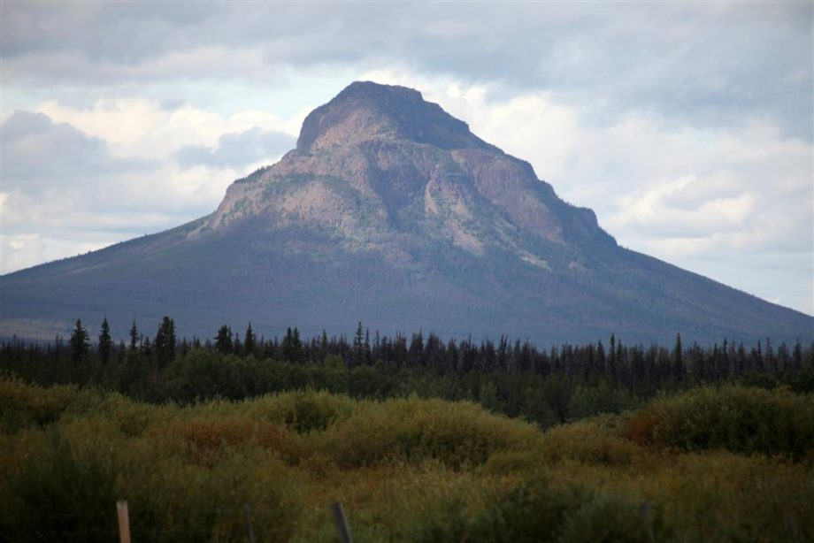
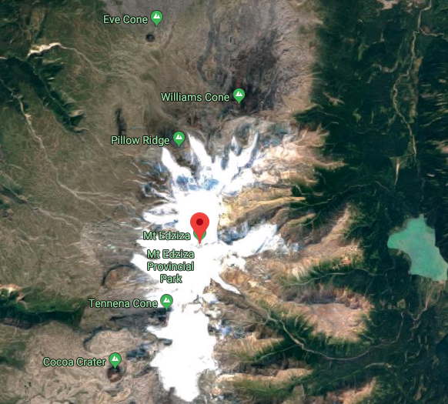
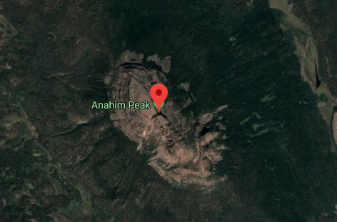
Chapter 3
Trade Economies
Anahim Peak

Slide 12
Chapter 3
Trade Economies ☺
Because there are only three places the Obsidian could come from, scientists can take samples to find out where the obsidian originated form.
Scientists are able to Carbon Date the Obsidian found in B.C.
It has been used in trade routes since 6,000 BCE.

Slide 13
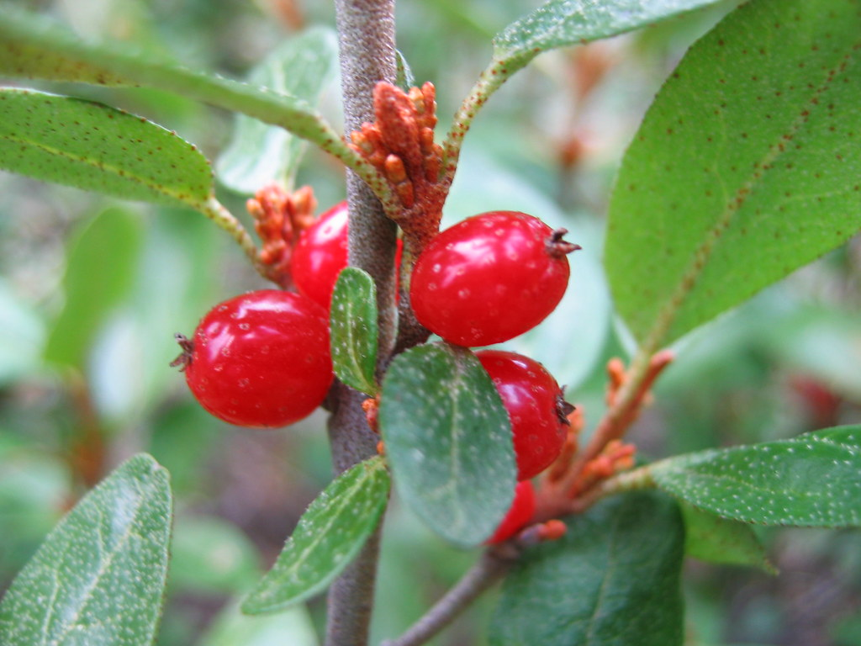
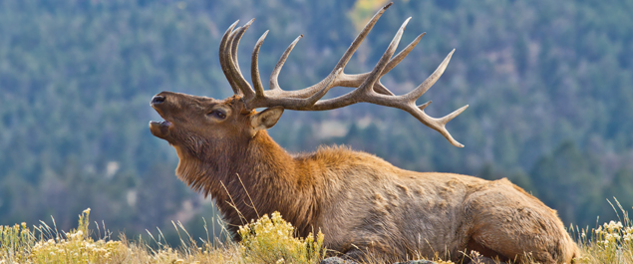
Chapter 3
Trade Economies ☺
Most trade occurred between neighboring nations.
The soapberry was a highly prized item. Found mainly in the interior, the berries can be whipped into a froth referred to as “Indian Ice Cream”
The Plant “Indian Hemp” was also traded, due to its strength in ropes and netting.
The complex networks let to a “Medium of Exchange” = Currency
Ex: Elk Skins became a form of currency.

Slide 14
Outline
CNN 10
Journal Prompt #5
Classwork on Project + Ch. 3 Assignments
THANKSGIVING WEEKEND - ☺

Slide 15
Journal Prompt #5
Write about a trade or bartering system in our community—any exchange of goods or services that doesn’t involve money.
Comment on the following statement → “Trading promotes more communication than buying and selling.”
What is something you’re thankful for this weekend?

Slide 16
Outline
CNN 10
Wrap up Ch. 3 – Trade Economies/Education

Slide 17
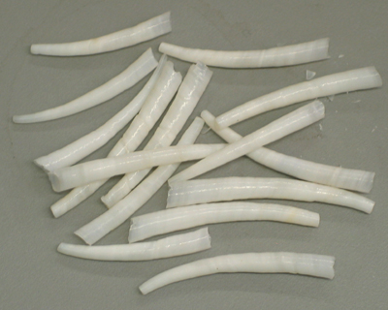
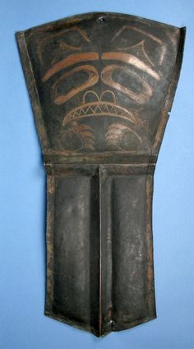
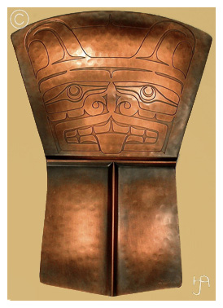
Chapter 3
Trade Economies ☺
Trade goods are divided into two groups:
  Items of Provision
  Items of Prestige/Status
Items of Prestige required Wealth to purchase.
Often these items were hard to acquire.
  Ex: Dentalium – A small tusk shell.
  Ex: Copper - Easy to shape, came out
  of Alaska.
  Ex: Slaves – Captured along the coast. Added to the labor force of a Chief.

Slide 18
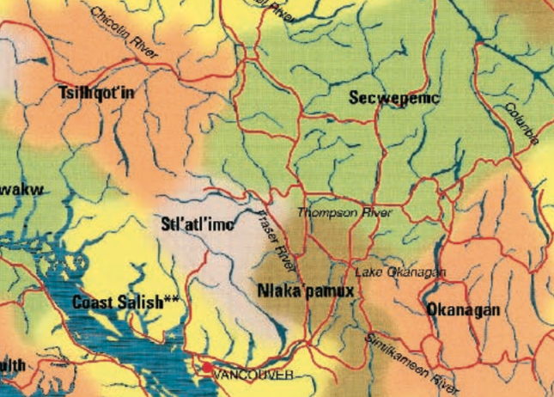
Chapter 3
Controlling the Trade ☺
Some FN groups became well known as traders, rather then producers.
These were often groups that had access to large quantities of Salmon.
A good example of this is the Four Secwepemc (Shuswap) bands living on the lower Chilcotin River.
This area enabled the bands to trade between the Secwepemc and Tsilhqot’in territories.
Some chiefs gained extensive wealth by forcing people to pay them for moving through their territory.
Sometimes they would build a fort on the mouth of the river to protect their interests, or to create a monopoly.

Slide 19
Chapter 3
FN Education
“In Aboriginal educational tradition, the individual is viewed as a whole person with intellectual, spiritual, emotional and physical dimensions. Each of these aspects must be addressed in the learning process. Holistic education is the term used to describe the kind of education traditionally used by Aboriginal peoples.”
Would our school benefit from taking on a more holistic approach ?
How might we be meeting the spiritual/emotional dimensions (needs) of students?

Slide 20
Chapter 3
Education: Learning About Values and Resource Use
FN educations is part of the fabric of society by which values and skills to preserve the land can be transmitted.
Children are seen as gifts; keepers of the culture.
For FN people learning is a life long endeavor.
Extended families take responsibility for caring for children.
Children were raised in an atmosphere of tolerance without criticism or direct control of their child’s behavior – teach them to be independent and self-sufficient.
  Q: What are your thoughts about this statement?

Slide 21
Chapter 3
Education: Learning About Values and Resource Use ☺
FN children would learn by participating in daily activities, by watching and doing.
  Example: Trapping/Hunting/Fishing
Transition from Adolescents to Adulthood came through special ceremonies and rites.
Men would often go on a vision quest.
  They would leave the community and seek visions/dreams.
  Sometimes acquiring a “spiritual guardian”
Women would learn about womanhood at menstruation.
  They would leave the camp for days to weeks and be taught by an elder.

Slide 22
Chapter 3
Education: Learning About Values and Resource Use
FN people were all required to have a complete knowledge/understanding of the land and its resources, including their families territories and which belonged to others.
You would learn about your ancestors and the land.
These stories were passed down orally, throughout the travels between camps and over the winter months.

Slide 23
Chapter 3
Stories
Story-telling was often used among native peoples, not only for moral teaching, but for practical instruction, to help you remember the details of a craft or skill, and for theoretical instruction, whether about political organization or the location of the stars.
One advantage of telling a story to a person rather than preaching at him directly is that the listener is free to make his own interpretation. If it varies a little from yours, that is all right. Perhaps the distance between the two interpretations is the distance between two human lives bound by the same basic laws of nature illustrated by the outline of the story. However many generations have heard the story before the youth who hears it today, it is he who must now apply it to his own life.
George Manuel, Secwepemc

Slide 24
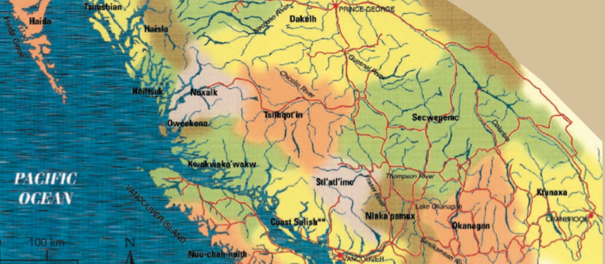
Chapter 3
People at the Borders
Borders between territories were not hard and fast lines like we see on maps today.
FN regions often overlapped and were shared by groups.

Slide 25
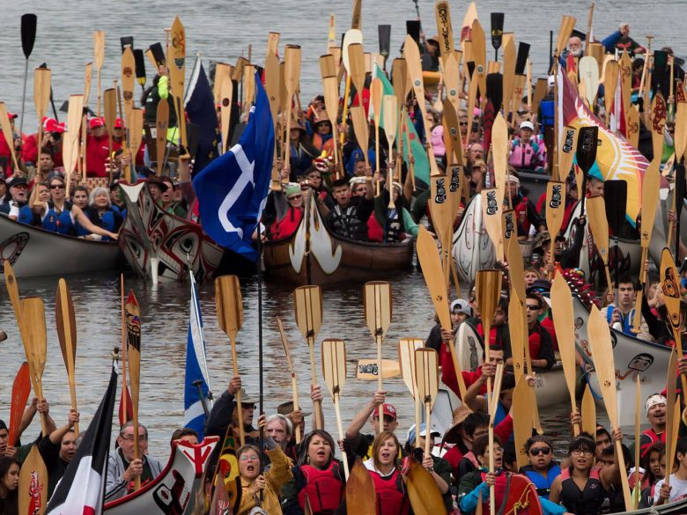
Chapter 3
Gatherings ☺
FN people gathered throughout the province to trade goods and ideas.
These gatherings were a place to meet new people, possibly find a partner.
Games and Feats of Strength were common at these gatherings.
  Lahal – The Bone Game
  Races
Gatherings would occur for food harvesting.
Gatherings would occur for trade
Photo: Gathering of First Nations, during Reconciliation Week
September 17th - 2013

Slide 26
Chapter 3
The Potlatch ☺
The Potlatch integrates the spiritual, political, economical and social dimensions of a community’s life.
Potlatch means to “give”
Potlatches occurred for a specific purpose:
  A boy’s first kill
  A marriage
  Completion of a canoe
  Raising of a totem pole
Once a potlatch was called for, the individual would call upon their family/kin to help prepare for it.
They may take weeks to years to prepare.
People are invited from neighboring tribes/bands to attend.

Slide 27
Chapter 3
The Potlatch
The potlatch begins with a welcoming ceremony.
People sit down for a meal.
The hosts will share their families history through dance and song.
The ceremony for the reason the potlatch has been called will be conducted.
Trained speakers will conduct the ceremony.
Then the wealth that has been brought will be distributed to the guests.
By accepting the gift, you’re saying that you were a witness to the ceremony and the validity of it.
Concluding speeches by the guests.
These ceremonies are important to FN people, as a means of acknowledging their people and past.

Slide 28
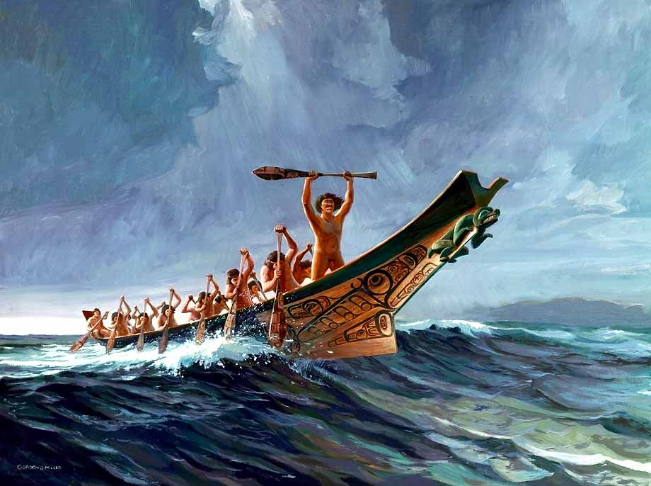
Chapter 3
Conflict between Nations ☺
Conflict amongst FN was inevitable – trade routes, proximity to similar resources, slavery, etc.
Wars were fought to preserve traditional territories, to expand their territory and to acquire goods and slaves.
Some groups were far more aggressive then others. For instance, the Haida were known to travel far down the coast – as far as Vancouver Island to raid camps.

Slide 29
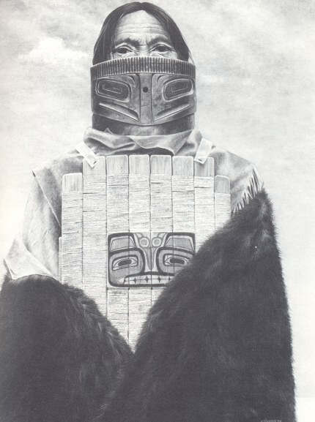
Chapter 3
Conflict between Nations
Prior to battle, warriors often fasted and purified themselves.
Families, and Elders would often support this by keeping themselves pure.
Wooden helmets and protective armour made of elk skin, were worn by some people.
Defensive sites were constructed on hilltops; utilizing fortified log walls and defensive weapons such as rocks, spears and logs.
Warrior returning after war, had to clear their minds and bodies of the energy connected with war before re-entering society.

Slide 30
Test – Friday Oct 18th/21st
October 18th
Definitions
Mapping
Short Answer
Oct 21st
Essay

Slide 31
Section 1 - Definitions
Choose 4 of the following 9 terms to define and give an example of it.
Elder
Oolichan
Intertidal Zone
Seasonal Rounds
Muskeg
Stewardship
Obsidian
Medium of Exchange
Lahal

Slide 32
Section 2- Mapping Section
On the Map Below, identify (by drawing) the location of the following places in British Columbia.
      (2) Mountain Ranges: Cascade, Coast, Rockies, Columbia
      (3) Rivers: Fraser, Thompson, Kootenay, Columbia, Skeena
      (3) FN Territories: Kwakwaka’wakw , Haida, Sto:lo, Squamish, Nisga’a
      (2) Lakes: Kootenay, Harrison, Okanagan, Atlin, Quesnel

Slide 33
Section 3 - Short Answer – Choose 10 of the following 20 questions to answer. Always offer examples to supplement your responses.
Explain the difference between the Metis, Inuit and First Nations in Canada.
Explain the Story of the “Raven and the First Men” and the significance to FN people.
Explain the Story of “Turtle Island” and the significance to FN people.

Slide 34
Explain the Theories around how “First Peoples” arrived in North America (make reference to the Beringia Theory, Sea Routes, (be sure to reference dates) and why it’s important to First Peoples today.
Explain what a worldview is, how it is constructed, and how it differs between First Peoples and Western Europeans?
Explain what a Traditional Territory is, with reference to the traditional territories of the 4 tribes M.S.S is found on.
Pick one of the Four Regions in B.C. (The Coast, Southern Interior, Northern Interior, and North-East Region) and explain what the climate is like, what resources can be found there, and what the culture of the people was like (buildings, arts, spiritual practices, etc)

Slide 35
Explain what Traditional Ecological Knowledge is and how FN people are utilizing it today with the scientific community?
Explain what controlled burning is and how it was used in FN communities in B.C. in the past?
Explain how FN communities have used different trapping methods to catch fish, be sure to reference at least 3 types – use illustrations to explain how they function.
Explain the process of tanning a hide, from beginning to end, with reference of how hides are used in FN cultures today.
Explain the difference of buildings, between the Sto:lo and Haida, and that of the interior FN. Be sure to draw illustrations where appropriate to explain to your reader what you’re writing about.

Slide 36
Explain how the trade economy worked in FN communities in B.C. and how Obsidian has helped the scientific community understand this trade network?
Explain the FN education system, how is different from that of our western society? What are the benefits/limitations of this system?
Explain why FN communities fought with each other, the reasoning behind it, and how FN warriors would cleanse themselves after and why?

Slide 37
Section 4 – Essay
Write a 500 – 1000 word essay (Introduction, 3 Body Paragraph, Conclusion) - Challenging the following statement. To do this, use the information you gathered during class discussions on “Myth Busting”
“B.C. First Nations have it made. The Canadian Government gives them everything and then some. Free education, free homes on reserves, free use of all resources. They can hunt whenever they want, and can fish whatever they want without any limits, they’re given so much. They don’t pay taxes for anything, they have it made in the shade.”

Slide 38
Classwork
Wrap up Intro + Ch.1/2/3 Questions
Finish Project – It’s due Friday
Finish Origin Stories
Finish T’Lina the Rendering of Wealth
Tomorrow → Kahoot + Classwork
Thursday → Study Guide + Classwork
Friday → Test ☺

Slide 39
Chapter 3
Assignment “Items Traded for Status”
Using pages 48-51 in the textbook complete the assignment “Blackline Masters 3-1 “Items Traded for Status”

Slide 40
Chapter 3 - Blackline Master 3-4
Cross-Cultural Trading Networks
Please begin working on the “Cross-Cultural Trading Networks”
Try to pick two nations to focus on, you may use the big map on page 17 of your textbook as well as the notes from Ch. 1 & 2 to help you with this assignment.
Think of the resources available in each area and how that might be advantageous to each other.

Slide 41
Chapter 3
The Potlatch
Please grab a copy of “Introducing the Potlatch or Feast”
You’re simply marking TRUE or FALSE.
☺ If you have any questions, please ask!

Slide 42
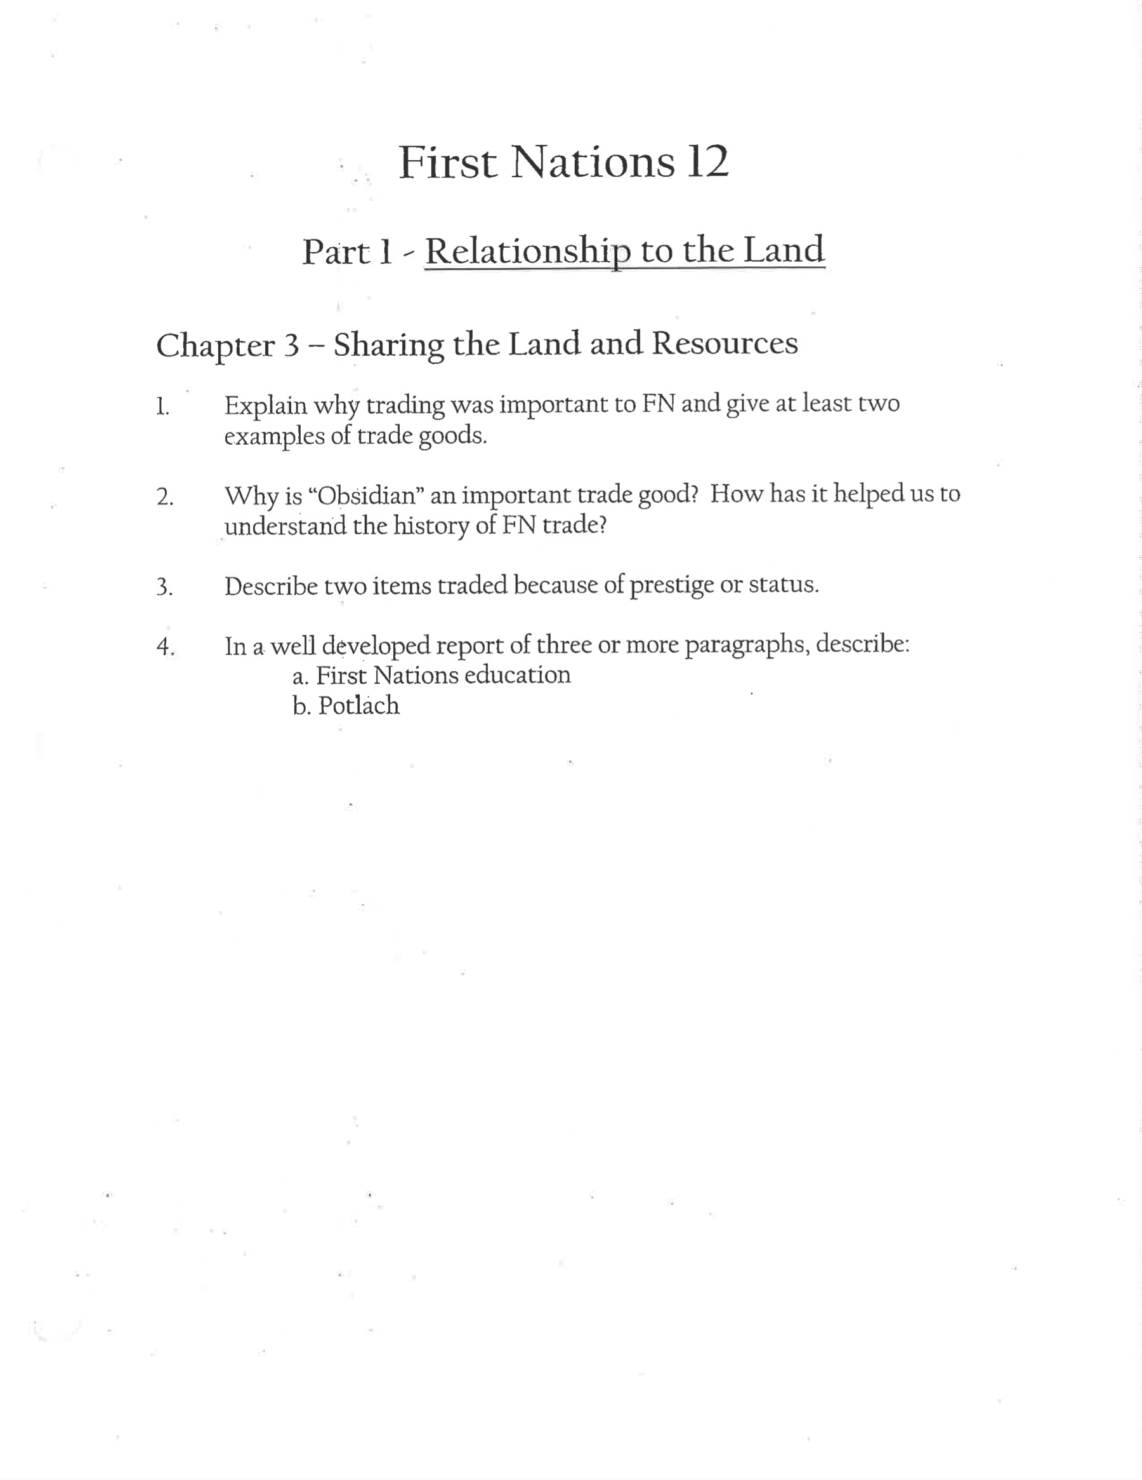
Chapter 3
Ch. 3 Questions
Please come grab a copy of the Ch. 3 Questions.
You may work with a partner to complete these, however you each must submit an answer sheet.
Listen to some music, rest and enjoy ☺
If you have any questions, as always, please feel free to ask – always here to help!

