Slide 1
Camp Emerging HOPE
Emerging HOPE Family Strengthening Program
Ministers Curtis L. and Dr. Pamela Robinson

Slide 2


Slide 3
Camp Emerging HOPE
We believe that urban youth may benefit from camp activities that emphasize socialization, character development, effective communication skills, problem-solving, and decision-making. The impact of camp programs is far-reaching and touches the entire family. Summer camp can be one of the most rewarding, unforgettable experiences in a child’s life.
Camp provides children with a community of caring mentors who provide experiential education that leads to self-respect and appreciation for life. All of the outcomes—friendships, overcoming challenges, staying healthy and building character— prepare them for bigger, brighter lives down the road. In addition to great friendships and enduring memories, many important life skills are learned at camp.

Slide 4
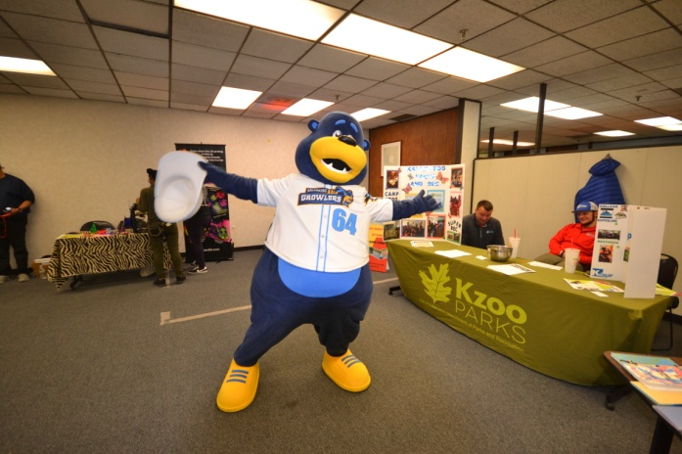
Emerging HOPE has proudly partnered with many summer day programs and residential summer camps and over the past twelve years to provide fun-filled summer experiences for urban youth.

Slide 5
Camp Emerging HOPE
Theme “Catching Fire: Igniting Our Faith in God”
(Ephesians 2:8)
Camp Emerging HOPE is a program provided by our new ministry partners Living Water Ministries.
Urban Youth ages 8-14 are eligible a free one-week
residential summer camp scholarship.
Location: Living Water Ministries, 7898 W Stony Lake Rd, New Era, MI 49446
Dates: Sunday– July 29th through Thursday – August 2nd

Slide 6
Testimonials
I love to see this kind of activity going on in our community. When I was raising my boys, I looked for positive summer programs for them to be involved in.
Thank you and your husband for your service to our community and world.
God bless you.
Lillian
Hello,
Thank you for an opportunity for my child to be able to be one of the many participants of this year's scholarship grants.
Kimberly

Slide 7
Testimonials
Hi, my name is Krishanna.
I had such a blast at Beechpoint Christian Camp. We rode horses, went swimming, had a cookout, went zip lining, drove go carts, and much much more! I am so blessed to be in contact with Sister Pamela Robinson. Thank you so much sister, Pamela, for EVERYTHING!
Krishanna
“The camp scholarship program is such a blessing. I am a single parent without extra money to be able to afford to send my child to camp. I am so grateful that you offered me the scholarship. I really wanted my child to have something I never had, something that would really impact her life.”
Deion, Emerging H.O.P.E. scholarship recipient camp parent.

Slide 8
WHAT IS
CULTURAL AGILITY?
Cultural agility is the attitudes, skills and knowledge necessary to provide effective leadership in an ever-changing diverse community.

Slide 9
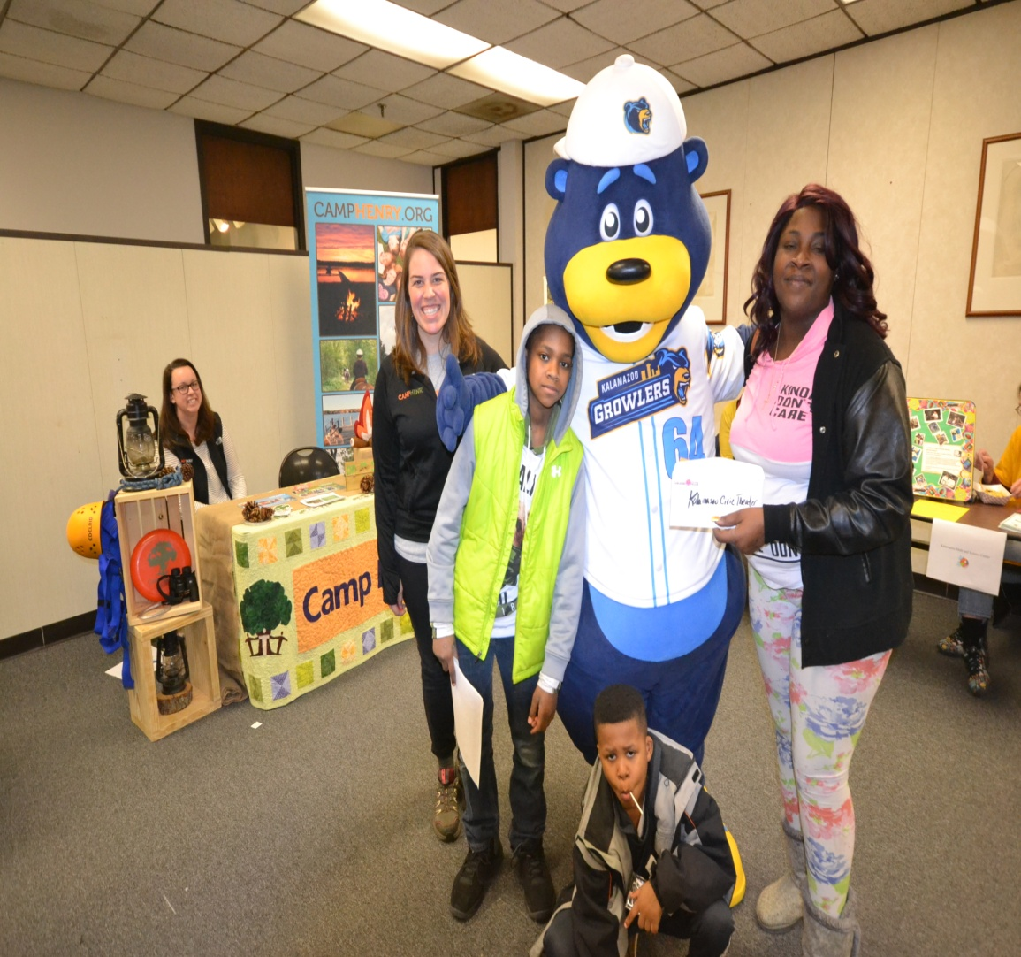
Cultural Agility
Understanding
slang words.
Wildin – acting wack, out of control
Bae - an abbreviation of the word “babe,” and basically means a significant other.
Ratchet – It has been used similarly as the word "ghetto".

Slide 10


Twerk/Nae Nae/Whip Dances twerking, the whip and nae nae
Turn Up – get loose, get wild
No Shade – A term for talking trash about someone.

Slide 11
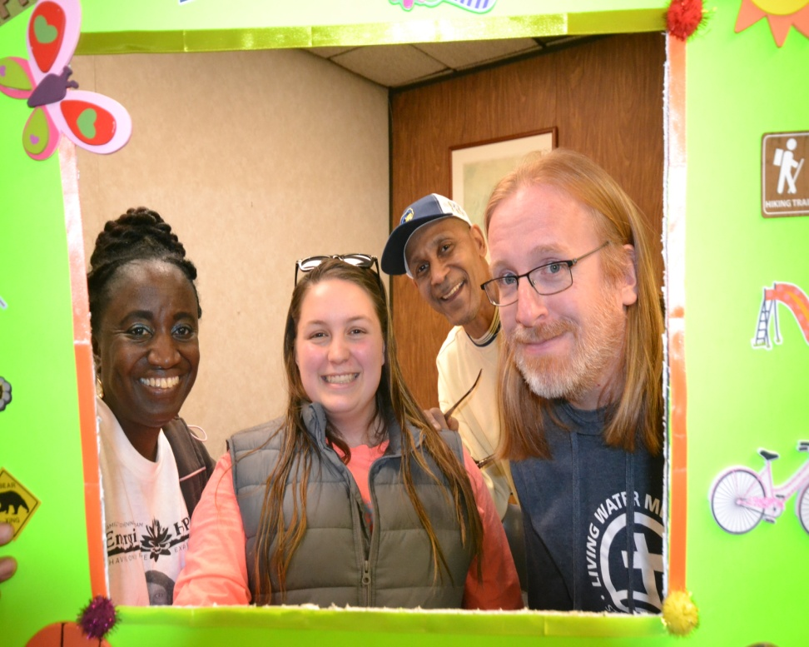

What we think about the kids we work with will come out during discipline training and correction.

Slide 12
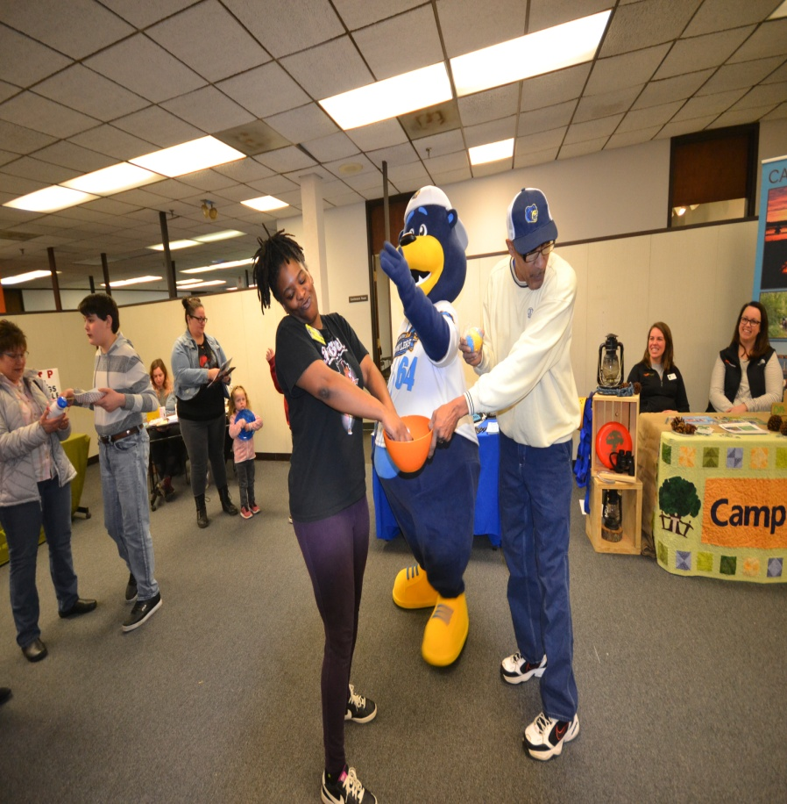
CULTURAL AGILITY
Self-awareness. Being aware of your own cultural biases, behaviors, and worldviews.
Being attuned to your environment, and to cultural nuances. Adjusting your behavior to harmonize the relationship–without mimicking.
Adapting to cultural differences and ambiguities. Being flexible to the situation.
Six key skills that will help you master cultural agility.

Slide 13
Being authentic. (It’s not about putting on somebody else’s culture, but about being able to interact in a way that’s relevant and important to them.)
Acquiring knowledge about other cultures. Immersing yourself in the foreign culture and seeking out new experiences.
Continually assessing how you’re developing in each of these areas, and looking for opportunities to grow.
CULTURAL AGILITY

Slide 14
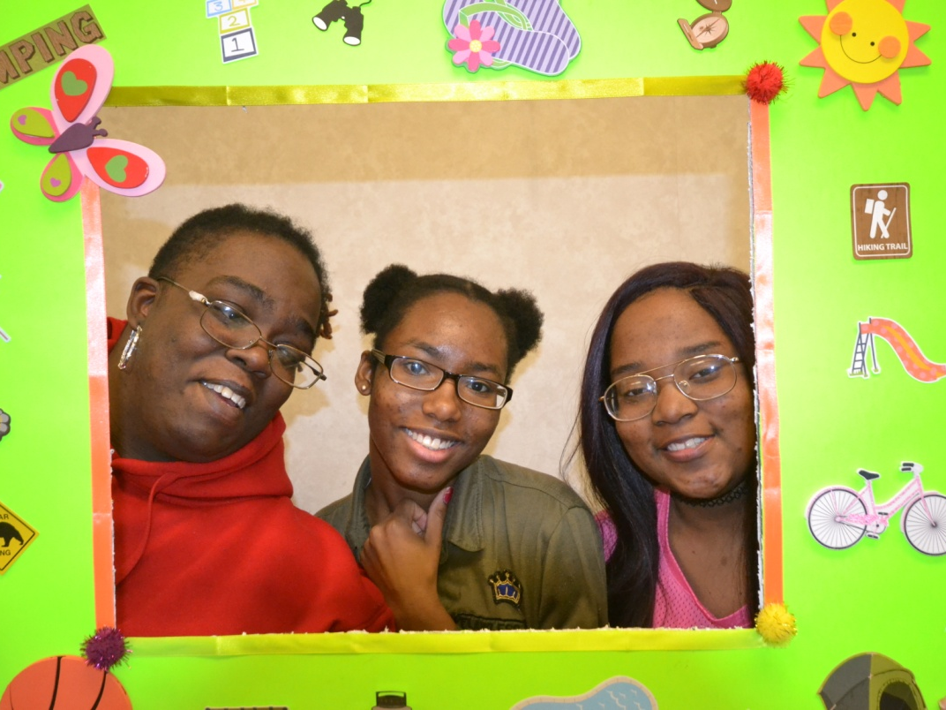
How will Cultural Agility help me this summer when working with Camp Emerging HOPE youth?

Slide 15
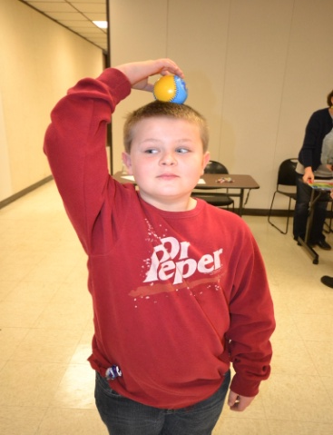
(1) It will help you to understand your own culture and how it shapes your experience.
(2) It will help you to understand and appreciate cultural difference with others
(3) It will help you to incorporate the knowledge into your interactions and decision making.
(4) It will help you provide effective leadership in with diverse youth.
HOPE
Having Only Positive Expectations

Slide 16
The name “Emerging HOPE" was inspired by the book of Jeremiah (29:11), which focuses on God bringing hope to a people living in despair. Emerging HOPE wants to bring hope to a generation of young people that many have given up on.

Slide 17
A Chinese Poem, written by Lao-Tzu around 700 B.C, sums up the felt-need concept.
"Go to the people.
Live with them, learn from them, love them.
Start with what they know, build with what they have.
But of the best leaders, when the work is done, the task accomplished,
The people will say, "We have done this ourselves."

Slide 18
Q & A

