Slide 1
Encampment Resolution Team San Francisco’s Approach to Homeless Encampments
Jeff Kositsky
Director, Department of Homelessness and Supportive Housing
Jason Albertson, LCSW
Encampment Resolution Team Leader
Notes:
Jeff

Slide 2
Agenda
Homelessness in San Francisco
Resolving Encampments
Outcomes and Lessons Learned
Notes:
Jeff

Slide 3

Homelessness in San Francisco
7,500 people experiencing homelessness on any given night
Includes youth, families and adults
51% are unsheltered
68% have a chronic health condition
Notes:
Jeff

Slide 4
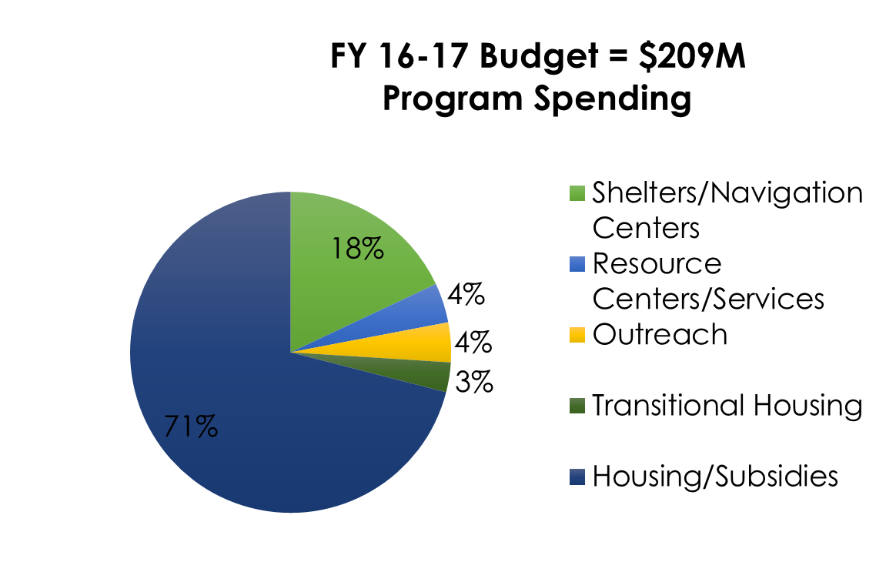
Services and Spending
Includes over 7,000 units of housing
Help nearly 3,000 people a year exit homelessness
Flat or slightly decreasing rates of homelessness in past 10 years
Notes:
Jeff

Slide 5
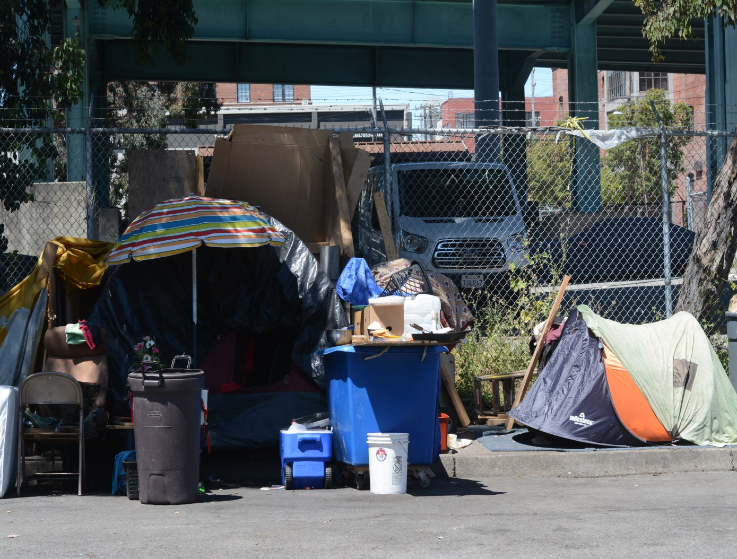
Increasing Visibility
Increase in real estate development
Concentration of social services
Impact of Occupy and Super Bowl
Opioid epidemic
Notes:
Jeff

Slide 6
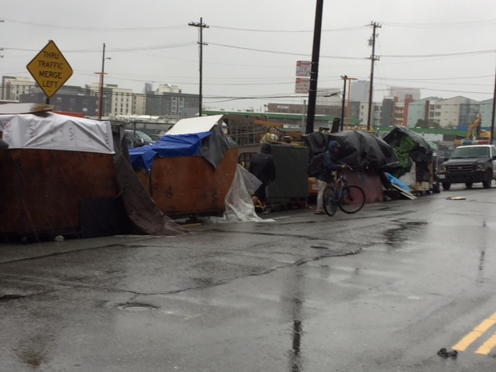
Encampments in San Francisco
Approximately 105 encampments in San Francisco
1-5 people – 50
6-20 people – 45
20+ people - 20
About 1,000 people in encampments
13% of homeless population
25% of unsheltered population
Notes:
Jeff

Slide 7
Why Resolve Encampments:
PROBLEM
Higher levels of substance abuse and communicable disease in large encampments
Increase in public health and public safety concerns in and around encampments
Public outrage impacts City’s ability to address homelessness
GOAL
Assist as many people as possible by connecting them to shelter, services and housing
Address quality of life issues for housed and unhoused
Change culture on streets to permanently eliminate large, long term encampments
Notes:
Jeff

Slide 8

Selecting Encampments for Resolution
6 tents, 6 persons, 1 month
Evaluation of Community Impacts with Partners
Coordinated through City Wide Encampment Working Group
Notes:
Jason

Slide 9
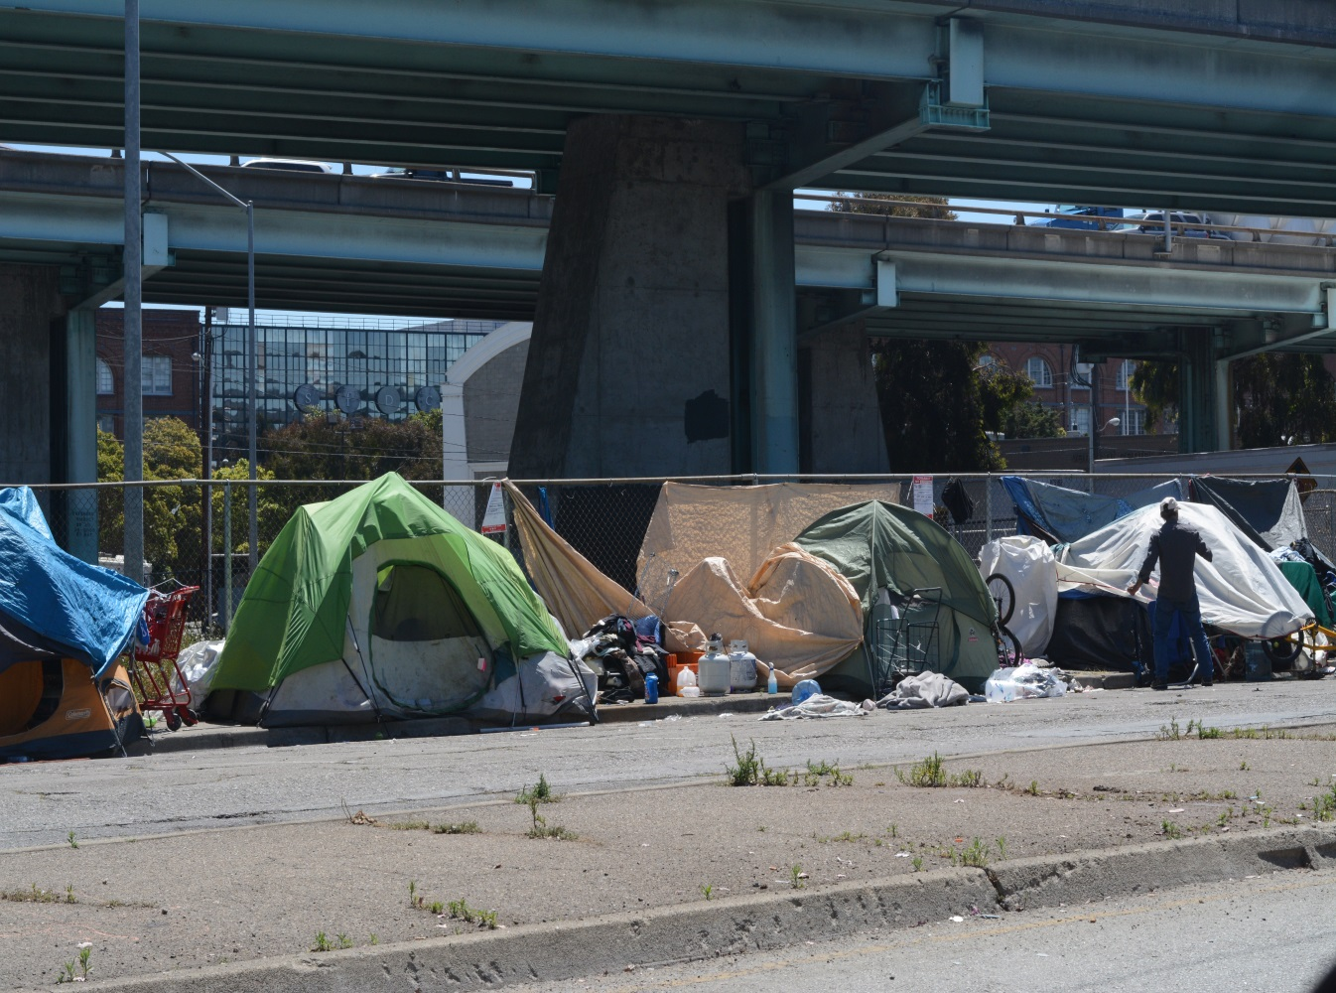
Resolving Encampments: Overview
Encampment noticed of resolution date
3 weeks engagement
Intensive outreach (daily)
Individual service assessment
Transportation to places of safety
Intensive Case Management
Notes:
Jason

Slide 10

Resolving Encampments: Services
Health and Wellness Fair
Incentives (gift cards) successful
Testing/treatment for disease
Urgent care, suboxone starts
Prevention medications for HIV
Notes:
Jason

Slide 11
Resolving Encampments: Process
1st week: Focus on engagement, relationship building
2nd week: Increased contact. Residents logged to Encampment Master log. Lookups in data sets to assess needs. Action steps on service needs
2nd week features: Finalization of service plans for each engaged resident. May include a community meeting if encampment situation allows. Housing applications for open waitlists
3rd week: Increased connection with residents. Begin to emphasize alternatives and remind of resolution date.
Notes:
Jason

Slide 12
Resolving Encampments: Completion
Reservation of navigation and shelter beds
Addressing needs of high acuity Individuals
72 hour notice is posted advising residents will need to depart
Mobilization to site with police, the Public Works Department, ERT
Remaining individuals offered available options
Notes:
Jason

Slide 13
Preventing Re-Encampment
Walkthrough with Public Works to assess safety and access
Coordinate with neighbors on prevention (fencing, lighting, security)
Ongoing re-encampment prevention team (outreach workers, police and public works)
Notes:
Jason

Slide 14
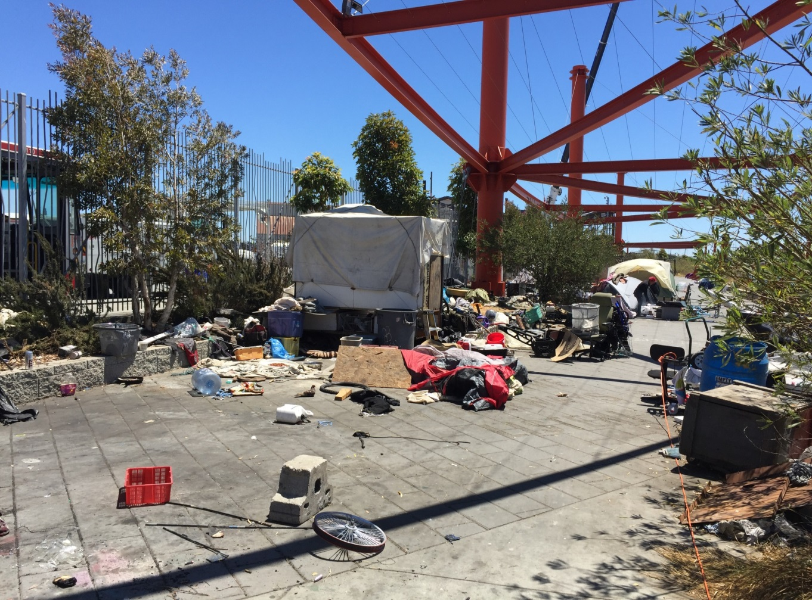
Case Study: Islais Creek Park.
Resolved Aug. 29, 2016
Over 50 persons in a park
Community meetings weekly
TB testing to clear for shelter
Over 40 individuals accepted help
Park returned to service
Notes:
Jason

Slide 15
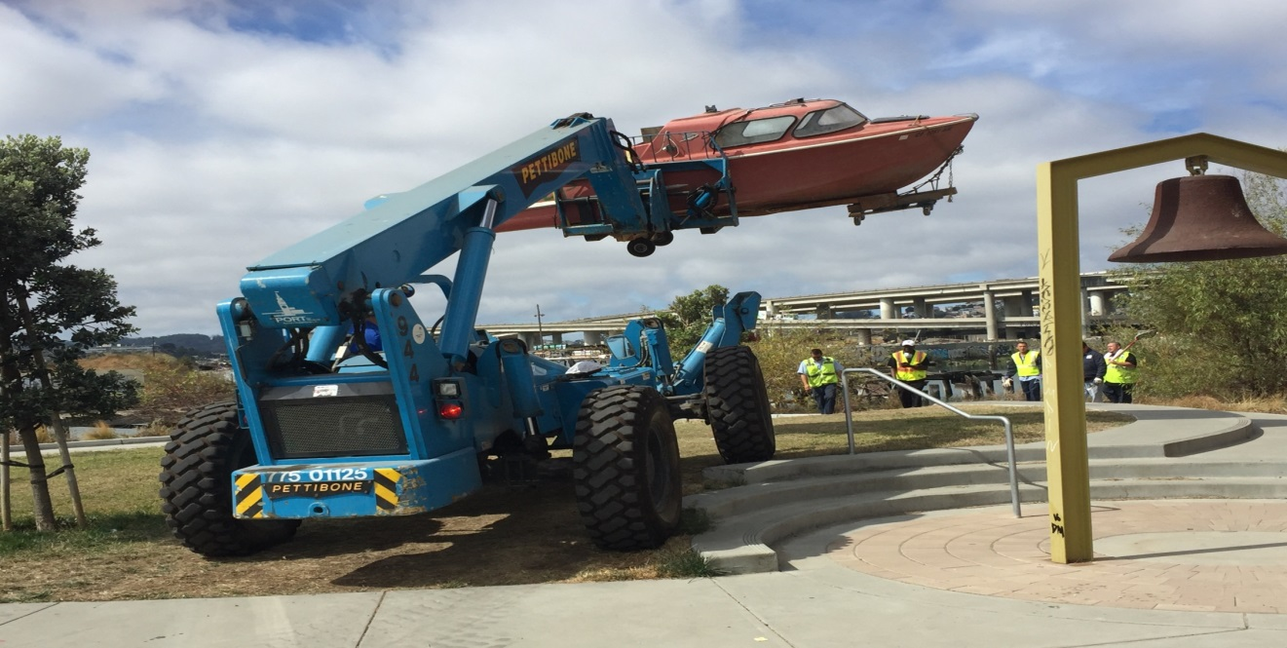

Case Study: Islais Creek Park.
Boat was used as live-aboard—individual accepted services.
Placement of a debris box reduced belongings.
Placement of portable toilet enhanced client dignity, improved engagement
Notes:
Jason

Slide 16
Outcomes: August – May 2017
ERT has resolved 11 encampments
461 people were involved in these eleven sites
329 accepted a place of safety off the streets – 71%
Approximately 25% exited homelessness
9 of the 11 encampments have remained clear
Notes:
Jeff

Slide 17
Lessons Learned - Systems
Compared to past efforts, this process is humane, legal and effective
Access to temporary shelter and housing exits are critical
Entire homeless response system cannot be focused on encampments
Partnerships with other agencies and systems to manage these partnerships are critical
Notes:
Jeff

Slide 18
Lessons Learned - Individuals
Intensive and ongoing outreach to encampment residents is the most critical part of this process
Must work with both house and unhoused people affected by the encampments
Providing medical and other services at the encampments assists with the transition
Having access to substance abuse and behavioral health programs is critical
Notes:
Jeff

Slide 19
END
Contact Info:
Jeff.Kositsky@sfgov.org
Jason.Albertson@sfgov.org
Notes:
Jeff

