Slide 1
Housing Not Handcuffs
nlchp.org
Engaging Law Enforcement In
Efforts to End Street Homelessness

Slide 2
Framing the Issue
Why are so many Americans living outdoors, sleeping in cars, or living in homeless shelters?
Lack of affordable housing and limited government help
Wages not keeping up with cost of housing
No funding / programs to provide mental health treatment
Youth who have run away from unsafe situations at home
Housing and social services would be the rational and cost effective response, but at no level of government is the U.S. providing this at appropriate scale

Slide 3
Framing the Issue
Law enforcement officials in frequently come in contact with homeless persons who are living outdoors, in cars, or in shelters where they cannot stay during the day
Those contacts can either be helpful or harmful to people experiencing homelessness
U.S. advocates strongly oppose criminalization of homelessness – the use of law enforcement to harass, threaten, detain, cite, arrest, or otherwise punish homeless persons living in public spaces
U.S. advocates can support outreach efforts that involve police and are geared towards linking people living outdoors to housing, social services, and other government or private assistance

Slide 4
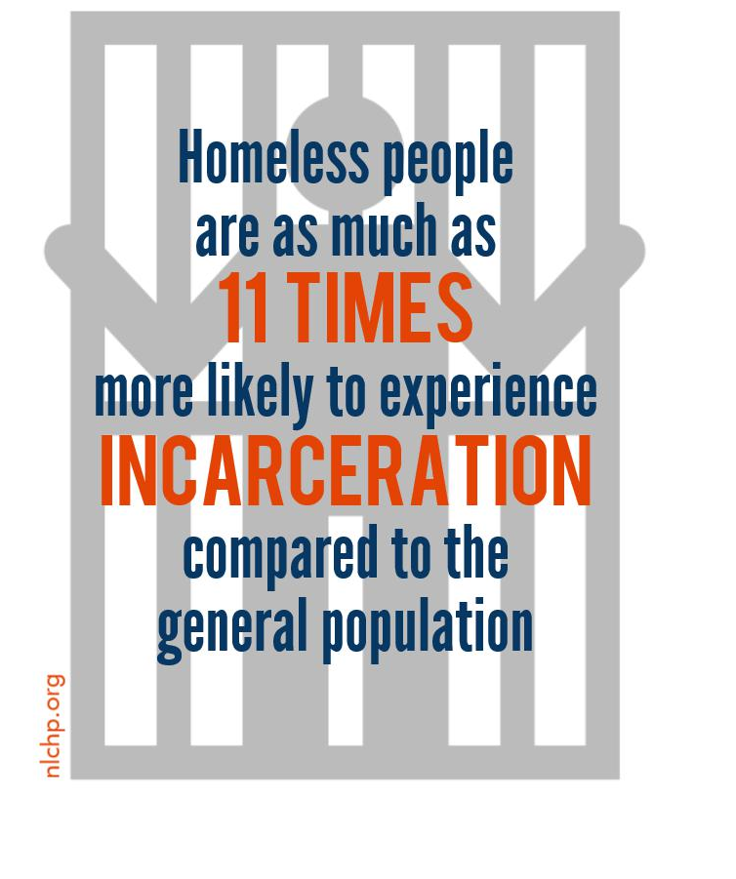
Criminalization 101
What is it?
Criminal laws
Civil laws
Practices that displace homeless people from public places (e.g. “sweeps”)
Does it work?
Ineffective
Expensive
Often unconstitutional

Slide 5
Why do communities criminalize?
Response to pressure from important local interests
Business community
Tourism interests
Homeowners / renters in gentrifying areas
Instead of solving problems humanely, politicians pressure law enforcement to “get rid of homeless people in plain sight”

Slide 6
Impact of Criminalization
For communities
Almost always ineffective – homeless people remain
For homeless persons
May lose jobs / harder to get one
Cannot qualify for subsidized or private housing
If incarcerated lose all public benefits; must re-qualify when released
Felony conviction could deprive individual of voting rights

Slide 7


Housing Not Handcuffs Report
Tracked 187 cities across the country since 2006
Urban and rural communities
Only national data on prevalence of laws punishing homelessness
Dramatic increase in laws punishing homelessness over past 10 years

Slide 8
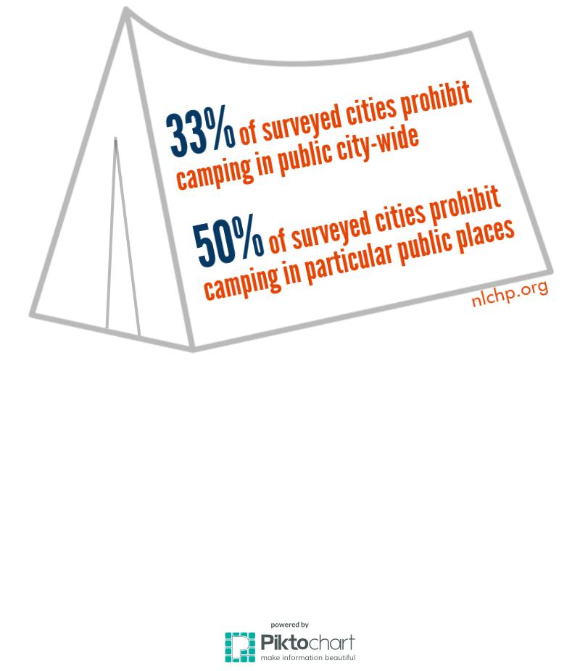
Camping in Public
33% of cities prohibit camping in public city-wide
69% increase since 2006
50% of cities prohibit camping in particular public places
48% increase since 2006

Slide 9
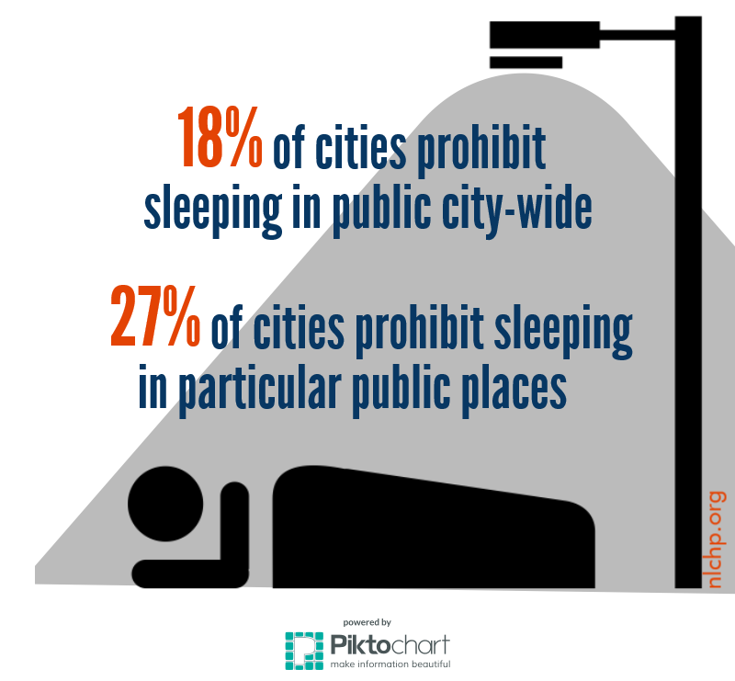
Sleeping in Public
18% of cities prohibit sleeping in public city-wide
31% increase since 2006
27% of cities prohibit sleeping in particular public places
11% decrease since 2006
Only decrease found for any measured category since 2006

Slide 10
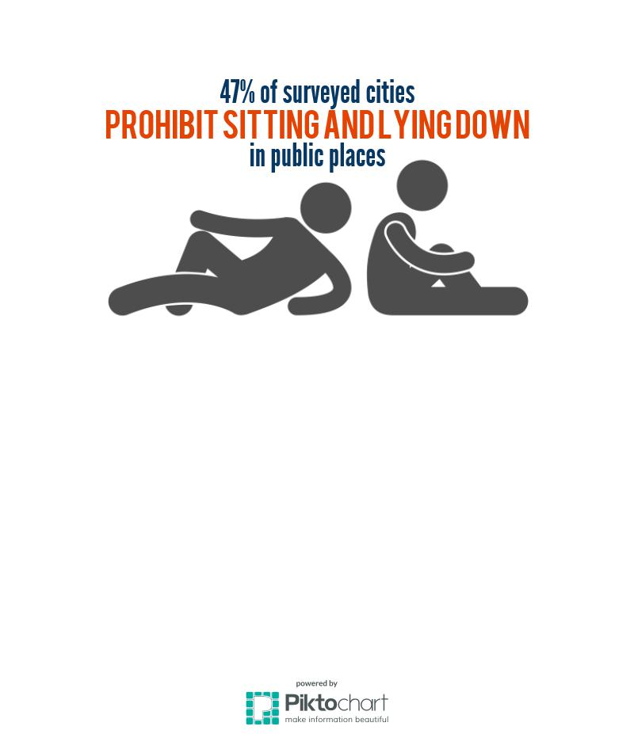
Sitting and Lying Down
47% of cities prohibit sitting and lying down in public.
52% increase since 2006
Honolulu, HI
Highest rate of homelessness per capita
Issued a whopping 16,215 warnings and 534 written summons since the law was enacted in late 2014
Study by University of California Berkeley Law’s Policy Advocacy Clinic
No effect on economic activity
Costly to implement and enforce

Slide 11
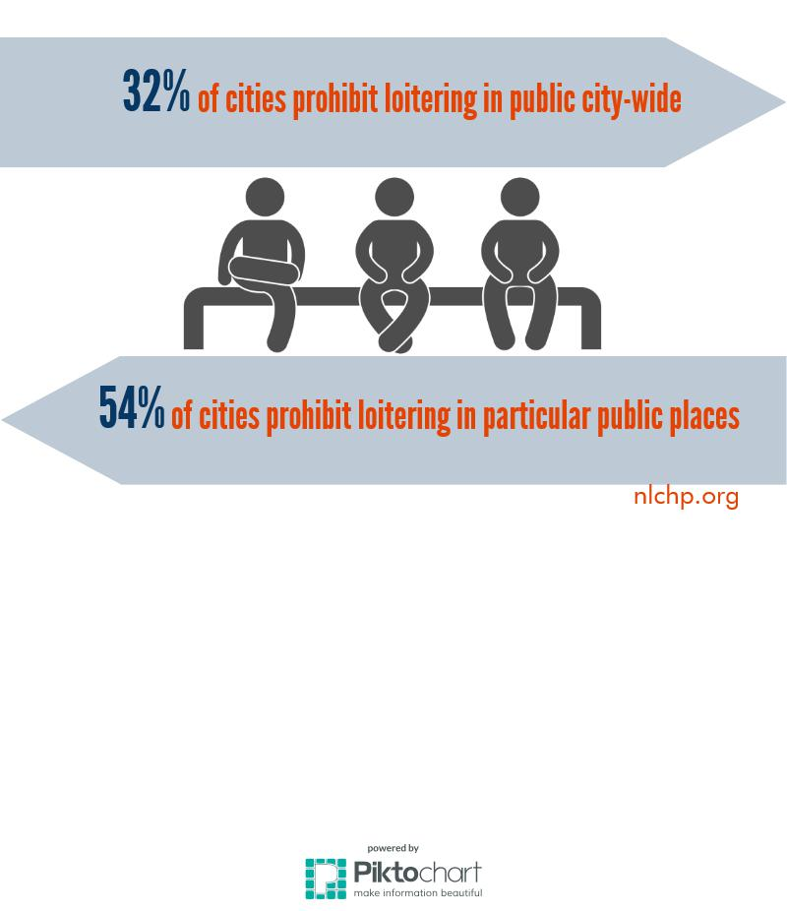
Loitering, Loafing, and Vagrancy
32% prohibit loitering, loafing, and vagrancy city-wide
88% increase since 2006
54% prohibit loitering, loafing, and vagrancy in particular public places
14% increase since 2006
“Loitering” is broadly defined
Burlington, VT
“…remaining idle in essentially one location”
“…walking about aimlessly”
Newport, RI
“…hanging around”

Slide 12
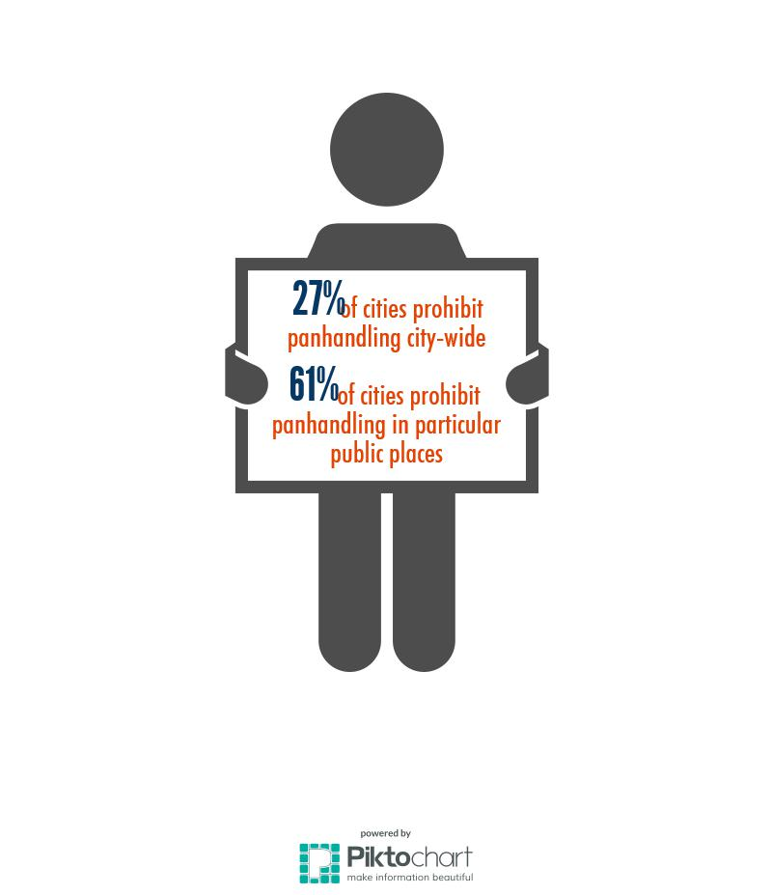
Panhandling
27% of cities prohibit panhandling city-wide
43% increase since 2006
61% of cities prohibit panhandling in particular public places
7% increase since 2006
“Aggressive” panhandling
Limitations on how and where the action is performed
Raleigh, NC
Permit to beg
Permit process requires photo ID
Springfield, IL
Restriction of vocal requests
Buffer Zones

Slide 13
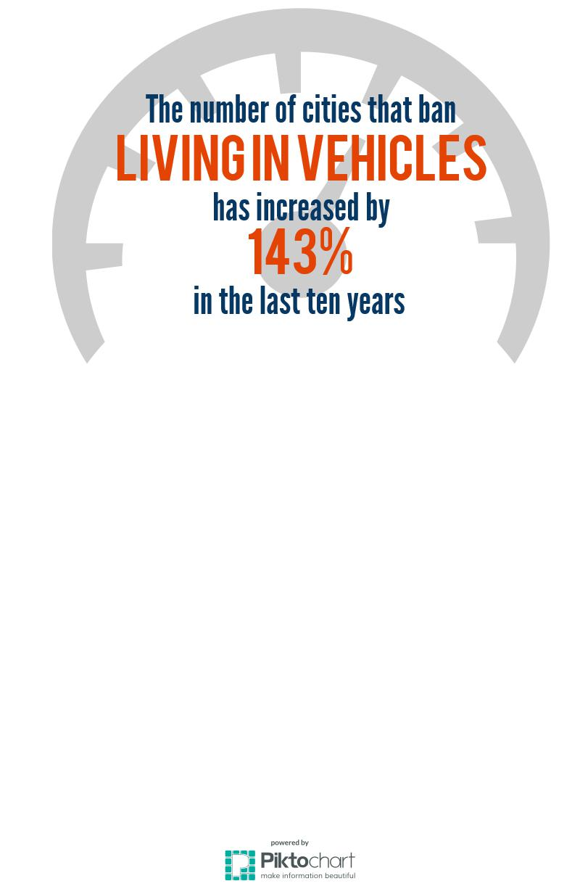
Living in Vehicles
39% of cities prohibit living in vehicles
143% increase since 2006
Most dramatic increase of all categories of prohibited conduct
Vehicle Impoundment
Loss of transportation, shelter, and all belongings
Drivers license suspension
Loss of employment or employment opportunities
Creates risk of criminal penalties for driving with suspended license

Slide 14
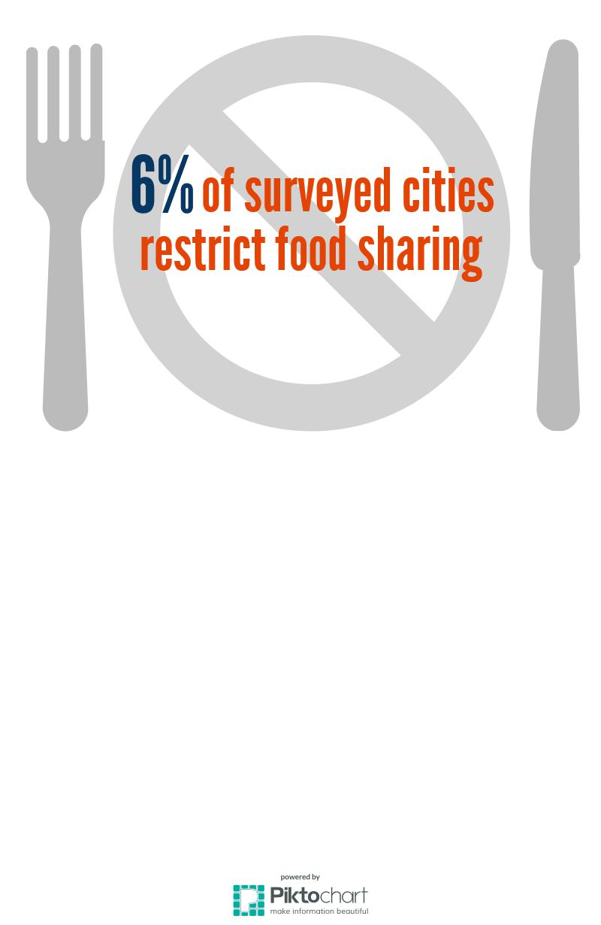
Food Sharing
6% of cities restrict sharing food in public
Tracked laws since 2014
May impose onerous, expensive requirements on faith-based organizations or other service providers
Creates liability for homeless service providers
Legal challenges
State-level Religious Freedom Restoration Act
Religious expression under 1st Amendment
Unconstitutional restraint on expressive conduct

Slide 15
Good Law Enforcement Practices
Repeal laws providing authority to arrest / give citations
Police should collaborate with outreach workers to help move homeless persons into housing / treatment
Better police training to help de-escalate potentially violent confrontations with people who have mental illnesses
Improved police training to understand the legal/constitutional boundaries of their authority.
Courts working with service providers and using “alternative sentencing” models – dismissing tickets or charges if people accept housing or treatment

Slide 16

Persuasive Human Rights Theory
Ratified treaties have the same binding force as federal law (CERD, ICCPR, CAT)
Cruel, inhuman, degrading treatment
Freedom of movement
Equal protection/Freedom from discrimination.
Freedom from forced evictions

Slide 17
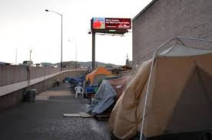
DOJ Statement of Interest Brief: Bell v. Boise
Bell v. Boise lawsuit
“It should be uncontroversial that punishing conduct that is a universal and unavoidable consequence of being human violates the Eighth Amendment…Sleeping is a life-sustaining activity—i.e., it must occur at some time in some place. If a person literally has nowhere else to go, then enforcement of the anti-camping ordinance against that person criminalizes her for being homeless.”
Bell case dismissed on standing grounds, but appeal to the 9th Circuit is pending
Positive impact across the country
Successful legal challenges citing to brief or its rationale in WA, CA, and WV

Slide 18

Successful Challenges to Panhandling Laws
Reed v. Town of Gilbert
Content-based restriction subject to strict scrutiny
Norton v. City of Springfield applied rationale of Reed to panhandling law
Since Norton, panhandling bans in Worcester and Lowell, Massachusetts; Portland, Maine; Grand Junction, Colorado; and Tampa, Florida were similarly struck down
Voluntary cessation of panhandling law enforcement in at least four Ohio cities and Madison, WI

Slide 19

Federal Funding Incentives to Reduce Criminalization
U.S. Department of Housing & Urban Development
Funding in 2015 and 2016
$1.9 billion in federal homeless assistance grants
Grants up to 2 points to communities that have implemented specific strategies to prevent criminalization
Competitive grant
Loss of a single point can make the difference between receiving funding or not

Slide 20

U.S. Interagency Council on Homelessness: Guidance on Homeless Encampments
“Ending Homelessness for People Living in Encampments: Advancing the Dialogue” published in 2015
Encampments are an indicator of the critical need for more effective responses to the crisis of homelessness
Forced dispersal of encampments
Not an appropriate solution to homelessness
Makes it more difficult to achieve lasting housing and service outcomes
Key actions include:
Planning and preparation
Engage homeless encampment residents
Collaboration across stakeholders
Meaningful outreach
Low-barrier pathways to permanent housing

Slide 21
Contact Information
nlchp.org
Eric Tars
Senior Attorney
etars@nlchp.org
202-638-2535 ext. 120
Jeremy Rosen
Consultant (not employed by NLCHP)
jnrosen@uwalumni.com
(703) 887-6200

