Slide 1
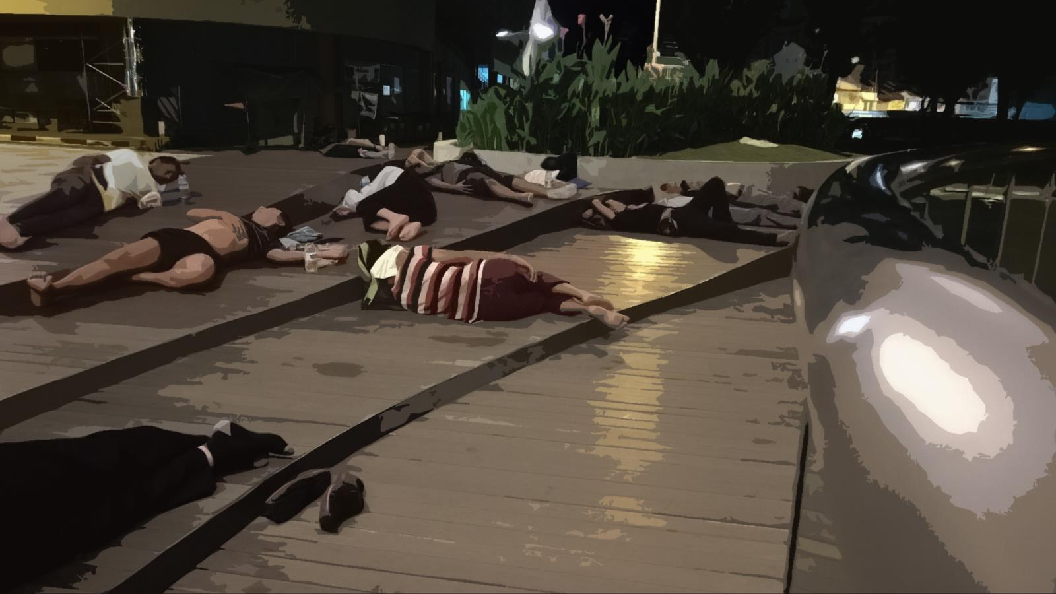

Destitute Persons Act and Government Welfare Homes
Singapore
Notes:
Good afternoon, I am Harry from Monash University.
My research is an ethnographic study of older homeless people in Singapore
The focus on older homeless people is because they make up the majority who are sleeping rough in public spaces in Singapore, and it is a group that I come to know well from my volunteer work.
Today, I am going to speak on the legal and enforcement aspects of homelessness in Singapore. Singapore is actually a really interesting place to study homelessness because it is a country that really prides itself on its affordable public housing policy and often boasts that every citizen will have a roof under their head. It is perhaps not surprising that many Singaporeans do not know that homeless people are living in their midst.
In Singapore, it is illegal to sleep rough in public spaces. The government relies on a specific law to keep people off the streets. This Act is entitled the Destitute Persons Act (enacted since the country became independent in 1965). If someone is caught sleeping rough, the current approach is to send this person to any one of the 10 welfare homes around the island. Once admitted, thi individual is under the jurisdiction of the Director of the Welfare Home.
The picture in this slide shows a group of homeless people sleeping rough at a sheltered area near the Central Business District in Singapore. These scenes are actually quite common in different parts of Singapore. However, most people do not see this because unlike many other cities, most homeless people in Singapore would only return to their squats or sleeping areas from 11pm onwards.

Slide 2
Outline of Presentation
Are there homeless people in Singapore?
Destitute Persons Act
Government Welfare Homes
Notes:
There are three main areas that I will cover in this presentation.

Slide 3
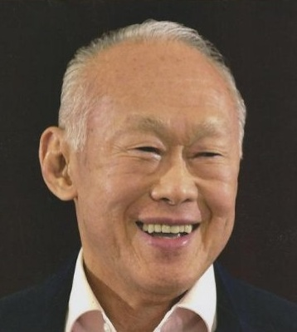
Are there homeless people in Singapore?
You go down to New York, Broadway. You will see the beggars, people on the streets. … Where are the beggars in Singapore? Show me. … Anyone without a home left to die in the streets and have to be collected as dead corpses?
(1989)
Lee Kuan Yew
Prime Minister
(1959-1990)
Notes:
Are there homeless people in Singapore? Well, if you ask the late-Lee Kuan Yew, Singapore’s first prime minister since its independence, he will say no. In fact, he points us to this country that we are now in…

Slide 4
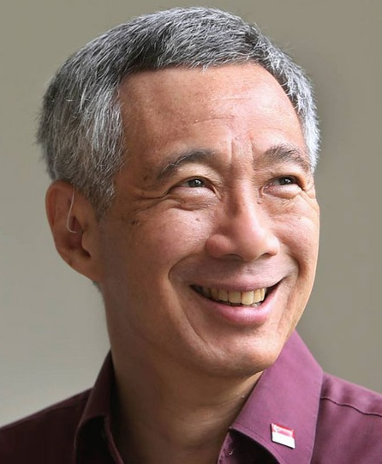
Are there homeless people in Singapore?
Low income Singaporeans are
much better off than low income groups in any other country in Asia. We do not have destitute persons sleeping on the streets.
(2005)
Lee Hsien Loong
Prime Minister
(2004-present)
Notes:
Similarly, his son, Singapore’s current prime minister would also say the same thing some 6 years later in 2005. There are no destitute persons sleeping on the streets.
Come to think of it, he may have a point. For the government, there should not be any homeless people sleeping on the streets because there is a legal Act ensuring that that is not the case.

Slide 5
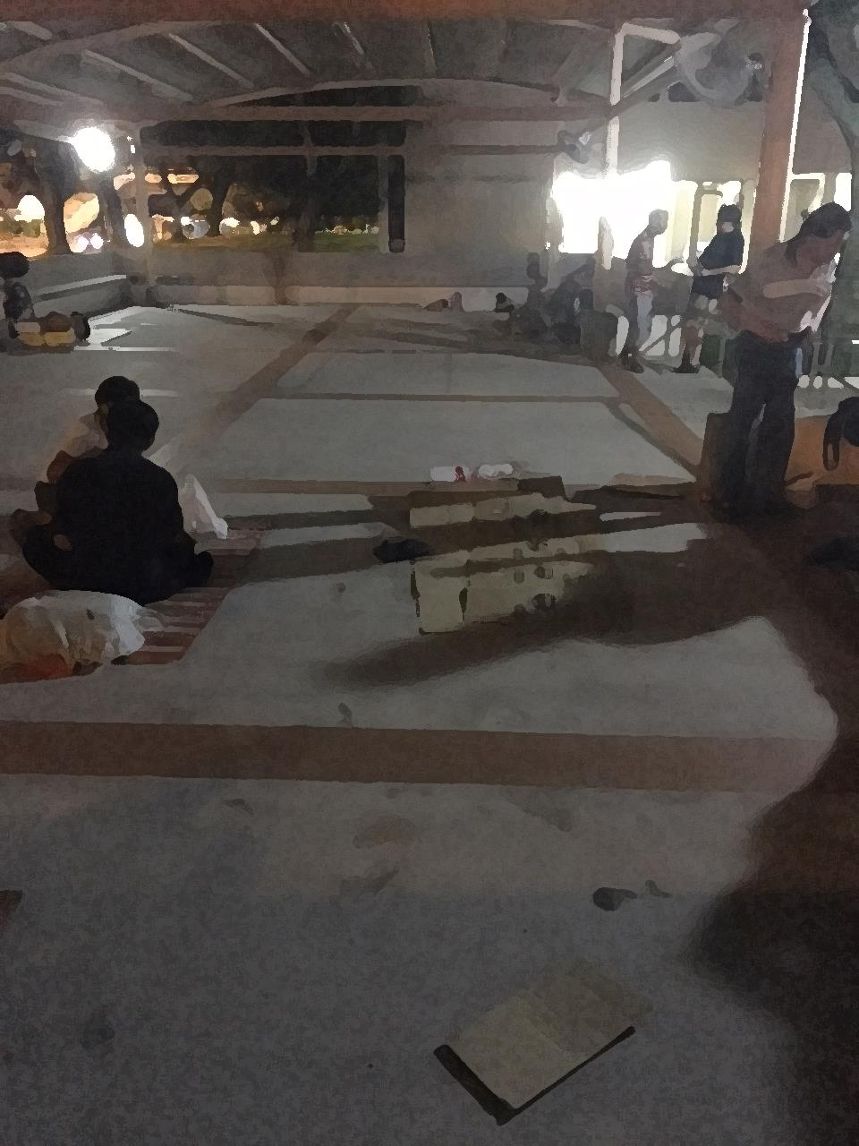
Are there homeless people in Singapore?
Help people, no house. [voice trembling, sobbing] Give them a place to stay. That is part of my wish. Make them all have house to stay. Don’t let them suffer, sleeping all over the place. Give them house. Tell the government, help all these people. That is very important for me. [uncontrollable sobbing] (Ali, 61 years old)
The first night I went out [to sleep], Toa Payoh alone is about hundred! It’s about hundred of them (George, 61 years old)
Not many people know us, where we stay, how we live (Aziz, 65 years old)
Notes:
This is a photo depicting a typical night of outreach and it shows that there are people who are homeless in Singapore. In 2010, Al Jazeera made an online news report on homelessness in Singapore and blamed it on the rigid government housing policy. Al Jazeera is of course no longer available on Singapore TV.
What do the older homeless people in my study have to say about people sleeping rough in Singapore?
When I ask George (not his real name) who slept rough at this pavilion area that we are seeing now, whether he saw others sleeping rough, this was his reply:
The first night I went out [to sleep], Toa Payoh alone is about hundred! It’s about hundred of them (George, 61 years old)
The next quote stuck with me because I remember this older man just sobbing and crying next to me when I asked if he had any other things to say before we ended the interview. This was what I wrote in my transcript:
Help people, no house. [voice trembling, sobbing] Give them a place to stay. That is part of my wish. Make them all have house to stay. Don’t let them suffer, sleeping all over the place. Give them house. Tell the government, help all these people. That is very important for me. [uncontrollable sobbing] (Ali, 61 years old)
Finally, Aziz probably sums up about the current state of awareness of homelessness in Singapore:
Not many people know us, where we stay, how we live (Aziz, 65 years old)

Slide 6
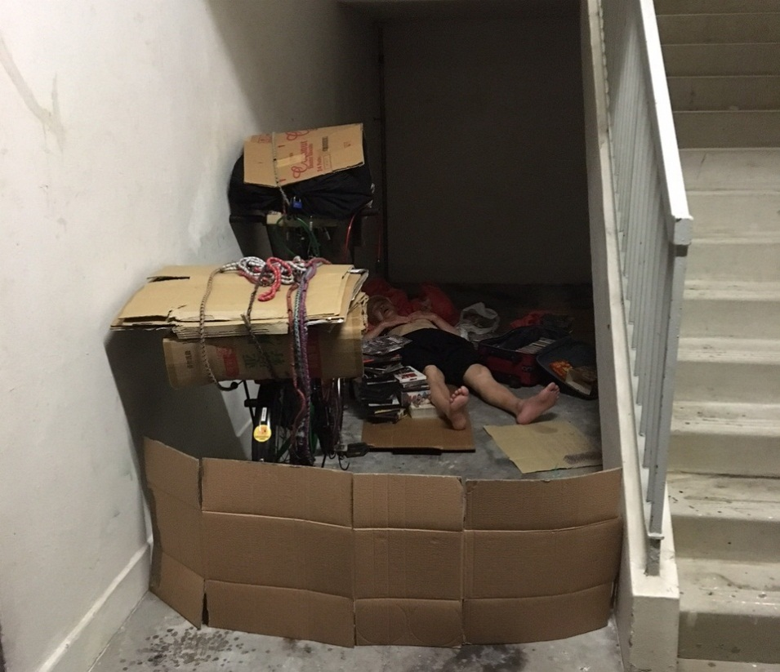
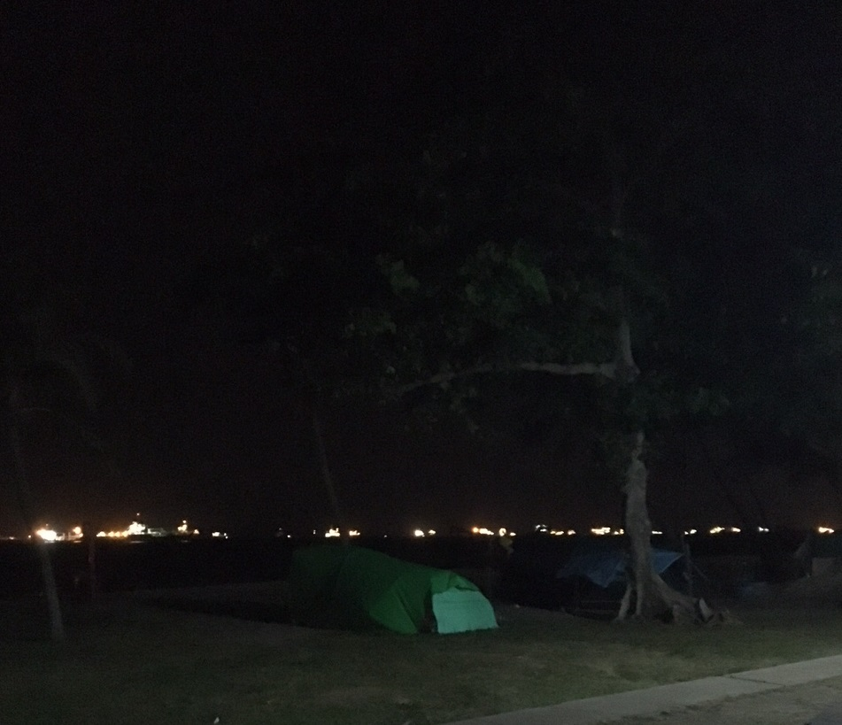
Are there homeless people in Singapore?
Notes:
These two photographs show two common areas that some homeless people in Singapore would sleep at.
The first is the ground floor of the public housing flats in Singapore.
The second is the beach.

Slide 7
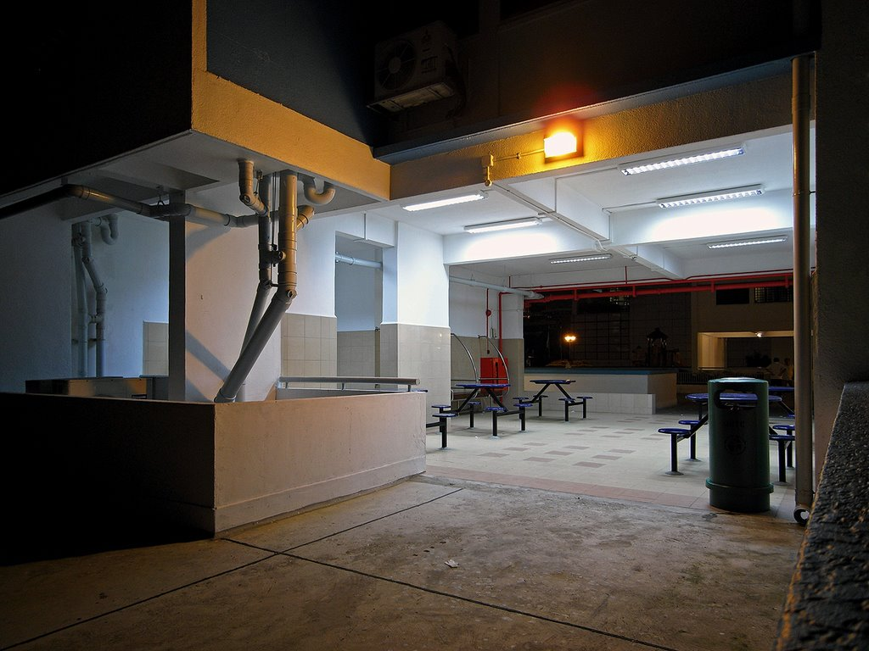
Notes:
This photograph here gives a better understanding of what a ground floor of a public housing flat in Singapore would look like. It serves also as a communal area for people to just sit and chat.
Optional:
Joanne decided to literally sit at one of these chairs through the night because she felt so stressed over her husband’s gambling and womanising ways.

Slide 8
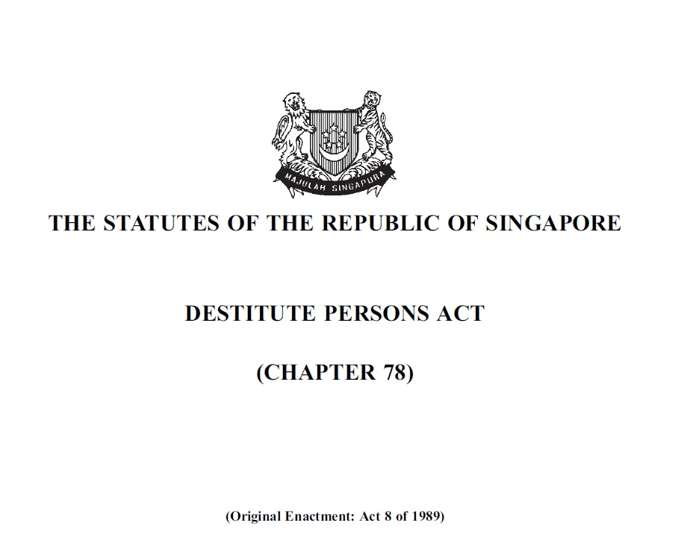
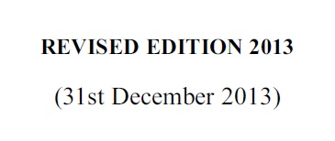
Notes:
Legally, no one is supposed to sleep at the beach, or at the ground floor of a public flat, or, as I mentioned earlier, at a pavilion shelter or any public place for that matter.
Anyone sleeping rough in Singapore is subjected to the Destitute Persons Act.

Slide 9
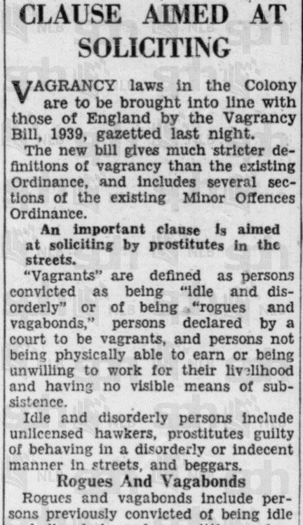
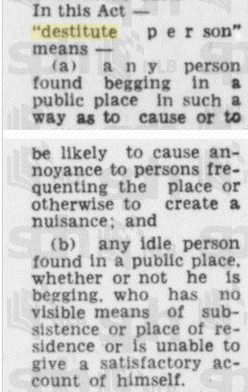
Notes:
The Act itself harks back to the British Vagrancy Laws during Singapore’s colonial days.
(Refer to the news article instead of the ‘wordy legal explanations.’ Both articles are published in the Straits Times, the flagship newspaper in Singapore since 1845. The one on the left comes from an article titled “Vagrancy Laws in Colony to be Stricter” (1933) and the article on the right, titled “The Destitute in Law” (1966) published a year after Singapore became an independent state.
“destitute person” means:
any person found begging in a public place in such a way as to cause or be likely to cause annoyance to persons frequenting the place or otherwise to create a nuisance; or
any idle person found in a public place, whether or not he is begging, who has no visible means of subsistence or place of residence or is unable to give a satisfactory account of himself;
For the purposes of this Act, a person shall be deemed to be begging if his conduct is calculated to induce the giving of alms, whether or not there is any pretence of singing, playing, performing, offering anything for sale or otherwise.
N.B. Destitute Persons Act (2013) and Miscellaneous Offences (Public Order and Nuisance) Act, Part IV “Vagrancy” (1997)

Slide 10

Notes:
The government body that enforces the Destitute Persons Act is called the Ministry of Social and Family Development.
(optional)
Thus far, three key sets of information has been released to the public by this ministry:
First, the majority of homeless people in Singapore are men in their 50s and above.
These men have mostly attained secondary education or lower (equivalent to Year 10 or lower in Australia).
They are homeless due to a variety of personal reasons. For example, selling their flats to resolve their financial problems without being able to buy another one. Others reasons include strained family relationships, anti-social behaviours or addiction-related problems of the homeless person.
Optional:
In my interview with the Senior Policy Officer in MSF, the following was revealed:
From 2005 to 2015, MSF provided assistance to an average of 300 cases each year. As of 2015, 80% were men and 20% were women. The majority were between 50 to 69 years old, with about 20% above 70 years old.
Homelessness occurs when an individual or family does not have a home to return to and has no family and friends that are able or willing to provide housing support.

Slide 11
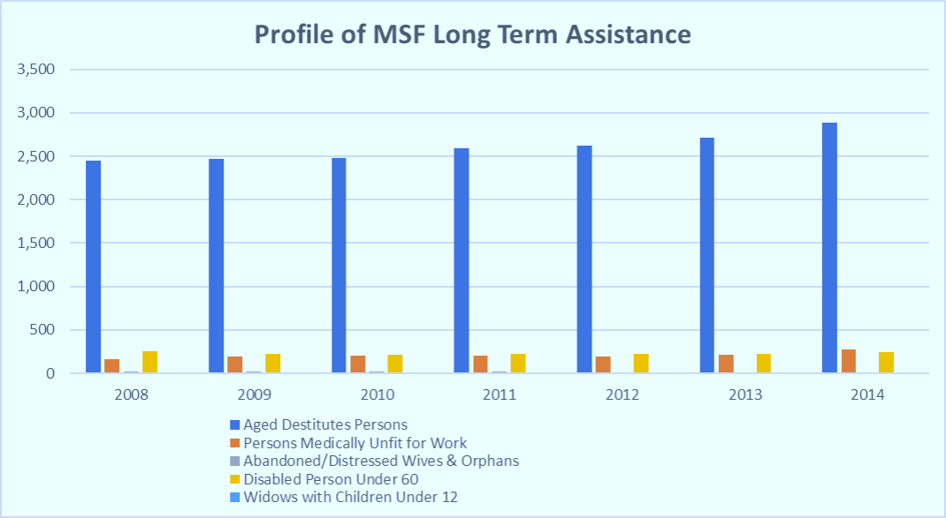
Notes:
This chart shows the profile of those who had received government financial assistance. The term “Aged Destitute Persons” refers to people who have no homes to go back to.
This also confirms that in Singapore, the group of people who are prone to sleep rough are older people.

Slide 12
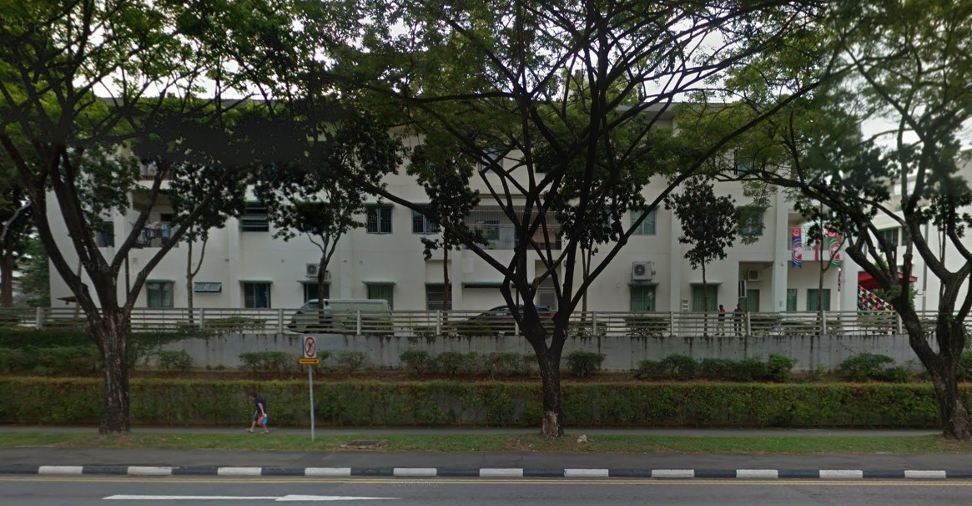
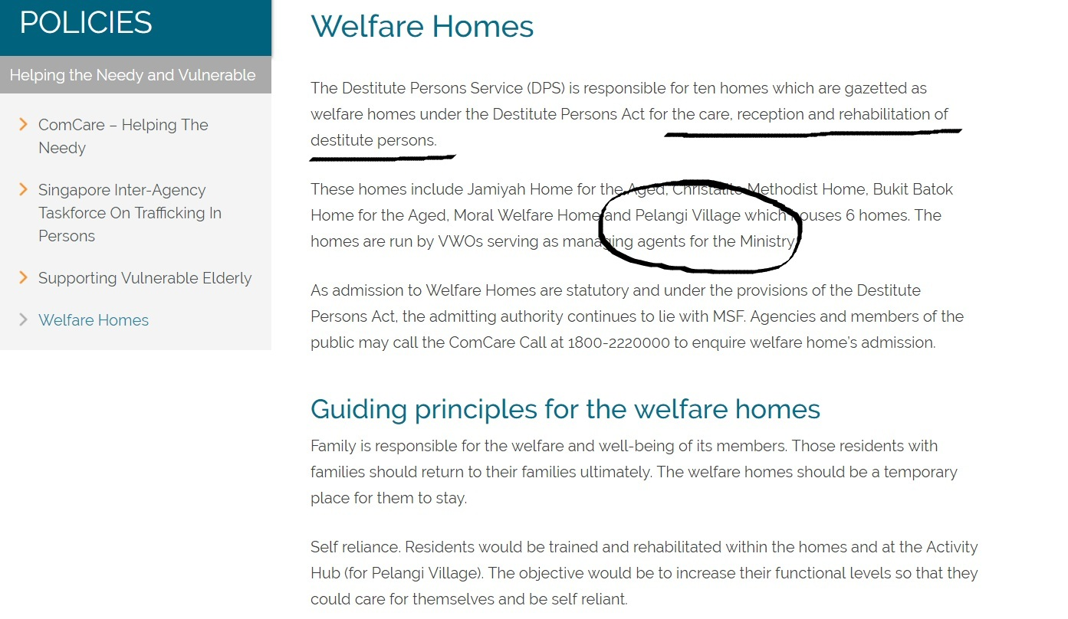
Notes:
This picture shows the exterior of a government welfare home. Government welfare homes are not open to the public and my request to the Ministry to grant me access to the officers working in these homes were ‘politely’ ignored time and time again.
Under the Destitute Persons Act, a person sleeping rough can be sent to a state welfare home such as this, [click slide] an institution that ‘cares for’ and ‘rehabilitates’ homeless people. The choice does not lie with the individual concerned but it is a statutory decision.
(optional)
Power to require destitute person to reside in welfare home
3.(1) Any public officer acting under the direction of the Director or any police officer may take in his charge any destitute person and deliver him to the custody of the Director.
(2) If the Director has reasonable cause to believe that any person so delivered into his custody has no visible means of subsistence, he may arrange for that person to be temporarily admitted into a welfare home until an inquiry has been held by him.
(3) Every such inquiry shall be completed within a period of 30 days from the date of that person’s admission into a welfare home or such further period, not exceeding 30 days, as the Minister may approve.
(4) If after holding such inquiry the Director is satisfied that that person is a destitute person within the meaning of this Act, he may by warrant under his hand require that person to reside in a welfare home.

Slide 13
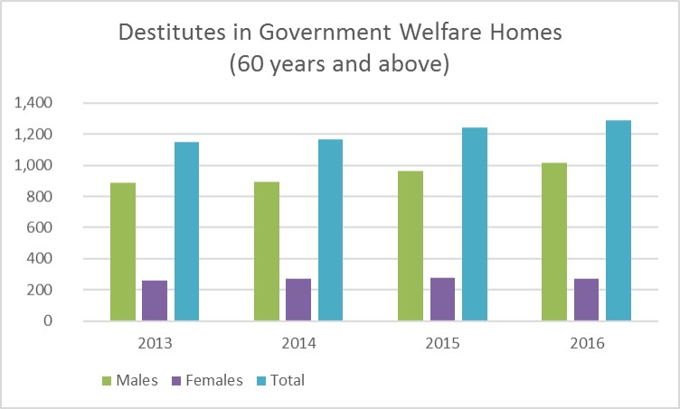
Notes:
These bar graphs gives an estimate of the number of people in the government welfare homes. I could not get data for the entire population because the ministry only gave figures for those who are 60 years and above.
From my conversations with older homeless people, there is no age restriction in these government welfare homes and those who were admitted in my study confirmed that there are younger people there, and according to them, as young as late 30s, early 40s.

Slide 14
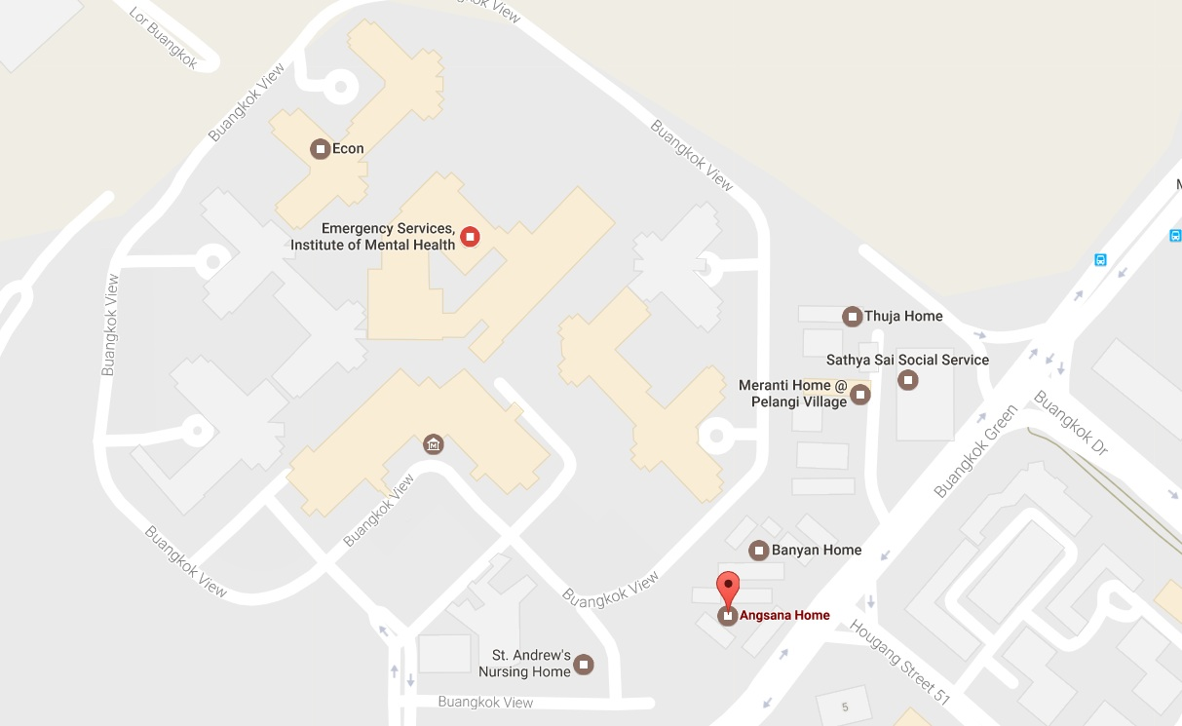
Notes:
Although there are 10 welfare homes in Singapore, those who have been ‘caught’ sleeping rough mentioned just one. This is the Angsana Home situated next to the Institute of Mental Health in Singapore.
This area is designated by the government as a social service hub as well.
While I did not manage to get it on the map, there is a National Addiction Management Centre here as well.

Slide 15
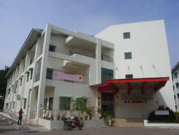
Angsana Home
Notes:
A key theme that emerge in the research was that the government welfare home enforces a routine that some homeless people finds boring and mundane. For instance, Ganeson who felt that he was arrested into Angsana Home said that things repeats in an endless loop.
Angsana Home is just another day, routine where you know. Wake up 6 o’clock, take a shower, go for your breakfast at 7 [am], then you sit around in the canteen until 12 [pm] for your lunch, they [finish] lunch then you go back to your room. You rest for 1, 2 to 3 hours then you go back to the canteen, you sit around then go for shower again, go for your dinner, then watch TV until 9 o’clock [pm], then go back to bed.
He continues,
It was so bored you know, in the Home. You are doing the same old thing. Repeating and repeating and repeating. The same old story again and again and again. The guys there you know, will talk the same thing again, again. “I’m here, I’m there, I used to be there.” Then once I was outside the home only, the atmosphere changed [P’s tone lifted].
What Ganeson tries to say is that there is no freedom, this comes through in Mr Tan’s description of the Home:
When you are inside Angsana Home, you cannot come out. There is no freedom. The officer inside will do a muster check every morning at 6am. “Muster Check!” Everyone will have to wake up and go upstairs. There are level 1, level 2, level 3, level 4 lah. “All wake up, wake up!” It is the same every day. 6am in the morning and then 8pm at night. Then before bedtime, “Muster check!” [this is the 8pm check] They will do it twice a day.

Slide 16
Angsana Home
Notes:
A second theme that emerge is that homeless people felt that they are not treated with dignity inside. Aziz, whose quote I used at the start of this presentation felt that he was treated worse than a dog.
Everything you have to ask for permission, “Sir, I want to make the call.” “Okay lah, coming, I coming back, I come back later 5 minutes,” they would reply. 5 hours, they don’t come still you know. So, we were treated like a—not a dog, they treat dog better than us, you know. So, I’m saying that in Angsana [Home], it’s a hell. Yah, it’s hell.
He continues,
The system is, whoever comes in, brought in, okay, they will charge us. They will charge us [pause] with vagrancy. You will only see the paper when they put your barang barang [Malay for “things”], they send you to isolation. This is you and your number or whatever. Then you will see, you realised that you’ve been charged with vagrancy.
Said, another homeless man I come to know well actually thought that he would be sent back to Angsana Home after our first interview. He pleaded not to be sent back there.
I don’t like the residents, they are always fighting. The officers sometimes very angry. One officer angry, all people will be scolded. I don’t like stay Angsana. I don’t like Angsana Home. Sorry don’t bring me go Angsana Home. . I scared to go Angsana. Torture people lah that one. Not help people, torture people, the officers. Torture one, I know. 3 years stay
Because the Home arranges work outside of the Home for those who are fit to work as part of their rehabilitation program, many escaped once they went out to work and did not report back as they should once work is done. Escaping is an offence and if one is caught, they would be sent back to Angsana and thrown into a personal confinement room/cell.

Slide 17
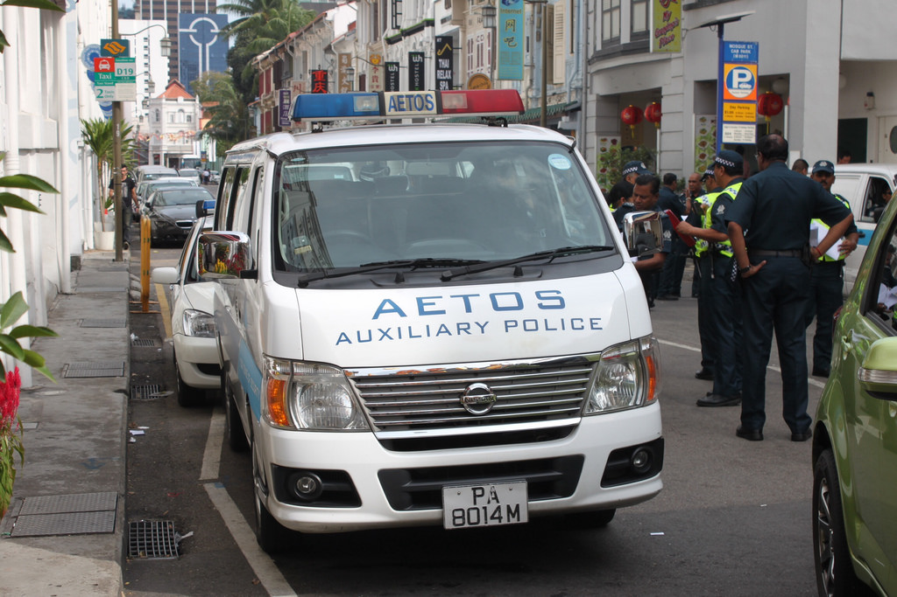
Notes:
Those who do the enforcement of the Destitute Persons Act on the ground these days are actually auxiliary police officers. They are known as AETOS, named after the Greek word for “Eagle”.
John describes the night he was picked up by the AETOS officers,
And then one night, one night, I cannot remember exactly 2 or 3 or 4 am, “Come, come, come, come. Come quickly!” [pause] Like you are under arrest lah! One more time see you here what [John was actually given 2 warnings]. “Come, come, come! Wake up! Wake up, let’s go!” Put in the van or what, {move you to the} Angsana Home.”
According to Surjan who had a recent stay in Angsana, the auxiliary police have also been deployed into the Home these days.
It’s a second prison. Yes. It’s all lock up. Everything lock up. You cannot move out, you cannot go do this, you cannot that. They charge you. Now they got Aetos [Auxiliary Police]. You do anything wrong, catch you straight, [and] put you inside the punishment cell. This is a homeless place you know? And you arrest and put them inside the punishment cell. This is not the prison you know!

Slide 18
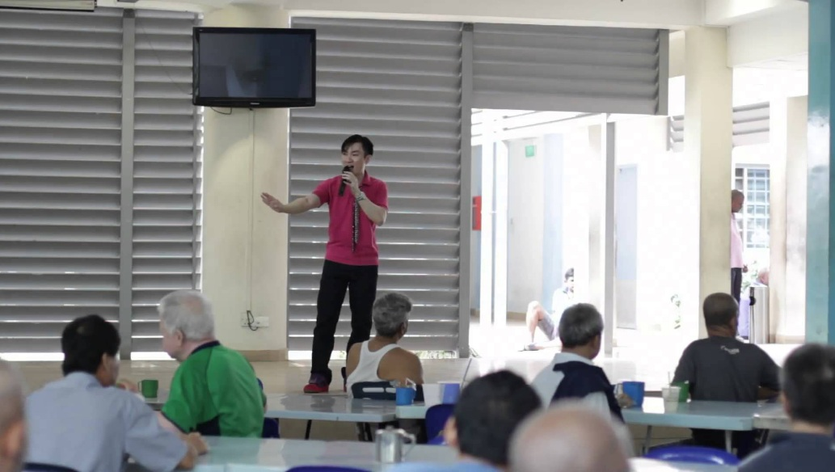
Notes:
And I will end with this last point. Not everyone felt that Angsana Home was bad. Shalom, an ex-army regular actually felt that Angsana was fun.
Angsana is quite fun in a way that if you go out and work. Because I actually went out to work, then I sort of smuggle alcohol into the home to sell to the inmates. If you don’t go out and work that means you have to do shelter workshop [meaning work within the compound).
When I told Shalom that other homeless people felt that it was like a prison, he replied,
They purposely make it in a way to make you feel that way.
What about the strict rules, I asked.
Hmm everywhere there’s rules and regulations. And all those rules are actually common sense. Okay basically they try and encourage people to go out and work and once you work for six months continuously, then they will ask you to find a partner and they will apply a HDB [Housing & Development Board] rental flat on your behalf.
And with these voices from the homeless people that I come to know well, I conclude my presentation.

Slide 19
THANK YOU
Notes:
Thank you.

