Slide 1
Data collection on homelessness in EU:
Recent Eurostat initiative explained
Contribution FEANTSA
IGH Conference
Ending street homelessness in your city
5/6 June 2017 - Chicago

Slide 2
Data collection on homelessness in EU: quick overview
State level
  Most no data
  Regular large surveys
    FR, ES, IT
  Solid data (admin, surveys, NGO)
    DK, IE, NL
  Not comparable across borders
Local level
  Regular surveys
  Quality of data
EU
  Nothing
  Huge ethical problems
Alice Chapman-Hatchett

Slide 3
Link data - policy
Better data – better policies?!
Missing
  Time people are homeless
    Chronic, Episodical, Transitional
    Link with complexity of need
  Pathways in and out
    Reasons

Slide 4
What data at EU level
EU-SILC
  Household survey
    Housing exclusion
      Housing costs
        Housing cost overburden
          40% of income
      Housing deprivation
        Overcrowding
        Quality housing
      Specific modules
        Reasons loss of housing
    No homelessness
Eurofound
  Quality of life household survey
    More detail on housing exclusion
Eurobarometer
  Public opinion surveys
    Fear of becoming homeless …
OECD
  Pooling data MS
    Housing exclusion data base
      Quality!
Eurostat Census 2011
  Homeless need to be included

Slide 5
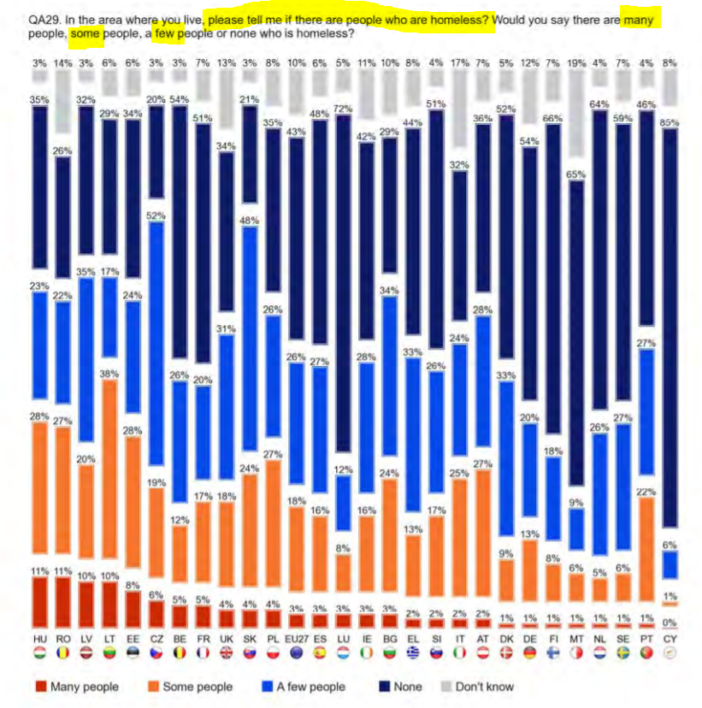
Eurobarometer

Slide 6
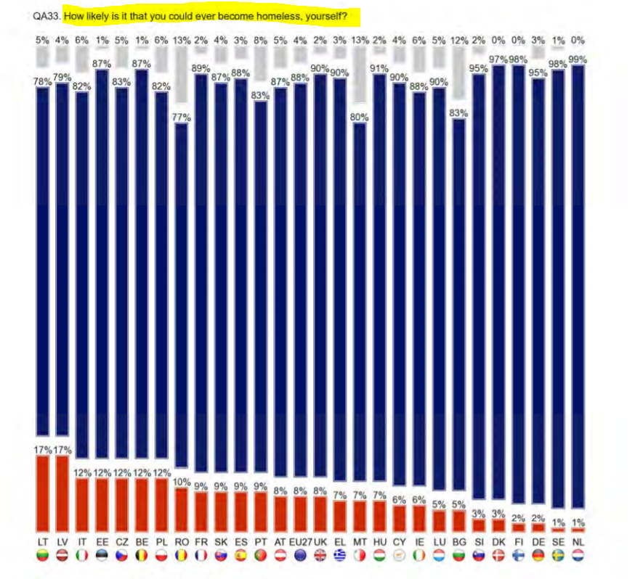
Eurobarometer

Slide 7
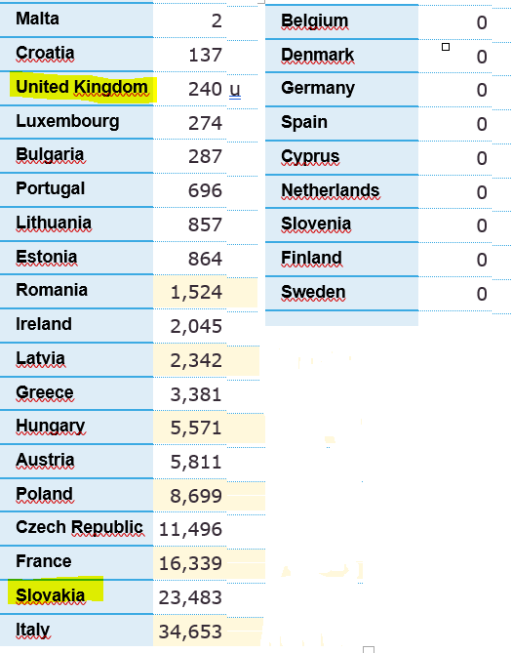
Census

Slide 8
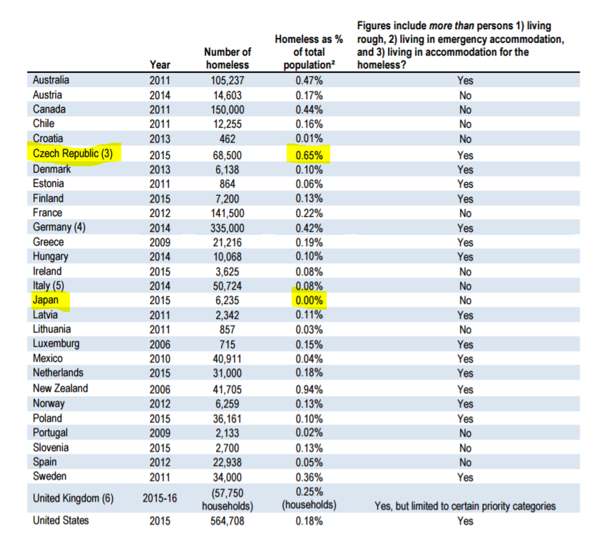
OECD

Slide 9
How many ppl are homeless in EU
????
Rough estimate
  4 million per year
Academically not robust
  400.000 in shelter/street any given date
    No data for ½ MS
    Extrapolation on basis population
    Indication underestimate
      Service paradox !
  Facto 10 – PIT/prevalence
    Indications overestimate

Slide 10
What trends
Growing
  Except FI
  Rapidly in many States
Profile
  Growth young & family
Causes
  Increasingly changes to social welfare system / dysfunctional housing markets

Slide 11
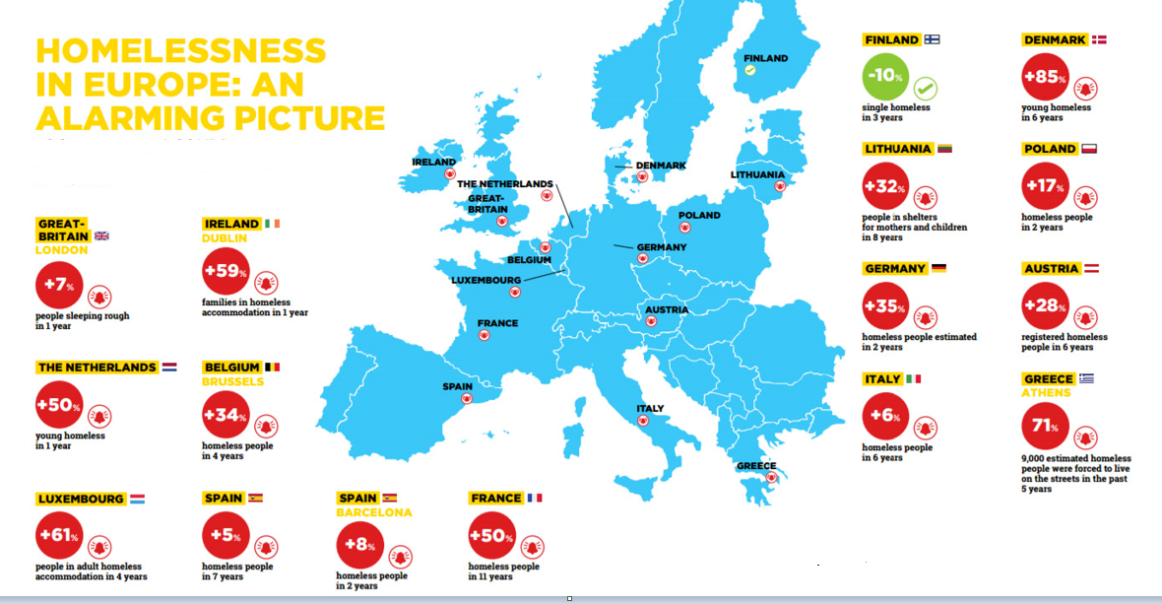

Slide 12
Eurostat specific module
2018
Module on material deprivation & well being & housing difficulties
Questions on past experience of homelessness
Voluntary
  NSI not keen on more…
Maybe integrated in new EU Regulation of social surveys post 2020

Slide 13
What questions
Have you ever been “homeless”?
  Rough sleeping
  Homeless shelter
  Family/friends
  Place not intented as permanent home
Duration of last experience
Main reason
  Relationship or family problems
  Health problems
  Unemployment
  End of rental contract
  Uninhabitable accommodation
  Leaving an institution after a long stay and no home to go to
  Financial problems/Insufficient income
  Other
Other reason
Reasons for exiting
  Existing, new or renewed relationship with family or partner
  Addressed health problems
  Gained employment
  Moved into social or subsidised private housing
  Other
  Still experiencing housing difficulties

Slide 14
But
Voluntary
Unclarity in definitions
Sample size
  App 10.000 individuals (+16) per State
  Maybe too small to capture statistically relevant into

Slide 15
Thank you for your attention
Freek.Spinnewijn@feantsa.org

