Slide 1
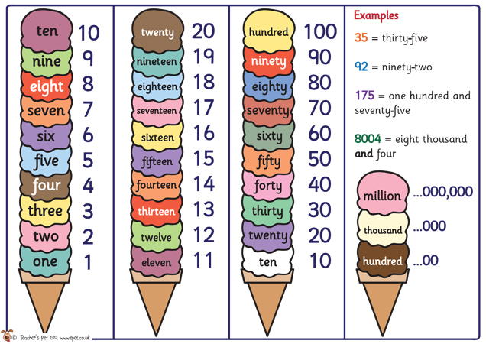

Slide 2
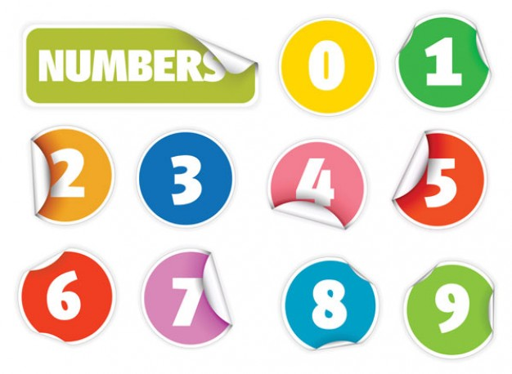

Slide 3
Zero ['zərəu]
9
2
1
7
4
6
5
3
8
0

Slide 4
One [wʌn]
9
2
1
7
4
6
5
3
8
0

Slide 5
Two [tu:]
9
2
1
7
4
6
5
3
8
0

Slide 6
Three [θri:]
9
2
1
7
4
6
5
3
8
0

Slide 7
Four [fɔ:]
9
2
1
7
4
6
5
3
8
0

Slide 8
Five [faɪv]
9
2
1
7
4
6
5
3
8
0

Slide 9
Six [sɪks]
9
2
1
7
4
6
5
3
8
0

Slide 10
Seven ['sev(ə)n]
9
2
1
7
4
6
5
3
8
0

Slide 11
Eight [eɪt]
9
2
1
7
4
6
5
3
8
0

Slide 12
Nine [naɪn]
9
2
1
7
4
6
5
3
8
0

Slide 13
Ten [ten]
9
12
11
7
4
6
5
3
8
10

Slide 14
Eleven [ə'levən]
11
2
1
7
12
6
10
3
8
0

Slide 15
Twelve [twelv]
9
2
10
7
12
6
5
11
8
0

Slide 16
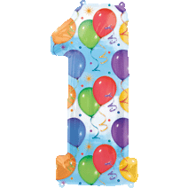
One [wʌn]
Twelve [twelv]
Eight [eɪt]
Seven ['sev(ə)n]
Four [fɔ:]
Three [θri:]
Six [sɪks]
Five [faɪv]
Two [tu:]
Nine [naɪn]
Ten [ten]
Eleven [ə'levən]

Slide 17

One [wʌn]
Twelve [twelv]
Eight [eɪt]
Seven ['sev(ə)n]
Four [fɔ:]
Three [θri:]
Zero ['zərəu]
Five [faɪv]
Two [tu:]
Nine [naɪn]
Ten [ten]
Eleven [ə'levən]

Slide 18
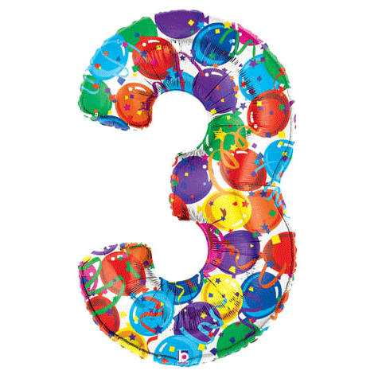
One [wʌn]
Twelve [twelv]
Eight [eɪt]
Seven ['sev(ə)n]
Four [fɔ:]
Three [θri:]
Six [sɪks]
Five [faɪv]
Two [tu:]
Nine [naɪn]
Ten [ten]
Eleven [ə'levən]

Slide 19
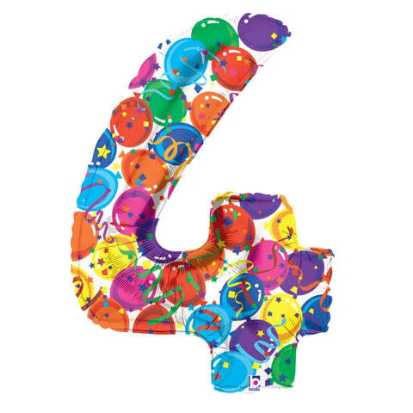
One [wʌn]
Twelve [twelv]
Eight [eɪt]
Seven ['sev(ə)n]
Four [fɔ:]
Three [θri:]
Six [sɪks]
Five [faɪv]
Two [tu:]
Nine [naɪn]
Ten [ten]
Eleven [ə'levən]

Slide 20
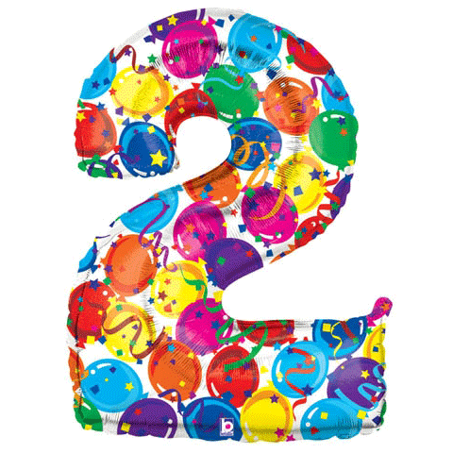
One [wʌn]
Twelve [twelv]
Eight [eɪt]
Seven ['sev(ə)n]
Four [fɔ:]
Three [θri:]
Six [sɪks]
Five [faɪv]
Two [tu:]
Nine [naɪn]
Ten [ten]
Eleven [ə'levən]

Slide 21
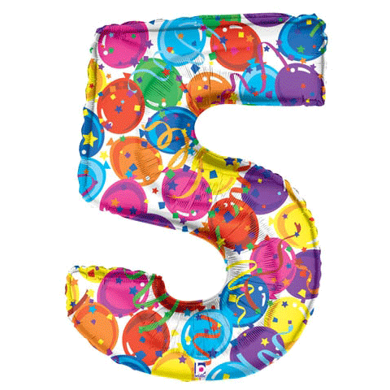
One [wʌn]
Twelve [twelv]
Eight [eɪt]
Seven ['sev(ə)n]
Four [fɔ:]
Three [θri:]
Six [sɪks]
Five [faɪv]
Two [tu:]
Nine [naɪn]
Ten [ten]
Eleven [ə'levən]

Slide 22
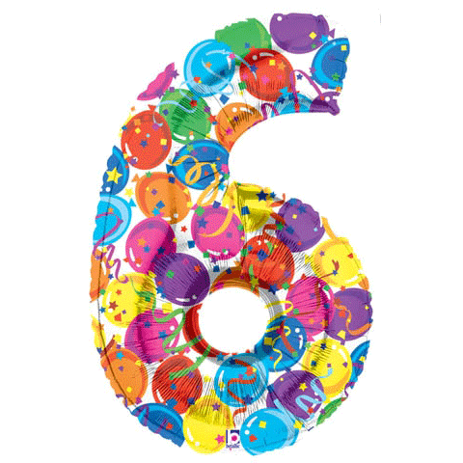
One [wʌn]
Twelve [twelv]
Eight [eɪt]
Seven ['sev(ə)n]
Four [fɔ:]
Three [θri:]
Six [sɪks]
Five [faɪv]
Two [tu:]
Nine [naɪn]
Ten [ten]
Eleven [ə'levən]

Slide 23
One [wʌn]
Twelve [twelv]
Eight [eɪt]
Seven ['sev(ə)n]
Four [fɔ:]
Three [θri:]
Six [sɪks]
Five [faɪv]
Two [tu:]
Nine [naɪn]
Ten [ten]
Eleven [ə'levən]

Slide 24
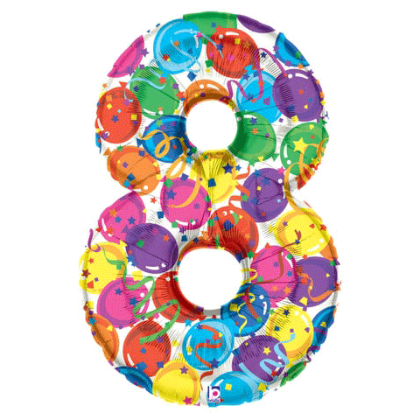
One [wʌn]
Twelve [twelv]
Eight [eɪt]
Seven ['sev(ə)n]
Four [fɔ:]
Three [θri:]
Six [sɪks]
Five [faɪv]
Two [tu:]
Nine [naɪn]
Ten [ten]
Eleven [ə'levən]

Slide 25
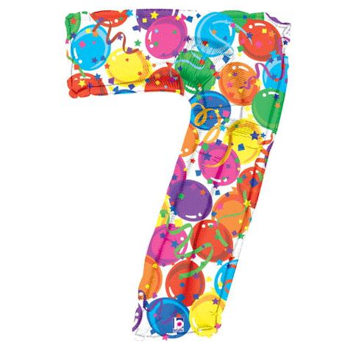
One [wʌn]
Twelve [twelv]
Eight [eɪt]
Seven ['sev(ə)n]
Four [fɔ:]
Three [θri:]
Six [sɪks]
Five [faɪv]
Two [tu:]
Nine [naɪn]
Ten [ten]
Eleven [ə'levən]

Slide 26
One [wʌn]
Twelve [twelv]
Eight [eɪt]
Seven ['sev(ə)n]
Four [fɔ:]
Three [θri:]
Six [sɪks]
Five [faɪv]
Two [tu:]
Nine [naɪn]
Ten [ten]
Eleven [ə'levən]

Slide 27
One [wʌn]
Twelve [twelv]
Eight [eɪt]
Seven ['sev(ə)n]
Four [fɔ:]
Three [θri:]
Six [sɪks]
Five [faɪv]
Two [tu:]
Nine [naɪn]
Ten [ten]
Eleven [ə'levən]

Slide 28
One [wʌn]
Twelve [twelv]
Eight [eɪt]
Seven ['sev(ə)n]
Four [fɔ:]
Three [θri:]
Six [sɪks]
Five [faɪv]
Two [tu:]
Nine [naɪn]
Ten [ten]
Eleven [ə'levən]

Slide 29
Seven ['sev(ə)n]
Six [sɪks]
Twelve [twelv]
Five [faɪv]

Slide 30
One [wʌn]
Five [faɪv]

Slide 31
Nine [naɪn]
Seven ['sev(ə)n]
Twelve [twelv]
Eleven [ə'levən]

Slide 32
Two [tu:]
Three [θri:]

Slide 33
Four [fɔ:]
Twelve [twelv]
Two [tu:]
Three [θri:]

Slide 34
Nine [naɪn]
Five [faɪv]

Slide 35
One [wʌn]
Four [fɔ:]
Two [tu:]
Three [θri:]

Slide 36
Twelve [twelv]
Seven ['sev(ə)n]

Slide 37
One [wʌn]
Eight [eɪt]
Seven ['sev(ə)n]

Slide 38



