Slide 1


Slide 2

Ordinal number
10
20
30
40
50
My emotions
10
20
30
40
50
Past Simple (+)
10
20
30
40
50
Past Simple (-)
10
20
30
40
50
Past Simple (?)
10
20
30
40
50
Notes:
Автор шаблона Салиш С.С., учитель начальных классов СШ №53 г. Актобе.

Slide 3
Ordinal number
10
Числительные – это …
Какие они бывают?

Slide 4
Ordinal number
10
Что такое числительные?
Именем числительным называется часть речи, которая обозначает количество или порядок предметов.
Какие они бывают?
Количественными и порядковыми

Slide 5
Ordinal number
20
Какие исключения Вы знаете?

Slide 6
Ordinal number
20
С 1-го по 12-й | С 13-го по 19-й | 20-го по 100-й
1st - first
2nd – second |  | 20th – twentieth
3rd – third | 13th – thirteenth | 30th – thirtieth
4th – fourth | 14th – fourteenth | 40th - fortieth
5th – fifth | 15th – fifteenth | 50th - fiftieth
6th – sixth | 16th – sixteenth | 60th - sixtieth
7th – seventh | 17th – seventeenth | 70th - seventieth
8th – eighth | 18th – eighteenth | 80th - eightieth
9th – ninth | 19th - nineteenth | 90th - ninetieth
10th – tenth |  | 100th - hundredth
11th – eleventh
12th – twelfth

Slide 7
Ordinal number
30
Сопоставьте цифру и слово.
1
72
26
17
80
Eightieth
Twenty sixth
Seventy second
First
Seventeenth

Slide 8
Ordinal number
30
1
72
26
17
80
Eightieth
Twenty sixth
Seventy second
First
Seventeenth
1 | 2 | 3 | 4 | 5
D | E | B | E | A

Slide 9
40

Slide 10

Ordinal number
40
What is in the middle* of Paris?
* middle - середина

Slide 11
Ordinal number
40
The letter "Rr".
PaRis

Slide 12
Ordinal number
50
Напишите полностью порядковые числительные и их краткое обозначение
52
43
95
39
12
Пример:
0. 1 1st first

Slide 13
Ordinal number
50
52
43
95
39
12
52nd
43rd
95th
39th
12th
Fifty second
Forty third
Ninety fifth
Thirty ninth
Twelfth

Slide 14
My emotions
10
Как злой в переводе на английский язык(написать слово)?

Slide 15


My emotions
10
A | n | g | r | y

Slide 16

My emotions
20
Напишите перевод слов
Грустный
Голодный
Скучающий
Уставший
Злой
Испуганный

Slide 17
My emotions
My emotions
20
20
Перевод
Sad
Hungry
Bored
Tired
Angry
Scared

Slide 18
30

Slide 19

My emotions
30
What is found* over your head but under your hat?
*Found - находится

Slide 20

My emotions
30
Hair.

Slide 21

My emotions
40
Прочитай и переведи
Keep – сохранять

Slide 22
My emotions
40
Сохраняйте спокойствие и учите английский язык
; -)

Slide 23
My emotions
50
[sər'praɪzd]
[kɑ:m]
[ˈθɜːstɪ]
['leɪzɪ]
[ʃaɪ]
[ʌn'hæpɪ]
[ʃɒkt]
['brɪljənt]
Прочитай и переведи транскрипцию

Slide 24
My emotions
50
Surprised [sər'praɪzd] удивленный
Calm [kɑ:m] спокойный
Thirsty [ˈθɜːstɪ] жаждущий
Lazy ['leɪzɪ] ленивый
Shy [ʃaɪ] робкий
Unhappy [ʌn'hæpɪ] несчастный
Shocked [ʃɒkt] шокированный
Brilliant ['brɪljənt] гениальный

Slide 25
Past Simple (+)
10
His name _____ Mark.
My kids _____ not with me.
I _____ busy.
He _____ thirty-five years old.
1 | 2 | 3 | 4

Slide 26
Past Simple (+)
10
His name was Mark.
My kids were not with me.
I was busy.
He was thirty-five years old.
1 | 2 | 3 | 4
was | were | was | was

Slide 27
Past Simple (+)
20
Вставьте Was или Were.
I … ill last week.
He … in Great Britain last month.
My little sisters … very naughty 2 years ago.
Our dogs … so angry yesterday.
1 | 2 | 3 | 4

Slide 28
Past Simple (+)
20
Вставьте Was или Were.
I was ill last week.
He was in Great Britain last month.
My little sisters were very naughty 2 years ago.
Our dogs were so angry yesterday.
1 | 2 | 3 | 4
was | was | were | were

Slide 29
Past Simple (+)
30
Вставьте Was или Were.
The third day 1) ___ Wednesday. The boys 2) ___ in the swimming-pool. Steve 3) ___ the fastest swimmer! On Thursday we 4) ___ at the circus! The bears 5) ___ funny! The fifth day 6) ___ Friday. In the morning we 7) ___ in the zoo.
1 | 2 | 3 | 4 | 5 | 6 | 7

Slide 30
Past Simple (+)
30
Вставьте Was или Were.
The third day 1) was Wednesday. The boys 2) were in the swimming-pool. Steve 3) was the fastest swimmer! On Thursday we 4) were at the circus! The bears 5) were funny! The fifth day 6) was Friday. In the morning we 7) were in the zoo.
1 | 2 | 3 | 4 | 5 | 6 | 7
was | were | was | were | were | was | were

Slide 31
Past Simple (+)
40
Переведите устно предложения написанные Present Simple в Past Simple.
Я ученик.
Он летчик.
Она доктор.
Мы школьники.
Они ученики.

Slide 32
Past Simple (+)
40
Переведите устно предложения написанные Present Simple в Past Simple.
Я ученик.
Он летчик.
Она доктор.
Мы школьники.
Они ученики.

Slide 33
50

Slide 34
Past Simple (+)
50
What always runs but never walks, often murmurs*, never talks, has a bed* but never sleeps, has a mouth* but never eats?
* Murmurs – урчать, шум, журчание
* Mouth – рот, уста
* Bed - дно

Slide 35
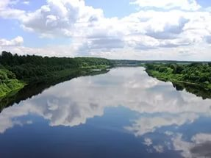
Past Simple (+)
50
A river

Slide 36
10

Slide 37
Past Simple (-)
10
We have legs but cannot walk.

Slide 38
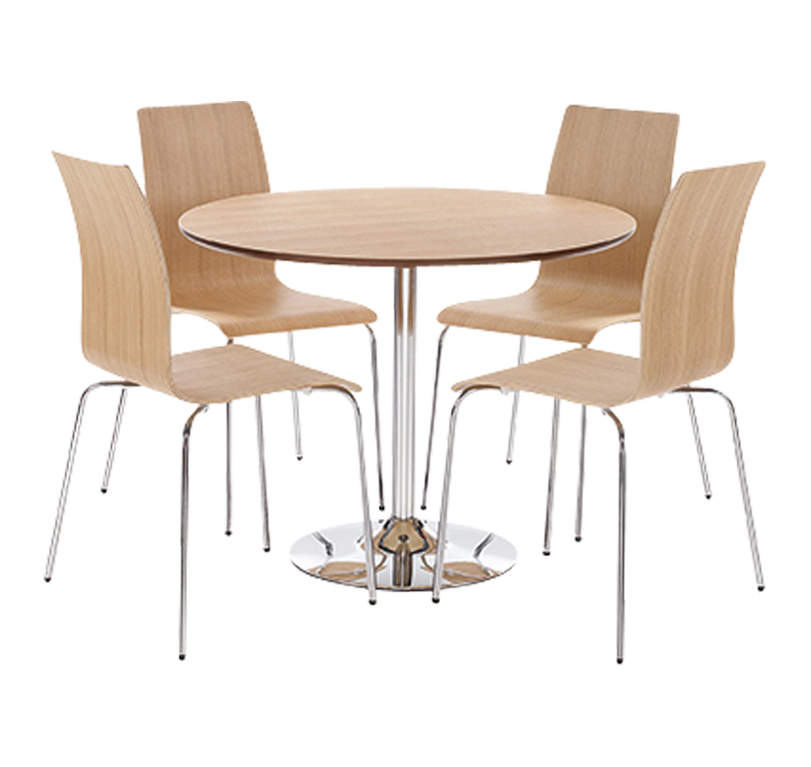
Past Simple (-)
10
Tables and chairs.

Slide 39
Past Simple (-)
20
Вставьте Wasn’t или Weren’t .
I ___ a student.
Her cousin ___ a shop-assistant
I and Jane ___ scientists two years ago.
My parents ___ at home yesterday.
His friend ___ a photographer.
1 | 2 | 3 | 4 | 5

Slide 40
Past Simple (-)
20
Вставьте Wasn’t или Weren’t .
I wasn’t a student.
Her cousin wasn’t a shop-assistant
I and Jane weren’t scientists two years ago.
My parents weren’t at home yesterday.
His friend wasn’t a photographer.
1 | 2 | 3 | 4 | 5
Wasn’t | Wasn’t | Weren’t | Weren’t | Wasn’t

Slide 41
Past Simple (-)
30
Вставьте was, wasn’t или were, weren’t .
My father ... a teacher, he ... an engineer.
My brother ... a worker, he ... a scientist 3 years ago.
My sister ... at home, she … at work.
Kate and I ... actresses, they … doctors
My uncle’ dogs ... in the park.

Slide 42
Past Simple (-)
30
Вставьте was, wasn’t или were, weren’t .
My father wasn’t a teacher, he was an engineer.
My brother wasn’t a worker, he was a scientist 3 years ago.
My sister wasn’t at home, she was at work.
Kate and I weren’t actresses, they were doctors
My uncle’ dogs were in the park.

Slide 43
Past Simple (-)
40
Вставьте was, wasn’t или were, weren’t .
Helen 1) ... a baker, she 2) … a painter. She had some fine pictures. They 3) ... on the floor, they 4) … on the walls. She had much paper. It 5) ... on the table, it 6) … on the shelf. The shelf 7) ... brown.
Helen has a brothers. Ron and Harry 8) … students, they 9) … mechanics.

Slide 44
Past Simple (-)
40
Вставьте was, wasn’t или were, weren’t .
Helen 1) wasn’t a baker, she 2) was a painter. She had some fine pictures. They 3) weren’t on the floor, they 4) were on the walls. She had much paper. It 5) wasn’t on the table, it 6) wasn’t on the shelf. The shelf 7) was brown.
Helen has a brothers. Ron and Harry 8) were students, they 9) were mechanics.

Slide 45
Past Simple (-)
50
Переведите устно на английский язык, употребляя глагол to be в Past Simple.
Я и Катя не были в кино 2 дня назад.
Мои друзья не были в школе вчера.
Я не был в парке неделю назад.
Он не был в школе вчера.
Мой папа не был учителем.

Slide 46
Past Simple (-)
50
Переведите устно на английский язык, употребляя глагол to be в Past Simple.
Я и Катя не были в кино 2 дня назад.
Мои друзья не были в школе вчера.
Я не был в парке неделю назад.
Он не был в школе вчера.
Мой папа не был учителем.

Slide 47
Past Simple (?)
10
Вставьте Was или Were.
________ you in Kongo?
________ you happy yesterday?
________ Lumpy quiet yesterday?
________ your parents in the local gym yesterday?
________ Jenny at the party?
________ your friend at school yesterday?
1 | 2 | 3 | 4 | 5 | 6

Slide 48
Past Simple (?)
10
Вставьте Was или Were.
Were you in Kongo?
Were you happy yesterday?
Was Lumpy quiet yesterday?
Were your parents in the local gym yesterday?
Was Jenny at the party?
Were your friend at school yesterday?
1 | 2 | 3 | 4 | 5 | 6
were | were | was | were | was | were

Slide 49
20

Slide 50
Past Simple (?)
20
I am purple, yellow, red, and green
The King cannot reach* me and neither* can the Queen.
I show my colours after the rain
And only when the sun comes out again
*reach – достичь, достать
*Neither – ни, не

Slide 51

Past Simple (?)
20
A rainbow.

Slide 52
Past Simple (?)
30
Задайте вопросы и дайте на них короткие ответы.
Пример: (you/at home/last night) -
Were you at home last night? Yes, I was.
(you/at home/on Sunday) No, ....
(the weather in Moscow/ good/yesterday) No, ....
(you/at the Zoo/last Sunday) No, ....
(your mother and father /in St. Petersburg /last year) Yes, ....

Slide 53
Past Simple (?)
30
Пример: (you/at home/last night) -
Were you at home last night? Yes, I was.
Were you at home on Sunday? No, I wasn’t.
Was the weather in Moscow good yesterday? No, It wasn’t.
Were you at the Zoo last Sunday? No, I wasn’t.
Were your mother and father in St. Petersburg last year? Yes, they were.

Slide 54
Past Simple (?)
40
3aполните пропуски словами yesterday или last.
Bob wasn't at work ... week.
I was at home ....
The pupils were absent ... Friday.
Ann wasn't at home ... night.
We watched TV ….
She came to Moscow ... summer.

Slide 55
Past Simple (?)
40
3aполните пропуски словами yesterday или last.
Bob wasn't at work last week.
I was at home yesterday
The pupils were absent last Friday.
Ann wasn't at home last night.
We watched TV yesterday.
She came to Moscow last summer.

Slide 56
Past Simple (?)
50
Переведите устно
Вы были в Москве в прошлом году?
Том и Анна были в парке вчера?
Его родители был в Лондоне 2 года назад?
Катя была в школе в прошлое воскресенье?

Slide 57
Past Simple (?)
50
Переведите устно
Were you in Moscow last year?
Were Tom and Ann in the park yesterday?
Were his parents in London 2 years ago?
Was Kate at school last Sunday?

