Slide 1
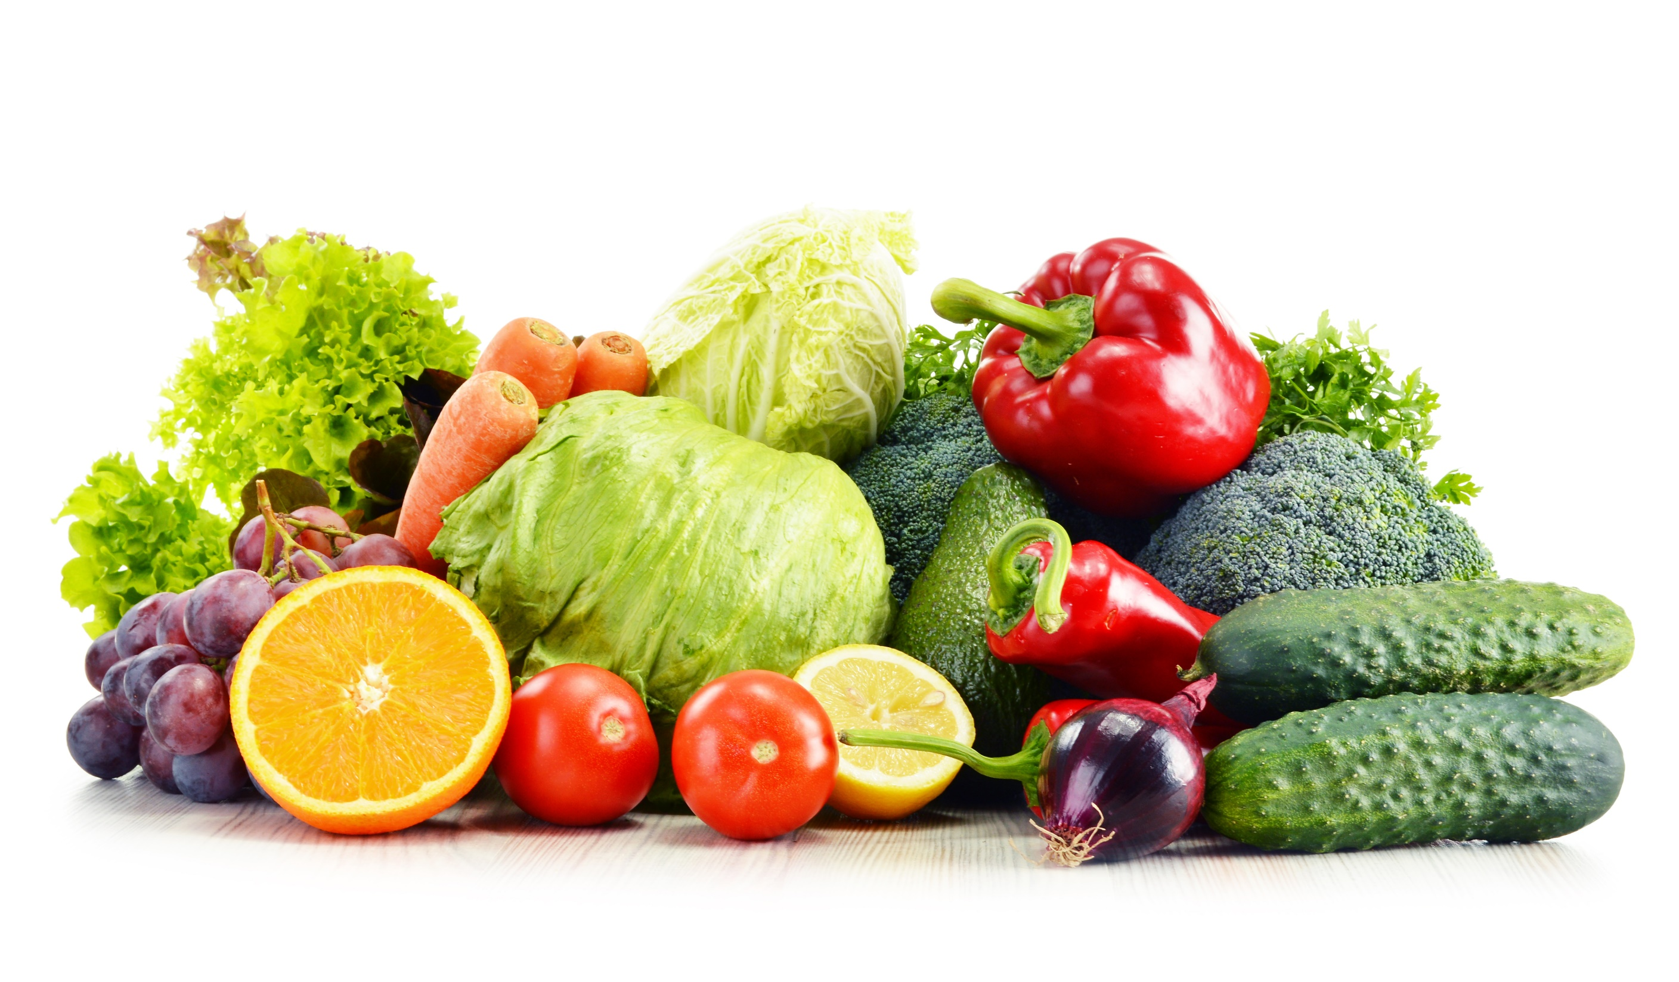
FOOD Part 1

Slide 2
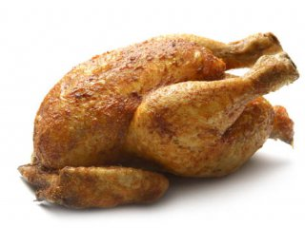
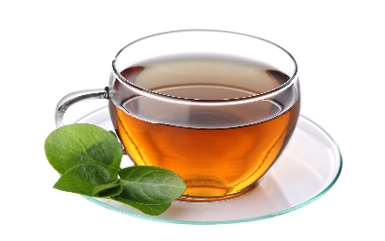
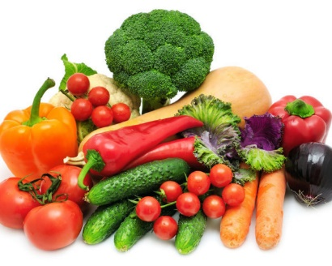
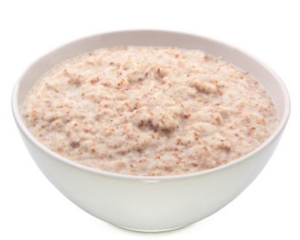
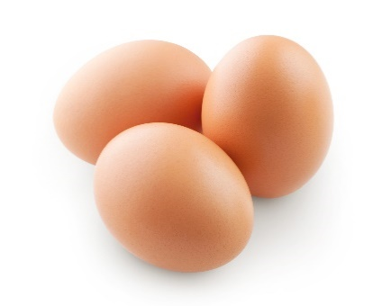

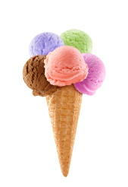
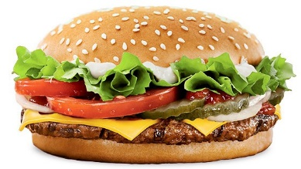
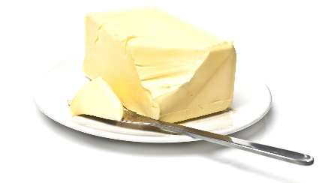
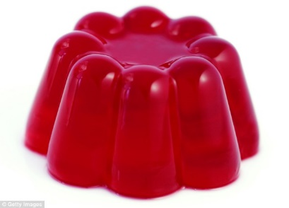
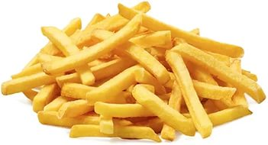
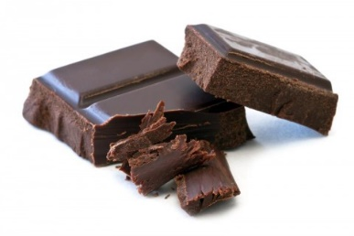
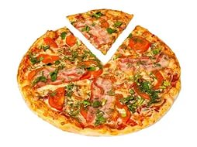
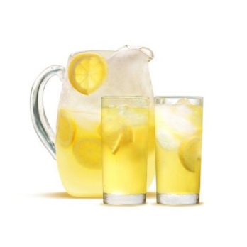
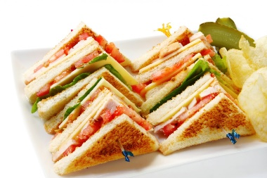
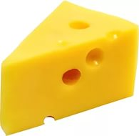
[ˈsænwɪdʒ]
A
J
H
E
I
B
O
P
M
F
G
C
K
D
L
N

Slide 3
[ˌaɪsˈkriːm]
A
J
H
E
I
B
O
P
M
F
G
C
K
D
L
N

Slide 4
Chocolate
A
J
H
E
I
B
O
P
M
F
G
C
K
D
L
N

Slide 5
Vegetables
A
J
H
E
I
B
O
P
M
F
G
C
K
D
L
N

Slide 6
[ˈtʃɪkɪn]
A
J
H
E
I
B
O
P
M
F
G
C
K
D
L
N

Slide 7
Lemonade
A
J
H
E
I
B
O
P
M
F
G
C
K
D
L
N

Slide 8
[ɛɡ]
A
J
H
E
I
B
O
P
M
F
G
C
K
D
L
N

Slide 9
Pizza
A
J
H
E
I
B
O
P
M
F
G
C
K
D
L
N

Slide 10
Water
A
J
H
E
I
B
O
P
M
F
G
C
K
D
L
N

Slide 11
Tea
A
J
H
E
I
B
O
P
M
F
G
C
K
D
L
N

Slide 12
Burgers
A
J
H
E
I
B
O
P
M
F
G
C
K
D
L
N

Slide 13
Jelly
A
J
H
E
I
B
O
P
M
F
G
C
K
D
L
N

Slide 14
[tʃiːz]
A
J
H
E
I
B
O
P
M
F
G
C
K
D
L
N

Slide 15
Butter
A
J
H
E
I
B
O
P
M
F
G
C
K
D
L
N

Slide 16
[tʃɪps]
A
J
H
E
I
B
O
P
M
F
G
C
K
D
L
N

Slide 17
Porridge
A
J
H
E
I
B
O
P
M
F
G
C
K
D
L
N

Slide 18


