Slide 1
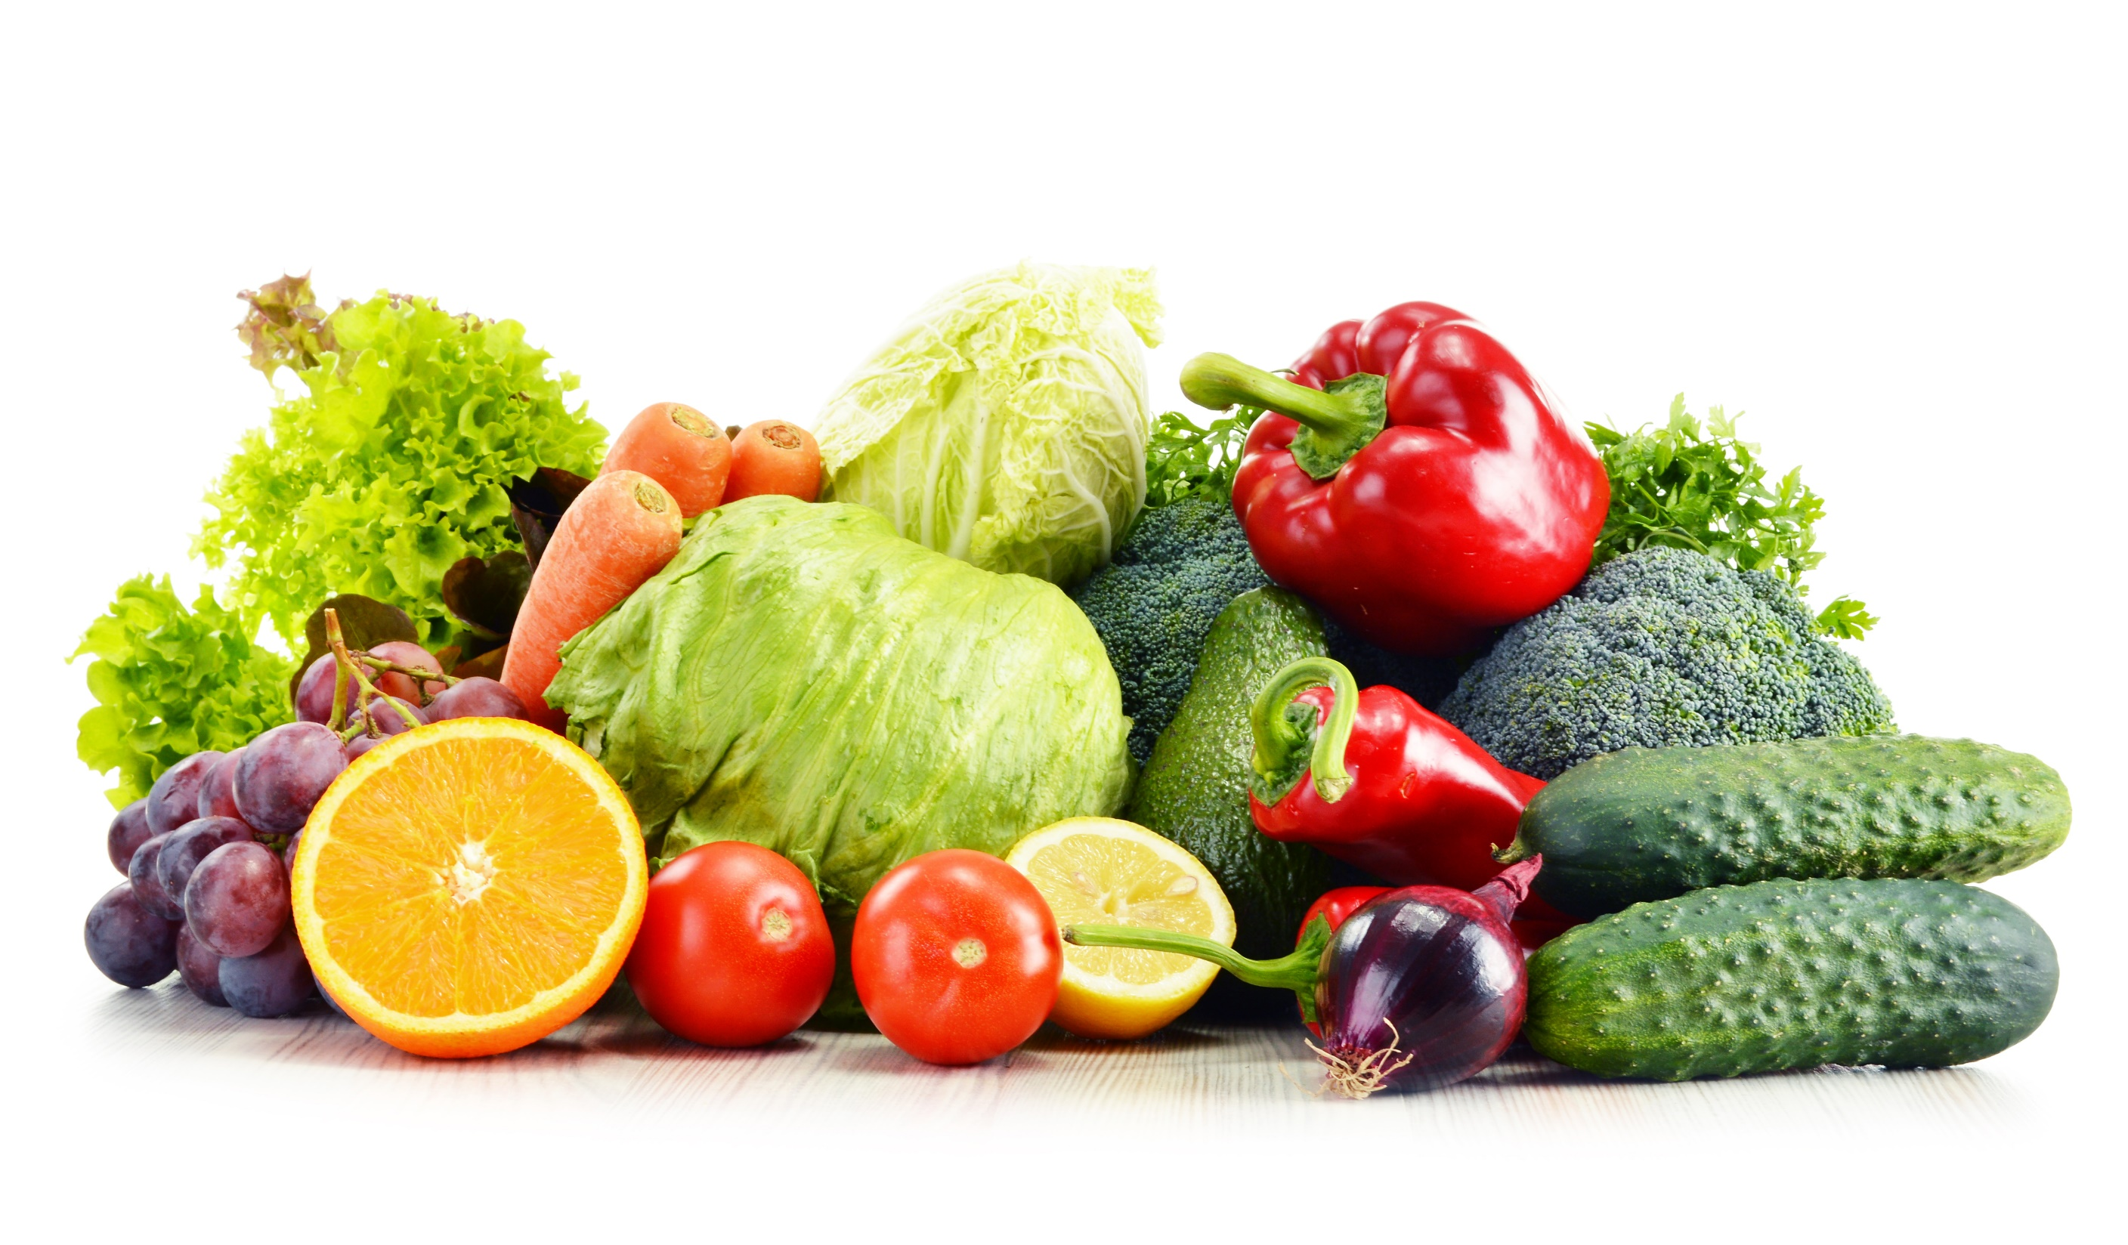
FOOD Part 2

Slide 2
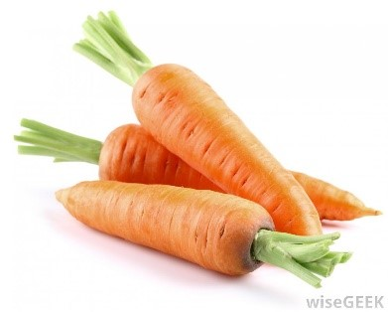

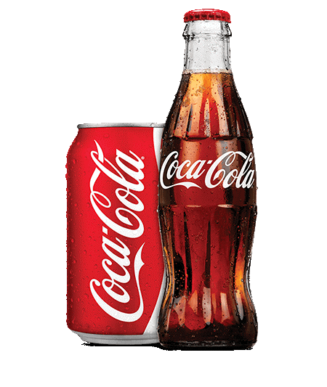
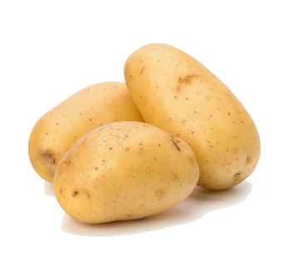
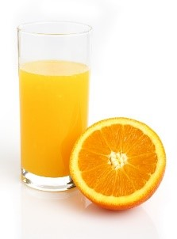

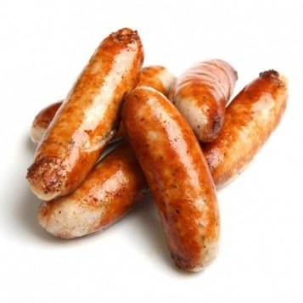
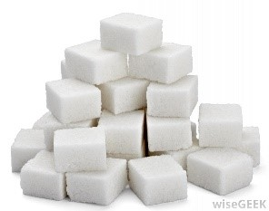
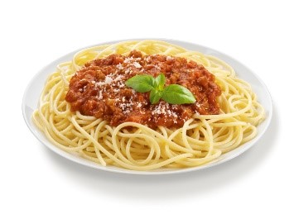
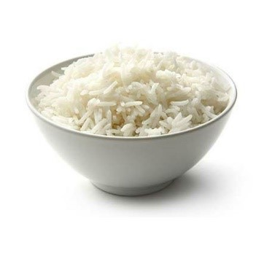
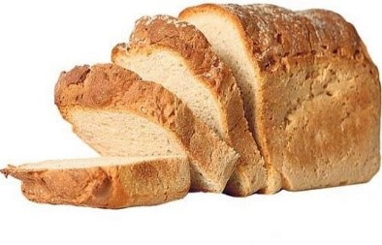
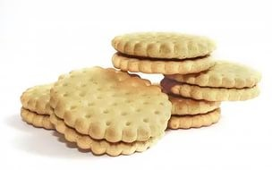
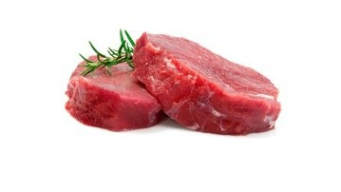
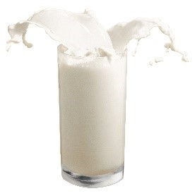
Pasta
A
H
J
I
E
B
M
F
G
K
C
D
N
L

Slide 3
Sugar
A
H
J
I
E
B
M
F
G
K
C
D
N
L

Slide 4
Bread
A
H
J
I
E
B
M
F
G
K
C
D
N
L

Slide 5
Biscuits
A
H
J
I
E
B
M
F
G
K
C
D
N
L

Slide 6
Potatoes
A
H
J
I
E
B
M
F
G
K
C
D
N
L

Slide 7
Meat
A
H
J
I
E
B
M
F
G
K
C
D
N
L

Slide 8
Coke
A
H
J
I
E
B
M
F
G
K
C
D
N
L

Slide 9
Rice
A
H
J
I
E
B
M
F
G
K
C
D
N
L

Slide 10
Popcorn
A
H
J
I
E
B
M
F
G
K
C
D
N
L

Slide 11
Milk
A
H
J
I
E
B
M
F
G
K
C
D
N
L

Slide 12
Sausages
A
H
J
I
E
B
M
F
G
K
C
D
N
L

Slide 13
Cake
A
H
J
I
E
B
M
F
G
K
C
D
N
L

Slide 14
Carrots
A
H
J
I
E
B
M
F
G
K
C
D
N
L

Slide 15
Orange juice
A
H
J
I
E
B
M
F
G
K
C
D
N
L

Slide 16


