Slide 1
old family recipes

Slide 2
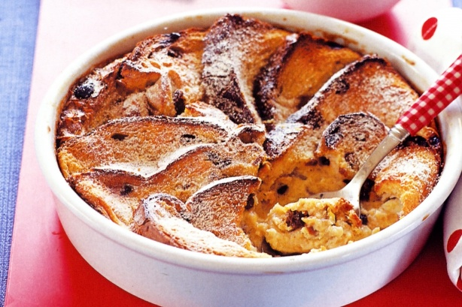

Slide 3
Bread Pudding Recipe
INGREDIENTS for Bread Pudding:
A loaf of bread
A carton of milk
2 Eggs
2 cups of sugar
2 spoons of vanilla
A cup raisins [reɪzn] (изюм)
3 spoons of butter

Slide 4
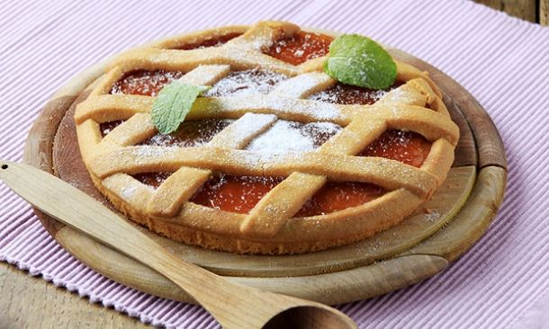

Slide 5
jam tart Recipe
INGREDIENTS for jam tart :
A packet of flour
A spoon of salt
3 spoons of sugar
A piece of butter
A bottle of water
24 spoons of jam

Slide 6
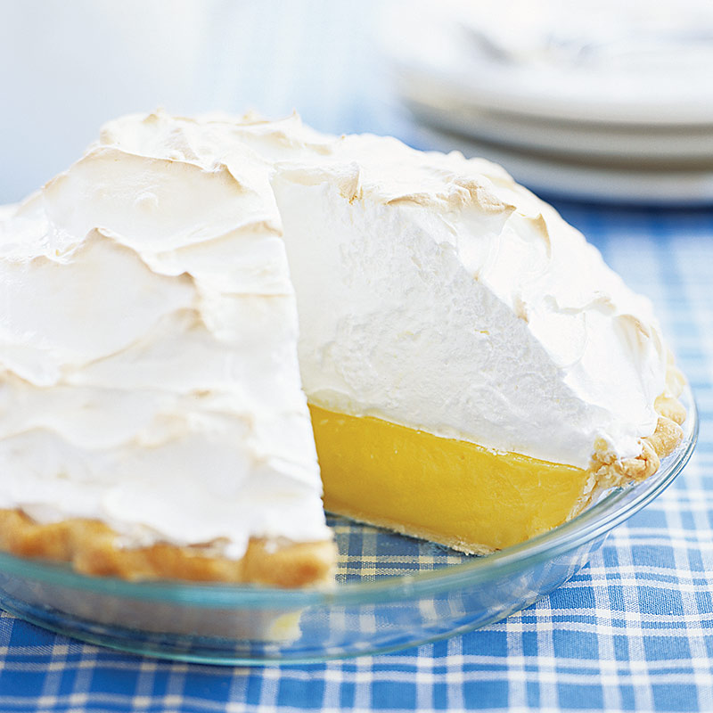

Slide 7
lemon meringue Recipe
INGREDIENTS for lemon meringue:
a cup of sugar
2 spoons of flour
a spoon of salt
a cup of water
2 lemons
2 spoons of butter
4 eggs

Slide 8

How much does Bread Pudding cost?
Can I have a loaf of bread , please?
Here you are. That’s one pounds twenty pence.
INGREDIENTS for Bread Pudding:
A loaf of bread – 1, 20
A carton of milk -1, 10
2 Eggs – 0, 99
2 cups of sugar – 0, 30
2 spoons of vanilla – 0, 54
A cup raisins – 1, 94
3 spoons of butter – 0, 87

Slide 9
How much does Bread Pudding cost?
INGREDIENTS for Bread Pudding:
A loaf of bread – 1, 20
A carton of milk -1, 10
2 Eggs – 0, 99
2 cups of sugar – 0, 30
2 spoons of vanilla – 0, 54
A cup raisins – 1, 94
3 spoons of butter – 0, 87
(one pounds twenty pence).

Slide 10
How much does Bread Pudding cost?
10,51
INGREDIENTS for Bread Pudding:
A loaf of bread – 1, 20
A carton of milk -1, 10
2 Eggs – 0, 99
2 cups of sugar – 0, 30
2 spoons of vanilla – 0, 54
A cup raisins – 1, 94
3 spoons of butter – 0, 87
(one pounds twenty pence).
(one pounds ten pence).
(ninety nine pence).
(thirty pence).
(fifty four pence).
(one pounds ninety four pence).
(eighty seven pence).

