Slide 1

Разработка Бурлаковой Е.С.

Slide 2

Professions
10
20
30
40
50
In the city
10
20
30
40
50
Present Simple
10
20
30
40
50
Have to
10
20
30
40
50
Time
10
20
30
40
50
Notes:
Автор шаблона Салиш С.С., учитель начальных классов СШ №53 г. Актобе.

Slide 3
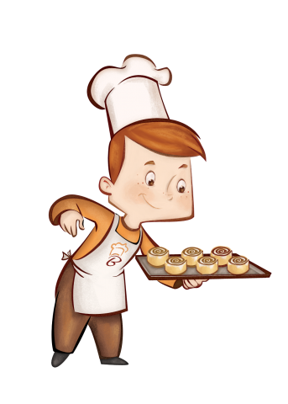
Professions
10
Who is he?

Slide 4
Professions
10
He’s a baker

Slide 5

Professions
20
Read the transcription
[mɪˈkænɪk]

Slide 6

Professions
20
A mechanic

Slide 7

Professions
30
Who is this person?
I work in the hospital.
I help sick people.
I wear a uniform.

Slide 8
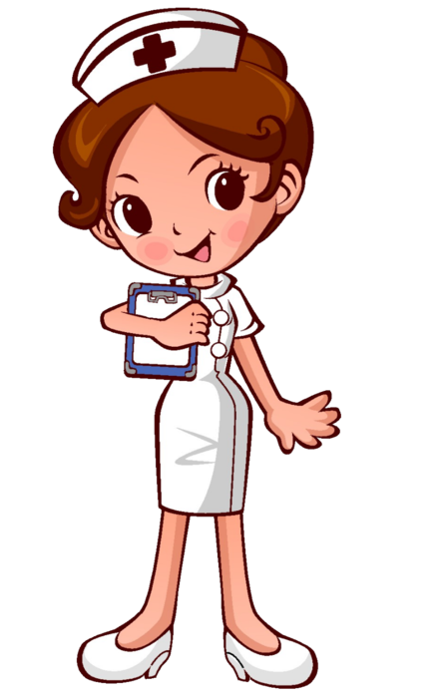
Professions
30
She is a nurse.

Slide 9
40

Slide 10
Professions
40
This job is very responsible. People of this job must be very brave and strong, kind and clever, clean and smart, because this job is very difficult. You must work hard on Monday, Tuesday, Wednesday, Thursday, Friday, Saturday and Sunday. And you mustn’t be a couch potato. Be careful: you can’t fall ill because your job is important. You must help sick people or animals any time. You must do sports, you mustn’t skip breakfast, lunch or dinner. If you don’t like people and animals, this job isn’t for you.
People of this job always have many friends.
Responsible - ответственный
a couch potato – лежебока

Slide 11
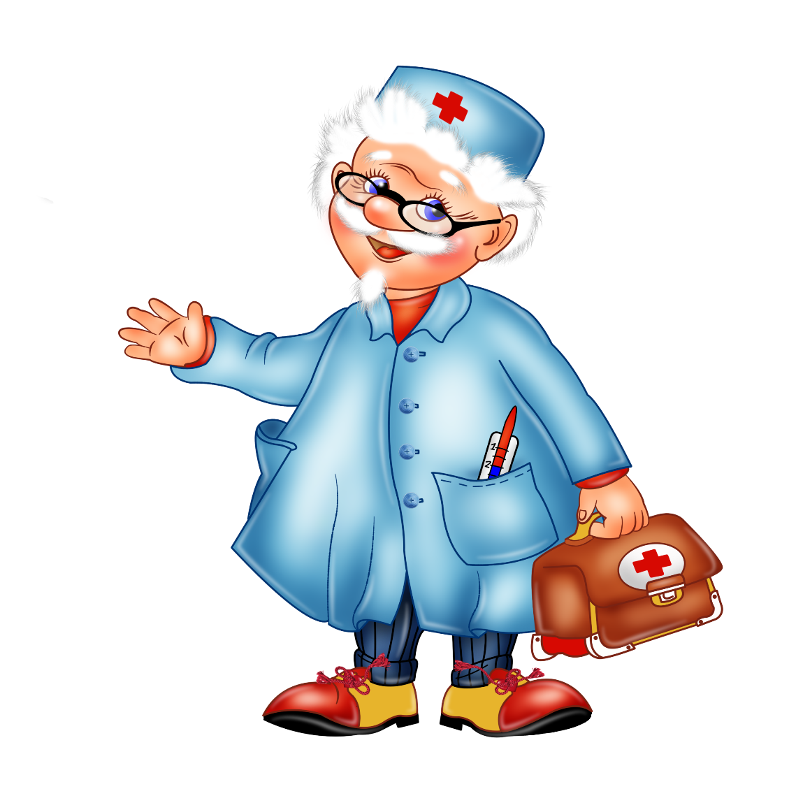
Professions
40
This person is a doctor

Slide 12
Professions
50
a teacher
a doctor
a policeman
a clown
a postman
a dancer
a fireman
a baker
a dentist
a pupil
i) He bakes bread.
f) He works in a circus.
o) He takes care of our teeth.
s) He fights fires.
n) She studies at school.
e) He delivers letters.
p) She gives pupils homework.
r) He helps sick people.
o) He protects people.
s) She works in a theatre.
1 | 2 | 3 | 4 | 5 | 6 | 7 | 8 | 9 | 10

Slide 13
Professions
50
a teacher
a doctor
a policeman
a clown
a postman
a dancer
a fireman
a baker
a dentist
a pupil
i) He bakes bread.
f) He works in a circus.
o) He takes care of our teeth.
s) He fights fires.
n) She studies at school.
e) He delivers letters.
p) She gives pupils homework.
r) He helps sick people.
o) He protects people.
s) She works in a theatre.
1 | 2 | 3 | 4 | 5 | 6 | 7 | 8 | 9 | 10
P | R | O | F | E | S | S | I | O | N

Slide 14
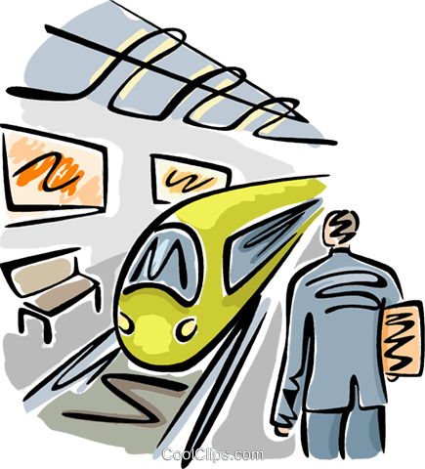
In the city
10
What is it?

Slide 15
In the city
10
It’s a station.

Slide 16
In the city
20
Read the transcription
[pəʊst ˈɔfɪs]

Slide 17
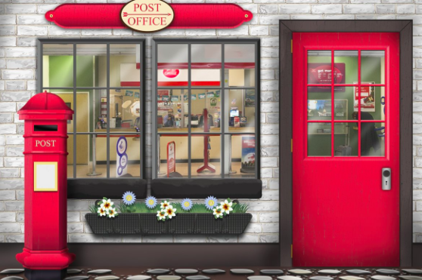
In the city
20
A post office

Slide 18
30

Slide 19
In the city
30
I have cities but no houses
Forests but no trees
Rivers without water
What am I?

Slide 20
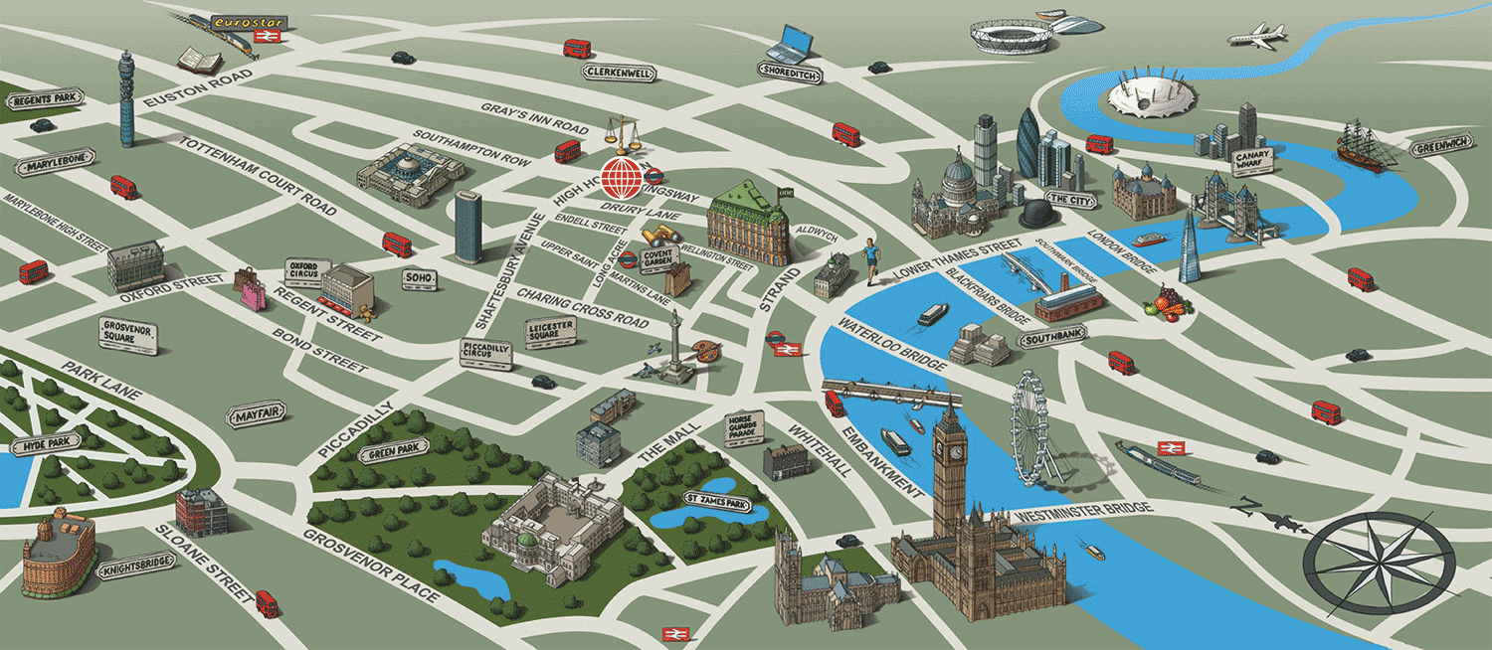
In the city
30
It’s a map.

Slide 21
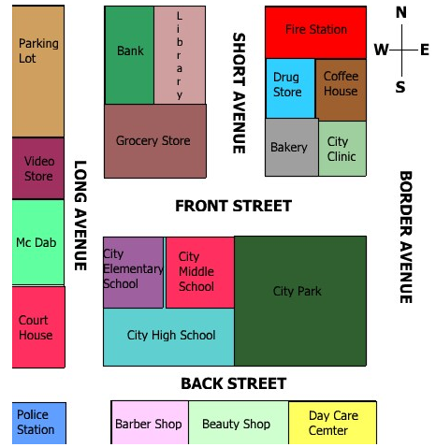
In the city
40
What is this place?
A: Pardon me, but I'm looking for the nearest da-da-da. Can you help me? B: Umm. . . I think the da-da-da is on Front Street across the street from the Elementary and Middle Schools.

Slide 22
In the city
40
It’s Grocery Store

Slide 23
In the city
50
This building is big and blue. There are four floor, stairs, toilets, a library and a dining room in this building.
I go to this building five times a week. I study there.
And this place is …

Slide 24

In the city
50
It’s school.

Slide 25
Present Simple
10
My life is so boring - I just ________ TV every night.
watchies
watches
watch

Slide 26

Present Simple
10
My life is so boring - I just watch TV every night.

Slide 27
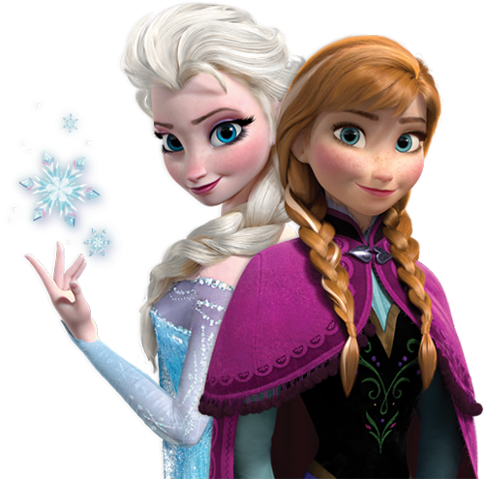
Present Simple
20
Anna and Elsa _____ (not, like) bad weather.
1. doesn’t like
2. not like
3. don't like

Slide 28
Present Simple
20
Anna and Elsa don't like bad weather.

Slide 29


Present Simple
30
Where does a greengrocer work?
Where do a greengrocer work?
Where does a greengrocer works?

Slide 30

Present Simple
30
Where does a greengrocer work?

Slide 31
Present Simple
40
Translate it into English:
Медсестра не работает в кафе, она работает в больнице.

Slide 32
Present Simple
40
A nurse doesn’t work at a cafe, she works at a hospital.

Slide 33
50

Slide 34
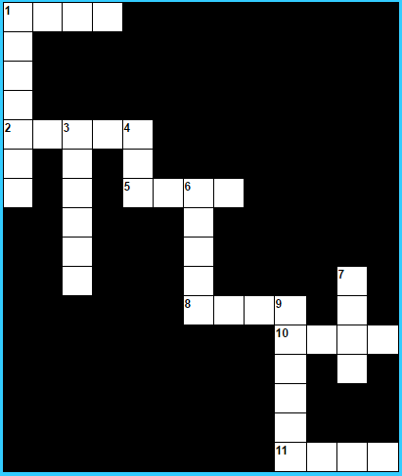
Present Simple
50
Across: 1: I ..........(work) at school.
Down: 1: He ............(watch) tv.
Across: 2: My mother ........(help) me with my homework.
Down: 3: The bus ........(leave) at half past four.
Down: 4: We ........(see) a lot of people from here.
Across: 5: The weekend ......(end) on Sunday night.
Down: 6: My friends ...........(drink) no alcohol.
Down: 7: They ........(play) a game every Friday evening.
Across: 8: I ........(know) the answer to this question.
Down: 9: Rob ..........(write) beautiful stories.
Across: 10: We ...........(read) 2 English books every year.
Across: 11: You ........(sing) a lot, don't you?

Slide 35
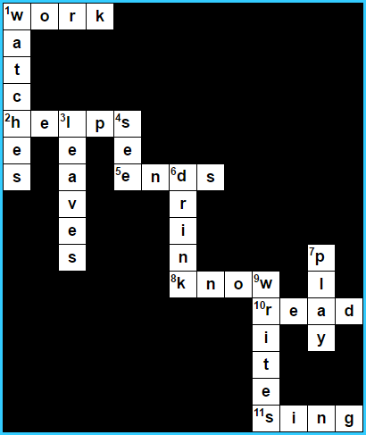
Present Simple
50

Slide 36
10

Slide 37
Have to
10
How translate “have to” into Russian?
Вынужден, необходим
Не нужно, не должен
Иметь, обладать

Slide 38

Have to
10
Вынужден, необходим.

Slide 39
Have to
20
Для каких местоимений мы используем HAVE TO, а для каких HAS TO?

Slide 40
Have to
20
I have to
You have to
He has to
She has to
It has to
We have to
They have to

Slide 41
Have to
30
You ______ be back at 10 o’clock.
Have to
Has to

Slide 42

Have to
30
You have to be back at 10 o’clock.

Slide 43
Have to
40
Jane don't have to eat that porridge.
Jane doesn't have to eat that porridge.
Jane doesn't has to eat that porridge.

Slide 44

Have to
40
2. Jane doesn't have to eat that porridge.

Slide 45
Have to
50
Carl doesn’t has to wash the dishes.
Drake have to do the test
Does Emma and you have to do this difficult exercise?
Harry and I has to water the plants.
Eric don’t have to draw on the desk.
Does Ann has to play tennis?

Slide 46
Have to
50
Carl doesn’t have to wash the dishes.
Drake has to do the test.
Do Emma and you have to do this difficult exercise?
Harry and I have to water the plants.
Eric doesn’t have to draw on the desk.
Does Ann have to play tennis?

Slide 47
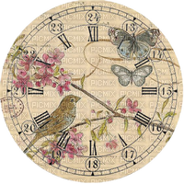
Time
10
What’s time is it?
It’s 12 o’clock
It’s o‘ clock 12
It’s quarter past twelve
It’s quarter to twelve
It’s half past twelve

Slide 48
Time
10
What’s time is it?
It’s 12 o’clock

Slide 49
20

Slide 50

Time
20
I go at night and all the day, and yet I never go away.

Slide 51
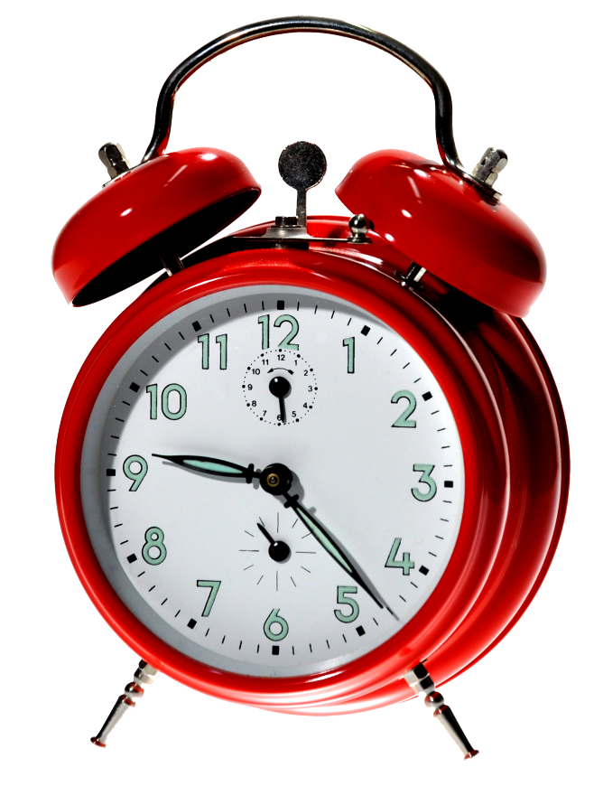
Time
20
It’s a clock

Slide 52

Time
30
It’s quarter to seven
A
B
C
D

Slide 53

Time
30
B

Slide 54
Time
40
4:45 – It’s a quarter past five
6:30 – It’s half past seven
3:00 – It’s o’clock 3
8:15 – It’s a quarter to eit

Slide 55
Time
40
4:45 – It’s a quarter to five
6:30 – It’s half past six
3:00 – It’s 3 o’clock
8:15 – It’s a quarter past eight

Slide 56
Time
50
It’s half past three.
It’s a quarter past two.
It’s a quarter to twelve.
It’s half past eight.
It’s a quarter to four.
It’s nine o’clock.
It’s a quarter past ten.
8:30
9:00
11:45
3:45
3:30
10:15
2:15
1 | 2 | 3 | 4 | 5 | 6 | 7

Slide 57
Time
50
It’s half past three.
It’s a quarter past two.
It’s a quarter to twelve.
It’s half past eight.
It’s a quarter to four.
It’s nine o’clock.
It’s a quarter past ten.
8:30
9:00
11:45
3:45
3:30
10:15
2:15
1 | 2 | 3 | 4 | 5 | 6 | 7
e | g | c | a | d | b | f

