Slide 1
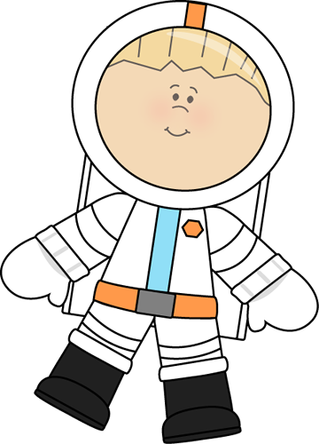
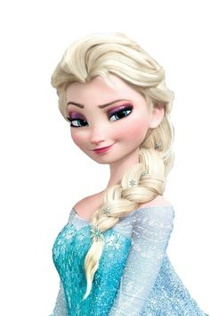
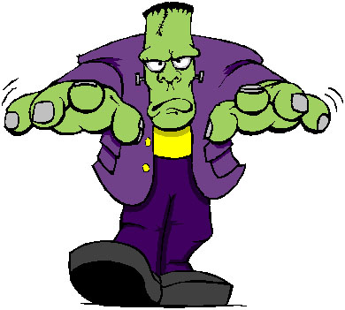
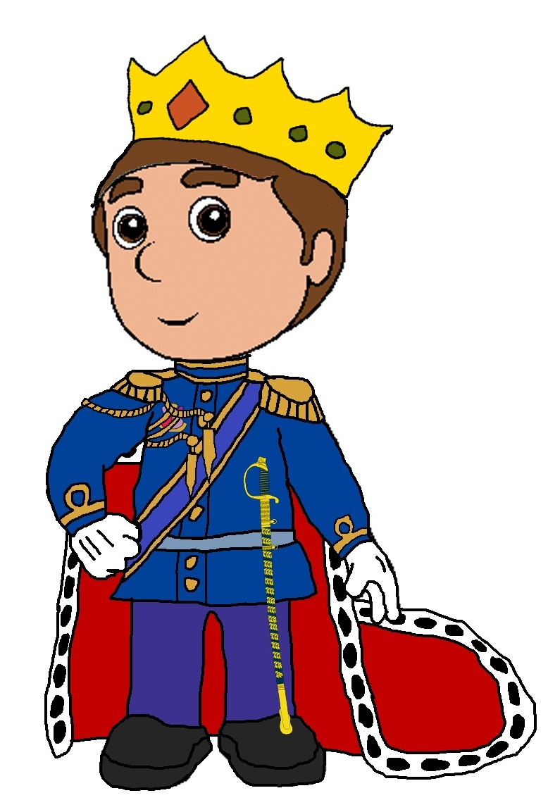
A | a |  |  |  | B | b
C | c |  |  |  | D | d
E | e |  |  | H | h
F | f |  |  | G | g
I | i |  | J | j |  | K | k
L | l |  |  | M | m

Slide 2
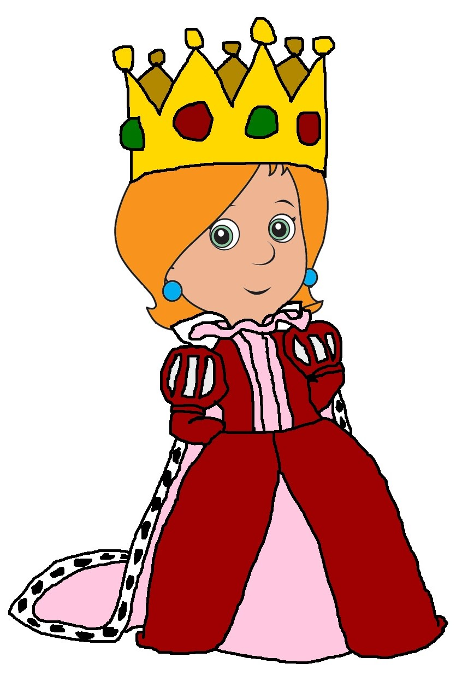
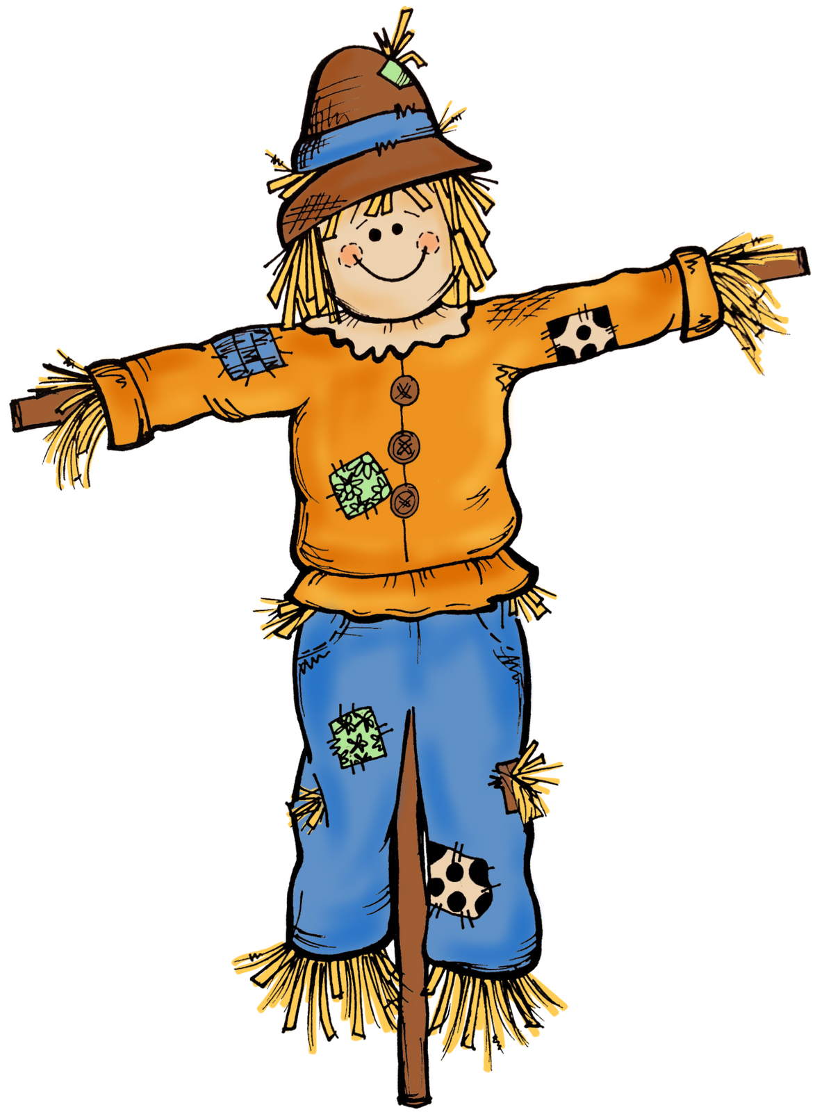
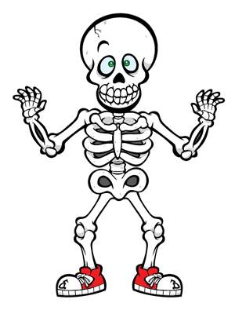
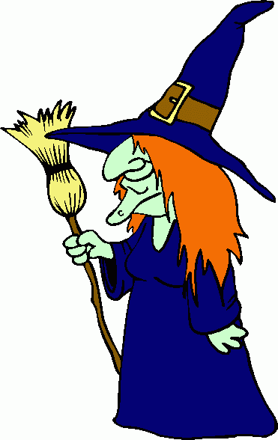
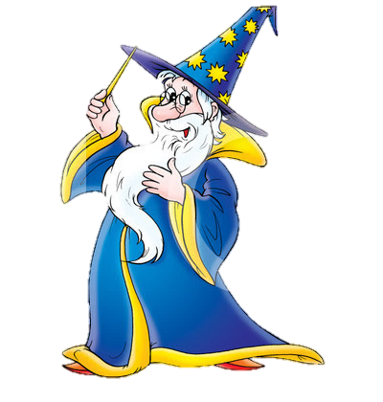
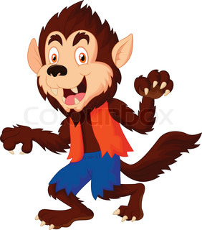
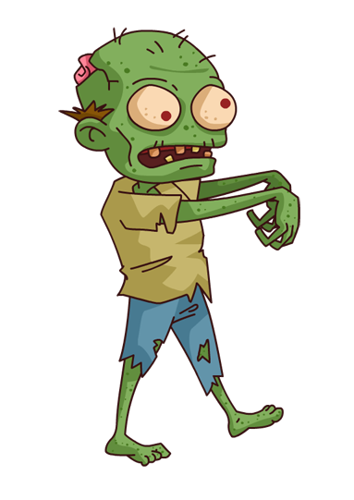
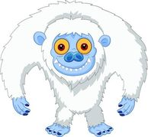
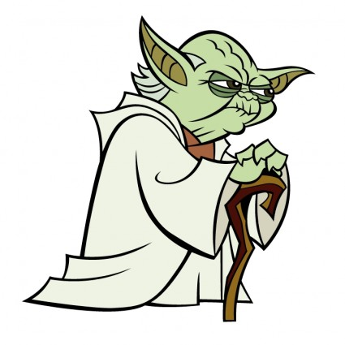
N | n |  |  | O | o
P | p |  | Q | q |  | R | r
S | s |  |  |  | T | t
U | u |  | V | v
W | w |  |  |  | X | x
Y | y |  |  | Z | z

Slide 3
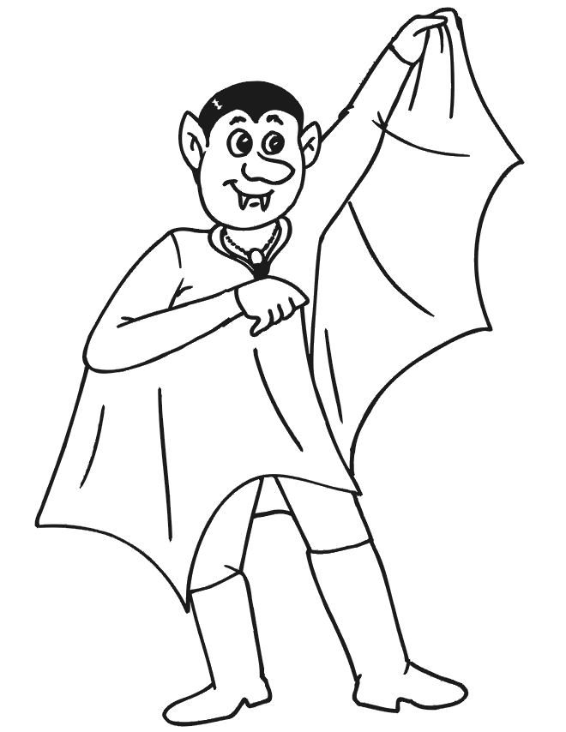
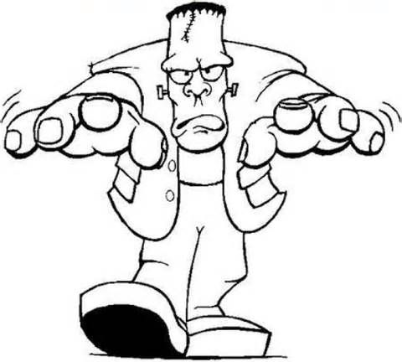
!
My secret sentence is:
o | n | a | e | D | o | M | s
s | t | h | r | t | e | h | M

Slide 4
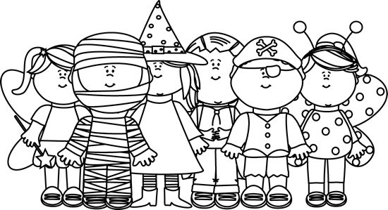
?
My secret sentence is:
o | m | a | u | W | u | o | i | s
e | h | t | r | y | s | c | t

Slide 5
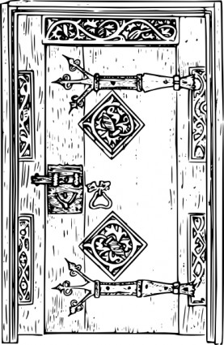
,
.
My secret sentence is:
d | e | B | o | r | w | y | e | a | r
e | u | r | a | n | e | f | t | e | i

Slide 6
“
”
!
My secret sentence is:
o | b | t | s | h | s
a | y | s | o | G | o

Slide 7
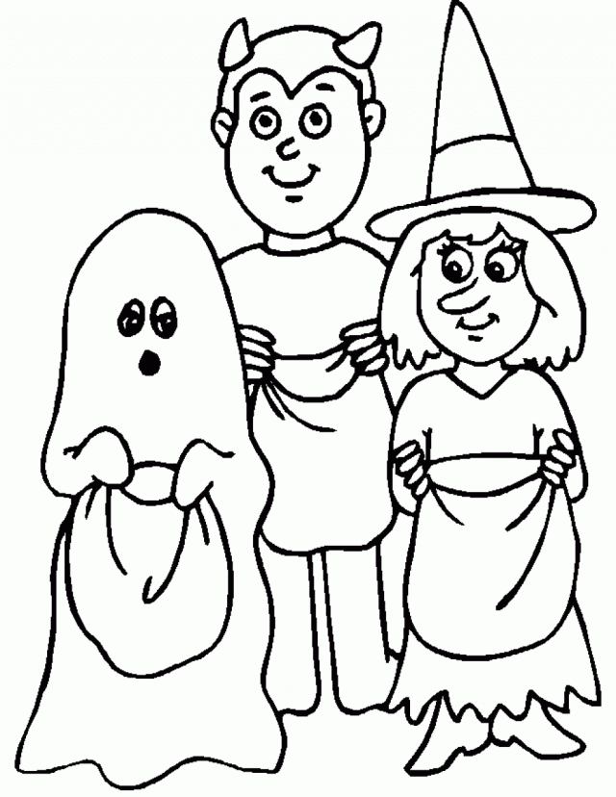
’
!
My secret sentence is:
g | e | n | r | r | k | g | o | t | e | i
t | i | s | t | c | L | o | a | t | r

Slide 8
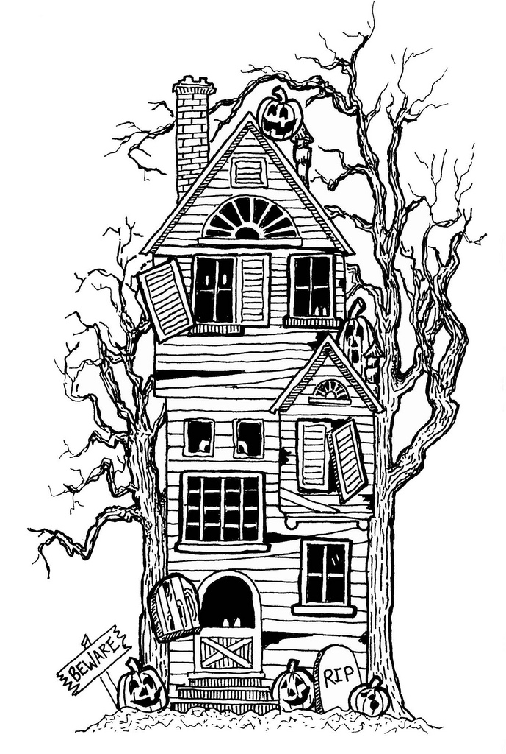
?
My secret sentence is:
a | s | e | o | u | t | s | u | d | h | h
W | i | h | t | a | n | a | n | e | i

Slide 9
!
My secret sentence is:
v | m | I | n | p | p | a | u
a | e | c | r | k | d | i

Slide 10
!
My secret sentence is:
t | w | c | n | l | e | r | i | o | O
l | a | e | n | s | i | H | e | o | n

Slide 11
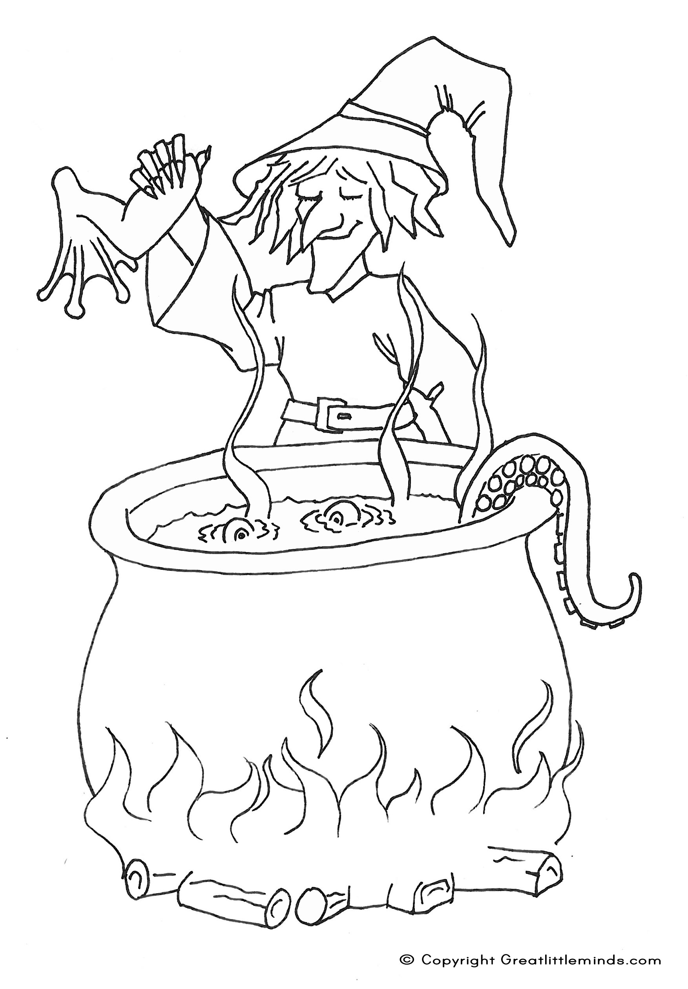
.
My secret sentence is:
w | r | g | a | h | i | e | t | i | e | c | p
s | T | b | h | i | t | i | w | n | o | n | o

Slide 12
!
My secret sentence is:
I | i | l | e | d | n | k | y | a | c

Slide 13
’
.
My secret sentence is:

Slide 14
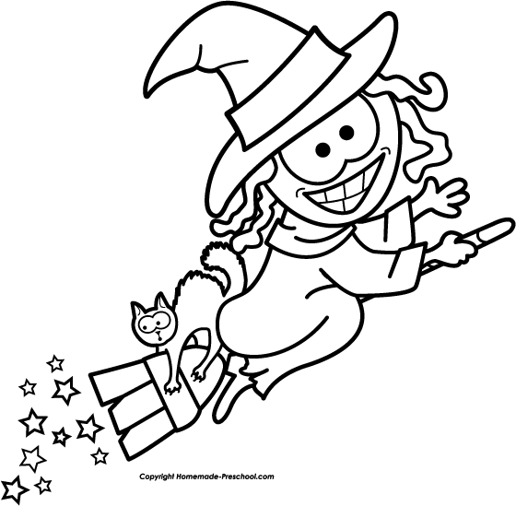
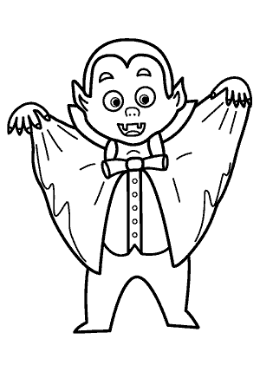
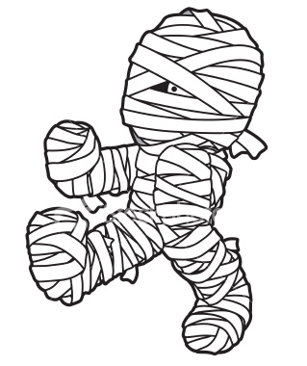
n | l | s | a | H | e
o | w | t | l | v | o
l | r | o | E | h | s
A | o | m | c | l | e
t | o | e | l | u | s
a | n | m | t | p | o
y | T

Slide 15
?
My secret sentence is:

Slide 16
!
My secret sentence is:
a | o | n | l | p | w | H
p | l | e | H | a | y | e

