Slide 1
Development of Test Setup to Support Acoustic Structural Health
Monitoring Technique
Erek Croteau
Alex De Sena
Nelson Lezama
Jordan Parris

Slide 2
Table of Contents
Project purpose and overview
Design schedule and procedures
Analysis of Design
Results, conclusions, and recommendations

Slide 3
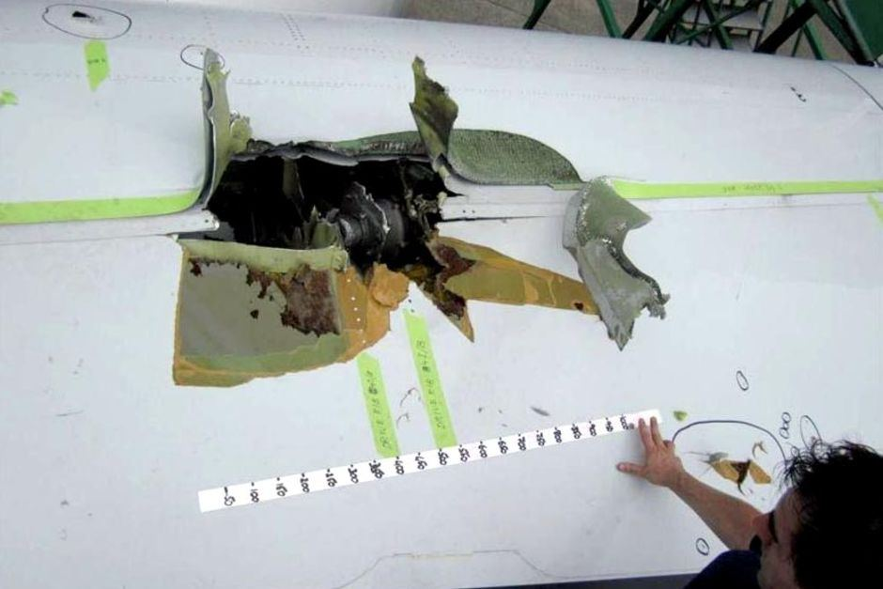
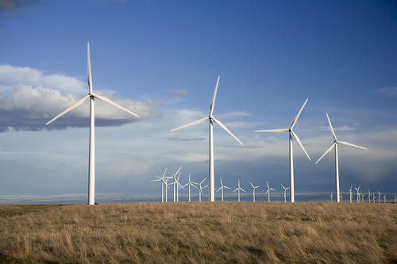
Project Purpose & Overview
Design a hollow model wing section made of a glass fiber composite to use as a test specimen for an acoustic structural health monitoring (SHM) test procedure
Develop a support fixture for use in a wind tunnel
With a developed test system and procedure for acoustic SHM, a quick and inexpensive process can be implemented for different structures
Qantas A380 Wing Damage

Slide 4
Design Procedures
Design and fabricate a mold (mandrel) to use for creating composite wing sections [February 8 - April 11]
Make composite wing sections with glass fiber composite (Twintex) using the mandrel [April 12 - April 19]
Design and assemble a test set-up for acoustic SHM using the composite wing section [February 22 – April 27]

Slide 5
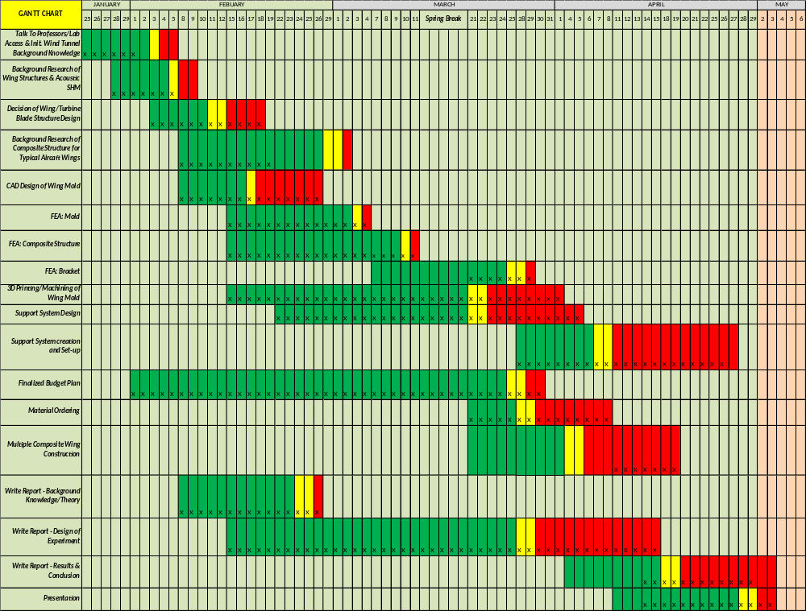
Gantt Chart

Slide 6
Gantt Chart

Slide 7
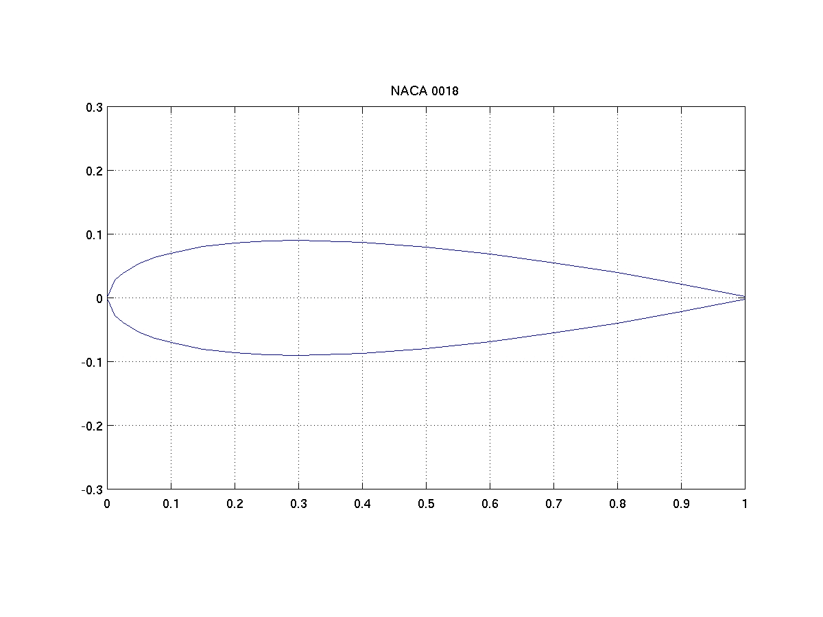
Design Procedures – Airfoil Selection
Name | Maximum Height as a Percent of Length | Chord Length to achieve 3” Microphone Clearance (in) | Symmetric
E169 | 14.4% | 20.8 | Yes
Eppler 297 | 11.4 % | 26.3 | Yes
NACA0018 | 18 % | 16.67 | Yes
Airfoil must:
  Be symmetric
  Allow 2.5” – 3” of space for microphone and speaker
  Have a minimum resulting chord length
Three different airfoil designs selected
NACA-0018 ultimately selected
  Minimum chord length to achieve 3” mic clearance
  Used in full scale wings

Slide 8
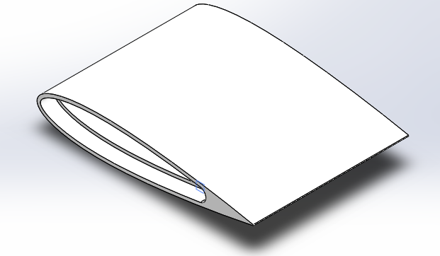
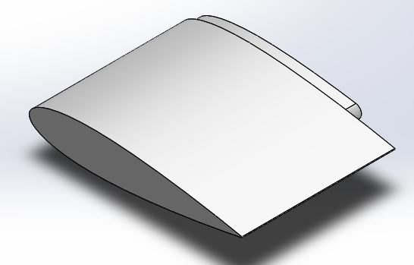
Design Procedures – Mandrel Design
Initial design: 23” span, 2.81” max height, 16” chord length, 0.465” wall thickness
Several fabrication processes considered
  3D printing (At UML or AFS)
  Acrylic sheets with foam fill
  Machined aluminum
Design for 3D printing:

Slide 9
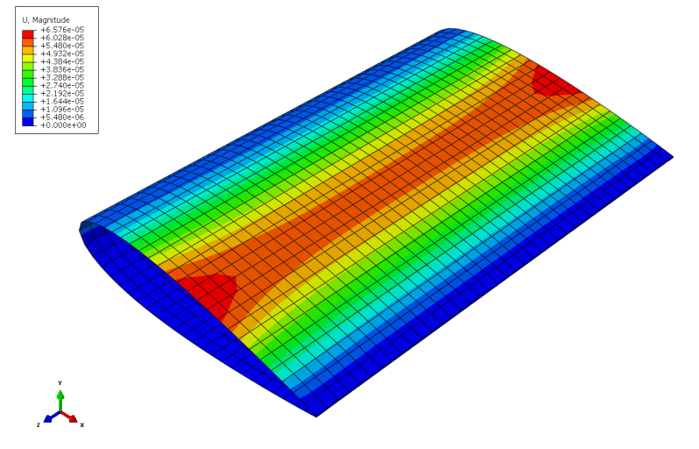
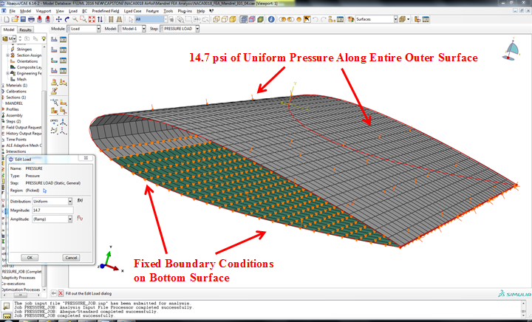
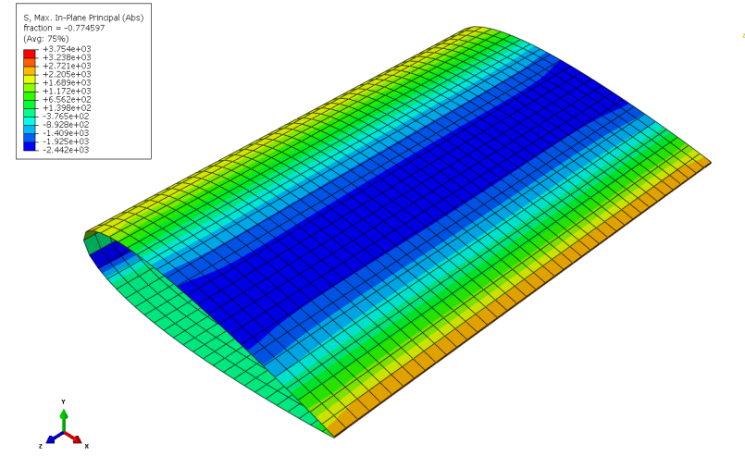
Design Procedures – FEA of Mandrel
1st Test – ABS (Uncapped)
14.7 psi Pressure
Fixed BC on Bottom Face
Case | Variable | Value
Mandrel (ABS) | Thickness (in) | 0.425
 | Applied Pressure (psi) | 14.7
 | Max Stress (psi) | 5165
 | UTS (psi) | 5802
 | Max Displacement (in) | 1.02 x 10⁻⁴
 | Thickness (in) | 0.500
 | Applied Pressure (psi) | 14.7
 | Max Stress (psi) | 3754
 | UTS (psi) | 5802
 | Max Displacement (in) | 6.576 x 10⁻⁵
Displacement
Max Principal Stress

Slide 10
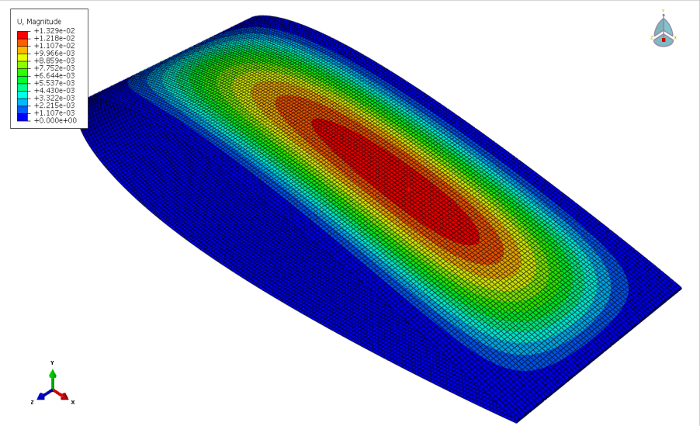
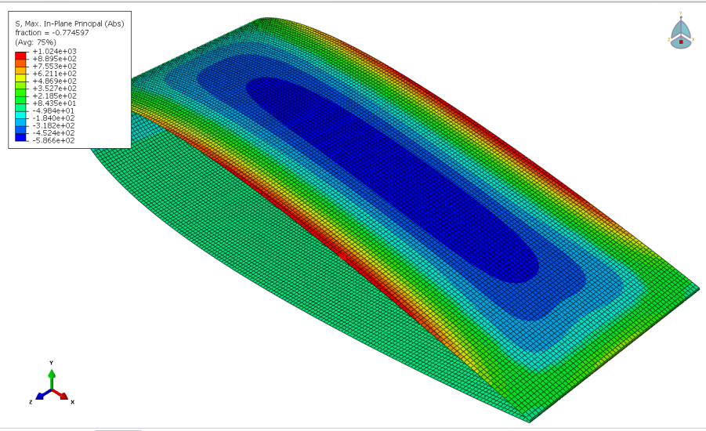
Design Procedures – FEA of Mandrel
2nd Test – ABS & ULTEM (Capped); 14.7 psi Pressure
Case | Variable | Value
Mandrel (ABS) | Thickness (in) | 0.465
 | Applied Pressure (psi) | 14.7
 | Max Stress (psi) | 1030
 | UTS (psi) | 5802
 | Max Displacement (in) | 0.0286
Mandrel (ULTEM) | Thickness (in) | 0.465
 | Applied Pressure (psi) | 14.7
 | Max Stress (psi) | 1024
 | UTS (psi) | 17000
 | Max Displacement (in) | 0.0133
Rod | Applied Moment (lb-in) | 84 (5.25 lb. weight)
 | Max Stress (psi) | 855.6
 | UTS (psi) | 40000
 | Max Displacement (in) | 3.08 x 10⁻³
Displacement
Max Principal Stress

Slide 11
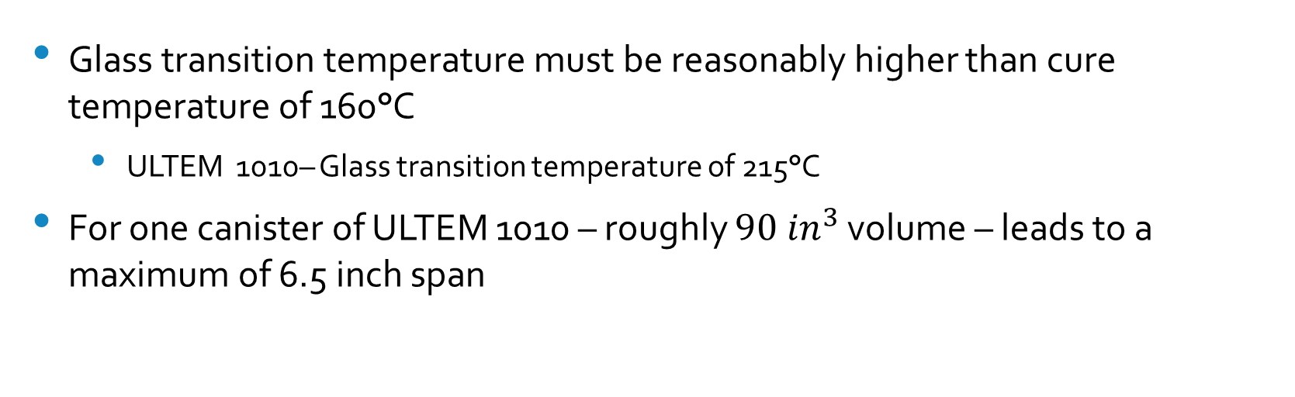
Design Procedures –Mandrel Material and Cost Considerations and Re-design
Glass transition temperature must be reasonably higher than cure temperature of 160°C
  ULTEM 1010– Glass transition temperature of 215°C
For one canister of ULTEM 1010 – roughly ${90 in}^{3}$ volume – leads to a maximum of 6.5 inch span

Slide 12
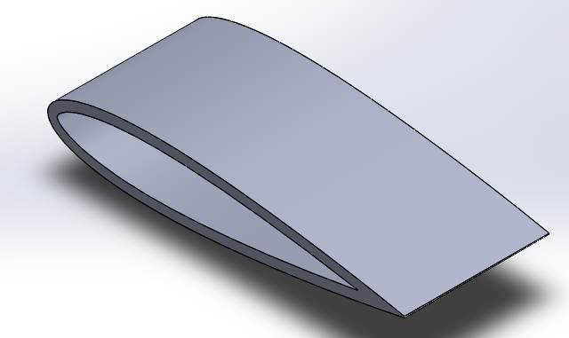
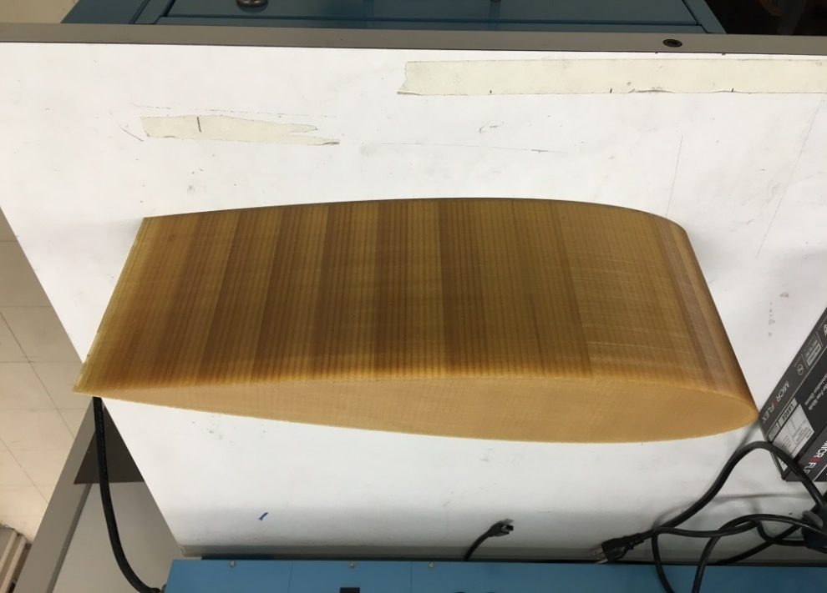
Design Procedures –Mandrel Fabrication
6.5 inch-span mandrel designed and created with a sparse fill

Slide 13
Design Procedures – Composite Fabrication
Composite model was produced using Twintex
  Thermoplastic resin makes it ready-to-use and reduces preparation time
  Fast processing cycle time under high temperatures and relatively low pressures
  Recommended for vacuum-molding processes

Slide 14
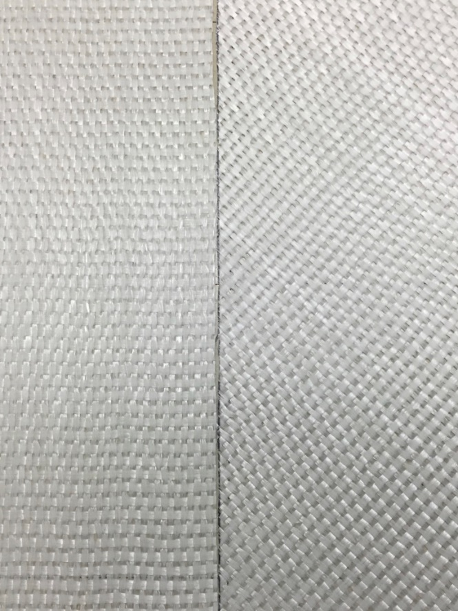
Design Procedures – Composite Fabrication
Four layers of Twintex sheets cut to strands at…
90-degrees
45-degrees
45-degrees
90-degrees

Slide 15
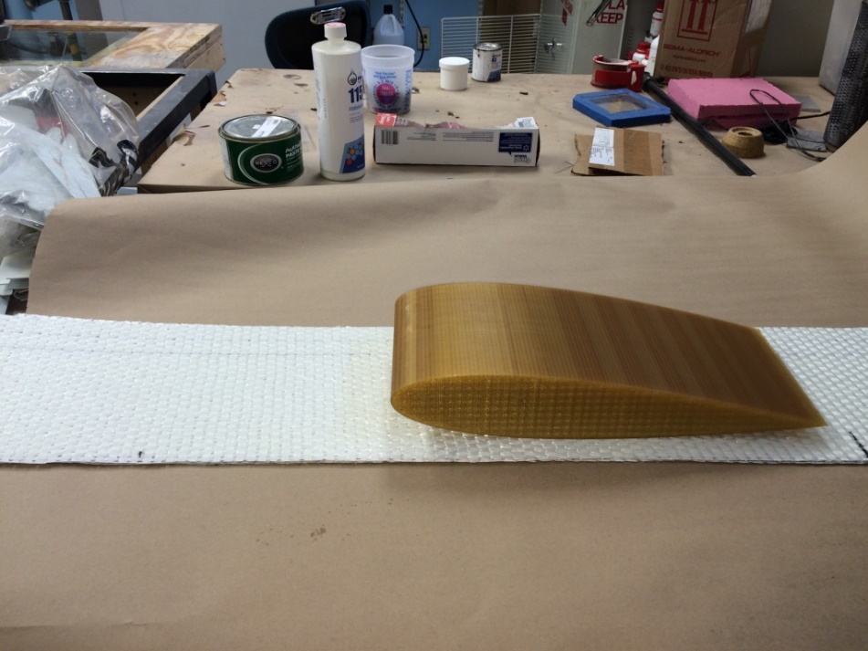
Design Procedures – Composite Fabrication
Mandrel with Layers of Twintex

Slide 16
Design Procedures – Composite Fabrication
Additional vacuum-bagging materials
  Release peel ply
  Breather or bleeder
  Vacuum-bagging film

Slide 17
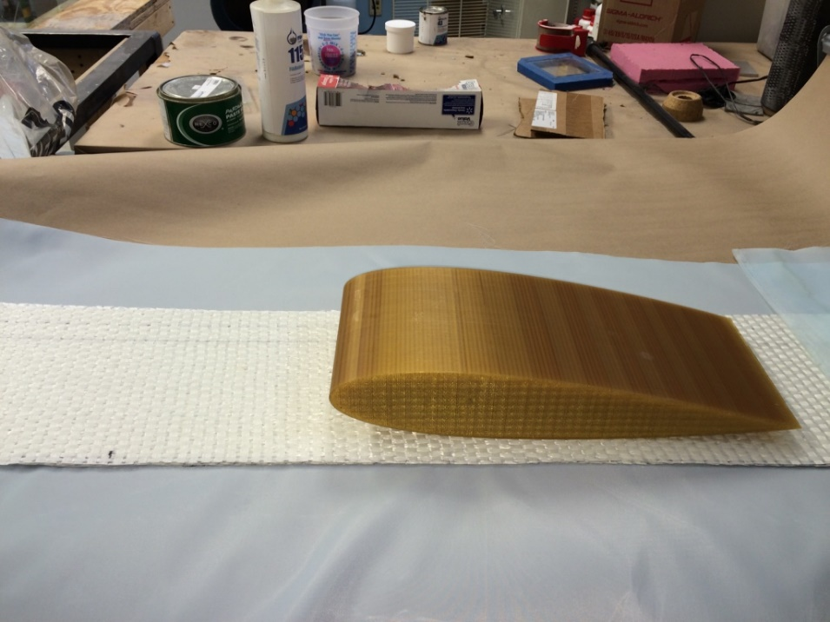
Design Procedures – Composite Fabrication
Mandrel with Layer of Release Peel Ply

Slide 18
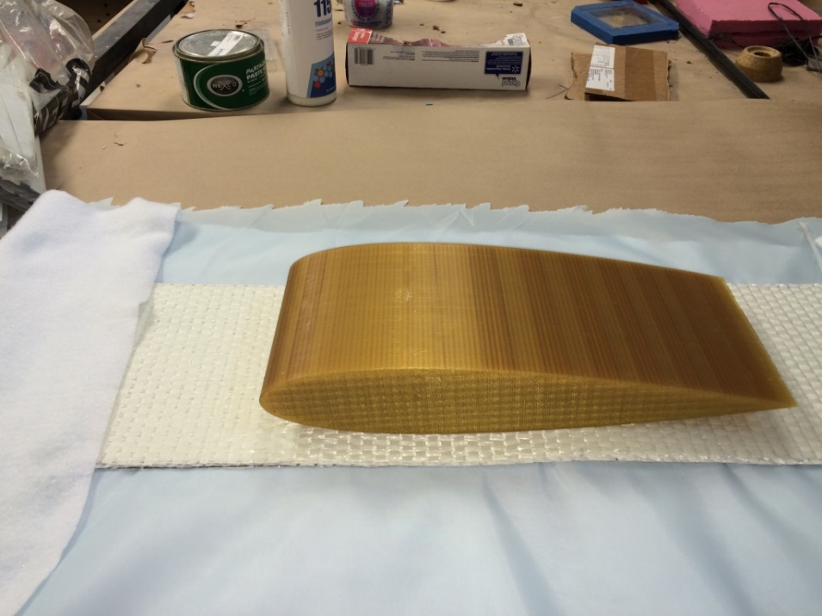
Design Procedures – Composite Fabrication
Mandrel with Addition of Layer of Breather

Slide 19
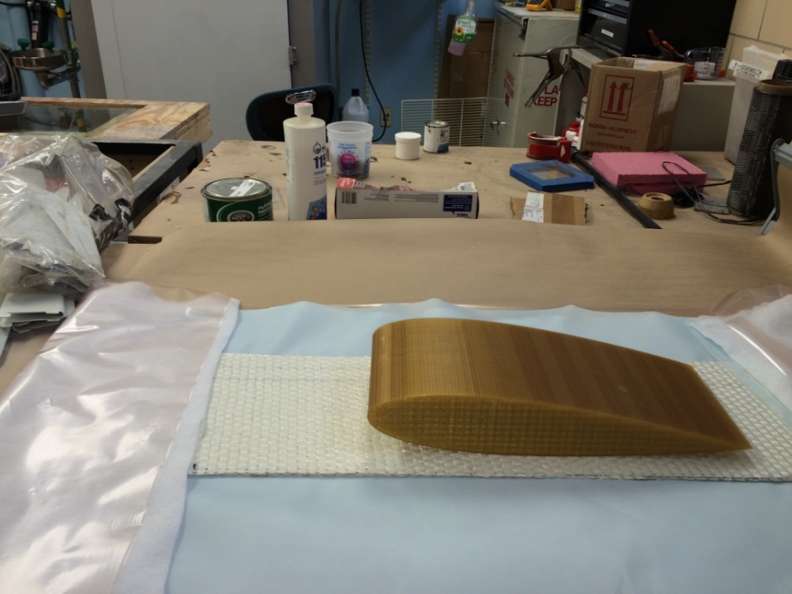
Design Procedures – Composite Fabrication
Mandrel with Addition of Layer of Vacuum-Bagging Film

Slide 20
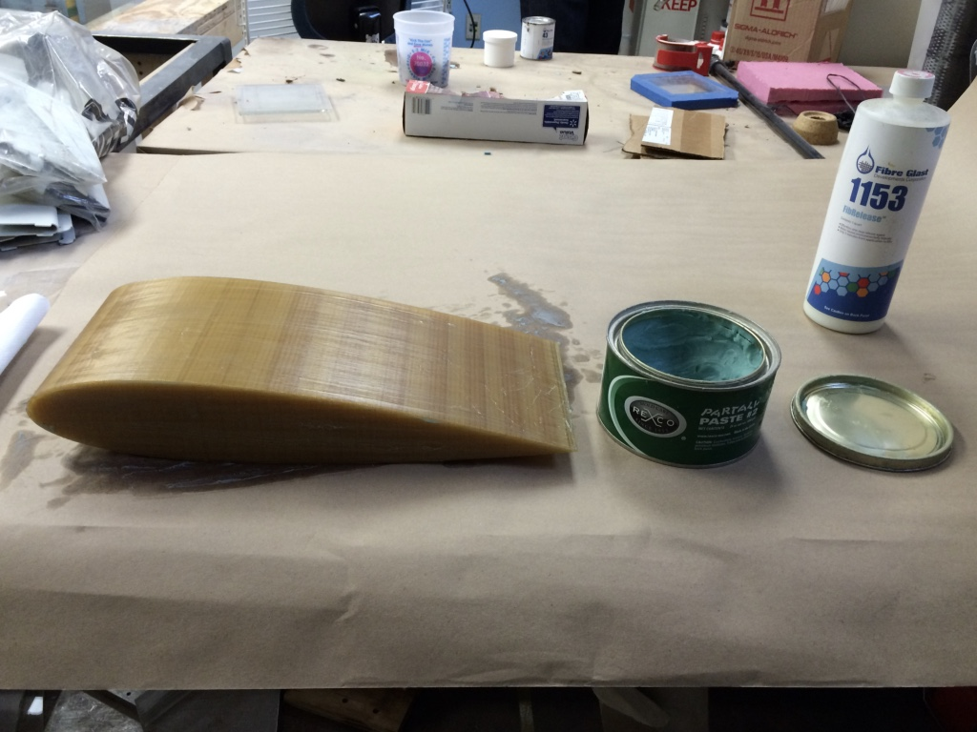
Design Procedures – Composite Fabrication
Mandrel coated with PARTALL Paste #2
  General purpose polishing compound
  Designed for thermoset molding resins

Slide 21
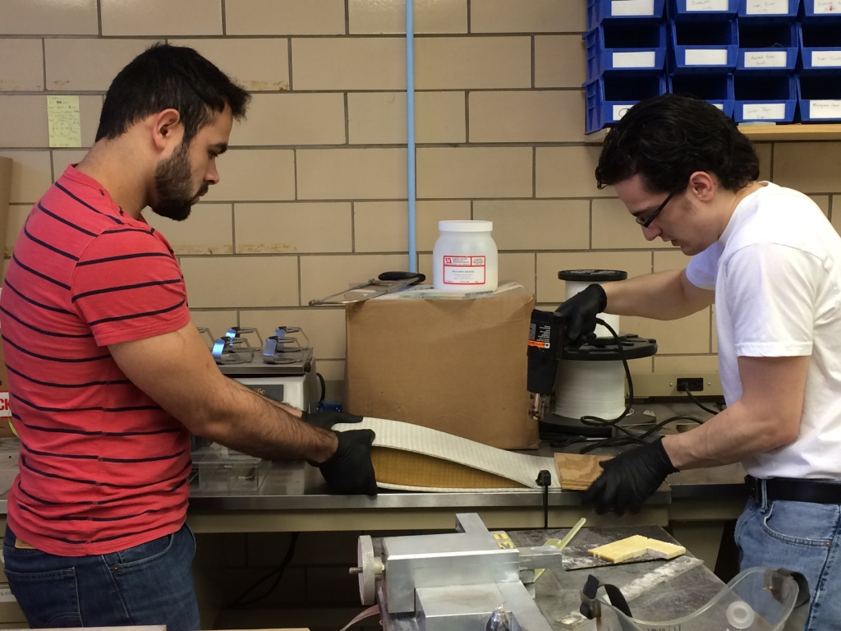
Design Procedures – Composite Fabrication
Twintex layers tightly wrapped around mandrel
Heat gun and clamps used to begin fusing process at trailing edge with addition of each Twintex layer
Kapton tape wrapped around span of mandrel (by trailing edge) to ensure fusion

Slide 22
Design Procedures – Composite Fabrication
Wrapped Twintex layers and mandrel centered and placed on vacuum-bagging materials
Ply and breather neatly folded over Twintex layers
    Leading edge of Twintex layers and mandrel aligned with and touched fold of vacuum-bagging materials

Slide 23
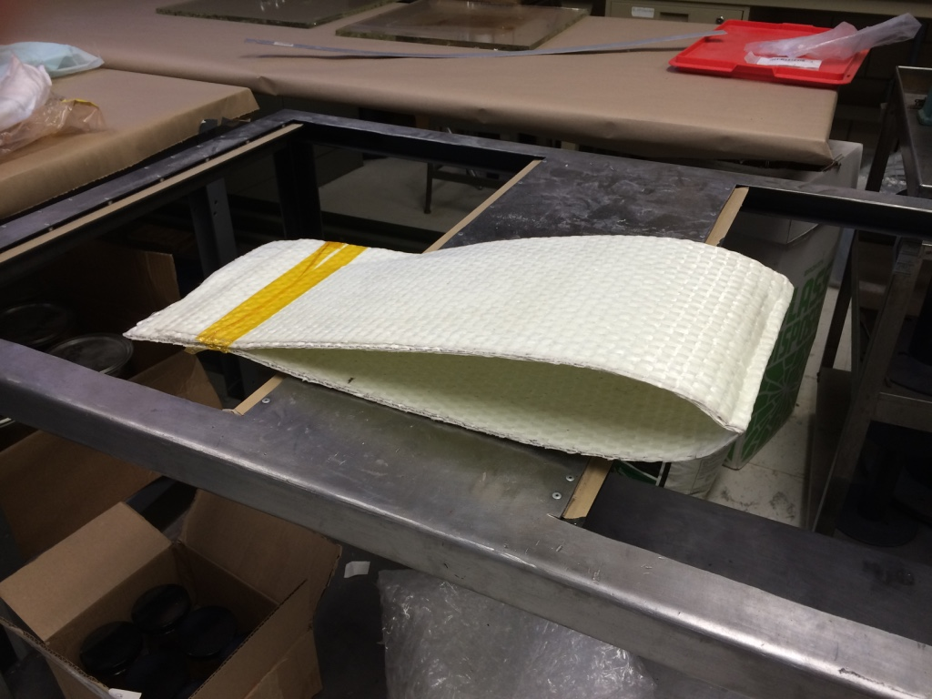
Design Procedures – Composite Fabrication
Failure to align leading edge and fold resulted in deformation by leading edge

Slide 24
Design Procedures – Composite Fabrication
Base of vacuum connector placed on breather by trailing edge of Twintex layers
Vacuum tape placed precisely along exposed edges of vacuum-bagging film
Film neatly folded over and pressed along vacuum tape
Small hole introduced and body of vacuum connector screwed onto vacuum bag

Slide 25
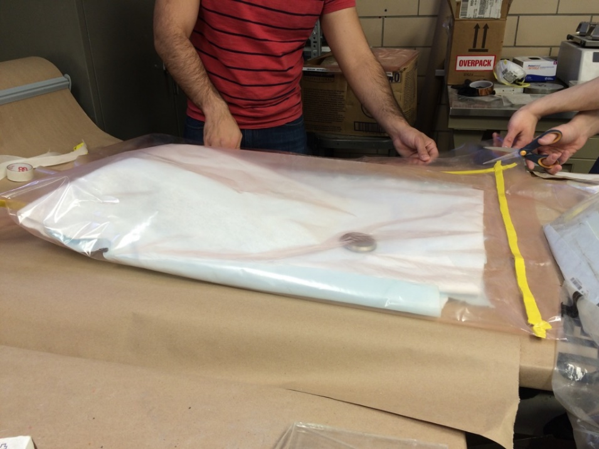
Design Procedures – Composite Fabrication
Mandrel with Layers of Twintex inside Vacuum Bag

Slide 26
Design Procedures – Composite Fabrication
Vacuum bag held up by end closest to trailing edge and vacuum tube connected to vacuum connector
Pressure valve turned and vacuum bag began to experience vacuum pressure (pressure of about 18 inHg)
After examining bag, vacuum tube disconnected and reconnected within VWR 1600 HAFO Series (Model 1685) oven set to 160°C

Slide 27
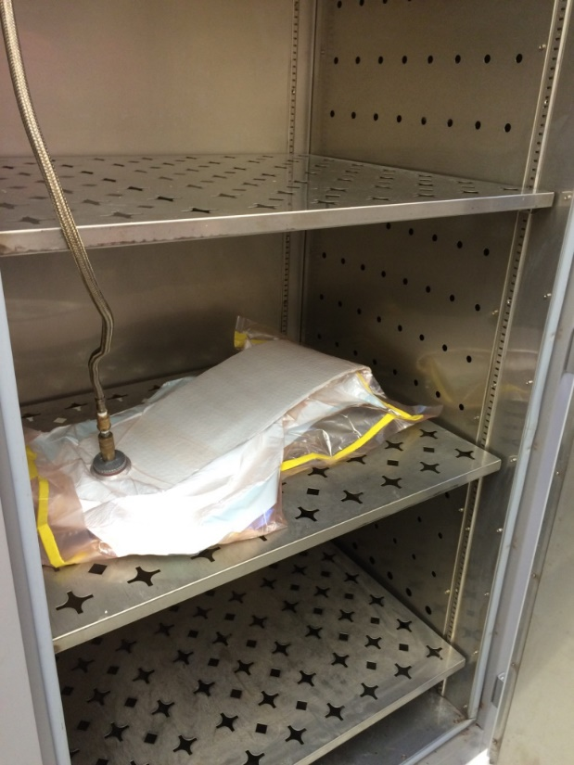
Design Procedures – Composite Fabrication
Vacuum Bag in Oven

Slide 28
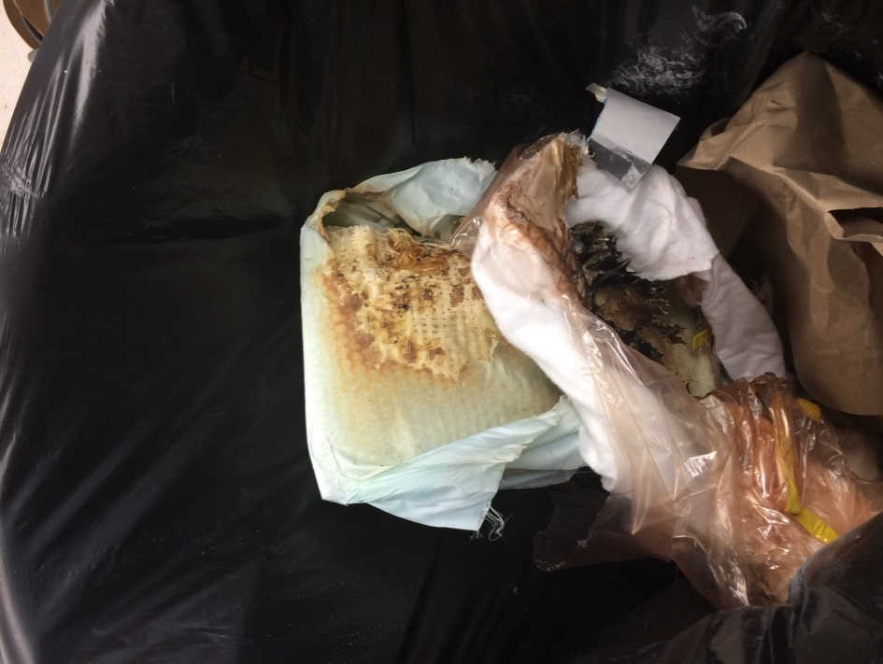
Design Procedures – Composite Fabrication
Initially, much smaller oven was used
Excess vacuum-bagging film touching walls of oven reached temperatures significantly higher than 160°C
  Film melted and burned because it exceeded temperature threshold

Slide 29
Design Procedures - Composite Fabrication
Vacuum bag left in vacuum in oven for period of one hour
After curing, oven turned off and bag left in vacuum in oven to cool for 30 minutes
After cooling, composite model and mandrel removed from bag

Slide 30
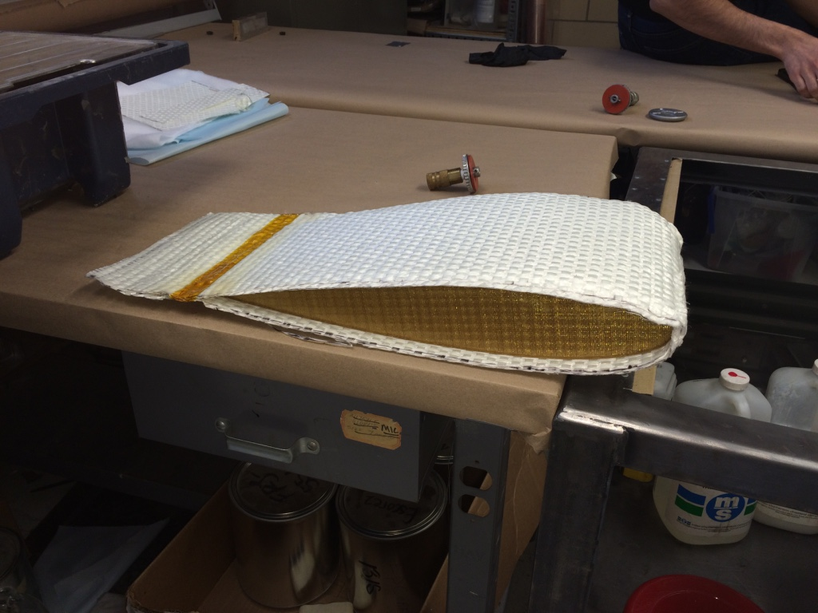
Design Procedures – Composite Fabrication
Cured Composite Model and Mandrel

Slide 31
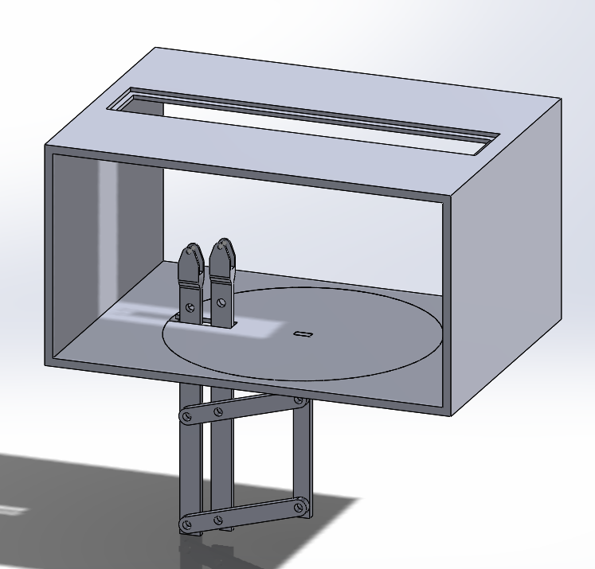
Design Procedures – Wing Support Design
Wind tunnel test area: 3’ x 4’ x 25”
Support links available
For 2-dimensional flow representation, vertical wing orientation is preferred
Wing section must be completely sealed

Slide 32
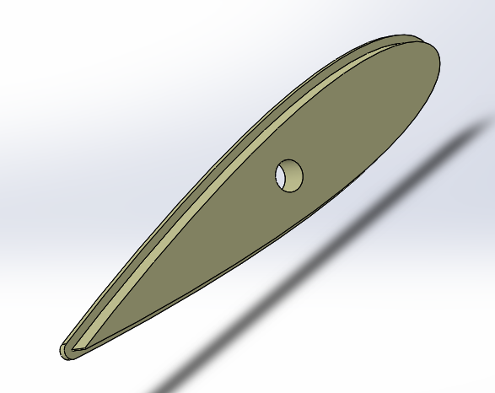
Design Procedures – Wing Support Design
Caps used to seal wing section
Rods press-fit into caps to support the wing section
Shaft collars purchased from McMaster-Carr
Manufacturing setbacks
  Wind tunnel maintenance – new top plate cannot be created
  Unavailability of CNC machines – caps hand-cut with wood

Slide 33
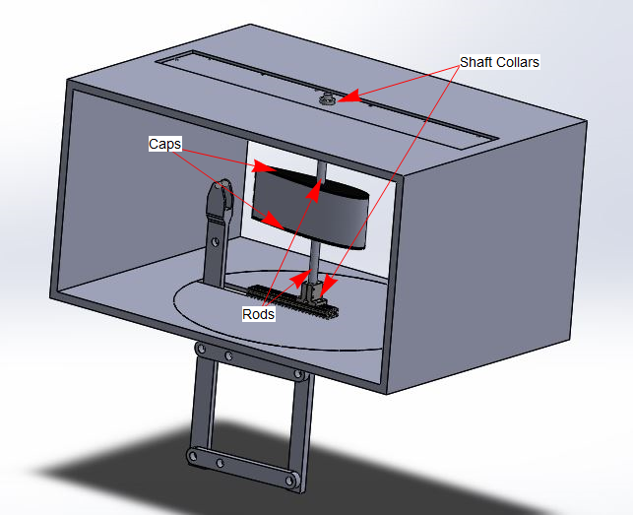
Design Procedures – Intended Final Support System Design

Slide 34
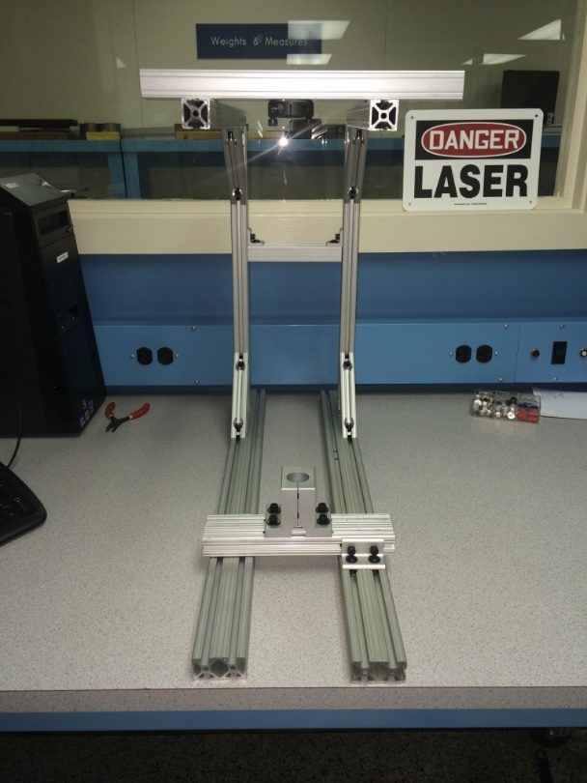
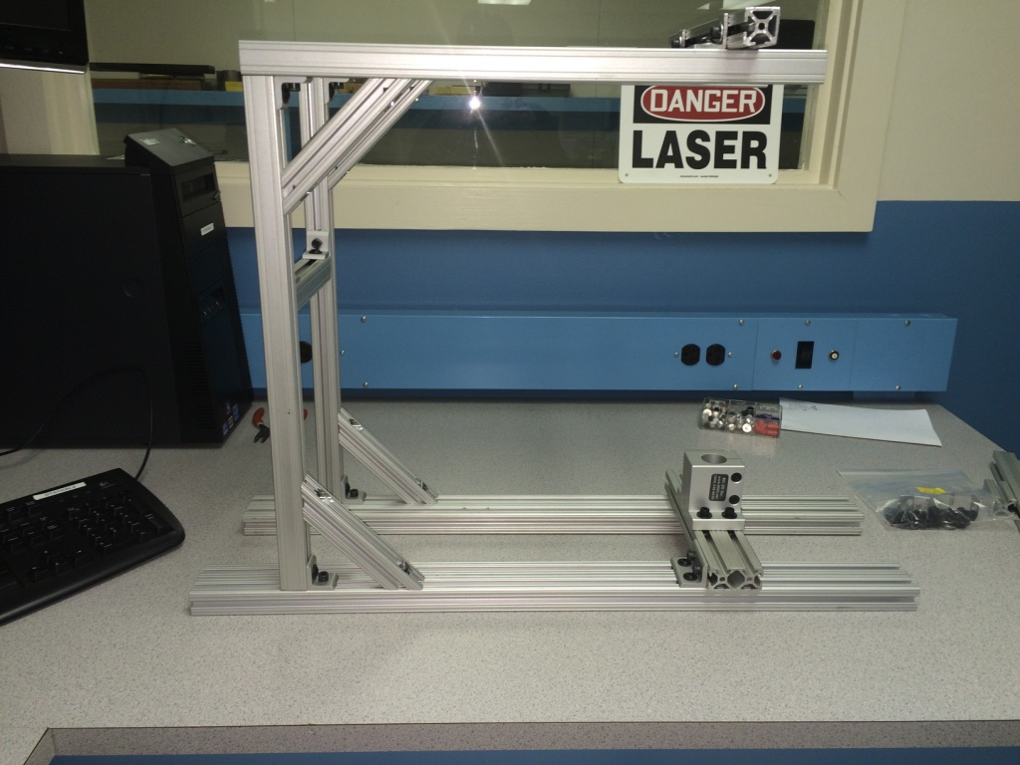
Final Test Set-Up
Frame Made of 80/20 Extrusions

Slide 35
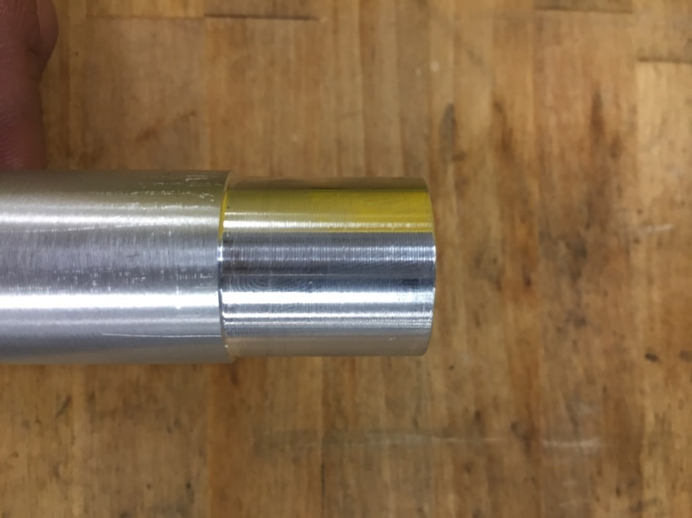
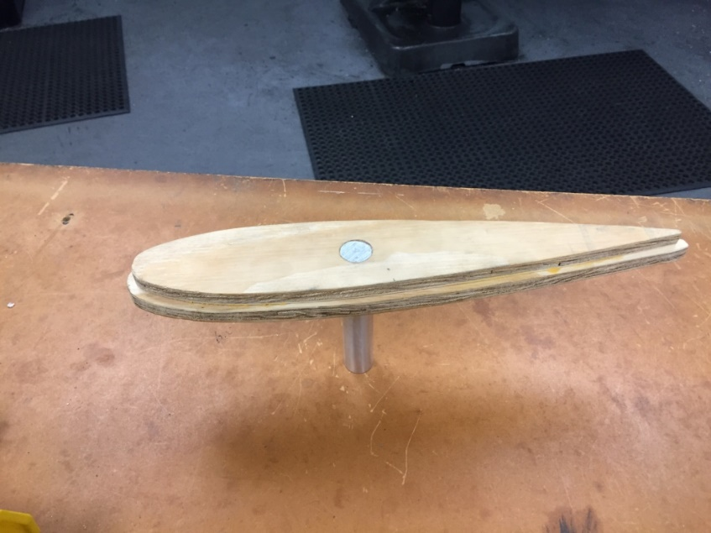
Final Test Set-Up
Support rods cut/lathed
Rods press-fit into caps

Slide 36
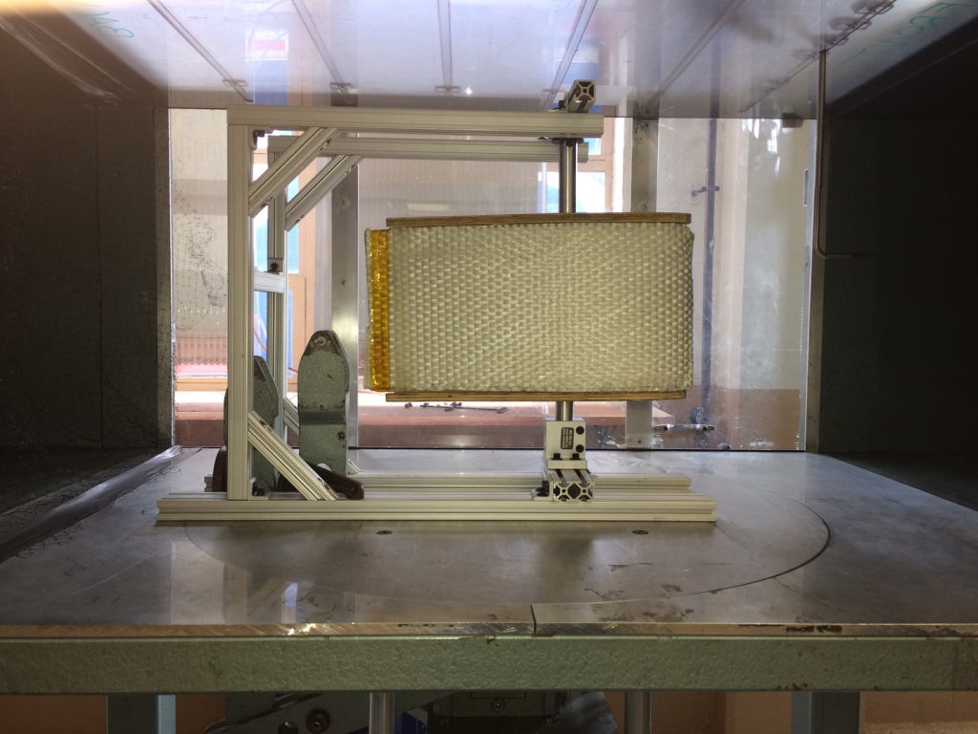
Final Test Set-Up
Composite Section Mounted on Final Test Set-Up Secured by Clamps

Slide 37
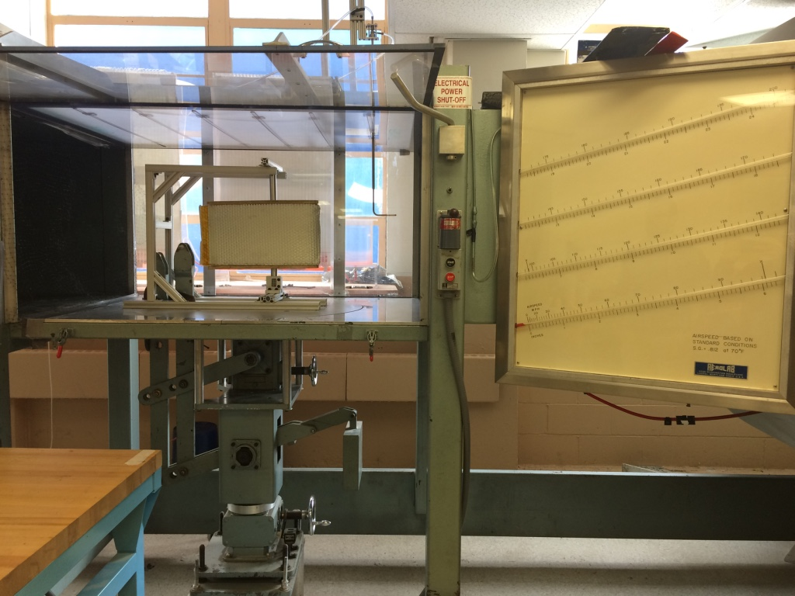
Analysis of Design
Degrees of freedom are fixed
About 3 inches of space allowed for microphone and speaker
Composite section is capable of being sealed and unsealed (maintaining accessibility)

Slide 38
Results and Conclusions
The final assembly is practical and suitable for SHM testing
Test setup is sturdy and easy to work with inside the wind tunnel
The fixture allows the angle of attack to be changed if necessary
Composite wing can be sealed to form an isolated chamber with enough room for the mounting of equipment
ULTEM 1010 proved to be the correct choice for this type of curing procedure
Twintex did not cure as well as expected so some gaps may still be present between the fibers

Slide 39
Recommendations
Adhering egg crate foam to the inside of the caps to isolate the acoustics of the caps from the wing chamber
Base line measurements should be taken at fixed wind speeds before damages are introduced to the composite wing
If Twintex does not provide a completely sealed chamber, an alternate material with a more reliable curing process should be considered

Slide 40

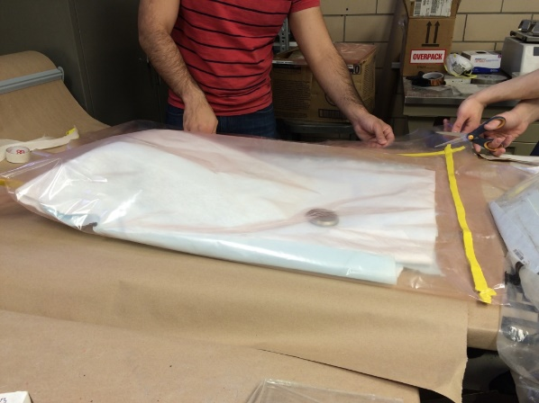


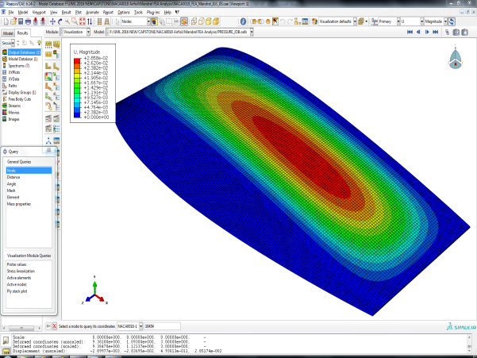


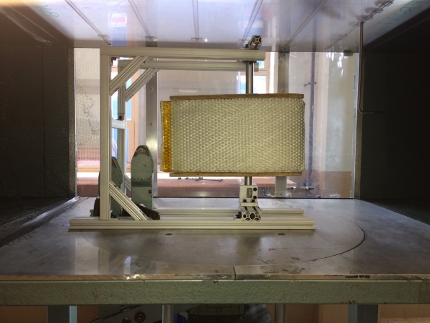
Thank You!
Questions?

