Slide 1

Attention, Intention & Action
Lessons From the Tactical World
for Medical Simulation
James Munis, MD, PhD
Departments of Anesthesiology and Perioperative Medicine,
Physiology and Biomedical Engineering
Mayo Clinic Rochester

Slide 2
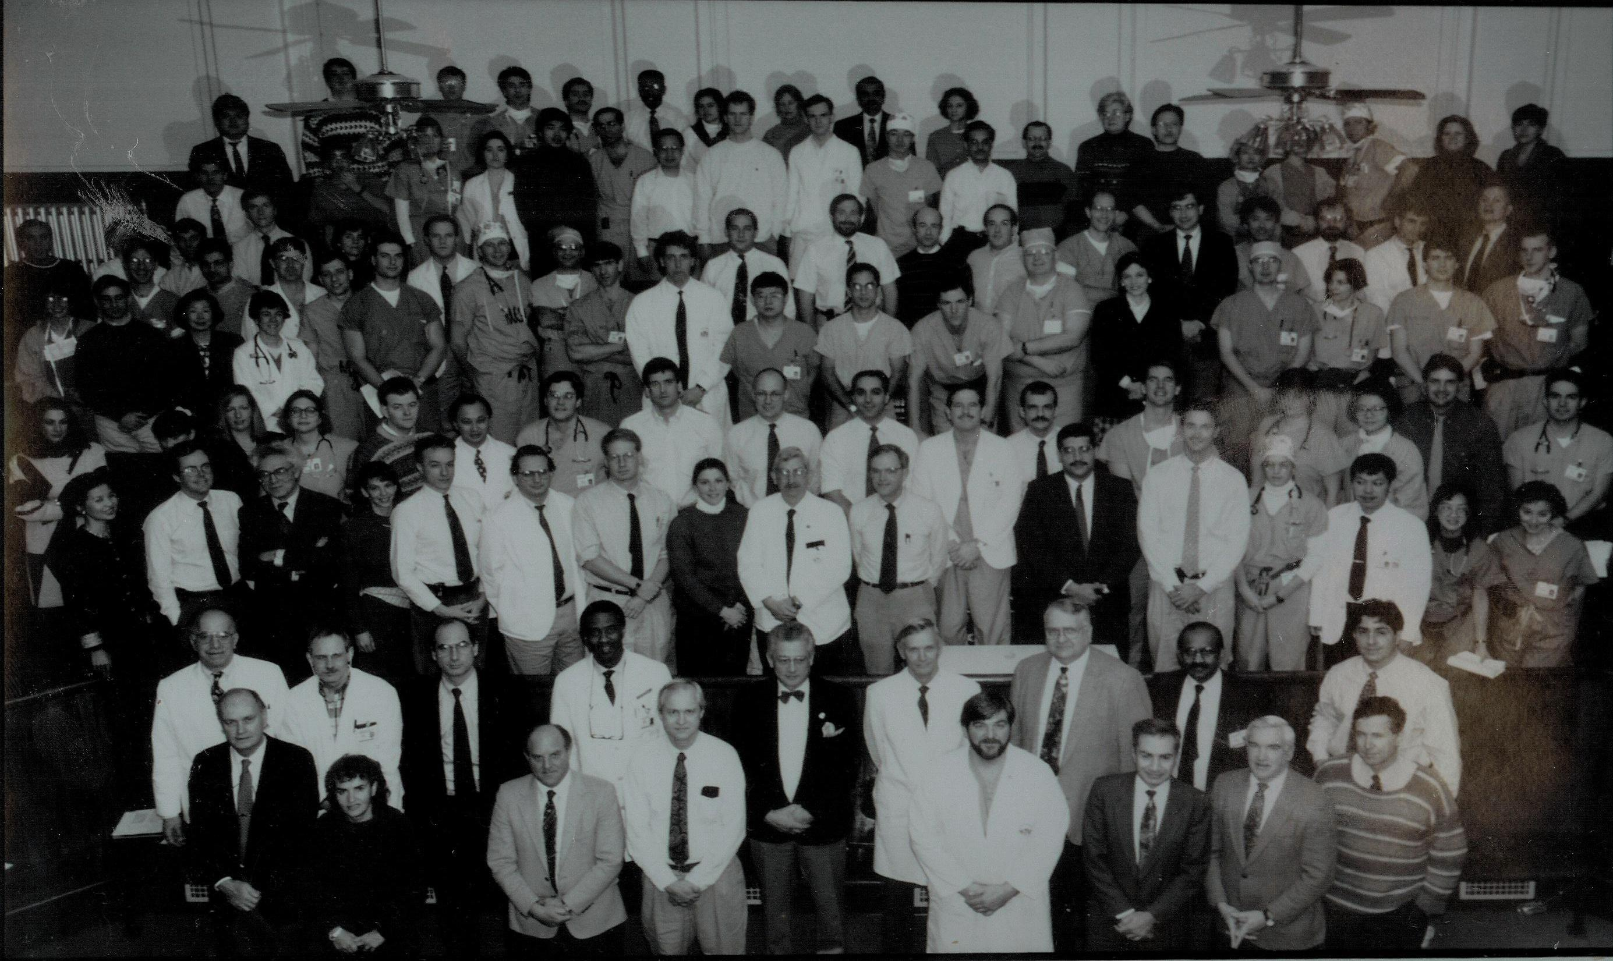

Slide 3
Disclosures:
Neither I nor my spouse have any relationships with industry relevant to this presentation.

Slide 4
Learning Objectives:
To understand elements of training methods that derive from force-on-force simulation and from the resolution of select real-world tactical problems.
To apply those concepts and methods to medical simulation at the boundary between an “emergency” and a “crisis.”

Slide 5

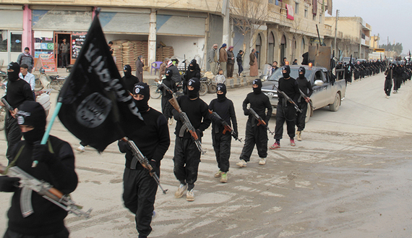


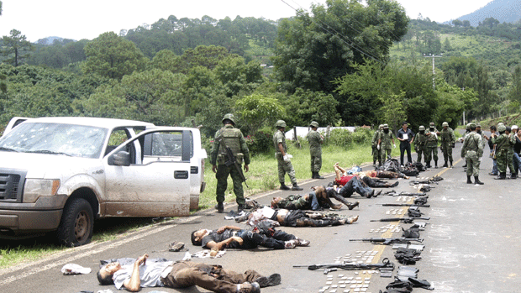

My Dad
J.M.
My Son
Egypt
Iraq
Sudan
Mexico
Somalia
Nigeria
Cameroon
D.R.Congo

Slide 6


ISTM (L.E.)
Military
Didactic
Hostage Rescue
Force-on Force
Simulation
Target Extraction
Live-Fire Range
Low-Signature

Slide 7
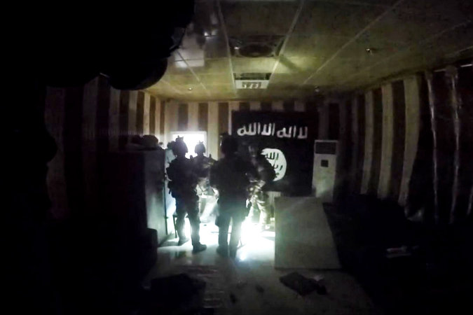
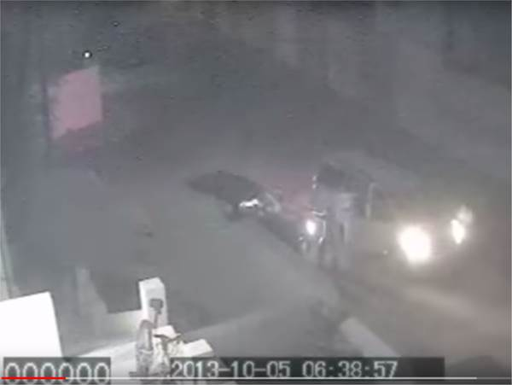
To a physiologist, a tactical problem is simply a matrix of interlocking feedback loops between autonomous but communicating agents. The sequence plays out between oppositional forces who are using both designed and improvised tools, and in an environment that is often complex, cluttered, dark, and kinetic.
Does any of this apply to medicine?

Slide 8
Asymmetric (unfair) Advantages:
Night Vision (NOD/NVG)
IR Illumination/IR Laser Targeting
Com Sets
Off-site Coordination (TOC)
Real Time Video Feeds (ISR)
Real time Heads-up Displays
Collectively, these tools harness Visual (including invisible thermal and IR) and Auditory afferent information and communicate that information to efferent actors.

Slide 9
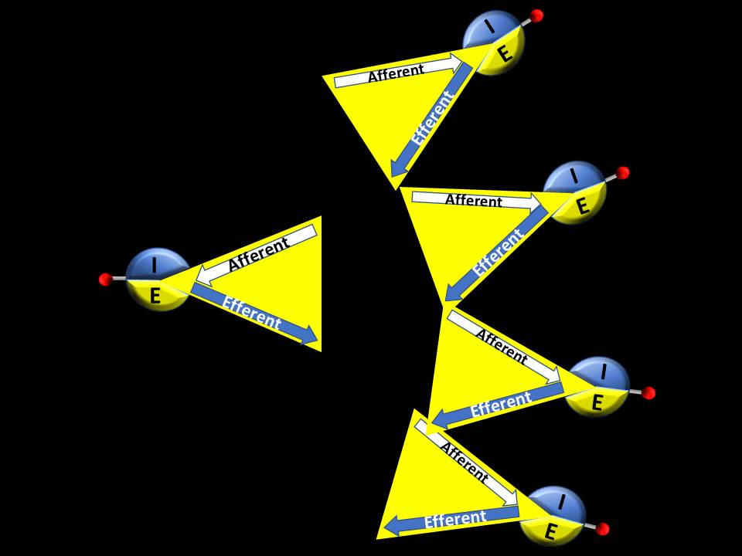
Building a simple model that includes a semi-autonomous agent with:
Internal Attention Network
External Attention Network
Constrained Visual Field of Reference
Unconstrained Auditory Field of Reference
Motor Capability (translational)
Motor Capability (combative)
Motor Capability (reflexive)
Differential (asymmetric) Visual Field Advantage
Possibility of Auditory & Visual Coordination
Volitional (Intentional) Planning and Override

Slide 10
The
Illusion of
Resolution
Afferent
You do NOT have 180º HD resolution. If between 100 – 300 microns of your fovea are taken out of play, you will be legally blind. Our perception of visual field resolution is an illusion.

Slide 11
Afferent
Reactionary
Gap
Efferent

Slide 12
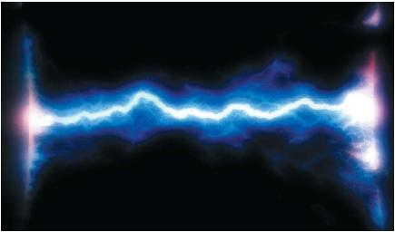

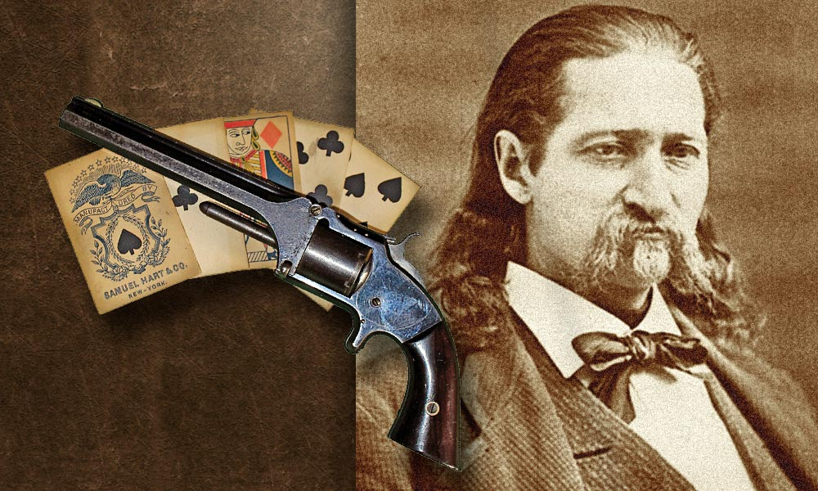
The Reactionary Gap
(As taught by “Wild Bill” Hickok)
250 ms
Afferent
Efferent

Slide 13
Afferent
Unconditioned
vs.
Conditioned
Reflexes
Reactionary
Gap
Efferent

Slide 14
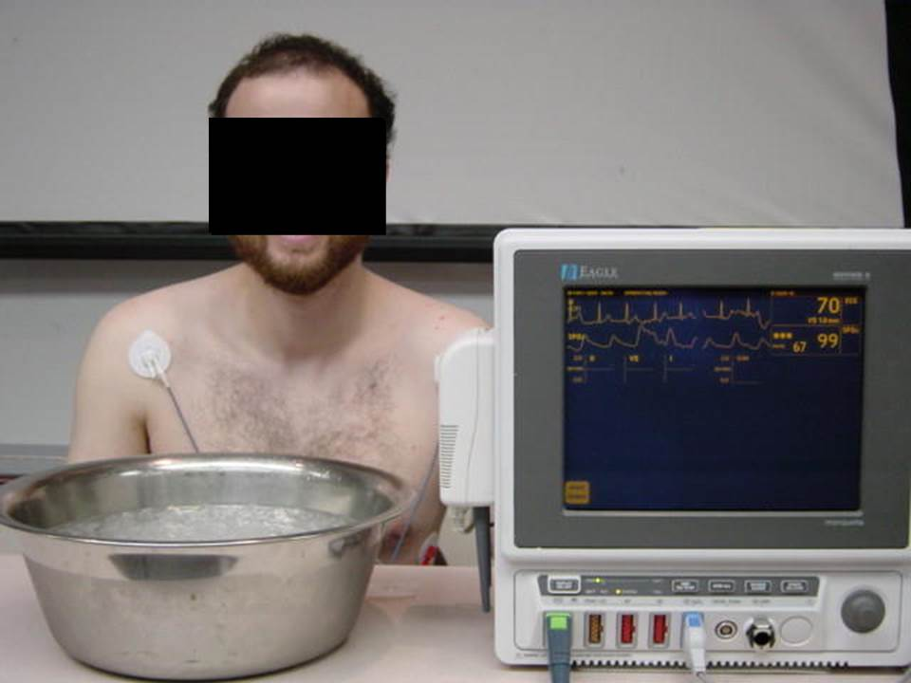

Slide 15
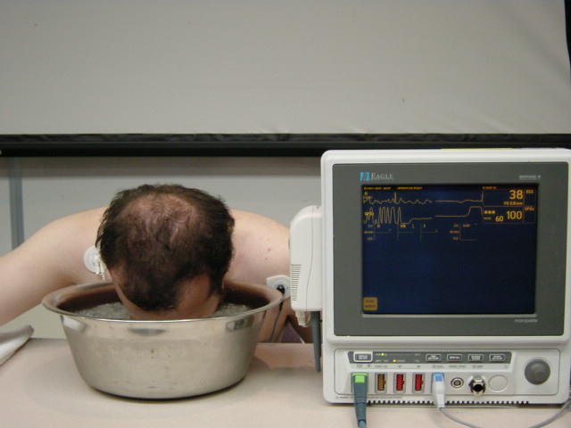
Awake, Listening
ASYSTOLE

Slide 16
Internal
Attention
Network
Afferent
I
Reactionary
Gap
E
Efferent
External
Attention
Network

Slide 17
Afferent
Intention
I
Reactionary
Gap
E
Efferent
Intention = Volitional control of what would otherwise be reflexive.

Slide 18
Planned
or
Reflexive
Motor
(translational
or
rotational)
Afferent
I
Reactionary
Gap
E
Efferent

Slide 19
Planned
or
Reflexive
Motor
(translational
or
rotational)
Afferent
I
Afferent
Reactionary
Gap
I
I
E
Reactionary
Gap
Reactionary
Gap
E
Efferent
E
Efferent

Slide 20
You will always attend to something.
The question is, “What will you attend to?”

Slide 21
Attentional Shifts
Afferent
Afferent
I
I
E
E
Efferent
Efferent

Slide 22
Attentional Shifts
Afferent
I
Afferent
I
E
E
Efferent
Efferent

Slide 23
An Example: The “Leopard Attack”
Response to a Massed Threat
When confronted by multiple (human) threats, the leopard chooses one, and only one, target, ignores the rest, then attacks as if that target was the only thing in the world. For several reasons, this is a brilliant tactic for dealing with a massed threat. It is also an example of an intentional shift from external to internal attention networks as well as an example of an intentional shift from a receiver to a feeder mode.

Slide 24
Intention and Initiative: Feeder vs. Receiver
Feeder
Turning the Tables …
Receiver
Efferent Afferent
I
I
Afferent
E
E
Efferent

Slide 25
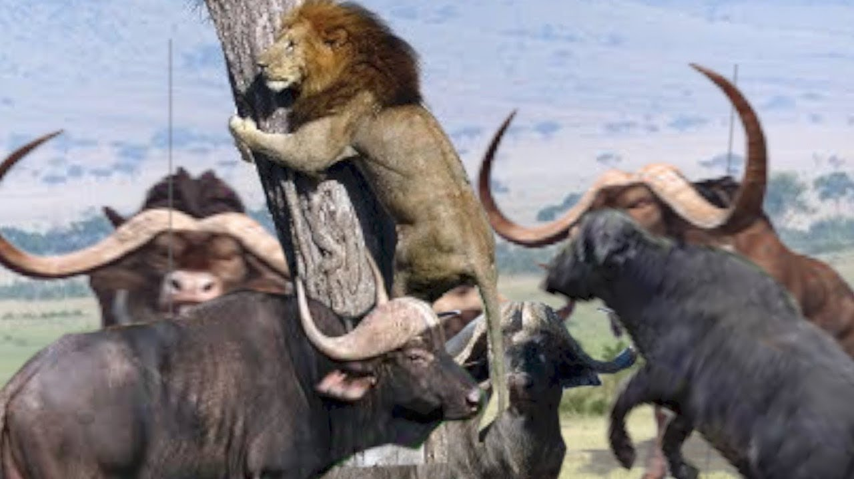
Intention and Initiative: Feeder vs. Receiver
Receiver
Turning the Tables …
Feeder
Afferent Efferent

Slide 26
Two motor events (translation + disabling) result in:
Pacification of the target actor
Interposition of the target actor between the operator and the remaining threats
Intimidation of the remaining threats
Involuntary shift to External Attention networks in the remaining threats
Unintentional
I
Afferent
I
Afferent
E
E
Efferent
I
Afferent
E
I
Afferent
E
Intentional
Efferent
I
Afferent
I
E
I
Afferent
E
Efferent
E
Efferent
All this is accomplished by:
Selection from a rehearsed and conditioned repertoire
Intentional shift from a predominantly External to a predominantly Internal attentional network
Afferent
I
Afferent
I
Afferent
I
E
E
E
Efferent
Afferent
I
Efferent
E

Slide 27
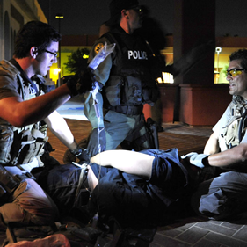
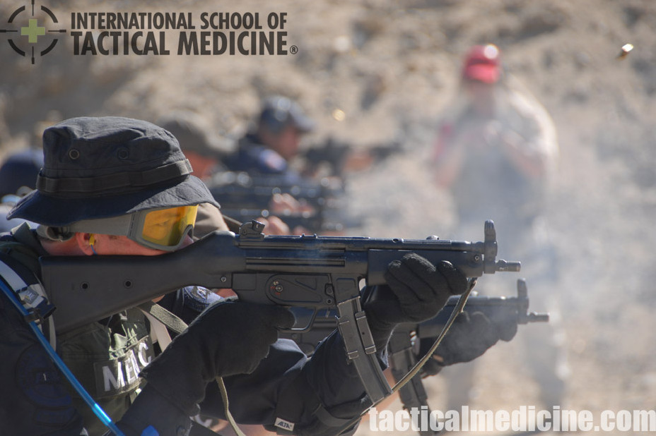

In spite of the shift to predominantly external attention networks in a provoked target, or “Receiver,” disabling perceptual distortions like auditory exclusion are the rule, not the exception. Ironically, a “freeze” state is not necessarily a usefully receptive state.
In both new tactical operators and medical students, this is ubiquitous.

Slide 28
Selection
(emphasizes motor)

Slide 29
Afferent
I
Reactionary
Gap
E
Efferent
Efferent
10-80-10 Rule

Slide 30
Training

Slide 31
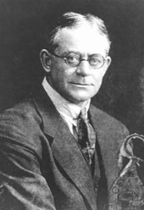
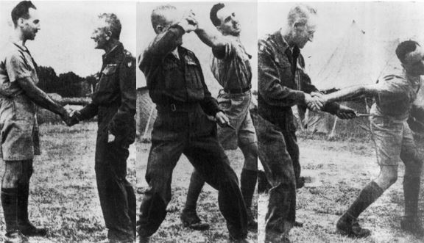
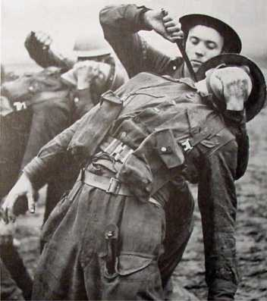
WWII: An Emphasis on
Conditioned Motor Responses
(repetitive task transfer)
Capt. William Fairbairn (1885-1960)

Slide 32

Arisaig, Scotland
STS 103 “Camp X”
U.S.

Slide 33
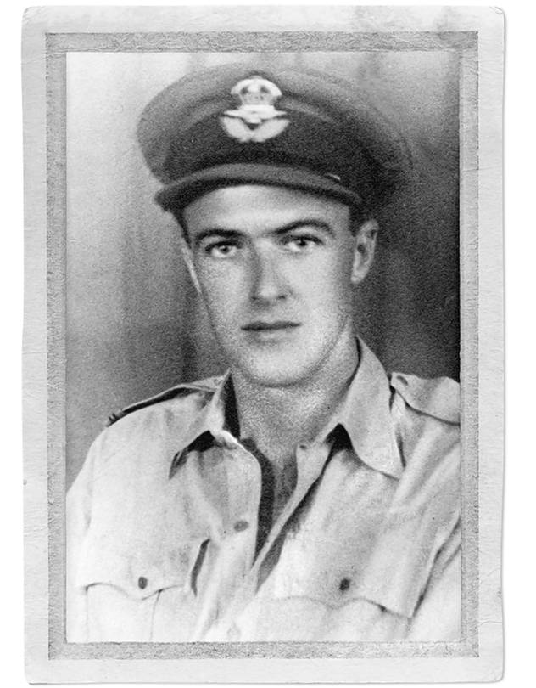

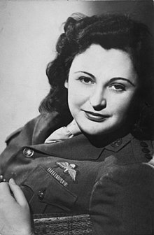
Instruction not for the Squeamish
(But that didn’t prevent the pilot, spy, and children’s book author
Roald Dahl, or the heroine Nancy Wake, from attending.
And it helped the S.O.E. to help the Allies to win the war)

Slide 34

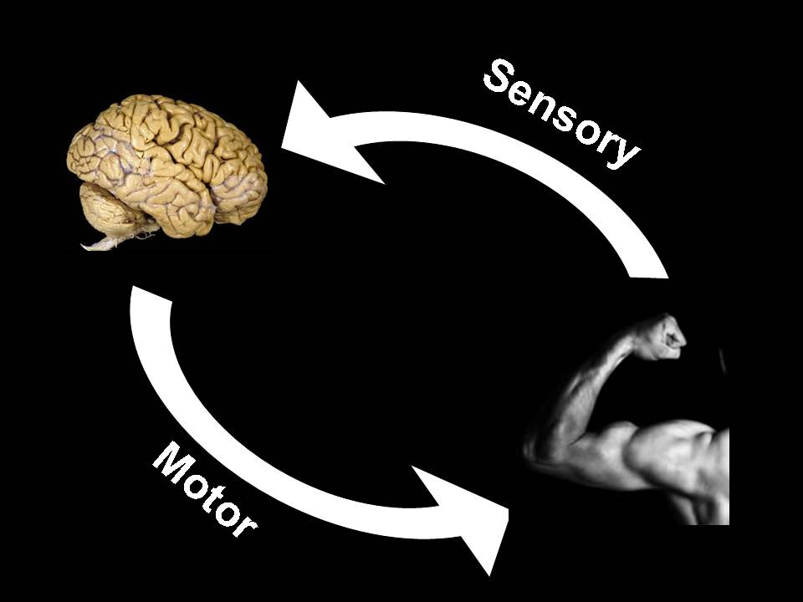
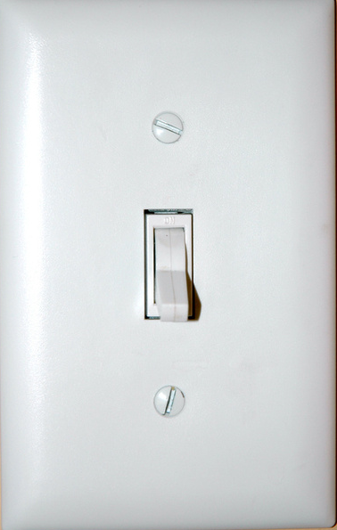
“Timers”
(V – V_{o})
P_{ms} =
(vascular
targets)
C
“Switches”
(nerve, c.t.
targets)

Slide 35
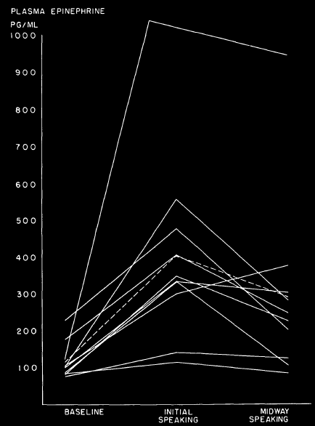
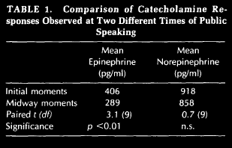
Equivalent to 2 mcg total IV dose
Dimsdale JE & Moss J, JAMA (243) 340-342,1980

Slide 36
Stress Inoculation
1
Pain
&
Fear
3
Pain
&
Fear
Pain
&
Fear
Pain
&
Fear
2
Responsiveness
Responsiveness
Readiness

Slide 37
Triangular Instruction

Slide 38
A
B
C

Slide 39
See One
Do One
Teach One

Slide 40
“Scaffolding” Instruction

Slide 41

How did this get here?

Slide 42

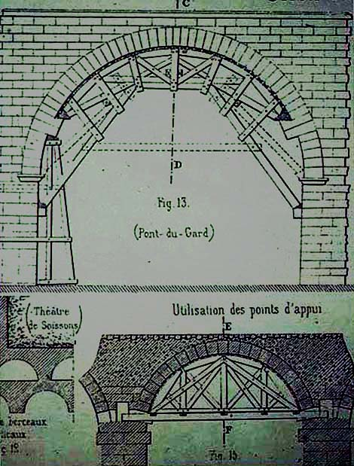
… The same way this got here.
Doing
Talking

Slide 43
Intentional
Attentional Shifts

Slide 44
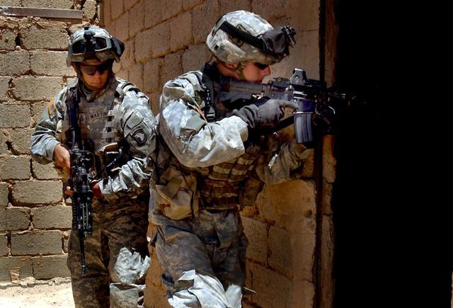
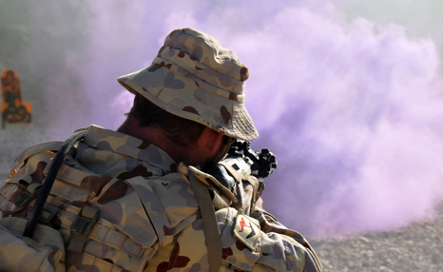
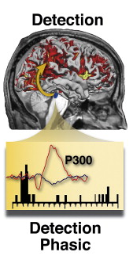
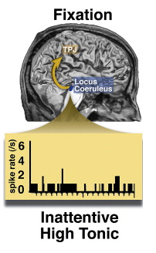
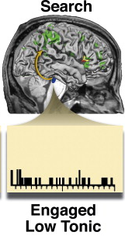
How does the rTPJ play into
the operator’s attentional shifts?
Figure above from:
Corbetta et al. Neuron (58) 306-324, 2008

Slide 45
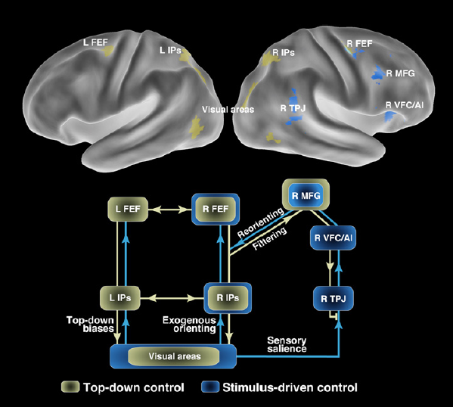
Locus Ceruleus, Sympathetic Activation
Internal
Awareness
External
Awareness
Internal
Attention
Network
External
Attention
Network
Corbetta M, Patel G, Shulman GL, Neuron (58) 306-324, 2008

Slide 46
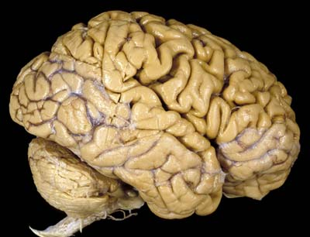
Internal
External
LC

Slide 47

Internal
Internal
External
Reset
LC
+
Stimulus-Driven

Slide 48
Goal-Driven
Top-Down
Filtering
(Verbal
Override)
Internal
SCAN
External
External
SCAN
LC
SCAN
** This applies to VISUAL, AUDITORY, and SOMATOSENSORY events.

Slide 49
Options for partial autonomic override?
Breathing
Verbal
Override
Conscious
Control
Autonomic
Control
Eye blinking
“Stress Inoculation”

Slide 50
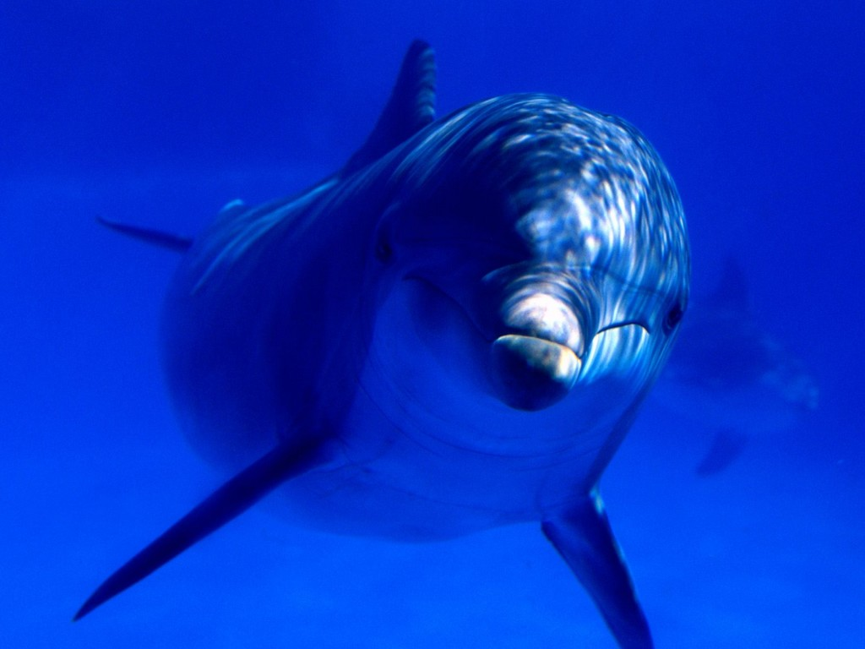
Nature’s Best Tactical Breathing Machine:
Dolphin
Human
IRV
IRC
VC
V_{T}
TLC
ERV
FRC
RV
…but dolphins don’t talk much

Slide 51
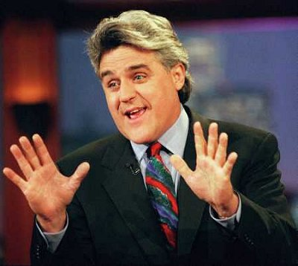

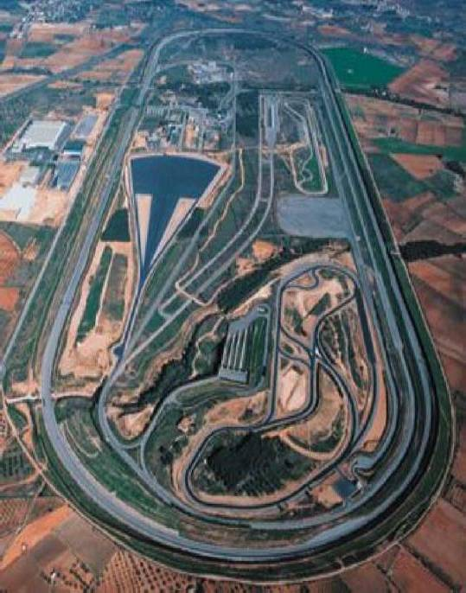
Mastering the Autonomic Nervous System with Jay
Jay Leno’s Spin Recovery:
“Look where you want to go –
Steer where you want to go”
Idiada Proving Grounds, Spain

Slide 52
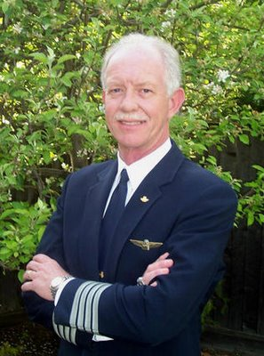
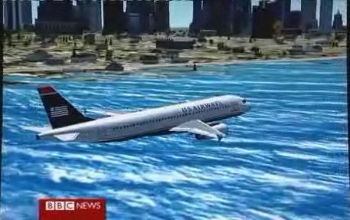
Mastering the Autonomic Nervous System with Sully
US Airways flight 1549 - 15 Jan, 2009
No auditory exclusion
No tunnel vision
No time distortion
Repeated verbal interactions w/:
ATC
Crew
Passengers
Himself
Captain Chesley “Sully” Sullenberger

Slide 53
Find the threat…

Slide 54
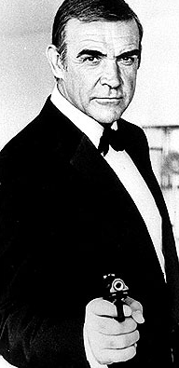

Corbetta, 2008
Miss this one?

Slide 55
Let’s try that again…
… But, this time, use Verbal Override
to continue to scan for threats:

Slide 56
Verbal Override: “Scan for Threats”
Corbetta, 2008
Internal
Reset
Internal
External
External

Slide 57
Attentional
Control
rTPJ
ToM Network/
Social Perception

Slide 58
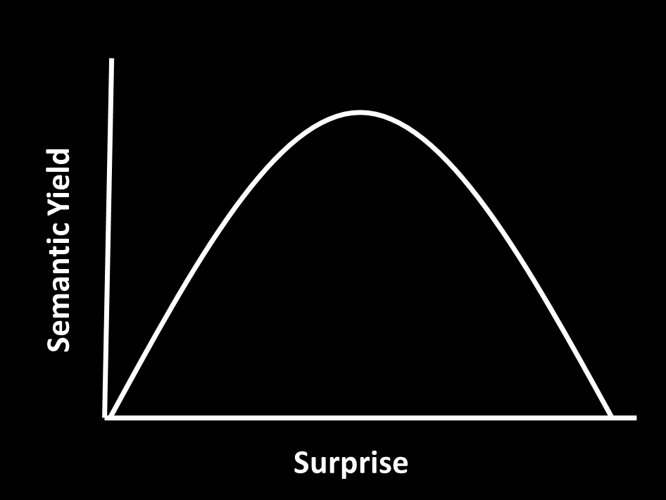
Surprise = Expected - Observed
Surprise can be instructive. Up to a point.
Even prior to that point, though, it can distract from intention
rTPJ Activation

Slide 59
Munis, 2015

Slide 60
Putting it all together - Shoot Houses, Snatch Vehicles & Other Scenarios:
Realistic
Reconfigurable
(reasonably) Safe
Debriefings

Slide 61
Intentional Attention Shifts
On-Site
Confederate
Perceptual Set
Visual
Auditory
Vestibular
Proprioceptive
Lensing
Enemy/
Receiver
Feeder
Lensing/Illusion/Distraction
Motor Set
Movement
Position
Tool Deployment
Weapon Deployment
Lensing
Off-Site
Confederate
Conditioned Motor Skills

Slide 62
Intentional Attention Shifts
On-Site
Confederate
Perceptual Set
Visual
Auditory
Vestibular
Proprioceptive
Lensing
Enemy/
Receiver
Feeder
Lensing/Illusion/Distraction
Motor Set
Movement
Body Position
Tool Deployment
Weapon Deployment
Lensing
Off-Site
Confederate
Conditioned Motor Skills

Slide 63
Remember?
Asymmetric (unfair) Advantages:
Night Vision (NOD/NVG)
IR Illumination/IR Laser Targeting
Com Sets
Off-site Coordination (TOC)
Real Time Video Feeds (ISR)
Real time Heads-up Displays
Collectively, these tools harness Visual (including invisible thermal and IR) and Auditory afferent information and communicate that information to efferent actors.

Slide 64
Intentional Attention Shifts
On-Site
Confederate
Perceptual Set
Visual
Auditory
Vestibular
Proprioceptive
Lensing
Enemy/
Receiver
Feeder
Lensing/Illusion/Distraction
Motor Set
Movement
Body Position
Tool Deployment
Weapon Deployment
Lensing
Off-Site
Confederate
Conditioned Motor Skills

Slide 65
On-Site
Confederate
ENHANCED
Perceptual Set
Visual (NODs/IR targeting)
Visual Attention (eye tracking/cueing/heads-up)
Auditory (Com Sets/cueing)
Vestibular (GVS)
Proprioceptive (Haptic)
Lensing
Enemy/
Receiver
Feeder
Lensing/Illusion/Distraction
Motor Set
Movement
Position
Tool Deployment
Weapon Deployment
Lensing
Off-Site
Confederate
Conditioned Motor Skills

Slide 66
Tactical
(oppositional)
Medical
(non-oppositional)
You plan to make something bad happen, then force the targets to respond (you start as the Feeder).
You’re minding your own business until something bad happens (you start as the Receiver).

Slide 67
How does this apply to medicine
or to medical simulation?
Validation for a repertoire of useful and rehearsed diagnostic scripts and corresponding interventions (nothing especially new here except the advice to keep it small and to keep it simple).
Endorsement of a deliberately rehearsed ability to shift from external to internal attention networks (verbal override).
A motor component to a response is a two-edged sword: it can lock a participant into a perseveration mode, or it can help to avoid attentional hijacking by the external attention network. Verbal override favors the latter over the former and preserves intention.
Perceptual enhancement devices may, ironically, decrease distraction and maintain top-down intentional control of attention.
All this may help to prevent an emergency from becoming a crisis.

Slide 68
Selected References:
Corbetta M and Shulman GL, Control of goal-directed and stimulus-driven attention in the brain. Nature Reviews / Neuroscience (3) 201-215, 2002.
Kubit B, and Jack AI, Rethinking the role of the rTPJ in attention and social cognition in light of the opposing domains hypothesis. Frontiers in Human Neuroscience (7) 1-18, 2013.
Schuwerk T et al. The rTPJ’s overarching cognitive function in networks for attention and theory of mind. Social Cognitive and Affective Neuroscience (12) 157-168, 2017.
Eckhoff P et al., Optimality and robustness of a biophysical decision-making model under norepinephrine modulation. J Neurosci (29) 4301-4311, 2009.
Corbetta M, Patel G, Shulman GL, The reorienting system of the human brain: from environment to theory of mind. Neuron (58) 306-324, 2008.
Sara SJ, The locus coeruleus and noradrenergic modulation of cognition. Nature Reviews / Neuroscience (10) 211-223, 2009.
Dimsdale JE and Moss J, Plasma Catecholamines in Stress and Exercise. JAMA (243) 340-342,1980.
Grossman D and Christensen LW, On Combat: The Psychology and Physiology of Deadly Conflict in War and in Peace, 2008.
Munis JR, More A than I: Why Artificial Intelligence Isn’t, but You Are, IEEE SMC 2015.
Munis JR Physical Performance Enhancement in the Tactical Environment, International School of Tactical Medicine - Module C, 2013.
Munis JR Stress and Combat Physiology, International School of Tactical Medicine - Module C, 2013.
Munis JR, High Yield Combatives, Training Manual for The STG, 2017.

Slide 69
munis.james@mayo.edu

