Slide 1

TSC and Genetics
Dr Colina McKeown
Clinical Geneticist
Genetic Health Service NZ

Slide 2
Overview
GHSNZ
General genetic principles
TSC genetics
Reproductive options
Questions and discussion
Notes:
Previously: There are 11 major criteria, which include the classic features of macrosomia, macroglossia, abdominal wall defects and anterior ear lobe creases, as well as seven minor criteria.

Slide 3
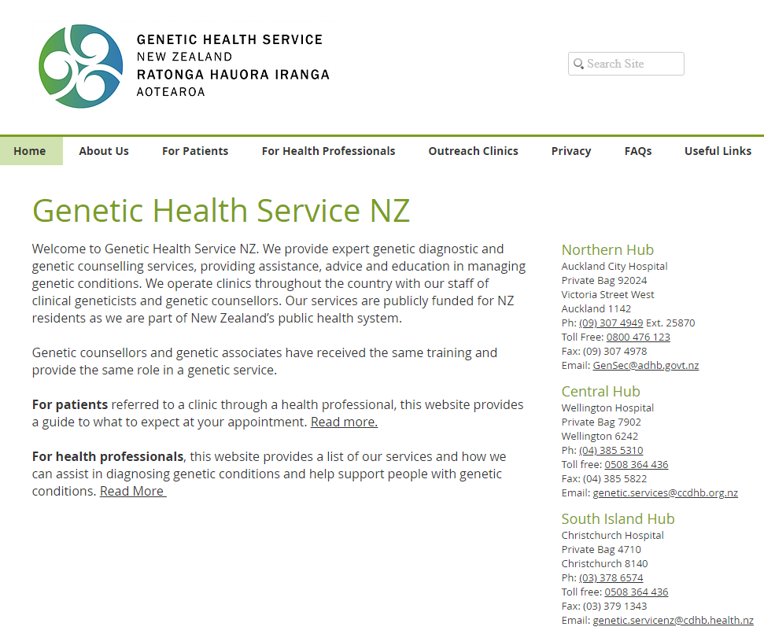
Notes:
Previously: There are 11 major criteria, which include the classic features of macrosomia, macroglossia, abdominal wall defects and anterior ear lobe creases, as well as seven minor criteria.

Slide 4
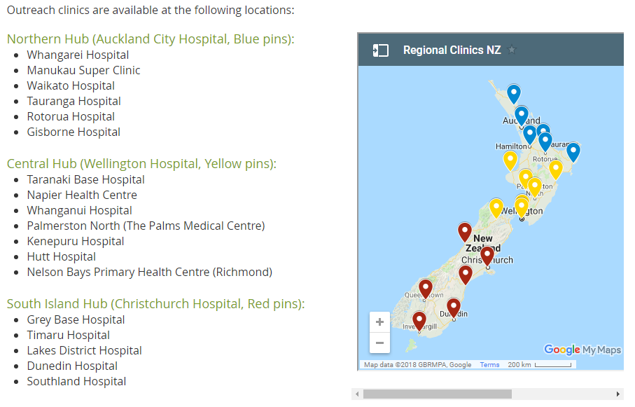
Notes:
Previously: There are 11 major criteria, which include the classic features of macrosomia, macroglossia, abdominal wall defects and anterior ear lobe creases, as well as seven minor criteria.

Slide 5
GHSNZ
Clinical Geneticists: medical doctors with specialist training in medical genetics
Genetic Counsellors: healthcare professionals with training in human genetics and counselling
Time points that you may see our service:
- when diagnosis is first raised
- when genetic testing is required
- around the time of family planning
- when family members wish to discuss potential implications for them
Notes:
Previously: There are 11 major criteria, which include the classic features of macrosomia, macroglossia, abdominal wall defects and anterior ear lobe creases, as well as seven minor criteria.

Slide 6
Genetic Counselling
An education process that seeks to assist affected (and/or at risk) individuals and their families to understand the:
- nature of the genetic condition
- management/surveillance for the genetic condition
- inheritance pattern and possible implications for other family members
- role/option/availability of genetic testing
- options for family planning
Empower individuals/families with knowledge

Slide 7
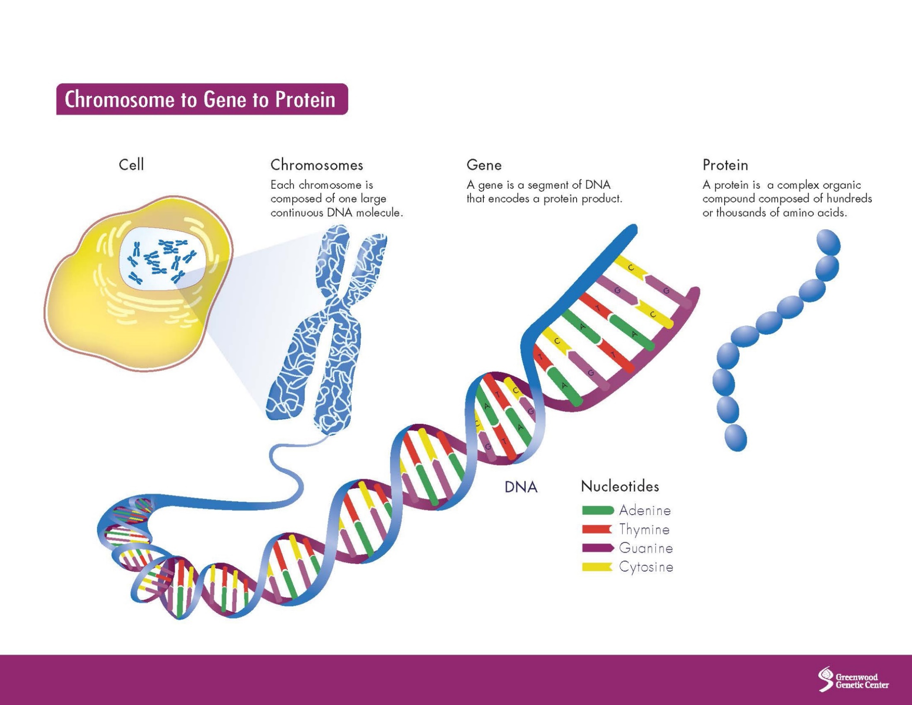
General Genetic Principles

Slide 8
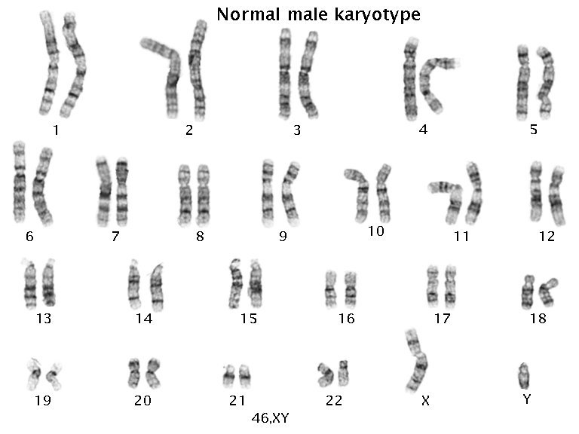
Notes:
Previously: There are 11 major criteria, which include the classic features of macrosomia, macroglossia, abdominal wall defects and anterior ear lobe creases, as well as seven minor criteria.

Slide 9
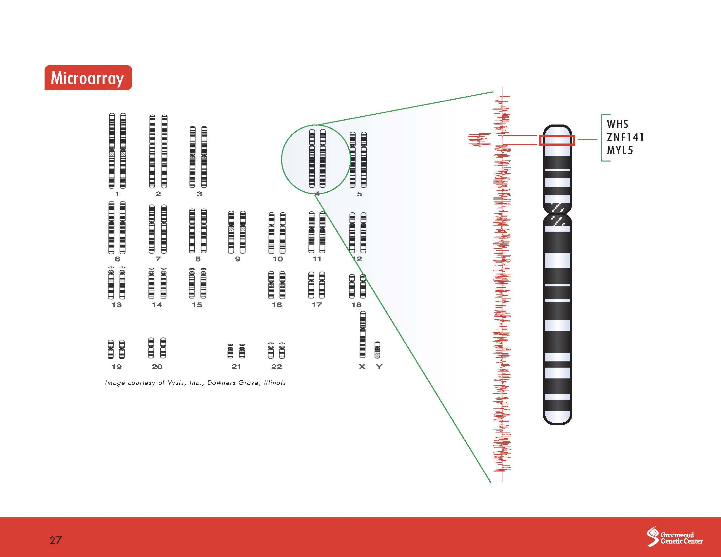

Slide 10
One base pair
(A - T) or (G - C)
1000 base pairs –
One kilobase (kb)
1,000 000 base pairs - One megabase (Mb)
3 billion base pairs (3000MB)=human genome

Slide 11
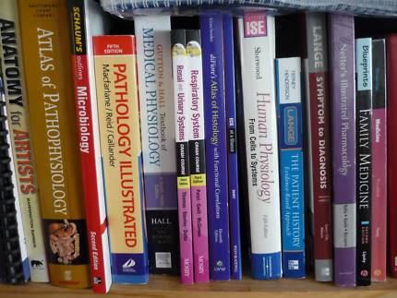



Slide 12
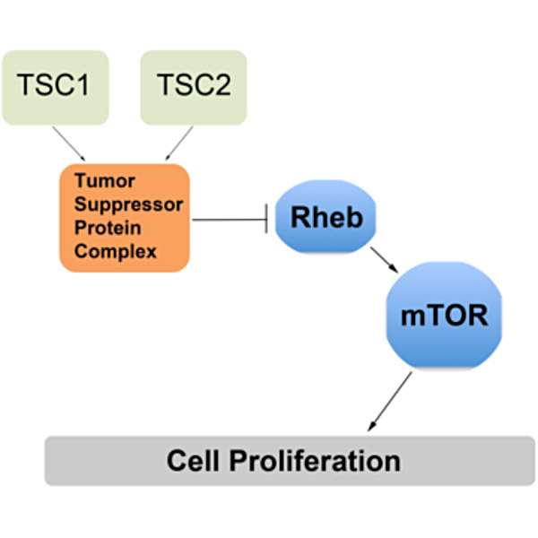
Genetics of TSC
TSC is caused by pathogenic variants (mutations) in one of two genes – TSC1 (9q34.13)
- TSC2 (16p13.3)
These genes encode for the proteins hamartin and tuberin which are involved in regulating cell growth through the mTOR pathway.

Slide 13
Genetics of TSC
Diagnosis of TSC can be made clinically or by identifying a pathogenic variant in either TSC1 or TSC2
TSC1 and TSC2 were identified in 1997 and 1993
The availability of genetic testing is increasing
With current testing a pathogenic variant can be identified in approximately 90% of patients who have a confirmed clinical diagnosis of TSC.

Slide 14
Genetics of TSC
2/3 of people with TSC have a new ‘de novo’ genetic change
1/3 have inherited the change from a parent
TSC has very variable expression meaning that different people can be affected more or less severely than others

Slide 15
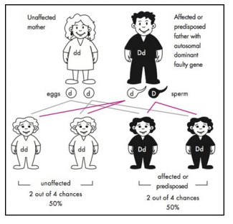
Autosomal dominant inheritance
Notes:
Previously: There are 11 major criteria, which include the classic features of macrosomia, macroglossia, abdominal wall defects and anterior ear lobe creases, as well as seven minor criteria.

Slide 16
Family planning
If a parent has TSC then there is a 50% (1 in 2) chance that each child will inherit TSC
Gonadal mosaicism – 1-2% chance recurrence
There are several reproductive options available, each of which is a personal choice and there is no right or wrong decision.
No testing
Prenatal testing
Pre-implantation genetic diagnosis

Slide 17
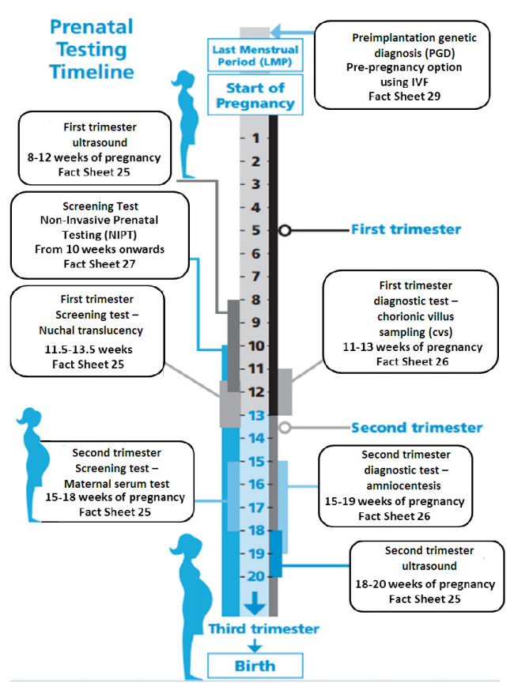
Prenatal testing
Requires prior identification of the pathogenic variant in the family
CVS from 11-12 weeks gestation - <1% miscarriage risk
Amniocentesis from 15 weeks gestation - <0.5% miscarriage risk
Publically available (main centres)
Notes:
Previously: There are 11 major criteria, which include the classic features of macrosomia, macroglossia, abdominal wall defects and anterior ear lobe creases, as well as seven minor criteria.

Slide 18
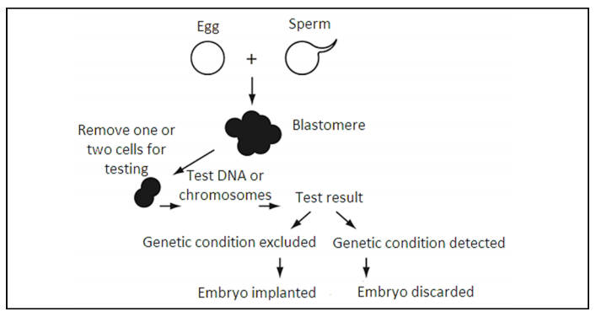
Preimplantation Genetic Diagnosis (PGD)
Requires prior identification of the pathogenic variant in the family
IVF procedure – complex process, physical/emotional toll
Some public funding in NZ – but waiting list

Slide 19
Questions/Discussion
genetics.edu.au information sheet

