Slide 1
Feedback & Presentations

Slide 2
Discussion:
What are the qualities of a good presentation?
What are the qualities of a not-so good presentation? How do we avoid them?

Slide 3
Practice!!!

Slide 4
Feedback Checklist
1. Did they say what country their story is from?
2. Did they tell you name of their story?
3. Did they talk about the characters in their story?
4. Did they talk about the setting of their story?
5. Did they give information about the plot of their story?
6. Did they speak loudly and clearly?
7. Did they use pictures/video/media in their presentation? Or, do they plan to show pictures during their presentation?

Slide 5
Presentation Practice Time
Groups of 3-4, 6min per person!

Slide 6
During In-Class Presentations
Be an active, respectful listener!
Complete the in-class feedback for your 2 presenters.
Any other suggestions?

Slide 7
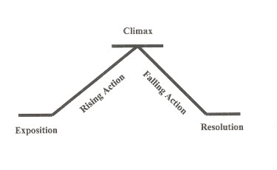
HW: Create a storyboard for a story you heard today, or the story you presented using the 5 elements of dramatic structure.

