Slide 1
Intro to Fiction
Short Stories

Slide 2
Post-it notes activity: What are examples of fiction, nonfiction, or both?

Slide 3

Characters
Who the main people in the story are

Slide 4
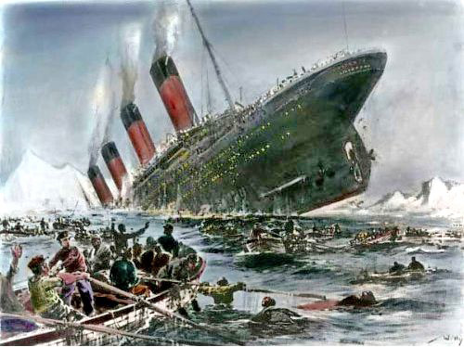
Plot
What happens

Slide 5
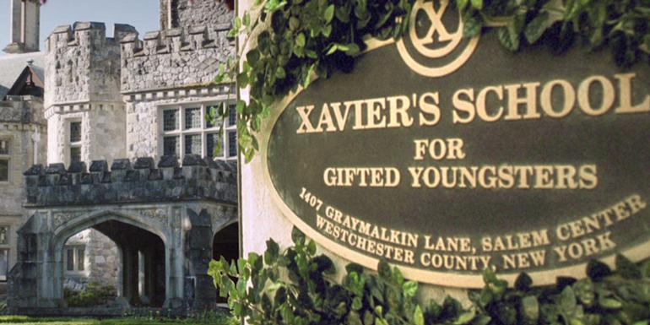
Setting
Where the story happens

Slide 6

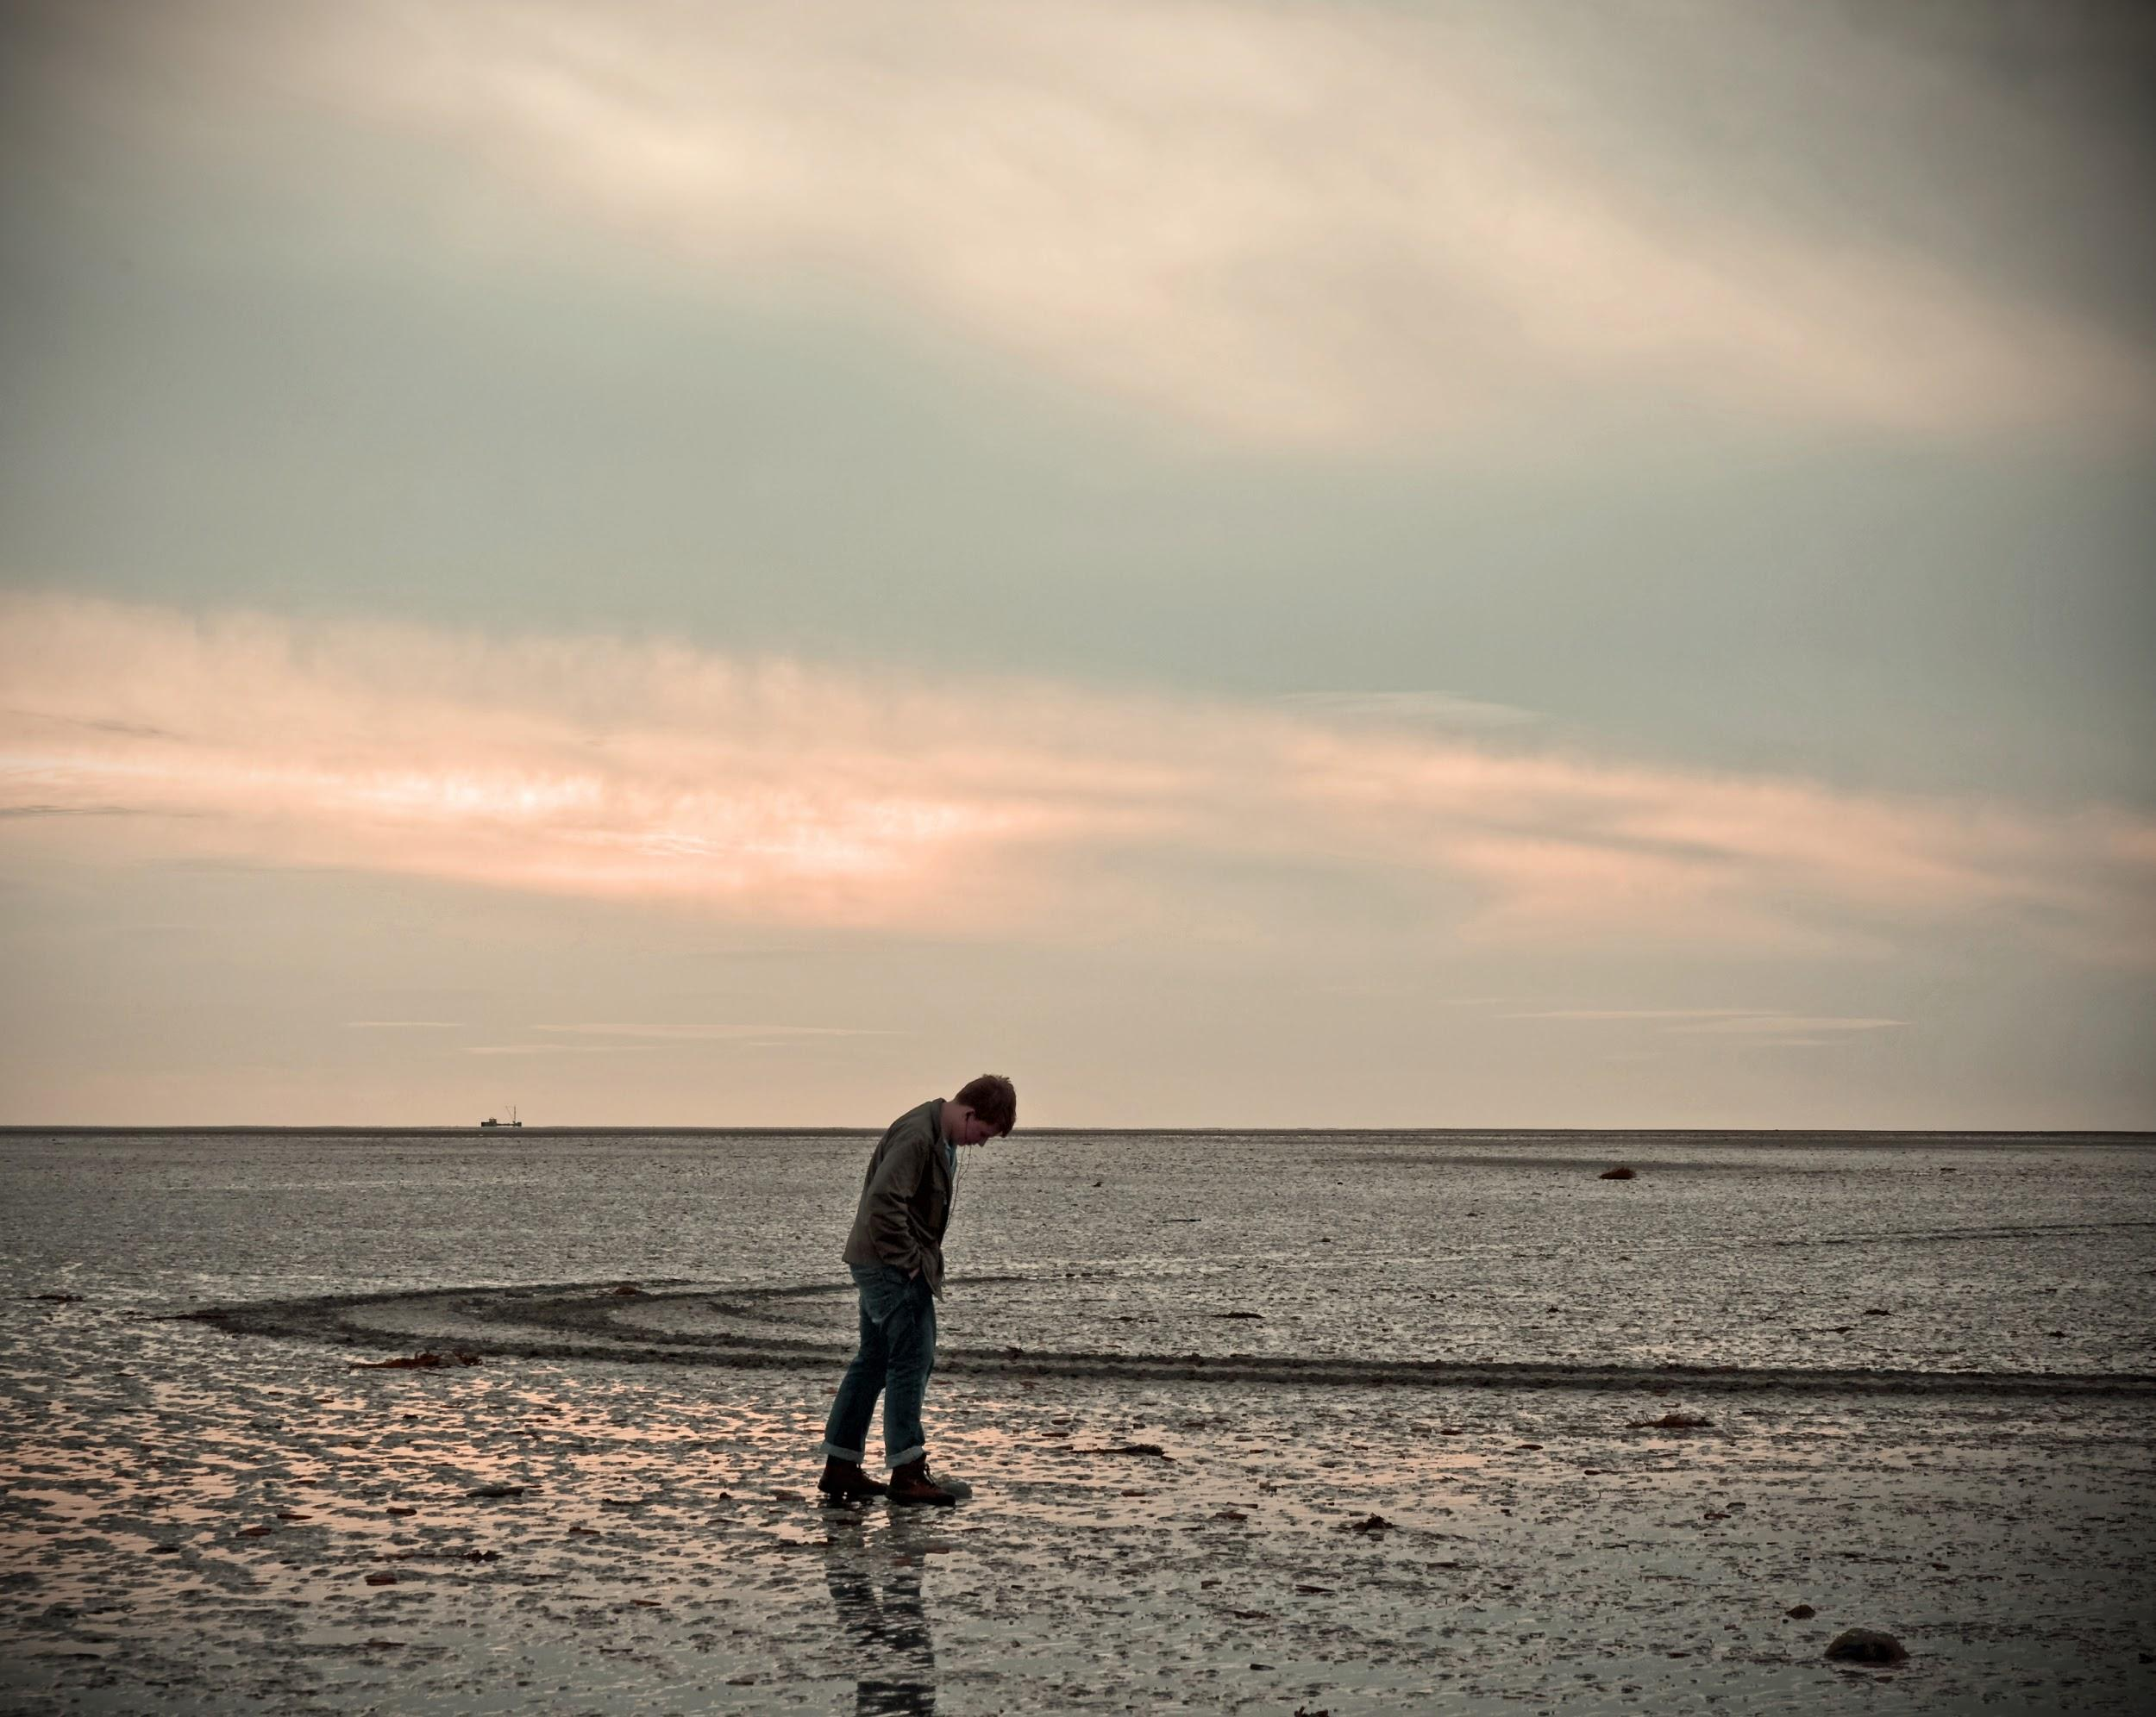
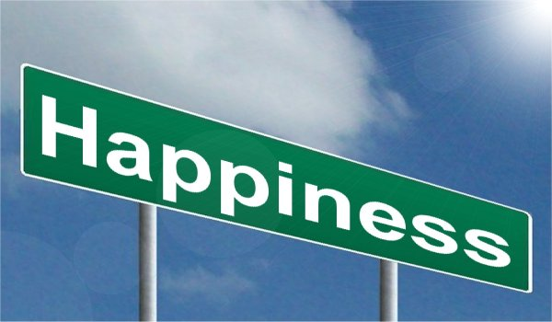
Theme
The main idea of the story

Slide 7
When reading fiction, we practice important reading skills:
Vocabulary strategies
Making predictions
Summarizing
Making connections

Slide 8
Folk Lore / Folk Stories (Mythology)
Every culture has folk stories.
Some of these are about magical people or creatures.
Some of these stories talk about how a cultural practice or belief started.
For example, in the US we celebrate Santa Claus and Christmas. This came from old European folk stories about a man who brought presents to children.

Slide 9
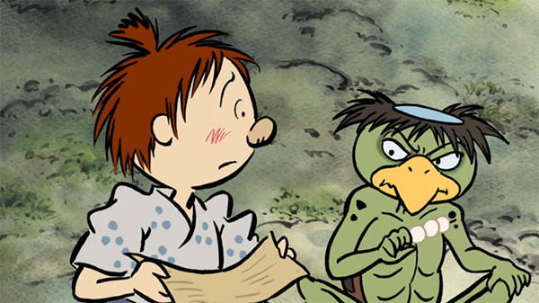
Notes:
Kappa from Japan

Slide 10
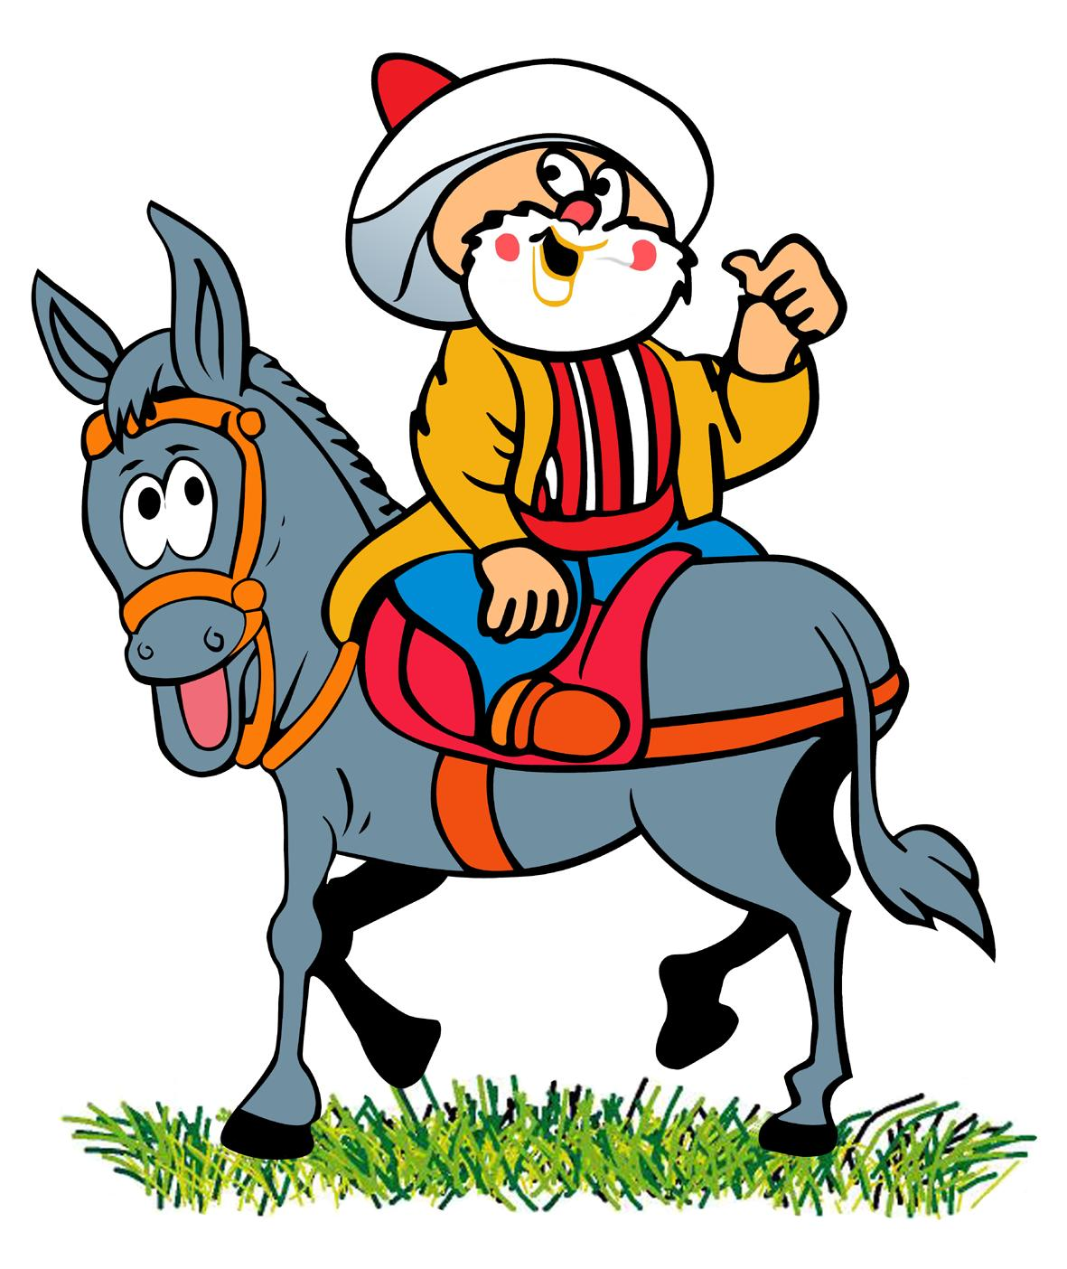
Notes:
Nasreddin Hoca

Slide 11


Slide 12
Group Discussion:
Do you have a favorite magical person/creature/animal?
Do you have a favorite folk tale or story from your country? Share a short summary of the story (<1 min) with your group.
Listen to the main ideas of the stories from your classmates. Do you have a similar story in your culture?

Slide 13
The Leprechaun & the Pot of Gold

Slide 14
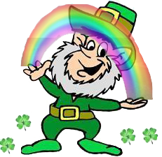
Leprechaun
Irish Folklore (folk story)
A kind of fairy
Hide pots of gold at the ‘ends’ of rainbows

Slide 15
Fiction: Guided Reading
Who are the main characters in the story?
What is the setting of the story?
Short summary
Questions about the story.
Strategy: Ask questions to yourself as you read.
Key Vocabulary

Slide 16
Homework: Short story + phrases & collocations (7)

