Slide 1
The AHS Matchbox Diary Project A Visual Diary
What’s a diary?
“A way to remember what happens to you. Usually it’s a book people write in. When I was your age, I had a lot I wanted to remember, but I couldn’t read or write. So I started this.”

Slide 2
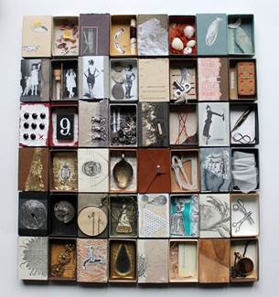
Allen Reads!
Students all over Allen are reading books about memory, identity, and our individual history

Slide 3
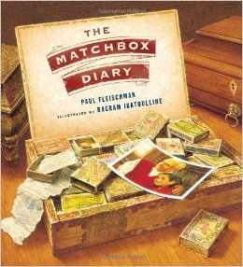
For this project, we are specifically looking at this picture book But encourage you to explore the others

Slide 4
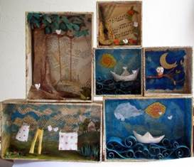
Every art student at AHS will create a matchbox memory piece

Slide 5
Your piece will be part of a whole AHS Matchbox Diary and displayed throughout the community

Slide 6
Artist: Joseph Cornell
Joseph Cornell was an American artist and sculptor
Created art between 1925 – 1960s
He was one of the key artists in “assemblage art”
Influenced by the Surrealists
Hoarder turned artist…
http://www.josephcornellbox.com
http://www.theartstory.org/artist-cornell-joseph.htm

Slide 7
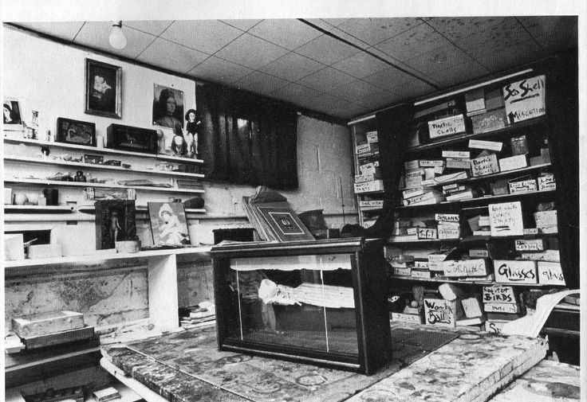
Hoarder turned artist…

Slide 8
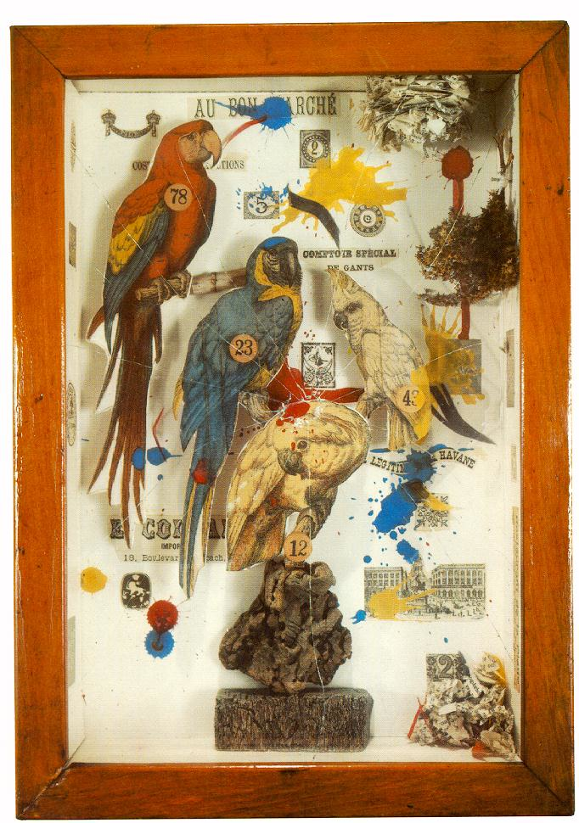
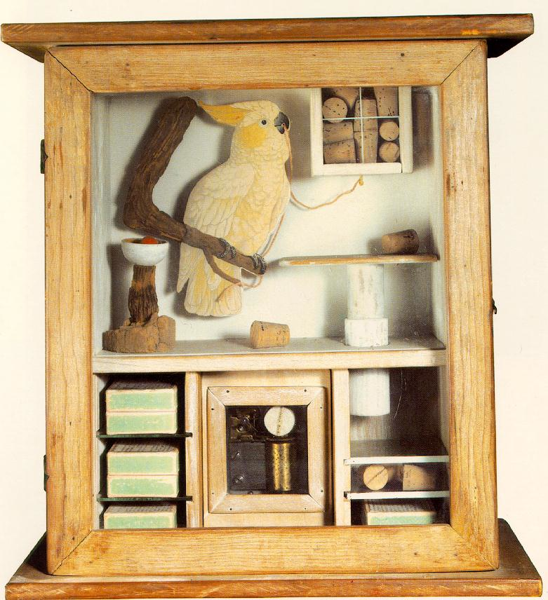
Known for his “Cornell Boxes”

Slide 9
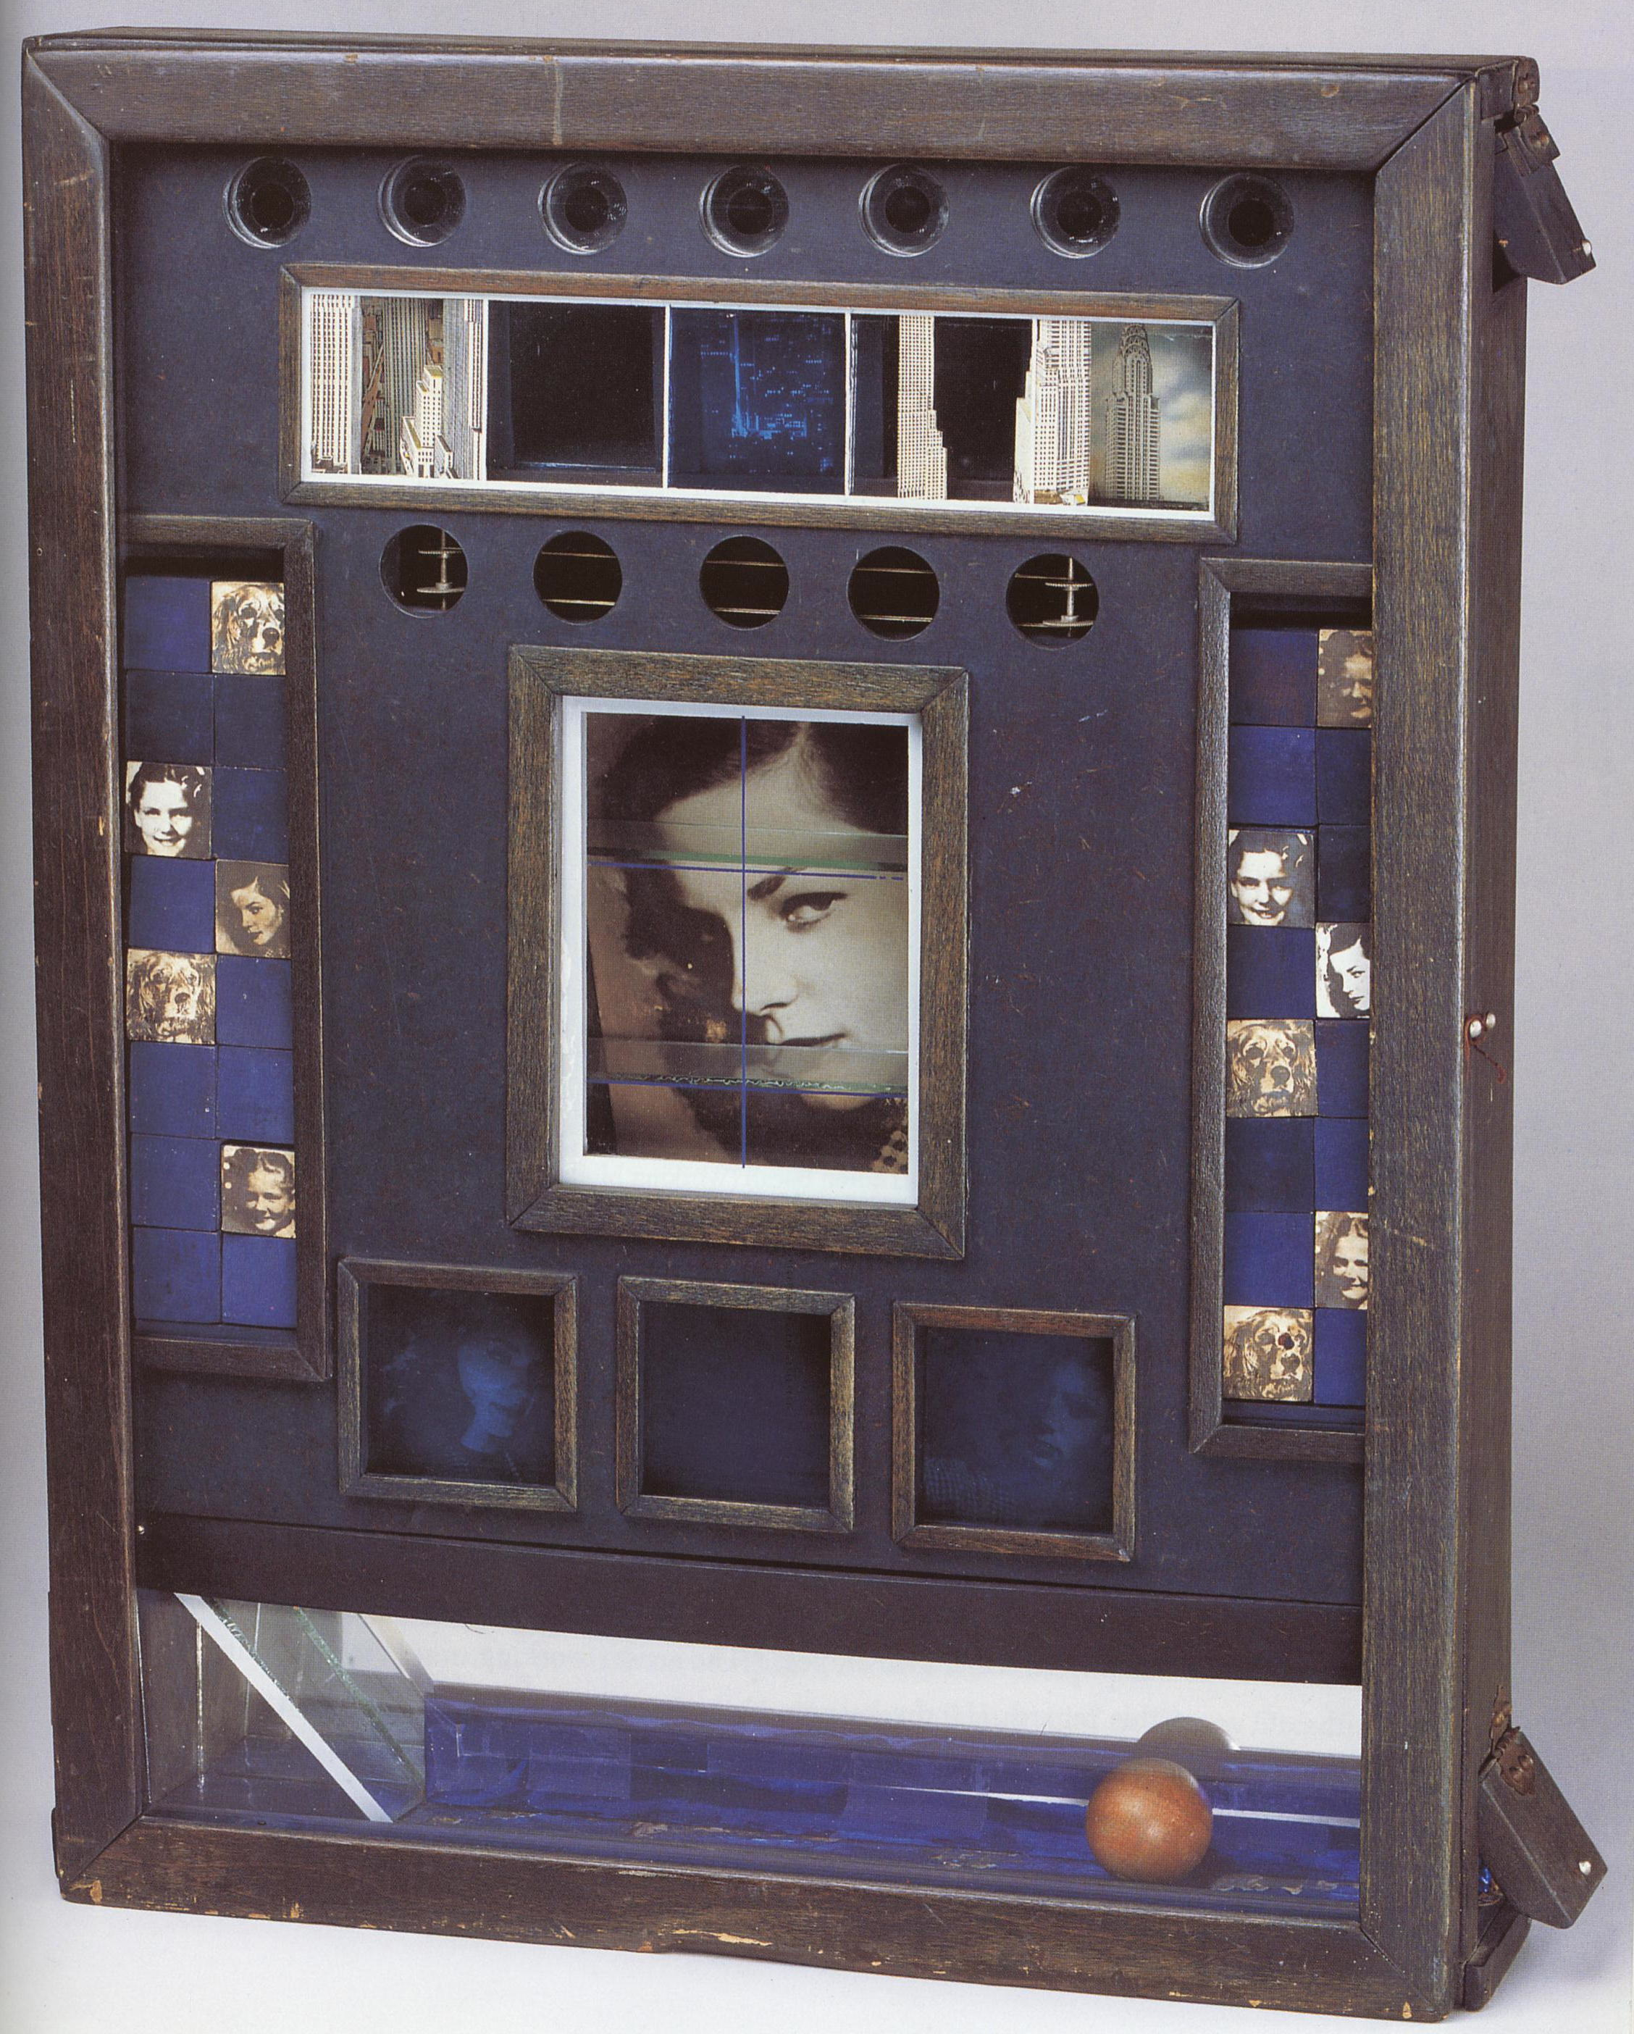

Slide 10
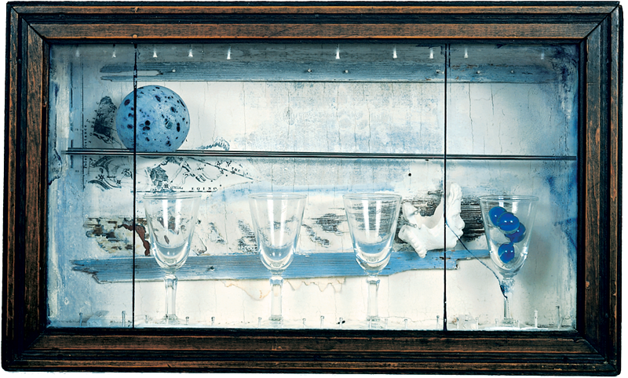

Slide 11
Its Your Turn
Create and decorate a matchbox to hold a memory, diary entry or theme in your life.
It must be visual.
The outside must be decorated. The inside must be decorated.
The box must contain 1 “found object” to represent the memory or event.

