Slide 1

HVAC Design for
Triton S40 Tidal Power Platform
Clara Decan
Alscott Air Systems
Winter 2016

Slide 2
Agenda
Background Information
Project Overview
Design Objectives
HVAC Design Calculations
Specifics of Design
Current Status

Slide 3
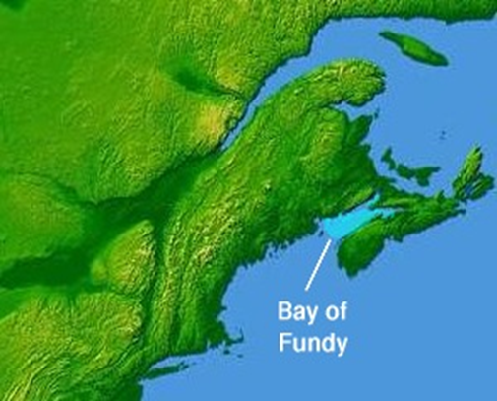
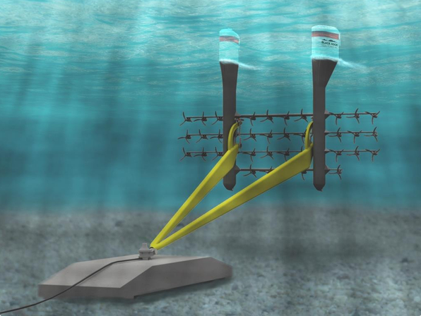



Background Information
Ref. http://www.marinerenewables.ca/wp-content/uploads/2015/11/BRTP_MRC_Infrastructure_Dec15th2105.pdf

Slide 4
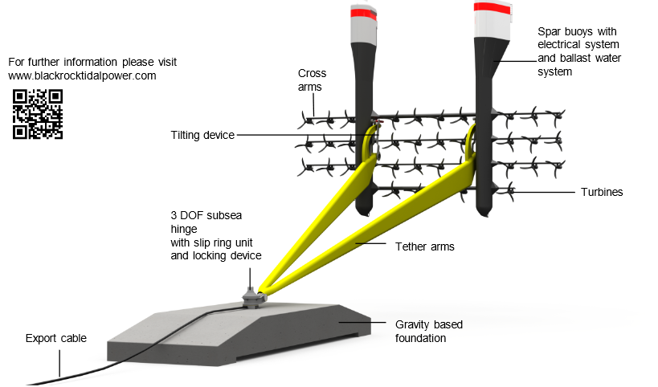
Overview - Triton S40 Tidal Power Platform

Slide 5
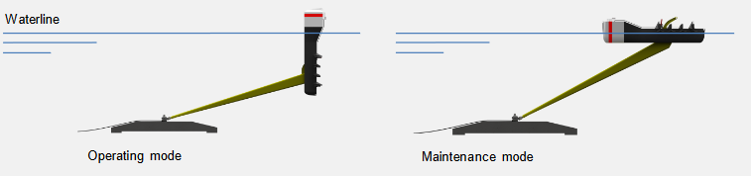
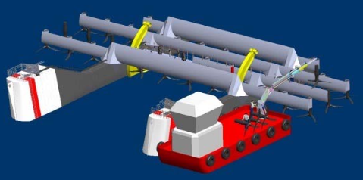
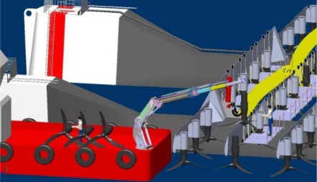
Overview - Triton S40 Tidal Power Platform
Ref. http://www.blackrocktidalpower.com/fileadmin/data/pdf/SCHOTTEL_HYDRO/TRITON_S36_-_FORCE_2014.pdf
Ref. http://www.marinerenewables.ca/wp-content/uploads/2015/11/BRTP_MRC_Infrastructure_Dec15th2105.pdf

Slide 6
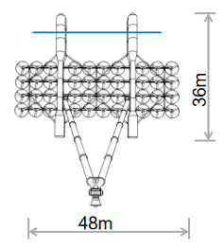
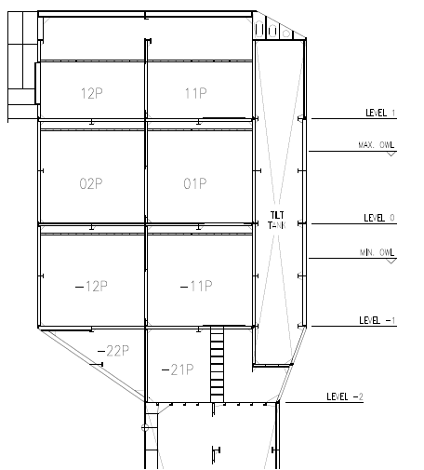
Engineering Drawings
4m
3.025m

Slide 7
HVAC Design Objectives
Provide a Dehumidification System
Provide adequate ventilation for Battery Room during battery charging
Purge system
Design and suggest equipment of quality for a life span of 15 years.

Slide 8
Specifics of Design
System Description
Power Spar Buoy
Control System
Dehumidification System
Fresh Air/Purge System
Local Space Heating
Utility Spar Buoy
Battery Room Exhaust

Slide 9
Basis of HVAC Design Calculations
Layout Dimensions
Heating & Cooling Load Calculations
Airflow Calculations
Equipment Sizing
Internal and External Design Conditions
Notes:
1
2- Temperatures and %RH
3
4 – Once we obtain the highest airflow values, we determine the size and type of equipment to be implemented
5

Slide 10
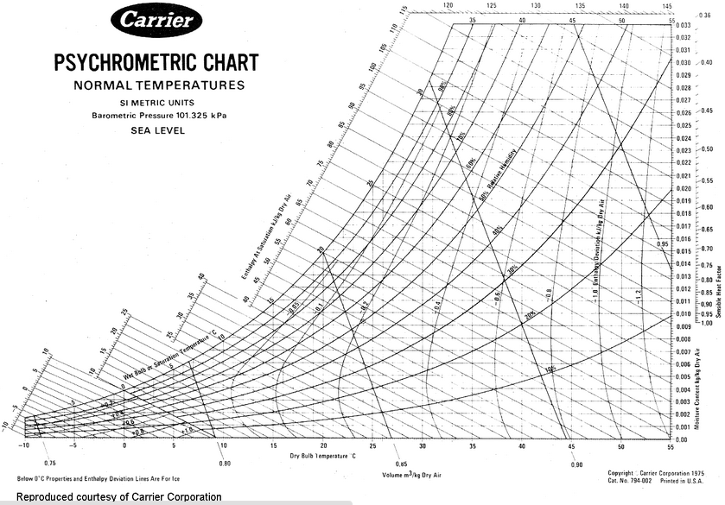
HVAC Design Calculations
Technical Details (Operational Mode)
Internal Space Temperature: 10-35º C
Max. Absolute Humidity: 6.2 g/kg
Sea Water Temperature: 7º C
Relative Humidity: 81%RH @ 10ºC
18%RH @ 35º C
6.2g/kg
10º
35º

Slide 11
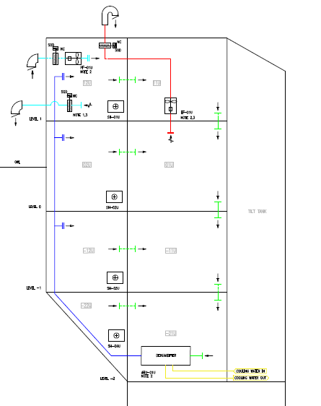
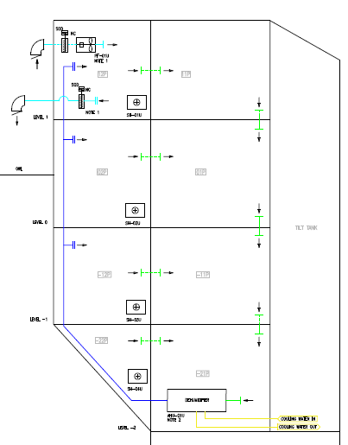

Specifics of Design
Battery
Exhaust Fan
Purge Fan
Transfer (Openings & Grating
Dampers
Fresh Air Intake
Fresh Air Intake
Space
Heaters
Dehumidifiers
Utility Spar Buoy
Power Spar Buoy
Notes:
Hot air is concentrated on top of the buoys, and will travel downwards tru the openings.

Slide 12
Current Status
Overall Platform Design Under Review
Dehumidifier Concept Under Development

Slide 13

Questions?

